Slide 1
The conjugate beam method

Slide 2
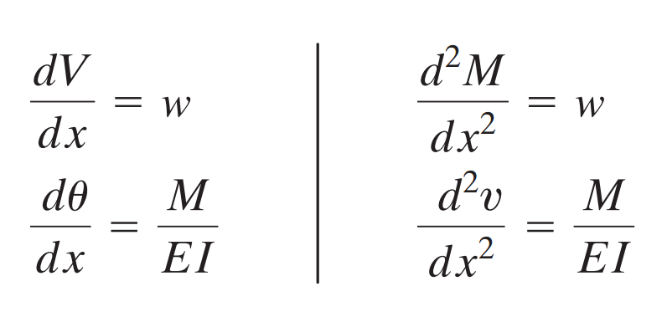
The Conjugate Beam Method
The conjugate beam is derived from the fact that similar relationships can be observed b/n the moment-area theorems and statical procedures

Slide 3
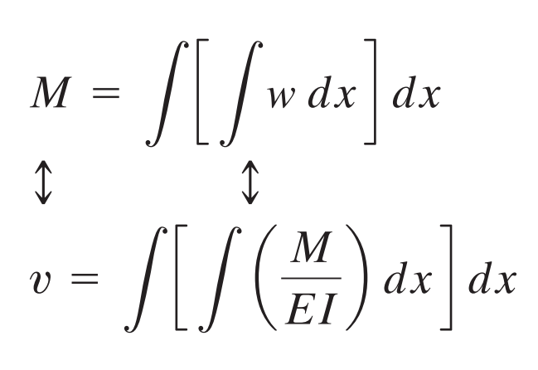
The Conjugate Beam Method
Reformulating, we see that if the beam was loaded with the equivalent load magnitude of M/EI instead of w, the moment produced at any point due to this loading is equal to the deflection at that point in the beam due to the actual loading

Slide 4
The Conjugate Beam Method
the shear produced at any point due to the M/EI loading is equal to the rotation at that point in the beam due to the actual loading

Slide 5
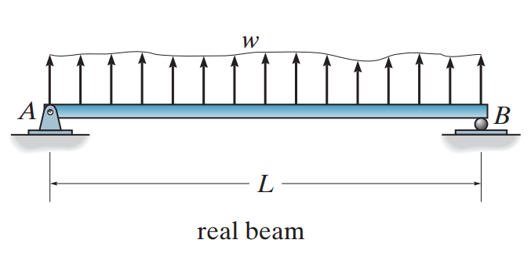
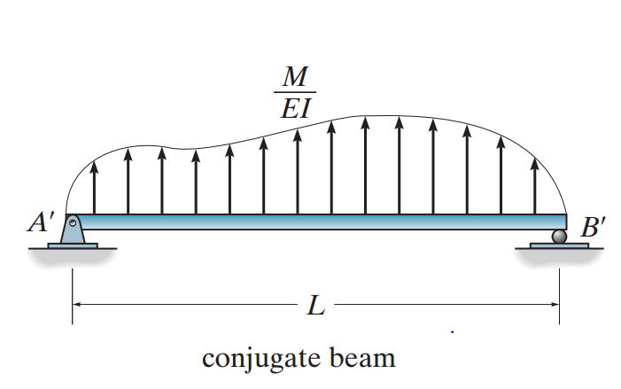
The Conjugate Beam Method

Slide 6
The Conjugate Beam Method
The beam to which the M/EI diagram is applied to is called the conjugate beam.
As a consequence of the two theorems from moment-area, supports and joints corresponding to the real beam shall have their appropriate counterparts in the conjugate beam equivalent, such that V(rotation) and M(deflection) values obtained in the conjugate beam reflect those present in the actual beam.

Slide 7
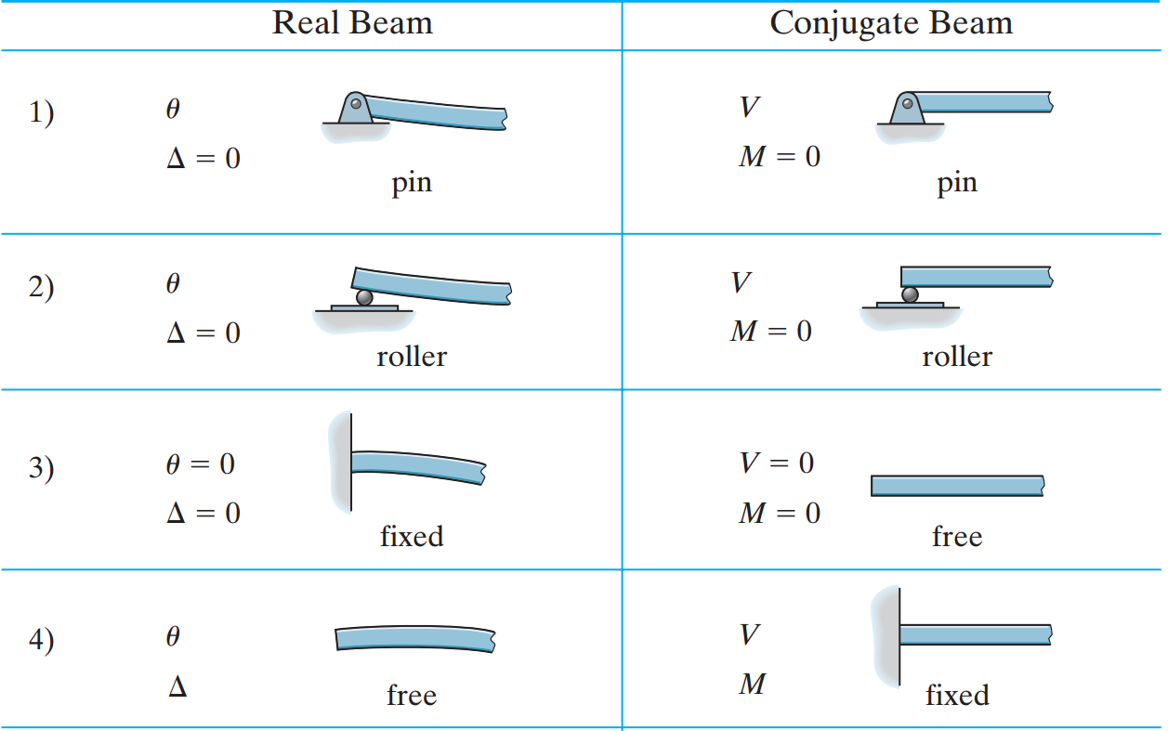
The Conjugate Beam Method

Slide 8
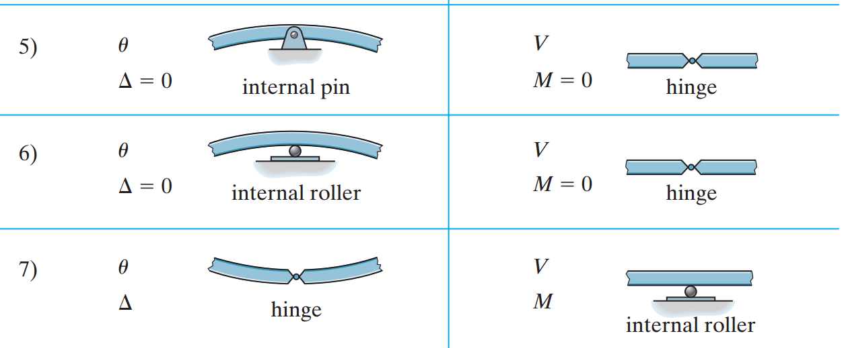
The Conjugate Beam Method

Slide 9
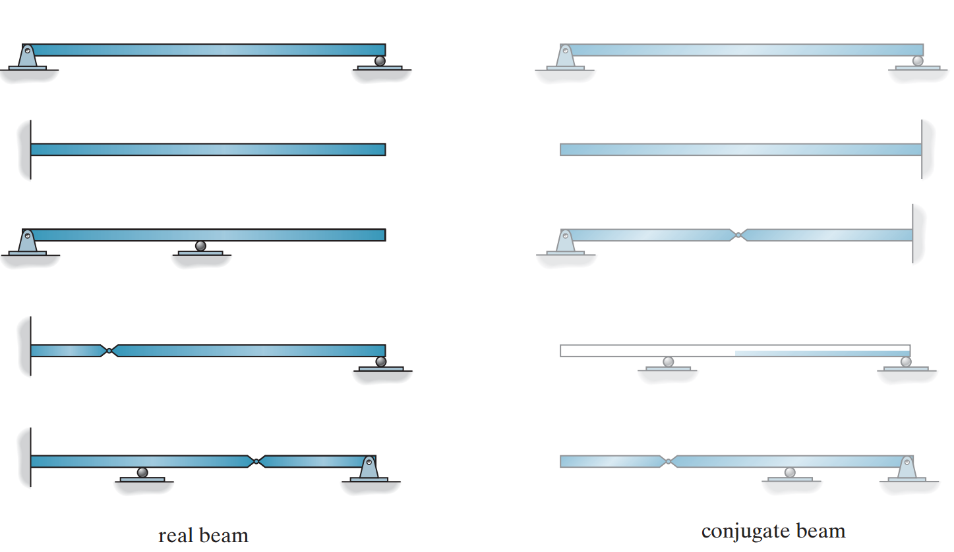
The Conjugate Beam Method
Examples

Slide 10
The Conjugate Beam Method
Procedure:-
1. Develop the bending moment diagram of the beam from static analysis.
2. Draw the M/EI diagram for the beam, using respective values at different parts of the beam.
3. Draw the Conjugate beam and load it with the real beam’s M/EI diagram. The loading always acts away from the beam. (upward if M/EI is positive and downward if negative)

Slide 11
ANY QUESTIONS ??

