Slide 1
Research methods in Tourism
For 3rd year Tourism Management
By: Derera Ketema (MA)
Otober,2018

Slide 2
Objectives of the Chapter
Understand different concepts of research
Describe sources of knowledge
Explain meaning of research
Explain characteristics of research
Describe motivations in research
Describe questions that researchers address
Explain types of research

Slide 3
What is knowledge?

Slide 4
Task – small groups – 15mins
Discuss the meaning and the type of knowledge you have been give.
Generate a description in your own words
Identify an example of this type of knowledge
Be prepared to feedback what you have understood to the whole group

Slide 5
Definition of Knowledge
The definition of knowledge is a matter of ongoing debate among philosophers in the field of philosophy.
Knowledge is a familiarity, awareness or understanding of someone or something, such as facts, information, descriptions, or skills, which is acquired through experiences or education by perceiving , discovering , or learning .
The study of knowledge is called Epistemology
On the other hand ,knowledge is the practical /theoretical understanding of the subject

Slide 6
Definition of knowledge
Knowledge can refer to a theoretical or practical understanding of a subject.
It can be implicit (as with practical skill or expertise) or explicit (as with the theoretical understanding of a subject);
It can be more or less formal or systematic
The study of knowledge is called epistemology

Slide 7
Knowledge can acquired through experience ,education ,tradition ,belief or any other means that helps us to understanding the subject.

Slide 8
Sources of Knowledge
Custom – is a group pattern of habitual activity usually transmitted from one generation to another. It is a habitual practice and the usual way of acting in a given circumstances of a certain environment.
Traditions – is the handling down of statement, beliefs, legends, and custom from generation to generation especially by words of mouth or by practice.

Slide 9
Other source of Knowledge
Sense Perception – This is inherent capacity of any of the faculties, as sight, hearing smell, taste, or touch by which man perceive stimuli from outside and inside the body.
Intuition – This is a direct perception of fact and truth, which is independent of any reasoning process and considered one possible source of knowledge

Slide 10
Other source of Knowledge
Intuition – According to Carl Jung, a psychologist, this is “thinking which is done on the level of unconsciousness”. On the other hand, Henri Bergson, renowned French Philosopher, referred to intuition as a “dynamic process of thought which penetrated the static limitation of logic”.

Slide 11
Other source of Knowledge
Authority – Testimonies by individuals who are considered authorities in their specialized fields and verified facts from exceptional and extraordinary fields of various sciences found and attested by qualifies bodies are sources or our knowledge.
Reason – faculty or power acquiring intellectual knowledge, wither by direct understanding of first principles or by argument to form conclusion, judgments or inferences from facts and premises.

Slide 12
Methods of acquiring knowledge
Intuition
Anecdotal Evidence
Authority or Faith
Tenacity
Rationalism
Empiricism (Observations via senses)

Slide 13
Intuition
Gut feeling; hunches; instinct
Anecdotal Evidence
Accept unquestioningly what your own personal judgment or a single story about a person's experience tells you about the world.
Authority/faith
Expert/respected source
Sacred texts/individuals, internet

Slide 14
Tenacity
Long-held beliefs; Repetition makes ideas more believable
Rationalism
Seeking answers using logical reasoning.
(All apples are fruits. Some fruits are oranges. Therefore, some apples are oranges.)
Empiricism
Attempts to answer questions by direct observation or personal experience

Slide 15
Meaning and Characteristics of Research
Dear Learners;
What is research for you ?
Do you have any experience with research ?
Have you conducted any research project before ?

Slide 16
Definition of Research
Research is a very general term for an activity that involves finding out, in a more or less systematic way, things you did not know
It is about advancing the frontiers of knowledge
In common sense research is a search for knowledge

Slide 17
Research is what we do when we have a question or a problem we want to resolve
We may already think we know the answer to our question already
We may think the answer is obvious, common sense even
But until we have subjected our problem to rigorous scientific scrutiny, our 'knowledge' remains little more than guesswork or at best, intuition.

Slide 18
As a result , research is :
The systematic investigation into and study of materials, sources, etc, in order to establish facts and reach new conclusions /or an endeavour to discover new or collate old facts etc by the scientific study of a subject or by a course of critical investigation

Slide 19
Characteristics of Research
Do you think any attempts to search for answers to any question is a research ?
Do you think that research has its own unique characteristics that distinguish it from other sources of knowledge ?
Could you mention the characteristics that a research should have for you ?

Slide 20
Characteristics ….
    Objectivity
    Systematic
    Reliability
    Validity
    Empiricism
    Logical reasoning
    Probabilistic thinking

Slide 21
Characteristics …
Objectivity
Procedure/ explicitly
Systematic
Follows orderly and sequential procedure.
Reliability
the consistency of the research results and the extent to which studies can be replicated.
Quality of data gathered by procedures ..
all findings are logically based on empirical/unbiased
The extent in which data collection, analysis and interpretation is consistent : can be replicated by another researcher at different times.

Slide 22
Validity
Appropriateness, meaningfulness, and usefulness of the specific inferences made by the researcher
Empiricism
Based on observations and experimentation on theories
Logical reasoning
using prescribed rules of logic (deductive reasoning/inductive reasoning )
Has logical roots that help to establish facts or principles

Slide 23
Probabilistic thinking
There is always a room for error
Empiricism
Guided by Evidence /data not by opinion or authority

Slide 24
MOTIVATION IN RESEARCH
Discuss What motivates you to conduct a research ?

Slide 25
Motivations for Research
Academic reasons & its consequential benefits;
Desire to face the challenge in solving the unsolved problems, i.e., concern over practical problems

Slide 26
Desire to get intellectual joy of doing some creative work;
Desire to be of service to society;
Desire to get respectability

Slide 27
directives of government,
employment conditions,
curiosity about new things,
desire to understand causal relationships,
social thinking and awakening
For decision making

Slide 28
Questions that a Researcher Should address
What are the specific purposes of the research?
How are the general research purposes and aims operationalized into specific research questions?
What are the specific research questions?
What needs to be the focus of the research in order to answer the research questions?
What is the main methodology of the research

Slide 29
How will validity and reliability be addressed?
What kinds of data are required?
From whom will data be acquired (i.e. sampling)?
Where else will data be available (e.g. documentary sources)?
How will the data be gathered (i.e. instrumentation)?
Who will undertake the research?

Slide 30
Types of Research
Factors to classify research :
Objectives
Nature of data
Nature of the findings
On the bases of experimental manipulation
On the bases of Approach involved

Slide 31
Criterion | Types of research
Objectives | Fundamental | Applied research | Action research
Approach | Qualitative research | Quantitative research
Nature of findings | Explanatory research | Exploratory research | Descriptive research
Experimental Manipulation | Experimental research | Non experimental research
Nature of data involved | Longitudinal research | Cross sectional research

Slide 32
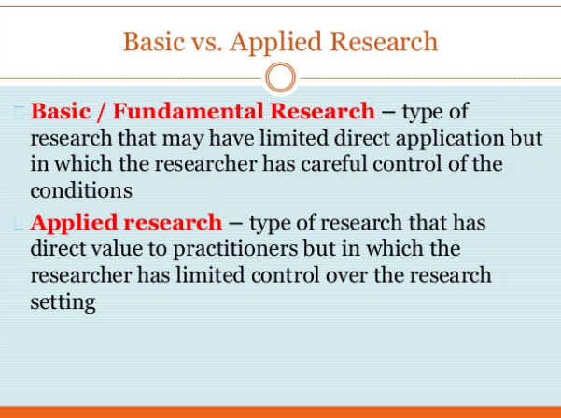

Slide 33
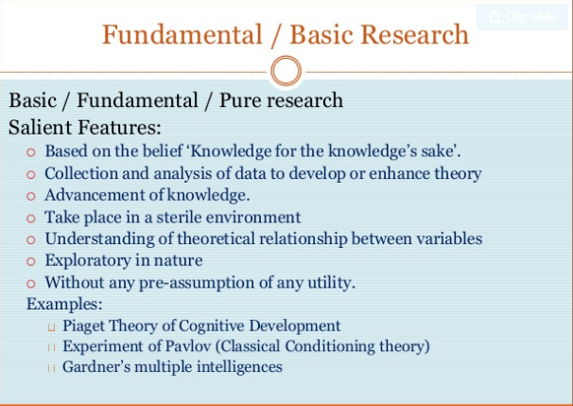

Slide 34
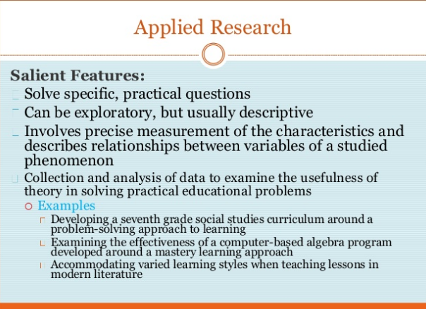

Slide 35
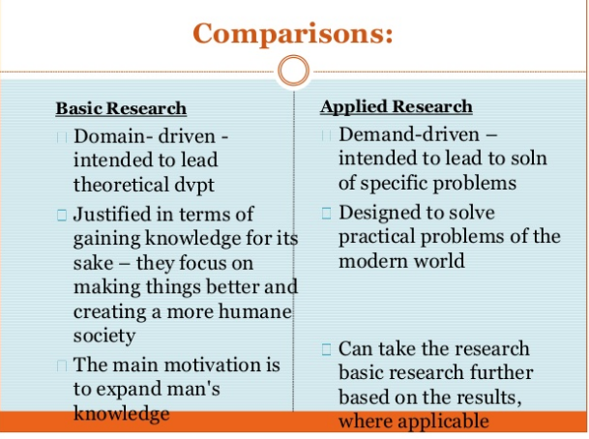

Slide 36
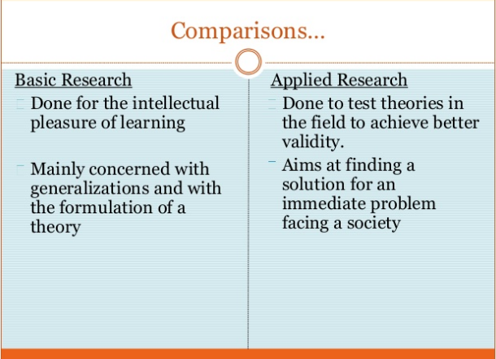

Slide 38
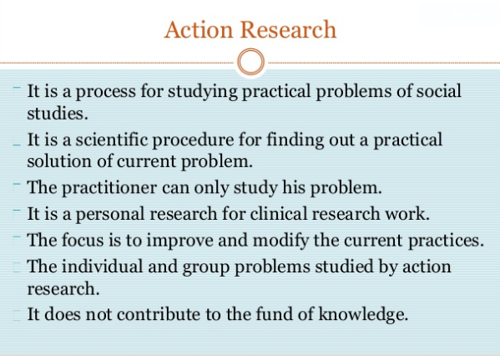

Slide 39
Qualitative vs quantitative Research
Qualitative research : non- numerical data
Quantitative research : numerical data

Slide 40
The distinction of both Qualitative and Quantitative Research Approach
Orientation | Quantitative | Qualitative
Assumptions about the world | A single objective reality, i.e., measured by an instrument | Multiple realities, e.g., interviews of principal, teachers and students about a social situation
Research purpose | Establish relationships between measured variables | Understanding a social situation from participants' perspectives
Research methods and process | Procedures (sequential steps) are established before study begins. It follows theories. | Flexible, changing strategies; design emerges as data are collected
Prototypical study (clearest example) | Experimental design to reduce error and bias | Ethnography using "disciplined subjectivity"
Researcher role | Detached with use of instrument | Prepared person becomes immersed in social situation
Importance of context | Goal of universal context- free generalizations | Goal of detailed context bound generalizations

Slide 41
Explanatory, exploratory, and descriptive research
Explanatory | Exploratory | Descriptive
Cause and effect relationship Answers the question why? | Initial research into a hypothetical or theoretical idea. New idea/ new way of thinking | An attempts to explain and explore additional information Describing what is happening Answer the question of what

Slide 42
Longitudinal vs cross sectional research
Longitudinal research | Cross sectional research
Takes places over times Researchers conduct several observations of the same subjects over a period of time | Takes place at a point of time It can compare different population groups at a single point in time.

Slide 43
Chapter Two
The nature of research problems, back ground and objectives of the research

Slide 44
Research problem
A research problem is a statement about an area of concern, a condition to be improved upon, a difficulty to be eliminated, or a troubling question that exists in scholarly literature, in theory, or in practice that points to the need for meaningful understanding and deliberate investigation

Slide 45
Research problem vs research topic
Do research problem and research topic/title are same ?

Slide 46
Research problem/statement of the problem is the verbal statement of the problem
Research topic is the definition of the research problem that delimits the focus of the study
They are not same but they are inclusive/interdependent

Slide 47
Objectives of the chapter
    Defining a problem
    Characteristics of a problem
    Clarifying and stating a problem
    Evaluating the problem
    Objective of the study
    Research questions and hypothesis
    Define research problem
    Understand characteristics of research problem
    Write statement of the problem
    Evaluate research problems
    Understand objective of the study
    Understand how to write research questions and hypothesis

Slide 48
Selecting a Research Topic

