Slide 1
Front Office Management(TMgt 2064)
By
Belay akele
Tourism management Department
AMBO University

Slide 2
Hospitality Industry
What is the meaning of HOSPITALITY?
Hospitality is the act of kindness in welcoming and looking after the basic needs of guests mainly in relation to food, drink and accommodation.
Hospitality refers to the relationship process between a guest and a host.
“Hospitality Industry”, is companies or organisations which provide food and/or drink and/or accommodation to people who are away from home.

Slide 3
THE HOSPITALITY AND TOURISM INDUSTRY
meets the needs of people with kindness and goodwill while they are away from their homes.
The H&T industry has four service sectors:
food and beverage
lodging- also known as accommodation, is a place to sleep for one or more nights.
recreation, and
travel and tourism.

Slide 4
Hospitality and Tourism Industry is about service
SERVICE
Smile
Make Eye contact
Respect and welcome all guests
Value the magic
Initiate guest contact
Creative service solutions
End with a “thank you”

Slide 5
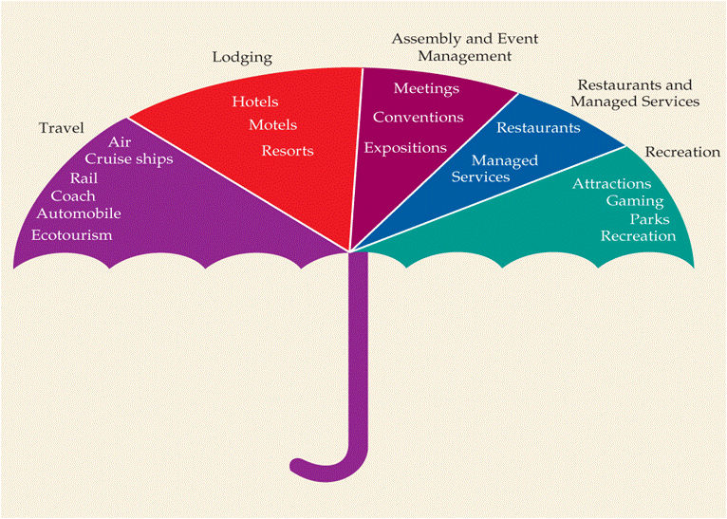

Slide 6
Introduction to Hotel
Hotel is a place where a bonofied traveler receives food, beverage, lodging services away from their home.
It is a transient home away home.
A hotel (inn) may defined as an establishment whose primary business is providing lodging facilities for the general, which furnished one or more of the following services.

Slide 7
Hotel establishments may provide:
Food and beverage services
Room(lodging) services
Bell and door attendant/uniformed services
Laundry services
Safety and security
Lounge and entertainment facilities
Auto rental, airline ticketing, tour, reservation, booking, postal services

Slide 8
Hotel can be
Small- which has <25rooms
Medium -which has 25-100 rooms
Large – which has more than 100 rooms
in order to provide an efficient and satisfactory services to its guests/customers, a hotel is usually divided in to different functional departments each being responsible for certain functions and duties.

Slide 9
Therefore, ……
Based on work specialization
Departmentalization
Pattern of authority
Span of control
Method of co-ordination
a typical organizational chart of large hotel is look like in the following way.

Slide 10
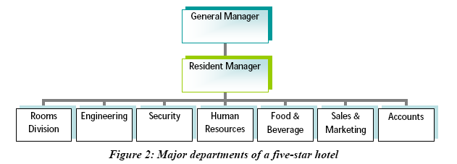
The Functions and Departments of a Hotel

Slide 11
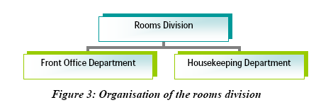
Functions of major hotel departments
Rooms division

Slide 12
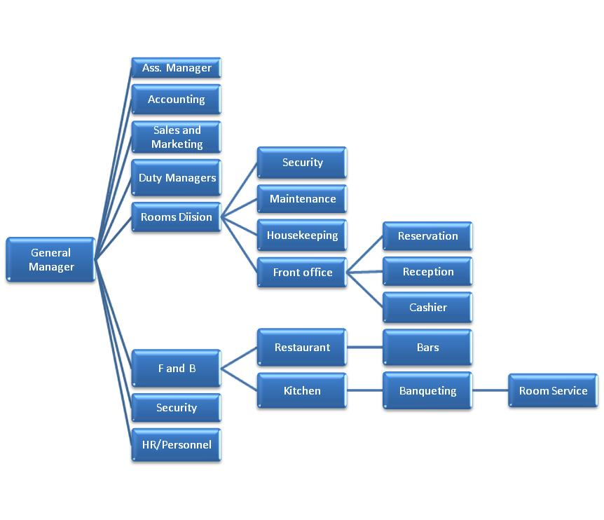

Slide 13
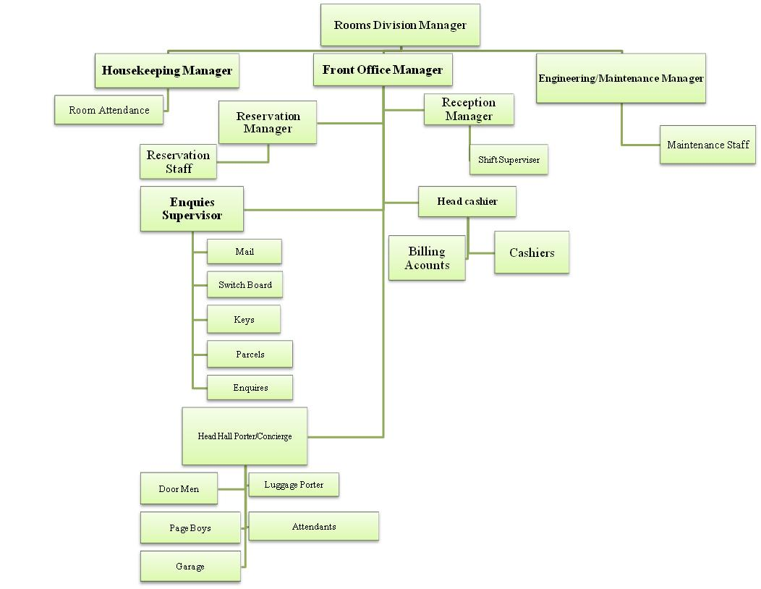

Slide 14
Chapter- one
The front office department

Slide 15
What is front office Department?
It is considered as the nerve center/face of the hotel operations. Why?
It is concerned with welcome, reception, and registration of the guest in hotel.
Allocates rooms to the guest, provides information about hotel and the place or attractions, deals in cash and foreign currency, handles mails, telephone calls, receiving and dropping of guest to the airport etc.

Slide 16
Important of front office
Hospitality, warm welcome
provides first and last impression.
Often has longest contact with guest.
Continuity: Long term service, recognition of repeat guests, remember names, guest histories.
Acquaint guest with hotel.
Sell hotel food and beverage outlets.
Up sell: Suggest deluxe and suites.
Smoother over disgruntled guests.

Slide 17
Front of the House and Back of the House
In a normal classification of the hotel operations areas, can be divided in to two major areas.
Front- of-the-house-
it is the functional areas or departments in which revenue is generated (revenue centered).
These departments sell their products and services directly to the customers.
Guests also have the right to get services from those departments directly.

Slide 18
Con’d…….
Front-of-the-House operations are known so because these operations take place in front of the guests.
Example of front of the house
front office, Bar and restaurant, Cafeteria and pastry, Gym, sauna and steam, business centre, and other areas in which sales are conducting in front of the guests.

Slide 19
2. Back-of-the-house
It is also the functional areas of hotel operation. However, they can not sell their products/services directly to the customer or guests.
Guests do not allowed to enter to these departments unless permission of top level management team.
It is non-revenue centered area.
e.g. Housekeeping, security and maintenance, store, finance, laundry and kitchen

Slide 20
Front Office department
Reservation Section- is responsible for booking of rooms in advance. It is responsible for the receiving of the room requests, reservation analyzing and documentation of the room requests received.
This section of the department depends upon the size of the hotel; if the hotel is small sized there may be not be a separate section for reservations.
This section is mostly found in mid sized and large sized hotel.

Slide 21
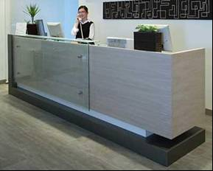

Slide 22
Front Desk Section
This section is responsible for receiving the guest, registering of the guest, assigning of room and room keys and remote controls for television and air conditioners if such services are available and assistance to the guest during their stay.
They are also a source of information for government offices.

Slide 23
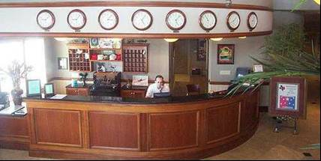
Front desk

Slide 24
Bell Desk
It is mainly responsible for luggage handling of the guests. It consists of group of uniformed staff for guest services.
This section is maintained separately in large hotels only.
Travel Desk Section
It handles the transportation facility of the hotel guest.
It assists in the booking of air tickets, hiring of the car and other transportation facilities. It also arranges / organizes city tours, sight seeing tours to the guests on request.

Slide 25
Business Centers
It serve the guests with laptops, internet, mobiles, facsimile, LCD projectors, and photocopier and also on request secretarial facilities.
This is the latest addition in the large and medium sized hotels, in line with the electronic era.

Slide 26
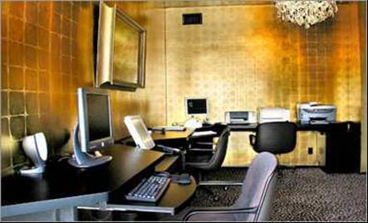
Business centers

Slide 27
Concierge Section
It provides information about the hotel, its services and amenities, city, town, country, travel and transport, banks etc.
They can also handle the guest luggage and bags if the hotel does not have the bell desk section.
The receiving and distribution of mail and message, packets, news papers and magazines in the early mornings to guest room are also attended to.
In addition, it may also handle the hiring of the car and booking of air tickets and other transportation facilities if there is no travel desk in the hotel.

Slide 28
Cashiering Section
It is responsible for maintaining and recording guest accounts and bills and folio of guest and either cash or credit settlement of guest folios at the time of departure.
Communication and Telephone Section
It handles the guest telephones and messages, both incoming and out going of the guest.

Slide 29
Front Office Organization Chart
General Manager
Assistant Manager
Front Office Manager/
Lobby manager
Night Auditor
Front Desk
Agent
Reservations
Agent
Switchboard
Operator
Front Office
Cashier
Uniformed
Service
Concierge

Slide 30
Front Office Manager
Assistant Front Office Manager
Assistant Manager
Telephone Services Manager
Reservations Manager
Front Desk Manager
Chief Concierge
Executive Floor Manager
Guest Relations
Officer
Telephone Supervisor
Reservations Supervisor
Front Desk Supervisor
Baggage Supervisor
Senior Airport Representative
Executive Floor/Business Centre
Telephone Operator
Reservations Clerk
Front Desk Clerk
Baggage Porter
Airport Representative
Door Attendant
Parking Attendant

Slide 31
Front office Personnel and Their Duties and Responsibilities

Slide 32
General Manager
He (or she) oversees the efficient and profitable running of the hotel or lodging property.
Hiring and management of the hotel management team
Management of the: Hotel staff; Finance and budgets; Marketing and sales
Renovations, maintenance and projects
Issues or emergencies relating to guests, hotel staff or the hotel property
Public relations and dealing with the media as well as a myriad of other duties.
• Providing leadership to the management team.

Slide 33
Front Office Manager
Reviewing the final draft of the night audit.
A daily review of the financial accounting procedures at the front desk and other guest service areas.
operating and monitoring the reservation system.
Developing and operating an effective communication system with front office staff and other department directors; supervising daily registrations and checkouts.
Overseeing and developing employees.
Preparing budgets and cost-control systems.
Forecasting room sales; and maintaining business relationships with regular corporate and community leaders.
•

Slide 34
The front office manager works with an assistant front office manager, a night auditor, a reservations manager, and a bell captain to tend to the details of running an efficient department.
The front offices a pivotal point in communication among in-house sales, delivery of service to the guest, and financial operations.
It requires an individual who can manage the many details of guest needs, employee supervision, interdepartmental communication, and transmittal of financial information.
The front office manager must train personnel in the technical aspects of the Property Management system (PMS), a hotel computer system that networks the software and hardware used in reservation and registration databases, point-of-sale systems,

Slide 35
Assistant Front Office Manager
Assist front office manager in supervising and co-ordinating the day to day operation of the front office staff and resolves internal problems.
Coordinate with sales department for present and future convention and group bookings.
Corresponds with future guest and blocks suites and special request for large convention.
Deals with problem arising from guest complains and reservation and room assignment activities.
Interview and hires applicants.
Assume responsibilities of front office manager upon his absence.

Slide 36
Lobby Manager
Schedules the duty roster and determines justification for complain, and ensures that the front office has good relation with all departments.
Co-ordinate with various departments for effective guest handling.
Handle the guest complains and ensures that the front office has good relation with all departments.
Co-ordinates with front office to facilitate rooming and departure of guest and front office cash (to allow credit)
Co-ordinates between the travel counter, airline regarding arrival & departure of flight.
Takes constant rounds at night of all operating areas to ensure smooth functioning

Slide 37
Front Desk Agent
JobDescription:Front Desk Agent
Basic Function: To assist guest in all front office-related functions in an efficient, courteous, and professional manner that maintains high standards of service and hospitality.
Relationships: Reports to the front office manager.
The most noticeable personnel in a hospitality operation.
In many cases, the front desk agent is the first person a guest sees on entering the property and the last person the guest sees on leaving.
The traditional duties of a front desk agent center on registration.
They determine a guest’s reservation status and identify how long the guest needs and wants to stay.

Slide 38
Register guests and assign rooms ; accommodate special requests whenever possible.
Understand room status and room status tracking.
Know room locations, type of rooms available, and room rates.
Use suggestive selling techniques to sell rooms and to promote other services of the hotel.
Front desk agents place guest and room information in the appropriate front desk racks and communicate this information to the appropriate hotel personnel.
In terms of hotel security, the front desk agents maintain guestroom key storage, and maintain and supervise access to safety deposit boxes.
Front desk agents also must know how to recognize and respond to suspicious and emergency situations.

Slide 39
Coordinate room status updates with the housekeeping department by notifying housekeeping of all check-outs, late check-outs, early check-ins, special requests, and part-day rooms.
Possess a working knowledge of the reservations department take same day reservations and future reservations when necessary. Know cancellation procedures.
File room keys.
Know how to use front office equipments.
Process guest check-outs.
Post and file all charges to guest, master, and city ledger accounts.
Follow procedures for issuing and closing safe deposit boxes used by guests.
Use proper telephone etiquette.
Use proper mail, package, and message handling procedure.

Slide 40
Be aware of daily activities and meetings taking place in the hotel.
Attend department meetings.
Coordinate guestroom maintenance work with the engineering and maintenance division.
Report any unusual occurrences or requests to the manager or designated manager.
Know all safety and emergency procedures. Be aware of incident prevention policies.
Maintain the cleanliness and neatness of the front desk.
Finally, front desk agents must be sales-minded.

Slide 41
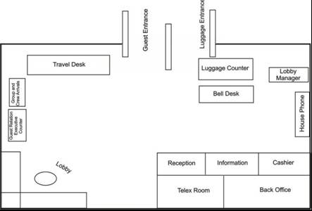
Front desk layout

Slide 42
Reservations Agent
Reservations agents are responsible for all aspects of reservations processing.
Reservations agents respond to communications from guests, travel agents, and referral networks concerning reservations arriving by mail, telephone, telex, cable fax, or through a central reservation system.
The agent creates and maintains reservation records – usually by date of arrival and alphabetical listing. Sometimes they also determine room rates. They also prepare letter of confirmation and promptly process any cancellations and modifications.

Slide 43
Job Description: Reservations Agent
Basic Function: To handle all future reservations, matching the needs of the guests with the hotel.
Relationships: Reports to the front office manager.
Duties and Responsibilities:
Process reservations by mail, telephone, telex, cable, fax, or central reservation system referral.
Process reservations from the sales office, other hotel departments, and travel agents.
Know the types of rooms available as well as their locations and layout.
Know the selling status, rates, and benefits of all package plans.
Create and maintain reservation records by dates of arrival and alphabetical listing.
Communicate reservation information to the front desk.

Slide 44
Process cancellations and modifications. Promptly relay this information to the front desk.
Help develop room revenue and occupancy forecast.
Prepare expected arrival lists for front office use.
Assist in preregistration activities when appropriate.
Handle daily correspondence; respond to inquiries and make reservations as needed.
Make sure that files are kept up to date.
Maintain a clean and neat appearance at all times in your dress and in your work area.
Promote good will by being courteous, friendly, and helpful to guests, managers, and fellow employees.

Slide 45
Job Description: Switchboard Operator
Basic Function: Receives and directs incoming calls to individual guests, staff, or departments.
Duties and Responsibilities:
Answer incoming calls and place outgoing calls.
Direct calls to guestrooms, staff, or departments through the switchboard or PBX system..
Receive telephone charges from the telephone company and forward charges to the front desk for posting.
Take and distribute messages for guests.
Know what action to take when an emergency call is requested or received.
Monitor automated systems, including fire alarms and telephone equipment, when the engineering and maintenance department is closed.

Slide 46
Job Description: Front Office Cashier
Basic Function: To perform tasks relating to guest check-in and check-out and settling guest accounts.
Duties and Responsibilities:
Operate front office posting equipment .
Obtain the house bank and keep it balanced.
Take departmental readings at the beginning of the shift.
Complete guest check-in procedures.
Post charges to guest accounts.
Transfer guest check balances to other accounts as required.
Cash guest checks.
Settle guest accounts.
Handle cash, traveler’s checks, personal checks, credit cards, and direct billing requests properly.

Slide 47
Job Description: Uniformed Service
Basic Function: To work closely with the front desk staff, room service employees, and other hotel personnel in providing guest assistance with luggage, transportation, and miscellaneous needs.
Duties and Responsibilities:
Maintain a good personal appearance at all times. Wear the standard uniform and name tag.
Escort guests to and from their rooms if requested.
Deliver arriving baggage and remove departing baggage promptly, per guest request.
Work closely with the front office in carrying out all guest requests.
Obtain telephone messages from the front desk and promptly deliver them to guestrooms.
Watch for any unusual persons or activities and report them to management.
Transport hotel guests to and from the airport on request, obeying all traffic laws and forms of courtesy.

Slide 48
Job Description: Concierge
Basic Function: To serve as the guest liaison with both hotel and non-hotel attractions, facilities, services, and activities.
Duties and Responsibilities:
Develop a strong knowledge of the hotel’s facilities and services and of the surrounding community.
Provide guests with directions to attractions or facilities in or outside the property.
Provide guests with information about attractions, facilities, services , and activities in or outside the property.
Make guest reservations for air or other forms of transportation when requested: obtain necessary itinerary and tickets.

Slide 49
Coordinate guest requests for special services or equipment with t he appropriate department.
Handle guest complaints.
Make guest reservations the theater and other forms of entertainment when requested; obtain necessary tickets and provide directions to facilities.
Organize special functions as directed by management.
Arrange secretariat and other office services.
Relationships: Reports to the front office manager

Slide 50
Night Auditor
Front office accounting records must be checked for accuracy, summarized, and compiled on a daily basis for the hotel’s financial records. Traditionally, these tasks are conducted at the close of the business day during the hotel’s night shift. This process is referred to as the night audit, and the employee handling these tasks as the night auditor.
Night auditors must be skilled record keepers since the job requires them to track room revenues, occupancy percentages, and other front office operating statistics.
the night auditor may be the only person behind the front desk during the late evening to early morning. For this reason, the night auditor must possess the skills and talents of a front desk agent- especially in terms of check-in and check-out procedures.
Relationships: Reports to the front office manager or to the accounting department.

Slide 51
Job Description: Night Auditor
Basic Function: To ensure the accuracy and balance of front office accounting records and prepare summaries of financial data on a daily basis.
Duties and Responsibilities:
Post room charges and taxes to guest accounts.
Process guest charge vouchers and credit card vouchers.
Post guest charge purchase transactions not posted by the front office cashier.
Verify all account postings and balances.
Monitor the current status of coupon, discount, and other promotional programs.

Slide 52
Prepare a summary of cash, check, and credit card activities.
Summarize results of operations for management.
Understand principles of auditing, balancing, and closing out accounts.
Understand and know how to perform check-in and check-out procedures.

Slide 53
Chapter Two
Front Office Operation

Slide 54
Guest Cycle
A division of the flow of business through a hotel that identifies the physical contacts and financial exchanges between guests and hotel employees.
It starts from the potential customer’s first contact with the hotel through to checkout and reconciliation of the account.

Slide 55
The Guest Cycle and Related Front Office Functions
Guest Cycle
Front Office Functions
Guest Services
Guest Accounting
Pre-Arrival
Reservations
Arrival
Registration
Establishment of
Credit
Occupancy
Occupancy
Services
Charge Posting
Night Audit
Check-Out and
History
Departure
Settlement

Slide 56
Pre-Arrival
The guest chooses a hotel during the pre-arrival stage of the guest cycle.

Slide 57
The guest’s choice can be affected by many factors:
Previous experiences with the hotel;
Advertisements;
Recommendations from travel agents, friends, or business associates;
The hotel’s location or reputation and preconceptions based upon the hotel’s name or chain affiliation;
Ease of making reservations;
How the reservations agent describes the hotel and its facilities, room rates, amenities;
The attitude, efficiency, and knowledge of the front office staff may influence a caller’s decision to stay a particular hotel.

Slide 58
Reservations
An agreement between the hotel and a guest that the hotel will hold a specific type of room for a particular date and length of stay.
The most important outcome of the reservations process is having a guestroom ready and waiting when the guest arrives

Slide 59
If a reservation can be accepted as requested, the reservation agents creates a reservation record.
The creation of a reservation record initiates the hotel guest cycle.
This enables the hotel to identify guest service and appropriately schedule needed staff and facilities.
By confirming reservation, the hotel verifies a guest’s room request and personal information, and assures the guests that his or her needs will be addressed.

Slide 60
Based on information collected during the reservations process, a hotel may also be able to perform pre-registration.
Such activities include assigning a specific room and rate for guests who have not yet arrived, and creating guest folios.
A guest folio is a record of the charges incurred and credits acquired by the guest during occupancy.

Slide 61
A reservation agent must be able to respond quickly and accurately to requests for future accommodation.
The proper handling of reservation information can be critical to the success of a lodging property.
Efficient procedures will also open up more time for the reservation agent to attend to detail and to market hotel services.

Slide 62
Arrival
This stage includes the following activities:
a. Registration Function;
b. Rooming Function.

Slide 63
The front desk agent should determine the guest’s reservation status before beginning the registration process.
Guests with reservations may have already undergone pre-registration activities.
Guests with without reservations – or walk-in guests –present an opportunity for front desk agents to sell guestrooms.
To sell successfully, the front desk agents must be very familiar with the hotel’s room types and guest services, and be able to describe them in a positive way.
A guest will not register if he or she is not convinced of the value of renting a particular hotel room.

Slide 64
Registration
Begins when the front desk agent extends a sincere welcome to the guest.
The procedure by which an incoming guest signifies his or her intent to stay at a property by completing and signing a registration card.
To a great degree, registration relies on the information contained in a reservation record.

Slide 65
Occupancy
The center of front office activity, where the front desk is responsible for coordinating guest services.

Slide 66
A major front office objective throughout the guest cycle is to encourage repeat visits.
Sound guest relations are essential to this objective.
Guest relations depend on clear, constructive communications between the front office, other hotel departments and divisions, and the guest.
Security is another primary front office concern during occupancy.

Slide 67
The guestroom is usually the largest single charge on the guest account. Additional expenses can be charged to a guest’s account if he or she established acceptable credit at the front desk during the arrival stage.
Goods or services purchased from the hotel may also be charged to guest accounts. Front desk accounting records must be periodically reviewed for accuracy and completeness. This need is met through the night audit.
Although the name implies that this process takes place in the evening, this is not necessarily the case. In hotels with computerized front office accounting system, the audit can be conducted at any time during the day. Some computerized properties choose to call the audit the front office audit or update.

Slide 68
Departure
This is the final element of guest service. Checking the guest out of the hotel and creating a guest history record.

Slide 69
At check-out, the guest vacates the room, receives an accurate statement of account for settlement, returns the room keys, and departs from the hotel.
Once the guest has checked out, the front office updates the room’s availability status and notifies the housekeeping department.
During the check-out, the front office determines whether the guest was satisfied with the stay and encourages the guest to return to the hotel – or another property in the chain.

Slide 70
The final element of guest accounting is settlement of the guest’s account.
The purpose of account settlement is to collect money due the hotel. Depending on the guest’s credit arrangements, the guest will pay cash, sign a credit card voucher, or verify direct billing instructions.
Account balances should be verified and errors corrected before the guest leaves the hotel. Problems may occur in guest account settlement when charges are not posted to the guest’s account until after the guest checks out. These charges are called late charges.

Slide 71
Settling accounts for departed guests is generally handled by the accounting department – not the front office. However, the front office is responsible for providing complete and accurate billing information, to assist the back office accounting division in these efforts.
Once the guest has checked out, the front office can analyze data related to the guest’s stay. Front office reports can be used to review operations, isolate problem areas, where corrective action may be needed, and pinpoint out business trends.
Operation analysis can help managers establish a standard of performance which can be used to evaluate the effectiveness of front office operations.

Slide 72
Front Office Accounting
A front office accounting system monitors and charts the transactions of guests and businesses, agencies, and other non-guests using the hotel’s services and facilities.

Slide 73
An effective guest accounting system consists of tasks performed during each stage of the guest cycle.
In brief, a front office accounting system:
Creates and maintains accurate accounting file for each guest or non-guest account;
Tracks financial transactions throughout the guest cycle;
Ensures internal control over cash and non-cash transactions;
Records settlement for all goods and services provided.

Slide 74
Figure 6: Reservation form

Slide 75
ACYTIVITY 2
a) Fill in the Answer column below with the correct alphabet (A-D) which denotes the four different stages of the guest cycle.

Slide 76
A – Pre-arrival | B – Arrival
C – Occupancy | D – Departure
No. | Guest Transaction or Service | Answer(s)
1 | Reservation | A
2 | Mail and information
3 | Transportation
4 | Telephone call and message
5 | Check-in and registration
6 | Flight confirmation
7 | Room assignment
8 | Safe deposit
9 | Issuing of key
10 | Baggage handling
11 | Maintaining guest account
12 | Bill settlement
13 | Issuing of breakfast coupon
14 | Currency exchange
15 | Wake-up call
16 | Check-out
17 | Booking of theatre ticket

Slide 77
Chapter Three
Accommodation Products and Hotel Guest

Slide 78
The Accommodation Product
Accommodation is one of the largest sources of revenue for the operation of a hotel. It is the main product provided by a hotel.
A guest who books accommodation receives more than just a room with a bed. It includes the facilities and services provided by the hotel staff. Since guests in general cannot examine the hotel product before purchase, front office staff must have a clear understanding of the accommodation product and describe it accurately and clearly to the guest. Examples include:
    Room rates
    Size of beds
    Frequent-guest programme
    Other services provided to the guest

Slide 79
HOTEL GUESTS
A hotel customer or client is called a guest because the hotel offers homely and professional service to him, and establishes an intimate relationship with him during his stay.
Hotel guests may be defined as "people who have, who are, or who will be availing the services of hotel, for a particular period in order to satisfy their demand for accommodation, food and beverage or entertainment, for which they are willing and able to pay".

Slide 80
HOTEL GUESTS
Guest relation is the integral part of the hotel industry.
It is a means for the management to reach out to the guest and convey to him the feeling of warmth and welcome.

Slide 81
3.2 Types of Hotel Guest
Hotel guests can be classified according to their:
Trip purpose – pleasure or business travellers
Numbers – independent or group travellers
Origin – local or overseas travellers

Slide 82
Pleasure travellers
They are individuals who travel to engage in leisure activities, outdoor recreation, relaxation, visiting friends and relatives or attending sports or cultural events.
Corporate business travellers
They are individuals whose frequent bookings are usually made by companies with reduced room rates. Business travellers travel to conduct business, attend business meetings or workshops, and engage in selling or purchasing products.

Slide 83
Free independent travellers (FITs)
They are sometimes referred to as "foreign independent travellers". FITs are international tourists who purchase their own accommodation and make their own travel arrangements.
Group inclusive tours (GITs)
Tourists who travel together on package tours with accommodation and sometimes meals which are booked through travel agencies. Group tourists tend to spend less and budget their spending allowance.

Slide 84
Domestic tourists
They are local residents who stay at a hotel for special occasions and functions.
Conference participants
Individuals who travel to attend conference and whose accommodation is usually reserved by himself/herself, his/her company or a conference organiser before their arrival.
Very important persons (VIPs)
Very important persons may include celebrities, frequent-stay guests, guests in expensive rooms, guests with security risks and top executives from companies.

Slide 85
transient guest an individual traveler with a reservation, staying in a hospitality property for a maximum of 30 consecutive days

Slide 86
Types of room | Explanations
Single | A room that sleeps only one person and has been fitted with a single, double or queen-size bed.
Twin | A room that can accommodate two persons with two twin beds.
Double | A room that can accommodate two persons with a double or queen-size bed.
Twin double (also double-double or queen double) | A room that can accommodate two to four persons with two twin, double or queen-size beds.
Triple | A room that can accommodate three persons and has been fitted with three twin beds, one double bed and one twin bed or two double beds.
twin | A room that can accommodate two persons with two twin beds joined together by a common headboard.
Murphy | A room that is fitted with a Murphy bed, i.e. a bed that folds out of a wall or closet.
Suite | Room with one or more bedrooms and a living space. The bedrooms might be singles, doubles or twin doubles.
Adjacent | Rooms close by or across the corridor, but are not side by side.
Adjoining | Rooms that are side by side, but do not have a connecting door between them.
Connecting | Two rooms that are side by side and have a connecting door between them.
Figure 10: Types of room

Slide 87
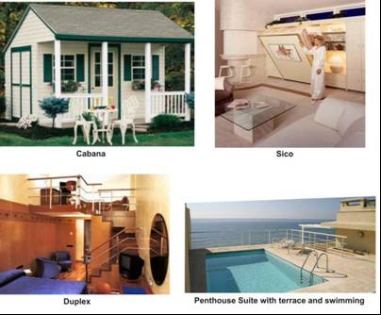

Slide 88
Room rates
Front desk personnel need to know how the room rates are derived. The following criteria will influence the room rate charged to the guests:
Type, size, décor and location of room
Meal plan
Season and seasonal events
Kind of guest
Length of stay and day of the week

Slide 89
The room rate categories have variations in all hotels. Many hotels offer a number of different room rates to attract different guests who will provide repeat business and help ensure full occupancy.
Examples of different room rates are as follows:
Rack rate
The standard rate charged for the room only.
Corporate rate
Room rate offered to executive personnel who are regular guests or employees of a corporation that has a contract rate with the hotel which reflects all businesses from that corporation.

Slide 90
Commercial rate
Room rate offered to executive personnel of a company who have infrequent visit.
Airline rate
The rate agreed between an individual airline and the hotel as determined by the volume of business the hotel obtains from the airline.
Group rate
Room rate given to bookings for a large group of people made through a travel agency or professional organisation.

Slide 91
Children’s rate
Each hotel has a specific age limit for the child to stay with their parents in the same room free of charge or at a nominal rate.
Package rate
Room rate, which includes goods and services and the rental of a room, is developed by the hotel to attract guests in during low sales periods.
American Plan (AP)
Room rate that includes room and three meals.
Modified American Plan (MAP)
Room rate that includes room and two meals; usually breakfast and dinner.

Slide 92
European Plan (EP)
Room rate that includes room only.
Hotel brochures and tariffs
Hotel brochures and tariffs are sales and marketing tools used by the hotel to provide information on the room rate (rack rate) charged and the facilities and services provided to the guests.
In general, the brochures contain pictures of guestrooms, restaurant outlets and other facilities.
Tariffs are usually printed separately as an insert, as the price may change every season or year.

Slide 93
Chapter Four
Front Office Telecommunication

Slide 94
The role of reception to front office communication
Virtually all the information that is received in a hotel comes in via reception.
One of the key skills for a hotel receptionist is that of communication.
Communication is a vital part of the role of the reception, and of the smooth running of hotel.
Communication between people can be made in a variety of ways:
Verbal/ non-verbal
Written
Telecommunication

Slide 95
Spoken/verbal communication
Here, three roles
Information received
Information filtered
Information circulated
What receptionist do during verbal communication ?
Speak – use clear and regular tone , pronouncing words clearly,
Listen – the art of listening is so important for understanding while communicating.
Filter and redirect-the received information should be stored and transmitted to the appropriate place.

Slide 96
Take note
If you cannot rely upon your memory, take note, or identify and highlight the important points.
If you are unsure about something, check or question the information that you have received.
Therefore, always keep a note book at hand.
Take action -Above all, listen, and act upon what you have heard.
Non-verbal Communication- This describes all the silent ways in which you display your feelings.
Non-verbal communication is conveyed in your facial expression, which can show a welcoming smile or a forbidding frown.

Slide 97
Neat appearance
A neat appearance is essential at all times in front office. A neatly presented individual gives the impression of a well-organized and well-run department.
A clean and ironed uniform and polished shoes will reflect your interest and pride.
A neat and tidy appearance is obviously important in order to convey the vital good first impression.
Personal Hygiene
Personal hygiene is a very basic aspect of non-verbal communication, but one that cannot be over emphasized.

Slide 98
Posture
Both sitting and standing postures should be carefully attended to.
Different postures can suggest shyness, reluctance, aggressiveness, willingness, confidence and enthusiasm etc.
Eye Contact
Use of correct eye contact is one of the vital skills that is essential in any ‘people’ industry.
It is the non-verbal equivalent of using someone’s name.

Slide 99
Social Skills
Social skills have been described as the way in which a person behaves towards others in different social situations.
This can be characterized by the difference between a receptionist’s behavior towards a VIP guest and their behavior towards the page.
Social skills are achieved by the co-ordination of verbal and nonverbal behavior in a given situation.

Slide 100
Written Communication
Written communication forms a major part of the work of the front office staff.
Basically the written communication and documentation in front office may be divided into two categories: internal and external.
Internal
Internal communication may often be informal and brief, e.g. the housekeeper notifying reception of ready rooms, or reception notifying other departments of an arrival.

Slide 101
Documents in common use for internal communication are many and varied but could include some of the following:
Memos
tour rooming lists
arrival and departure lists
function lists
guest lists
External
For many potential guests the written communication that they receive from a hotel may be their first contact with the establishment.

Slide 102
Telecommunication
Effective communication by telephone will not only assist in selling the hotel, but will also promote an image of efficiency .
The client judge the standard of the hotel via only telephone conversation .
As long as the call is answered promptly with an appropriate greeting, the client will feel confident that the organization is efficient.

Slide 103
Making Calls
Before making calls, you organize and pen down what you want to say
You have prepared/gathered the necessary reference materials and documents.
You check that the telephone number you are going to dial is correct.
You allow the other party’s telephone to ring for 1 minute, which is about 7-10 rings.
When the other party answers the phone, you identify yourself and your company.
You state your reasons/purpose for calling.

Slide 104
Answering the Telephone
You answer promptly, if possible, within 3 rings. If you cannot answer the call promptly, you apologize to the caller at the start of the conversation.
You greet the caller with the appropriate greeting
You identify your company or your name/dept. You are proud to identify yourself
You always have pen and paper at hand
You take notes, instructions, details and information as required
You repeat all instructions or requests
You listen to the callers’ tone/mood, not just what he is saying.

Slide 105
Answering the Telephone
During the conversation, if you need to leave the phone to get something, you inform the caller the reason/situation.
If you estimate you will take a long time, you inform him and suggest you take down his phone number and contact him when you have got the information. And of course, you keep your word
If the caller is looking for somebody who is not around, you offer to transfer the call to somebody who can help or offer to take a note/message.

Slide 106
Transferring Calls
If you need to transfer the call to another person or dept, you state the reason to the caller.
You get the caller’s permission before transferring the call.
You inform the caller the dept/job title you are transferring to and the name of the person you are transferring to.
You ensure both parties are properly introduced. You can do this by briefly explaining the situation to the person taking the call before you put through the call.

Slide 107
Taking Messages
You get all the necessary information from the caller.
You repeat all information obtained to the caller for accuracy.
After ending the call, you fill up the message form completely and indicate the following items – full name of caller, caller’s company name, message, caller’s contact number, name of person whom the message is for, room number, person who took the message, date and time
You pass the message to the person concerned as soon as possible.

Slide 108
The Property Management
System

Slide 109
The Property Management System (PMS) in Hotels
A Property Management System (PMS) is a software system employed to handle basic objectives of all the departments in the hotel business and coordinate functions between them for optimum business outcomes.
It can also control food and beverage operations and information, remote point-of-sale equipment, management information systems, and systems that link the hotel to worldwide information networks.

Slide 110
Benefits of implementing PMS:
It integrates all critical operations of the hotel on one platform.
It provides real-time information on accommodations, reservations, restaurants, spas, bars, and about every working arm of the hotel.
It provides highly accurate information which is helpful for the management to plan new goals and handle the investments in a better way.
It boosts the efficiency of the front office staff and in turn maximizes the performance of the hotel business.
It simplifies the time-taking or complex operations otherwise done manually.
It works for the convenience of the hotel staff, managing body, as well as the guests.

Slide 111
Introduction
Hotels use a variety of computer systems to manage the operations of their front office. Called a property management system (PMS),
These computer systems manage a variety of tasks.
A hotel PMS manages a guest’s check-in and checkout, cash transactions at the front desk, outlet/ancillary transactions, reservations, housekeeping, night audit and other tasks.
The PMS impacts the rooms division before, during and after the arrival chronology.

Slide 112
Selecting the PMS
The first step in deciding on the right PMS is to conduct a needs analysis, which is a process where hotel managers and senior managers determine the required scope of their PMS needs.
Factors such as the hotel size, product type, location and target market affect the analysis.
Not all lodging ownership associations allow for independent PMS procurement, most franchise and management contract hotels use the PMS chosen by their chain.

Slide 113
Selecting the PMS (Cont…)
Once the needs are determined the appropriate software should be secured, PMS software is a computer program designed on a particular programming platform.
Hotels that are given a mandated PMS by their chain typically receive a system with many more capabilities than needed.
The software often dictated the hardware needs.

Slide 114
Selecting the PMS (Cont…)
The end users of the chosen configuration are the hotel employees
The areas where an employee or manager can access the PMS are called PMS workstations and each workstation will include the software, hardware and computer monitor
Depending on the needs of the end user, other applications such as email, word processing, Internet access etc, might be available at a particular workstation
The size and look of the PMS system must be appropriate

Slide 115
Selecting the PMS (Cont…)
Hotel PMS stations are generally linked to each other in some type of network.
The PMS network (also called a LAN – local area network) allows each station to communicate with the other – this is vital so that every PMS station will know the status of every room and every guest.
PMS’s are more than communication tools, they can also be thought of as extended databases, as they store information and preferences, and capture demographics and other information on each guest.

Slide 116
Guest Account
Most PMS’s are organized based on a series of menus
Within the PMS the guest account tracks all the data that pertains to an individual guest.
The guest registration menu contains all the pertinent information obtained from the initial reservation and during the stay.
The guest accounting menu will be used to track all the credit/debit transactions related to the guest’s stay.

Slide 117
Guest Registration Menu
The date contained in the guest registration menu helps to track all the information pertinent to the guest’s stay
Each PMS will contain this information in some format
Though the order and the verbiage may differ, the following lists the information contained within the registration menu:

Slide 118
Guest Registration Menu (Cont…)
REQUIRED FIELD MEANING
Guest Name Name of individual’s account
Arrival Date Date of check-in
Departure Date Date of checkout
Address Address of guest
Phone Phone of guest
Reservation Status Type of reservation/Status of stay (after check-in)
Room Number Actual Room Assigned
Room Type, configuration & designation
Room Rate Actual rate paid
Room Status Lists the current room status
Method of Payment Cash, Credit Card, Direct Billing or Cheque
Billing Method EPO, SRT, SAC
Guest Loyalty # Frequent stay program number

Slide 119
Guest Registration Menu (Cont…)
REQUIRED FIELD MEANING
Frequent Flier # Airline incentive partnership
Special Requests Early/Late check-in/checkout, upgrade
requests
Comments Free form field that allows front desk staff communicate to each other regarding a specific guest
Market Code Used to track the accuracy of the guest room rate

Slide 120
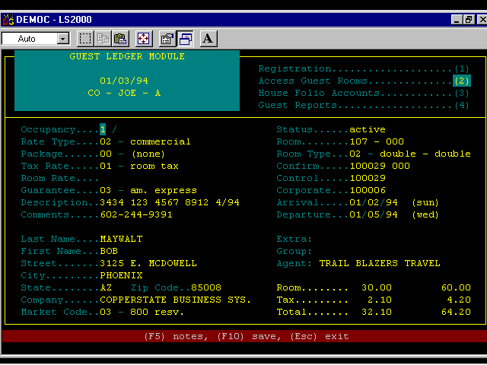
Guest Registration Menu
Figure 8-4

Slide 121
Check-in Illustration
The actual check-in of a guest is a very good way to illustrate the guest registration menu within PMS.
The following slides illustrate the registration of a walk-in guest, that is, a guest without a reservation.
What factors might a front office manager take into consideration when setting that day’s walk-in rate?
Figure 8-6

Slide 122
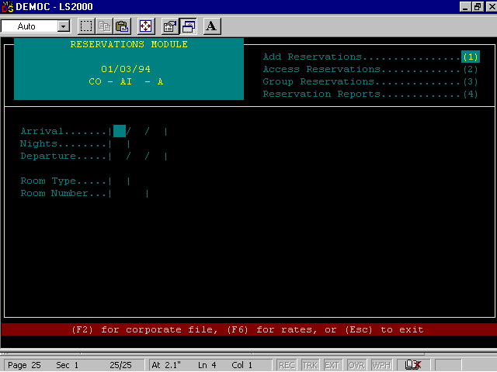
Step 1 is to identify the arrival and departure information, and if need be, verify with management the availability of sleeping rooms.
Figure 8-7

Slide 123
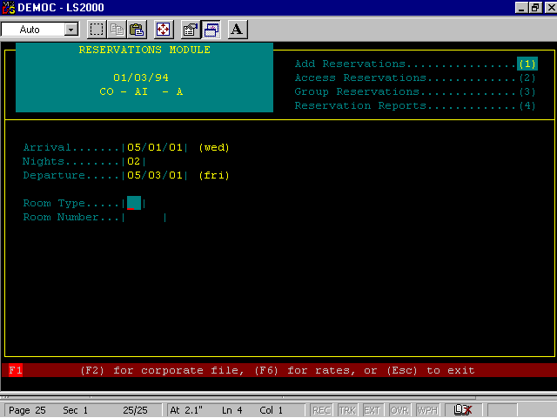
Step 2 is to identify the room type the guest prefers. Agents should do their best to match the guest’s room preferences with what is available.
Figure 8-8

Slide 124
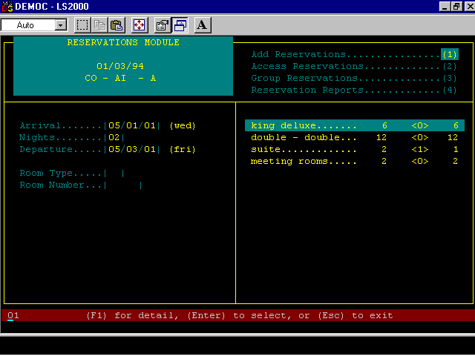
Step 3 is to use the PMS system to determine what available rooms in the hotel inventory match the guest’s room preferences.
Figure 8-9

Slide 125
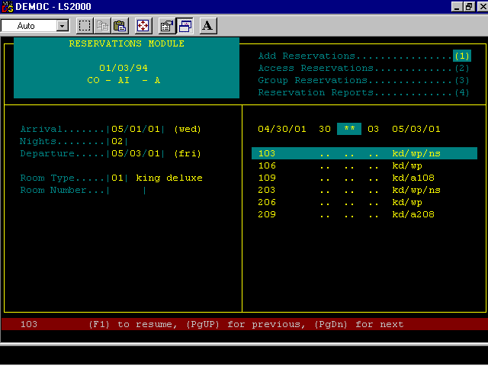
Step 4 is to assign a specific room number based on what PMS indicated was available.

Slide 126
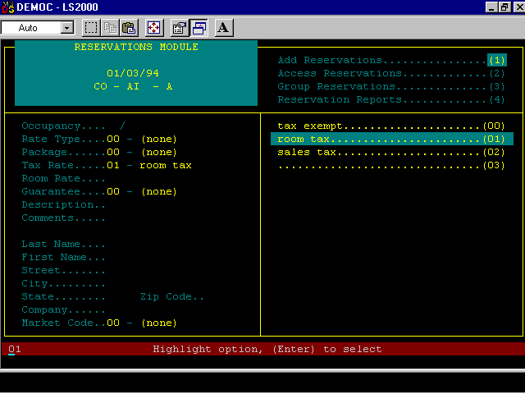
Step 5 is to determine the tax status of the guest. If the guest works for agencies of the government, or certain not-for-profit organizations, he or she may be tax exempt.

Slide 127
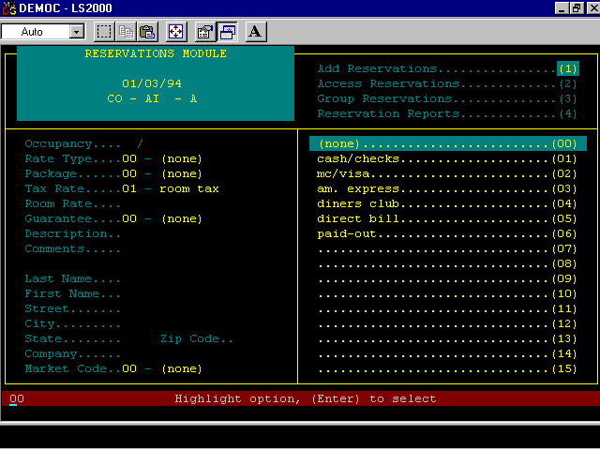
Step 6 is needed to determine method of payment.
Figure 8-12

Slide 128
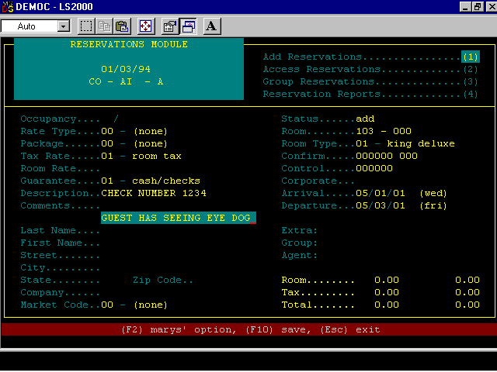
Step 7 In this step, the front desk agent is able to make notes relevant to the guest for other employees. Because this guest is paying by check, a good practice is to note the check number in the registration menu. Also, another note was made indicating that this disabled guest may need assistance later.
Figure 8-13

Slide 129
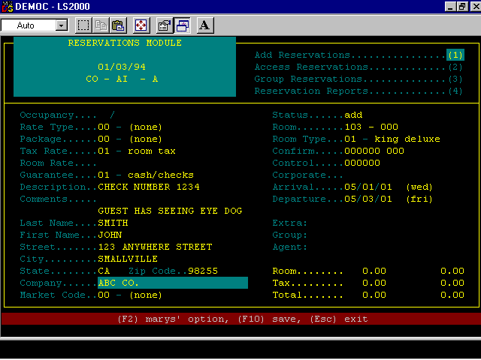
Step 8 is to gather personal identification information, such as name, address, phone, and company name, if applicable. A driver’s license or some other proper form of identification should be shown.
Figure 8-14

Slide 130
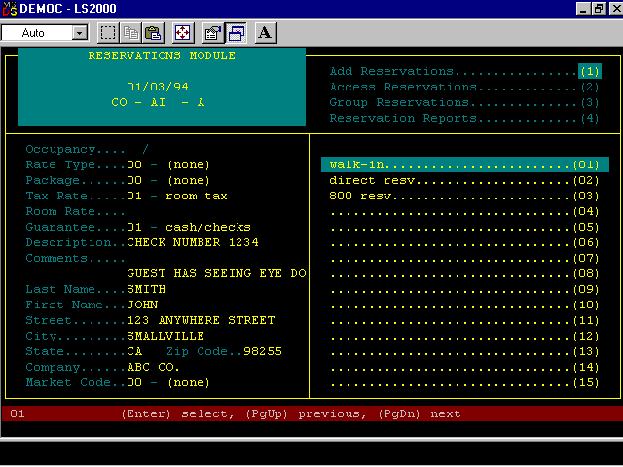
Step 9 is to verify the market code. The market code is needed to serve as a “check and balance” to the sleeping room rate assigned. The market code should match the rate. This is needed to uncover any possible fraud by front desk employees (e.g., reducing a rate for a friend).

Slide 131
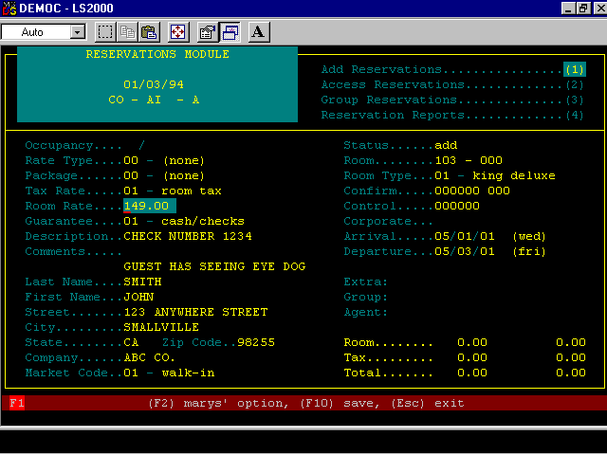
Step 10 is the final step. The rate is typically assigned at the time a market code is issued. However, since this was a walk-in, and the walk-in rate changes, this rate was assigned last.
Figure 8-16

Slide 132
Registration Card
A registration card summarizes much of the information contained in the guest registration menu of PMS.
The information on the card is used to verify the accuracy of information in PMS, such as:
  Arrival/departure information
  Spelling of the guest’s name
  Assigned rate
Figure 8-17

Slide 133
Guest Accounting Menu
The guest accounting menu will contain a limited amount of information relating to the guest’s reservation
It’s primary purpose is to document every financial transaction relating to the guest
Each time a charge is posted, a credit issues, or a payment made it will be reflected in this display
Though the order and verbiage may differ, the following lists the information contained on the accounting menu:

Slide 134
Guest Accounting Menu (Cont…)
REQUIRED FIELD MEANING
Guest Name Name of individual’s account
Arrival Date Date of check-in
Departure Date Date of checkout
Room Number Actual room assigned
Method of Payment Cash, Credit, Direct Billing, Cheque
Reservation Status Lists the current rooms status of the room reserved
The remainder of the guest accounting menu summarizes the financial transactions, each is issued a line number so the record is easy to follow
The final item of note is the record of the employee who made the transaction

Slide 135
The Check-in
The section illustrates the check-in of a walk-in guest (that is, a guest with no prior reservation)
The walk-in rate is set by the Front Office Manager, who will notify front desk staff if the hotel finds itself in need of occupancy for on a certain night
The mechanics of checking in a walk-in guest are very similar to making an advanced reservation

Slide 136
The Check-in (Cont…)
Once the reservation process is complete, the PMS may issue a registration card
A registration card summarises much of the information contained in the guest registration menu of the PMS
The registration card is viewed by the guest to confirm all details and by signing the card the creates a binding agreement between the hotel and the guest

Slide 137
Registration Card Example
Room Number ______
Nice Hotel and Towers
123 Nice Avenue, Anywhere, USA
Card # 001
Arrival Date ___________ Departure Date __________ Payment ________
Room Preference _____________ Rate ___________
Signature __________________
(By signing the above, I hereby confirm all details contained herein are correct and agree to abide by hotel policies)
Guest Name ______________________
Company ________________________
Address _________________________
Telephone ________________________
Check-in time is 3pm
Checkout time is 12pm

Slide 138
Guest accounting Management system

Slide 139
Front Office Accounting
Front Office Accounting System: The automated and/or manual data collection and reporting system that summarizes and documents the financial activities of a front office.

Slide 140
Front Office Accounting
Guest Ledger: The set of accounts used to record charges to and payments from the hotel’s registered guests.
City Ledger: The set of accounts used to record charges to and payments from the hotel’s non-registered guests.
General Ledger: The primary ledger that contains all of a hotel’s accounts and that is used to create its income (profit and loss) statement.

Slide 141
Back Office Accounting
Back Office Accounting: The process of summarizing and documenting the financial activities and condition of the entire hotel.
Controller: The individual (or department) in a hotel responsible for maintaining the back office accounting system.

Slide 142
Back Office Accounting
Settlement (Account): The collection of a payment for an outstanding account balance. Settlement may involve the guest paying cash or charging the account balance to a valid payment card or another hotel-approved account.

Slide 143
Managing the Check-Out Process
Departure List: A report, by name and room number, of all guests scheduled to leave the hotel on a specific date.
Late Check-out: An arrangement that allows a guest scheduled to leave the hotel to maintain access to his/her room after the standard check-out time.

Slide 144
Managing the Check-Out Process
Check-out fundamentals:
  Creation of departure list
  Confirmation of guest identity
  Quality of stay inquiry
  Property exchange
  Final data entry/posting of charges
  Processing guest payment
  Future reservation inquiry
  Filing documentation
  Revision of room status

Slide 145

Revenue/Yield Management
Evaluating front office operation

Slide 146
Yield/revenue management
A process of planning to achieve maximum room rates and most profitable guests (guests who will spend money at the hotel’s food and beverage outlets, gift shops, etc.),
Encourages front office managers, general managers, and marketing and sales directors to target sales periods and develop sales programs that will maximize profit for the hotel.

Slide 147
Definition of Occupancy Percentage
Occupancy Percentage - reveals the success of a hotel’s staff in attracting guests to a particular property
Number of Rooms Sold x 100 = single
Number of rooms available occupancy %
Double Occupancy Percentage – measure of a hotel staff’s ability to attract more than one guest to a room; thus a higher room rate and additional income
Number of Guests – Number of Rooms Sold x 100
Number of Rooms Sold

Slide 148
Definition of Average Daily Rate ADR
Average Daily Rate (ADR) - A measure of the hotel’s staff efforts in selling available room rates.
  Total Room Revenue/sales
  Number of Rooms Sold

Slide 149
Occupancy Percentage Example
Number of Rooms Occupied
Number of Rooms Available
95 rooms occupied
150 room available
95 =
150
63%

Slide 150
Average Daily Rate Example
Rooms Revenue/sales
Number of Rooms Sold
generate $10,000 Rooms Revenue
Sold 100 rooms
$10,000 =
100
$100

Slide 151
Definition of Revenue per available room (RevPAR)
RevPAR – ability of a hotel to produce income and how many dollars each room is producing.
Room Revenue
Number of Available Rooms
or
Hotel occupancy % x ADR
Measures revenue capabilities of the hotel.

Slide 152
RevPar Example
Actual Rooms Revenue
Number of Available Rooms
$10,000 Rooms Revenue
150 room available in the hotel
$10,000 =
150
$67

Slide 153
Forecasting Rooms Revenue
Forecasted Annual Rooms Revenue =
Rooms Occupancy Average
Available Percentage Daily Rate
Rooms Available = Total Rooms X 365 Days

Slide 154
Forecasting Rooms Revenue Example
100 Room Hotel
100 x 365 days = 36,500 Rooms Available
75% Occupancy Percentage
.75
$50 Average Daily Rate
= 36,500 x .75 x $50 = $1,368,750

Slide 155
Forecasting Data
No-shows
  Expected guests who did not arrive.
Walk-ins
  Guests without reservations.
Overstays
  Guests who stay beyond their departure date.
Under stays
  Guests who check out before departure date.

Slide 156
Percentage Of No-shows
Number of Room No-Shows
Number of Room Reservations
Purpose:
  Helps front office managers decide when (and if) to sell rooms to walk-in.

Slide 157
Percentage Of Walk-ins
Number of Room Walk-Ins
Total Number of Room Arrivals
Purpose:
  Helps front office managers know how many walk-ins to expect.

Slide 158
Percentage Of Overstays
Number of Overstay Rooms
Number of Expected Check-Outs
Purpose:
  Alerts front office managers to potential problems when rooms have been reserved for arriving guests.

Slide 159
Percentage Of Understays
Number of Under stay Rooms
Number of Expected Check-Outs
Purpose:
  Alerts front office manager to additional room availability.
  20% of hotels charge under stay guests

Slide 160
Use of Yield Management
Goals of yield management
  Maximize profit for guest room sales
  Maximize profit for hotel services
  (food, beverage, and convention services)

Slide 161
Components of Revenue Management
Yield – the percentage of income that could be secured if 100% of available rooms are sold at their full rack rate (highest room rate posted for a room in a hotel)
Revenue Realized
Number of Rooms Sold x Actual Rate
Revenue Potential
Number of Rooms Available for Sale x Rack Rate
Yield = Revenue Realized (# Rooms Sold x ADR)
Revenue Potential (# Rooms Available x Rack Rate)

Slide 162
Optimal Occupancy and Optimal Rate
Optimal occupancy- Achieving 100% occupancy with room sales which will yield the highest room rate.
Optimal Rate - A room rate which approaches the rack rate.

Slide 163
Chapter Five
Front Office Safety and Security

Slide 164
Security encompasses areas such as security of the property itself, company assets, employees' and customers' personal belongings and valuables, life security, personal security etc.

Slide 165
Safety and Security Measures
Resident card (identity card) has to be provided to the employees and insisted to use them regularly at all times during work.
Key control system should be employed. Bellboy errand card should be instituted.
Maintain record of master key used by staff.
Housekeeper's occupancy report to be made regularly. Proper procedure of checking keys in rack should be followed.

Slide 166
Safety and Security Measures
Double lock system, magic eye and a door chain system to be installed.
Proper "left luggage system" to be followed.
Safety lockers for guest valuables should be provided.
Smoke detectors to be installed.
Install modern and efficient fire fighting system.
Proper regular maintenance of equipment, appliances and building should be carried out.

Slide 167
Install close circuit camera at parking and other strategic areas in the hotel.
Security frisking (body check) if needed (without offending the guest).
Computer and data processing security installed.
Preferably use computerized magnetic keys or room keys.
Employ house detective.
With regard to guest valuables, management informs guests that the hotel is not responsible for valuables left in the room,
Advising them to secure these in safety deposit boxes provided by the hotel.

Slide 168
Management and operational policies regarding the security of guest rooms, public areas, back-of-the-house areas
Employment and training of security personnel
Free flowing communication with local, national and international security authorities
Training of staff in guest and valuable security
Effective supervision and control procedures.

Slide 169
Some of the security measures taken by hotels
Key Card Locks:
While key card locks on guest rooms are quickly becoming the standard, some hotels still don't take advantage of the added safety provided to guests.
Guest room locking systems these days include magnetic key cards which have locks with flash memory and other productivity linked functions. The system can directly be linked with PMS.

Slide 170
Security Guards:
Most hotels do not have security guards while some employ them only at night. we have our own staff of trained security guards working 24-hours every day to provide the best in safety and security for our guests.
Defibrillation Units:
A life saving device in case of heart attacks, defibrillation units are starting to be deployed among police and emergency personnel across the nation.

Slide 171
Security Cameras:
Few Hotels have security cameras with digital technology, intelligent access central system, software interface with CCTV for matching undesirable visitors and criminals, interfacing with motion detectors, pocket lie detectors and spy cameras and use of biometric readers like hand key reader or face recognition system etc.

Slide 172
Fire Alarms:
While most hotels now have smoke detectors and fire alarms, Some hotels have a state of the art alarm system with smoke detectors in each guest room and throughout the entire complex that is monitored 24 hours a day, 7 days per week that pinpoints the exact point of the alarm allowing our security staff to respond immediately to the area of any alarm condition.

Slide 173
Emergency Power:
Very few hotels have any provision for emergency power in case of an electrical outage while a few hotels provide limited emergency stand-by power to provide elevator service and some lighting.
Some hotels has a 2-Megawatt stand-by generator that provides 100% emergency power that can provide uninterrupted guest service during a power outage.

Slide 174
Importance of a Security System
The guest, who comes to a particular hotel, comes with an understanding that he and his belongings both will be safe and secure during his stay at the hotel.
At the same time it is also quite important that the hotel staff and assets are protected and secure.
Hence it is very important to have a proper security system in place to protect staff, guests and physical resources and assets.

Slide 175
The management must take care that the security and safety systems cover the following areas:
Guest:
Staff:
Guest luggage:
Hotel equipment:
Protection of raw materials, goods, provisions and groceries etc.

Slide 176
TYPES OF SECURITY
1) Physical aspect
2) Security of persons
3) Security of systems
Physical aspect is divided into two parts:
a) Internal
b) External

Slide 177
1) Internal security
Against theft
Fire safety
Safeguarding assets
Track unwanted guests
2) External Security
Proper lighting outside the building
Proper fencing of the building
Fencing of pool area to avoid accidents in the night
Manning of service gates to restrict entry
Fixing of closed circuit TV cameras

Slide 178
2) Security aspects of persons
a) Staff
Effective recruitment and selection
Identification of staff
Key control
Training
Locker inspection
b) Guests:
Check scanty baggage guests
Guest room security:
Trained the employees not to do the unwanted thing for guests
Housekeeping staff always keep guest room key for the guests.

Slide 179
3) Security aspects of systems:
Record of all losses and missing items immediately
Inventory control should be proper
Auditing should be done on a regular basis
Proper system for cash disbursements should be made
What is SAFETY ISSUES
When we take the same hotel as example, it is management's duty to ensure "safety" in several areas, such as:
The structure itself
Installations and fixtures (check electrical, plumbing, air-conditioning and other installations)
Public and work areas (e.g. slippery floors, hazardous obstacles in traffic areas), safety of furniture, equipment, appliances, and utensils.

Slide 180
This is followed by:
Health safety (nontoxic cleaning material and detergents used)
Good quality air (what we breathe, dependent upon the type of equipment, installations and fixtures used, and regular repairs and maintenance)
Food safety (a whole world in itself including sanitation, food quality, food spoilage, correct handling procedures, allowable and recommended temperatures, etc.), and checking and control procedures.
An important "preventive measure" is eliminating the possibility of communicating contagious diseases. Another preventive measure is the formulation and implementation of policies and procedures related to employee accidents which may present a threat to food sanitation.

Slide 181
Key Control
The room key is an important instrument that housekeeping staff use to access the guestroom and carry out their duties.
All keys must be kept securely and distributed properly. Every room attendant is responsible for taking care of the keys under their charge and not allowing anyone else access to their keys.
All keys are kept in the housekeeping office in a locked cabinet and are properly coded. The housekeeping co-ordinator is responsible for the distribution and control of keys.

Slide 182
The housekeeping co-ordinator takes inventory of the
keys at the beginning of each shift and prior to the handover of keys to the subsequent shift in charge.
The key cabinet must remain locked at all times.
Keys must never be taken out of the hotel premises. The misplacing or loss of key is a very serious matter and should be reported to the executive housekeeper or assistant manager and security officer immediately. An immediate search must be made until the key can be located.
.

Slide 183
Group Assignment
Handling Emergency Situations
Death of a guest in the hotel
Handling accident cases
Situation of Theft.
Situation of illness and epidemics
Handling a drunk guest:

