Slide 1
Chapter Four
Research Methodology

Slide 2
Objectives of the Chapter
At the end of the chapter, Students Will be able to :
Understand research methodology
Differentiate research methods and research methodology
Explain research design
Describe Characteristics of good research design
Explain Problems in research design

Slide 3
Objectives CONTD..
Objectives
Objectives
Understand qualities of research measurement
Define test of validity
Define test of reliability
Define test of practicality
Explain sources of data
Know how to determine sample size
Explain types of data gathering instrument
Describe population
Describe sample
Describe sampling design
Understand the need for sampling
Explain types of sampling design
Describe data gathering instruments
Develop data gathering instruments

Slide 4
Research Methods versus Research Methodology
Research Method
Research Methodology
It is a particular research technique or way to gather evidence about a phenomenon
The theory of how inquiry should proceed” that “involves analysis of the principles and procedures in a particular field of inquiry.”
It involves the researchers’ assumptions about the nature of reality and the nature of knowing and knowledge.

Slide 5
METHOD
METHODOLOGY
WHAT-did-the-researchers-use-for-their-study' part.
Methods are the specific research tools
The range of approaches used in research to gather data
E.G. surveys, interviews, participant observations
“a theory and analysis of how research does or should proceed.”
Methodology encompasses our entire approach to research
HOW-did-the-researchers-complete-their-study' part
Methodology therefore explains why we use x, y or z methods relevant to particular research

Slide 6
Methodology vs Methods
Methods
Methodogy
are the tools, techniques or processes that we use in our research
Methodology is about the principles that guide our research practices.
Methodology therefore explains why we’re using certain methods or tools in our research.

Slide 7
Research Design
Research design refers to the plan and structure of the investigation used to obtain evidence to answer research questions.
Describes the procedures for conducting the study, including when, from whom, where, and under what conditions the data will be obtained, analyzed and reported.

Slide 8
Design indicates how the research is set up: what happens to the participants and what methods of data collection and analyses are used.
Thus design is concerned with four basic things

Slide 9
the time when the research is carried out
the nature and selection of research participants or subjects of the study
the place where research is conducted and
the how of data collection, analysis and reporting or the conditions under which the research takes place.

Slide 10
It is the blueprint of the research
Quantitative Research Design
Exploratory,
Descriptive and
Explanatory (or causal) designs.

Slide 11
Characteristics of Good Research Design
It should be free from bias.
It should be free from confounding effect
There should be a statistical precision
There should be enough scope to impose the control over the situation. There are basically four ways by which control can be enhanced:
(a)Through the method of Randomization.
(b)Holding conditions or factors constant.
(c)Building conditions or factors into the design as independent variables.
(d)Statistical adjustment.

Slide 12
POTENTIAL PROBLEMS IN RESEARCH DESIGN
There are several difficulties that make poor research design:
1. Inadequately stating and testing hypotheses.
2. Missing or unusable data.
3. Bias in sampling.
4. Inadequate measurement.
5. Lack of precision in statistical technique or inappropriate statistical devices.

Slide 13
Sources of Error in Measurement
Respondent :fatigue, boredom, anxiety reluctant : little knowledge
Situation:
Measurer : behavior, style and looks may encourage or discourage : incorrect coding, faulty tabulation and/or statistical calculations
Instrument:
defective measuring instrument :
The use of complex words, beyond the comprehension of the respondent, ambiguous meanings, poor printing, inadequate space for replies, response choice omissions

Slide 14
Qualities of Sound Measurement
Sound measurement must meet the tests of validity, reliability and practicality
Validity refers to the extent to which a test measures what we actually wish to measure
Reliability has to do with the accuracy and precision of a measurement procedure.

Slide 15
Practicality is concerned with a wide range of factors of economy, convenience, and interpretability

Slide 16
Test of Validity
Validity is the most critical criterion and indicates the degree to which an instrument measures what it is supposed to measure
validity is the extent to which differences found with a measuring instrument reflect true differences among those being tested.

Slide 17
Types of Validity
validity
Content validity
Criterion-validity
Construct validity

Slide 18
Content validity
It is the extent to which a measuring instrument provides adequate coverage of the topic under study
It can also be determined by using a panel of persons who shall judge how well the measuring instrument meets the standards, but there is no numerical way to express it.

Slide 19
Criterion-related validity
Relates to our ability to predict some outcome or estimate the existence of some current condition

Slide 20
Qualities Criterion-related validity
Relevance :A criterion is relevant if it is defined in terms we judge to be the proper measure.
Freedom from bias: Freedom from bias is attained when the criterion gives each subject an equal opportunity to score well.
Availability: (The information specified by the criterion must be available.)

Slide 21
Construct validity
It is the most complex and abstract
A measure is said to possess construct validity to the degree that it confirms to predicted correlations with other theoretical propositions.
Construct validity is the degree to which scores on a test can be accounted for by the explanatory constructs of a sound theory.

Slide 22
2. Test of Reliability
A measuring instrument is reliable if it provides consistent results.
Reliable measuring instrument does contribute to validity, but a reliable instrument need not be a valid instrument
a valid instrument is always reliable

Slide 23
Ways to improve reliability
By standardizing the conditions under which the measurement takes place
By carefully designed directions for measurement with no variation from group to group, by using trained and motivated persons to conduct the research and also by broadening the sample of items used. This will improve equivalence aspect.

Slide 24
Test of Practicality
The practicality characteristic of a measuring instrument can be judged in terms of economy, convenience and interpretability

Slide 25
Research Designs
1. A case study is an in-depth study of a particular research problem rather than a sweeping statistical survey or comprenhesive comparative inquiry.
It is often used to narrow down a very broad field of research into one or a few easily researchable examples.
The case study research design is also useful for testing whether a specific theory and model actually applies to phenomena in the real world.
It is a useful design when not much is known about an issue or phenomenon.

Slide 26
The design can provide detailed descriptions of specific and rare cases.
But difficult to generalize : The case may not be representative or typical of the larger problem being investigated.

Slide 27
Cross-Sectional Research Designs
Cross-sectional research designs have three distinctive features: no time dimension; a reliance on existing differences rather than change following intervention; and, groups are selected based on existing differences rather than random allocation.
The cross-sectional design can only measure differences between or from among a variety of people, subjects, or phenomena rather than a process of change.
As such, researchers using this design can only employ a relatively passive approach to making causal inferences based on findings.

Slide 28
Descriptive Research Design
Helps provide answers to the questions of who, what, when, where, and how associated with a particular research problem; a descriptive study cannot conclusively ascertain answers to why.
Descriptive research is used to obtain information concerning the current status of the phenomena and to describe "what exists" with respect to variables or conditions in a situation.

Slide 29
Experimental Design
A blueprint of the procedure that enables the researcher to maintain control over all factors that may affect the result of an experiment.
In doing this, the researcher attempts to determine or predict what may occur.
Experimental research is often used where there is time priority in a causal relationship (cause precedes effect), there is consistency in a causal relationship (a cause will always lead to the same effect), and the magnitude of the correlation is great.

Slide 30
The classic experimental design specifies an experimental group and a control group.
The independent variable is administered to the experimental group and not to the control group, and both groups are measured on the same dependent variable. Subsequent experimental designs have used more groups and more measurements over longer periods.
True experiments must have control, randomization, and manipulation.

Slide 31
Exploratory Design
An exploratory design is conducted about a research problem when there are few or no earlier studies to refer to or rely upon to predict an outcome.
The focus is on gaining insights and familiarity for later investigation or undertaken when research problems are in a preliminary stage of investigation.

Slide 32
Goals of exploratory design
The goals of exploratory research are intended to produce the following possible insights:
Familiarity with basic details, settings, and concerns.
Well grounded picture of the situation being developed.
Generation of new ideas and assumptions.
Development of tentative theories or hypotheses.
Determination about whether a study is feasible in the future.
Issues get refined for more systematic investigation and formulation of new research questions.
Direction for future research and techniques get developed.

Slide 33
Historical Design
The purpose of a historical research design is to collect, verify, and synthesize evidence from the past to establish facts that defend or refute a hypothesis.
It uses secondary sources and a variety of primary documentary evidence, such as, diaries, official records, reports, archives, and non-textual information [maps, pictures, audio and visual recordings].

Slide 34
Longitudinal Design
A longitudinal study follows the same sample over time and makes repeated observations.
For example, with longitudinal surveys, the same group of people is interviewed at regular intervals, enabling researchers to track changes over time and to relate them to variables that might explain why the changes occur.
.

Slide 35
Longitudinal research designs describe patterns of change and help establish the direction and magnitude of causal relationships.
Measurements are taken on each variable over two or more distinct time periods.
This allows the researcher to measure change in variables over time.
It is a type of observational study sometimes referred to as a panel study

Slide 36
Meta-Analysis Design
Meta-analysis is an analytical methodology designed to systematically evaluate and summarize the results from a number of individual studies, thereby, increasing the overall sample size and the ability of the researcher to study effects of interest.
The purpose is to not simply summarize existing knowledge, but to develop a new understanding of a research problem using synoptic reasoning.
The main objectives of meta-analysis include analyzing differences in the results among studies and increasing the precision by which effects are estimated.

Slide 37
A well-designed meta-analysis depends upon strict adherence to the criteria used for selecting studies and the availability of information in each study to properly analyze their findings.
Lack of information can severely limit the type of analyzes and conclusions that can be reached. In addition, the more dissimilarity there is in the results among individual studies [heterogeneity], the more difficult it is to justify interpretations that govern a valid synopsis of results.

Slide 38
Mixed-Method Design
Mixed methods research represents more of an approach to examining a research problem than a methodology. Mixed method is characterized by a focus on research problems that require,
an objective of drawing on the strengths of quantitative and qualitative data gathering techniques to formulate a holistic interpretive framework for generating possible solutions or new understandings of the problem.

Slide 39
Tashakkori and Creswell (2007) and other proponents of mixed methods argue that the design encompasses more than simply combining qualitative and quantitative methods but, rather, reflects a new "third way" epistemological paradigm that occupies the conceptual space between positivism and interpretive.

Slide 40
Ethnographic research design
Ethnographic research usually involves observing target users in their natural, real-world setting, rather than in the artificial environment of a lab or focus group.
The aim is to gather insight into how people live; what they do; how they use things; or what they need in their everyday or professional lives.

Slide 41
SAMPLING DESIGN
Term | Definition
Population | A population is a group of individuals persons, objects, or items from which samples are taken for measurement
Sample | The representative of the population or the portion of the population from where we collect data
Sampling | Sampling is the act, process, or technique of selecting a suitable sample, or a representative part of a population for the purpose of determining parameters or characteristics of the whole population.

Slide 42
SAMPLING DESIGN
Term | Definition
Sampling frame | It is a list of all elements or other units containing the elements in the population
Target population | It is a set of elements larger than or different from the population sampled and to which the researcher would like to generalize study findings
Sampling technique/design | The sampling techniques we use to determine the sample size of the study population
Sample Size | The act of choosing the number of observations or replicates to include in a statistical sample

Slide 43
Consider the following diagram

Slide 44
Consider the following diagram

Slide 45
Look at the differences

Slide 47
Purpose of sampling
To gather data about the population in order to make an inference that can be generalized to the population

Slide 48
Reasons of Sampling
Economy
Timeliness
Large size of many population
Inaccessibility of the entire population.
Destructive nature of many Observation
Reliability or accuracy.

Slide 49
Types of Sampling Design
Sampling Design
Probability Sampling
Simple random sampling
Systematic Sampling
Non – probability Sampling
Complex Random Sampling
Stratified Random Sampling
Cluster Sampling
Multistage sampling

Slide 50
Probability Sampling
It is based on the concept of random selection
Every member of the population has a nonzero/equal chance/ probability of being selected as a sample unit
Some times called random sampling

Slide 51
Simple random sampling
each unit or member of the population has an equal chance of being selected.
The law of chance/lottery system/ completely operates freely in the selection of such a sample

Slide 52
Selection process/procedure for simple random sampling

Slide 53
2. Systematic Sampling
When a frame of a population (i.e., a complete list of all members of the population) is available or when a population can be listed accurately and is finite, a method of systematic selection will provide a sample that approximates a simple random sample.

Slide 55
Get the complete list of population members, i.e., their names or type of identification ordered in some way, say in alphabetical order. Represent this with N (size of the population).
Determine the number of members to be included in the sample. This is represented by n (size of the sample).
Determine the sampling fraction by dividing N by n, that is, divide the total population to the required sample size. Let us represent this fraction by k. Then k = . Hence every k^{th} individual in the name list will be selected.

Slide 56
For example, a researcher wants to take a sample size of 40 from a population of 360 grade 5 students. Thus N is 360 and n is 40. Therefore, k = = 9. The researcher takes the name list of the students and selects the sample students at an interval of 9 in the list. A number from one to ten is randomly selected as a starting point.

Slide 57
Thus , in systematic sampling only the first unit is selected randomly and the remaining individuals of the sample are selected at fixed intervals.
Systematic and simple random sampling procedures are used when the population has homogeneous members and when a complete list of the population is available

Slide 58
Complex Random Sampling
Probably the most common reason is the nature of the population from which the sample is to be selected. When the population is very large, when it consists of several subpopulations (subgroups) that differ significantly on some characteristics, i.e., heterogeneous groups;

Slide 59
3.1. Stratified Random Sampling
It is used when the population is not homogeneous
This is because that the subpopulations may not be represented in the sample. Rather than selecting randomly from the entire population, the researcher divides the population into two or more subpopulations, called strata.

Slide 62
Consider the following figure

Slide 63
Formulas to determine the sample size of each strata in stratified random sampling
After you determine your sample size:
n_{h} = ( N_{h} / N ) * n
Where Nh is the population size for stratum h,
nh = is the sample size for stratum h,
N=N is total population size
n is total sample size

Slide 64
Assume that total house hold population is =30741 total sample size is =196

Slide 65
No. | Name of the Kebele’s | House hold size of Kebele’s | Sample size | Location | Remarks
1 | Menta Guchile | 5568 | 35 | Tocha District
2 | Chawuda | 815 | 5 | Esara District
3 | Gudimu | 3821 | 25 | Esara District
4 | Tulama | 613 | 4 | Esara District
5 | Churchura | 2253 | 14 | Esara District
6 | Ada Becho | 1566 | 10 | Esara District
7 | Cheta | 2365 | 15 | Esara District
8 | Nada | 5887 | 37 | Esara District
9 | Seri Shewa | 1194 | 8 | Esara District
10 | Delba | 2964 | 19 | Konta Special Woreda
11 | Chebera | 3695 | 24 | Konta Special Woreda
12 | Total | 30741 | 196 | Konta Special Woreda

Slide 66
3.3. Cluster Sampling
It is used when it is not possible to select a sample of individuals from a population.
The process of randomly selecting intact groups, not individuals, within the defined population sharing similar characteristics
Clusters are locations within which an intact group of members of the population can be found
e.g.
Neighborhoods
School districts
Schools
Classrooms

Slide 67
Selection process
Identify and define the population
Determine the desired sample size
Identify and define a logical cluster
List all clusters that make up the population of clusters
Estimate the average number of population members per cluster
Determine the number of clusters needed by dividing the sample size by the estimated size of a cluster
Randomly select the needed numbers of clusters
Include in the study all individuals in each selected cluster

Slide 68
3.4. Multistage sampling
Multistage sampling is a further development of the principle of cluster sampling.
It is used in large-scale surveys for a more comprehensive investigation.
The researcher may have to use two, three, four or more stage sampling.
For instance, a researcher wants to study the opinions of teachers towards “self -contained class.”
He/she wants to select a sample from all elementary school teachers in Ethiopia.
A simple random sampling would be impracticable or impossible.

Slide 69
Non probability sampling
In non-probability sampling, the members are selected at the discretion of the researcher.
That is, the researcher relies on his/her own personal judgments, experiences or assumptions to select the members of the population to serve as sample members.

Slide 70
NONPROBABILITY SAMPLING
There are a number of reasons why random sampling may not be appropriate or feasible. Some are:
Lack of access to the entire population
Low importance of research generalizability. When the researcher is mainly interested in solving an immediate problem in a local site rather than making generalizability, random selection may not be feasible
Few cases or groups. When there may be only one or a limited number of sites or groups relevant to the research, random sampling is not feasible.

Slide 71
Types of Non Probability Sampling
Non probability Sampling
Comprehensive (Available) Sampling
When every unit is included
When there is small number of population
Maximum Variation sampling
Quota Sampling
Accidental (Convenient) sampling
sample cases that differ markedly on a specified characteristic.
e.g poor and rich
Weak and intellignet
different strata
When the population has different strata
when availability and willingness to respond are major factors used in selecting respondents

Slide 72
Data Gathering Tools /Instruments
The followings are a commonly used data collection instruments;
It is a list of written questions that we supposed ask a respondents to collect data
Interviews are essentially vocal questionnaires
Re- searcher's seeing and hearing things and recording these observations, rather than relying on subjects' self-report responses to questions or statements.
Discussion with a group of people about the is sues specified for discussion with people of 6- 14 in number .

Slide 73
Questionnaire
Its Advantages
It is relatively economical, i.e., the researcher can collect large amount of data within a limited time from large number of participants.
It simultaneously presents the same questions for all subjects,
It can ensure anonymity, and
it contains questions written for specific purposes.

Slide 74
Steps in questionnaire preparation

Slide 75
Justification
The researcher should have a rational for choosing questionnaire as the data gathering instrument from among other instruments
Objectives
The second step in using a questionnaire is to define and list the specific objectives that the information will achieve
The objectives are based on the research problems or questions, and they show how each piece of information will be used. There must be a match between the research questions and the items of a questionnaire

Slide 76
Writing Questions and Statements
Follow the following guidelines to write your research questions and statements :
Make items clear/specific : it should not allow multiple interpretation
Avoid double-barreled questions: your question should be limited idea (avoid “and”)
Respondents must be competent to answer
Questions should be relevant

Slide 77
Simple items are best: Long and complicated items should be avoided
Avoid negative items: . Negatively stated items should be avoided because they are easy to misinterpret.
Subjects will unconsciously skip or overlook the negative word, so their answers will be the opposite of the intended
If researchers use negative items they should boldface, underline, or capitalize the negative word (not, not, or NO).
Avoid biased items or terms.

Slide 78
Form of items in questionnaire construction
Forms of questionnaire
Open ended questionnaire
Close ended

Slide 79
Open ended Questionnaire
The subject chooses between predetermined responses, or an open form, in which the subjects write in any response they want
E.g what is suggestion on research methods course offering mechanism
________________________________

Slide 80
Close ended questionnaire
Respondents choose from the listed alternatives and they do not write their opinions /saying
e.g : Check the box that indicates the number of hours you spent studying for the test.
[ ] 0-2
[ ] 3-5
[ ] 6-8
[ ] 9-11

Slide 81
Forms of close ended questions
Close ended questions
Scaled items
Ranked Items
Checklist Items
Multiple Choice items

Slide 82
Scaled Items
It is a values that describes various degrees of something
Scales are used extensively in questionnaires because they allow fairly accurate assessments of beliefs or opinions
The most widely used example is the Likert scale.
A true Likert scale is one in which the stem includes a value or direction and the respondent indicates agreement or disagreement with the statement.
Likert-type items use different response scales; the stem can be either neutral or directional.

Slide 83
Look at the following items

Slide 84
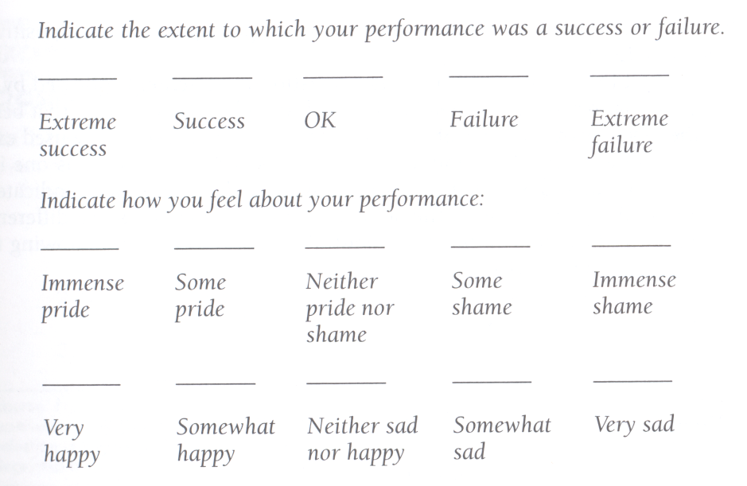

Slide 85
A variation of the Likert scale is the semantic differential.
This scale uses adjective pairs, with each adjective as an end anchor in a single continuum.

Slide 86
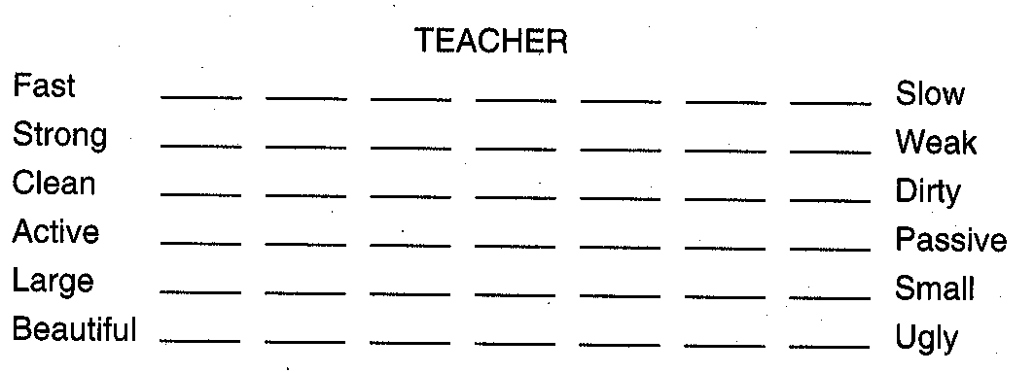

Slide 87
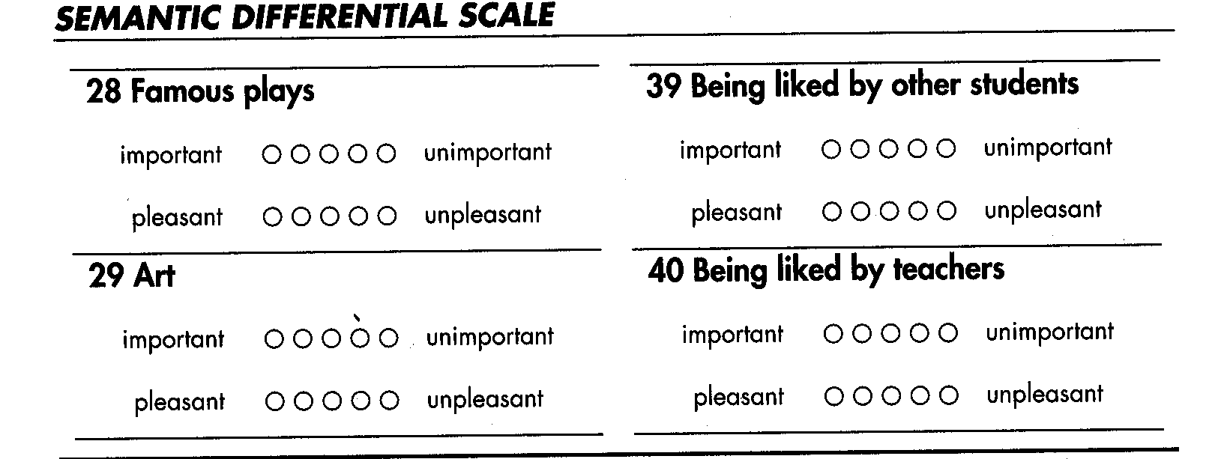

Slide 88
Ranked Items.
The respondents are asked to rank-order the five ways in sequential order from most to least important, then the researcher can gather more valuable information on ways to spend the money.

Slide 89
Consider the following
Rank-order the following activities with respect to their importance as to ways our research fund should be allocated the coming academic year. Use 1 = most important, 2 = next most important, and so forth until 5 = least important.
_____ Annual seminars
_____ Individual research projects
_____ Invited speakers
_____ Computer software
_____ Student assistantships

Slide 90
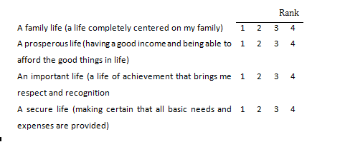
which comes next in importance, which is third, and which ranks fourth."

Slide 91
Checklist Items
A checklist is simply a method of providing the respondent a number of options from which to choose.
The item can require a choice of one of several alternatives (for instance, Check one:
Check as many as apply. The more enjoyable topics in Tourism are
____Transport
____ Ecotourism
____ Hotel management
____ Tourist Behavior
____ Customer care and service

Slide 92
E.g.2. Check the appropriate category: ____ single, never married
____ married
____ separated
____ divorced
____ widowed

Slide 93
Multiple Choice Questions
to write the item on one line and to place the response categories below, not next to, the item. It is also advisable to use boxes, brackets, or parentheses rather than a line to indicate where to place the check mark.
For example

Slide 94
Have you used the Tourism Management Curriculum Guide?
[ ] yes
[ ] no
If yes: How often have you used the activities suggested?
[ ] 0-2 times
[ ] 3-5 times
[ ] 6-10 times
[ ] more than 10 times

Slide 95
Each of the items in this section refers to a possible goal or emphasis of higher education. Check the appropriate letter after each of the following statements to indicate how important you believe the corresponding goal should be. Use this key: U = unimportant, S = somewhat important, I = important, V = very important, E = extremely important.

Slide 97
General rules for questionnaire construction
Carefully check grammar, spelling, punctuation, and other details.
Make sure printing is clear and easy to read.
Make instructions brief and easy to understand.
Avoid cluttering the questionnaire by trying to squeeze many items onto each page.
Avoid abbreviated items.
Keep the questionnaire as short as possible.
Provide adequate space for answering open-ended questions.
Use a logical sequence, and group related items together.
Number the pages and items.
Use examples if the items may be difficult to understand.
Put important items near the beginning of a long questionnaire.
Be aware of the way the positioning and sequence of the questions may affect the responses.
Print response scales on each new page.

Slide 98
Interview
Interviews are essentially vocal questionnaires.

Slide 99
Major Steps in Interview preparation
preparing a questionnaire-justification,
defining objectives,
writing questions,
deciding general and item format,
and pretesting

Slide 100
What is the difference between Interview and Questionnaire ?
interview involves direct interaction between individuals but questionnaire may not.
The interview technique is flexible and adaptable

Slide 101
Reading assignment
Identify the advantage and disadvantage of interview and questionnaire

Slide 102
Forms of Questionnaire
Structured,
Semi- structured, or
Unstructured

Slide 103
Structured questions (also called limited response questions) are followed by a set of choices, and the respondent selects one of the choices as the answer
E.g. Would you say the program has been highly effective, somewhat effective, or not at all effective?").

Slide 104
Semi-structured
Semi-structured questions have no choices from which the respondent selects an answer.

Slide 105
Unstructured Interview
questions allow the interviewer great latitude in asking broad questions in whatever order seems appropriate

