Slide 1
Unit Three: Market Concentration
3.1 Nature and Theories of Concentration
Market concentration refers to the situation in which an industry or a market is controlled by a small number of leading producers who are exclusively or very largely engaged in that industry.
Two variables that determinates such situation are:
  the number and
  size distribution of firms within the market.

Slide 2
How these two dimensions cause different forms of the market structure having vital consequences for the pricing and output decisions of the firm?
The implication of market concentration in industrial economics is far wider than theory of the firm.
Market concentration (the degree of sellers' concentration in the market), is an important element of the market structure, which plays a dominant role in determining the behaviour of a firm in the market.

Slide 3
A market is said to be more concentrated, the fewer the number of firms.
The "market structure-conduct-performance" requires a means of identifying different market structures:
  concentration in the ownership of the industry
  concentration of decision-making power, and
  concentration of the firms in a particular location or region, etc.
All of these elements of market concentration may have considerable impact on the market performance of the firms such as profitability, growth, and technological progress.

Slide 4
3.2 Measuring Market Concentration
Measurement of market concentration help us to test empirically the behavioral hypothesis about the firms and industries.
Various quantitative indices have been suggested for this purpose.
Some of them are used to measure the monopoly power and some others for market concentration.

Slide 5
These two terms are closely interrelated and cannot be separated from each other in the measurement process of market concentration.
The measures for monopoly power :
  It would be more appropriate at firm level.
  They indicate the actual monopoly power exercised by the firms.
The measures of concentration:
  it would give us the potential monopoly power in the market or industry as a whole.
Market concentration is therefore a necessary condition for the monopoly power.
A market concentration measure should be decreasing as the number of firms in the market keeps on increasing.

Slide 6
Some of the general conditions that should be satisfied by each one of the indices are:
  The measure must yield unambiguous ranking of industries by concentration.
  The concentration measure should be a function of the combined market share of firms rather than the absolute size of the market or industry.
  If the number of firms increases, then concentration should decrease. However, if the new entrant is large enough, then concentration may go up.
  If there is transfer of sales from a small firm to a large one in the market, then concentration increases.
  Proportionate decrease in the market share of all firms reduces the concentration by the same proportion.
  Merger activities increase the degree of concentration.

Slide 7
It may not be possible for an index of concentration to satisfy all of the above conditions.
There are several measures suggested for measuring market concentration all of which are not equally good or bad i.e., there is no perfect or the best index for concentration or monopoly power.
A measure of market concentration tries to transform the information on the number, size and distribution of firms presented on the concentration curve into a single value.

Slide 8
3.3 The Concentration Curve and Measures of Market Concentration
The Market concentration Curves plot the cumulative market share from the largest to the smallest.
It may provide information on the structural characteristics of the market.
Graphs between cumulative number of firms from largest to smallest (X-axis) and cumulative percentage of market supply (Y-axis) are shown by points: A, B & C for three industries separately. (See the following graph).

Slide 9
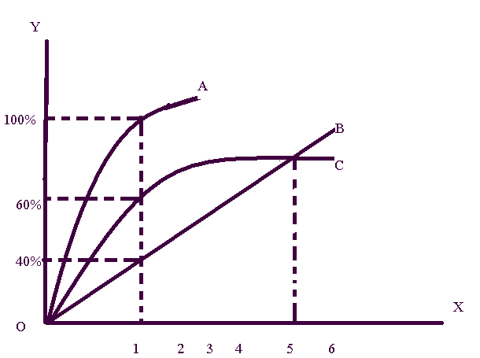
Fig 3.1: The Market Concentration Curve

Slide 10
Market A is the highly concentrated industry. For the first five largest firms, market C is more concentrated than B. But, for the number of firms greater than five, market B is more concentrated than C.
There are six main measures of concentration.
i. Concentration Ratio (C_{r)}: is the most popular and simplest index for measurement of market concentration or monopoly power. It is defined as the share of market held by some of the largest firms in the market.

Slide 11
More specifically, it is defined as a proportion of market share accounted by r largest firms, where r is an arbitrary number. The normal practice is to take r = 4.

Slide 12
Where S_{i} is the percentage of market share of firm i.
The higher the concentration ratio, the greater will be the monopoly power or market concentration existing in the industry.
If C_{r} is close to zero percent, then the largest ‘r’ firms supply a small share of the market.
If C_{r} is closer to 100%, it implies there high market concentration i.e. the largest ‘r’ firms supply the largest share of the market.
It is possible to calculate the C_{r} on the basis of value added, total employees, market supply, etc.

Slide 13
Example :We have eight firms in Edible Oil market. The information given in the table below will show us the market share of each firm. Now using the information below, compute the concentration ratio of the higher four firms.

Slide 14
S.N | Name of a firm | Market share in percentage
1 | Firm 1 | 25
2 | Firm 2 | 1
3 | Firm 3 | 4
4 | Firm 4 | 20
5 | Firm 5 | 3
6 | Firm 6 | 2
7 | Firm 7 | 15
8 | Firm 8 | 30

Slide 15
Now the first thing we do is to identify the four largest firms based on their market share. We will put then in descending order as you can see in the table below.
S.N | Name of a firm | Market share in percentage
1 | Firm 8 | 30
2 | Firm 1 | 25
3 | Firm 4 | 20
4 | Firm 7 | 15
Total |  | 90

Slide 16
Now using the formula given for concentration ratio, we can get the monopoly power of these four firms. The value of the concentration ratio is 0.9 or in other word the four firms took 90 percent of the total market.

Slide 17
Limitation of the concentration ratio
This index has two limitations: the arbitrary selection of r and only a single point on the concentration curve is taken without information on the size distribution of the ‘r’ firms.
The Arbitrary Selection of ‘r’ - when the concentration curves intersect, the measure (C_{r}) will give different ranking of industries for different values of ‘r’.
For instance, at C_{r3,} firm C is more concentrated than B. But at C_{r6} market B is more concentrated than market C.

Slide 18
The basic problem with Concentration ratio is that it provides no information about the size distribution of the r’ firms chosen for constructing the ratio.
Suppose in industry A where there are four firms, the largest firm has 97% market share and the other three account for 1% each.
In industry B there are four firms each with a market share of 25%.
For both industries (A&B) Cr₄ = 100% although the market structure is different.
That is, market A is more or less a monopoly market.

Slide 19
(ii)The Hirschman-Herfindahl (HHI)Index:
Unlike the concentration ratio (Cr), the HHI takes into account all points on the concentration curve.
HHI is the sum of the squares of the relative sizes (or market shares) of all firms in the market, where the relative sizes are expressed as proportions of the total size of the market. Mathematically, the HHI index is given by:

Slide 20
Where S_{i} = q_{i}/Q, q_{i} is output of i^{th} firm and Q is total output of all the firms in the market, and n is the total number of firms in the industry.
The index is close to zero when there is large number of equal sized firms, or equal to one under monopoly. The HHI has two principal advantages:
  Squaring the individual market shares gives more weight to the shares of the larger firms.
  It uses information about the market share of all relevant firms.

Slide 21
The HHI gives added weight to the biggest industries.
The higher the index, the more the market concentration and (within limits) the less open market competition.
Example
We have six firms in a given computer market. The following table shows the market share of the firm.

Slide 22
S.N | Name of a firm | Market share in percentage | Square of market share
1 | Firm 1 | 20 | 0.04
2 | Firm 2 | 15 | 0.0225
3 | Firm 3 | 10 | 0.01
4 | Firm 4 | 15 | 0.0225
5 | Firm 5 | 25 | 0.0625
6 | Firm 6 | 15 | 0.0225
Total |  |  | 0.018

Slide 23
Using the formula above, first you can compute the square of each market share of a given firm. After that just take the summation of the square of each market shares. It will give you the value of the Hirschman – Herfindahl index. That is 0.018 the value indicates that monopoly power of the firms is very low.

Slide 24
A monopoly, for example, would have Hirschman-Herfindahl index of S1² or 100², or 10,000. By definition, that is the maximum score.
By contrast, an industry with 100 competitors that each has 1% of the market would have a score of 1² + 1² + 1²+ ... + 1² or a total of 100.
The more typical situation might be a duopoly.
If each of the two firms has a market share of 50%, the Hirschman-Herfindahl index would be (50)² + (50)² = 2500 + 2500 = 5000.
With two firms that have of 75% and 25% respectively, the Hirschman-Herfindahl index would be: (75)²+ (25)² = 5,625 + 625 = 6,250
Notes:
DUOPOLY is a special case of oligopoly in which there are only two firms in the industry.

Slide 25
In recognition of its advantage, the HHI has been accepted as a measure of concentration in the United State of America, especially as a guideline to decide merger cases.
According to the guidelines to decide merger cases un-concentrated markets are defined, as those in which HHI is 1000 or less which is equivalent to 10 equal sized firms.
In this situation mergers (at least two firms merged in each other) leading to a rise of HHI = 200 points are challenged or disallowed.

Slide 26
A market is assumed to be concentrated if HHI is 1800 or more which is roughly equivalent to five equal sized firms.
Each one has a share of 20%. In this case mergers leading to a 100 point or more rises in HHI are rejected or challenged.
When two firms with market share of S₁ and S₂ merge the HHI increases by 2S₁S₂.
The purpose of disallowing merger is that it may lead to a monopoly situation.

Slide 27
iii. Entropy Index: it is quite recently to measure the degree of market concentration.
Market concentrations are weighted by the logarithms of the market shares.
It uses the following formula:
0< E < log (n)
where EI is defined as 'Entropy coefficient.'

Slide 28
It uses the formula where E is defined as Entropy Coefficient, P_{i} is the market share of i^{th} firm and ‘n’ the number of firm.
This coefficient in fact measures the degree of market uncertainty faced by a firm in relation to a given customer.
This will be the situation when number of firms is large enough, i.e., market is not concentrated.
For a monopoly firm (n=1) the Entropy coefficient takes the value of zero which means no uncertainty and there is maximum concentration.

Slide 29
Thus, we find inverse relationship between the Entropy coefficient (EI) and the degree of market concentration. If there are ‘n’ firms, all equal in size, then:
EI is similar to HHI, but the difference is that EI gives relatively more weight to the smaller firms.
Numerical Example
We have six firms in a given Mobile market. The following table shows the market share the firms.

Slide 30
S.N | Name of a firm | Market share In Percentage (P_{i}) | 1/P_{i} | Log 1/P_{i} | P₁(log 1/P_{i})
1 | Firm 1 | 20 | 5 | 0.7 | 0.14
2 | Firm 2 | 15 | 7 | 0.8 | 0.12
3 | Firm 3 | 10 | 10 | 1 | 0.1
4 | Firm 4 | 15 | 7 | 0.8 | 0.12
5 | Firm 5 | 25 | 4 | 0.6 | 0.15
6 | Firm 6 | 15 | 7 | 0.8 | 0.12
Total |  |  |  |  | 0.75

Slide 31
iv. The Dispersion method : is an index used to measure equality/ inequality using Gini coefficient (GC).
It is used to plot cumulative market share against the cumulative percentage of firms.
In this case, firms are cumulated from the smallest to the largest unlike that of the concentration curve.
That is, the Gini (or Lorenz curve) shows the variation in cumulative percentage distribution of market share with cumulative distribution of firms from smallest to largest in the market (as shown in figure below).

Slide 32
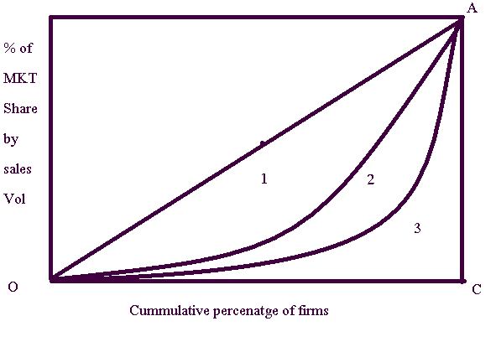
Fig: 3.2: The Lorenz Curve

Slide 33
In figure 3.2, Line OA is line of perfect equality, representing equal sized firms. Curves 2 & 3 represent Lorenz Curve.
Greater inequality results if Lorenz curve is farther from line of equality. Curve 3 thus reflects highest inequality.
A coefficient which we may call 'Lorenz coefficient' or 'GINI-coefficient' is obtained by dividing the area bounded between the Lorenz curve (say curve-2) and the diagonal line OA { shown with rectangles in it } by the area of the triangle under the diagonal (OAC).

Slide 34
That is,
In all case, 0 < GC < 1; greater the magnitude of GC say 0.5, 0.6 or 0.7 higher inequality exists and vice versa.
Limitation of Gini coefficient: one basic problem with GC is that it favors equality of market shares without regard to the number of equal sized firms, i.e. GC equal to zero for two firms with 50% market share each or 3 firms with 33.3% market share each, etc.

Slide 35
Thus, GC=0 implies equal level of competition.
But this is not always true because the level of competition differs with the number of firms but not equal size firms.
Sufficient and accurate data about the market share of every firm in the market may not be available.

Slide 36
VI. The Lerner Index (LI): is the best known measure of monopoly power. It is expressed as:
LI = =
The greater the deviation between price & MC, the higher the monopoly power of the firm & the greater the market concentration.
LI = 0 for perfect competition (since P=MC). Note that for profit maximization we have the familiar condition MR = MC, and MR = P (1-1/e).
Thus, from these two equations, we get the Lerner index as:

Slide 37
By substitution, we have:
Where e is the price elasticity of demand and hence, LI is the inverse of e, which is price elasticity of demand.

Slide 38
Example:
Suppose firms are operating in two markets: Market 1 where Price of the product is 100 birr and marginal cost of production is 25 birr and Market 2 where Price of the product is 50 birr and marginal cost of production is 20 birr
Compute Learner index for both Market
Which market is more concentrated?

Slide 39
IV. The Elasticity Index
The ratio of ‘own elasticity of demand’ and ‘cross–elasticity of demand’ for a firm could be used as a measure of monopoly power or market concentration in terms of ‘number –equivalent’ i.e.

Slide 40
Where e_{ii}= own elasticity of demand e_{ji} and = cross elasticity of demand.
An increase in the ratio means lesser number of firms in the market and a decrease means higher number.

Slide 41
Example
The product own elasticity of demand of a commodity was 0.15 and cross demand elasticity of the product was 0.60. The number of the firm in this year was ten. Compute the elasticity index
This indicates the ratio is very high or the number of firms is very less.

Slide 42
3.4 Concentration and the market performance
We know that a firm with substantial monopoly power will tend to:
  charge higher price
  produce and sell less output
  make high rate of profit
  grow faster than others
  capable of doing anything it wants in connection with its business such as: R & D, advertisement, etc.
If we assume that concentration is appropriate measure of monopoly power, we are then in a position to verify the various propositions of the economic theory which reflects the relationship between concentration and market performance of the firm.

Slide 43
i. Concentration and profit: a firm derives the market power or monopoly power in the situation of concentration.
Such a market power, through market conducts activities or directly leads to an increase to profitability of the firm.
It is frequently assumed that persistence of high rates of profits over a long period of time is the consequence of high degree of intra-industry concentration.
Bain was the first to make empirical study on the relationship between concentration and profit.

Slide 44
He argued that there is strong linkage between the two and hence profit rate can be a measure of concentration.
However, there are some difficulties in establishing the correct relationship between concentration and profit as both are subject to ambiguities of measurements.
For example, since we do have various measures of concentration, we do not know which one is the best measure of concentration. If one measure of concentration is selected, it may have strong correlation with profit but if another indicator of concentration is used it may have weak correlation with profit.

Slide 45
Further, the measurement of profit is not free from weaknesses.
For example, it is often based on accounting data which ignores certain opportunity cost elements that are related to own fund, own building and own entrepreneurial ability.
All in all, there is positive relationship between profit rate and degree of market concentration on the basis of theoretical logic, though the very precise estimation of which is yet to come.
? Researchable area????????????????????

Slide 46
ii. Concentration and Price – Cost Margins: Price margin is another way to define profitability.
It is a short term view of profitability based on current assets and cost figures.
Average price – cost margin is just a ratio of these two magnitudes.
Some empirical studies supported the positive relationship between concentration and price- cost margin.
However, some other studies indicate insignificant relationships between the two variables.
? Need a research. Hence, think over it.???????

Slide 47
iii. Concentration and growth of the firm: there are two different views (streams of thoughts) to explain the actual relationship between concentration and growth.
First view: a firm with the market power may prefer to maintain its high rates of profits by restricting output and charging high price.
If it grows, it has to scarify some profit margin and lower price which may not be in its interest.
Moreover, there will be all kinds of government restrictions to stop further growth of the firm.

Slide 48
Static diseconomies of scale and other bottle necks all adversely affect the growth of such a firm.
Thus, we expect the higher the monopoly power, the lesser may be the growth of the firm.
Second view: sees positive relationship between concentration and growth of the firm.
  To maximize the long term profit, firms may like to grow over time even under market concentration.
  They may create excess capacity to meet the future growing demand and
  to discourage new entry in the market.
For these firms may sacrifice some profit to stimulate long term growth. Thus, we find a case for positive relationship between initial market concentration and growth of the firm.

Slide 49
iv. Concentration and Technological Progress
we know that few firms that enjoy monopoly power in concentrated industries will be large enough.
They will be having stability, financial resource and ability to initiate the process of R& D and again the benefit from them.
Some recent researches show the situation when the market is concentrated and innovative activities are positively correlated.
However, there is no conclusive empirical evidence to prove such proposition.
???? You call for research???????????

Slide 50
Some argue that it may not be the concentration but the other attributes of market structure like the size of the firm, product differentiation possibilities that may be having collinearity with concentration and thus causing a spurious positive correlation between concentration and technological change.
Nothing can be said in either way about the relationship. It is open for further empirical verification. Ditto??????????????????

Slide 51
v. Concentration and other aspects of market performance: stability in the business, which may be judged either by persistent profit rates or sales volume or market share, is one of the indicators of performances.
Greater the market performance of a firm, the more we expect its stability. Uncertainty faced by the firm may be smaller.
Further, if there is high concentration, in the market the existing few firms may maintain their size ranking to keep the leadership with them.
If the size ranking of the firms, which is defined as ‘turnover’, is changing this implies that the competitive forces are in action in the market. Lack of such changes means lack of competition and a possible tacit or alright collusion between competitors and hence a perpetuation of the market concentration which ensures stability for the few oligopolistic firms.

Slide 52
3.5 Determinants of Concentration
Why concentration is high in some industries but not in others?
Two approaches have generally been used as an explanation of market concentration.
1) The Deterministic Approach
2) The Stochastic Approach
In this course we limit ourselves to the first of the two approaches.

Slide 53
The Deterministic Approach (Scale-Economies)
Concentrated market structure could come from persistent economies of scale.
Scale economies permit relatively large producers to manufacture and market their product at lower average cost per unit than relatively small producers
By definition, economies of scale constitute the relationship between:
  size of the firm & its costs of production.

Slide 54
This relationship may be explained (symbolized) by the long-run average cost curve (LAC), representing the least possible cost for every unit of output.
We can identify various relationships between average cost and level of output as discussed under the following.

Slide 55
(i) Constant Cost Case
In this case no cost advantages or disadvantages are associated with large-scale production.
Thus, long-run unit production costs are independent of the rate of output.
In this case, the market structure is indeterminate.

Slide 56
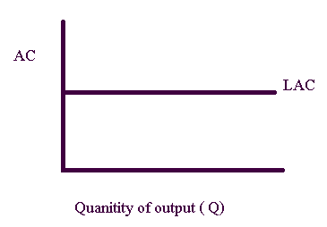
Fig 3.3: Constant Long Run Average Cost

Slide 57
(ii) Rapid fall in Unit Production Costs
In some cases, unit production costs fall rapidly and the economies of size are not exhausted until a very large level of output is attained.
This is the case of natural monopoly. Because of important scale economies, a single firm can supply the entire market demand.
The market structure is obviously a monopoly structure. Water supply, electricity supply, and communication sector are some of the examples.
Notes:
Monopolies created through efficiency are known as natural monopolies.

Slide 58
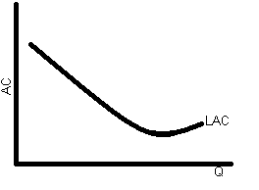
Fig 3.4: Rapid Fall in the Long Run Average Cost

Slide 59
(iii) Rapid Rise in Unit Production Costs
In some circumstances, the LAC rapidly rises. This is the mirror image of natural monopoly.
Economies of scale are negligible and diseconomies are encountered at relatively small rates of output.
A typical firm would operate on a modest scale & the market structure is competitive.
There would be a large number of small firms in the market.

Slide 60
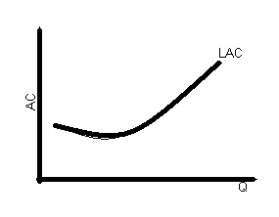
Fig: 3.6: Rapid Rise in the LAC

Slide 61
(iv) Constant Range of Minimum LAC Curve:
This one represents a situation in which a small rate of output enables the firm to take advantage of economies of scale.
That means diseconomies do not occur until the output rate is quite large.
Here, one might observe a mixture of a firm size. In this case both large and small firms can co-exist.

Slide 62
