Slide 1
Lecture Seven
Advertisement
The Nature and Roles of Advertising
The term ‘‘advertising’’ is expenditure undertaken by a firm to promote the sales of its products or services.
Advertising is a mass paid communication, the ultimate purpose of which is to impart information, develop attitudes and induce action beneficial to the advertiser.
The most visible form of advertising is paid-for space in print, media advertisements such as radio or television media, direct mail, leaflets, or sponsorship.
Advertising also includes promotional activity for a product, such as special displays, offers in shops or at commercial shows.

Slide 2
Economists distinguish two roles of advertising.
The first: is the provision of fact information to consumers about the characteristics of a product, its price and its availability.
Such advertising helps consumers to overcome information deficiencies.
The second: is the persuasion of consumers to buy a particular product or visit a particular shop or restaurant, by emphasizing the qualities of the product or associating the product with a particular life style or celebrity.
Such advertising is sometimes comparative in nature, with one producer comparing its product with those of others, with the intention of making the advertised firm’s product be look superior.

Slide 3
Advertising is one of many forms of promotional activity.
Instead of advertising, a firm might promote sales by employing more sales representatives, by altering the product's packaging, or by widening wholesale and retail margins.
Advertising can be either a substitution or a complement to, other forms of promotional activity.
Some economists refer to 'advertising' when they are really discussing promotional activity in general but different promo­tional activities may overlap. This complicates the economic analysis of its effects since it is difficult to separate them from those of other promotional activities.
Given that the effects of advertising and other promotional activity are similar, empirical work which considers only advertising will give misleading results.

Slide 4
Definition of Advertisement
According to Thomas Jefferson “advertising is a racket… its constructive contribution to humanity is exactly minus zero.”
According to Scott Fitzgerald, “Advertising has many purposes.
An advertisement may inform consumers that a firm has a new product or the lowest price, or
Advertising is often the principal method employed by firms to increase perceived differences between products among consumers and to create brand loyalty.
It may help to differentiate the firm’s product from that of its rivals. A firm uses advertisements to inform consumers of its product’s strengths but not its weakness.

Slide 5
Advertising may convey hard facts, vague claims, or try to create a favorable impression of a product.
Other advertisements merely show a product being used in a pleasant setting.
An attractive person consuming a soft drink near a water fall may convey to consumers the impression that this product is refreshing. By convincing consumers that its product has certain desirable traits, a firm can differentiate it from other products. As its product becomes differentiated, a firm may face a higher and less elastic demand curve, so that it can charge a higher price and earn greater profits.

Slide 6
Advertising is undertaken to stimulate demand and, thereby, lower the price elasticity of demand for the product.
If consumers are persuaded to buy more of a good at every price, so that the demand curve shifts outward to the right, then consumers will buy more at the current price;
Another motive for advertising is to lower average production costs as a consequence of selling more output.

Slide 7
A. Promotions
Advertising is only one of many ways to promote a product;
Firms also use price discounts
When it is hard to describe a product, a firm may include discount coupon in its advertisement of encourage consumers to try the product.
Sales staffs. Sales people act like living advertisements.
Firms may advertise indirectly by establishing a brand name or otherwise establishing a positive reputation.

Slide 8
B.‘’Search’’ versus’ Experience’’ Goods
The informational content of advertising depends on whether consumers can determine the quality of a product prior to purchase.
If a consumer can establish a product’s quality prior to purchase by inspection, the product has search qualities,
Examples are furniture, closeting (determine style), and other products whose chief attributes can be determined by visual or facile inspection.
If a customer must consume the product to determine its quality, it is said to have experience qualities.
Examples are processed foods & soft ware programmers.

Slide 9
Advertising provides direct information about the characteristics of products with search qualities;
advertisements for search products often include photographs b/c In some cases a consumer cannot directly observe a physical attribute
For example, food and drink advertisements may claim that their products are low in calories.
In contrast, for experience goods, the most important information may be conveyed simply by the presence of the advertising, some advertisement do little more than mention the name of the firm to enhance the firm’s reputation.

Slide 10
C. Informational versus Persuasive Advertising
Some economists distinguish between informational advertising, which describes a product’s objective characteristics, and persuasive advertising, which is designed to shift consumer’s tastes.
For example, informational advertising may cite the price of a product, compare the advertising store’s price of its rival’s prices, describe the features of the product, or list its uses.
Taking the view of advertising as information, the effects of informative advertising on market structures and prices explained below

Slide 11
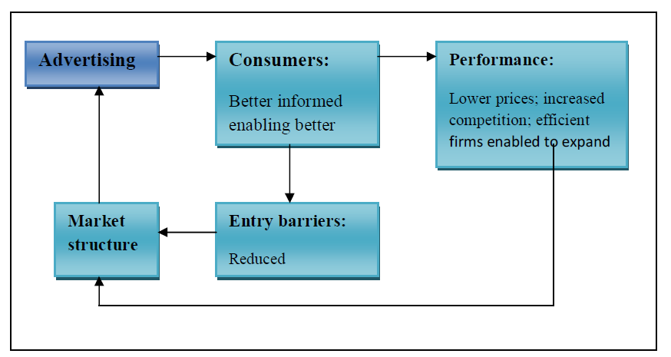

Slide 12
The tradi­tional view - advanced, among others, by Bain (1968) and Comanor and Wilson (1974) –is that advertising works by persuasion, and results in increases in both market power and prices (the process is summarized in the following figure)

Slide 13
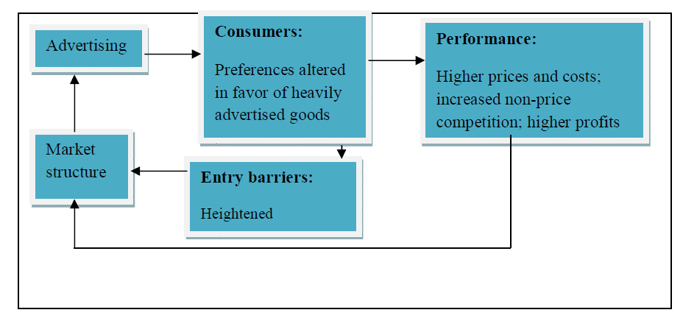

Slide 14
Advertising and Profitability
All advertising is designed to increase the demand for a firm’s product whether facts are used or not. An increase in informative or persuasive advertising expenditures from α to α’ causes an out ward shift of the demand curve facing a firm.
The firm chooses its output, given its advertising expenditures, by setting its marginal revenue with respect to quantity, equal to its marginal cost, MC.

Slide 15
What are the benefits and costs of Advertising?
The Social Benefits Advertising
Informational advertising provides consumers with truthful information about price, location, or quality.
Advertising may help manufactures take advantages of economics of scale in production and distribution.
Advertising provides a social benefit by subsidizing the mass media.

Slide 16
The Social Costs Advertising
Advertising merely manipulates consumer tastes and creates desires that would not otherwise exist.
By increasing product differentiation and encouraging brand loyalty advertising may make consumers less price sensitive, moving the market further from perfect competition towards imperfect competition

