Slide 1
Lecture Two
The Theory of the Firms
2.1.The Neoclassical Theory of the firm
2.2. Modern Theories of Firm
2.2.1. Managerial Theory of Firm
2.2.2. Principal Agent Theory
2.2.3. Transaction Cost Theory
2.3. The Growth of Firm
2.3.1. The Life Cycle of Firm
2.3.2 Downie’s Theory
2.3.3. Penrose’s Theory
2.3.4. Mari’s Theory

Slide 2
2.1 The Neoclassical Theory of the firm
It is also called Microeconomic theory of the firm.
The objective of the firm is taken here as purely profit maximizing (or cost-minimizing) economic agent operating in an exogenously given environment..
Behavior of a firm in pursuit of profit maximization can be analyzed in terms of:
  the quantities of inputs it utilizes
  production techniques it employs
  the quantity of outputs it produces, and
  the prices it charges

Slide 3
Profit is also maximized under conditions of perfect knowledge (information) about demand (which yields marginal revenue, MR) and cost conditions (from which marginal cost, MC, is derived).
That is, when MR = MC, then profit is said to be maximized.

Slide 4
Criticism of neoclassical theory of the firm
1. Firms may not aim at profit maximization by equating MR and MC; instead the right price might be based on recovering full cost.
2. Imperfect information, and thus uncertainty, is not taken as a relevant factor in this theory since the firm operates in a timeless environment.
3. The organizational complexity of firms may impede the application of the profit maximization principle.
4. The motivation and decision-making of individuals are more fundamental than that of the organizations which they form.
So as to overcome such drawbacks of the neoclassical theory of the firm, the modern theory of the firm is developed as discussed in the following section.

Slide 5
2.2 The Modern Theory of the Firm
The modern theories are developed because some important questions are left unanswered in the neoclassical theory.
Modern theory of the firm which can be further classified as:
Managerial theory,
Principal-Agent Theory and
Transactions cost theory.
Some economic activities are co-ordinated by the price system and some are administered explicitly within business organisation.

Slide 6
Whatever, the modern theory of the firm addresses the following and other crucial questions in studying industrial economics.
  Which economic functions will firms perform?
  What forces determine the size of firms?
  What types of organisational form will a firm adopt?

Slide 7
2.2.1 Managerial theory
The managerial theory emphasises on the complex nature of the modern corporate firm.
Firms are owned and controlled in a variety of ways.
A firm must raise money to finance itself, decide how its business is to be managed, and
Firms distribute its revenues to those who have contributed to its activity.
According to Berle and Means, the influence of shareholders in the decision making process of large firms has diminished from the turn of 20th century.

Slide 8
The focus is on the firm (same as the neoclassical theory) particularly:
  the relationship between owners and managers and
  the possible deviation of objectives (but not necessarily deviation of interest) between managers and owners.
The theory is based on two major principles/premises:
There is separation of ownership and control: in a today’s firm, ownership (by shareholders) is distinct from control (exercised by managers). Because of this, it is possible to conceive of a divergence of objectives between owners and controlling managers. Hence, there is a possibility of setting growth or revenue maximisation objectives as priority instead of profit maximisation.

Slide 9
  Firms operate in an environment that affords them an area of discretion in their behaviour. That is, firms are considered as an active entities that make a difference in their economic performance. They are not considered as passive entities .
  There are Variants of the Managerial Theory. We consider here:
  Baumol’s model and
  Marris’s model.

Slide 10
2.2.1.1 Baumol’s Model
As this model the objective of firms is sales/revenue maximization.
It supposes that hired managers may be more preoccupied by sales or revenue maximisation instead of profit maximisation.
The typical performance report of a firm is usually in terms of sales not profit. Why?
First, Sales data are easily accessible and hence one can have daily, weekly and monthly sales reports, while it requires some period of time (say three months or a year) to get reports on profitability.

Slide 11
Second, Salary and other monetary benefits of managers tend to be more closely related to sales revenue than to profits.
Third, banks and other financial institutions look at sales revenue while financing business ventures.
Fourth, trend in sales revenue is a readily available indicator of a firm’s performance.
Fifth, increasing sales revenue enhances manager’s prestige while profits go to the business owners.
Notes:
confer power on somebody or something

Slide 12
Six, managers find profit maximization as a difficult objective to fulfill consistently over time and at the same level. Profits fluctuate with changing economic conditions.
Finally, growing sales tend to strengthen competitive spirit of the firm in the market, and vice versa.

Slide 13
Baumol argues that even if there is divergence of objectives between the owners and their managers, the objectives are reconcilable, as this divergence of objectives is not based on the divergence of interest and existence of vested interests on the part of the managers.
Basically, it is argued that the managers are loyal to the success of the firm and set objectives professionally.

Slide 14
The model attempts to reconcile the behavioural conflict between profit maximisation and sales maximisation (i.e. its total revenue) by assuming that the firm maximises sales revenue subject to a minimum profit constraint.
The revenue-maximising level of output is the level at which the marginal revenue is zero and the elasticity of demand is unity.
This level of output that can be produced when constrained by minimum level of profit could be different from the revenue-maximising level of output.

Slide 15
Baumol calls the difference between the maximum possible level of profit and minimum constrained profit ‘sacrificeable’.
In his view, this profit will be voluntarily given up by the firm in order to increase sales revenues.
If the voluntarily given up level of profit is too apparent, it would tend to attract other firms operating in the same market, and would tend to create the ultimate threat of take-overs. This is why the sacrifice will be done quietly and only in a way which doesn’t look like sacrificing.

Slide 16
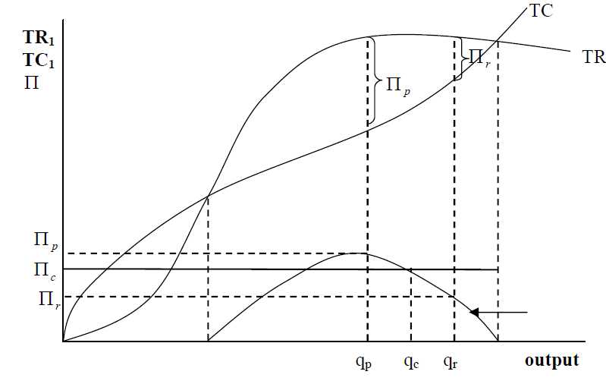

Slide 17
In any event, the profit maximising output will generally be less than the revenue-maximising level of output.
The profit-constrained revenue-maximising output (Qc) may be greater than or less than the revenue-maximising output (Qr).
If Qc < Qr, then the firm will produce Qc. If Qc > Qr, then the firm will produce Qr.
Baumol argues that the unconstrained equilibrium position never occurs in practice.
NB: Qp = profit maximising output; Qr = revenue-maximising output; Qc = revenue-maximising output, subject to a minimum profit constraint, Πc

Slide 18
2.2.1.2 Marris’s Model
Marris suggest that managerial control would lead to balanced growth as an objective, showing that shareholders were a less important constraint on such firms than financial markets.
Marris defines firm’s balanced growth rate (G) as: G = GD = GC ..……(1) where GD and GC are growth rate of demand for the firm’s product and growth rate of capital supply to the firm, respectively.
The model is dynamic in the sense that it incorporates the issue of growth of the firm.

Slide 19
In the Marris model, where the supply-growth and demand-growth relationships are satisfied, there will be a unique state of growth and profit equilibrium.
Like Baumol’s model, it assumes that managers will act to maximise utilities rather than profits, but in contrast to Baumol, it assumes that this will be achieved through growth rather than sales.
The maximization of business owner’s utility (Uo) implies maximization of demand for the firm’s product or growth of the supply of capital.
Growth arises through diversification into new products, rather than expansion of output.

Slide 20
The Three major principles around which general managerial theory came to be articulated during 1960s are as follows.
1. In a firm, the ownership (by shareholders) is distinct from control (exercised by managers)
2. Because of this separation, it is possible to conceive of a divergence of objective of owners and controlling managers.
3. Firms operate in an environment that affords them an area of discretion in their behavior.

Slide 21
2.2.2 The Principal - Agent Theory
It also known as the Agency Theory
There are two main actors
Principal: is the owner of an asset
Agent:is a decision makers who affect the value of that asset on behalf of the principal.
The key features of principal-agent problems are:
  Principal knows less than the agent about something important, and their interest conflict in some way.

Slide 22
Three types of factors which brings principal-agent problems
1st is problems where agents can do some costly action to improve outcomes for the principal but the principal can’t observe the action.
  These are known as effort aversion/moral hazard problems.
2nd is one includes problems where agents and principals can’t express the difference among them.

Slide 23
3rd is hidden information models, but this category does not seem very well-defined.
For example, managers in firms who take actions that advance their own careers but hurt shareholders, sounds like an effort aversion problem with a different definition of effort.

Slide 24
Principal-agent theory focuses on the contract.Agency theory focusing on contracts between the principal and the agent.
The Contracts: The theories of industrial organisation can be classified on the basis of the views/positions on contracts.
There are two main such approaches:
  Monopoly: which views contracts as a means of obtaining or increasing monopoly power; and
  Efficiency: which views contract as a means of economising.

Slide 25
Agents act differently when they are insured than they would otherwise. For instance, insured patients make more trips to the doctor than they would without insurance
One of the purposes of insurance is to reduce the private cost of going for help in event of accident, but it could be argued that when there is overuse of this kind the private cost should be increased. At any rate, these examples are traditionally referred to as “moral hazard”.

Slide 26
Moral Hazard: Conflict of interest and the existence of information asymmetry lead to the problem of moral hazard.
Where interests and objectives of the agent are different from that of the principal, and the principal cannot easily tell to what extent that agent is acting self-interestedly in ways diverging from the principal’s interests, and then the problem of moral hazard arises.
In the literature, terms such as: shirking, hidden action problem and post contract opportunism are used interchangeably with the concept of Moral Hazard.

Slide 27
Shirking is the moral hazard arising from the employment contract.
Principal-agent theory is more concerned with implications for shirking, i.e., a reduction in effort by an agent who is part of a team.
There may be a slight declining in total output as a result, but the cause will usually be unidentifiable.
The shirking manager knows that his/her diminished effort is unobservable.
What the principal can do, in the formulation of contracts, to offset shirking (and other types of management misbehaviour), is the key problem of principal - agent theory.

Slide 28
Thus, it is essential to think about contracts between principals and agents in two parts:
(i) Risk-sharing: With fixed probabilities and payoffs, the agent’s expected utility will be a decreasing function of his risk aversion.
To convince the agent to sign a contract, therefore, the principal must offer payoffs that are either more generous or more equal as the agent becomes more risk averse.

Slide 29
(ii)Incentives: By specifying different payments for different outcomes, the contract sets up incentives for the agent as he chooses an effort level.
If under a given contract payments are larger for higher outcomes, there will be higher effort.
iii. Salary plus a bonus based on the performance of the company.

Slide 30
iv. Development of efficient ways of monitoring the performance of individual managers (or management teams).
1-5 group works
v. Bonding (where the agent makes a promise to pay the principal a sum of money if inappropriate behavior by the agent is detected) and
vi. Mandatory retirement payments.

Slide 31
2.2.3 The Transaction Cost Theory
The neoclassical school is based on the assumption of zero transaction cost.
Decision makers can acquire and process any information they wish instantly and costlessly.
They possess perfect foresight and, hence, are able to write complete contracts that can be monitored and enforced with absolute precision.

Slide 32
The zero transaction cost implies that institutional arrangements play an inconsequential role in the economic process.
There is recognition that political, legal, monetary, and other institutions exist, but they are regarded as neutral in their effect on economic outcomes and largely ignored. In other words, institutions are taken as “allocationally neutral.”
In such a situation, decision makers operate with perfect information and perfect foresight.

Slide 33
It should be noted that in neoclassical theory, the price system is the only (explicitly modeled) device that is identified as a means for coordinating different activities.
Administrative coordination is disregarded because it is generally not thought to be necessary in a market-driven system.

Slide 34
However,in the real world institutional structure affects both transaction costs and individual incentives and hence economic behavior.
Why the existence of positive transaction costs makes it necessary to view institutions as endogenous variables in the economic model?
A distinguishing feature of the new institutional economics is its insistence on the idea that transactions costs are costly.
Transaction costs are encountered universally because of the character of the individuals who make decisions.

Slide 35
What are the causes of transaction cost?
Bounded rationality, refers to the imperfect ability to solve complex problems.
Opportunism relates to how people will respond to conflicts, given the existence of bounded rationality. They will behave opportunistically if they act in their self interests by, for example, finding loopholes in contracts. If there was unbounded rationality, the potential opportunistic behavior would be known, and avoided.

Slide 36
Asset specificity: refers to assets, involving non-trivial investment, that are specific to particular transactions (e.g. skills in an employer-employee contract).
Asset specificity refers either to physical or human elements in the transaction

Slide 37
In general transaction costs are costs of running the economic system. These costs arise from the establishment, use, maintenance, and change of:
  Institutions in the sense of law;
  Institutions in the sense of rights;
  Transaction costs arising from informal activities connected with the operation of the basic formal institutions.

Slide 38
We can identify three types of transaction costs. Each of the three may have two cost elements, fixed transaction costs, the specific investments made in setting up institutional arrangements, and the variable transaction costs that depend on the number of volume of transactions.
Market Transaction Costs: Market Transaction Costs include:
  cost of screening and selecting a buyer or seller;
  the cost of preparing contracts which includes the cost of obtaining information on the good or service;
  the cost of bargaining & negotiating a contract;
  cost of monitoring & enforcing the contractual obligations.
Managerial Transaction costs: The costs of implementing the labor contracts that exist between a firm and its employees.

Slide 39
Political Transaction costs: market and managerial transactions are assumed to take place against a well-defined political background; institutional arrangements consistent with a capitalist market order.

Slide 40
2.3 The Growth of the Firm
2.3.1 The Rationale for Growth of the Firms
Growth is one of the performance indicators of a firm.
There are four theories that attempt to explain the determinants of the growth of the firm. They are:
  Life-Cycle Theory
  Downie’s Theory
  Penrose’s Theory and
  The Marris’s Theory

Slide 41
2.3.1.1 Alternative Motives for Growth
2.3.1.1 Life – Cycle Theory: Growth as a Natural Process
The theme of the theory is that growth is a natural process.
The empirical observation that shows firms grow as a natural process over time.
Growth is an empirically established trend and daily-observed phenomena.
Most large firms that we see around were small when they were established, grew continuously and attained present status in the course of time.
If this is a common observation then growth is a natural process as observed in biological growth of organisms, which are born, grow to maturity and die.

Slide 42
A firm is created, grows, matures and finally dies out like any biological species. This is captured by the product-life cycle or the Sigmoid Curve / S-Curve/.
For example, in the young firms;
There is short hierarchy in the organizational structure
Young firms allow management economies
It is easier to handle and transmit information concerning the company’s product or idea at the early stage of a firm.
There is high communication in the firm, which implies prompt and flexible decision- making.

Slide 43
As a result of such managerial attributes and hence competence, firm’s growth rate accelerates ➔ the objective of management and shareholders coincides ➔ profit raises ➔ But later on Managerial diseconomies of older firms arise ➔ Growth slows.
The Life – Cycle Theory can be depicted by the following diagram.

Slide 44
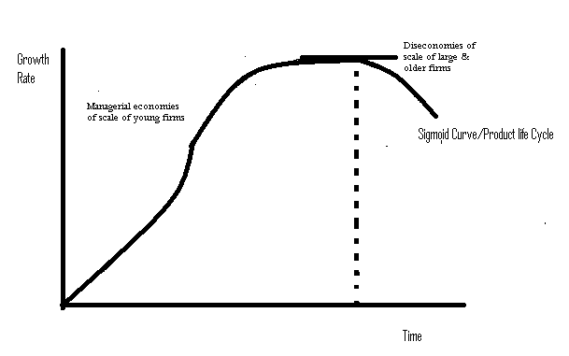
Figure: 2.4 Sigmoid Curves

Slide 45
2.3.1.2:Downie’s Theory or The Theory of Profit Constraint
It also called Downie’s theory in the literature.
According to Downie, alternative forms of market structure and conventions govern business behavior. It is concerned with the way in which alternative forms of market structures and the “rules of the game” lead to the divergences in efficiency and the rate of technical progress among firms.
For him in an industry, there will be dispersion of efficiency across the firms, i.e. Some firms have greater efficiency than the industry average while some others have lower efficiency.

Slide 46
The source of variation in efficiency (measured in terms of unit costs) across the firms is their technical processes. Efficiency variation is attributed to variation in technical progress. Firms with superior technology are assumed to be more efficient.
Given the competitive environment and assuming that the firms pursue the growth maximization objective, the process of growth according to Downie’s model starts with steady encroachment on the market share of less efficient firms by more efficient firms.

Slide 47
The efficient firms having advantageous access of the means of growth will be able to encroach on the market shares of the less efficient firms more or less rapidly.
Efficient firms take over large market shares of less efficient firms.
The means of the growth are capacity of production and customers. These can be examined from the supply and demand sides of growth of a firm.

Slide 48
i. Supply side: To expand capacity, investment in new technology is an optional case. Finance is needed for expansion, which in turn depends on the rate of profit generated. Thus, the rate of capacity expansion is positively related to the rate of profit and/or efficiency.
ii. Demand Side: According to Downie, an efficient firm better technique or efficient production may be able to offer price discounts for its product to attract new customers.
If the firm is to grow, then it has to be price competitive, in terms of selling at lower prices..

Slide 49
However, lower prices mean lower profit for the firm
The attraction of new customers or expansion of market by the efficient firm through its price reduction strategy will be feasible up to certain limit. This is possible as long as it is operating on the elastic zone of its demand curve, beyond which further reduction in price for expanding the market may lead to a reduction in the rate of profit for the firm.
Hence, there are two opposite forces in the growth process of the firm - the supply side (the capacity) of growth, which varies positively with the rate of profit and the demand side, which varies inversely with the rate of profit after some level of profit.

Slide 50
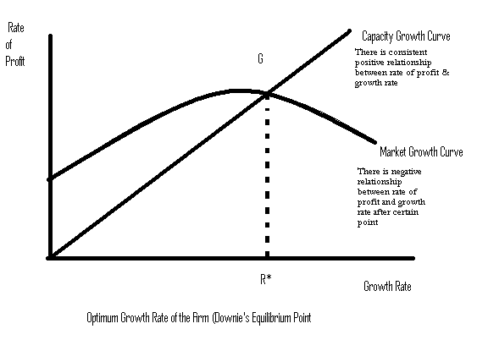
Fig: 2.5: The Downie’s Model representation

Slide 51
At point ‘G’ the capacity and the market growth curves intersect. This is called Downie’s Equilibrium Point.
An efficient firm will be able to sustain a higher rate of growth than an inefficient firm because of its initial higher rate of profit: rapidly growing market or customer expansion curve and expanding capacity of production.
Hence, financial constraints, (specifically profitability, which is the source of own finance) play the crucial role in the process of the growth of the firm in Downie’s framework.

Slide 52
Criticism of the Theory
Downoe’s theory ignores the possibility that inefficient firms might react positively and aggressively to declining market share.
Compelled to initiate innovations, firms can reverse the efficiency difference. As a result, inefficient firms may become efficient over time and vice versa.
If Downie were right, there would have been ever growing concentration in different industries, which however is not empirically supported.
The implication is that if one efficient firm controls a market, then there will not be any chance for inefficient firms to catch up.

Slide 53
  The argument that new customers are attracted through price-reduction ignores non-price competition strategy like: advertisement, new product development and so on.
  The model has not taken into account the managerial restraint, which plays very important role in limiting the growth of the firm.
  The model undermines the role of other sources of financing: Issuing of new shares, borrowing from banks, issuing bonds and others sources of finance. Though profitability affects the credibility of the firm in front of the other sources of money, it should not be exaggerated. A modest performance in profitability and managerial capacity to show prospect into the future could convince other sources of finance.

Slide 54
2.3.1.3: Penrose’s Theory; The Theory of Management Constraint
It is also known as Penrose’s Theory in the literature.
According to Penrose, the goal of the firm should be to increase the long run total profits. To achieve this objective, the firm continues to make investment as long as it gets positive return from that. It takes the advantages of the productive opportunities for expansion which it thinks profitable.

Slide 55
Penrose considers the firm as a pool of productive resources. The set of activities which the firm is aware of and able to undertake at a profit, defines its productive opportunity.
The firm will continue to grow if allowed by its productive opportunity but there will be some restraints which will limit the productive opportunity and hence growth of the firm.

Slide 56
These restraints can be of two types:
1. Internal Constraints:
Managerial capacities: if both administrative and entrepreneurial capacities are inadequate, the firm cannot sustain high rate of expansion. It may be possible to recruit new mangers, but newly appointed managers require time to gain experience and run the firm efficiently.
The process of growth is not automatic in the Penrosian framework. It is a deliberate and conscious choice of the management. If the managerial services are adequate, the firm can sustain higher rate of expansion, otherwise not.
Financial and market restraints: adequate resources are required to invest for expansion. Penrose treated financial constraint as relatively less important compared to managerial restraints.

Slide 57
2. External Obstacles: refer to both demand- and supply-side factors.
Fall in demand for the product under consideration;
Competition from rivals leading to narrow market;
Patent or other restrictions on the adoption of new technologies;
Lack or shortage of inputs, escalation of costs of major inputs, etc.
However, Penrose treated external factors relatively less important as far as expansion is concerned.
Penrose argued that external factors together with financial limitations can be easily handled if the management is strong.

Slide 58
The main task of management is to tackle marketing, financial, technological, and other related problems.
For example, engage in diversification to overcome demand constraint. Hence, Penrose concluded that the most important constraint to growth is shortage of competent and dependable managers.
This may be related to imperfection in the market for management skills- especially in developing countries.
One study (Richardson, 1964) also observed that among a number of managers contacted none felt restricted by shortage of labor, materials or equipment. Only two were held back by shortage of finance.

Slide 59
These were small firms and were subsequently taken over by strong and large firms. Most firms expressed the view that availability of competent management is the major resource required for growth.
Criticism of the Theory
  The theory gave more attention to managerial constariants than to financial and external constraints.
  It undermine the role of financial and external constraints. If these problems are severe they can be real hindrances.
  Management is not a perfect substitute to the other inputs. Rather management is a capacity to manage and deal with such problems.

Slide 60
2.3.1.4 :Marris Model:The Integrated Theory of Growth
The managerial theory was further developed by a number of writers particular by Marris whose work has become the standard one for analysis of the growth of the managerially controlled firms.
It is also known as Marris’s Model of the Managerial Enterprise in the literature.
It is referred to as an integrated theory of growth and at the same time managerial theory of the firm because:
  It integrates Downie’s & Penrose’s theories. All the three constraints, namely, financial, market demand & managerial restraints are integrated and made operative in the Marris’s theory;

Slide 61
  It is a Managerial Theory of the firm as it is based on the presumption of separation of ownership and control, which results in divergence of objectives of the owners and managers.
Marris formalised the hypothesis that managerial control would lead to growth as an objective, showing that shareholders were a less important constraint on such firms than financial markets.

Slide 62
The goal of the firm is defined as the maximization of the balanced rate of growth of the firm, that is, the maximization of the:
  Rate of growth of demand for the products of the firm; and Rate of growth of its capital supply.
  In other words, g = g_{d} = g_{c} is the Equilibrium Condition for Growth. Where; g is balanced growth rate; gd is growth of demand for products of the firm, which primarily maximizes the utility of the managers; g_{c} is growth of supply of capital, which primarily maximizes the utility of owners

Slide 63
The rationalization of this goal is that by jointly maximizing the rate of growth of demand and capital, the managers achieve maximization of their own utility as well as that of the utility of the owners.
That is, the joint maximization of g_{d} and g_{c} is said to maximize the utilities for both the management and shareholders.
Thus, according to Marris a firm maximizes the growth of total productive assets subject to a managerial constraint.

Slide 64
Utility Functions of Owners and Managers
The utility of mangers include maximization of salaries, status, power and job security where as owners (shareholders) want to maximize the rate of return on their investment. Thus manager’s utility function is given by:
Um = f (salaries, power, status, job security)
Utility function of owners: since the objective of the owners is to maximize return, their utility function is given by:
Uo = f (profits, capital, output, market share, public esteem).

Slide 65
Since capital growth happens to be compatible with the interests of the shareholders in general, the maximization of the growth rate of capital stock seems a priori plausible goal of owners. It follows then that the utility function of the owners can be written as: U owners = f(g_{c}).
The manager’s utility maximizing factors are strongly correlated with the growth of demand for the products of the firm. That is, managers will enjoy higher salaries and will have more prestige if there is faster rate of growth of demand. Therefore, the managerial utility function can be written as follows: Managers’ Utility =f (g_{d,} s) Where‘S’ is a measure of job security.

Slide 66
The security constraint is measured by a weighted average of three crucial ratios, the liquidity ratio, the leverage-debt ratio and the profit retention ratio, which reflect the financial policy of the firm.
Managerial security demands that the debt - equity ratio must be sufficiently high to support and stimulate growth but not too high which may cause a threat to the job of the managers.
The liquidity ratio of current assets to total assets must be low in order to have more assets that can be invested & so higher growth.
Balanced growth is necessary to avoid excess capacity or excess demand. Unless g_{d} and g_{c} are equalized, there would be a problem of spare capacity or excess demand. The existence of effective demand is considered as a resource that should not be wasted.

Slide 67
Compatibility of Objectives: there is no wide divergence of objectives of owners and managers. It is usually argued that the separation of ownership from control allows the managers to set goals which do not necessarily coincide with those of owners.
Nevertheless, Marris argues that this divergence of goals is not so wide as it is claimed so by other scholars.Like Buamol’s model, here the objectives of the owners and the managers are reconcilable.
This is because some of the variables appearing in both utility functions are strongly correlated with a single variable: the size of the firm. There are different measures of size: capital, output, revenue, growth rate and market share. However, there is no consensus on which of these measures is the best one to measure firm size.

Slide 68
Marris argued that managers prefer promotion within the same but growing firm enjoying higher salaries, power and prestige than moving from a smaller firm to another larger firm, where the environment might be hostile to the ‘new comer’ and the manager may have to spend much time and effort to learn about the mechanisms of the new organization.
There are many empirical evidences that show that the mobility of managers is very low. Hence, managers aim at the maximization of the rate of growth of the firm (rather than the absolute size of the firm).

Slide 69
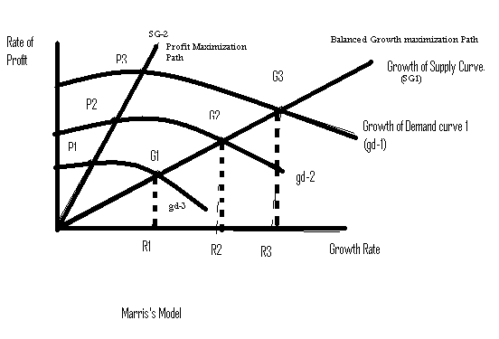
Fig: 2.6 the Marris’ Model Representation

Slide 70
Points G₁, G₂, and G₃ show the maximum attainable growth rates for the firm under alternative growth of demand situations. If the firm pursues the goal of profit maximization, then P₁, P₂ and P₃ are the levels of maximum attainable profit rates under the three given situations of the demand growth.
The long-run objectives and decisions for growth, sales, and profit maximization are virtually identical policies that maximize the long-run growth of a variable. Policies that maximize assets or sales will also be profit-maximizing policies.

Slide 71
Sources of Growth
Demand Side: the growth of demand (g_{d}) depends on:
The diversification rate, ‘d’ ; that is, g_{d} = f (d), where, g_{d} is growth of demand and ‘d’ is rate of successful diversification i.e., the number of successful new products introduced.
Note that diversification in not necessarily equal to product development. There are other ways of diversification like vertical diversification or investing in another industry, etc. If demand for a product reaches its saturation point, Marris advocated diversification and/or new product development (innovation) as the most effective way to grow further-continuous growth is thus possible.

Slide 72
Every product has its own product life-cycle: first small market, the market grows, and reaches a peak and declines. When it reaches its peak, the firm should diversify or try to develop a new product.
Supply Side: the growth of supply (g_{C}) is generated through the increase in the asset-base of the firm. The growth rate of assets is the ratio of new investment to capital employed. g_{C} = I/K, where: ‘I’ stands for new investment, and ‘K’ stands for capital stock. New investment depends on available finance.

Slide 73
A firm can raise finance for expansion from three sources:
  retained earnings;
  borrowing including bonds and debentures;
  issuing new equity shares
  Marris believed that there is a definite limit to the growth of capital supply (g_{C}). Each of the different sources of investment has its own drawback.

Slide 74
Retained earnings : possible only up to certain limits-need to pay dividends: Since the retention cannot be above unity, the profitability of the firm will be the upper limit, even if the shareholders may further give up their dividends. It also depends upon the profit retention ratio, as the shareholders may claim dividend instead of retaining the profit for further investment.
Borrowing: borrowing is required for two major reasons. First there could be credit supply shortage. Secondly even when the supply is available there is a limit to borrowing. Too much debt makes the firm vulnerable to takeover. Too much borrowing means high interest charges and low prices of share.
Issuing new equity shares: - primarily there could be shortage of demand for the shares of the firm. Too many shares can lower share prices and may trigger takeovers. If supply exceeds demand, it leads to price decline.

Slide 75
Growth Constraints
In pursuing balanced growth rate, the firm faces two constraints:
Management Constraint : it is a constraint set by the competence of a management team and its behavior;
Financial Constraint: A constraint set by the limit to the amount of capital a firm can mobilize at certain time.

Slide 76
Managerial constraint: Marris adopted Penrose’s thesis of the existence of a definite limit on the rate of efficient managerial expansion- deterioration in efficiency of managers as the firm expands rapidly.
Normally, competent and motivated management has the capacity to generate new ideas and introduce diversification to overcome demand constraint and find ways to overcome capital constraints.
However, mangers want job security-have disutility for dismissal-and look for generous pay and pension. Affected mangers adopt prudent financial policy (hired mangers are vulnerable to this):

Slide 77
Cautious in financial decisions- conservative and less innovative – risk averse, avoid expansion unless they are certain of the returns.
Avoid risky investment ; for example, investment on R&D
The job security constraint sets a limit to the growth of capital supply (g_{C}), which in turn constrains product diversification & hence demand expansion. So the divergence of interest leads to pursuance of constrained growth objective. The goal of the firm is then defined as the maximization of the balanced rate of growth of the firm, subject to managerial constraints.

Slide 78
Criticism of the theory
It does not recognize agency problem, moral hazard. reconcilability of objectives may be strong assumption to adopt.
It is based on the strong assumptions of the neoclassical theory
Marris’s model should be appreciated in that it postulates a solution to the problem of separation of management and ownership. The theory models joint maximization of the utilities of both the managers and the owners. However, whether the balanced-growth solution will maximize the utility of both depends on the assumption that all factors appearing in these functions are correlated with size of the firm and rate of growth.

Slide 79
The assumption that continuous growth is possible by creating new market-by developing new products and diversification - can be questionable.
The assumption that the firm has unlimited power to create new needs of the consumers via advertising and other selling activities seems rather far-fetched.
Marris model relies heavily on the restrictive assumption that firms have their own R&D departments. In reality, most firms do not have such departments but rely on imitation of the inventions of other firms.

