Slide 1
Chapter Three Boundary Layer Theory
When real fluid flows pass a solid boundary the layer that is in contact with the boundary can’t slip away from it and will have same velocity as that of the boundary, this condition is known as “no slip condition”
If a fluid boundary is moving, the fluid adhering to it will have the same velocity as that of the boundary.
If the boundary is stationary, the fluid velocity at the boundary surface will be zero. Thus at the boundary surface the layer of the fluid undergoes retardation to flow
Retardation goes further to adjacent layers
A small region in the immediate vicinity of the boundary surface in which the velocity of flowing fluid increases gradually from zero at the boundary surface to the velocity of the main stream. This region is known as boundary layer.

Slide 2
Flow is considered to have two regions:
Close to the boundary layer :due to larger velocity gradient appreciable viscous forces are produced.
In this region the effect of viscosity is mostly confined,
Outside the boundary layer zone: in which the viscous forces are negligible and hence the flow may be treated as non-viscous or in viscid.
Prendtl’s boundary layer theory
In 1904 prendtl developed the concept of the boundary layer. He provided an important link between ideal- fluid flow and real-fluid flow. For fluids having high Reynold’s number, no matter how small the viscous forces might be in the main flow they become large next to the solid surface, In this region he called a boundary layer the velocity changes from large value at the edge of the boundary layer to zero at the surface of the solid.

Slide 3
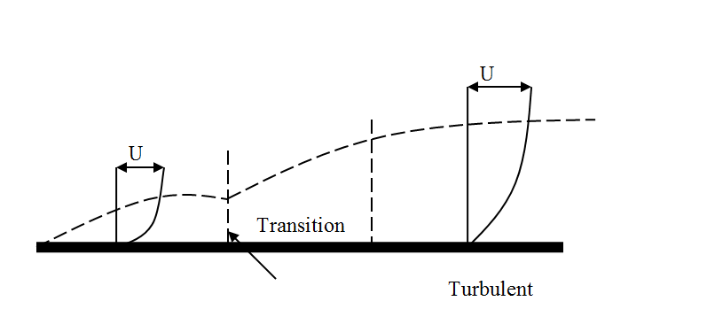
3.1 Description of the Boundary Layer
Consider a flow bounded on one side only
the flow just upstream of the plate) has a uniform velocity U∞. As the flow comes into contact with the plate, the layer of fluid immediately adjacent to the plate decelerates (due to viscous friction) and comes to rest.

Slide 4
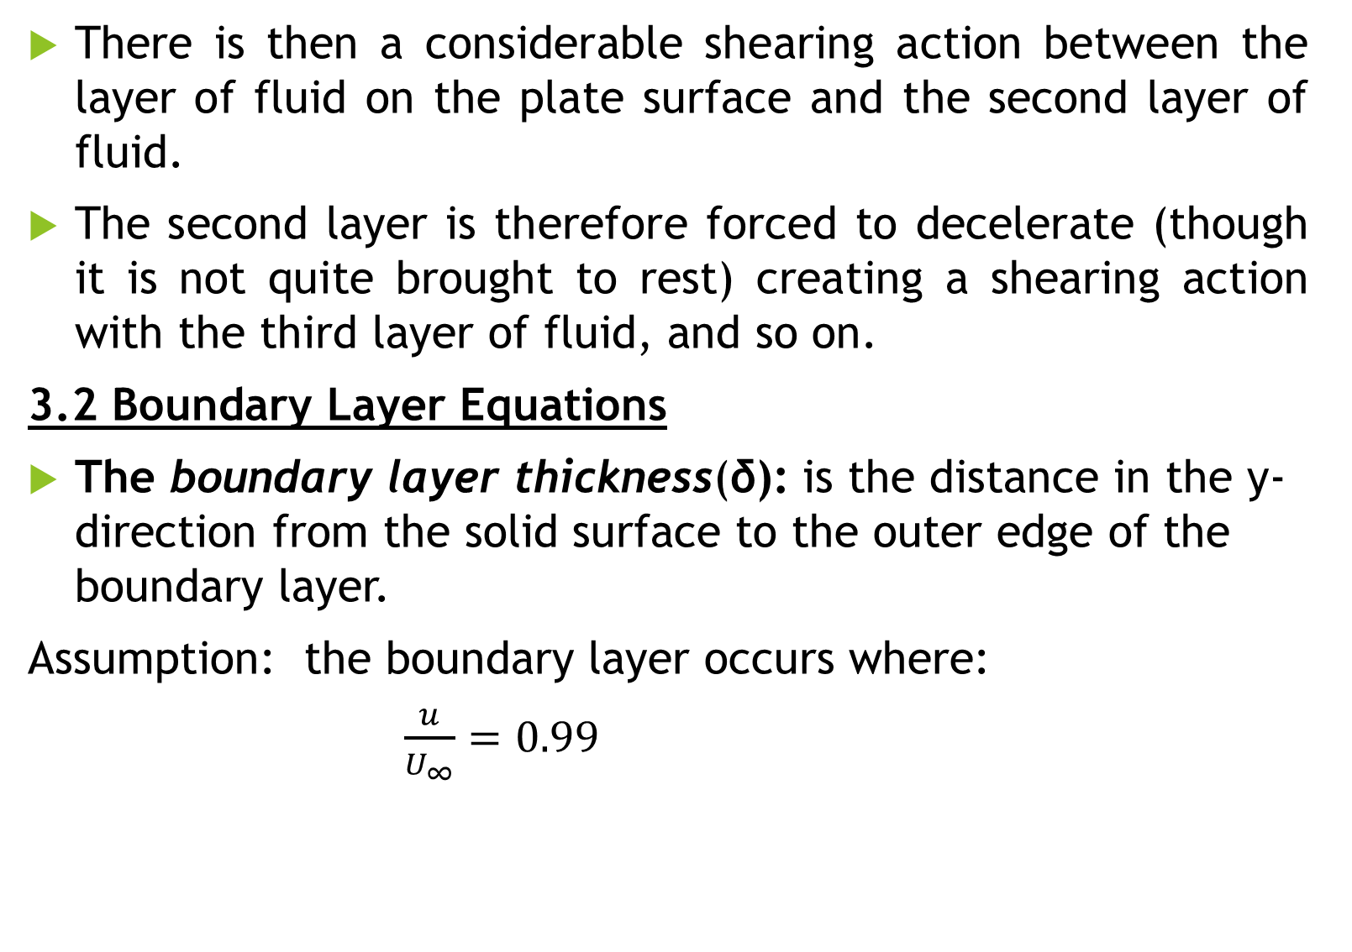
There is then a considerable shearing action between the layer of fluid on the plate surface and the second layer of fluid.
The second layer is therefore forced to decelerate (though it is not quite brought to rest) creating a shearing action with the third layer of fluid, and so on.
3.2 Boundary Layer Equations
The boundary layer thickness(δ): is the distance in the y-direction from the solid surface to the outer edge of the boundary layer.
Assumption: the boundary layer occurs where:
$\frac{u}{U_{∞}}=0.99$

Slide 5
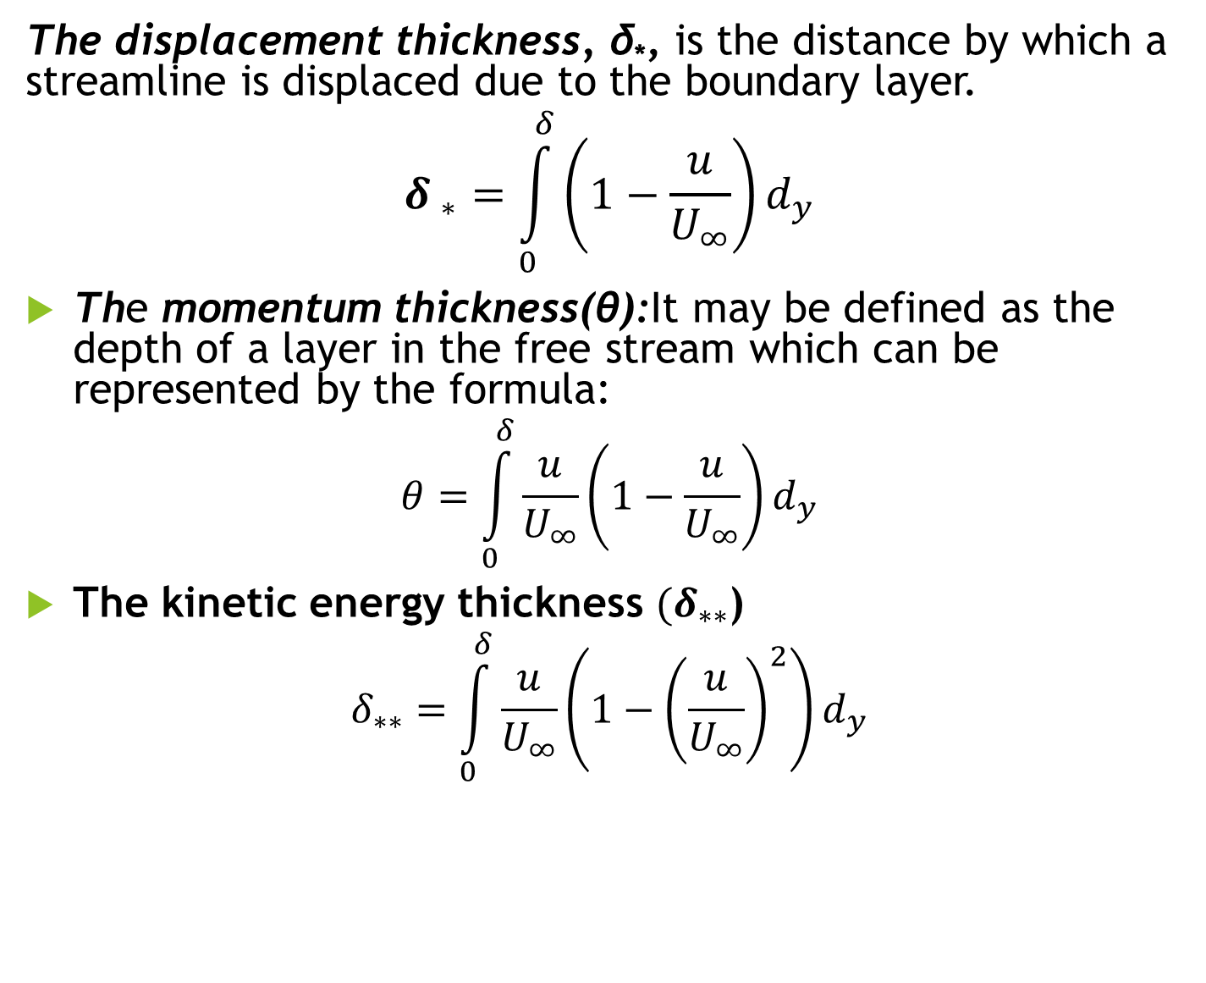
The displacement thickness, δ*, is the distance by which a streamline is displaced due to the boundary layer.
$${δ }_{∗}=\int_{0}^{δ}{\left(1−\frac{u}{U_{∞}}\right)d_{y}}$$
The momentum thickness(θ):It may be defined as the depth of a layer in the free stream which can be represented by the formula:
$$θ=\int_{0}^{δ}{\frac{u}{U_{∞}}}\left(1−\frac{u}{U_{∞}}\right)d_{y}$$
The kinetic energy thickness ${(δ}_{∗∗}$)
$$δ_{∗∗}=\int_{0}^{δ}{\frac{u}{U_{∞}}}\left(1−{\left(\frac{u}{U_{∞}}\right)}^{2}\right)d_{y}$$

Slide 6
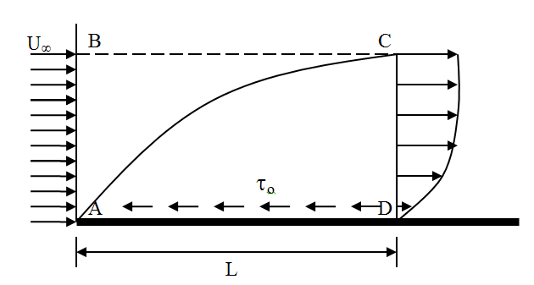

Consider the longitudinal section through a boundary layer, the section is bounded on its outer side by a streamline, BC, and is l m wide. The discharge across CD is
$$Q_{CD}=\int_{0}^{δ}{ud_{y}}$$

Slide 7
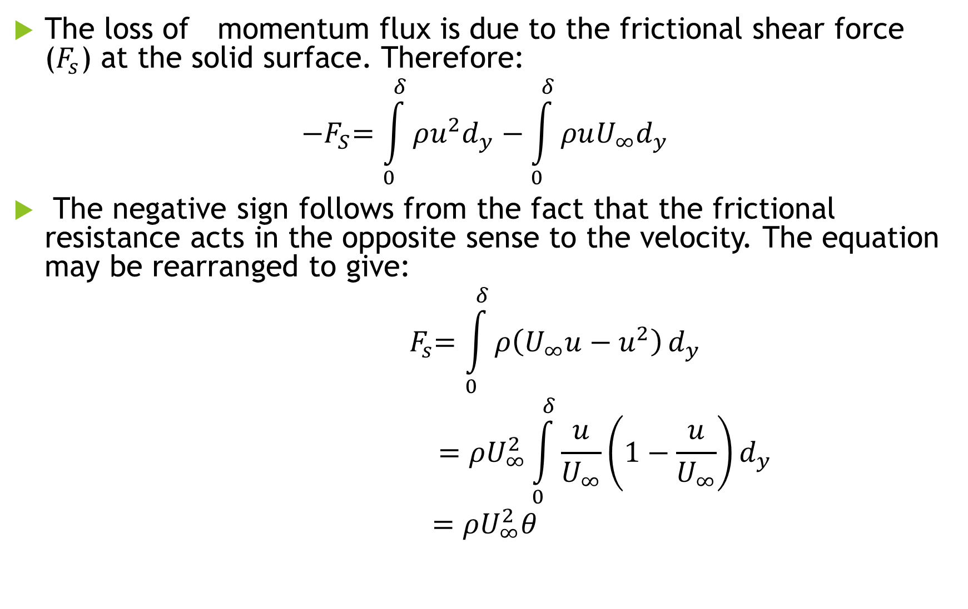
The loss of momentum flux is due to the frictional shear force ($F_{s}$) at the solid surface. Therefore:
$${−F}_{S}=\int_{0}^{δ}{ρu^{2}d_{y}}−\int_{0}^{δ}{ρuU_{∞}d_{y}}$$
The negative sign follows from the fact that the frictional resistance acts in the opposite sense to the velocity. The equation may be rearranged to give:
$${ F}_{s}=\int_{0}^{δ}{ρ\left(U_{∞}u−u^{2}\right)}d_{y}$$
$$=ρU_{∞}^{2}\int_{0}^{δ}{\frac{u}{U_{∞}}}\left(1−\frac{u}{U_{∞}}\right)d_{y}$$
$$=ρU_{∞}^{2}θ$$

Slide 8
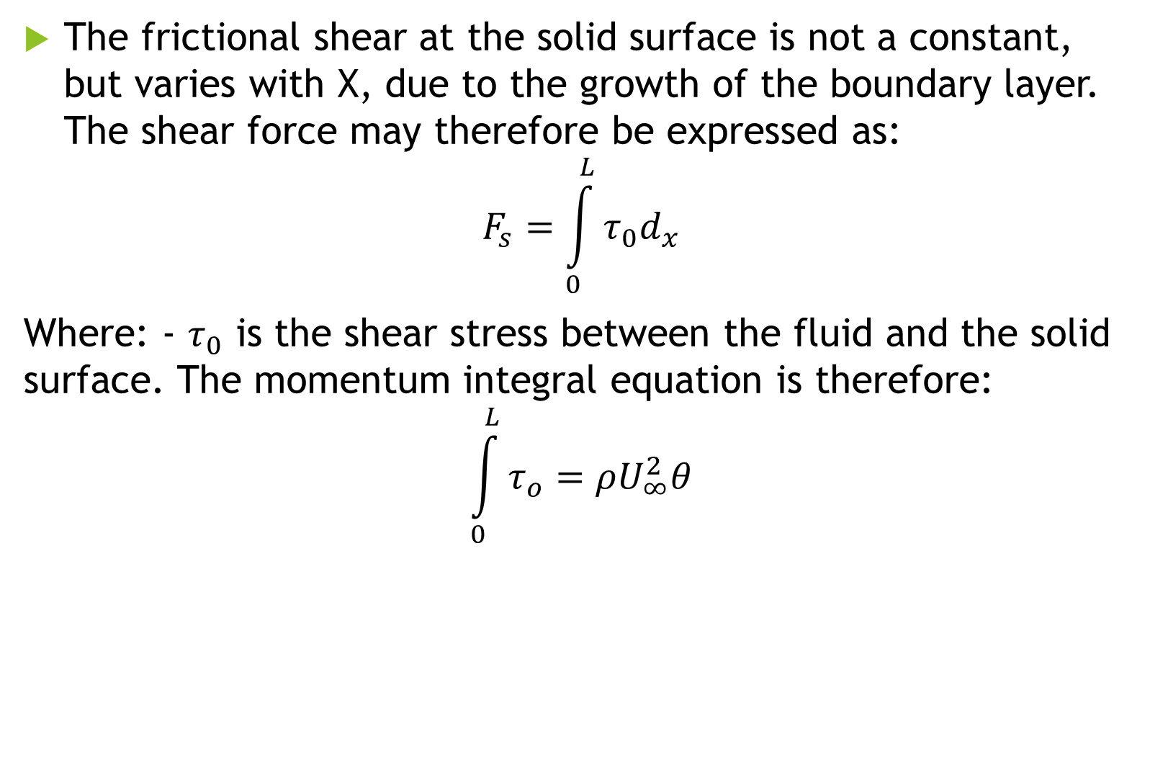
The frictional shear at the solid surface is not a constant, but varies with X, due to the growth of the boundary layer. The shear force may therefore be expressed as:
$$F_{s}=\int_{0}^{L}{τ_{0}d_{x}}$$
Where: - $τ_{0}$ is the shear stress between the fluid and the solid surface. The momentum integral equation is therefore:
$$\int_{0}^{L}{τ_{o}}=ρU_{∞}^{2}θ$$

Slide 9
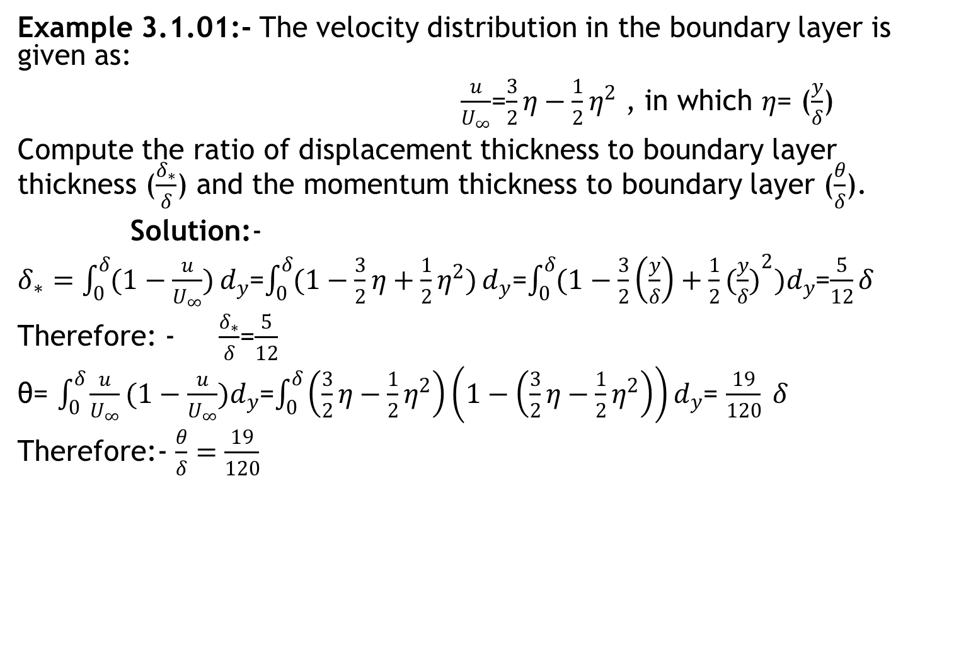
Example 3.1.01:- The velocity distribution in the boundary layer is given as:
$\frac{u}{U_{∞}}$=$\frac{3}{2}η−\frac{1}{2}η^{2}$ , in which $η$= ($\frac{y}{δ}$)
Compute the ratio of displacement thickness to boundary layer thickness ($\frac{δ_{∗}}{δ}$) and the momentum thickness to boundary layer ($\frac{θ}{δ}$).
Solution:-
$δ_{∗}=\int_{0}^{δ}{(1−\frac{u}{U_{∞}})}d_{y}$=$\int_{0}^{δ}{(1−\frac{3}{2}η+\frac{1}{2}η^{2})}d_{y}$=$\int_{0}^{δ}{(1−\frac{3}{2}\left(\frac{y}{δ}\right)+\frac{1}{2}}{(\frac{y}{δ})}^{2})d_{y}$=$\frac{5}{12}δ$
Therefore: - $\frac{δ_{∗}}{δ}$=$\frac{5}{12}$
θ= $\int_{0}^{δ}{\frac{u}{U_{∞}}}(1−\frac{u}{U_{∞}})d_{y}$=$\int_{0}^{δ}{\left(\frac{3}{2}η−\frac{1}{2}η^{2}\right)}\left(1−\left(\frac{3}{2}η−\frac{1}{2}η^{2}\right)\right)d_{y}$= $\frac{19}{120} δ$
Therefore:- $\frac{θ}{δ}=\frac{19}{120}$

Slide 10
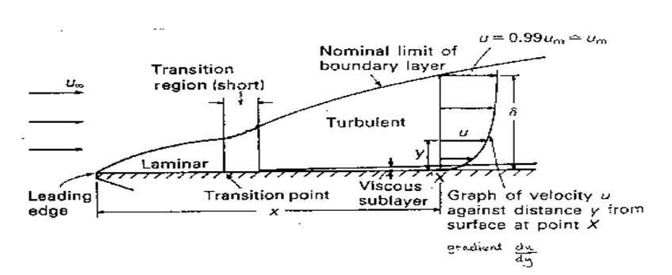
3.3 Boundary layer along a long thin plate
At the leading edge of the plate the thickness of the boundary layer is zero, but on downstream, for the fluid in contact with the boundary the velocity of flow is reduced to zero.

Slide 11
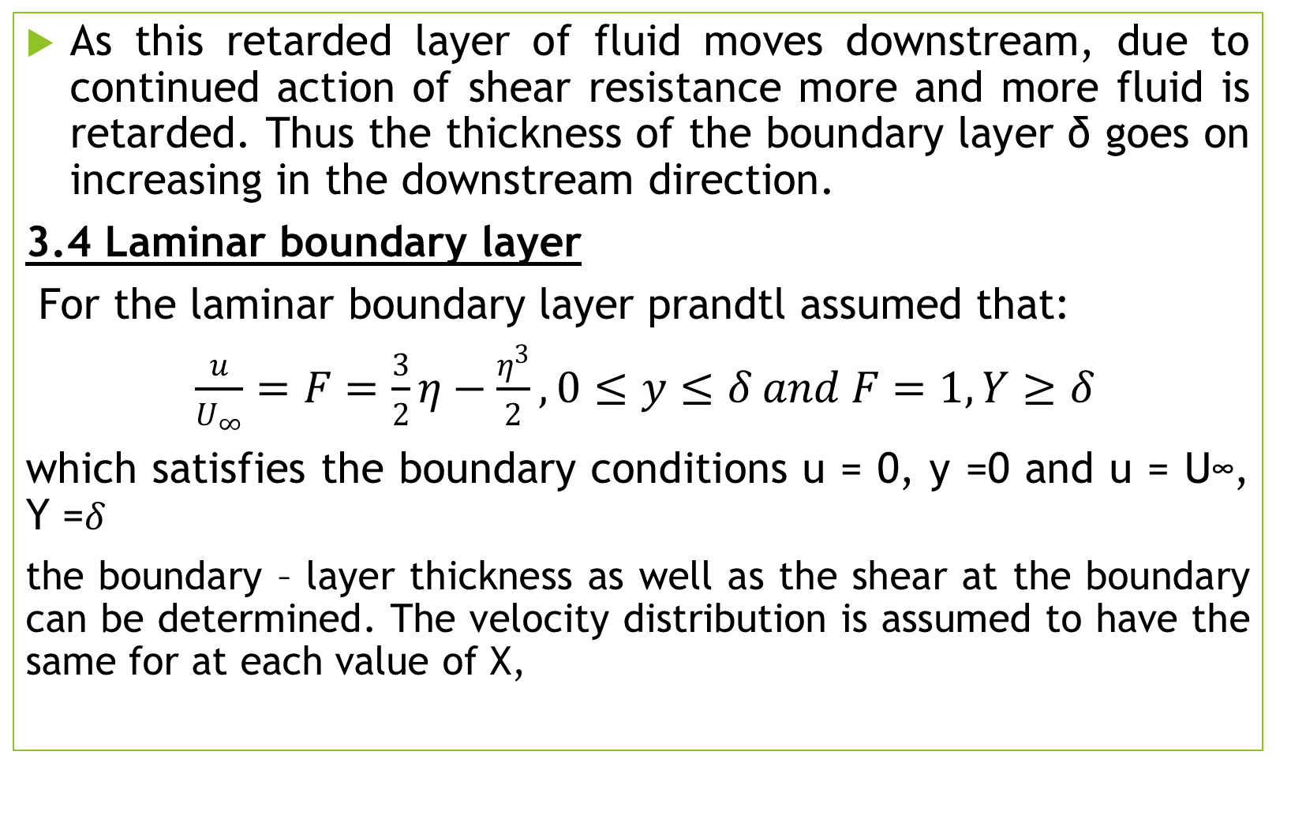
As this retarded layer of fluid moves downstream, due to continued action of shear resistance more and more fluid is retarded. Thus the thickness of the boundary layer δ goes on increasing in the downstream direction.
3.4 Laminar boundary layer
For the laminar boundary layer prandtl assumed that:
$\frac{u}{U_{∞}}=F=\frac{3}{2}η−\frac{η^{3}}{2}, 0≤y≤δ and F=1,Y≥δ$
which satisfies the boundary conditions u = 0, y =0 and u = U∞, Y =$δ$
the boundary – layer thickness as well as the shear at the boundary can be determined. The velocity distribution is assumed to have the same for at each value of X,

Slide 12
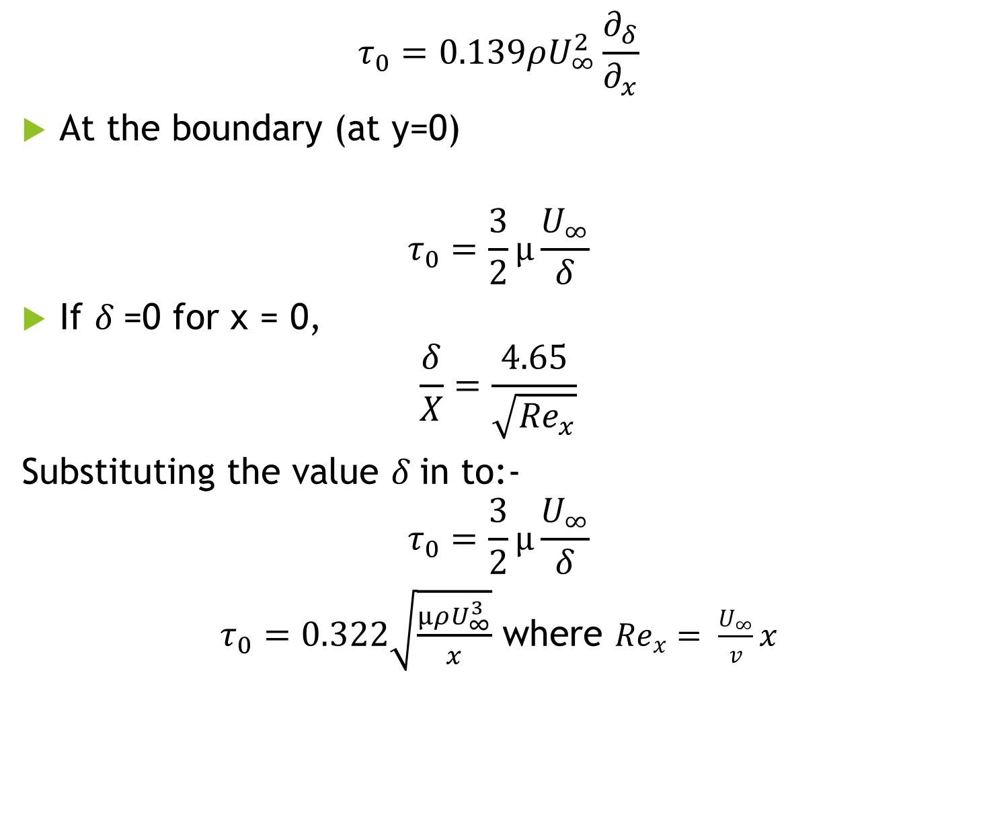
$$τ_{0}=0.139ρU_{∞}^{2}\frac{∂_{δ}}{∂_{x}}$$
At the boundary (at y=0)
$$τ_{0}=\frac{3}{2}µ\frac{U_{∞}}{δ}$$
If $δ$=0 for x = 0,
$$\frac{δ}{X}=\frac{4.65}{\sqrt{{Re}_{x}}}$$
Substituting the value $δ$in to:-
$$τ_{0}=\frac{3}{2}µ\frac{U_{∞}}{δ}$$
$τ_{0}=0.322\sqrt{\frac{µρU_{∞}^{3}}{x}}$ where ${Re}_{x}= \frac{U_{∞}}{v}x$

Slide 13
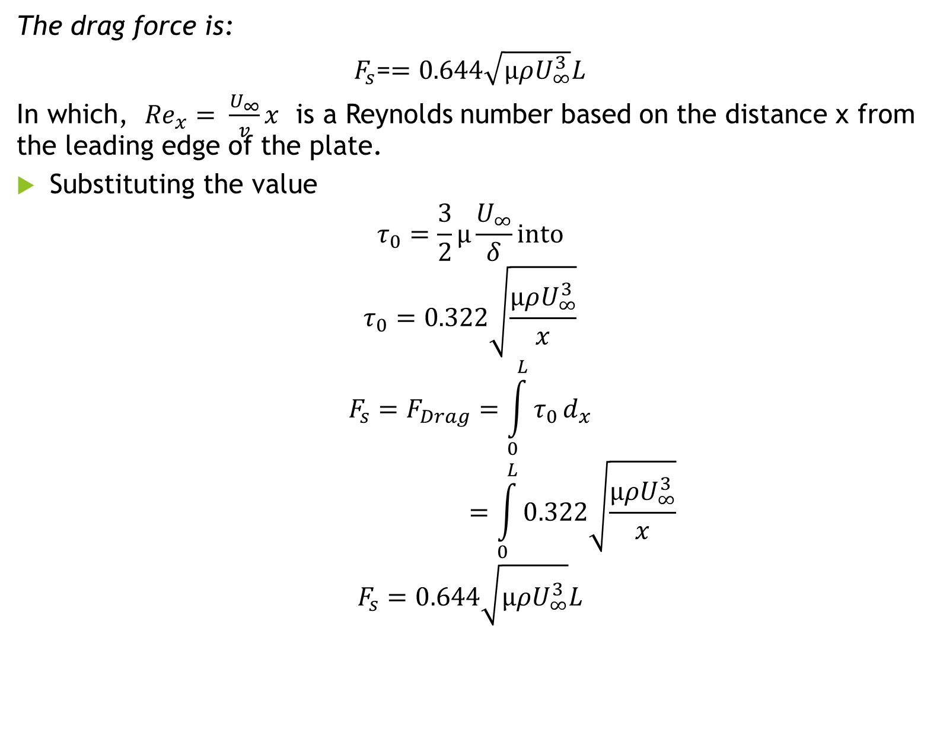
The drag force is:
$F_{s}$=$=0.644\sqrt{µρU_{∞}^{3}}L$
In which, ${Re}_{x}= \frac{U_{∞}}{v}x$ is a Reynolds number based on the distance x from the leading edge of the plate.
Substituting the value
$$τ_{0}=\frac{3}{2}µ\frac{U_{∞}}{δ}into$$
$$τ_{0}=0.322\sqrt{\frac{µρU_{∞}^{3}}{x}}$$
$$F_{s}=F_{Drag}=\int_{0}^{L}{τ_{0}}d_{x}$$
$$=\int_{0}^{L}{0.322\sqrt{\frac{µρU_{∞}^{3}}{x}}}$$
$$F_{s}=0.644\sqrt{µρU_{∞}^{3}}L$$

Slide 14
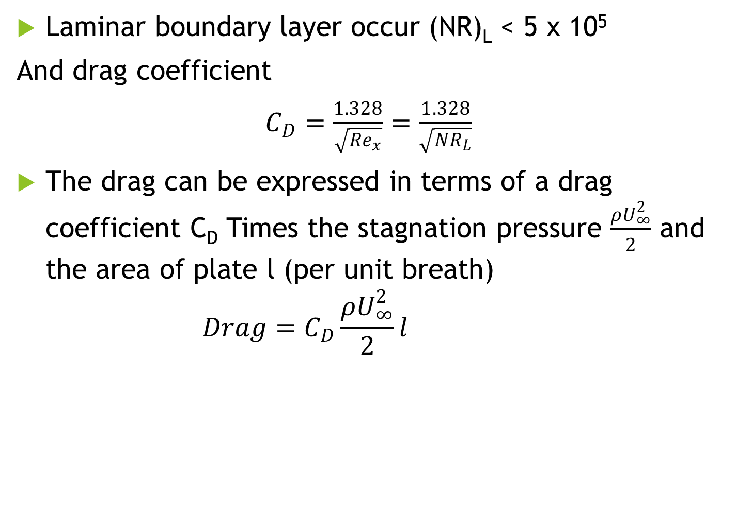
Laminar boundary layer occur (NR)_{L} < 5 x 10⁵
And drag coefficient
$C_{D}=\frac{1.328}{\sqrt{{Re}_{x}}}=\frac{1.328}{\sqrt{{NR}_{L}}}$
The drag can be expressed in terms of a drag coefficient C_{D} Times the stagnation pressure $\frac{ρU_{∞}^{2}}{2}$ and the area of plate l (per unit breath)
$$Drag=C_{D}\frac{ρU_{∞}^{2}}{2}l$$

Slide 15
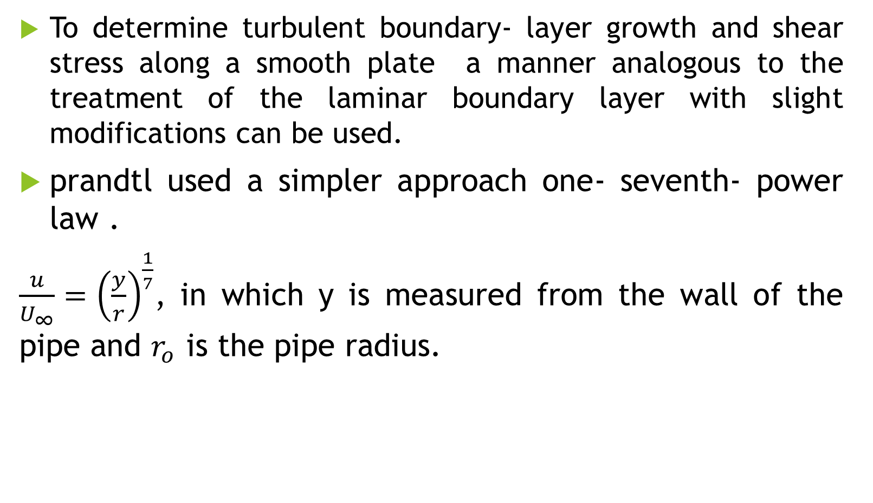
Turbulent boundary layer
To determine turbulent boundary- layer growth and shear stress along a smooth plate a manner analogous to the treatment of the laminar boundary layer with slight modifications can be used.
prandtl used a simpler approach one- seventh- power law .
$\frac{u}{U_{∞}}={\left(\frac{y}{r}\right)}^{\frac{1}{7}}$, in which y is measured from the wall of the pipe and $r_{o}$ is the pipe radius.

Slide 16
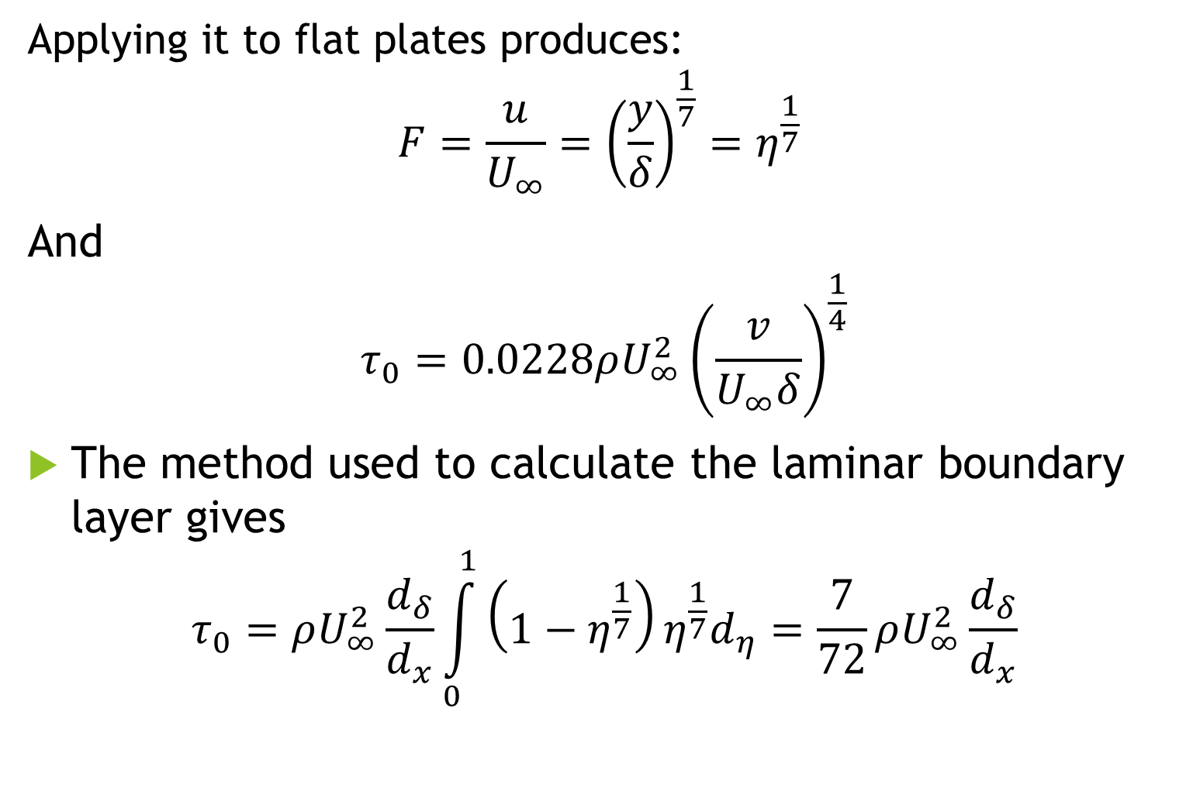
Applying it to flat plates produces:
$$F=\frac{u}{U_{∞}}={\left(\frac{y}{δ}\right)}^{\frac{1}{7}}=η^{\frac{1}{7}}$$
And
$$τ_{0}=0.0228ρU_{∞}^{2}{\left(\frac{v}{U_{∞}δ}\right)}^{\frac{1}{4}}$$
The method used to calculate the laminar boundary layer gives
$$τ_{0}=ρU_{∞}^{2}\frac{d_{δ}}{d_{x}}\int_{0}^{1}{\left(1−η^{\frac{1}{7}}\right)η^{\frac{1}{7}}d_{η}=\frac{7}{72}}ρU_{∞}^{2}\frac{d_{δ}}{d_{x}}$$

Slide 17
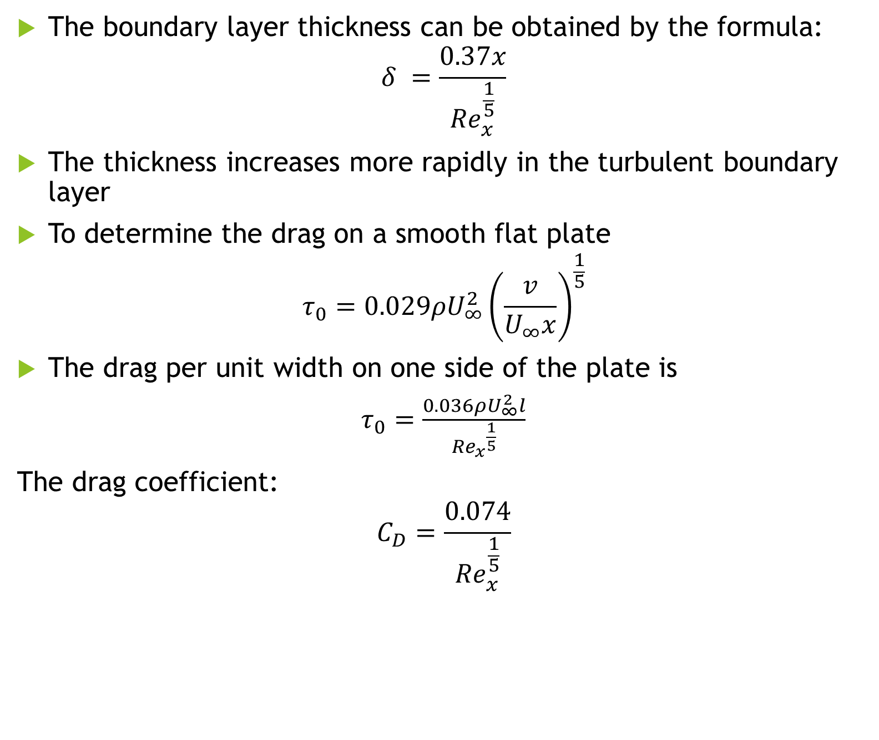
The boundary layer thickness can be obtained by the formula:
$$δ =\frac{0.37x}{{Re}_{x}^{\frac{1}{5}}}$$
The thickness increases more rapidly in the turbulent boundary layer
To determine the drag on a smooth flat plate
$$τ_{0}=0.029ρU_{∞}^{2}{\left(\frac{v}{U_{∞}x}\right)}^{\frac{1}{5}}$$
The drag per unit width on one side of the plate is
$τ_{0}=\frac{0.036ρU_{∞}^{2}l}{{{Re}_{x}}^{\frac{1}{5}}}$
The drag coefficient:
$$C_{D}=\frac{0.074}{{Re}_{x}^{\frac{1}{5}}}$$

Slide 18
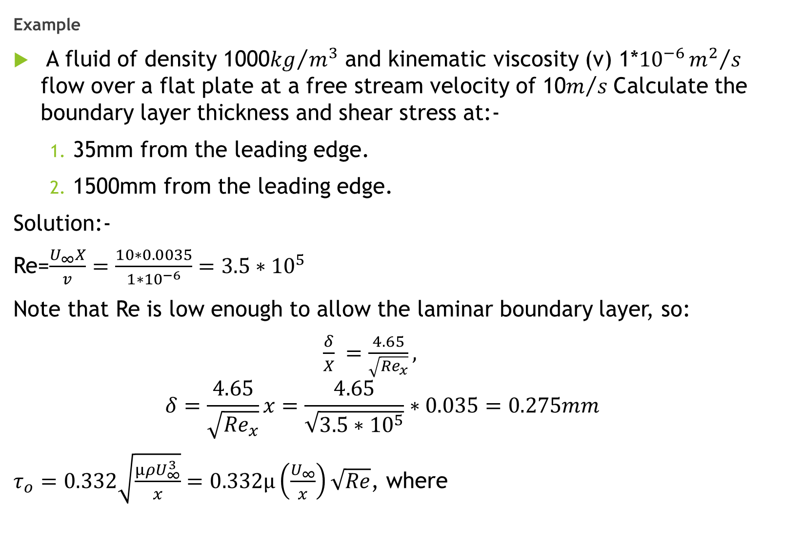
Example
A fluid of density 1000${kg}/{m^{3}}$ and kinematic viscosity (v) 1*${10}^{−6}{m^{2}}/s$ flow over a flat plate at a free stream velocity of 10$m/s$Calculate the boundary layer thickness and shear stress at:-
35mm from the leading edge.
1500mm from the leading edge.
Solution:-
Re=$\frac{U_{∞}X}{v}=\frac{10∗0.0035}{1∗{10}^{−6}}=3.5∗{10}^{5}$
Note that Re is low enough to allow the laminar boundary layer, so:
$\frac{δ}{X} =\frac{4.65}{\sqrt{{Re}_{x}}},$
$$δ=\frac{4.65}{\sqrt{{Re}_{x}}}x=\frac{4.65}{\sqrt{3.5∗{10}^{5}}}∗0.035=0.275mm$$
$τ_{o}=0.332\sqrt{\frac{µρU_{∞}^{3}}{x}}=0.332µ\left(\frac{U_{∞}}{x}\right)\sqrt{Re}$, where

Slide 19
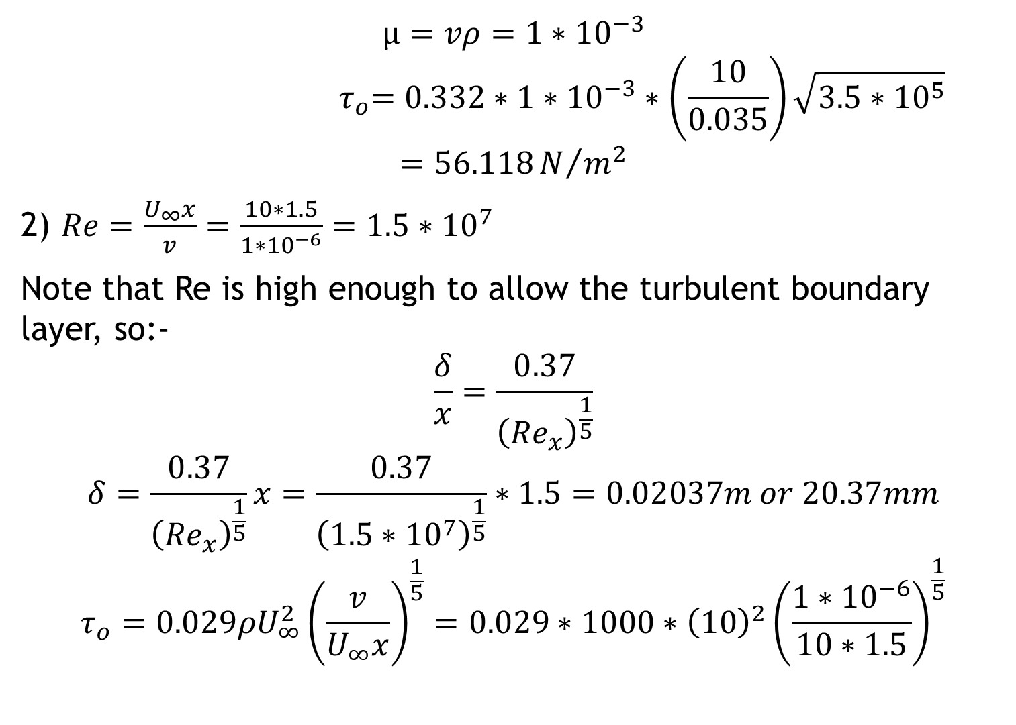
$$µ=vρ=1∗{10}^{−3}$$
$${ τ}_{o}=0.332∗1∗{10}^{−3}∗\left(\frac{10}{0.035}\right)\sqrt{3.5∗{10}^{5}}$$
$$=56.118N/{m^{2}}$$
2) $Re=\frac{U_{∞}x}{v}=\frac{10∗1.5}{1∗{10}^{−6}}=1.5∗{10}^{7}$
Note that Re is high enough to allow the turbulent boundary layer, so:-
$$\frac{δ}{x}=\frac{0.37}{{\left({Re}_{x}\right)}^{\frac{1}{5}}}$$
$$δ=\frac{0.37}{{\left({Re}_{x}\right)}^{\frac{1}{5}}}x=\frac{0.37}{{\left(1.5∗{10}^{7}\right)}^{\frac{1}{5}}}∗1.5=0.02037m or 20.37mm$$
$$τ_{o}=0.029ρU_{∞}^{2}{\left(\frac{v}{U_{∞}x}\right)}^{\frac{1}{5}}=0.029∗1000∗{\left(10\right)}^{2}{\left(\frac{1∗{10}^{−6}}{10∗1.5}\right)}^{\frac{1}{5}}$$

Slide 20
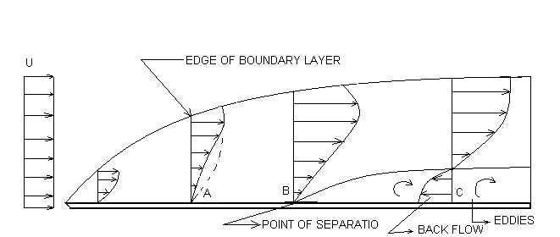
Separation of boundary layer
On a long flat plate the boundary layer continues to grow in the downstream direction, regardless of the length of the plate, when the pressure gradient remains zero, with the pressure decreasing in the downstream direction, the boundary layer tends to be reducing in thickness.
For adverse pressure gradients, for that pressure increasing in the downstream direction, the boundary layer thickness rapidly increases. The adverse gradient and the boundary shear decrease the momentum in the boundary layer, and if both act over a sufficient distance, they cause the boundary layer to come to rest. This phenomenon is called separation of the boundary layer.

Slide 21
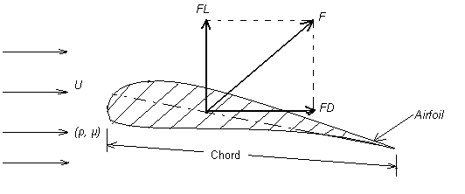
Drag and lift on a sphere and cylinder
Take an airfoil immersed in a fluid moving with velocity V

Slide 22
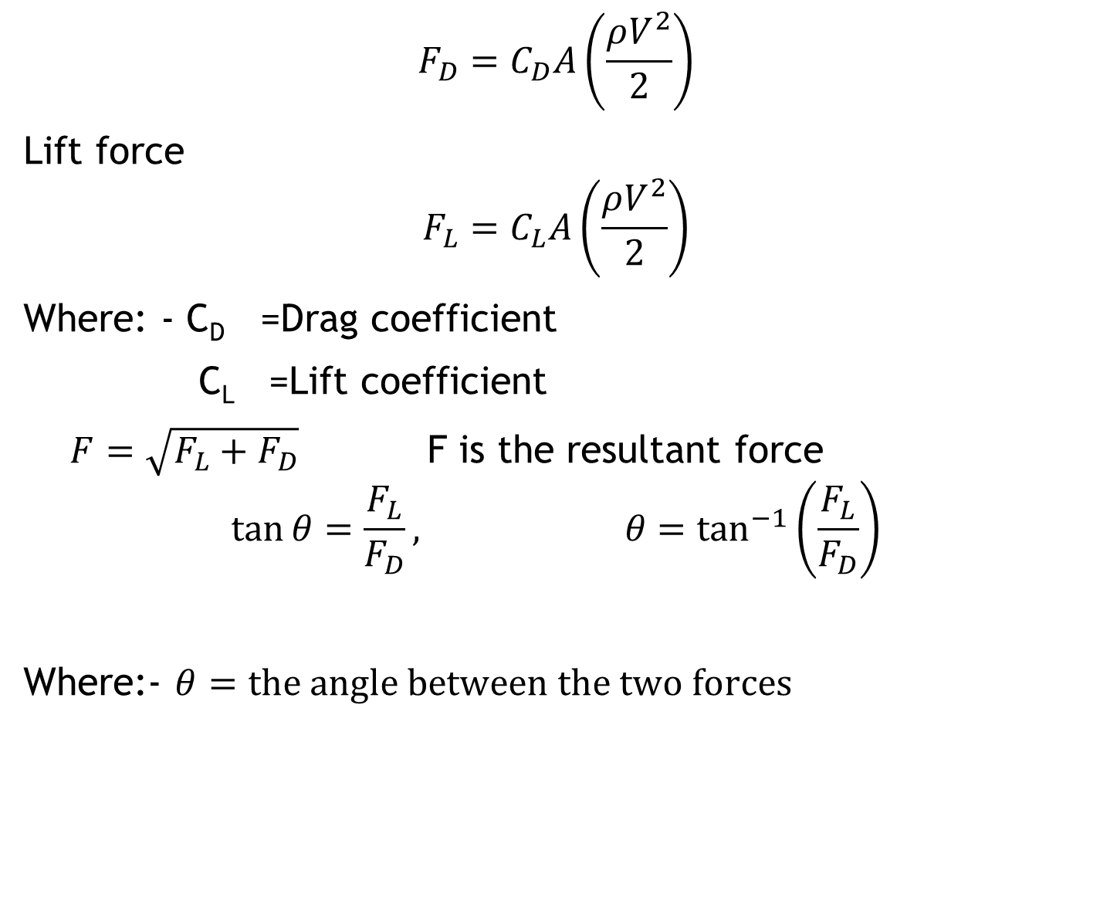
$$F_{D}=C_{D}A\left(\frac{ρV^{2}}{2}\right)$$
Lift force
$$F_{L}=C_{L}A\left(\frac{ρV^{2}}{2}\right)$$
Where: - C_{D} =Drag coefficient
C_{L} =Lift coefficient
$F=\sqrt{F_{L}+F_{D}}$ F is the resultant force
$$\tan{θ=\frac{F_{L}}{F_{D}}}, θ=\tan^{−1}\left(\frac{F_{L}}{F_{D}}\right)$$
Where:- $θ=the angle between the two forces$

Slide 23
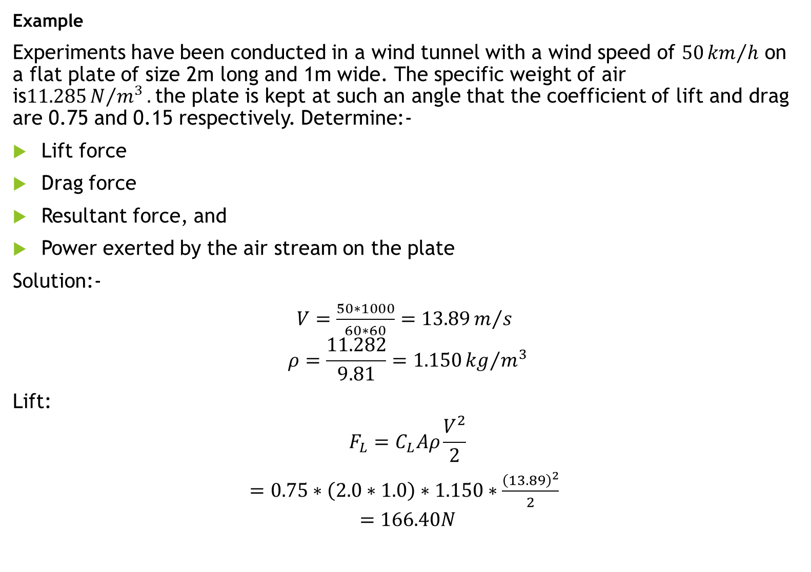
Example
Experiments have been conducted in a wind tunnel with a wind speed of $50{km}/h$ on a flat plate of size 2m long and 1m wide. The specific weight of air is$11.285N/{m^{3}}.$the plate is kept at such an angle that the coefficient of lift and drag are 0.75 and 0.15 respectively. Determine:-
Lift force
Drag force
Resultant force, and
Power exerted by the air stream on the plate
Solution:-
$V=\frac{50∗1000}{60∗60}=13.89m/s$
$$ρ=\frac{11.282}{9.81}=1.150{kg}/{m^{3}}$$
Lift:
$$F_{L}=C_{L}Aρ\frac{V^{2}}{2}$$
$=0.75∗\left(2.0∗1.0\right)∗1.150∗\frac{{\left(13.89\right)}^{2}}{2}$
$$=166.40N$$

Slide 24
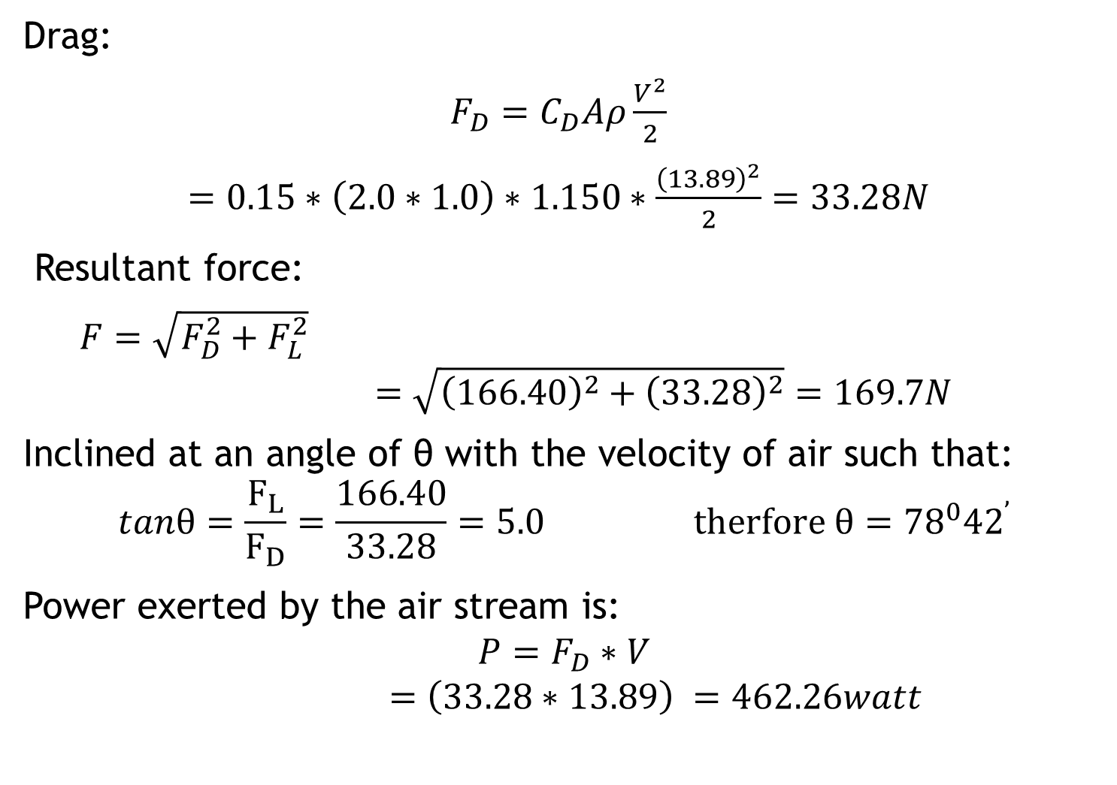
Drag:
$F_{D}=C_{D}Aρ\frac{V^{2}}{2}$
$=0.15∗\left(2.0∗1.0\right)∗1.150∗\frac{{\left(13.89\right)}^{2}}{2}=33.28N$
Resultant force:
$F=\sqrt{F_{D}^{2}+F_{L}^{2}}$
$$=\sqrt{{\left(166.40\right)}^{2}+{\left(33.28\right)}^{2}}=169.7N$$
Inclined at an angle of θ with the velocity of air such that:
$$tanθ=\frac{F_{L}}{F_{D}}=\frac{166.40}{33.28}=5.0 therfore θ={78}^{0}{42}^{’}$$
Power exerted by the air stream is:
$$P=F_{D}∗V$$
$$=\left(33.28∗13.89\right) =462.26watt$$

Slide 25
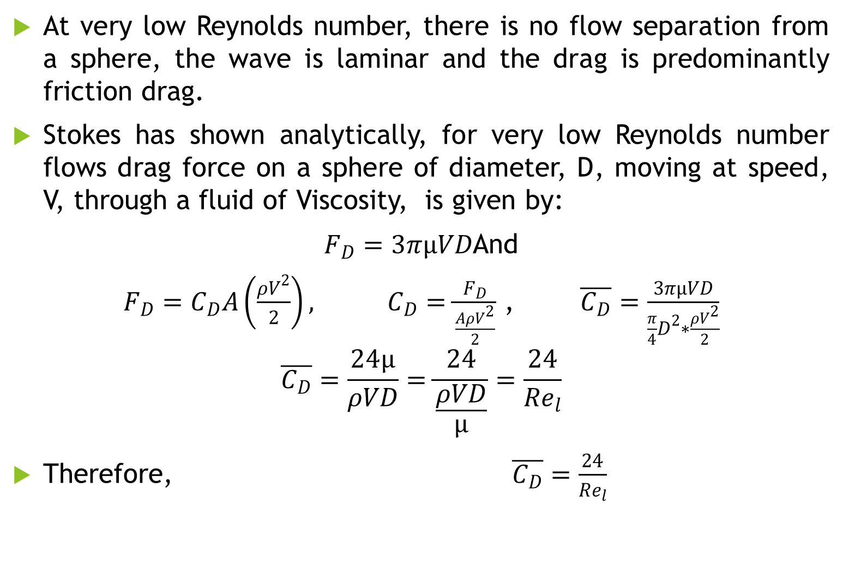
On a sphere
At very low Reynolds number, there is no flow separation from a sphere, the wave is laminar and the drag is predominantly friction drag.
Stokes has shown analytically, for very low Reynolds number flows drag force on a sphere of diameter, D, moving at speed, V, through a fluid of Viscosity, is given by:
$F_{D}=3πµVD$And
$F_{D}=C_{D}A\left(\frac{ρV^{2}}{2}\right), C_{D}=\frac{F_{D}}{\frac{AρV^{2}}{2}}$ , $\overline{C_{D}}=\frac{3πµVD}{\frac{π}{4}D^{2}∗\frac{ρV^{2}}{2}}$
$$\overline{C_{D}}=\frac{24µ}{ρVD}=\frac{24}{\frac{ρVD}{µ}}=\frac{24}{{Re}_{l}}$$
Therefore, $\overline{C_{D}}=\frac{24}{{Re}_{l}}$

Slide 26
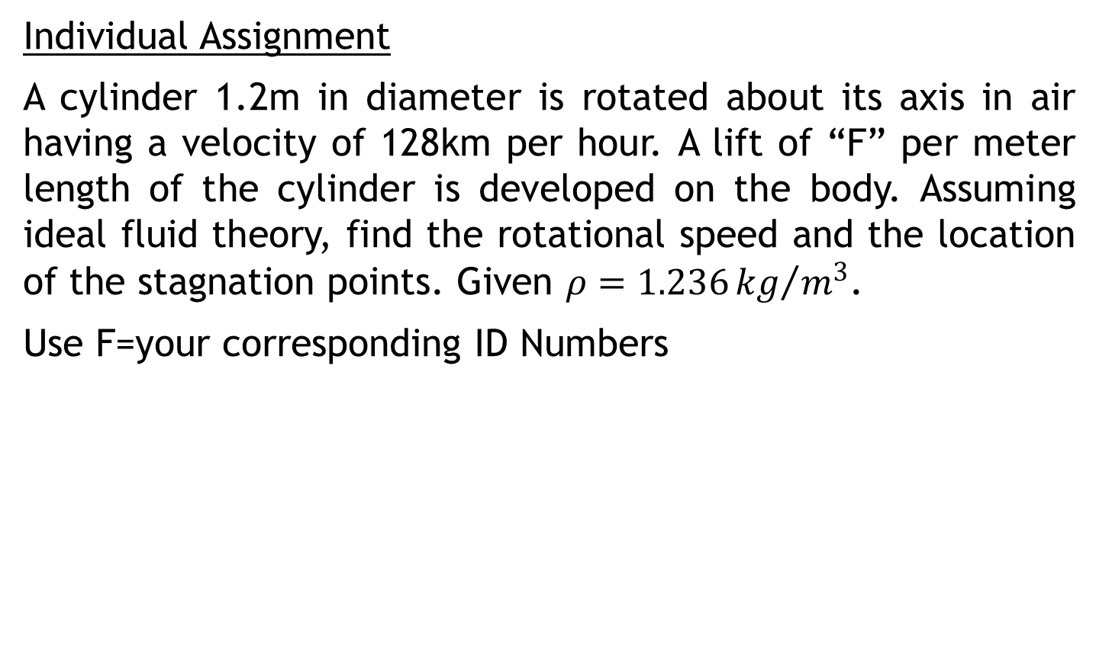
On cylinder- Reading assignment
Individual Assignment
A cylinder 1.2m in diameter is rotated about its axis in air having a velocity of 128km per hour. A lift of “F” per meter length of the cylinder is developed on the body. Assuming ideal fluid theory, find the rotational speed and the location of the stagnation points. Given $ρ=1.236{kg}/{m^{3}}$.
Use F=your corresponding ID Numbers

Slide 27
CHATPER FOUR Laminar and Turbulent Flow
Laminar flow: - flow in which the fluid moves in layers, or laminas.
Characteristics
Re less than 2000.
It occurs at Low velocity.
The viscous forces predominate over the inertial forces.
Rare in practice in water system.
Simple mathematical analysis possible.

Slide 28
Turbulent flow: - has very erratic motion of fluid particles, with a violent transverse interchange of momentum.
It had completely disrupted the orderly movement of laminar flow.
Re greater than 4000.
The losses are directly proportional to the average velocity.
mathematical analysis is very difficult.

Slide 29
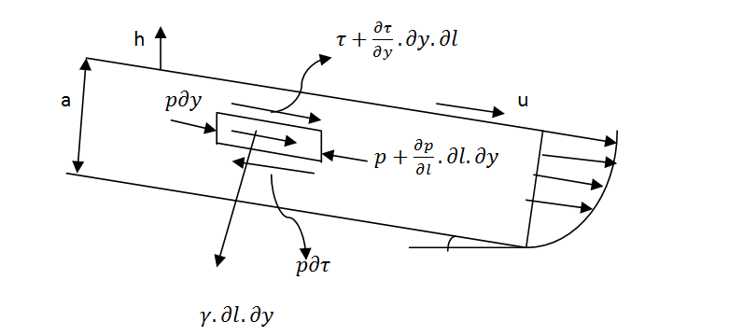
Laminar flow between parallel plates
For steady flow b/n parallel inclined plates; the bottom plate fixed, the upper plate has a constant velocity.

Slide 30
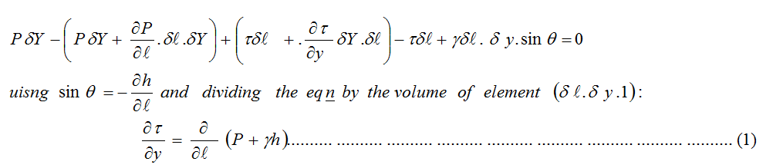
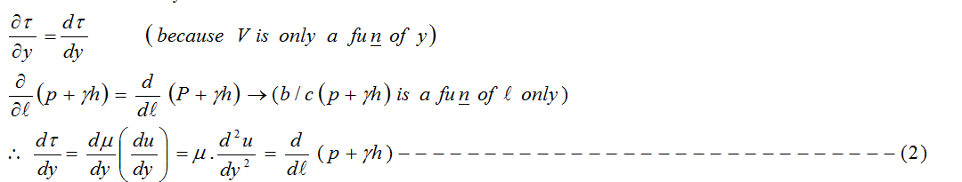
Analyzing the flow by taking a thin laminar of unit width as a free body, the equation of motion yields:

Slide 31
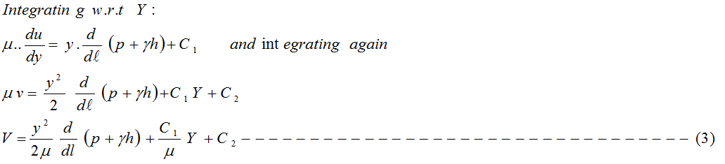
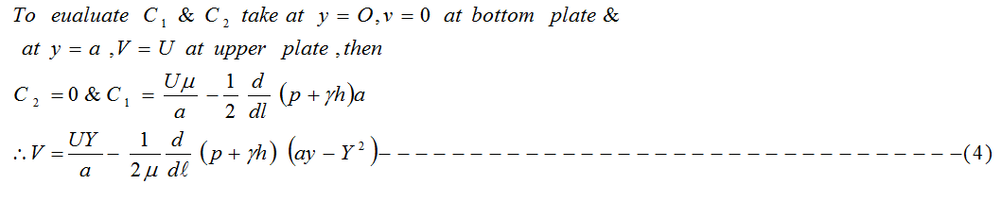

Slide 32

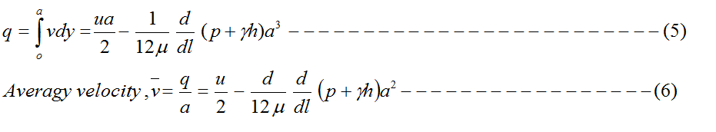
For both plates fixed U=0
The discharge of the laminar flow per unit width of the plate can be obtained by integrating eqn. (4) w. r. t. y, Yielding:
For the both plate stationary, U= 0, then,

Slide 33
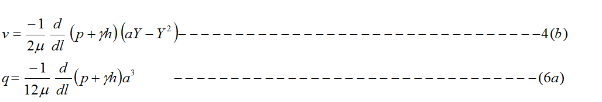
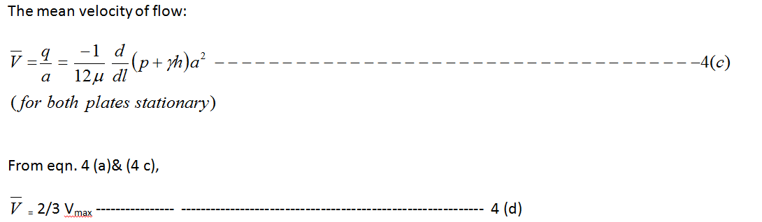

Slide 34
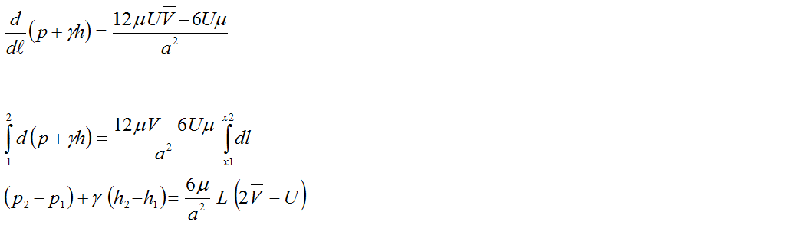
The shear stress Distribution is given by:
Head loss (Energy losses): From the equation (6)

Slide 35
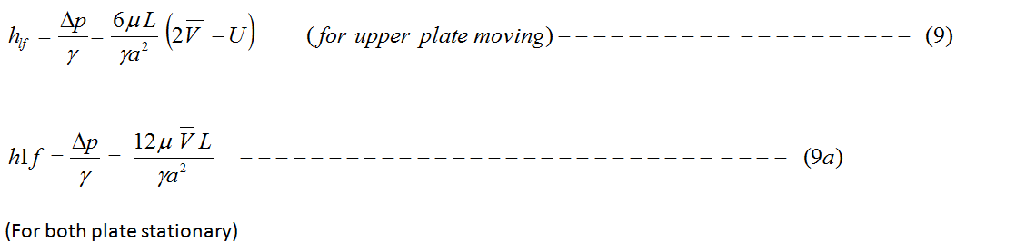

If the flow is laminar in a circular pipe:

Slide 36
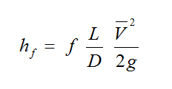
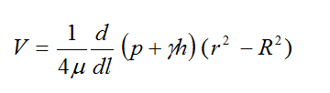
From Darcy- weisbach eqn. the head loss due to frictional resistance in a long straight pipe of length L diameter, D & mean velocity is given as:
Note: - The above equations are derived for horizontal pipes, but for inclined pipe it is given as:

Slide 37
Fully developed turbulent flow in pipes
Shearing in turbulent flows is both difficult to Visualize & less amenable to mathematical treatment.
As consequence, the solutions of problems involving turbulent flows tend to invoke experimental data.
In turbulent flow, a streamline broken into an eddy formation, that its success passage leads to a measurable fluctuation in the velocity at a given point.
The eddies are generally irregular in size & shape, so the fluctuation of velocity with time is correspondingly irregular.

Slide 38
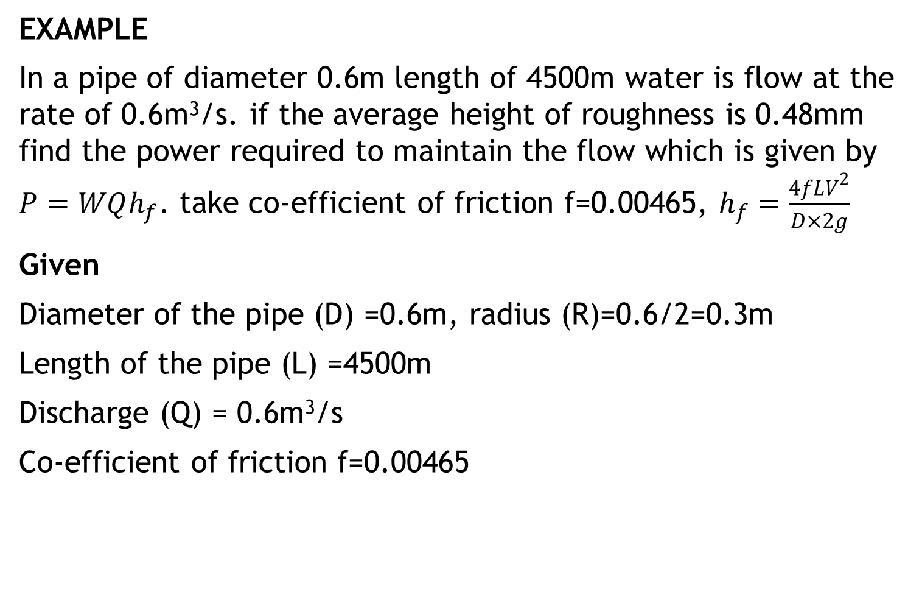
EXAMPLE
In a pipe of diameter 0.6m length of 4500m water is flow at the rate of 0.6m³/s. if the average height of roughness is 0.48mm find the power required to maintain the flow which is given by $P=WQh_{f}$. take co-efficient of friction f=0.00465, $h_{f}=\frac{4fLV^{2}}{D×2g}$
Given
Diameter of the pipe (D) =0.6m, radius (R)=0.6/2=0.3m
Length of the pipe (L) =4500m
Discharge (Q) = 0.6m³/s
Co-efficient of friction f=0.00465

Slide 39

Solution
$$V=\frac{Q}{A},A={πR}^{2}=3.14×{0.3}^{2}=2.122m/s$$
$$Headloss in friction=\frac{4fLV^{2}}{2Dg}=\frac{4×0.00465×{2.122}^{2}}{0.6×2×9.81}=32m$$
$$∴P=9.81×0.6×32=188.35KW$$

Slide 40
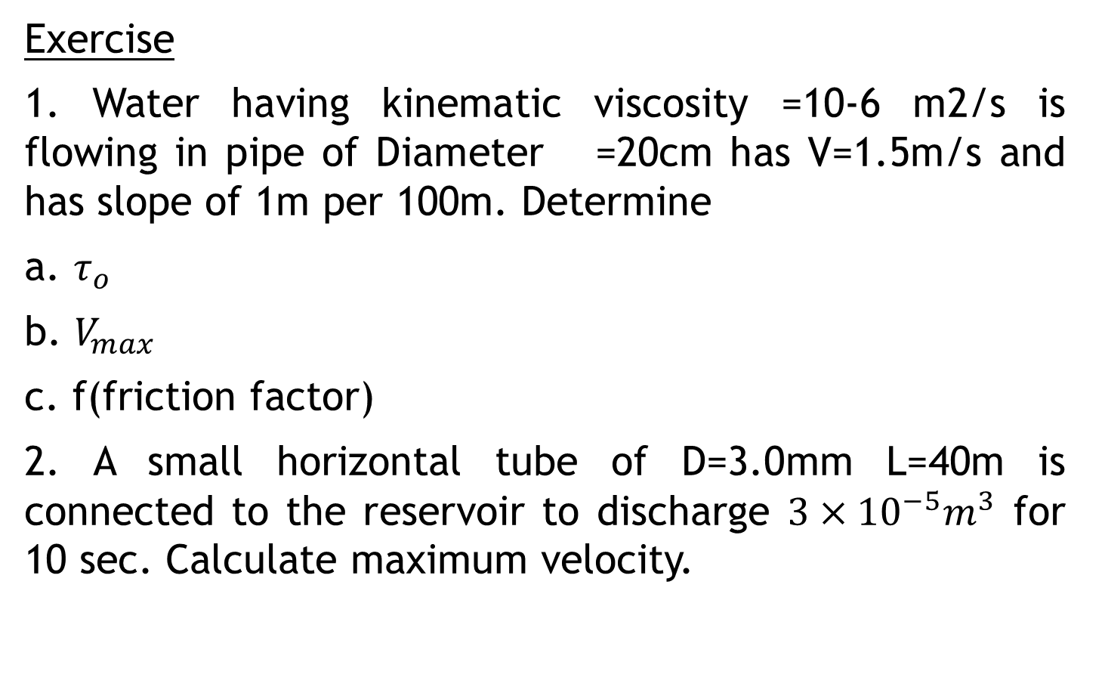
Exercise
1. Water having kinematic viscosity =10-6 m2/s is flowing in pipe of Diameter =20cm has V=1.5m/s and has slope of 1m per 100m. Determine
a. $τ_{o}$
b. $V_{max}$
c. f(friction factor)
2. A small horizontal tube of D=3.0mm L=40m is connected to the reservoir to discharge $3×{10}^{−5}m^{3}$ for 10 sec. Calculate maximum velocity.

Slide 41
THANK YOU

