Slide 1
CHAPTER EIGHT
FLOOD ROUTING AND HYDROLOGY OF UNGAUGED CATCHMENTS
By Mesfin M. (B.Sc. In WRIE, M.Sc. In WRE)

Slide 2
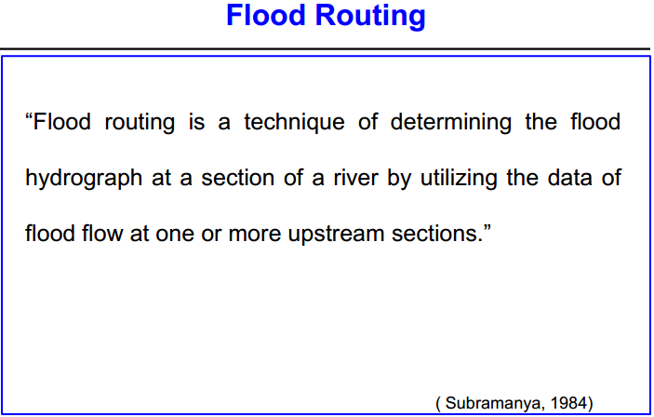

Slide 3
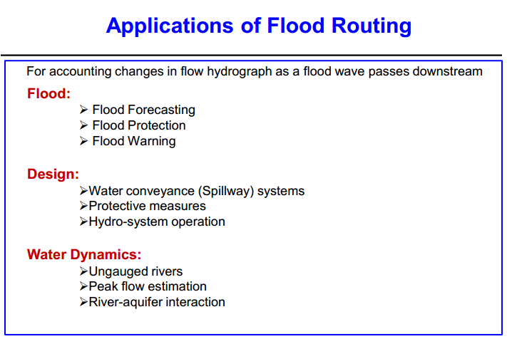

Slide 4
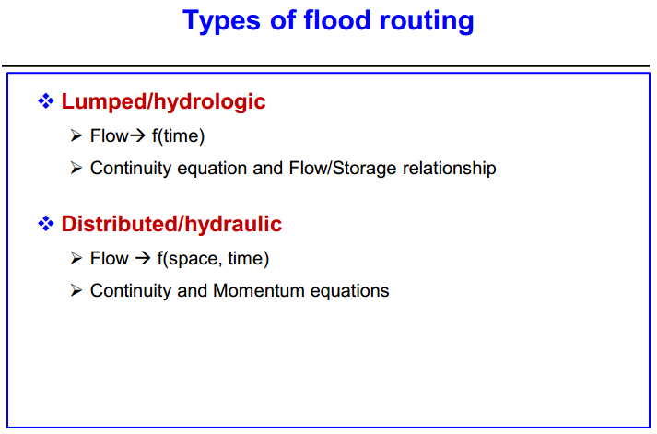

Slide 5
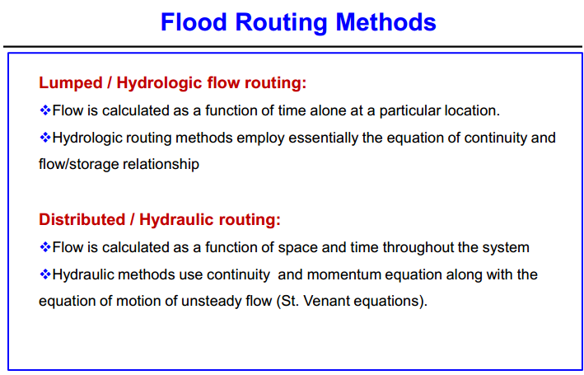

Slide 6
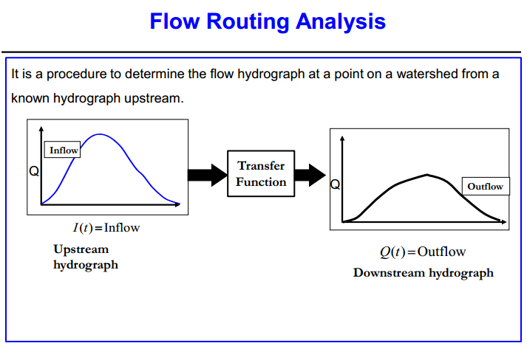

Slide 7
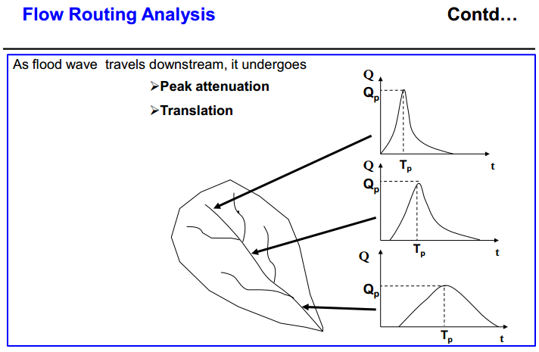

Slide 8
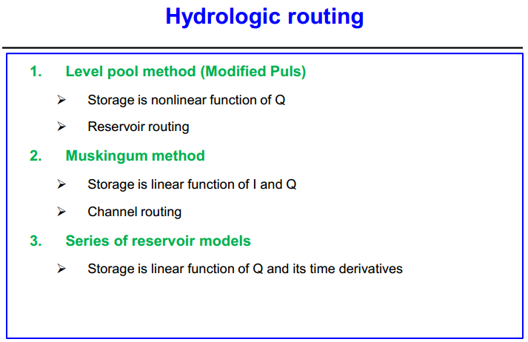

Slide 9
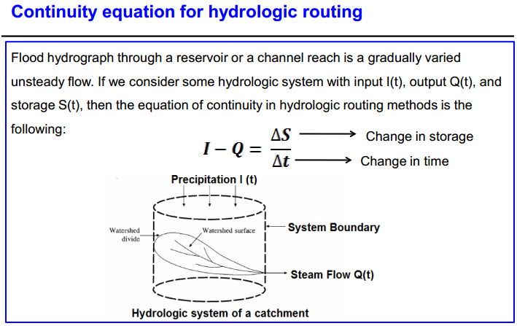

Slide 10
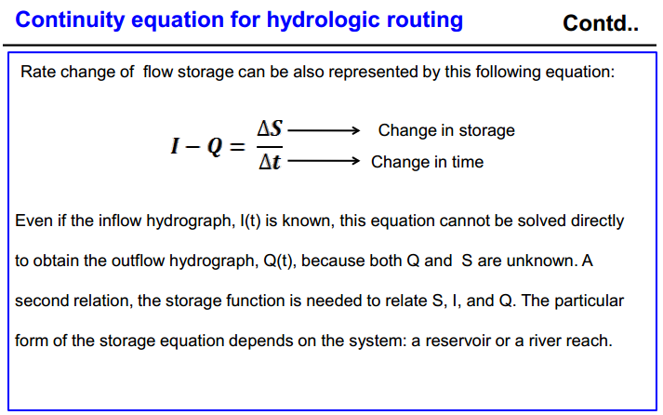

Slide 11
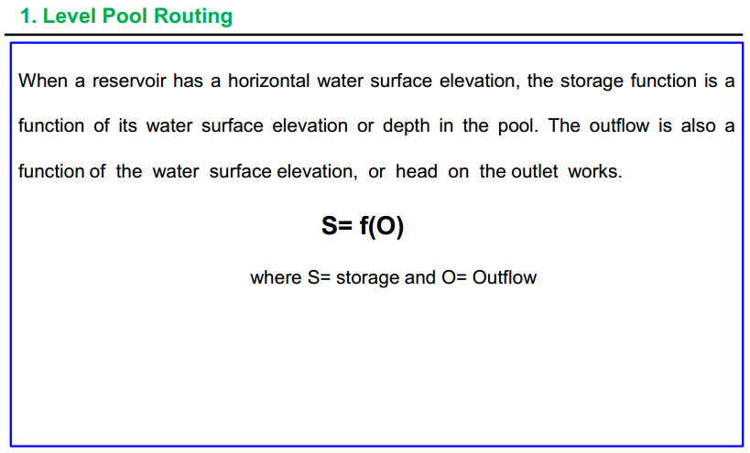

Slide 12
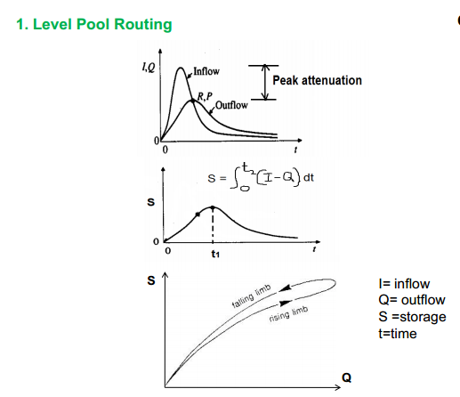

Slide 13
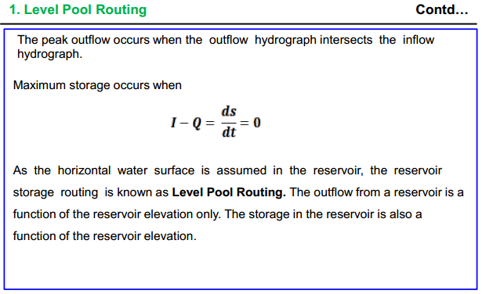

Slide 14
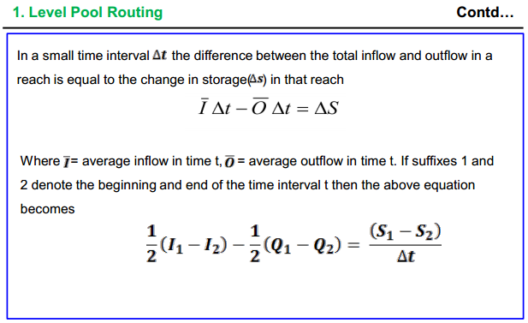
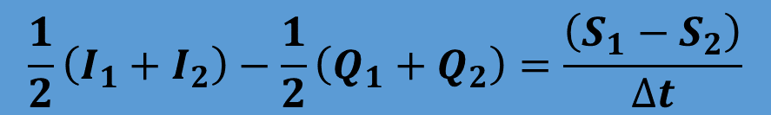
$$\frac{1}{2}\left(I_{1}+I_{2}\right)−\frac{1}{2}\left(Q_{1}+Q_{2}\right)=\frac{\left(S_{1}−S_{2}\right)}{∆t}$$

Slide 15
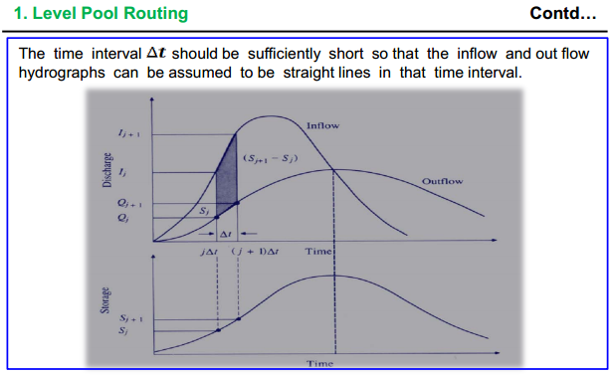

Slide 16
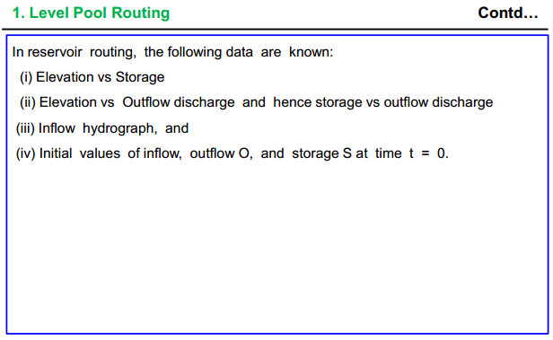

Slide 17
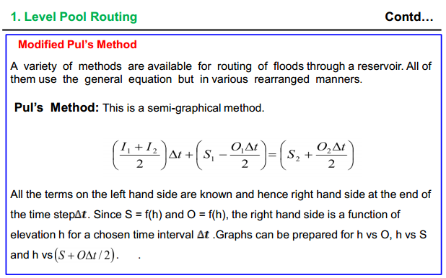

Slide 18
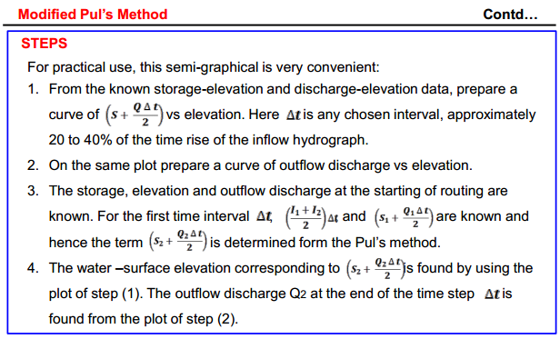

Slide 19
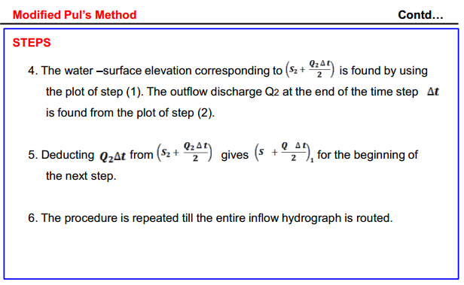

Slide 20
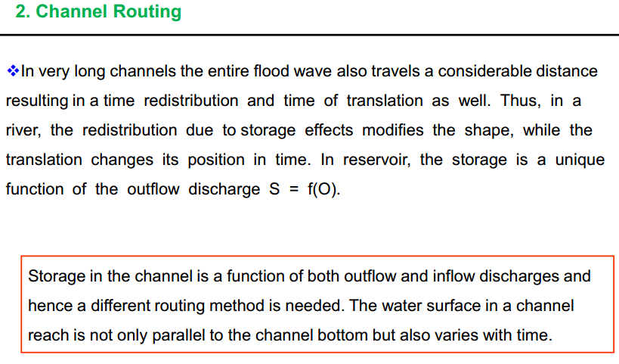

Slide 21
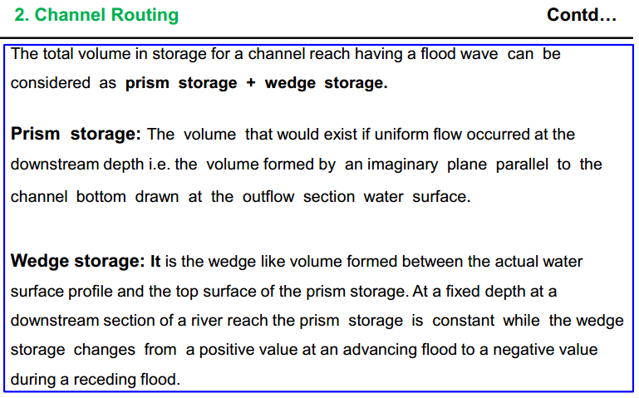

Slide 22
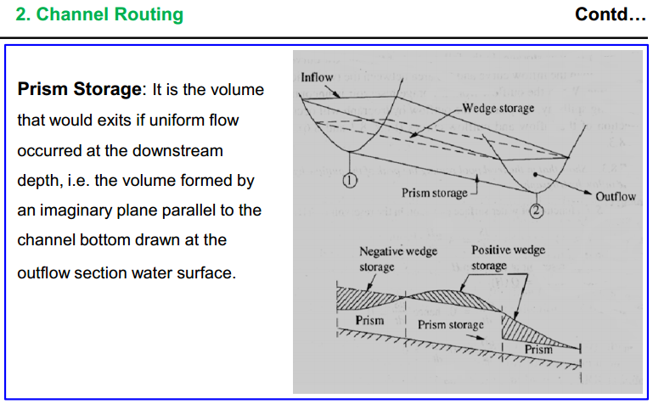

Slide 23
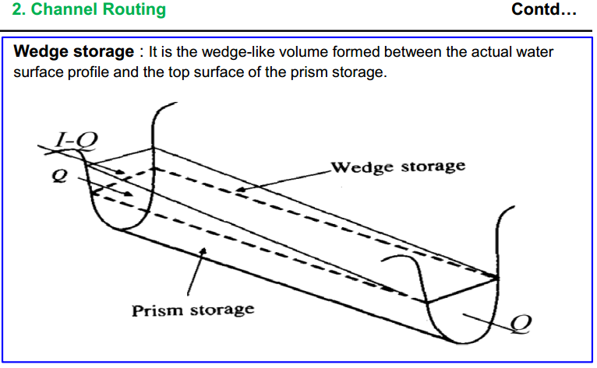

Slide 24
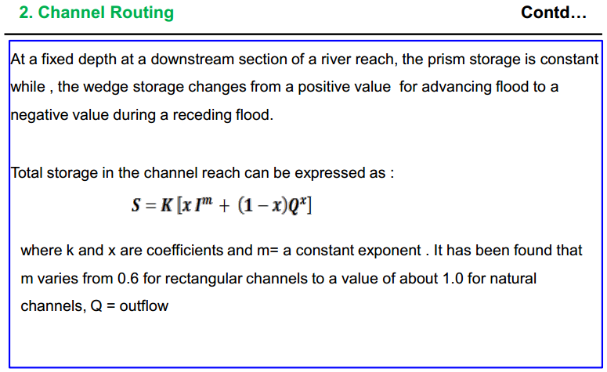

Slide 25
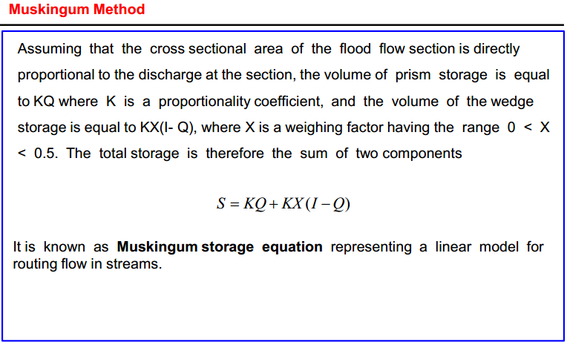

Slide 26
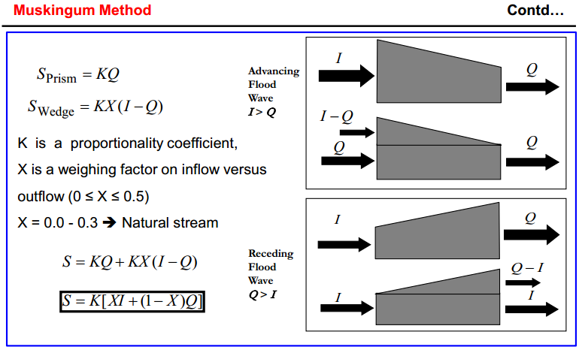

Slide 27
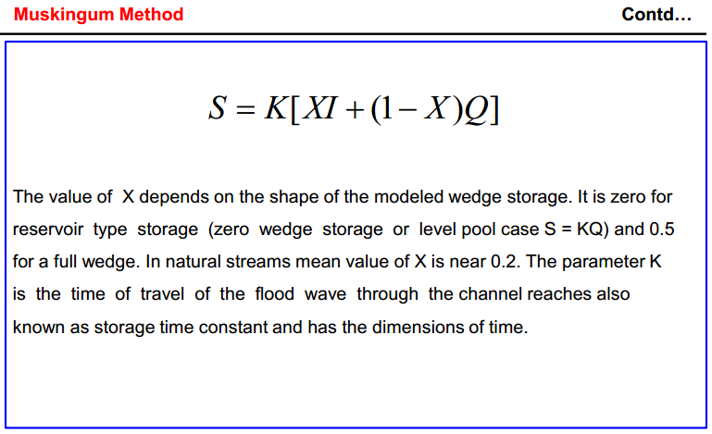

Slide 28
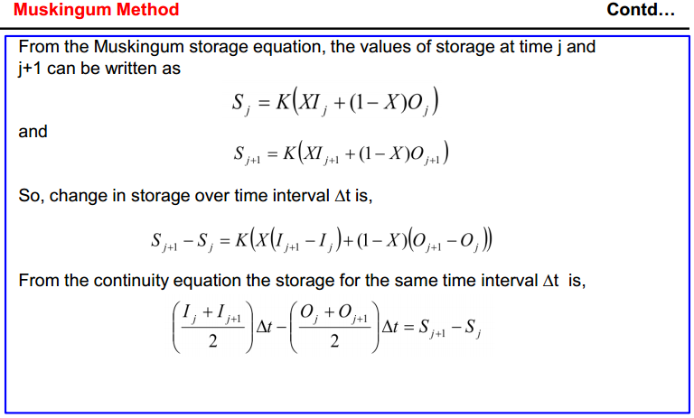

Slide 29
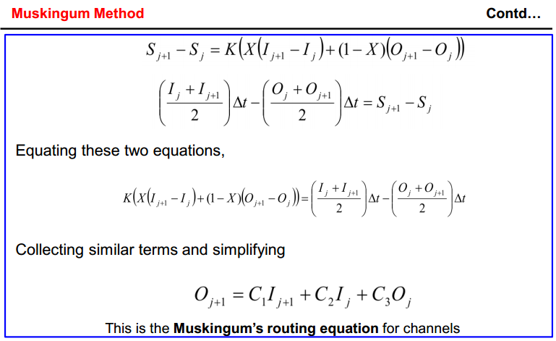

Slide 30
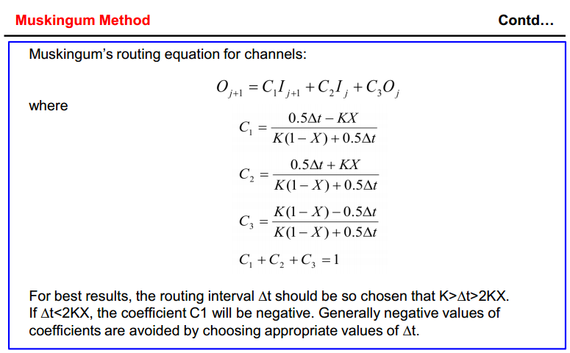

Slide 31
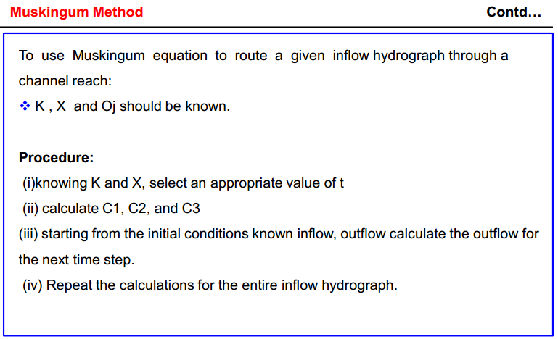

Slide 32
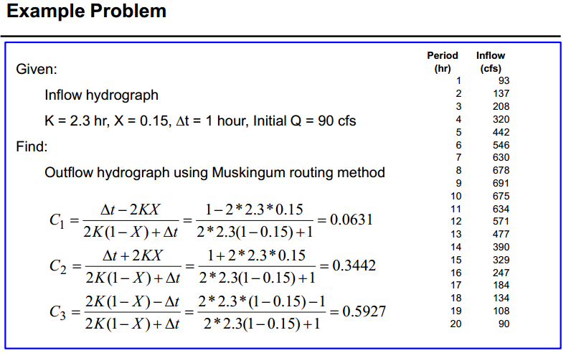

Slide 33
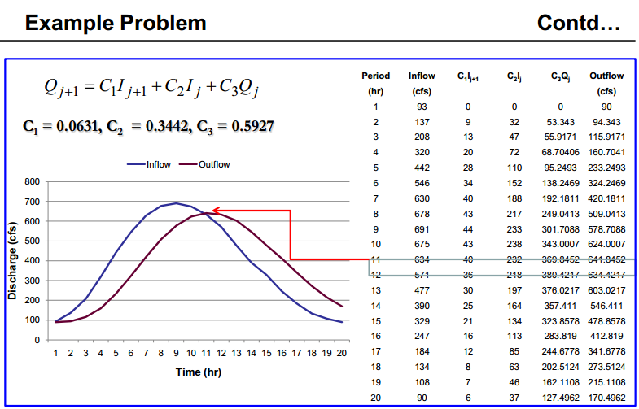

Slide 34
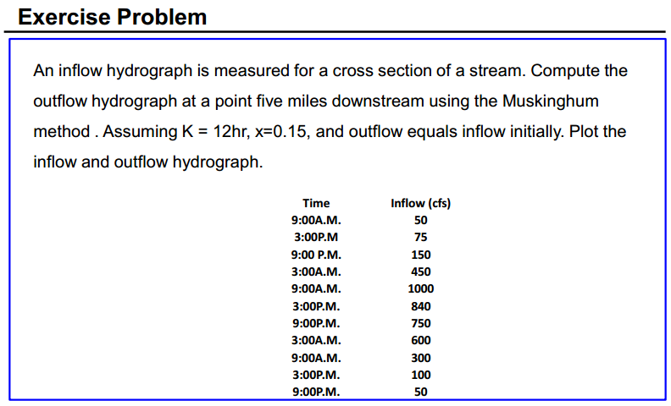

Slide 35
Synthetic Unit Hydrograph
In the absence of rainfall-runoff data, unit hydrographs can be derived by synthetic means.
A synthetic unit hydrograph is a unit hydrograph derived following an established formula, without the need for rainfall-runoff data analysis.
The development of unit hydrograph requires relation between physical geometry of basin and resulting hydrographs.

Slide 36
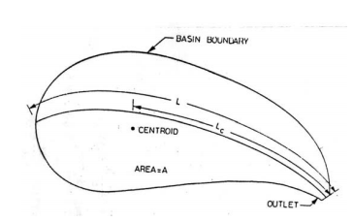

Snyder’s Method
Basin lag t_{p} (hrs) which is the time between center of mass of unit rainfall excess to the peak of the unit hydrograph is
$t_{p}=C_{t}(L.L_{c})^{0.3}hrs$

Slide 37
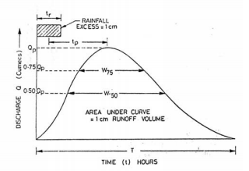
Where L = distance from gaging station (outlet) to catchment boundary (divide) along the main stream (km) Lc= distance from gaging station to centroid of catchment area, measured along the main stream to the nearest point(km) Ct=a coefficient depending on units and drainage characteristics.

Slide 38
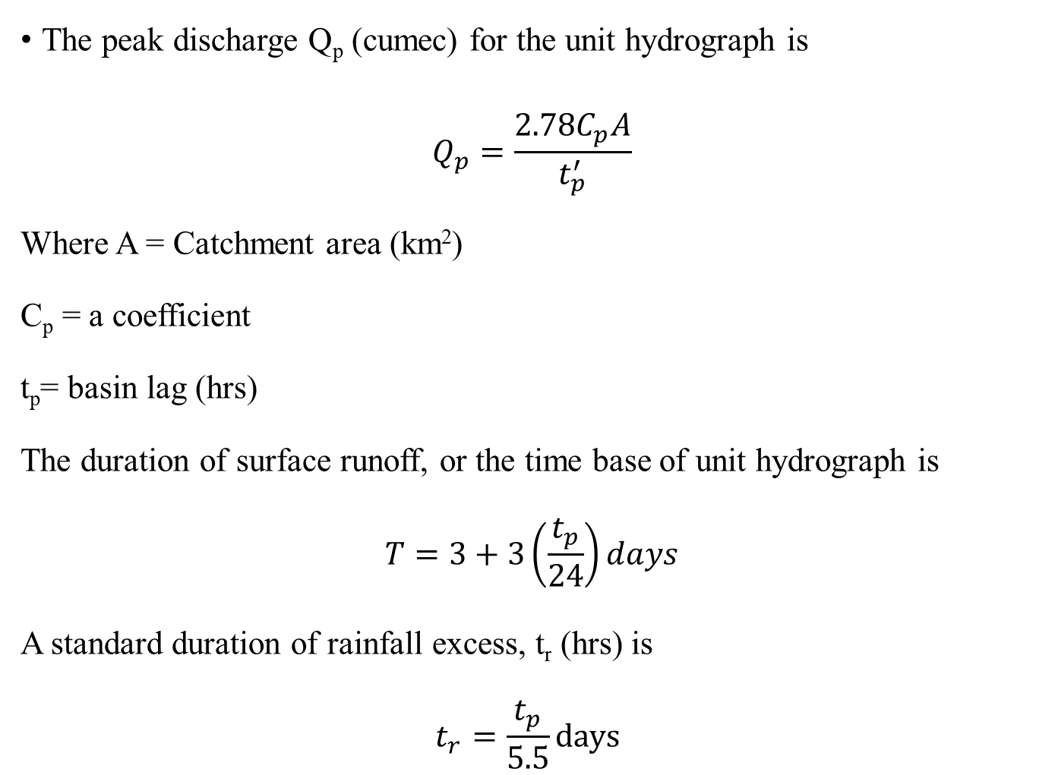
The peak discharge Q_{p} (cumec) for the unit hydrograph is
$$Q_{p}=\frac{2.78C_{p}A}{t_{p}^{′}}$$
Where A = Catchment area (km²)
C_{p} = a coefficient
t_{p}= basin lag (hrs)
The duration of surface runoff, or the time base of unit hydrograph is
$$T=3+3\left(\frac{t_{p}}{24}\right)days$$
A standard duration of rainfall excess, t_{r} (hrs) is
$$t_{r}=\frac{t_{p}}{5.5}days$$

Slide 39
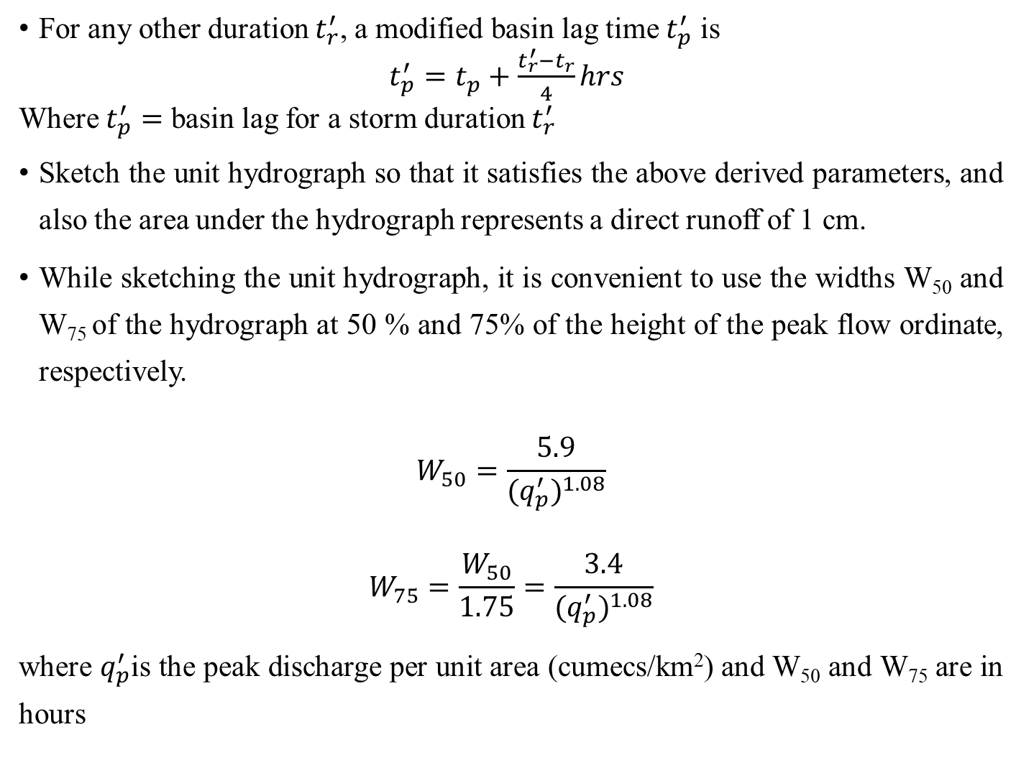
For any other duration $t_{r}^{′}$, a modified basin lag time $t_{p}^{′}$ is
$t_{p}^{′}=t_{p}+\frac{t_{r}^{′}−t_{r}}{4}hrs$
Where $t_{p}^{′}=$ basin lag for a storm duration $t_{r}^{′}$
Sketch the unit hydrograph so that it satisfies the above derived parameters, and also the area under the hydrograph represents a direct runoff of 1 cm.
While sketching the unit hydrograph, it is convenient to use the widths W₅₀ and W₇₅ of the hydrograph at 50 % and 75% of the height of the peak flow ordinate, respectively.
$$W_{50}=\frac{5.9}{{(q}_{p}^{′})^{1.08}}$$
$$W_{75}=\frac{W_{50}}{1.75}=\frac{3.4}{{(q}_{p}^{′})^{1.08}}$$
where $q_{p}^{′}$is the peak discharge per unit area (cumecs/km²) and W₅₀ and W₇₅ are in hours

Slide 40
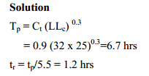
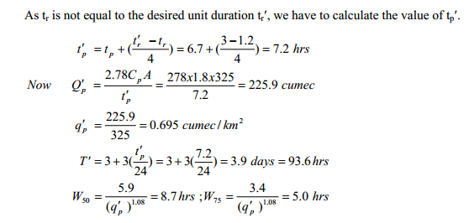
Example: Derive a 3-hr unit hydrograph for an ungaged basin from the following data. Length L =32 km; length Lc=25 km; Area of catchment =325 km2
Assume Ct=0.9 and Cp=1.8

Slide 41
