Slide 1

CHAPTER FIVE
RUNOFF
By Mesfin M. (B.Sc. in WRIE, M.Sc. in WRE)

Slide 2
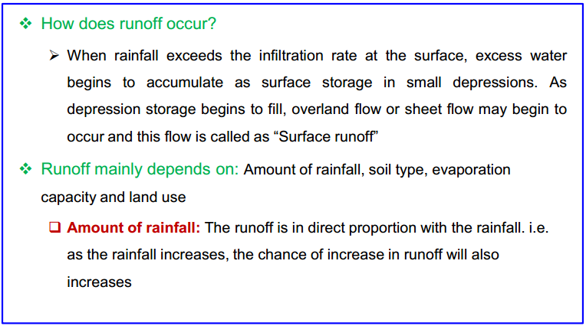
INTRODUCTION

Slide 3
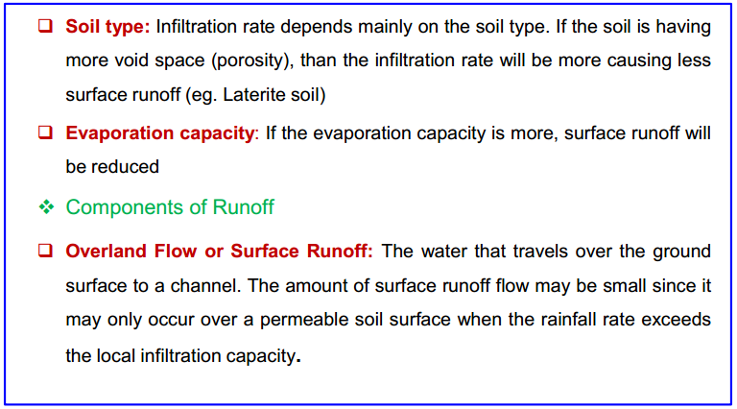
INTRODUCTION

Slide 4
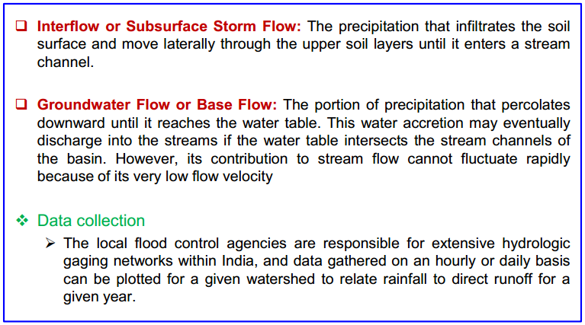
Components of runoff
Data collection
The local flood control agencies are responsible for extensive hydrologic gaging networks with in Ethiopia, and data gathered on daily basis can be plotted for a given watershed to relate rainfall to direct runoff for a given year.

Slide 5
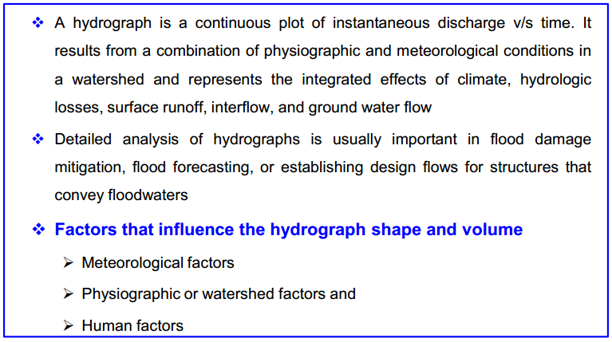
Hydrograph

Slide 6
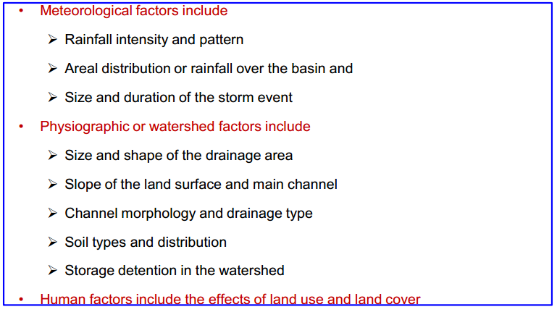
Hydrograph

Slide 7
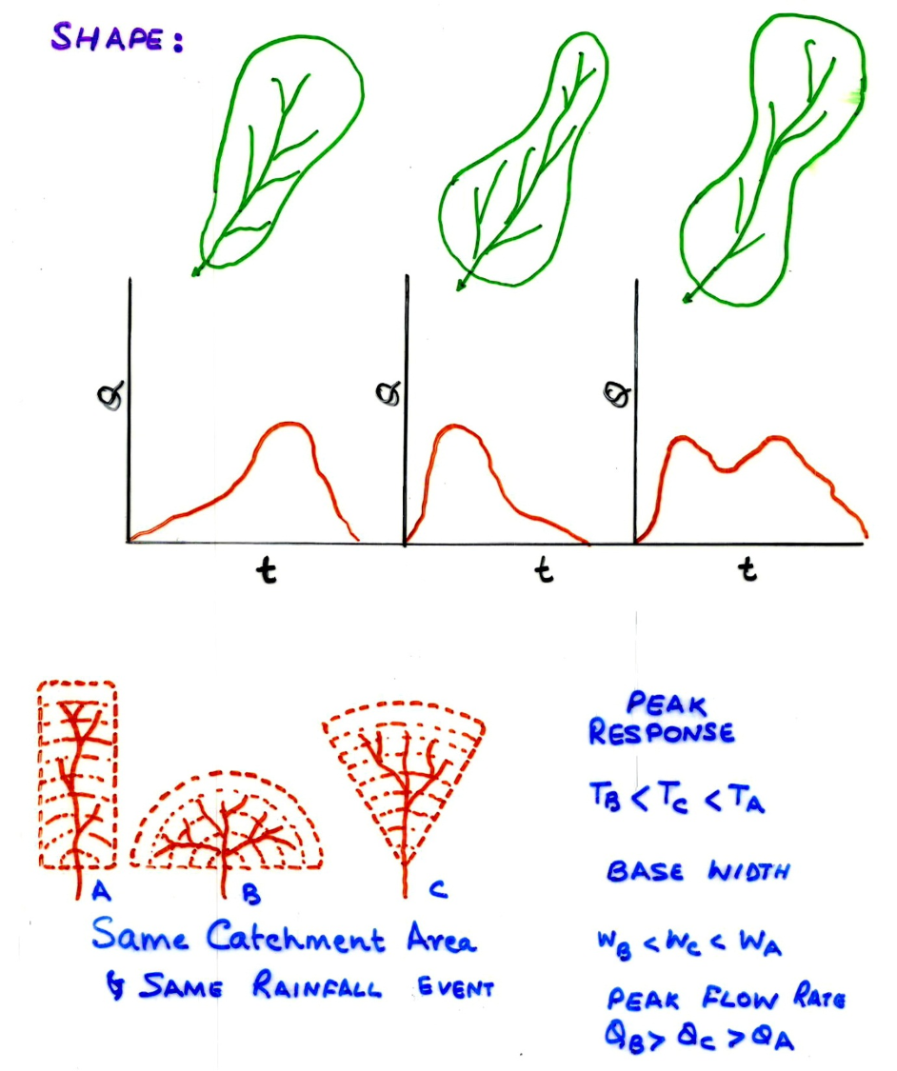
Hydrograph

Slide 8
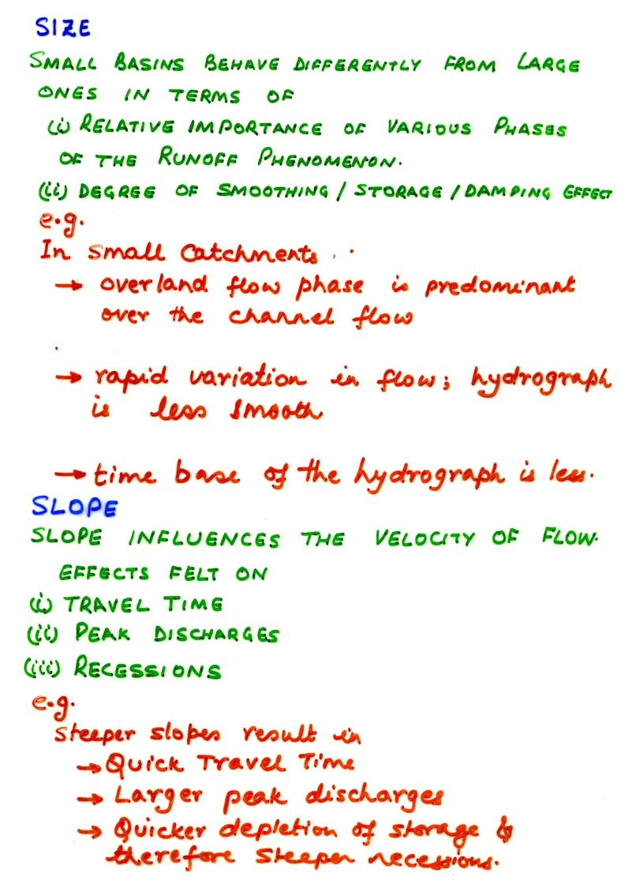
Hydrograph

Slide 9
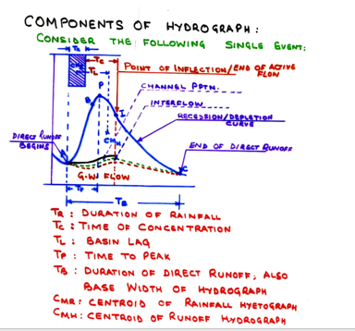

Slide 10
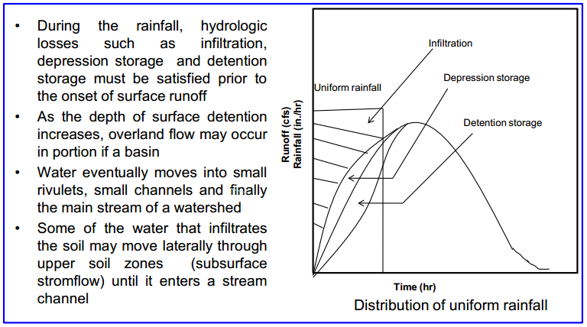

Slide 11
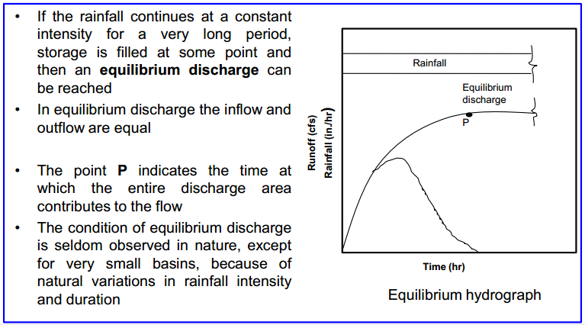

Slide 12
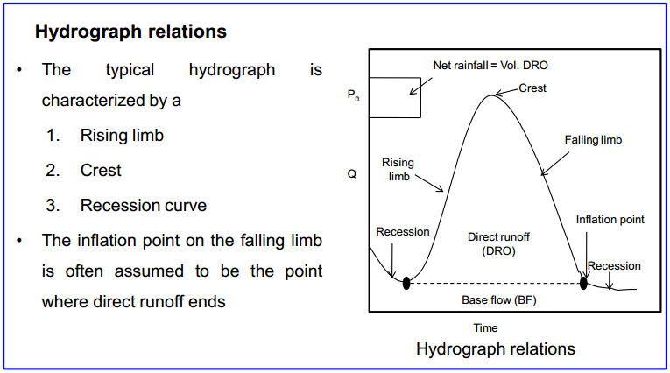

Slide 13
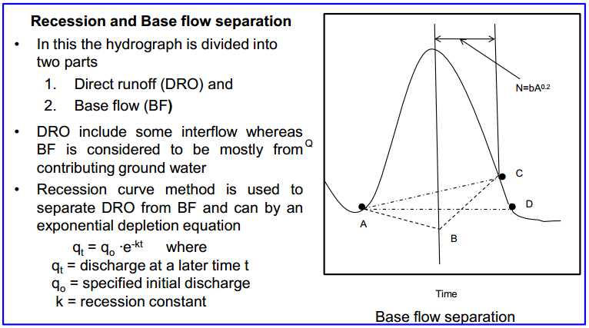

Slide 14
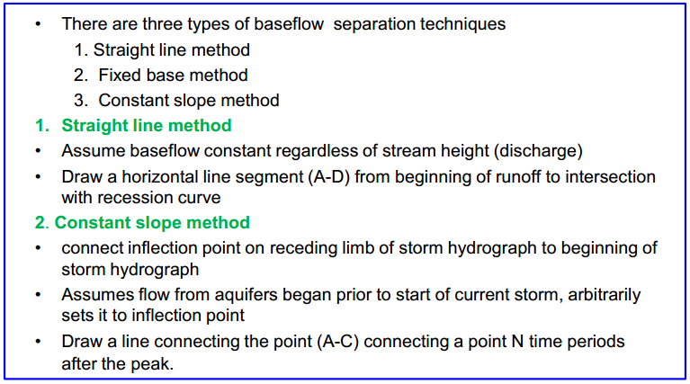
Baseflow Separation Methods

Slide 15
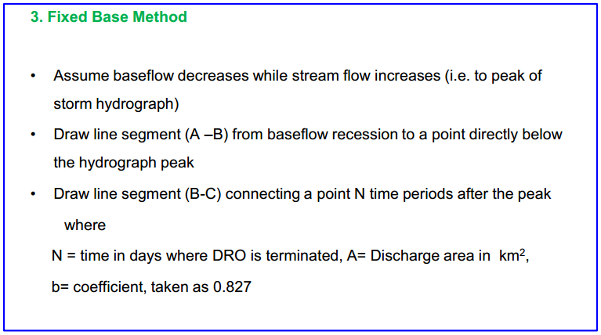
Baseflow Separation Methods

Slide 16
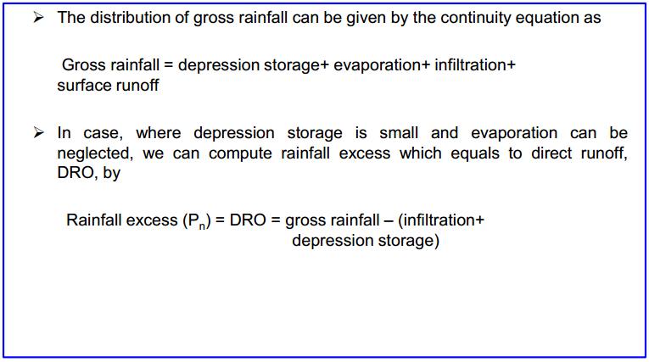
Rainfall excess

Slide 17
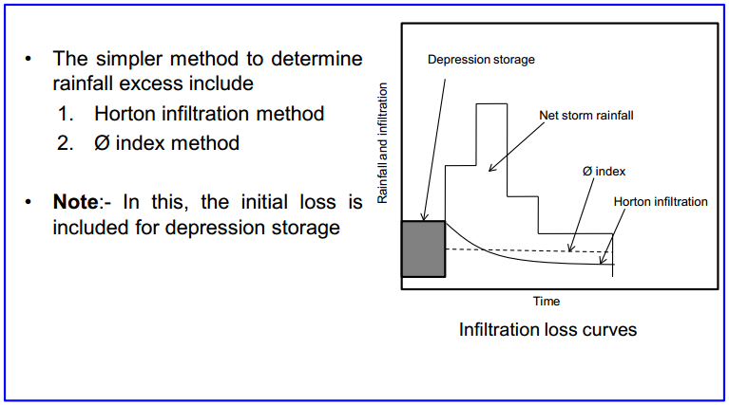

Slide 18
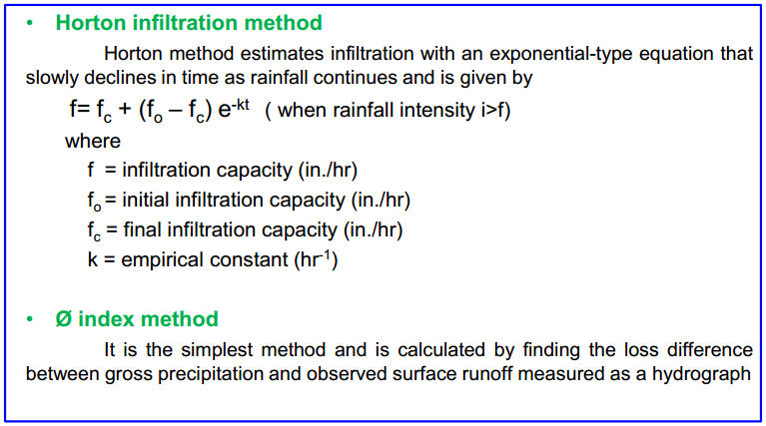

Slide 19
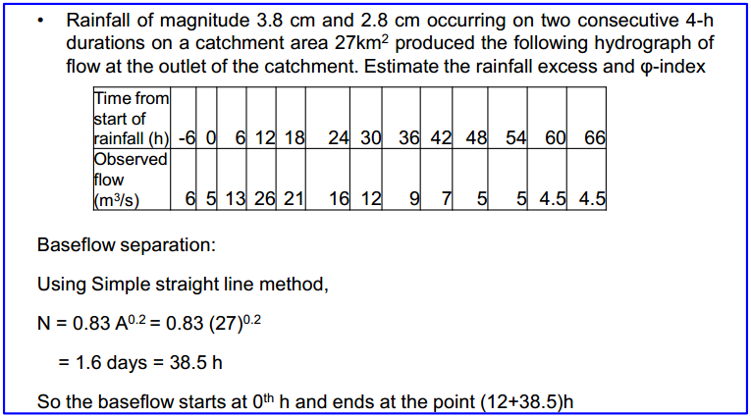
Example Problem-1

Slide 20
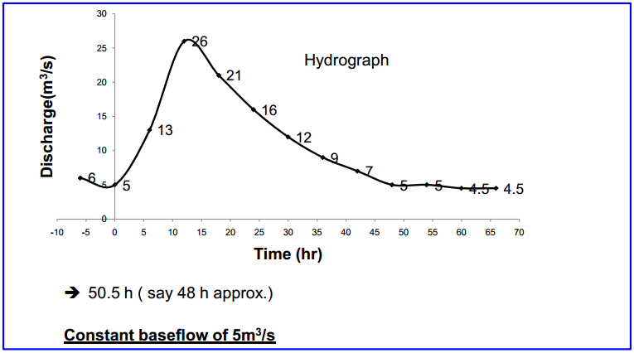

Slide 21
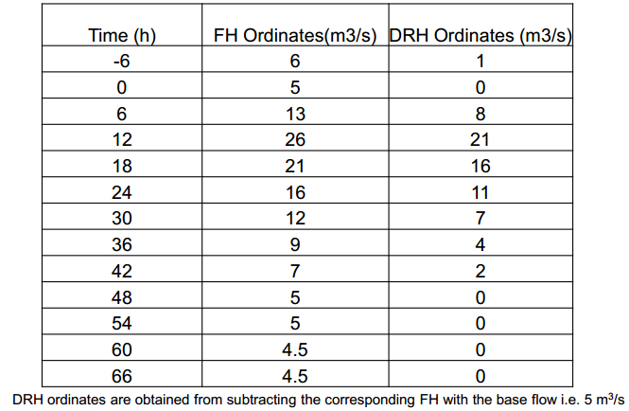

Slide 22
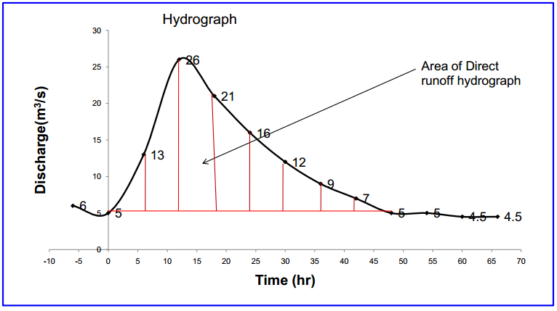

Slide 23
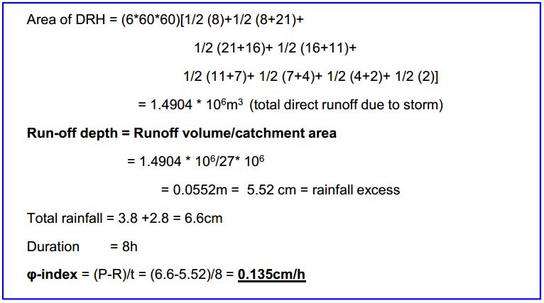

Slide 24
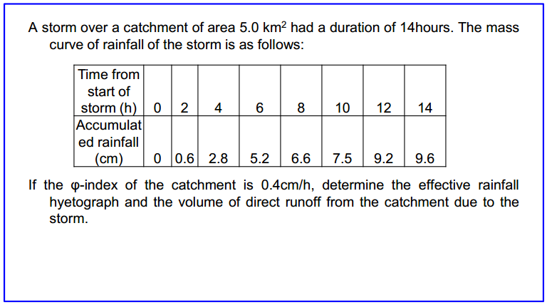
Example Problem-2

Slide 25
