Slide 1

CHAPTER FOUR
INFILTRATION
AYANSA T. (B.Sc. In HY., M.Sc. in WRE)

Slide 2
Infiltration
The process by which water on the ground surface enters the soil.
The rate of infiltration is affected by soil characteristics including ease of entry, storage capacity, and transmission rate through the soil.
The soil texture and structure, vegetation types and cover, water content of the soil, soil temperature, and rainfall intensity all play a role in controlling infiltration rate and capacity.

Slide 3
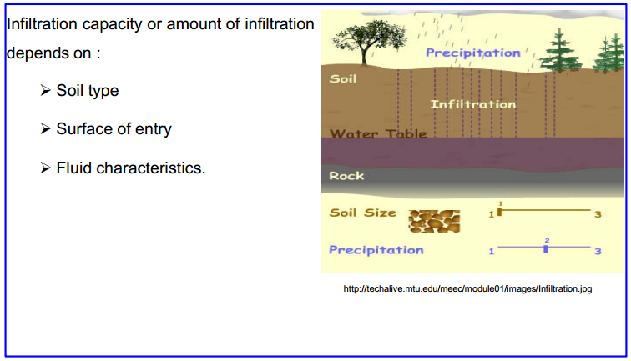
Factors affecting infiltration

Slide 4
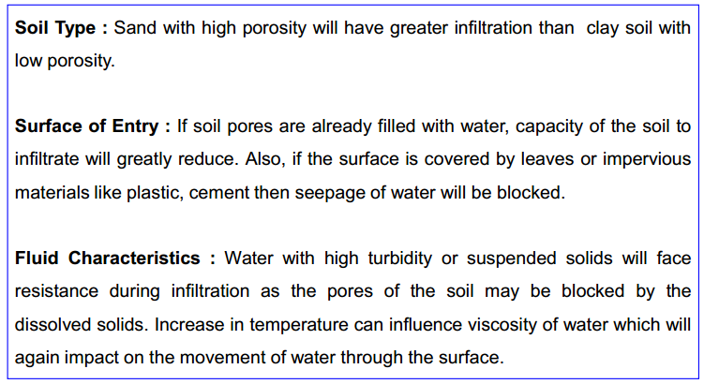
Factors affecting infiltration

Slide 5
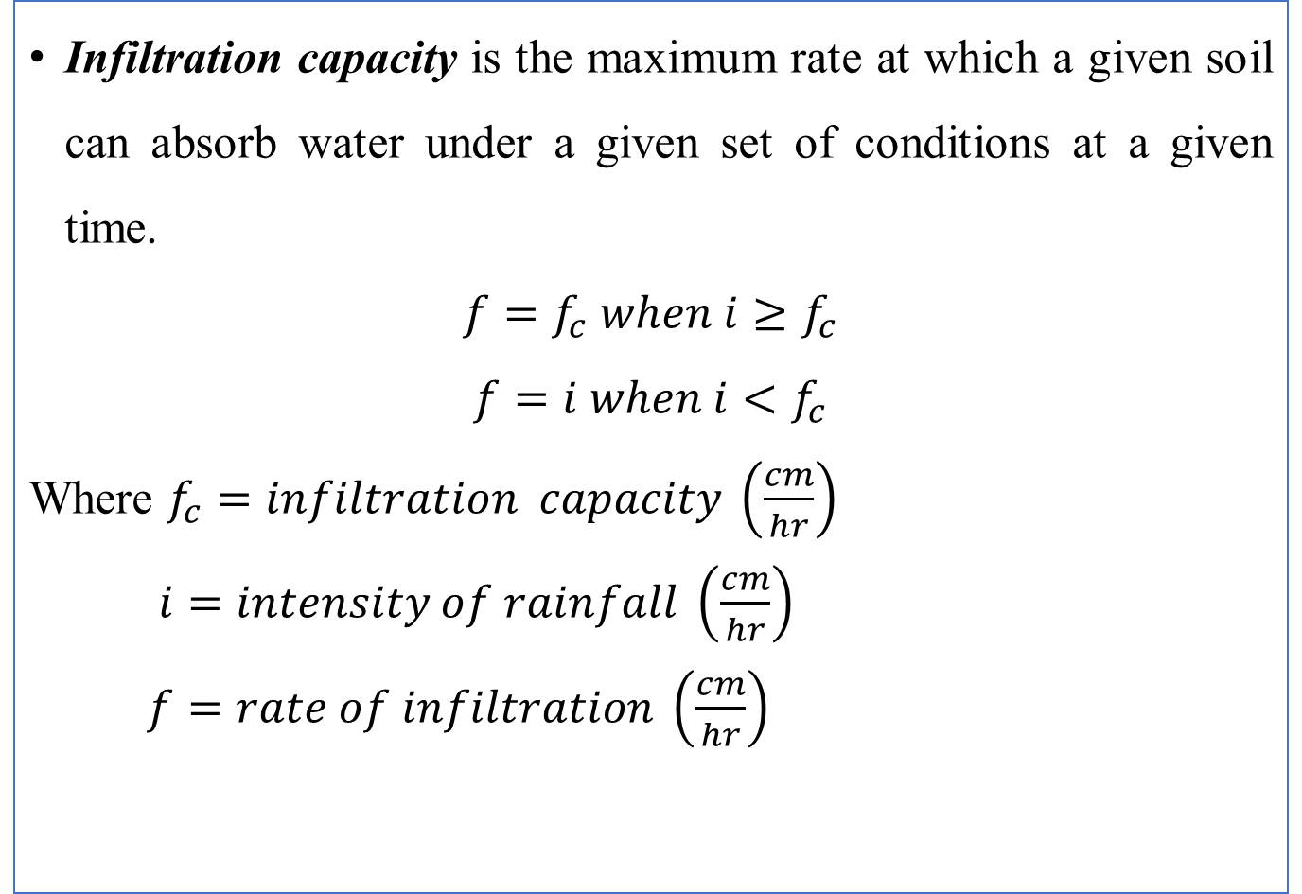
Infiltration rate
Infiltration capacity is the maximum rate at which a given soil can absorb water under a given set of conditions at a given time.
$$f=f_{c} when i≥f_{c}$$
$$f=i when i<f_{c}$$
Where $f_{c}=infiltration capacity \left(\frac{cm}{hr}\right)$
$i=intensity of rainfall \left(\frac{cm}{hr}\right)$
$f=rate of infiltration \left(\frac{cm}{hr}\right)$

Slide 6
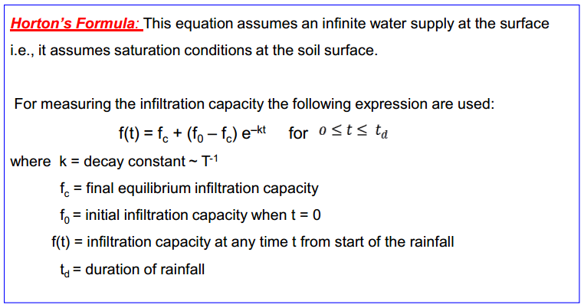
Infiltration rate

Slide 7
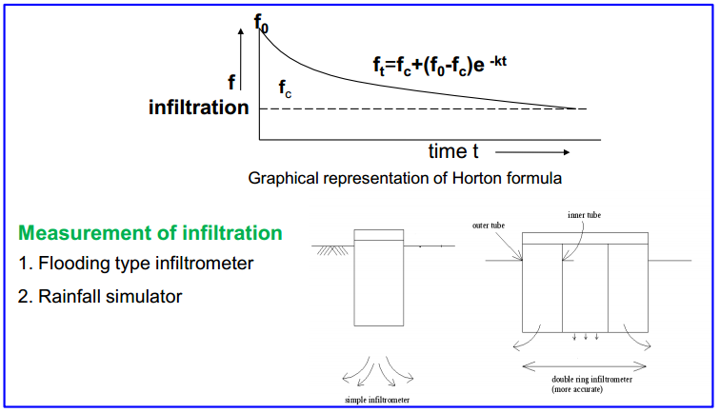
Infiltration rate

Slide 8
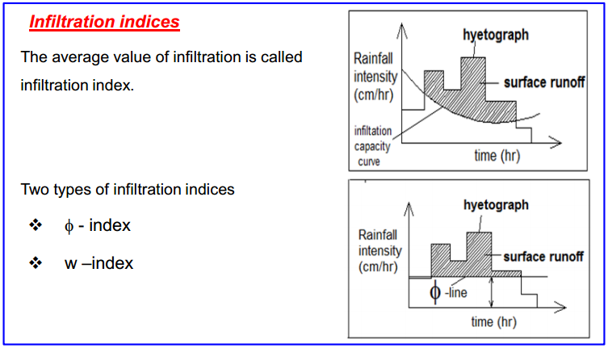
Measurement of infiltration
The average rate of rainfall above which the rainfall volume equals to runoff volume is called Φ-index.

Slide 9
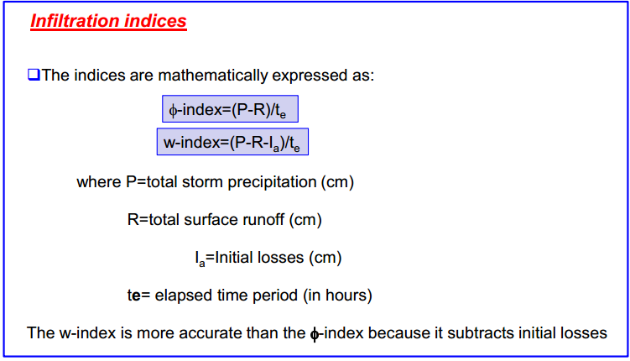
Measurement of infiltration

Slide 10
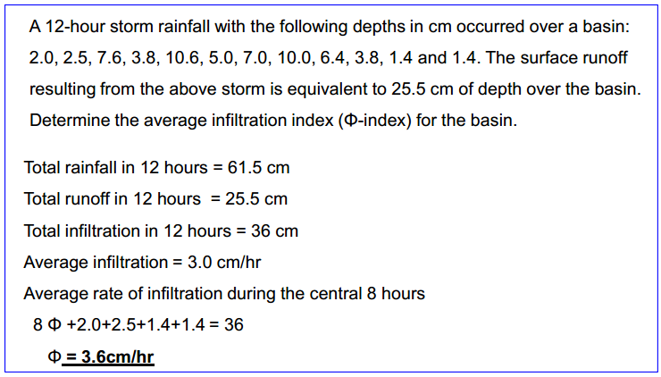
Example Problem

