Slide 1

CHAPTER ONE
INTRODUCTION
By Ayansa T. (B.Sc. In Met. And HYDR., M.Sc. in WRE)
Lecturer at Ambo University Woliso Campus, Civil Eng.

Slide 2
Introduction
Hydro+ logos (Both are Greek words)
“Hydro” means water and “logos” means study.
Hydrology is a science which deals with the occurrence, circulation and Distribution of water of the earth and earth’s atmosphere.
Hydrological Cycle: It is also known as water cycle.
  A Continuous process in which water is evaporated from water surfaces and the oceans, moves in land as moist air masses, and produces precipitation, if the correct vertical lifting conditions exist.

Slide 3
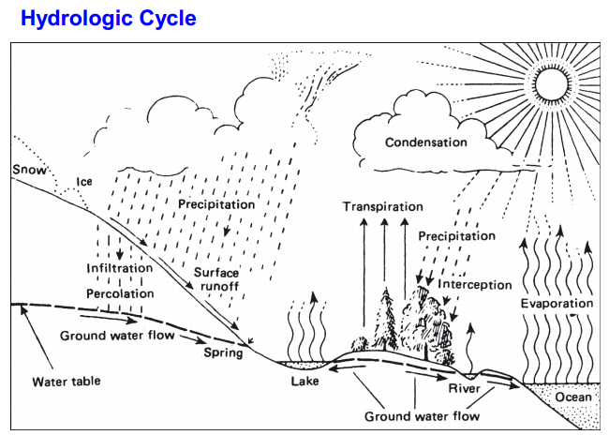

Slide 4
Stages of the Hydrologic cycle
  Precipitation
  Infiltration
  Interception
  Depression storage
  Run-off
  Evaporation
  Transpiration
  Groundwater

Slide 5

Water Budget/Balance Equation
The area of land draining into a stream or a watercourse at a given location is known as catchment area.
It is also called as drainage area or drainage basin.
For a given problem area, say a catchment, in an interval of time Δt, the continuity equation for water in its various phases is written as.

Slide 6
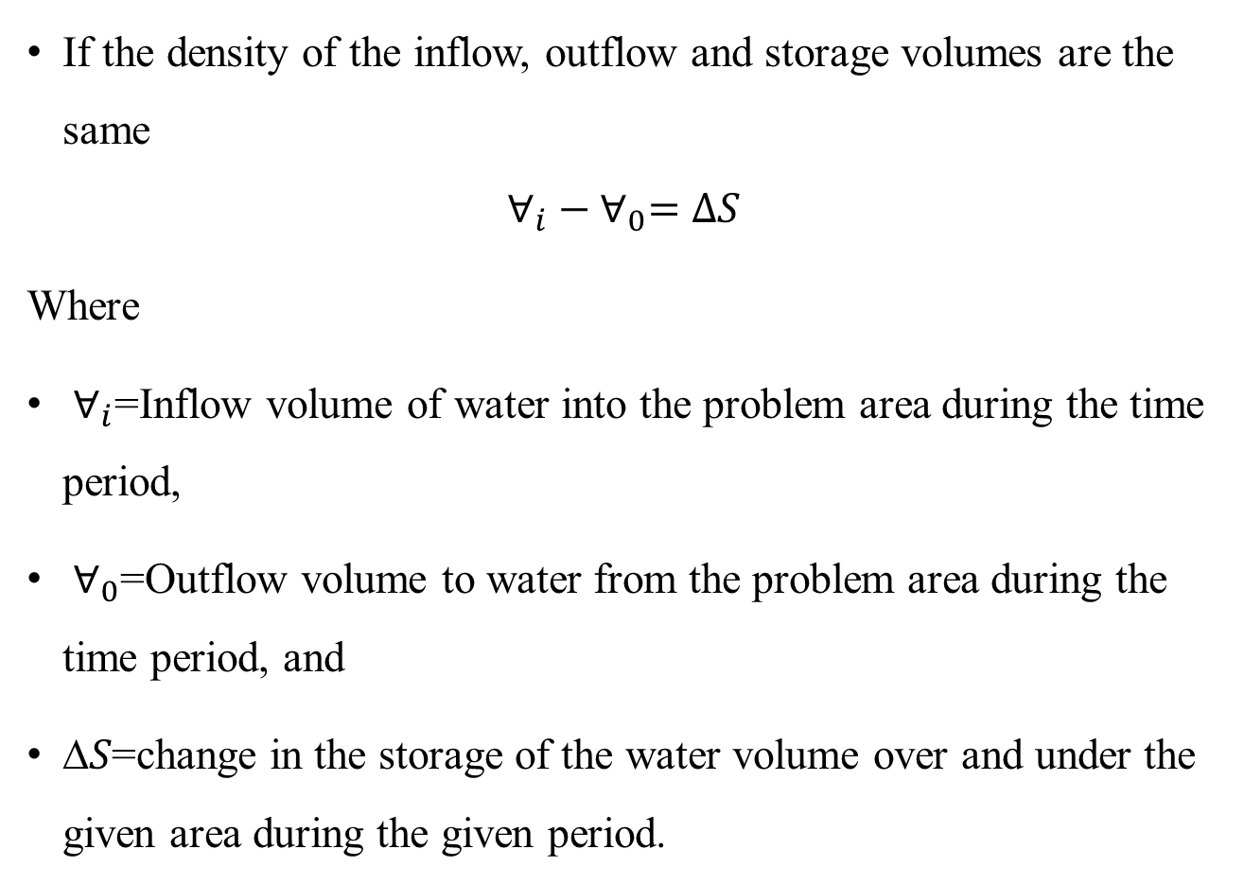
Water Budget/Balance Equation
If the density of the inflow, outflow and storage volumes are the same
$$∀_{i}−∀_{0}=∆S$$
Where
$∀_{i}$=Inflow volume of water into the problem area during the time period,
$∀_{0}$=Outflow volume to water from the problem area during the time period, and
∆𝑆=change in the storage of the water volume over and under the given area during the given period.

Slide 7
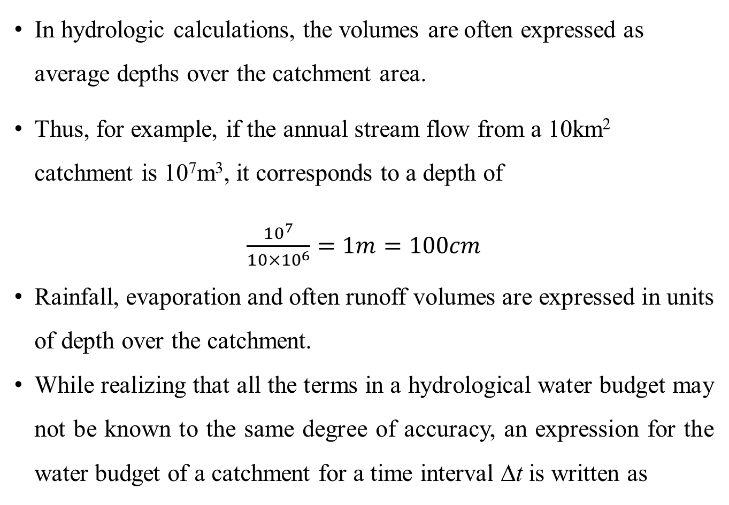
Water Budget/Balance Equation
In hydrologic calculations, the volumes are often expressed as average depths over the catchment area.
Thus, for example, if the annual stream flow from a 10km² catchment is 10⁷m³, it corresponds to a depth of
$\frac{{10}^{7}}{10×{10}^{6}}=1m=100cm$
Rainfall, evaporation and often runoff volumes are expressed in units of depth over the catchment.
While realizing that all the terms in a hydrological water budget may not be known to the same degree of accuracy, an expression for the water budget of a catchment for a time interval Δt is written as

Slide 8
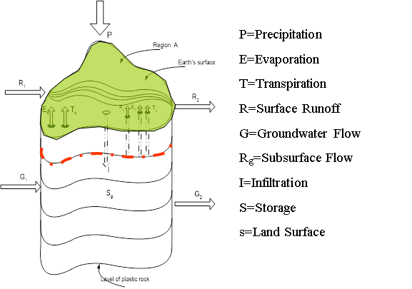

Slide 9
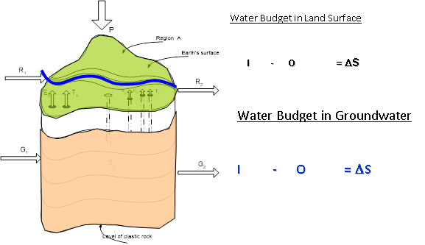

Slide 10
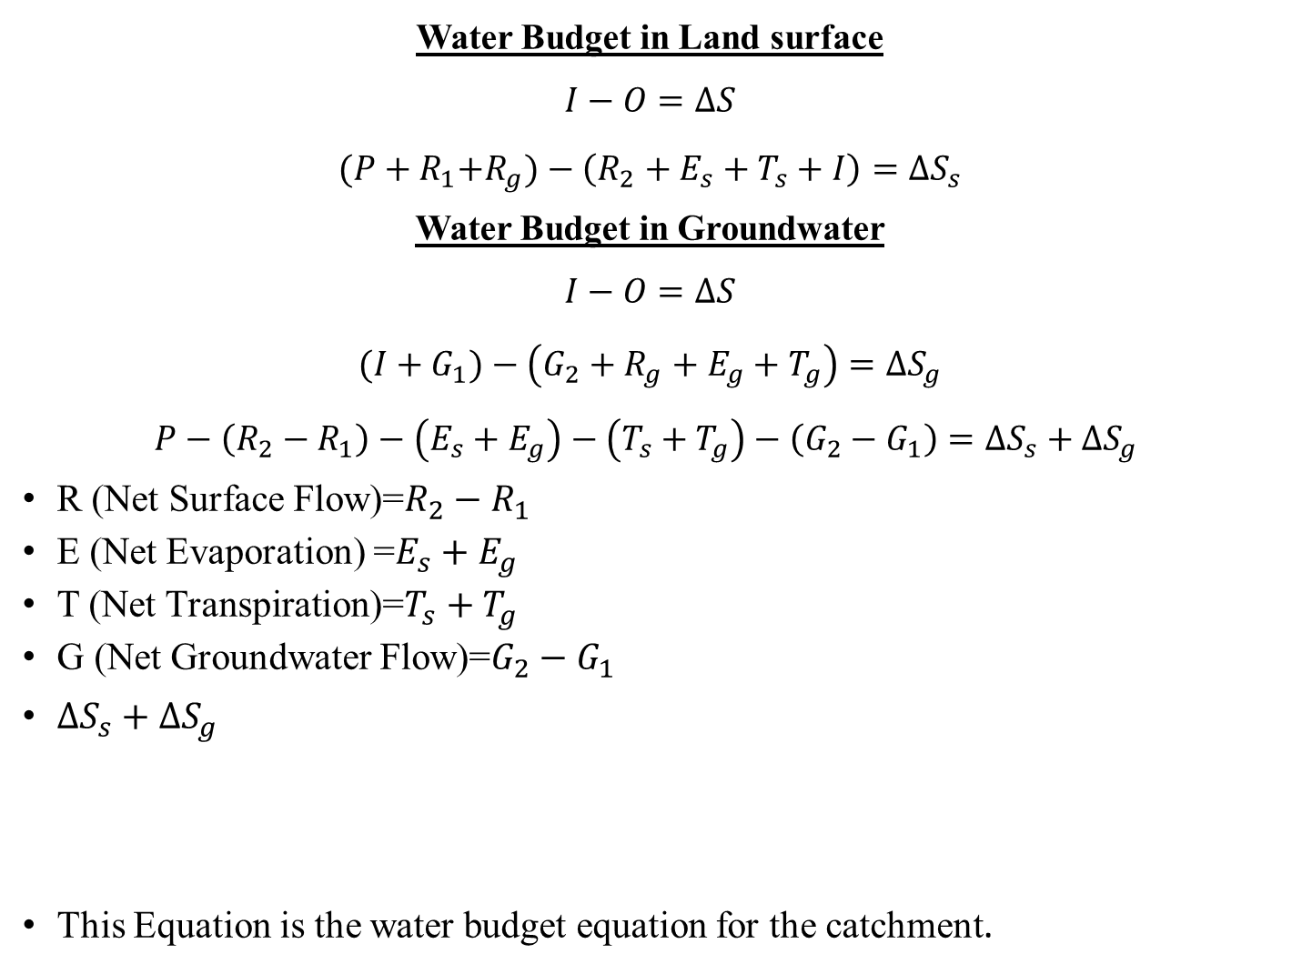
Water Budget in Land surface
$$I−O=∆S$$
$${(P+R}_{1}+R_{g})−\left(R_{2}+E_{s}+T_{s}+I\right)={∆S}_{s}$$
Water Budget in Groundwater
$$I−O=∆S$$
$${(I+G}_{1})−\left(G_{2}+R_{g}+E_{g}+T_{g}\right)={∆S}_{g}$$
$$P−\left(R_{2}−R_{1}\right)−\left(E_{s}+E_{g}\right)−\left(T_{s}+T_{g}\right)−\left(G_{2}−G_{1}\right)={∆S}_{s}+{∆S}_{g}$$
R (Net Surface Flow)=$R_{2}−R_{1}$
E (Net Evaporation) =$E_{s}+E_{g}$
T (Net Transpiration)=$T_{s}+T_{g}$
G (Net Groundwater Flow)=$G_{2}−G_{1}$
${∆S}_{s}+{∆S}_{g}$
This Equation is the water budget equation for the catchment.
P-R-E-T-G=ΔS

Slide 11
Water Budget/Balance Equation
Note that all these terms can be expressed as depth over the catchment area, (for Eq. in centimeters), and in fact this is a very common unit.
Further, the infiltration does not occur explicitly in the water budget as the infiltration, which is a loss to the runoff process is a gain to the ground water system.

Slide 12
Example 1: a lake had a water surface elevation of 103.200 m above datum at the beginning of a certain month. In that month the lake received
  an average inflow of 6.0 m³/s from surface runoff sources.
  In the same period the outflow from the lake had an average value of 6.5m³/s.
  Further, in that month, the lake received a rainfall of 145 mm and
  The evaporation from the lake surface was estimated as 6.10cm.
Write the water budget equation for the lake and calculate the water surface elevation of the lake at the end of the month.
The average lake surface area can be taken as 5000 ha. Assume that there is no contribution to or from the ground water storage.

Slide 13
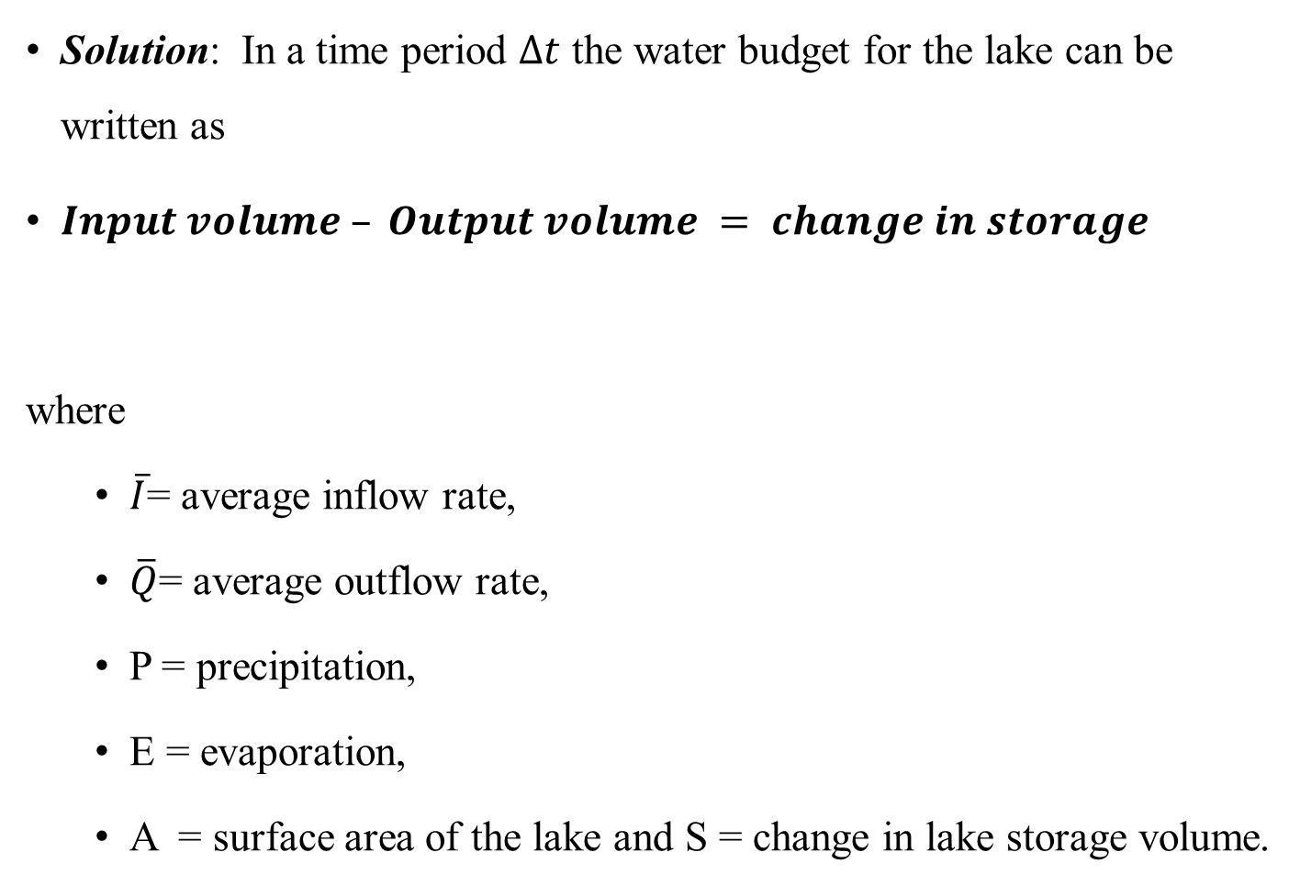
Water Budget/Balance Equation
Solution: In a time period $∆t$ the water budget for the lake can be written as
$Input volume – Output volume = change in storage$
where
  $\overline{I}$= average inflow rate,
  $\overline{Q}$= average outflow rate,
  P = precipitation,
  E = evaporation,
  A = surface area of the lake and S = change in lake storage volume.

