Slide 1
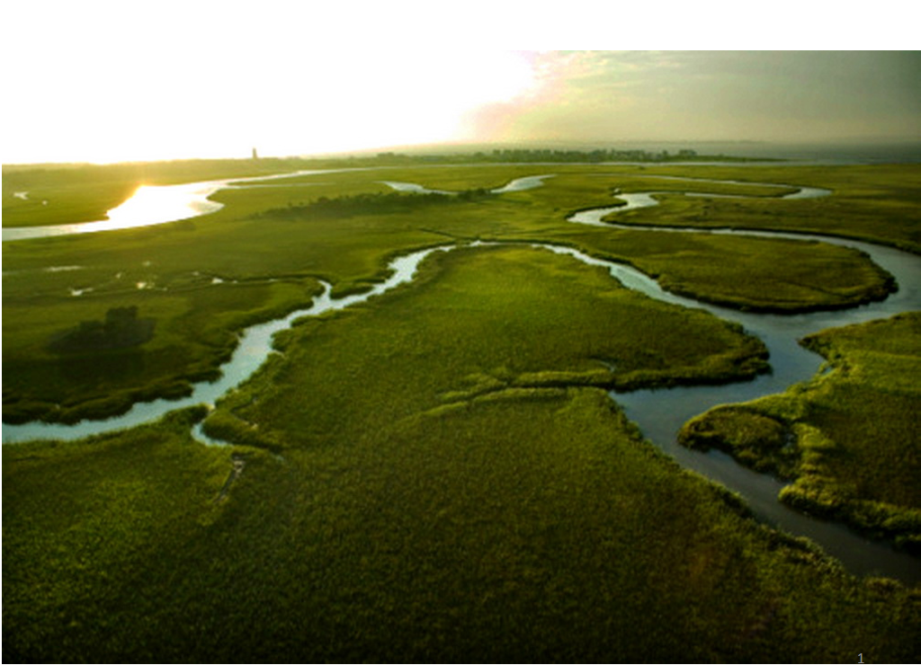
CHAPTER SIX
Rainfall-Runoff Relationships
By Mesfin M. (B.Sc. In WRIE, M.Sc. In WRE)

Slide 2
Introduction To Hydrological Models
Two classical types of hydrological models:
System
f(randomness, space, time)
Deterministic
Stochastic
Empirical
Lumped conceptual
Distributed physical based
Space Independent
Space correlated
Steady flow
Unsteady flow
Steady flow
Unsteady flow
Time Independent
Time Correlated
Time Independent
Time Correlated
OUTPUT
INPUT

Slide 3
Deterministic Hydrological Models
Permit only one outcome from a simulation with one set of inputs and parameter values.
Deterministic models use physical laws (such mass and momentum conservation).
Deterministic models can be either physically based (e.g. a model based on Saint-Venant equations for flood routing) and empirical (e.g. a rating curve used as a deterministic model for predicting a sediment load from water levels).
The three main groups of deterministic models:
  Empirical models (black box)
  Lumped conceptual models (grey box)
  Distributed process (physically) description based models (white box)

Slide 4
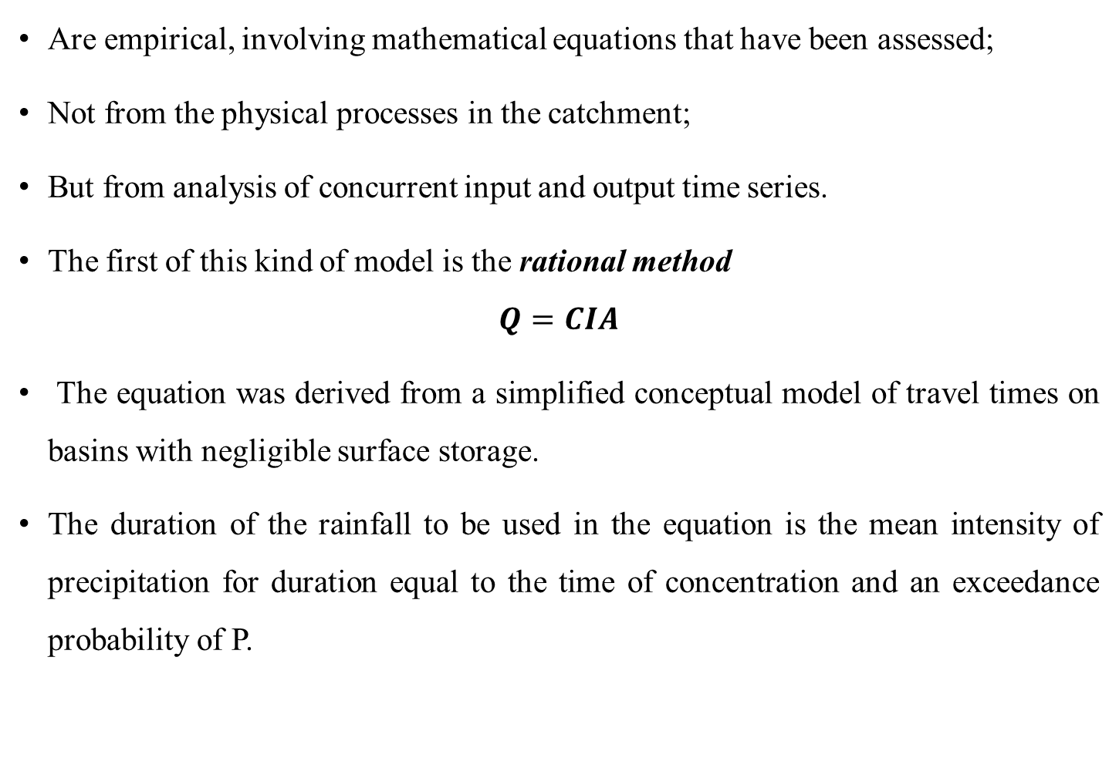
Empirical (Black Box) Models
Are empirical, involving mathematical equations that have been assessed;
Not from the physical processes in the catchment;
But from analysis of concurrent input and output time series.
The first of this kind of model is the rational method
$$Q=CIA$$
The equation was derived from a simplified conceptual model of travel times on basins with negligible surface storage.
The duration of the rainfall to be used in the equation is the mean intensity of precipitation for duration equal to the time of concentration and an exceedance probability of P.

Slide 5
The model reflects the way in which discharges are expected to increase with area, land use and rainfall intensity in a rational way.
The scaling parameter C reflects the fact that not all the rainfall becomes discharge.
In addition, the constant C is required to take account of the nonlinear relationship between antecedent conditions and the profile of storm rainfall and the resulting runoff production.
Thus, C is not a constant parameter, but varies from storm to storm on the same catchment, and from catchment to catchment for similar storms.

Slide 6
Lumped Conceptual Models
Treat the catchment as a single unit, with state variables that represent average values over the catchment area, such as storage in the saturated zone.
Description of the hydrological processes cannot be based directly on the equations that are supposed to be valid for the individual soil columns.
Hence, the equations are semi-empirical, but still with a physical basis.
Therefore, the model parameters cannot usually be assessed from field data alone, but have to be obtained through the help of calibration.
Treat precipitation input as uniform over a watershed and ignore the internal spatial variation of watershed flow.

Slide 7
Distributed Physical Based Models
Produce models based on the governing equations describing all the surface and subsurface flow processes in the catchment.
Distributed models have the possibility of defining parameter values for every element in the solution mesh.
They give a detailed and potentially more correct description of the hydrological processes in the catchment than do the other model types.
The process equations require many different parameters to be specified for each element and made the calibration difficult in comparison with the observed responses of the catchment.

Slide 8
The distributed process description based models can in principle be applied to almost any kind of hydrological problem.
Changes in land use, such as deforestation or urbanization often affect only part of a catchment area.
With a distributed model it is possible to examine the effects of such land use changes.
Considers hydrological processes taking place at various point in space and defines the model variables as a function of space dimensions.

Slide 9
Stochastic Time Series Models
Stochastic models allow for some randomness or uncertainty in the possible outcomes due to uncertainty in input variables, boundary conditions or model parameters.
Traditionally, a stochastic model is derived from a time series analysis of the historical record.
Used for the generation of long hypothetical sequences of events with the same statistical properties as the historical record.
In this technique several synthetic series with identical statistical properties are generated.

Slide 10
Stochastic Time Series Models
These generated sequences of data can then be used in the analysis of design variables and their uncertainties, for example, when estimating reservoir storage requirements.
Do not consider errors in model outcomes explicitly
We consider the hydrological variable as one for which we cannot know exact value (random variable), but for which we can calculate the probability distribution.
Model that provide probability distributions of target variables instead of single values are called stochastic models.

Slide 11
In Deterministic every set of variable states is uniquely determined by parameters in the model and by sets of previous states of these variables.
Therefore, deterministic models perform the same way for a given set of initial conditions.
In a stochastic model, randomness is present, and variable states are not described by unique values, but rather by probability distributions.

Slide 12
Although all hydrological phenomena involve some randomness, the resulted variability in the output may be quite small when compared to the variability resulting from known factors. In such cases, a deterministic model is appropriate
If the random variation is large, a stochastic models is more suitable, b/c the actual output could be quite different
Deterministic models of daily evaporation at a given location can be developed using energy supply and vapor transplant data
But such data cannot be used to make reliable models of daily precipitation at that location b/c precipitation is largely random.
Consequently, most daily precipitation models are stochastic.

Slide 13
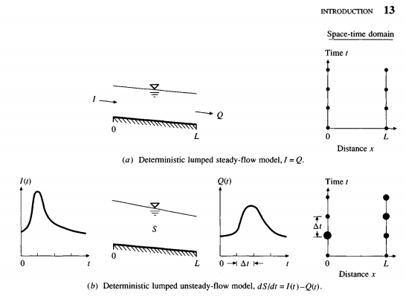

Slide 14
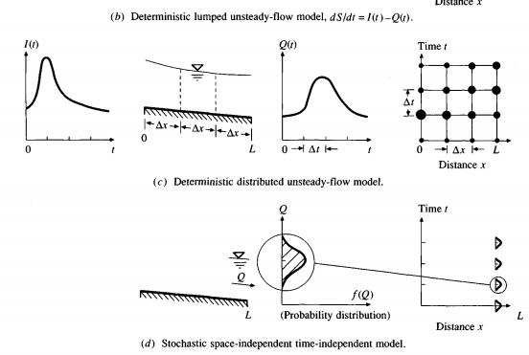

Slide 15
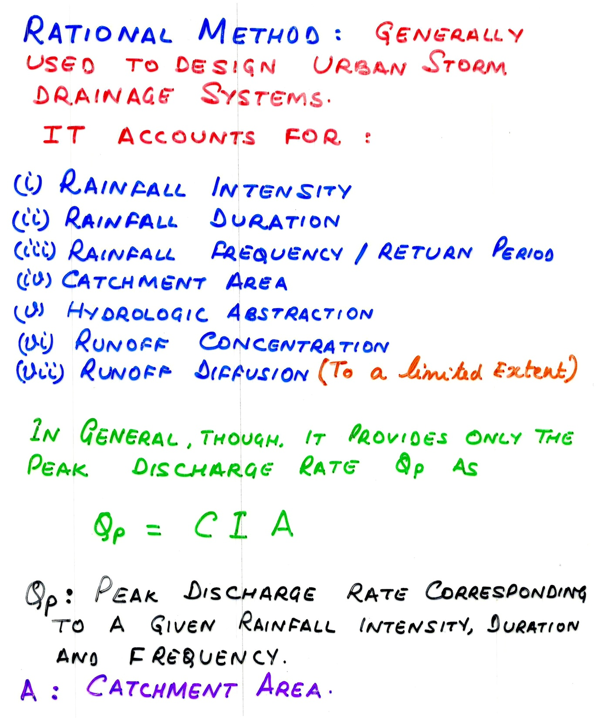
Rational Method

Slide 16
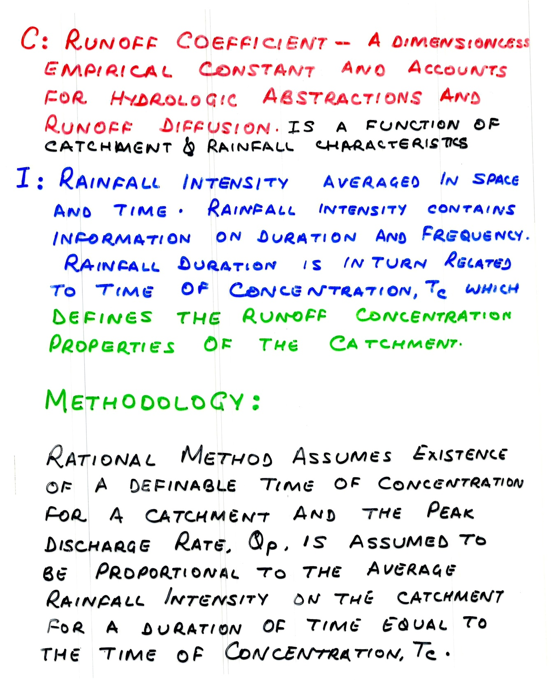

Slide 17
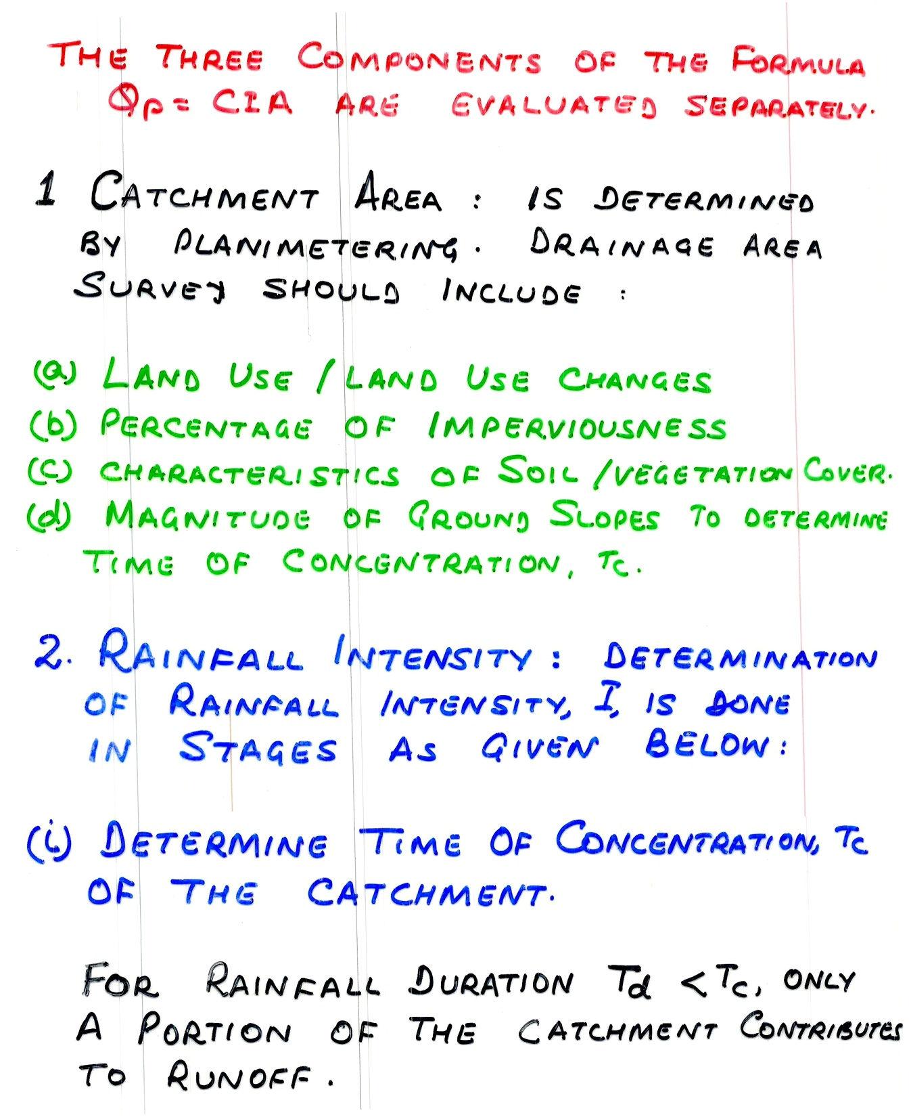

Slide 18
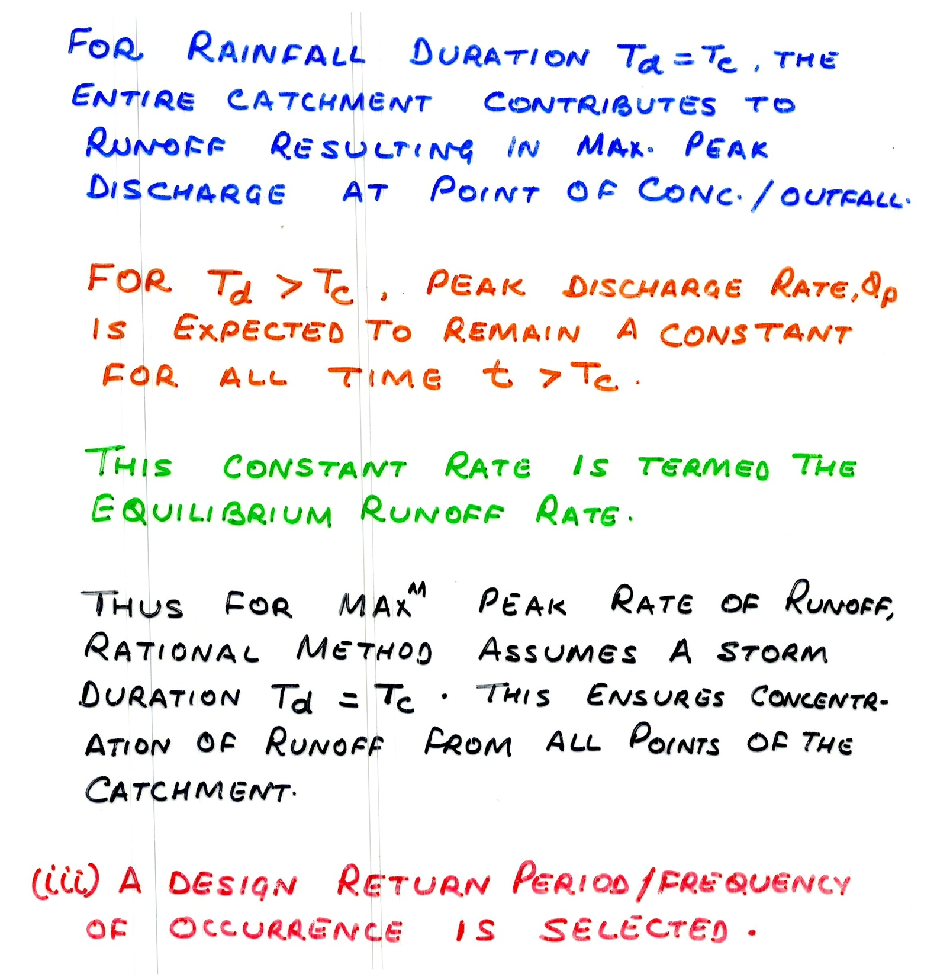

Slide 19
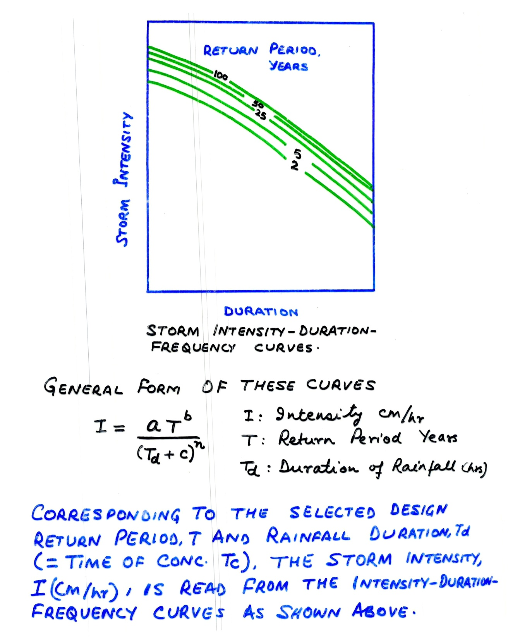

Slide 20
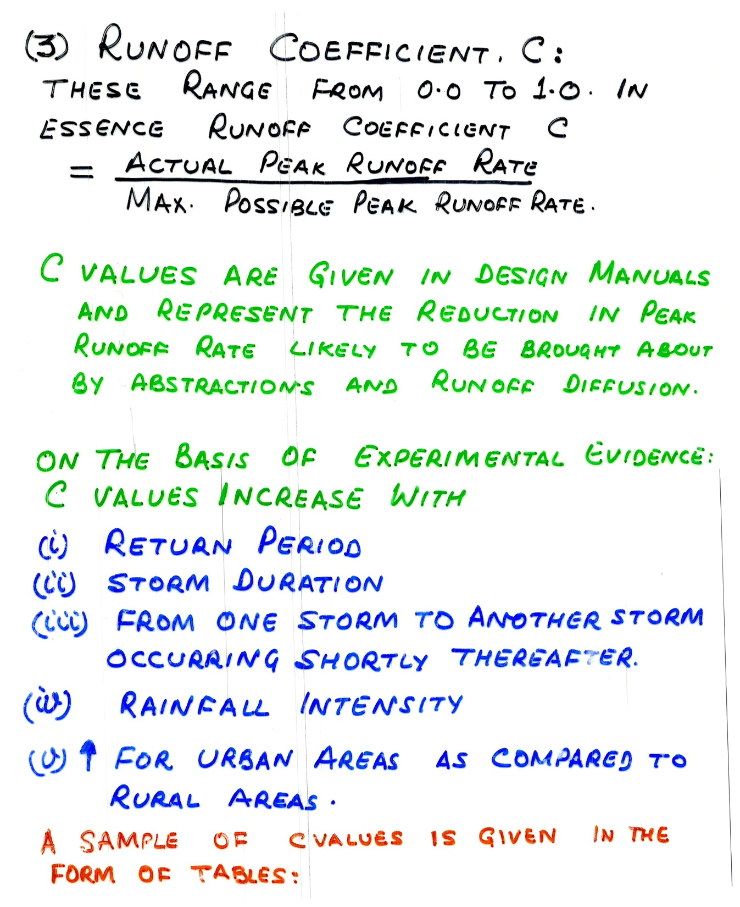

Slide 21
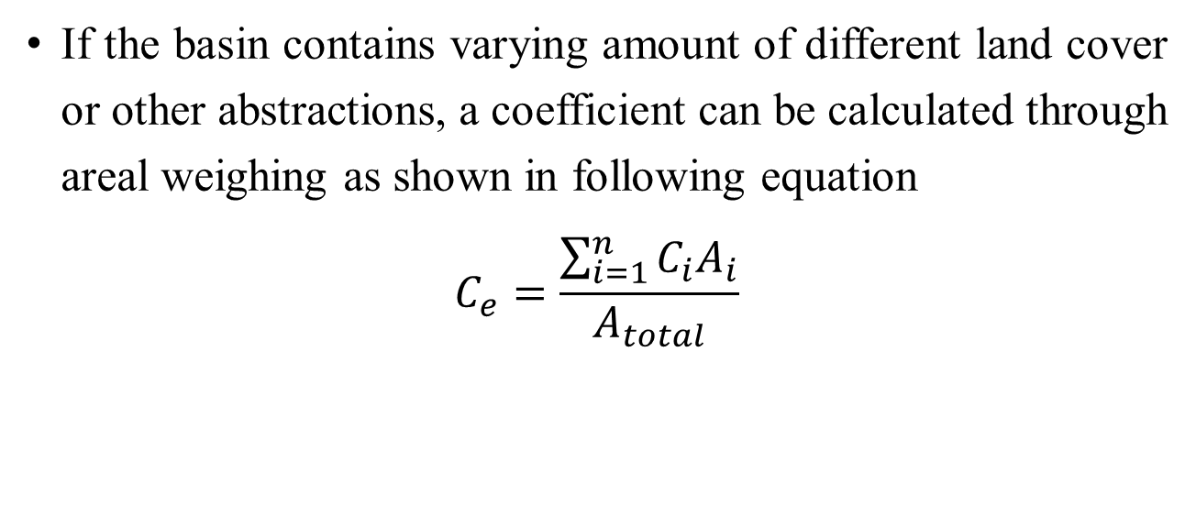
If the basin contains varying amount of different land cover or other abstractions, a coefficient can be calculated through areal weighing as shown in following equation
$$C_{e}=\frac{\sum_{i=1}^{n}{C_{i}A_{i}}}{A_{total}}$$

Slide 22
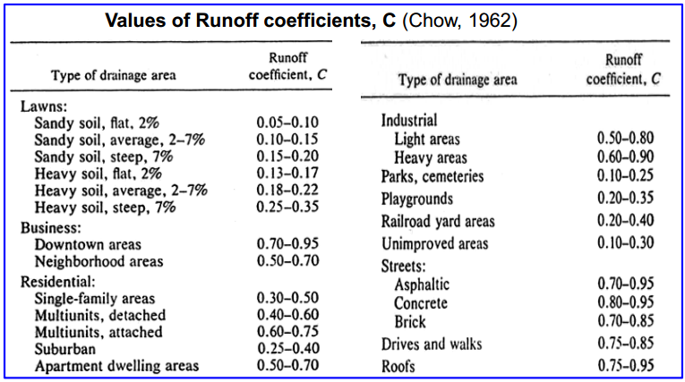

Slide 23
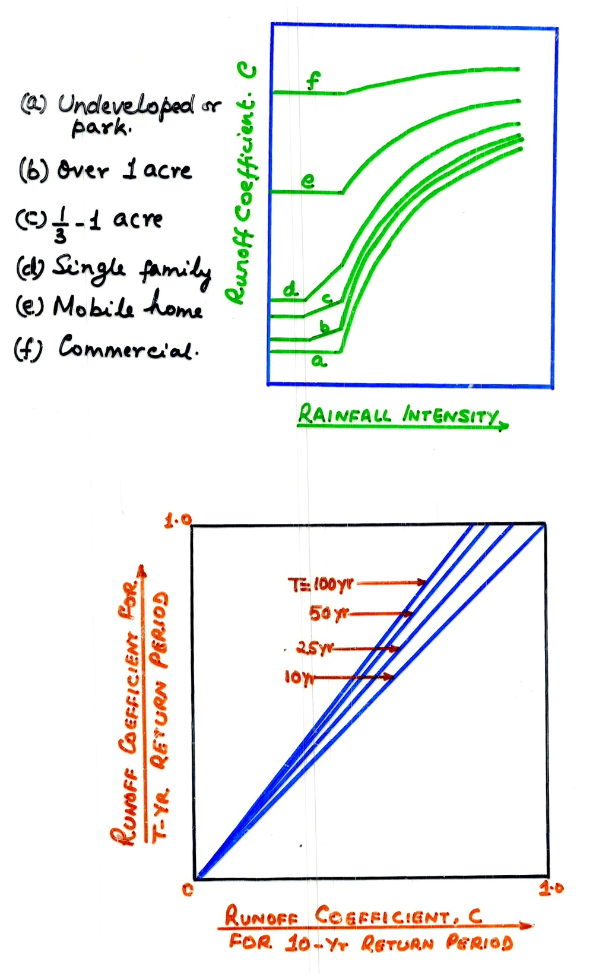

Slide 24
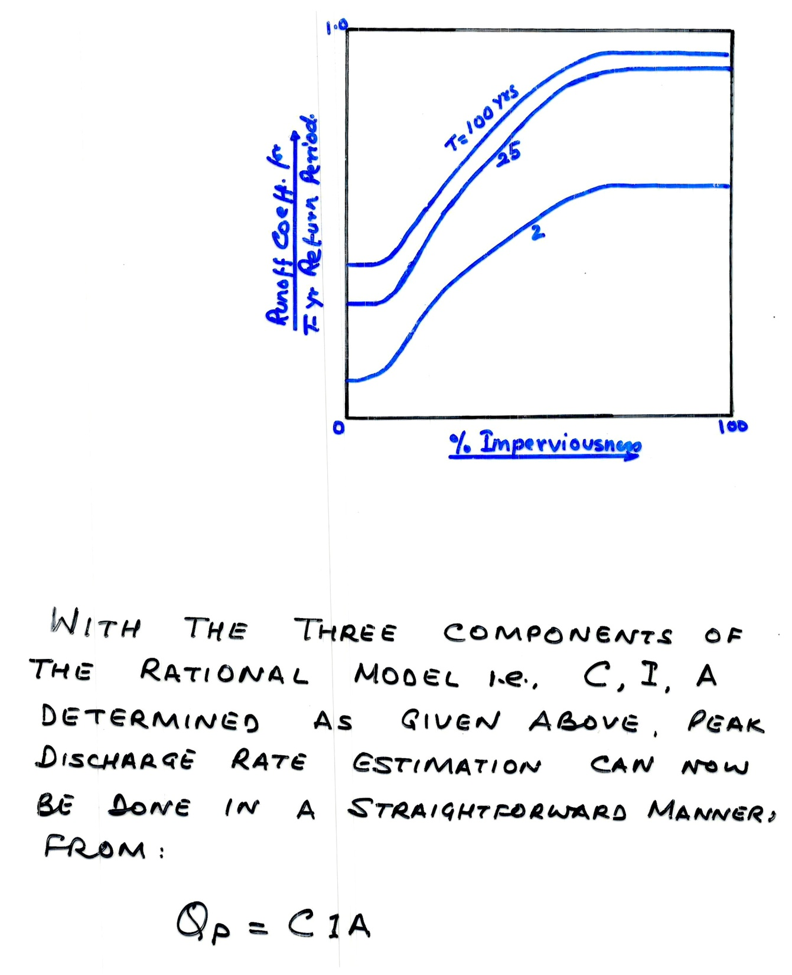

Slide 25
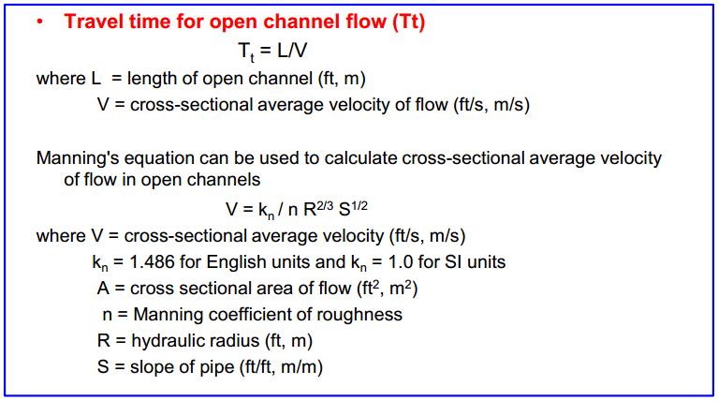

Slide 26
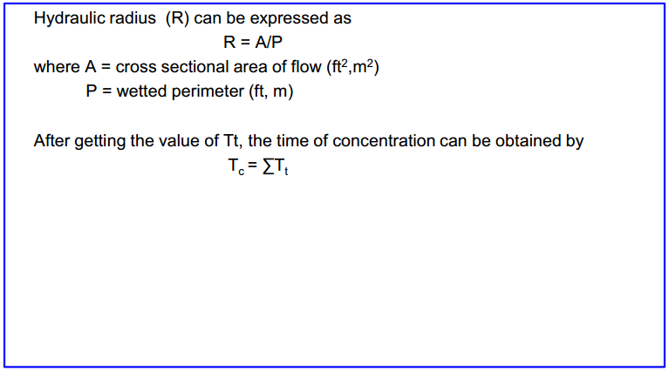

Slide 27
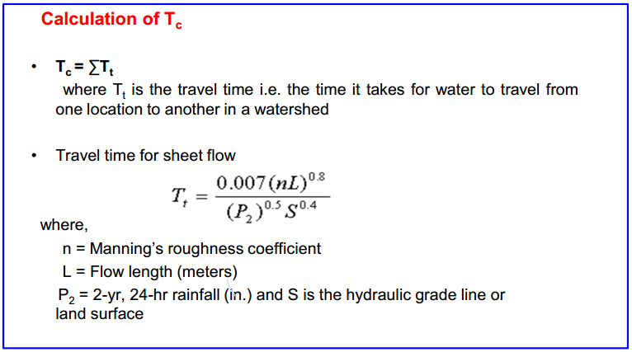

Slide 28
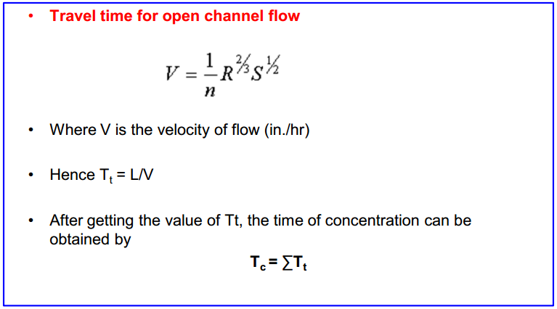

Slide 29
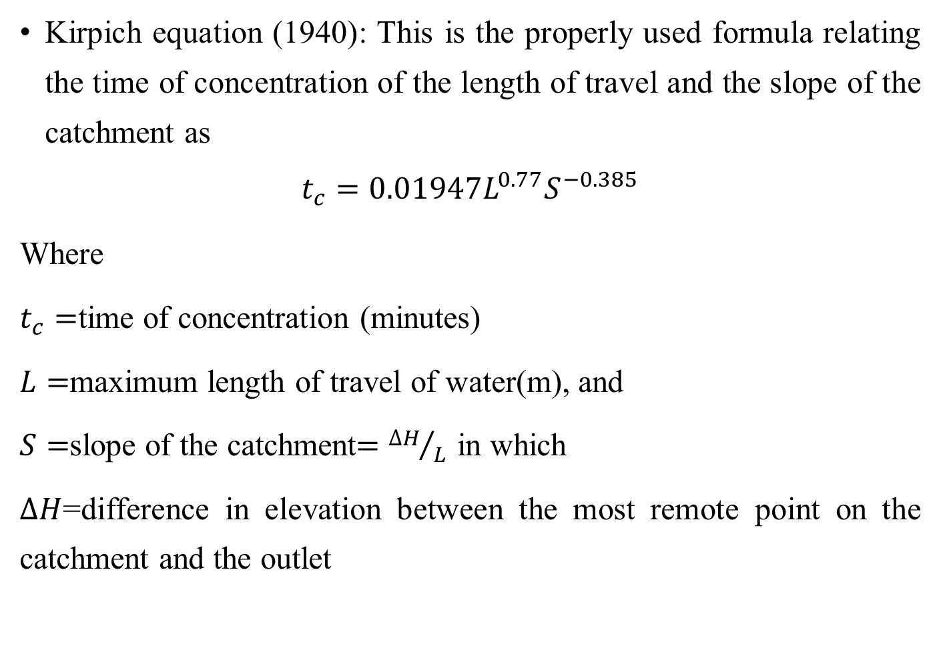
Kirpich equation (1940): This is the properly used formula relating the time of concentration of the length of travel and the slope of the catchment as
$$t_{c}=0.01947L^{0.77}S^{−0.385}$$
Where
$t_{c}=$time of concentration (minutes)
$L=$maximum length of travel of water(m), and
$S=$slope of the catchment$={∆H}/L$ in which
$∆H$=difference in elevation between the most remote point on the catchment and the outlet

Slide 30
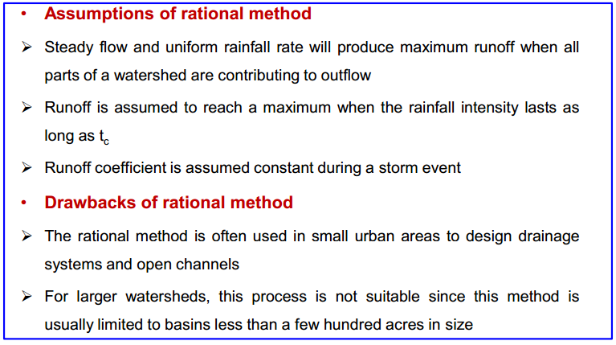

Slide 31
Example 1: An urban catchment has an area of 85ha. The slope of the catchment is 0.006 and the maximum of travel of water is 950m. The maximum depth of rainfall with a 25-year return period is as follows.
If the culvert for drainage at the outlet of this area is to be designed for a return period of 25years, estimate the required peak flow rate, by assuming the coefficient as 0.3.

Slide 32
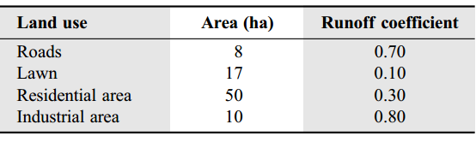
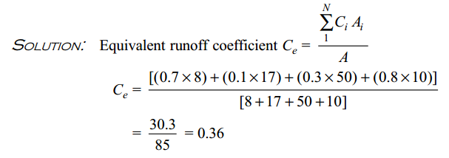
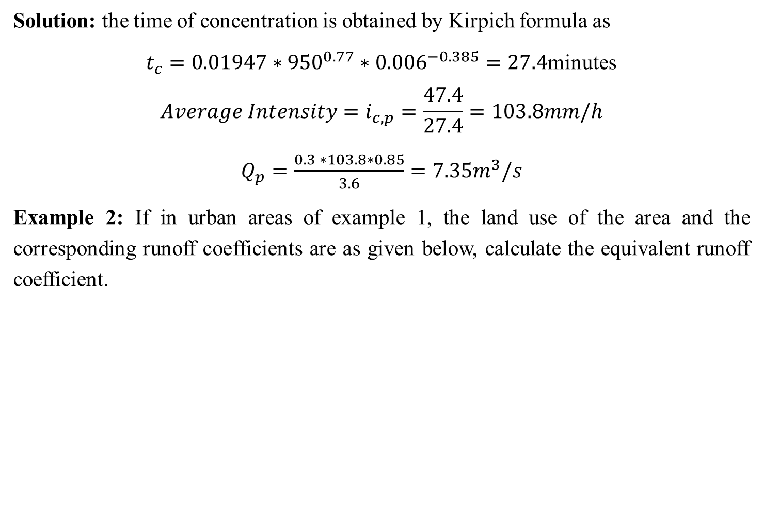
Solution: the time of concentration is obtained by Kirpich formula as
$t_{c}=0.01947∗{950}^{0.77}∗{0.006}^{−0.385}=27.4$minutes
$$Average Intensity=i_{c,p}=\frac{47.4}{27.4}=103.8mm/h$$
$Q_{p}=\frac{0.3 ∗103.8∗0.85}{3.6}=7.35m^{3}/s$
Example 2: If in urban areas of example 1, the land use of the area and the corresponding runoff coefficients are as given below, calculate the equivalent runoff coefficient.

Slide 33
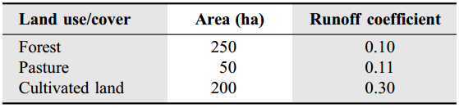
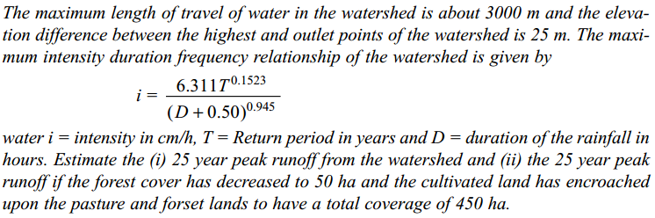
Example 3: A 500ha watershed has the land use/ cover and the corresponding runoff coefficient as given below:

Slide 34
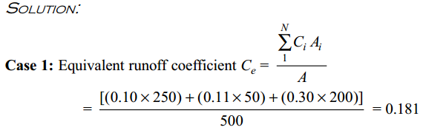
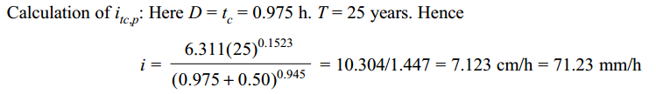

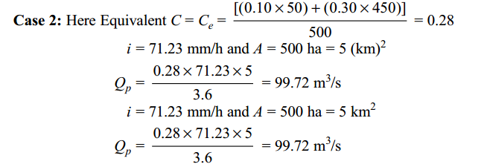

$t_{c}=0.01947L^{0.77}S^{−0.385}$=58.5min=0.975hr
$$=17.9m^{3}/s$$
$$27.7m^{3}/s$$

Slide 35
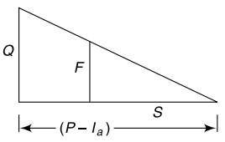
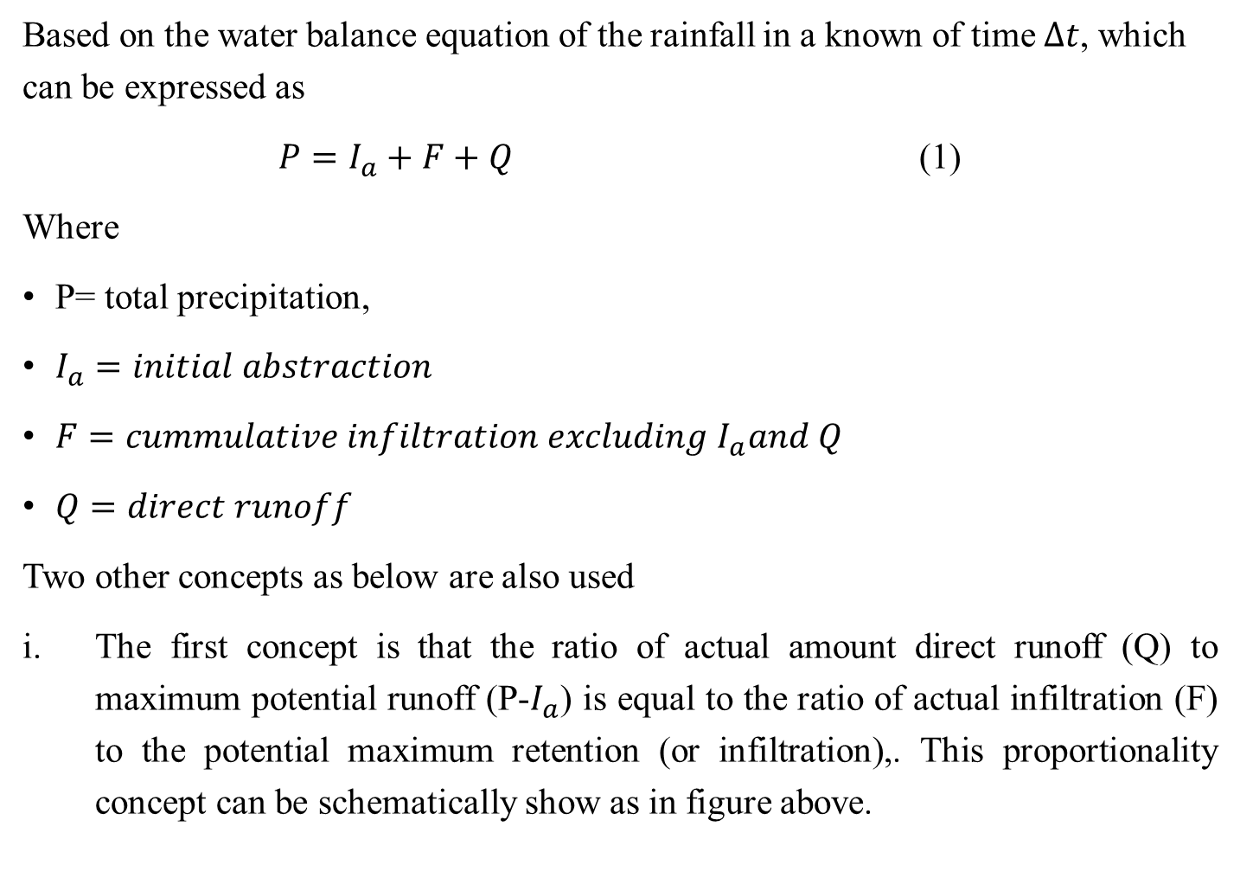
  SCS Curve Number Method
Based on the water balance equation of the rainfall in a known of time $∆t$, which can be expressed as
$P=I_{a}+F+Q$ (1)
Where
P= total precipitation,
$I_{a}=initial abstraction$
$F=cummulative infiltration excluding I_{a}and Q$
$Q=direct runoff$
Two other concepts as below are also used
The first concept is that the ratio of actual amount direct runoff (Q) to maximum potential runoff (P-$I_{a}$) is equal to the ratio of actual infiltration (F) to the potential maximum retention (or infiltration),. This proportionality concept can be schematically show as in figure above.

Slide 36
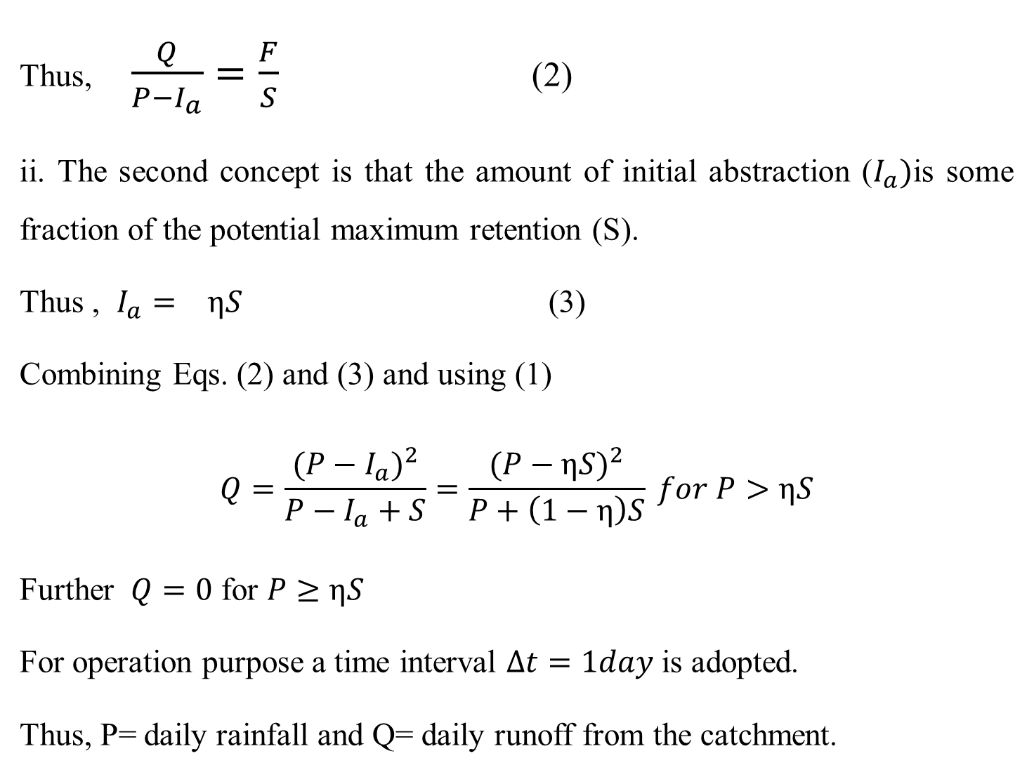
Thus, $\frac{Q}{P−I_{a}}=\frac{F}{S}$ (2)
ii. The second concept is that the amount of initial abstraction ($I_{a})$is some fraction of the potential maximum retention (S).
Thus , $I_{a}=  ηS$ (3)
Combining Eqs. (2) and (3) and using (1)
$$Q=\frac{(P−I_{a})^{2}}{P−I_{a}+S}=\frac{{(P−ηS)}^{2}}{P+\left(1−η\right)S} for P>ηS$$
Further $Q=0$ for $P≥ηS$
For operation purpose a time interval $∆t=1day$ is adopted.
Thus, P= daily rainfall and Q= daily runoff from the catchment.

Slide 37
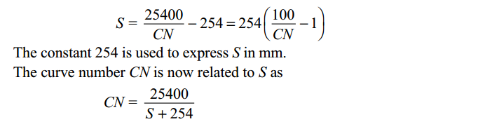
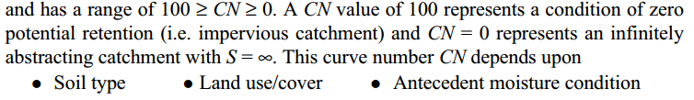
Curve number (CN): The parameter S representing the potential maximum retention depends upon the soil-vegetation-landuse complex of the catchment and also upon the antecedent moisture condition in the catchment just prior to the commencement of the rainfall event.
For convenience in practical application the soil conservation services (SCS) of USA has expressed S (in mm) in terms of a dimensionless parameter CN (Curve Number) as

Slide 38
Soils: In the determination of CN, the hydrological soil classification adopted.
Here, soils are classified into four classes:
  Group-A: (Low Runoff Potential)
  Group-B: (Moderately Low Runoff Potential)
  Group-C: (Moderately High Runoff Potential)
  Group-D: (High Runoff Potential)
Antecedent moisture condition (AMC): Refers to the moisture content present in the soil at the beginning of the rainfall-runoff event under consideration
It is well known that initial abstraction three levels of AMC are recognized by SCS as follows:
AMC-I: Soils are dry but not wilting point. Satisfactory cultivation has taken place.
AMC-II: Average conditions
AMC-III: sufficient rainfall has occurred within the immediate past 5 days. Saturated soil conditions prevail.

Slide 39
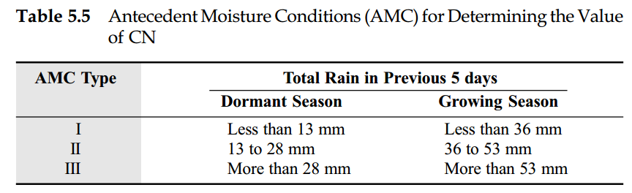
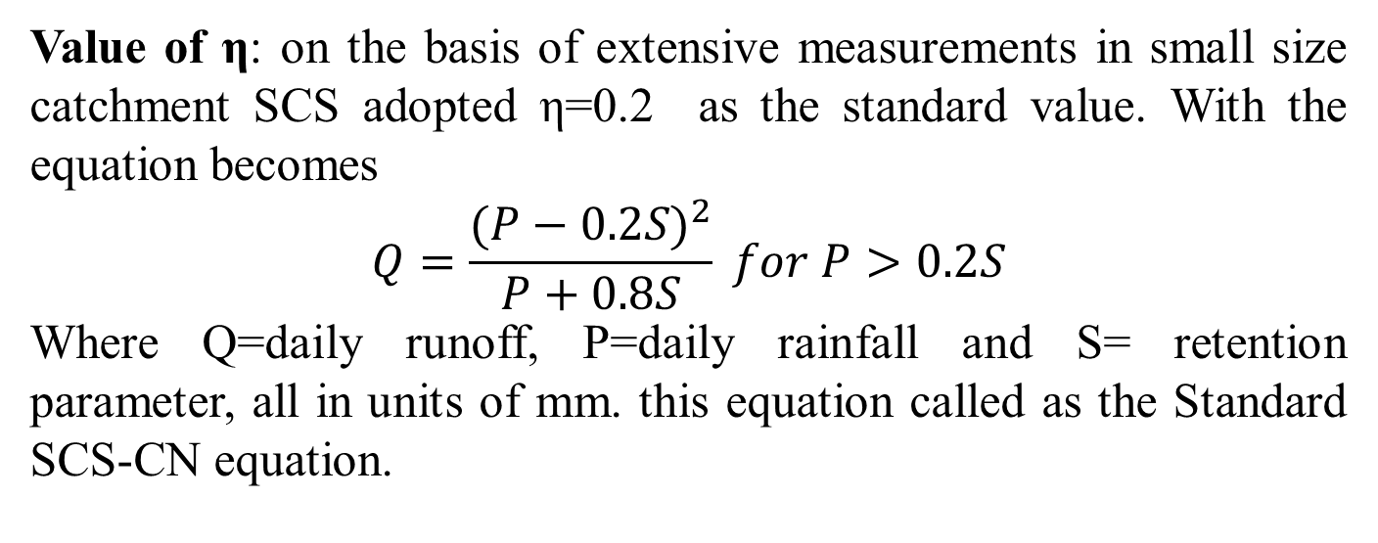
Antecedent moisture conditions (AMC) for determining the value of CN
Value of η: on the basis of extensive measurements in small size catchment SCS adopted η=0.2 as the standard value. With the equation becomes
$$Q=\frac{{(P−0.2S)}^{2}}{P+0.8S} for P>0.2S$$
Where Q=daily runoff, P=daily rainfall and S= retention parameter, all in units of mm. this equation called as the Standard SCS-CN equation.

Slide 40
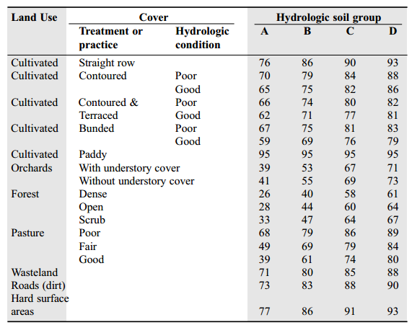
Run off curve numbers (CN_{II}) for hydrological soil cover complexes under AMC-II conditions

Slide 41

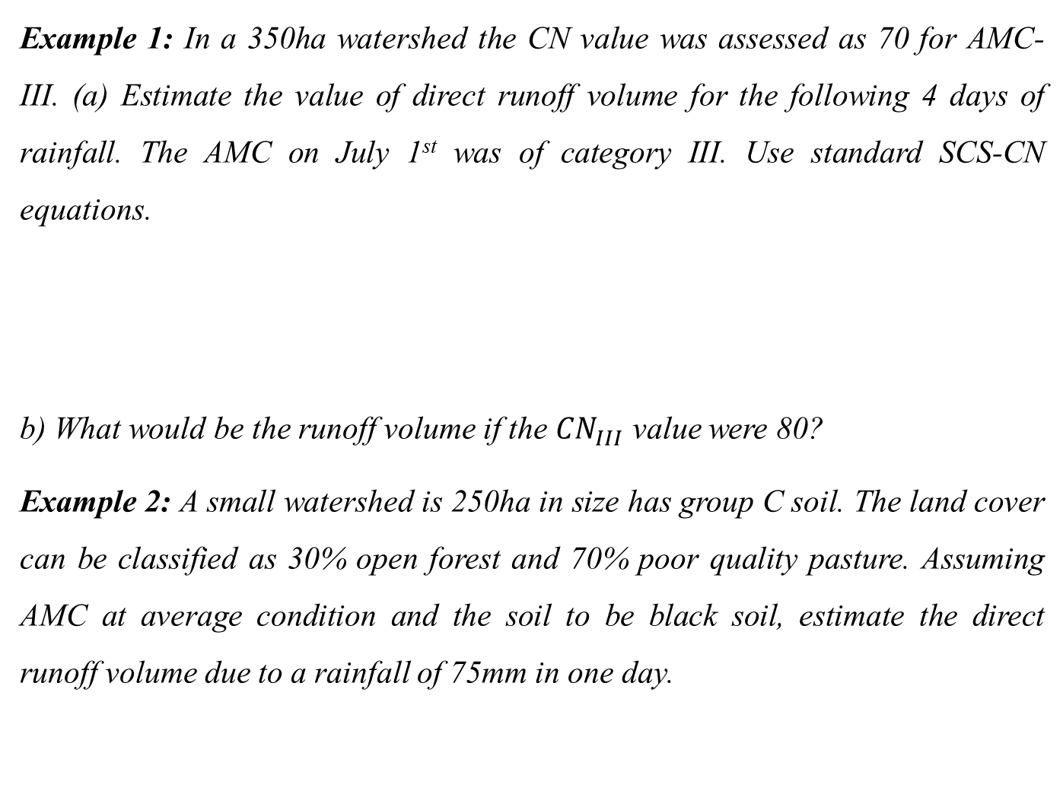
Example 1: In a 350ha watershed the CN value was assessed as 70 for AMC-III. (a) Estimate the value of direct runoff volume for the following 4 days of rainfall. The AMC on July 1st was of category III. Use standard SCS-CN equations.
b) What would be the runoff volume if the ${CN}_{III}$ value were 80?
Example 2: A small watershed is 250ha in size has group C soil. The land cover can be classified as 30% open forest and 70% poor quality pasture. Assuming AMC at average condition and the soil to be black soil, estimate the direct runoff volume due to a rainfall of 75mm in one day.

Slide 42
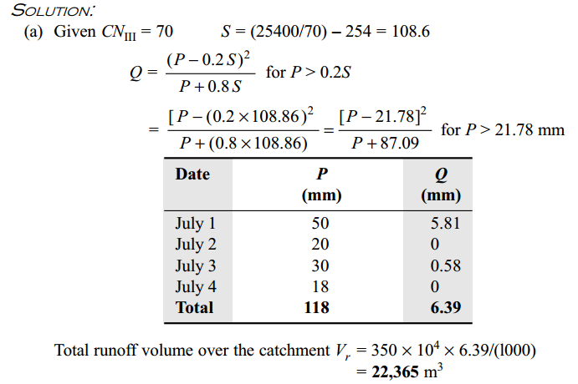

Slide 43
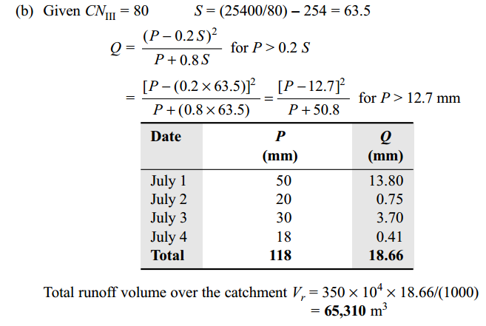

Slide 44
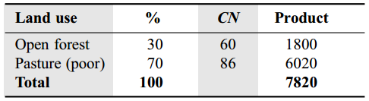
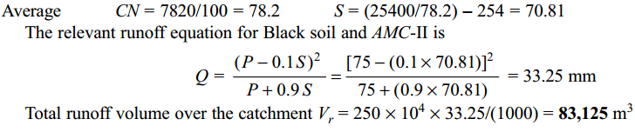
Solution Example-2
Referring to the table for C-group soil.

Slide 45
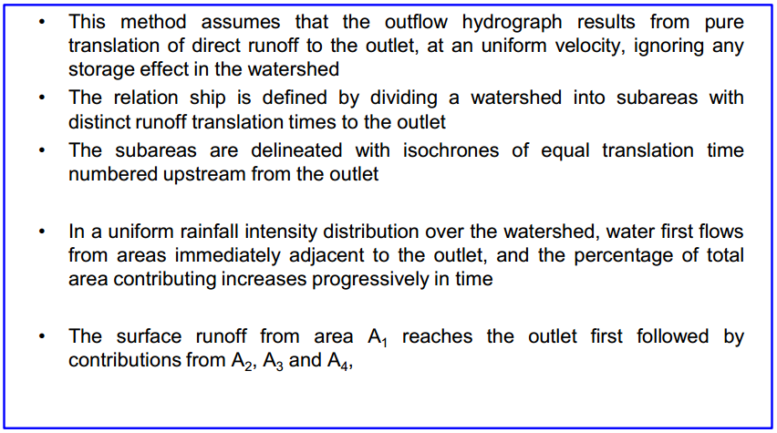
Time-Area method

Slide 46
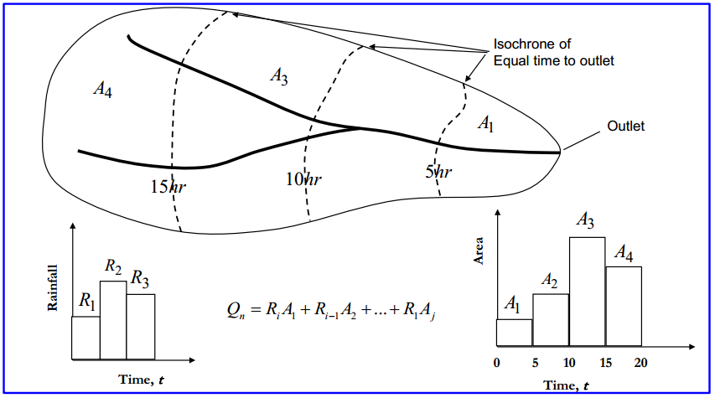

Slide 47
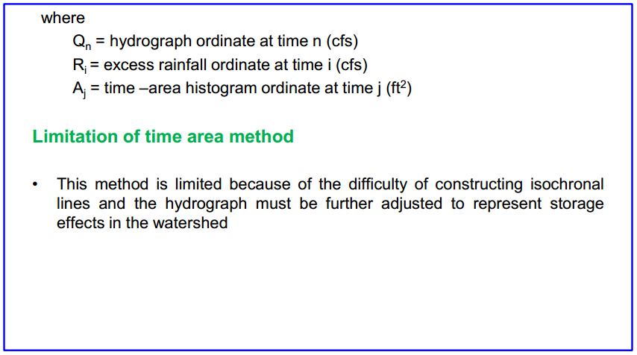

Slide 48
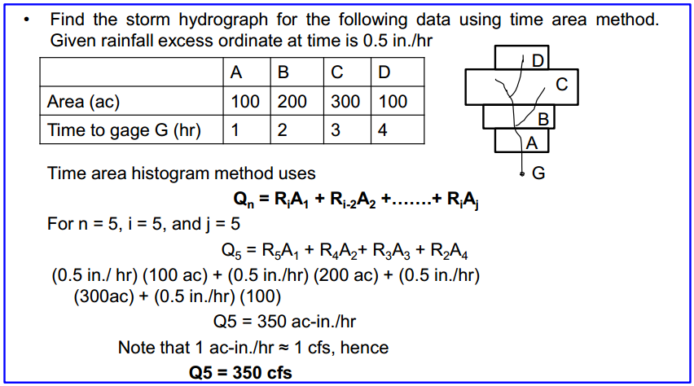
Example Problem

Slide 49
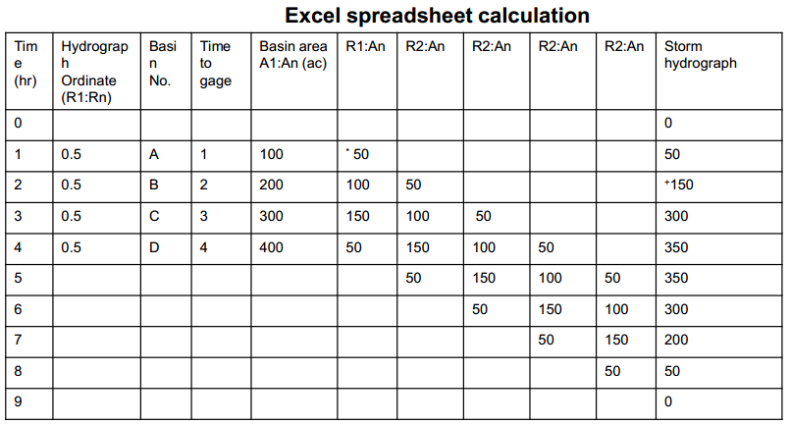

Slide 50
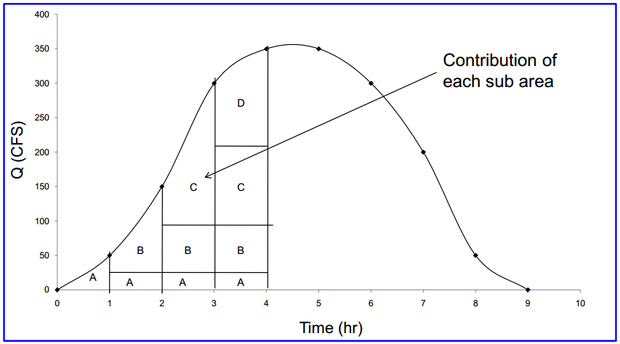

Slide 51
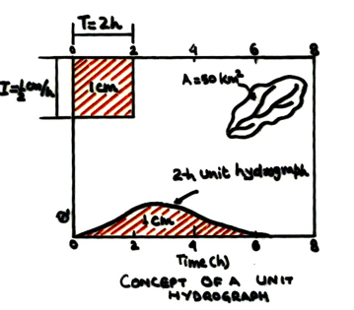
Unit hydrograph (UH)
Defined as the hydrograph produced by unit depth of excess rainfall uniformly distributed over the entire catchment and lasting a specified duration T hrs.
The unit hydrograph is therefore called the T hr. unit hydrograph.
The unit depth refers to a fixed values and generally a depth of 1cm or 1inch is taken as the unit depth.

Slide 52
Unit hydrograph represents the transformation of a unit depth of rainfall excess of duration T hr. into a unit depth of direct runoff and hence is a function of catchment characteristics as well as the duration of excess rain.
The resulting storm from the complex storm is divided into sub storms of equal duration and constant intensity.
After defining the effective rain from the individual storm and computing the direct runoff hydrograph, the composite DRH is obtained.
At various time intervals 1D, 2D, 3D, … from the start of the ERH, let the ordinates of the unit hydrograph be U₁, U₂, U₃, … and the ordinates of the composite DRH be Q₁, Q₂, Q₃,…. Then;

Slide 53
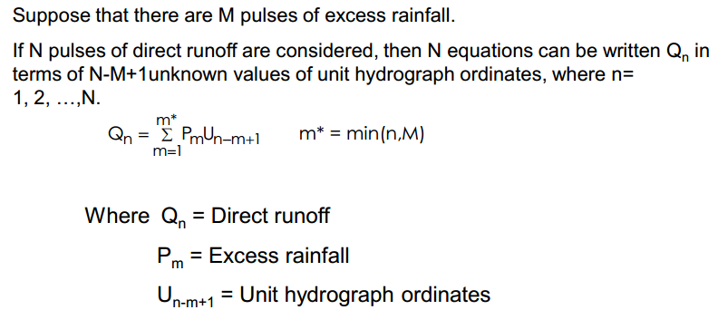

Slide 54
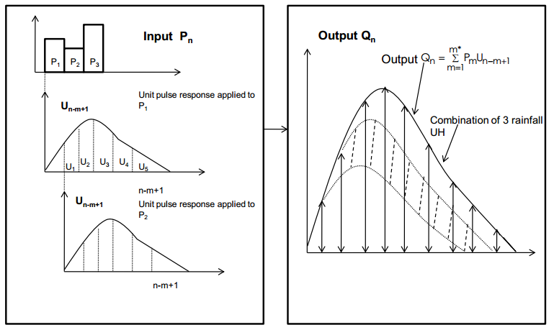

Slide 55

1

Slide 56

If
Number of Rainfall ordinates=3(r)
Number of non-zeros UH ordinates are=5 (m)
Number of non-zeros DRH ordinates=7 (n)
The following relationship holds n=m+r-1

Slide 57


Slide 58

Derivation of UH : Gauged watershed

Slide 59

Rules to be observed in developing UH from gaged watersheds

Slide 60

Essential steps for developing UH from single storm hydrograph

Slide 61

Example Problem

Slide 62


Slide 63


Slide 64


Slide 65


Slide 66


Slide 67

Example Problem

Slide 68


Slide 69


Slide 70


Slide 71


Slide 72


Slide 73


Slide 74


Slide 75

Example: Given below is the 4-hr U.H for a basin of 84 sq. Mile. Derive S-curve and find the 2-hr unit hydrograph.

Slide 76


Slide 77


Example: The Ordinates Of 3-hr U H Are Given Below:
Determine the resulting flood hydrograph from the following effective rainfall Hyetograph (ERH). Assume Constant base flow of 300 cfs.

Slide 78

solution

Slide 79

Questions?

