Slide 1

CHAPTER THREE
EVAPORATION AND
EVAPOTRANSPIRATION
AYANSA T. (B.Sc. In HY., M.Sc. in WRE)

Slide 2
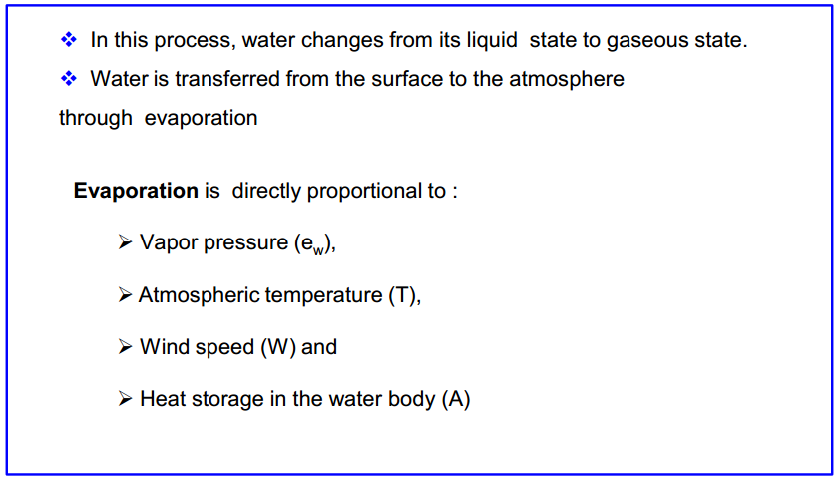
EVAPORATION

Slide 3
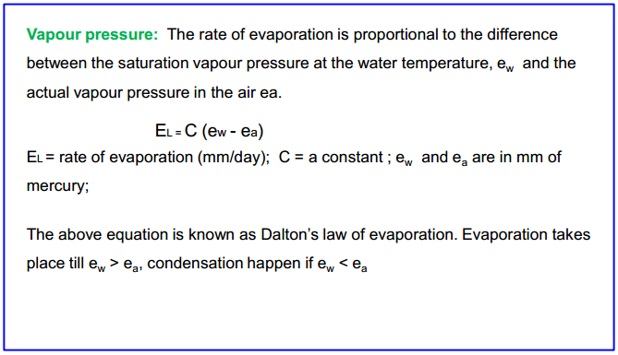
Factors affecting evaporation

Slide 4
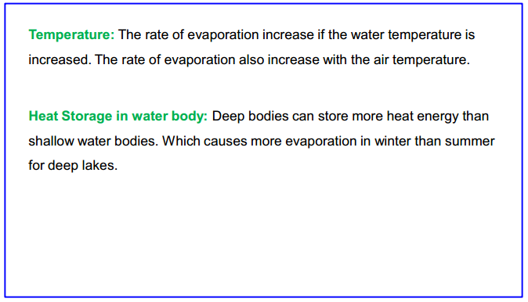

Slide 5
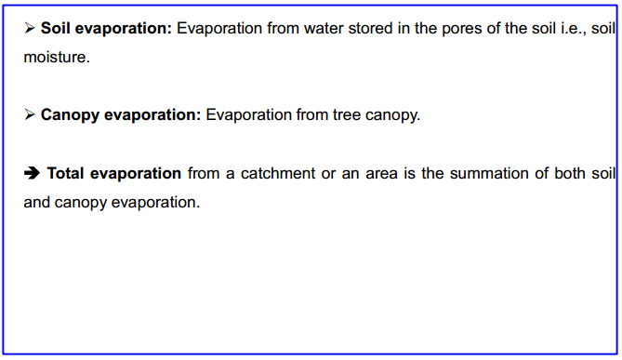
Types of Evaporation

Slide 6
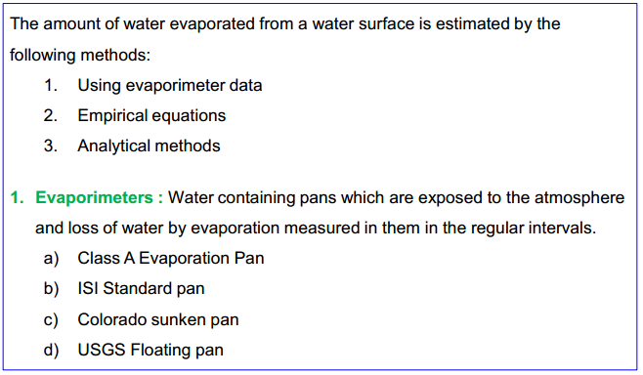
Measurement of evaporation

Slide 7
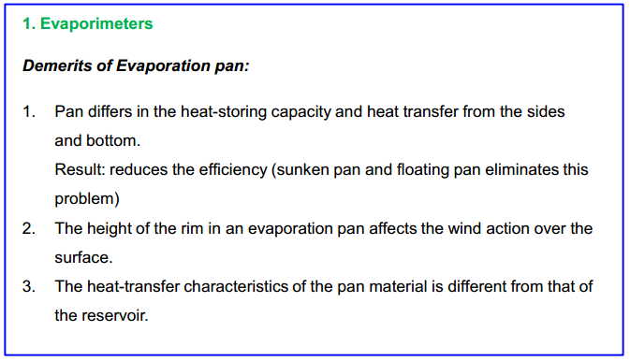

Slide 8
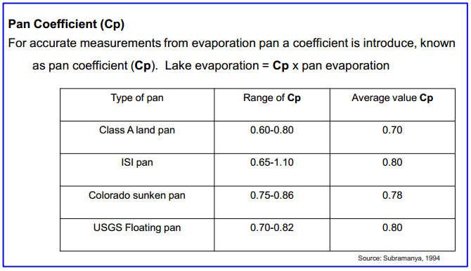

Slide 9
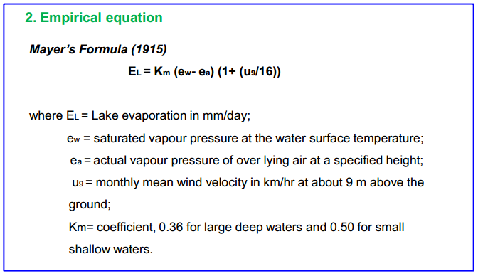

Slide 10
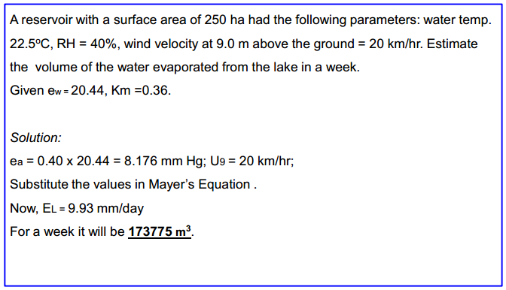
Example Problem

Slide 11
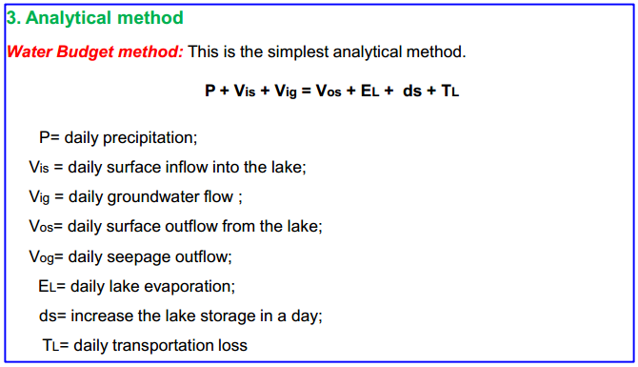

Slide 12
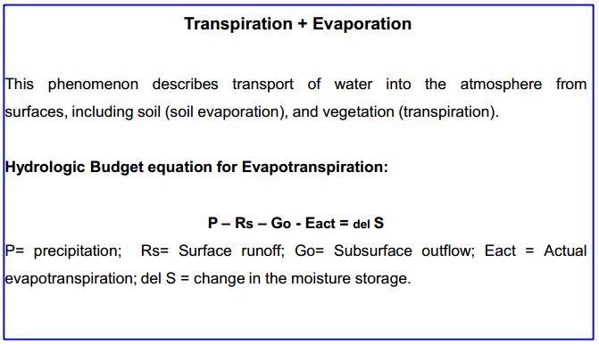
Evapotranspiration

