Slide 1

CHAPTER TWO
PRECIPITATION
AYANSA T. (B.Sc. In HY., M.Sc. in WRE)

Slide 2
Introduction
Precipitation is the part of atmospheric moisture, which reaches the earth's surface in different forms.
Some of the precipitation that might get intercepted while reaching the ground by trees and buildings and evaporates back is called the initial loss.
The other part meets requirements like depression storage and infiltrates into the ground.
The excess rainfall flows in streams to large water bodies.
Nearly one-fourth of the total precipitation that falls on land reaches large water bodies as direct runoff.
The balance three-fourths of water returns back to the atmosphere at different times as evaporation.

Slide 3
Forms of precipitation
Rain
Water drops that have a diameter of at least 0.5mm.
It can be classified based on intensity as,
Light rain up to 2.5mm/h
Moderate rain 2.5mm/h to7.5mm/h
Heavy rain >7.5mm/h
Snow
Precipitation in the form of ice crystals which usually combine to form flakes, with an average density of 0.1g/cm³

Slide 4
Cont’d
Glaze
When rain or drizzle touches ground at 0ºC, glaze or freezing rain is formed.
Sleet
It is frozen rain drops of transparent grains which form when rain falls through air at subfreezing temperature.
Hail
It is a showery precipitation in the form of irregular pellets or lumps of ice of size more than 8mm.
Drizzle
Rain-droplets of size less than 0.5mm and rain intensity of less than 1mm/h is known as drizzle.

Slide 5
Types of precipitation
Based on the “mechanism” by which air is lifted.
Frontal lifting:
Warmer air is forced to go above cooler air in equilibrium with a cooler surface.
Orographic lifting:
Air is forced to go over mountains (and it’s the reason why windward slopes receive more precipitation).
Convective Lifting:
Warm air rises from a warm surface and progressively cools down.
Cyclonic Lifting:
A cyclonic storm is a large, low pressure system that forms when a warm air mass and a cold air mass collide.

Slide 6
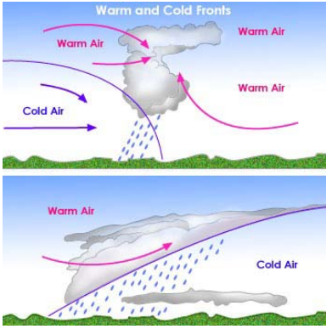
Frontal lifting

Slide 7
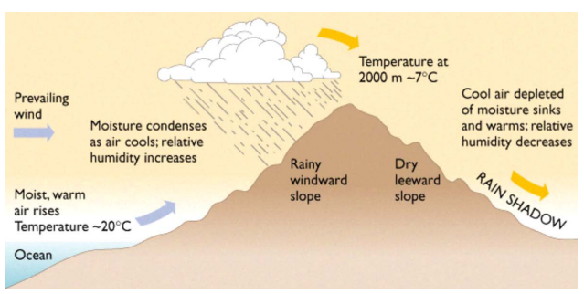
Orographic lifting

Slide 8
Convectional lifting

Slide 9
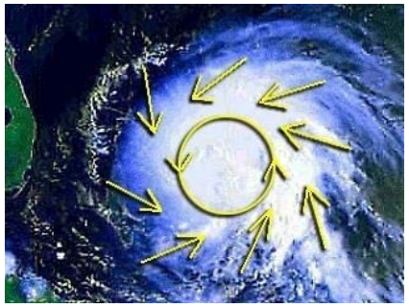
Cyclonic lifting

Slide 10
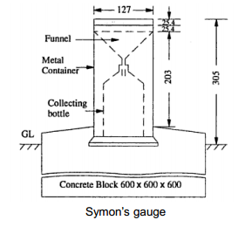
Measurement of precipitation
The instrument used to collect and measure the precipitation is called rain gauge.
Types of rain gauges:
Non-recording: Symon’sgauge
Recording
Tipping-bucket type
Weighing-bucket type
Natural-syphon type

Slide 11
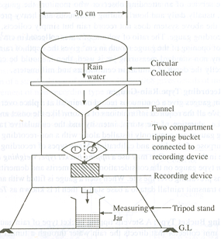
Recording rain gauges
The instrument records the graphical variation of the rainfall, the total collected quantity in a certain time interval and the intensity of the rainfall (mm/hour).
It allows continuous measurement of the rainfall.
Tipping-bucket type
These buckets are so balanced that when
0.25mm of rain falls into one bucket, it
tips bringing the other bucket in position.

Slide 12
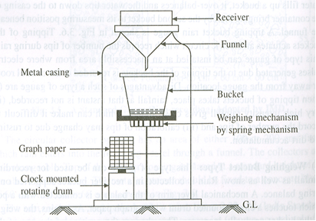
2. Weighing-bucket type
The catch empties into a bucket mounted on a weighing scale.
The weight of the bucket and its contents are recorded on a clock work driven chart.
The instrument gives a plot of cumulative rainfall against time (mass curve of rainfall).

Slide 13
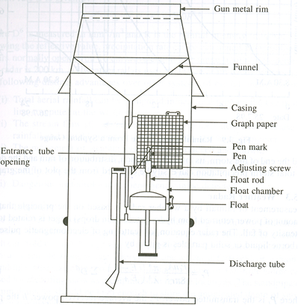
3.Natural Syphon Type (Float Type)
The rainfall collected in the funnel shaped collector is led into a float chamber, causing the float to rise.
As the float rises, a pen attached to the float through a lever system records the rainfall on a rotating drum driven by a clock work mechanism.
A syphon arrangement empties the float chamber when the float has reached a preset maximum level.

Slide 14
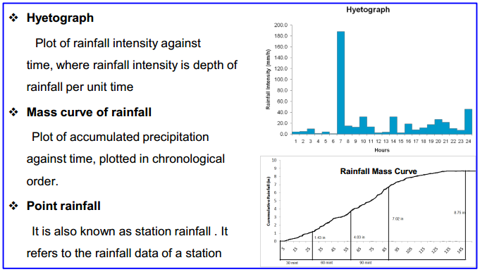
Presentation of rainfall data

Slide 15
Mean precipitation over an area

Slide 16
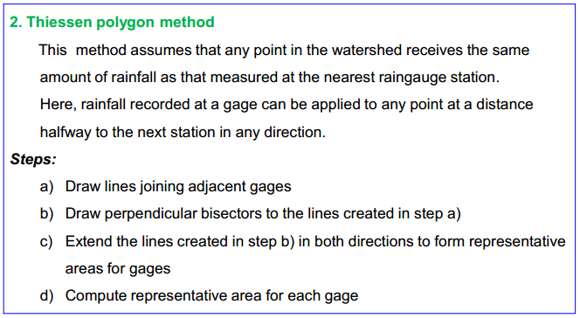

Slide 17
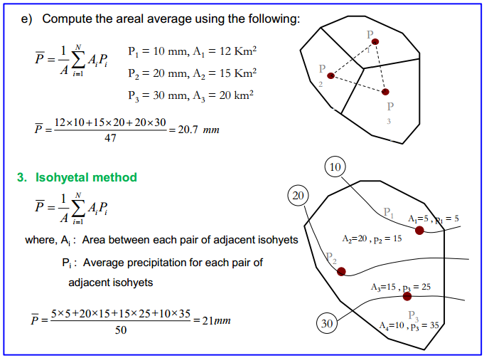

Slide 18
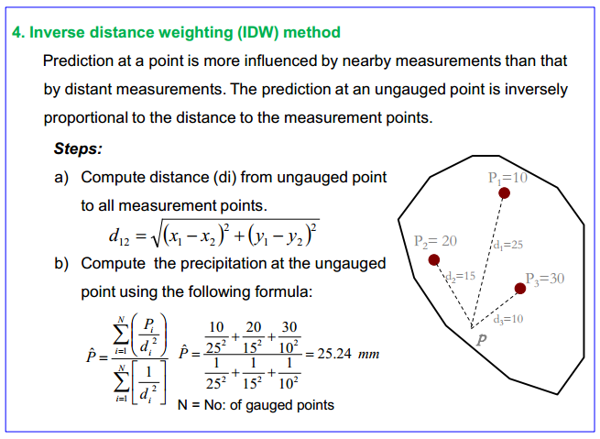

Slide 19
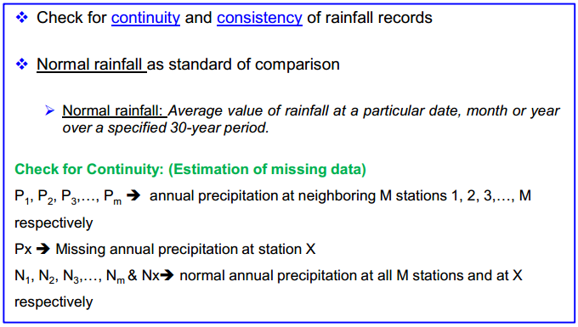
Adjustments of precipitation data

Slide 20
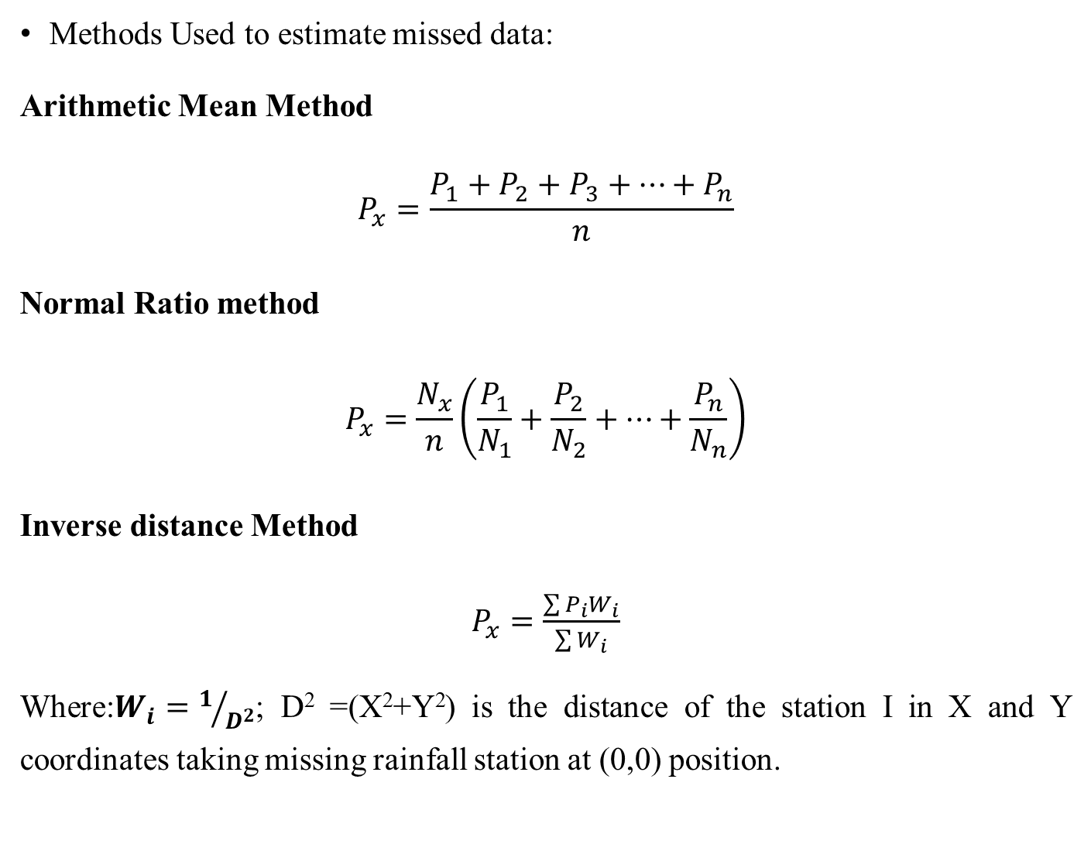
Methods Used to estimate missed data:
Arithmetic Mean Method
$$P_{x}=\frac{P_{1}+P_{2}+P_{3}+…+P_{n}}{n}$$
Normal Ratio method
$$P_{x}=\frac{N_{x}}{n}\left(\frac{P_{1}}{N_{1}}+\frac{P_{2}}{N_{2}}+…+\frac{P_{n}}{N_{n}}\right)$$
Inverse distance Method
$P_{x}=\frac{\sum{P_{i}W_{i}}}{\sum{W_{i}}}$
Where:$W_{i}=1/{D^{2}}$; D² =(X²+Y²) is the distance of the station I in X and Y coordinates taking missing rainfall station at (0,0) position.

Slide 21
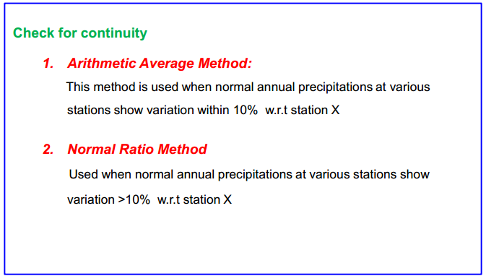

Slide 22
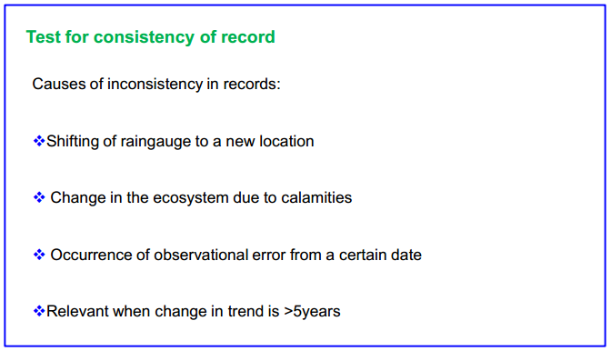

Slide 23
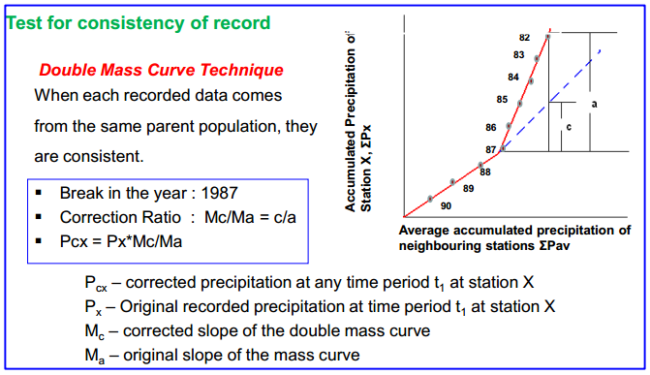

Slide 24
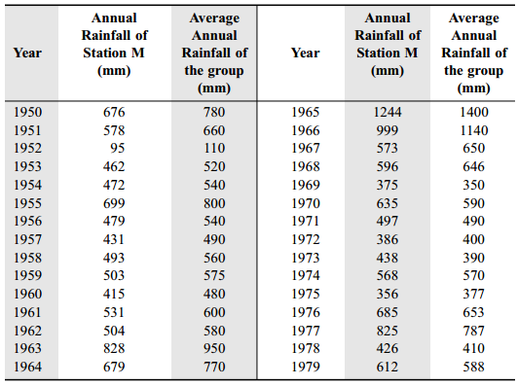
Example
Annual rainfall of station M and the average annual rainfall of Ten surrounding stations located in meteorological homogenous region are given below. Check the consistency of data of station M. If data is found inconsistent, then correct the inconsistent data.

Slide 25
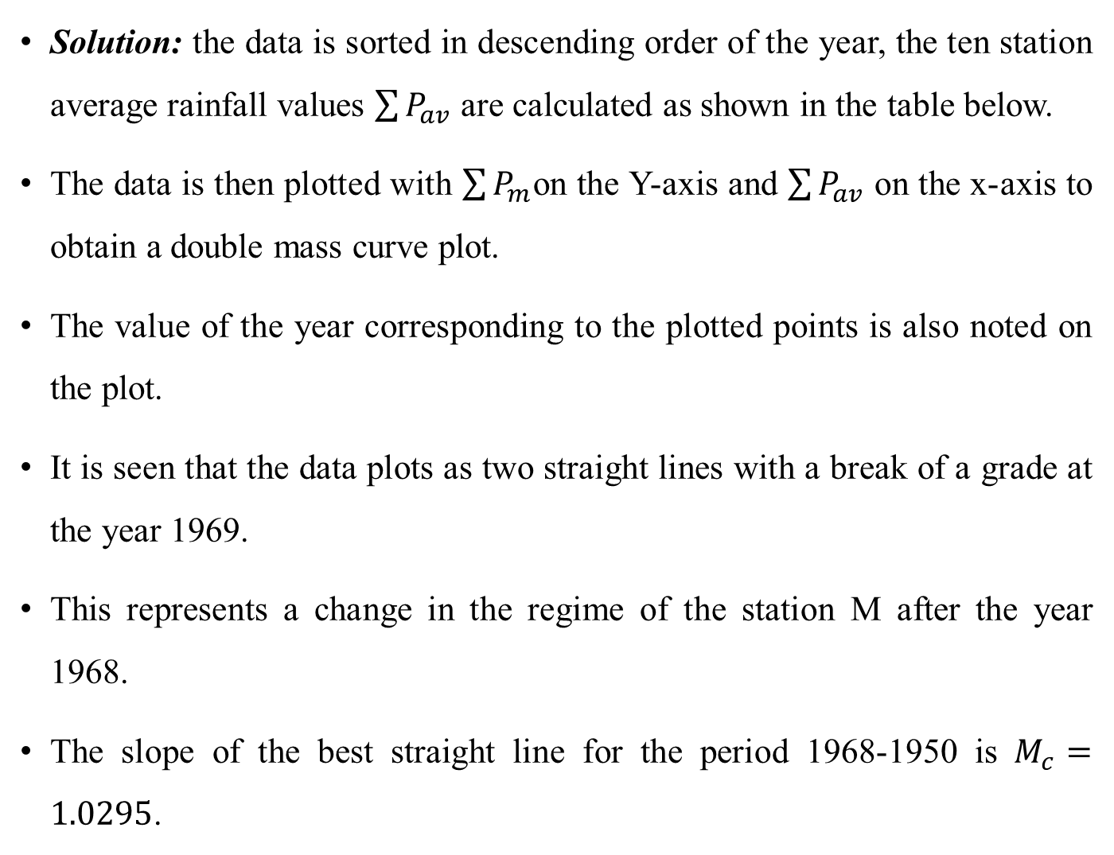
Cont’d
Solution: the data is sorted in descending order of the year, the ten station average rainfall values $\sum{P_{av}}$ are calculated as shown in the table below.
The data is then plotted with $\sum{P_{m}}$on the Y-axis and $\sum{P_{av}}$ on the x-axis to obtain a double mass curve plot.
The value of the year corresponding to the plotted points is also noted on the plot.
It is seen that the data plots as two straight lines with a break of a grade at the year 1969.
This represents a change in the regime of the station M after the year 1968.
The slope of the best straight line for the period 1968-1950 is $M_{c}=1.0295$.

Slide 26
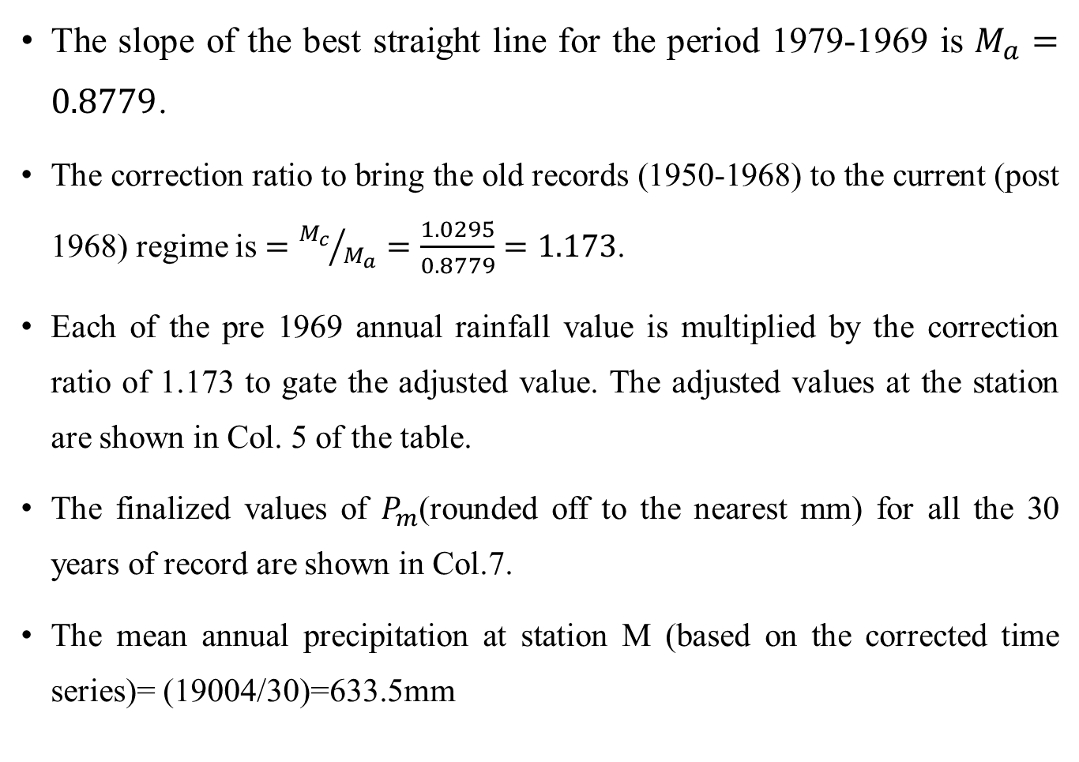
Cont’d
The slope of the best straight line for the period 1979-1969 is $M_{a}=0.8779$.
The correction ratio to bring the old records (1950-1968) to the current (post 1968) regime is $={M_{c}}/{M_{a}}=\frac{1.0295}{0.8779}=1.173$.
Each of the pre 1969 annual rainfall value is multiplied by the correction ratio of 1.173 to gate the adjusted value. The adjusted values at the station are shown in Col. 5 of the table.
The finalized values of $P_{m}$(rounded off to the nearest mm) for all the 30 years of record are shown in Col.7.
The mean annual precipitation at station M (based on the corrected time series)= (19004/30)=633.5mm

Slide 27
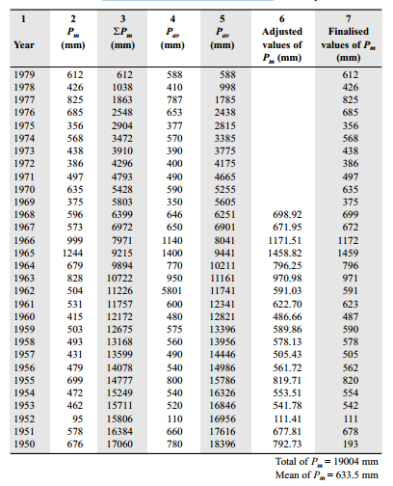

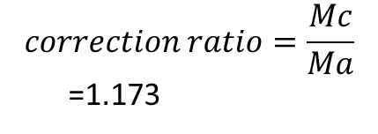

Cont’d
${M }_{a}=\frac{6399−17060}{6251−18396}$= 0.8779
${M }_{c}=\frac{612−5803}{588−5605}$=1.0295
$$correction ratio=\frac{Mc}{Ma}$$
=1.173

Slide 28
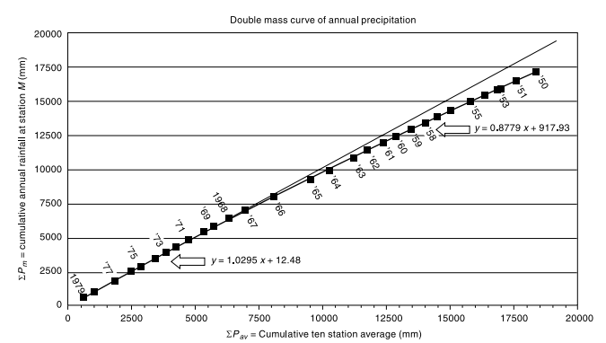
Double mass curve of Annual RF at Station M

Slide 29
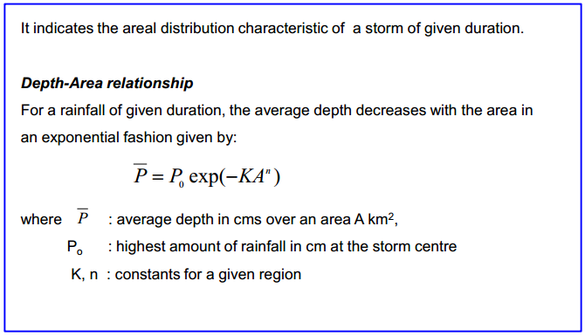
Depth-Area-Duration relationships

Slide 30
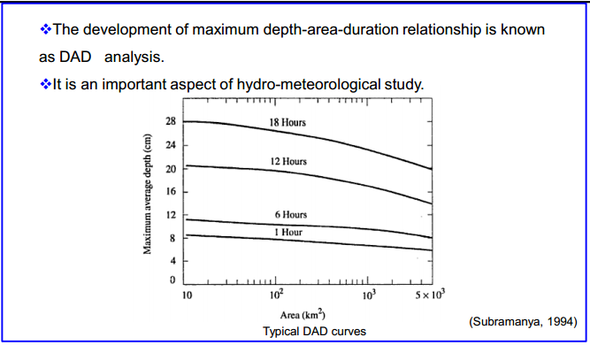

Slide 31
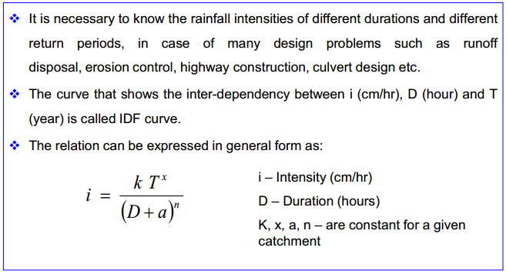
Intensity-Duration-Frequency (IDF) curves

Slide 32
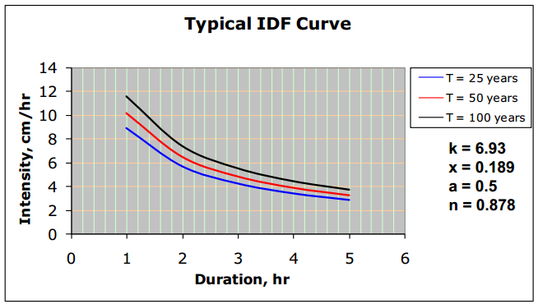

Slide 33
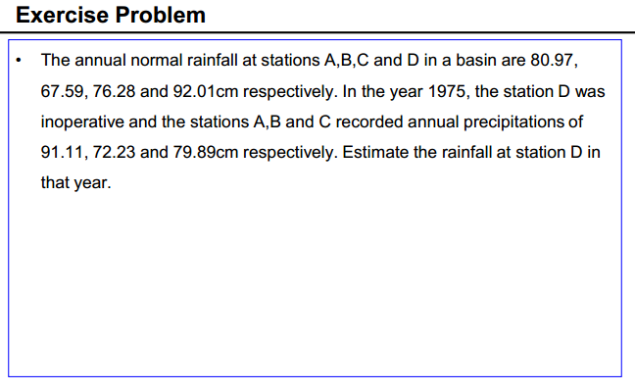

Slide 34
Example: For a catchment of 590 sq. km rainfall for the month of July along with their areas of influence for the stations are given below. Calculate average precipitation over the basin by (a) Thiessen-polygon method, (b) Isohyetal method.
Station | A | B | C | D | E | F | G | H | I | J | K | L | M
RF (cm) | 37.5 | 19 | 35 | 45 | 53 | 52.5 | 56 | 32.5 | 40 | 30 | 54 | 32 | 45
Area of influence (km²) (As per Thiessen-Polygon) | 3 | 8 | 91 | 15 | 69 | 79 | 88 | 70 | 6 | 30 | 66 | 55 | 10
Isohyet | <20cm | 20-30cm | 30-40cm | 40-50cm | 50-60cm
area (km²) | 3 | 44 | 82 | 242 | 219

