Slide 1
Design of Shallow Foundation
Contents of chapter
    Introduction to Design of shallow Foundation
        Requirements and consideration criteria of shallow foundation design
    Geotechnical Design /proportioning of footing dimension
    Structural design of shallow foundation(Isolated, strap footing, combined, & Mat foundation)
        Design procedures of structural design of footings

Slide 2
Introduction to Shallow Foundation Design
General Requirements of Foundations:
For a satisfactory performance, a foundation must satisfy the following three basic criteria:
    Location and depth criterion.
    Shear failure criterion or bearing capacity.
    Allowable Settlement.
1. Location and Depth Criterion:
As a general rule, any foundation should be placed at a depth where the soil stratum is adequate from the point of view of bearing capacity and settlement criteria.

Slide 3
Cont’d…
Minimum Requirements:
A foundation should be located at a minimum depth of 50cm below natural ground surface.
The foundation must be placed below the zone of volume change, where volume change is expected. For example, in areas where there is expansive soil the foundation should be taken below the active zone.
Foundations for structures in a river have to be protected from the scouring action of the flowing-stream. The depth of foundation for a bridge pier or any similar structure must be sufficiently below the deepest scour level.

Slide 4
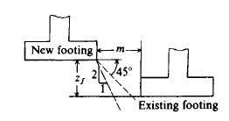

Foundations Near Existing Structures:
When footings are to be placed adjacent to existing structure, the line from the base of the new footing to the bottom edge of the existing footing should be 45º Or less with the horizontal plane. The distance m should be greater than Z_{f} .

Slide 5
Depth and location of foundation
Adjacent structures and property lines.
Structures may be damaged by the construction of new foundations, as a result of vibrations, undermining by excavation or lowering of the water table. After new foundations have been constructed, the (new) loads they place on the soil may cause settlement of previously existing structures as a result of new stress pattern in the surrounding soil.
Part extending
property line
Property line
In general, deeper the foundations and closer to the old structure, greater will be the potential for damage to old structures.
New Footing
45⁰
Existing Footing
Limit for bottom of deeper Footing

Slide 6
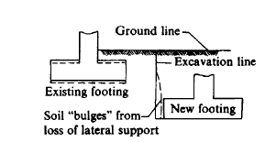
Foundations Near Existing Structures…
Conversely, the Figure below indicates that if the new footing is lower than the existing footing, there is a possibility that the soil may flow laterally from beneath the existing footing. This may increase the amount of excavation somewhat but, more importantly, may result in settlement cracks in the existing building.
This problem is difficult to analyze; however, an approximation of the safe depth Z_{f} may be made for C-ф soil.
Notes:
Tyty
Hj

Slide 7
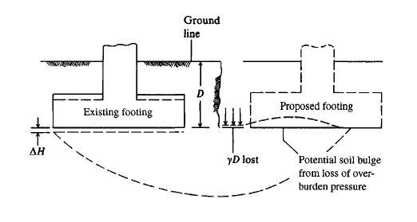
Foundations Near Existing Structures…
In the figure below illustrate how a problem can develop if the excavation for the foundation of the new structure is too close to the existing building. In this case the qN_{q} term of the bearing capacity equation is lost, for most foundations below the ground surface this is a major component of the bearing capacity.

Slide 8
Factors affect selecting of foundation type
The choice of the appropriate type of foundation is affected by:
  Type of superstructure to be supported: function and load that it transfers to the foundation.
  Subsurface condition and/or type of soil.
  Cost of foundation.
A safe foundation design provides for a suitable factor against,
    Shear failure of the soil: Which is not exceeding the bearing capacity of the soil.
    Excessive settlement (both uniform and differential settlement)

Slide 9
Shallow Foundations:
Shallow/spread footings are the most widely used type among all foundations because they are usually more economical.
Construction of footings requires a least amount of equipment, skill and no heavy or special equipment is necessary.
Shallow foundations are usually used when the soil at a shallow depth has adequate capacity to support the load of the superstructure. For reasons of economy, shallow foundations are the first choice unless they are considered inadequate.
The design of Foundation footings calls for the combined efforts of geotechnical and structural Design.

Slide 10
1. Geotechnical Design
Geotechnical Design Parameters
Geotechnical factors that influence the design include the:-
  thickness and lateral extent of bearing strata
  depth of frost penetration
  depth of seasonal volume change, and
  cut/fill requirements.
The strength, compressibility, and shrink-swell potential of the bearing strata are the properties of concern.
In addition, the presence or absence of groundwater and its minimum and maximum elevations have an important impact on the design process.

Slide 11
    Geotechnical Design
Geotechnical design is mainly to proportioning the footing size as it depends on the soil properties. Appropriate size should be calculated so that the footing is safe in:
    Bearing capacity
    Permissible settlement
There are two ways to proportioning a footing
    Based on presumptive allowable bearing capacity
    On the basis of soil parameter(c and Ø) by bearing capacity calculation
Generally which is covered in chapter 2 and 3 of this courses

Slide 12
Footings:
Footings belong to shallow foundation and their purpose is to transmit the load from the structure to soil or rock.
Footings that support a single column, referred to as: Isolated or spread footings: can be a square, rectangular or circular in shape depending on the relative magnitude of the moments Mx and My from the superstructure.
Footings that support two or more columns are classified as combined footings. Rectangular, Trapezoidal and strap combined footings are special versions of combined footings, patterned to meet certain conditions or restrictions.

Slide 13
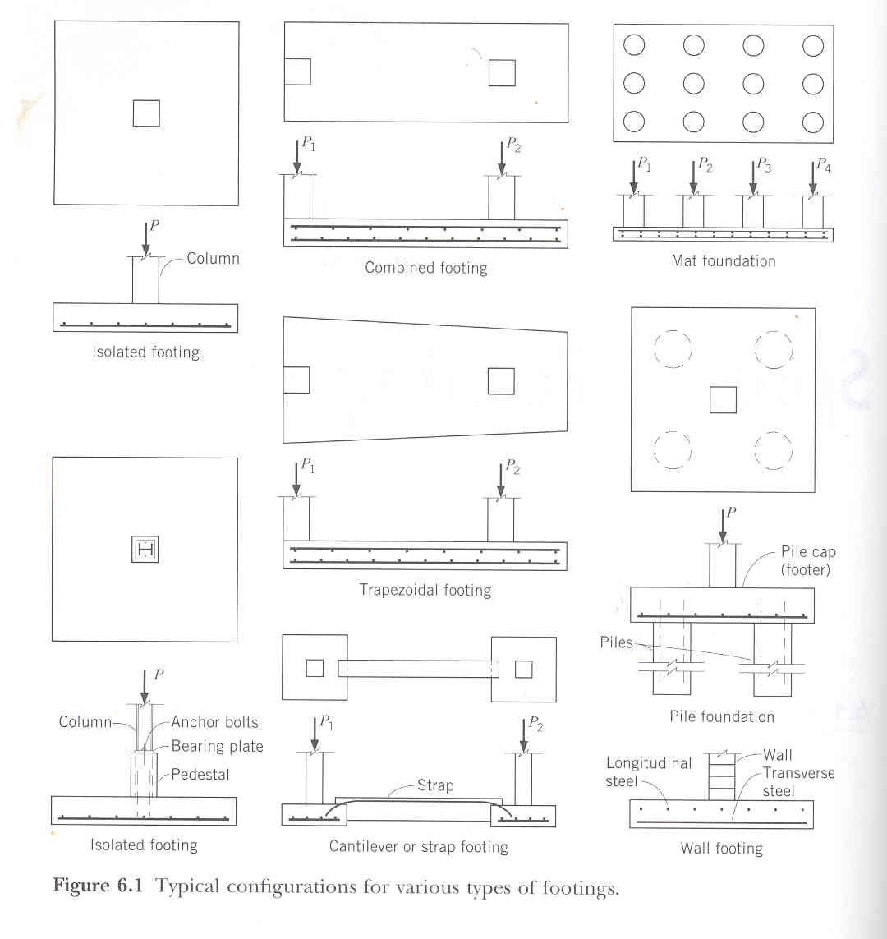
Figure Typical configurations for various types of footings

Slide 14
Footings…
Concrete is almost always the material used in footings. It is strong, durable, and is a convenient, economical construction material, workable and adaptable to field construction and requirements.
Concrete footings may be plain or reinforced, with reinforcement running in one (one way) or two (two way) directions, depending on the direction of flexure.

Slide 15
Footings…
Footing shapes usually vary with specific requirements and design needs.
For spread or isolated footings, square shapes are common and usually most economical, but rectangular shapes are used if space is limited in one direction, or when loads are eccentric in one direction.
The typically desired objective is to select the footing shape that makes the soil pressure (bearing pressure) as uniform as possible.
Furthermore, footings may be of uniform thickness or may be sloped or stepped. Stepped or sloped footings are most commonly used to reduce the quantity of concrete away from the column where the bending moments are small and when the footing is not reinforced.

Slide 16
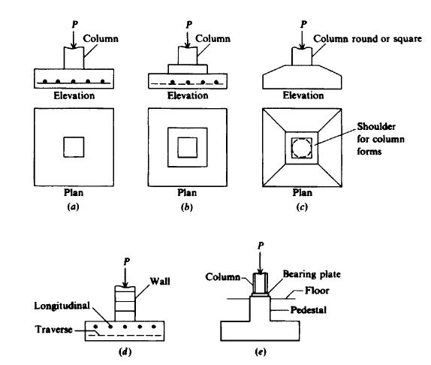
Figure:
Typical footings.
(a) spread footings;
(b) stepped footing;
(c) sloped footing;
(d) Wall footing;
(e) footing with
pedestal.

Slide 17
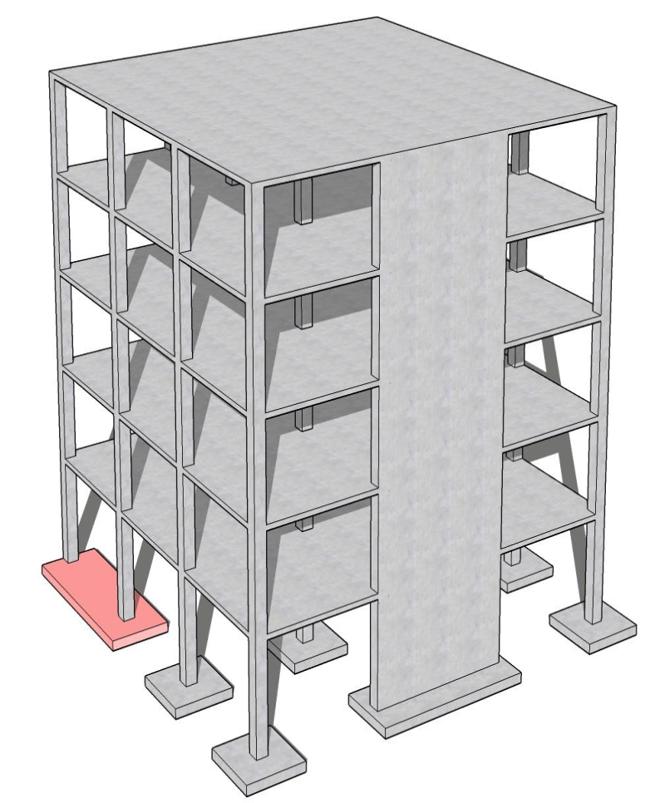
Foundation Footing Types and structural component
Isolated Footing
Combined Footing
Strip/wall Footing

Slide 18
Assumptions used in Footing Design
Theory of Elasticity analysis [Borowicka (1963)] and observations [Schultze (1961), Barden(1962)] indicate that the stress distribution beneath symmetrically loaded footings is not uniform. The actual stress distribution depends on both footing rigidity and base soil.
For footings on loose sand the grains near the edge tend to displace laterally, whereas the interior soil is relatively confined. This difference results in a pressure diagram qualitatively shown in Fig.[a].
Fig [b] is the theoretical pressure distribution for the general case of rigid footings on any material. The high edge pressure may be explained by considering that edge shear must occur before any settlement can take place.

Slide 19
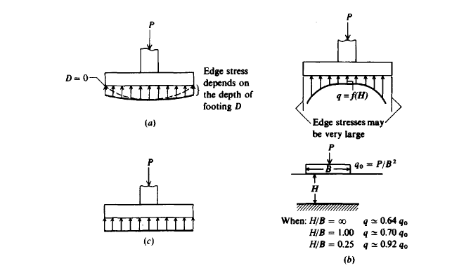
Assumptions…
The pressure distribution beneath most footings will be rather indeterminate because of the interaction of the footing rigidity with the soil type, state, and time response to stress. For this reason it is common practice to use the linear pressure distribution of Fig.[c ] beneath spread footings.
Figure: Probable pressure distribution beneath a rigid footing.
On a cohesionless soil;
Generally for cohesive soils;
(c) usual assumed linear distribution.

Slide 20
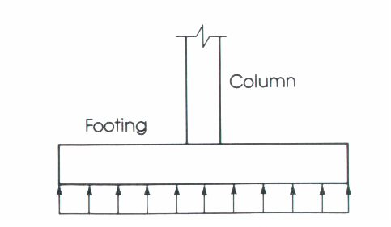
Distribution of Soil Pressure
When the column load P is applied on the centroid of the footing, a uniform pressure is assumed to develop on the soil surface below the footing area.
However the actual distribution of the soil is not uniform, but depends on may factors especially the composition of the soil and degree of flexibility of the footing.

Slide 21
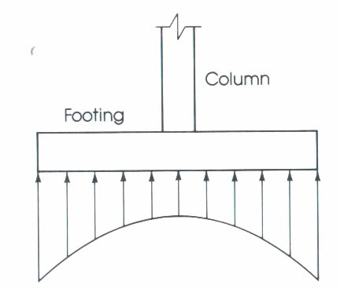
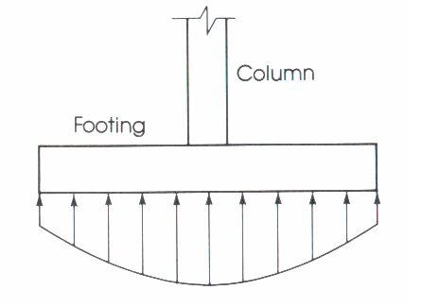
Distribution of Soil Pressure
Soil pressure distribution in cohesionless soil.
Soil pressure distribution in cohesive soil.

Slide 22
Ultimate Bearing Capacity of Soil
The maximum intensity of loading at the base of a foundation which causes shear failure of soil is called ultimate bearing capacity of soil, denoted by qu .

Slide 23
Allowable Bearing capacity of Soil
The intensity of loading that the soil carries without causing shear failure and without causing excessive settlement is called allowable bearing capacity of soil, denoted by qa .
The gross pressure represents the total stress in the soil created by all the loads above the base of the footing. These loads include:
    column service loads;
    the weight of the footing; and
    the weight of the soil on the top of the footing,

Slide 24
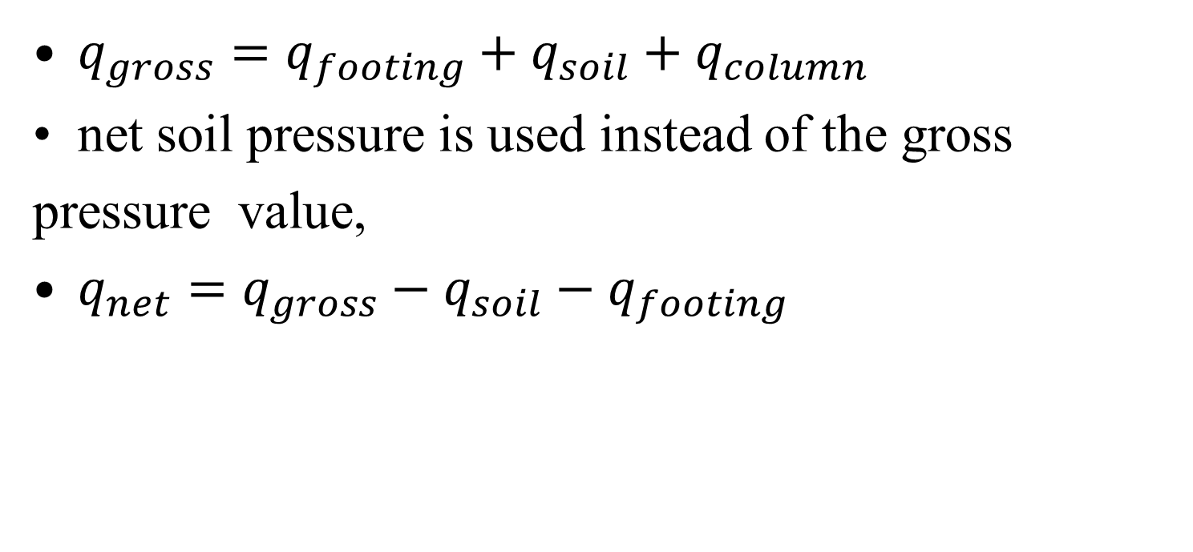
Allowable Bearing capacity of Soil

Slide 25
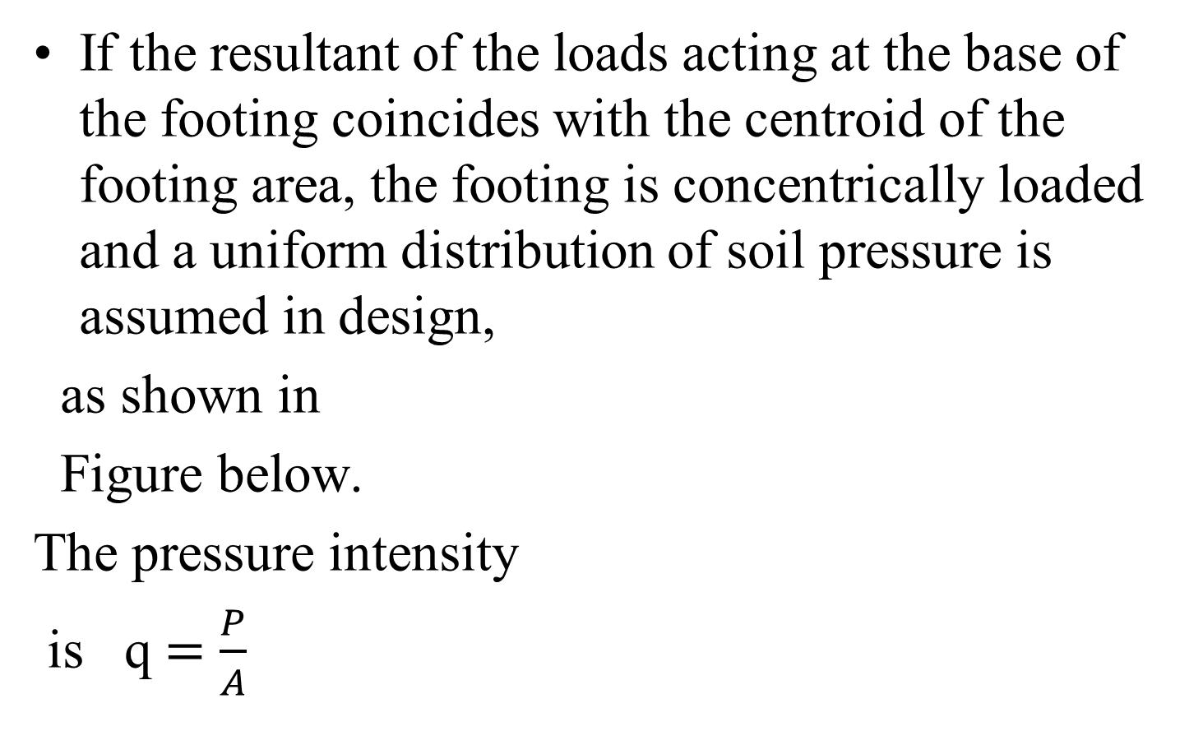
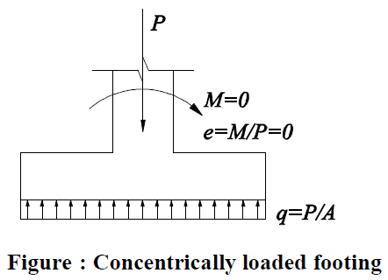
Concentrically loaded Footings

Slide 26
Design Considerations
The area of the footing based on the allowable bearing soil capacity
Two-way shear or punch out shear.
One-way bearing
Bending moment and steel reinforcement required
Bearing capacity of columns at their base
Dowel requirements
Development length of bars
Detail working drawings

Slide 27
2. Structural Design
Structural design parameters that influence the design of the shallow foundation include
    the building type and use,
    loading (live, dead, and uplift),
    column spacing,
    presence or absence of a basement,
    allowable settlement, and
    applicable building codes

Slide 28
Cont’d….
The following steps are typically followed for completing the structural design of the footing, based on ACI 318-05:
  Determine footing plan dimensions by comparing the gross soil bearing pressure and the allowable
  soil bearing pressure.
  Apply load factors in accordance of ACI 318-05.
  Determine whether the footing will be considered as spanning one-way or two-ways.
  Confirm the thickness of the footing by comparing the shear capacity of the concrete section to the factored shear load. ACI 318-05 provides guidance on selecting the location for the critical cross-section for one-way shear and two-way shear.

Slide 29
Cont’d….
  e. Determine reinforcing bar requirements for the concrete section based on the flexural capacity along with the following requirements in ACI 318-05.
Requirements specific to footings
  Temperature and shrinkage reinforcing requirements
  Bar spacing requirements
  Development and splicing requirements
  Seismic Design provisions
  Other standards of design and construction, as required

Slide 30
Design of Isolated Footings
Design of isolated rectangular footings is detailed in the following steps;
1- Select a trial footing depth.
  According to ACI Code 15.7, depth of footing above reinforcement is not to be less than 15cm for footings on soil. Noting that 7.5 cm of clear concrete cover is required if concrete is cast against soil, a practical minimum depth is taken as 25 cm.

Slide 31
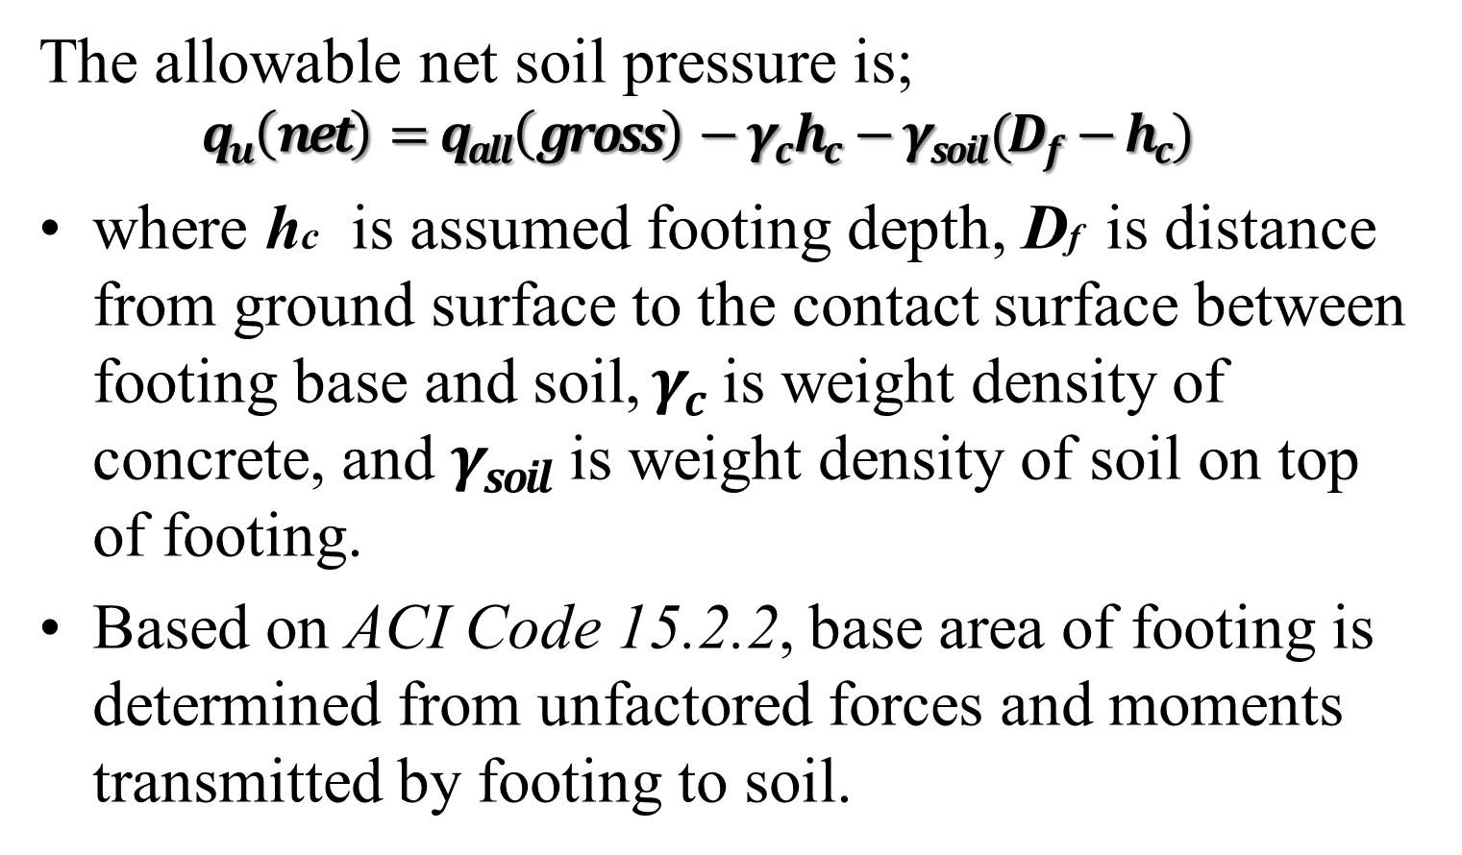
2- Establish the required base area of the footing

Slide 32
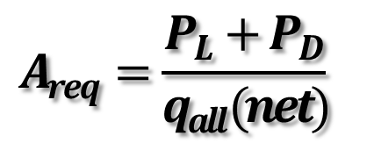
2- Establish the required base area of the footing
where PD and PL are column service dead and live loads respectively.
Select appropriate L, and B values, if possible, use a square footing to achieve greatest economy.

Slide 33
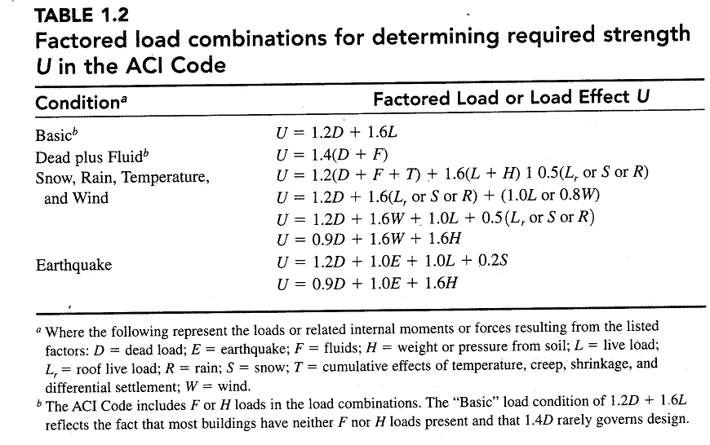
Cont’d…

Slide 34

3- Evaluate the net factored soil pressure
Evaluate the net factored soil pressure by dividing the factored column loads by the chosen footing area,

Slide 35
4- Check footing thickness for punching shear(Two-Way Shear)
Since large soil pressures are present under footings, high shear stresses are produced and since shear reinforcement is not normally used, shear rather than moment commonly determines the minimum required depth of footing.
The depth of the footing must be set so that the shear capacity of the concrete equals or exceeds the critical shear forces produced by factored loads.

Slide 36
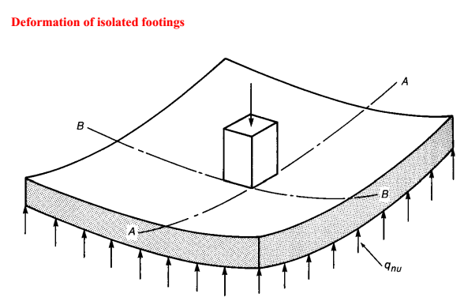

Slide 37
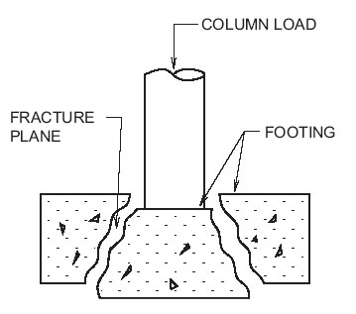
The column rested on the footing tends to punch through the footing due to the shear stress that act around the footing, the fracture forms a truncated pyramid shaped failure section.
truncated pyramid

Slide 38
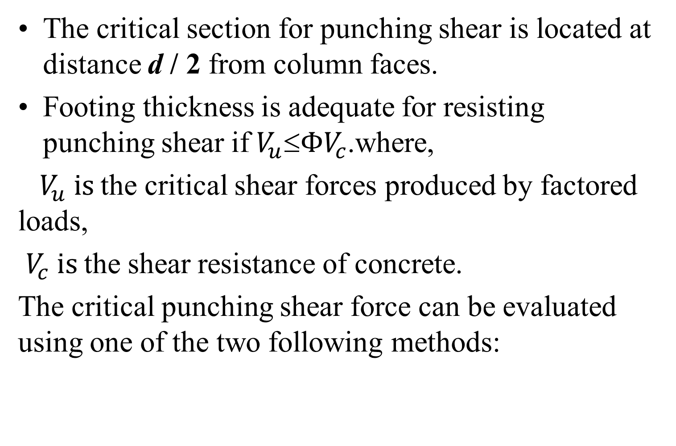
4- Check footing thickness for punching shear(Two-Way Shear)

Slide 39
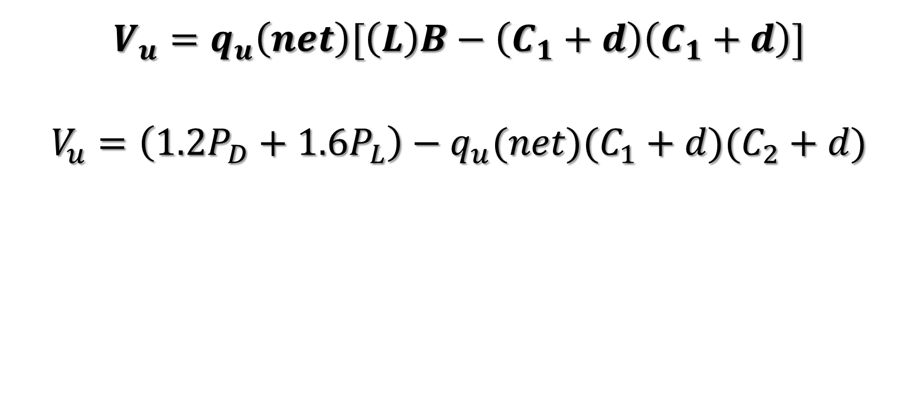
4- Check footing thickness for punching shear(Two-Way Shear)
where C₁ and C₂ are column cross sectional dimensions, shown in Figure a and b.

Slide 40
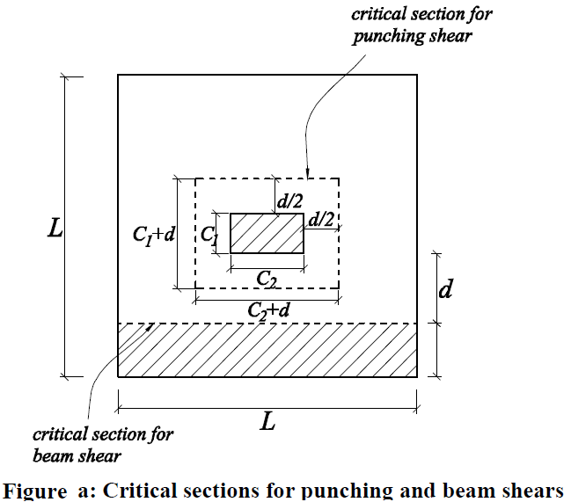
Square footing

Slide 41
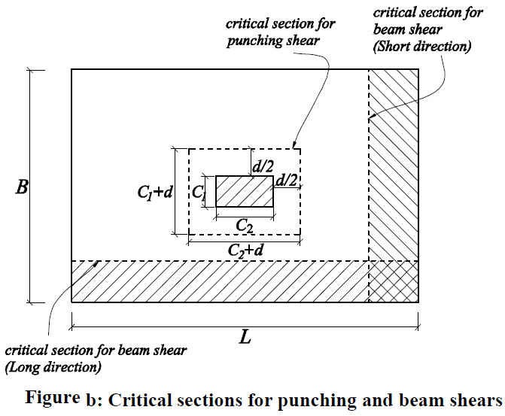
Rectangular footing

Slide 42
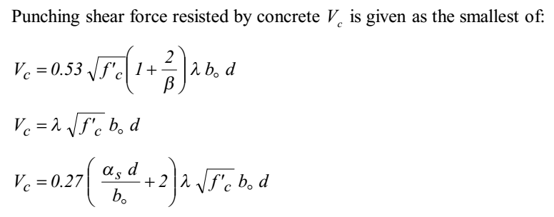
4- Check footing thickness for punching shear(Two-Way Shear)
--------------Equ.1
--------------------Equ.2
-----------------Equ..3

Slide 43
4-Check footing thickness for punching shear(Two-Way Shear)
b = equals the ratio of the long side to the short side of the column
When b = 2, the 1st &2nd equations give the same value, if b > 2 the 1st equation gives smaller value than the 2nd equation. Since there are two layers of reinforcement ,the average depth ,d, is
d_{averg} = h - 7.5cm - d_{b} ,
where d_{b} is bar diameter.
  b₀ = is perimeter of critical section
  For square column b₀ = 4(c + d)
  For rectangular column b₀ = 2(c₁+d) +2(c₂+d)

Slide 44
4- Check footing thickness for punching shear(Two-Way Shear)
λ =1 for normal weight concrete.
a_{s} = 40 for interior column
= 30 for edge column
= 20 for corner column
Φ= strength reduction factor , 0.75

Slide 45
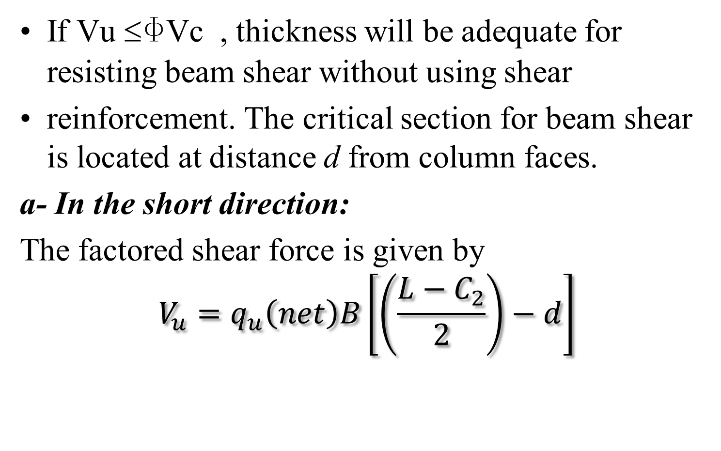
5. Check footing thickness for beam shear in each direction (one way shear)

Slide 46
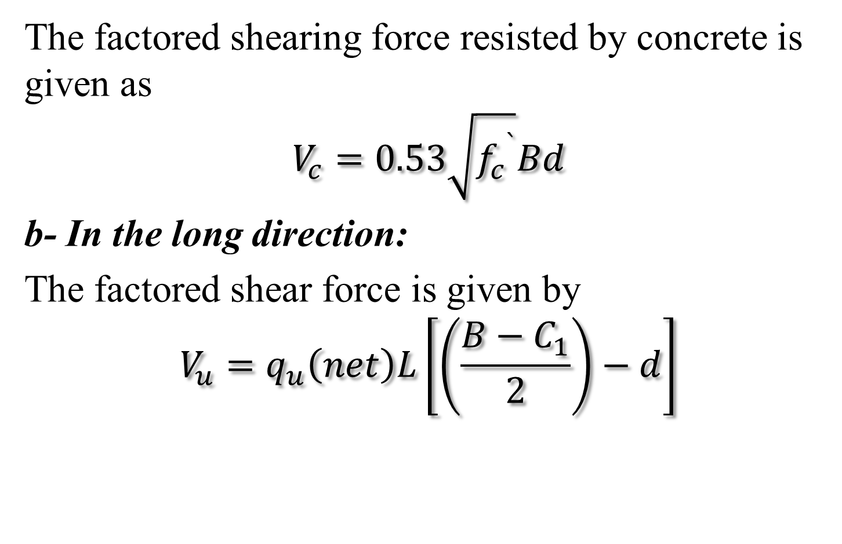
5. Check footing thickness for beam shear in each direction (one way shear)

Slide 47
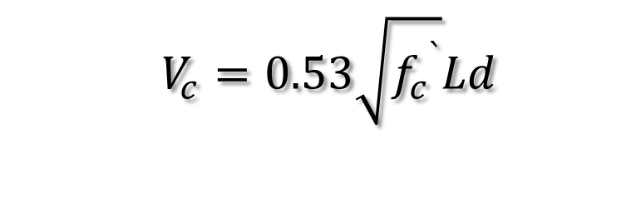
5. Check footing thickness for beam shear in each direction (one way shear)
The factored shearing force resisted by concrete is given as
Increase footing thickness if necessary until the condition Vu ≤ΦVC is satisfied.

Slide 48
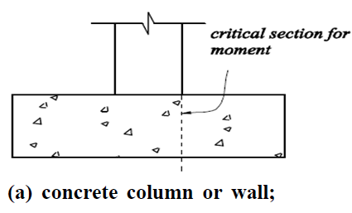
6- Compute the area of flexural reinforcement in each direction.
The critical section for bending is located at face of column, or wall, for footings supporting a concrete column or wall, as specified by ACI Code 15.4.2. Figure a,b&c shows critical sections for flexure for footings supporting concrete columns, masonry walls, and columns with steel base plates.

Slide 49
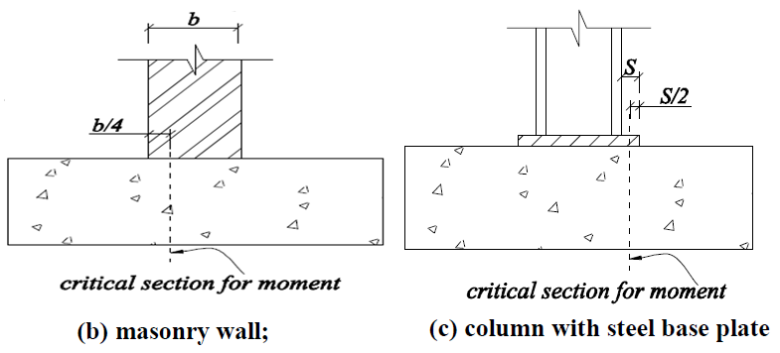

Slide 50
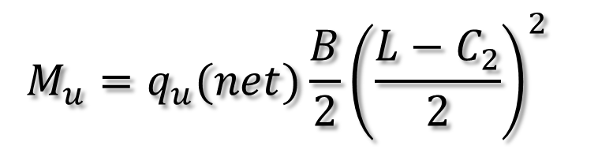
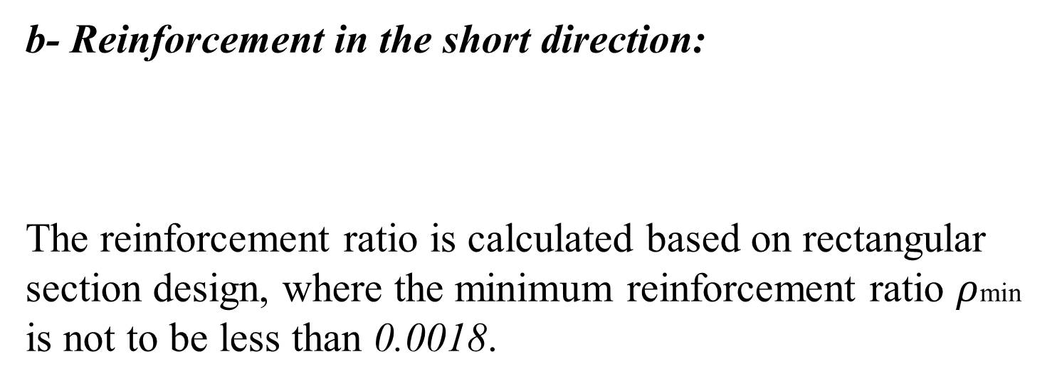
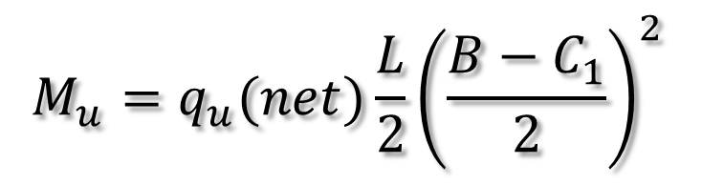
6- Compute the area of flexural reinforcement in each direction.
a- Reinforcement in the long direction:

Slide 51
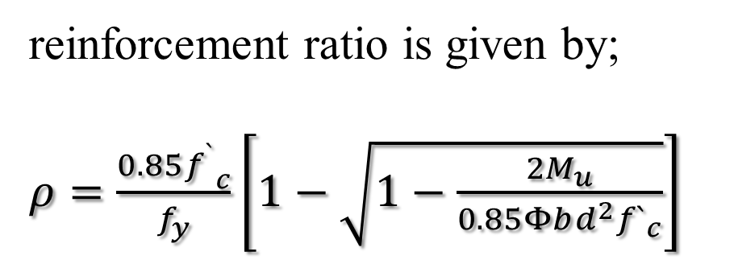

6- Compute the area of flexural reinforcement in each direction.

Slide 52
6- Compute the area of flexural reinforcement in each direction
According to ACI Code 15.4.3, for square footings, the reinforcement is identical in both directions as shown in figure.
For rectangular footings, ACI Code 15.4.4 specifies that the reinforcement in the long direction is uniformly distributed across the full width of footing.
however for short direction, the reinforcement is distributed in the central band as per calculations below. The rest reinforcement in short direction is distributed equally on both sides of the central band.

Slide 53
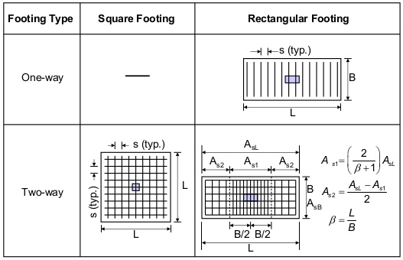

Slide 54
7- Check for bearing strength of column and footing concrete
All forces applied at the base of a column or wall must be transferred to the footing by bearing on concrete and/or by reinforcement. Tensile forces must be resisted entirely by the reinforcement. Bearing on concrete for column and footing must not exceed the concrete bearing strength.
The joint could fail by crushing of the concrete at the bottom of the column where the column bars are no longer effective or by crushing the concrete in the footing under the column.

Slide 55
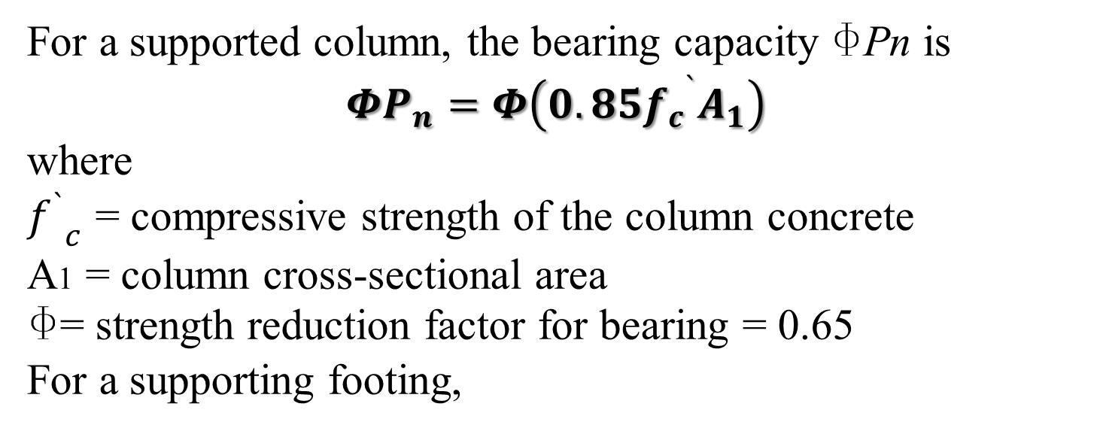
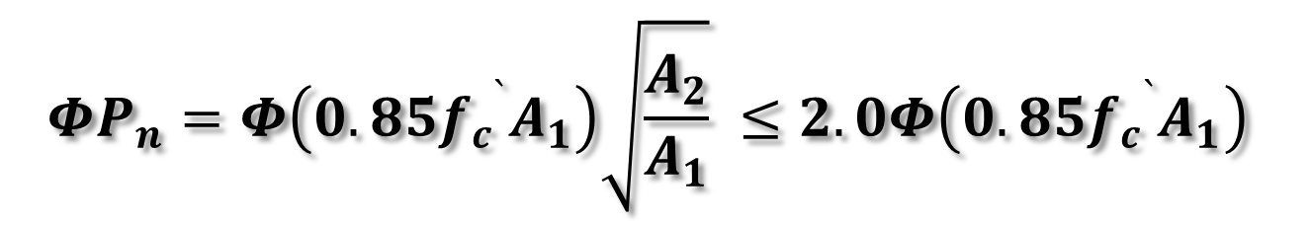
7- Check for bearing strength of column and footing concrete

Slide 56
7- Check for bearing strength of column and footing concrete
where
  f `_{c}= compressive strength of the footing concrete
  A2 = area of the lower base of the largest frustum of a pyramid, cone, or tapered wedge contained wholly within the footing and having for its upper base the loaded area, and having side slopes of 1 vertical to 2 horizontal.
When bearing strength is exceeded, reinforcement in the form of dowel bars must be provided to transfer the excess load.

Slide 57
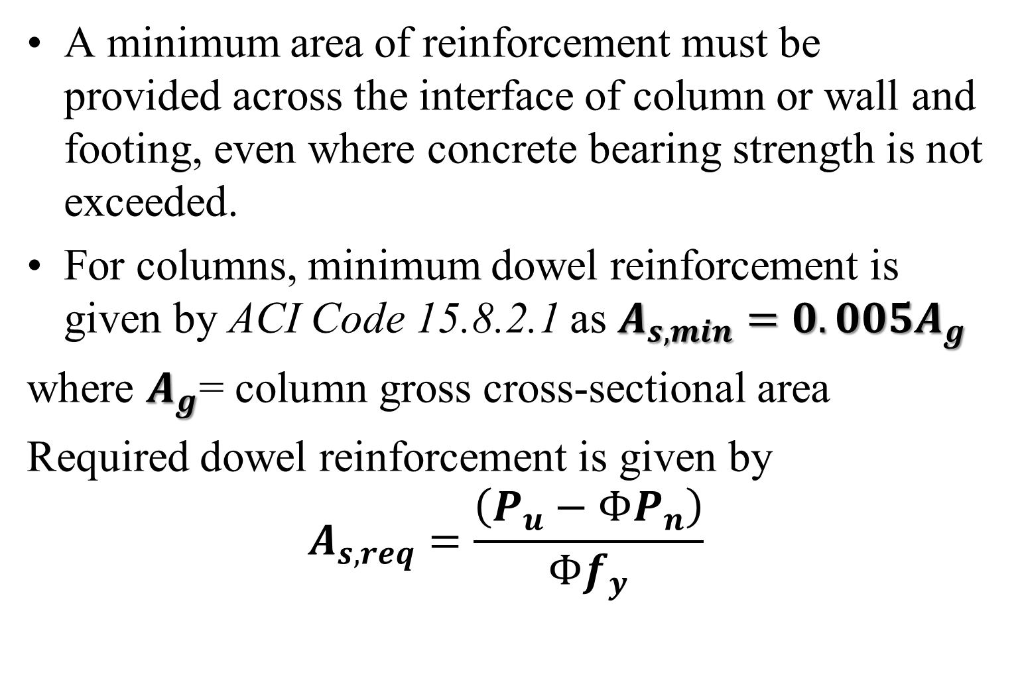
7- Check for bearing strength of column and footing concrete

Slide 58
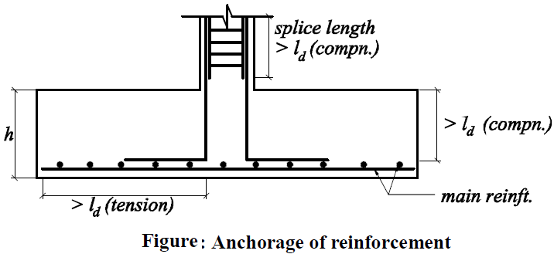
8- Check for anchorage of the reinforcement
Both flexural and dowel reinforcement lengths are checked for anchorage to prevent bond failure of the dowels in the footing and to prevent failure of the lap splices between the dowels and the column bars, as shown in Figure below.

Slide 59
8- Check for anchorage of the reinforcement
Lap length
When the length of reinforcement bar has to be extended in reinforced concrete structural member splicing is used to join two reinforcement bars to transfer the force from one bar to the joining bar.
  Lap length addresses the length of the bar needed to transfer the stresses to the other bar whereas Development length addresses the length of the bar needed to transfer the stresses to the concrete.

Slide 60
Development length of the Reinforcing Bars
The development length for compression bars was given
but not less than
Dowel bars must be checked for proper development length.

Slide 61
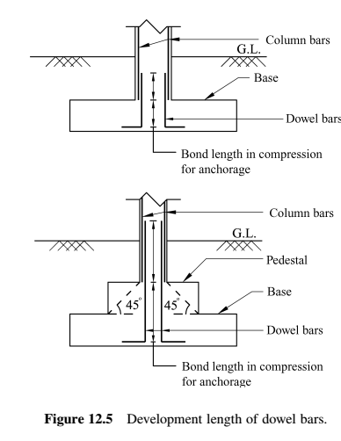
Cont’d…

Slide 62
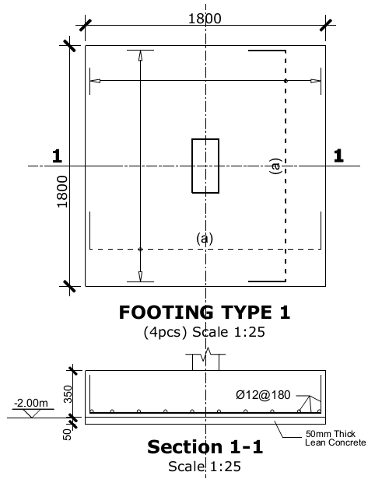
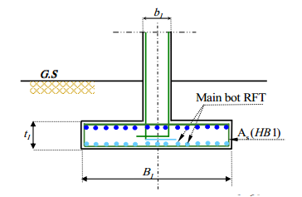
9- Prepare neat design drawings showing footing dimensions and provided reinforcement.

Slide 63
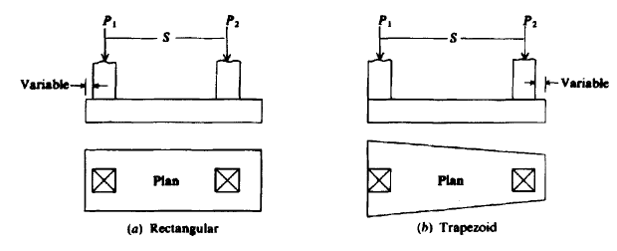
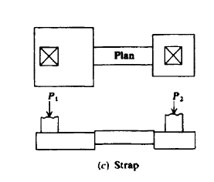
Combined Footings Design
When a footing supports a line of two or more columns, it is called a combined footing.
A combined footing may have either rectangular or trapezoidal shape or be a series of pads connected by narrow rigid beams called a strap footing.

Slide 64
Combined Footings…
Combined footings are used when:
    Columns are closely spaced and design/proportioning of isolated footings results in an overlap of footing areas and/or,
    When there is a property line/boundary line/restriction and there exists a column along the boundary line and use of isolated footing is not possible.

Slide 65
Combined Footings…
Rectangular Combined footings are used:
  When case(a) is encountered and the spacing between the columns is less than 6m-7m and/or,
  When case (b) is encountered and the outer column, which is the one along the boundary line, carries a larger load as compared to the inner column (the one to be combined with the outer column).

Slide 66
Combined Footings…
Trapezoidal combined footings: are used
when case (b) is encountered and the inner column carries a larger load as compared to the load carried by the column along the boundary line.

Slide 67
Design Procedure for Rectangular Combined Footing
Generally, it is assumed that the rectangular footing is a rigid member, thus, the pressure is linear. The approach yields a rather conservative design; the moments are somewhat larger than those obtained by treating the footing as a beam on an elastic foundation.
Given: Typically included in the given part of the problem are column data (loads, sizes, reinforcement, location, and spacing), soil bearing, concrete strength (f_{ck}), and grade of reinforcement (f_{yk}).
Objective: The goal is to determine footing dimensions (width, length, thickness), steel reinforcement (bar sizes, spacing, placement, details, dowels), and relevant details for construction.

Slide 68
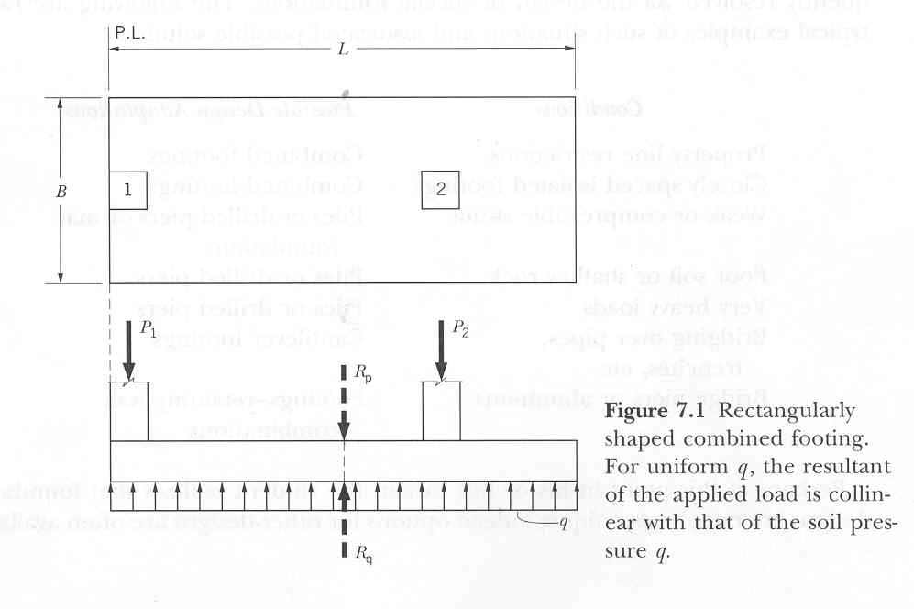
The Problem:
Figure Rectangular shaped combined footing.
For uniform q, the resultant of the applied load is collinear with that of the soil pressure q.

Slide 69
Design Procedure…
Procedure: The design is predicated on the assumption that the footing is rigid and that the soil pressure is uniform. The following explanation may illustrate the procedure:
Step 1: Convert the column loads to ULS loads via
P_{u} = 1.3(D.L.) + 1.6(L.L.). Then convert the allowable soil pressure to ULS pressure via q_{u} = (P_{lu} + P_{2u}) q_{a} / (P₁ + P₂).
Step 2: Determine the footing length (L) and width (B). First determine the location of the load resultant distance (X). This point coincides with the midpoint of L, thus yielding the value for L. B is then determined from:

Slide 70
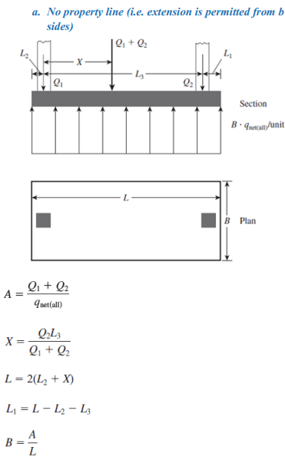
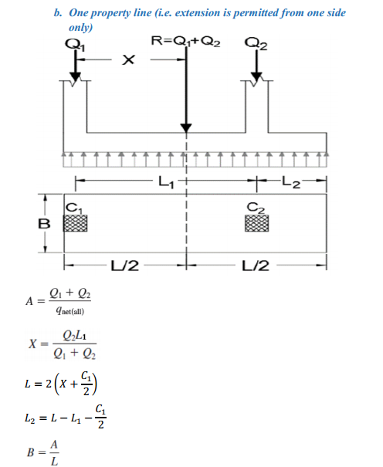

Slide 71
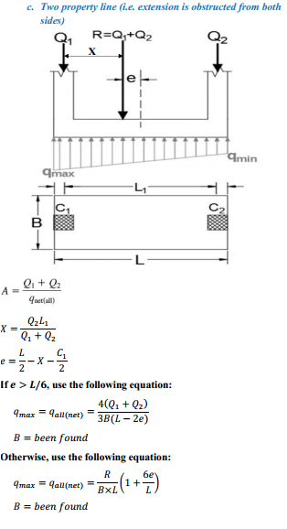

Slide 72
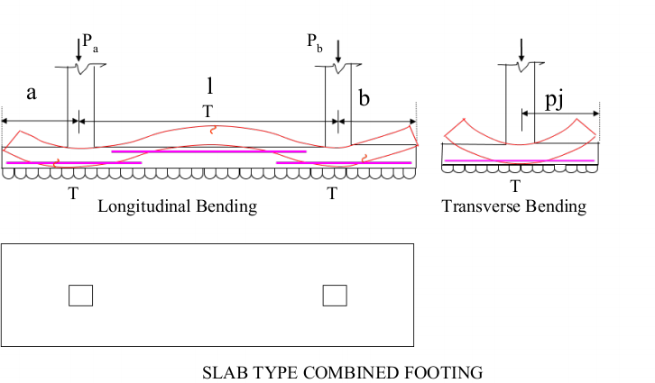
Cont’d…
Step 3: Draw shear and moment diagrams. The footing is treated as a beam, loaded with a uniform soil pressure (upward) and column loads (downward), which are treated as concentrated loads.

Slide 73
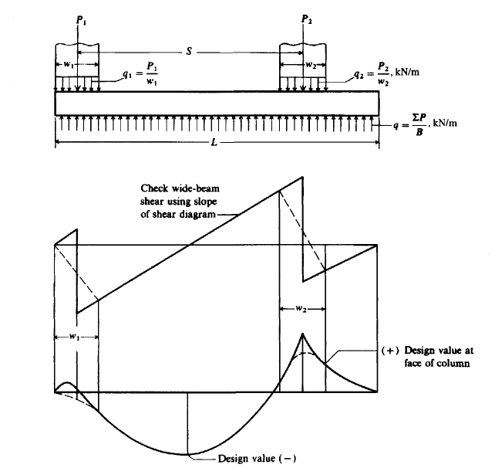
Design…

Slide 74
Cont’d…
Step 4: Determine the flexural reinforcing steel based on reasonable assumption of footing depth. The longitudinal (flexural) steel is designed using the critical moments (negative and positive) from the moment diagram. Thus, typically, combined footings will have longitudinal steel at both top and bottom of the footing.
Step 5: Check footing depth based on shear. Critical sections are at 1.5d for diagonal tension (or punching shear) and at the d for a wide beam, the same as for spread footings. The critical section for wide-beam shear is investigated only at one point (max. shear). For punching shear, however, an investigation of a three- or four-sided zone for each column may have to be done.

Slide 75
Cont’d……
Step 6: Determine the steel in the short direction. The steel in the transverse direction is-determined based on an equivalent soil pressure q' and subsequent moment, for each column. Even for stiff footings, it is widely accepted that the soil pressure in the proximity of the columns is larger than that in the zone between columns. Thus, for design, we account for this phenomenon by assuming an empirical effective column zone width of s. The soil pressure in this zone, q', is calculated as q' = P_{u}/ B_{s}, where P_{u} is the ULS column load, B the footing width and s an equivalent width of footer strip for the column in question. Commonly, the value of s is taken as the width of the column (in the longitudinal direction) plus about 0.75d on each side of that column.

Slide 76
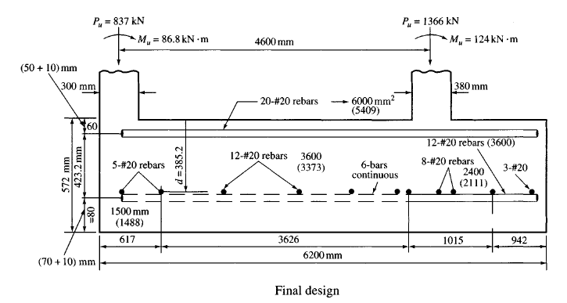
Cont’d…
Step 7: Evaluate dowel steel. The requirements are the same as for spread footings.
Step 8: Provide a drawing showing final design. This drawing is to show sufficient detail from which one may construct.

Slide 77
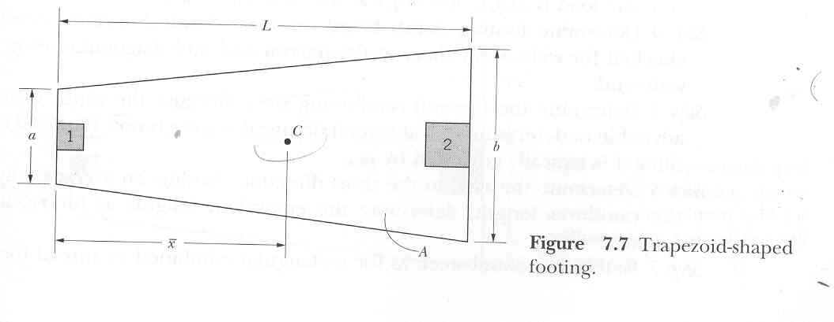
Example on Trapezoid-shaped Footings
Figure Trapezoid-shaped footing

Slide 78
Trapezoidal…
The area, A, is:

Slide 79
Trapezoidal…
Given: Included in the given data are column information (loads, sizes, location, and spacing), length of footing (L), soil bearing values (q_{a}), concrete strength (f_{ck}), and grade of reinforcement (f_{yk})
Objective: The goal is to determine footing dimensions (width, thickness), steel reinforcement (bar sizes, spacing, placement, details, dowels), and relevant details for construction.
Procedure: The design is predicated on the assumption that the footing is rigid and that the soil pressure is uniform. The basic steps are:

Slide 80
Trapezoidal…
Step 1: Convert the column loads to ultimate loads via
P_{u} = 1.3(DL) + 1.6(LL); then convert the allowable soil pressure to ultimate; that is, q_{u} = (P_{ul} + P_{u2}) q_{a}/(P_{I} + P₂).
Step 2: Determine dimensions a and b via simultaneous solutions of two independent equations.
Thus, we solve for a and b.

Slide 81
Trapezoidal…
Step 3: Draw the shear and moment diagrams. The footing is treated as a beam, loaded with a uniform soil pressure (upward) and column loads (downward), which are treated as concentrated loads. Note that while the pressure is uniform, the pressure force for-unit length varies with the width [e.g., at the narrow end, the load is a(q_{u}); and b(q_{u}) at the wide end, etc.].
Step 4: Determine footing depth based on shear (Use ρ_{min} and ρ_{e} = 0.015 for k₁ in wide beam shear and punching shear respectively). Critical sections are usually checked for wide-beam shear at the narrow end and punching shear at the wide end.

Slide 82


Slide 83
Trapezoidal…
Step 5: Determine the flexural reinforcing steel. Because the width varies, it is advisable to determine -A_{s} at several points; the same is now required for + A_{s} since it is typically governed by ρ_{min}.
Step 6: Determine the steel in the short direction. Assume an average length for the cantilever length; determine the equivalent lengths as for rectangular footings.
Step 7: Determine dowel steel, as for rectangular combined or spread footings.
Step 8: Provide a drawing with details for construction. Here some judgment is necessary to accommodate the steel arrangement in view of the variable width along the footing.

Slide 84

Strap Footings Design
Figure Typical configuration of a strap footing

Slide 85
Strap Footings…
Given Typically, included in the given part of the problem are column data (loads, sizes, reinforcement, location, and spacing), allowable soil bearing, q., concrete strength (f_{c}), and grade of reinforcement (f_{y}).
Objective The goal is to (a) determine the footing dimensions (length, width, and thickness) proportioned such that the soil pressure is reasonably uniform and differential settlement is minimal, (b) design the strap, (c) design the footings, and (d) show a drawing with pertinent details for construction purposes.

Slide 86
Strap Footings…
Procedure: The design assumes no soil pressure under the strap (other than that necessary to support the weight of the strap; hence, the weight of the strap is negated). The footings are designed as isolated footings subjected to column loads and strap reactions.
Step 1 (a) Convert to P_{u} and q_{u}, as previously described. (b) Try a value for e. This establishes the position of R₁; subsequently, this influences the ratio of Ll and B_{l} . An adjustment in e may be warranted if L_{l}/B_{l} appear unreasonable. (c) From equilibrium (i.e., ∑M = 0 and ∑F_{y} = 0), determine the values for R_{l} and R₂.

Slide 87
Cont’d…
Step 2 Determine footing dimensions, L and B. Note that q will be uniform when R coincides with the centroid of that footing. Also, for minimum differential settlement, q should be the same for both footings.
Step 3 Draw the shear (V) and moment (M) diagrams.

Slide 88

Strap Footings…

Slide 89
Cont’d…
Step 4 Design the strap as a beam. Use maximum, M in the section between footings. Affix the strap to the footings to effectively prevent footing rotation.
Step 5 Design the footings as spread (isolated) footings with reinforcement in both directions including -A_{s} steel to accommodate the negative moment. Some special assessment for the transverse steel near column 1 is recommended.
Step 6 Provide the final drawing showing details for construction.

Slide 90
Quiz (5%)
At what condition we use combined and strap footing when you compare with others shallow foundation footings.. (Delineate….
( Min. 3 point)

Slide 91

Structural Design of Mat Foundation

Slide 92


Slide 93

Cont’d…

Slide 94

Cont’d…

Slide 95

Cont’d…

Slide 96


Slide 97

Cont’d…

Slide 98

Cont’d…

Slide 99
Thank you…,!

