Slide 1
Linux Basics

Slide 2
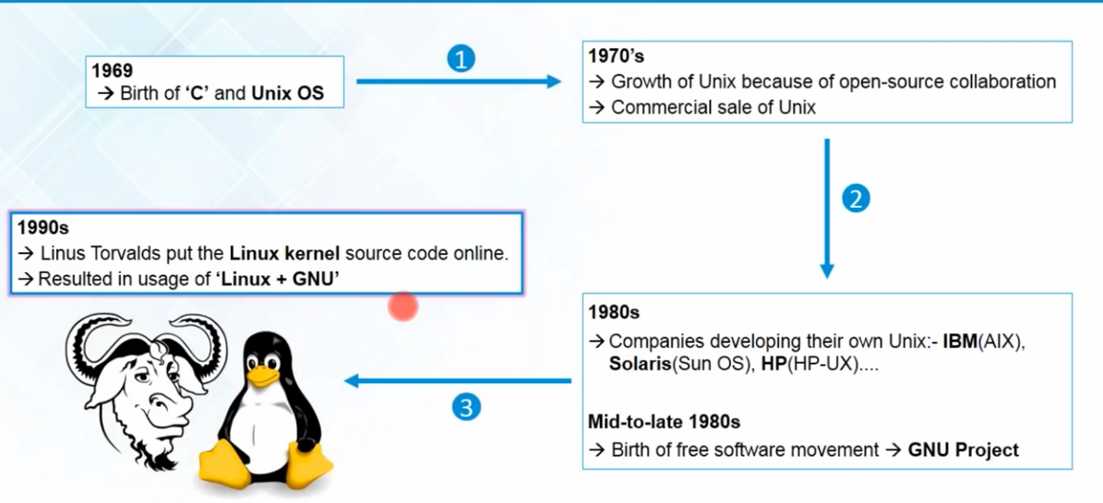
Birth of Linux

Slide 3
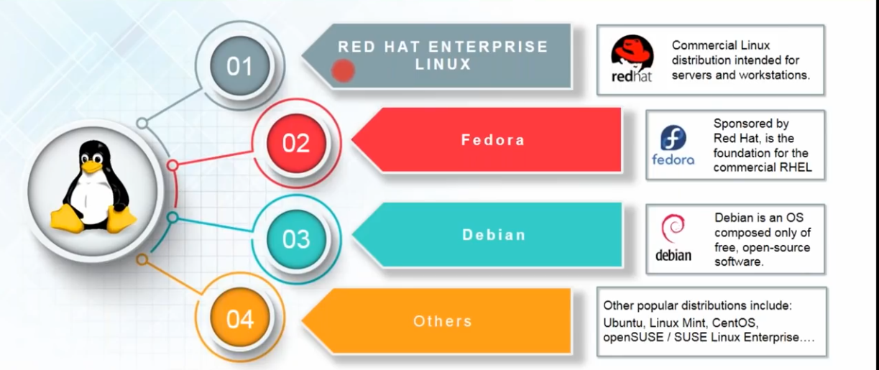
Various Linux Distributions

Slide 4
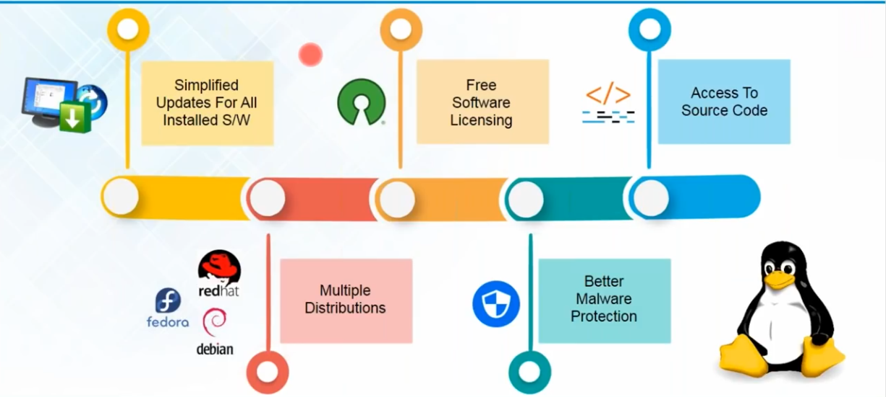
Linux’s Feature

Slide 5
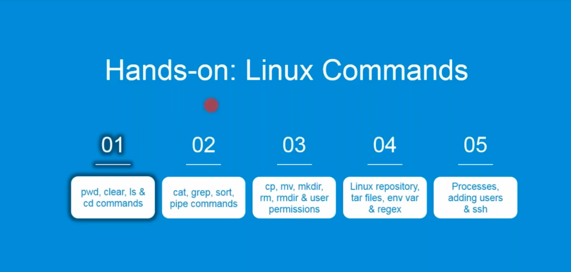
Linux Commands

Slide 6
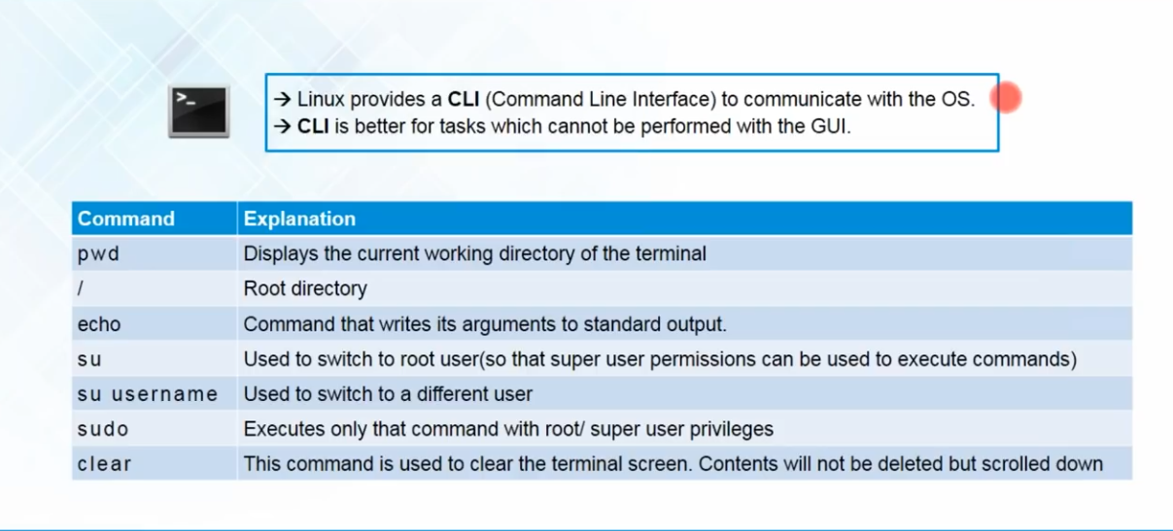
Working with Directories: ’pwd’&’clear’

Slide 7
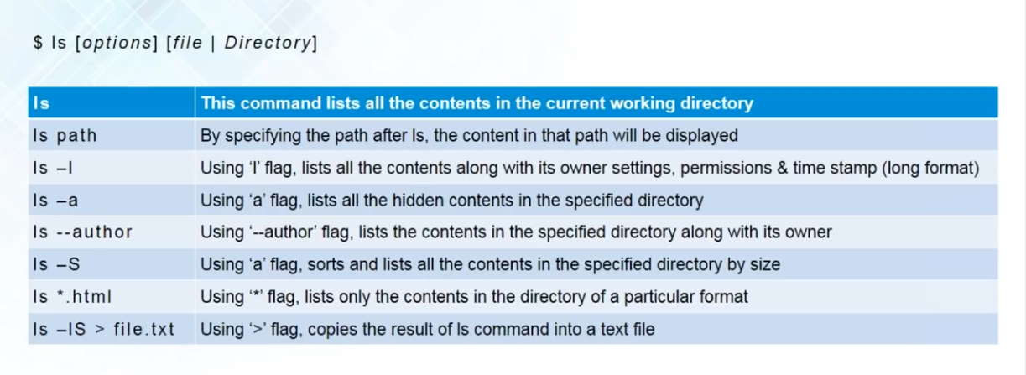
Working with directories:
‘ls’ command

