Slide 1
Ambo University Woliso Campus ,Technology and Informatics School Department of Computer Science
Data Communication and Computer Networks

Slide 2
CHAPTER- ONE DATA COMMUNICATION BASICS

Slide 3
Data Communication
deals with the transmission of signals in a reliable and efficient manner.
are the exchange of data between two devices via some form of transmission medium such as a wire cable.
When we communicate, we are sharing information. This sharing can be local or remote. Between individuals, local communication usually occurs face to face, while remote communication takes place over distance.
NB: The word data refers to information presented in whatever form is agreed upon by the parties creating and using the data.

Slide 4
The effectiveness of a data communications system depends on the following fundamental characteristics
Delivery: The system must deliver data to the correct destination. Data must be received by the intended device or user and only by that device or user.
Accuracy : The system must deliver the data accurately. Data that have been altered in transmission and left uncorrected are unusable.
Timeliness : The system must deliver data in a timely manner. Data delivered late are useless. In the case of video and audio, timely delivery means delivering data as they are produced, in the same order that they are produced, and without significant delay. This kind of delivery is called real-time transmission.

Slide 5
SIMPLE DATA COMMUNICATION MODEL
SOURCE
TRANSMITTER
COMMUNICATION SYSTEM
DESTINATION
RECIEVER

Slide 6
Source :- is where data is originated
it can be computer,pheripheral or communication equipment like cell phone
Transmitter :- converts data into a suitable form for transmission through the medium.
Communication system :- medium through which signal is sent.
Receiver :- which receives the signal and converts it into data or message.
Destination :- where the data is sent.
NB: One goal of data communications is to increase data rate (speed of transmission) while decreasing signal rate (bandwidth requirements).

Slide 7
Data Representation Technique
Information today comes in different forms such as text, numbers, images, audio, and video.
Text
In data communications, text is represented as a bit pattern, a sequence of bits (Os or Is). Different sets of bit patterns have been designed to represent text symbols. Each set is called a code, and the process of representing symbols is called coding.
Today, the prevalent coding system is called Unicode, which uses 32 bits to represent a symbol or character used in any language in the world.

Slide 8
Numbers
Numbers are also represented by bit patterns. However, a code such as ASCII is not used to represent numbers; the number is directly converted to a binary number to simplify mathematical operations
Images
Images are also represented by bit patterns. In its simplest form, an image is composed of a matrix of pixels (picture elements), where each pixel is a small dot.
The size of the pixel depends on the resolution. For example, an image can be divided into 1000 pixels or 10,000 pixels. In the second case, there is a better representation of the image (better resolution), but more memory is needed to store the image.
After an image is divided into pixels, each pixel is assigned a bit pattern

Slide 9
Audio
Audio refers to the recording or broadcasting of sound or music. Audio is by nature different from text, numbers, or images. It is continuous, not discrete. Even when we use a microphone to change voice or music to an electric signal, we create a continuous signal.
Video
Video refers to the recording or broadcasting of a picture or movie. Video can either be produced as a continuous entity or it can be a combination of images, each a discrete entity, arranged to convey the idea of motion. Again we can change video to a digital or an analog signal

Slide 10
Digital Data Transmission Format
Data : are entities that convey meaning, or information.
: raw facts.
Signals : a detectable transmitted energy that carries information.
: are electric or electromagnetic representations of data.
Signaling : is the physical propagation of the signal along a suitable medium.
Transmission : is the communication of data by the propagation and processing of signals.
Data must be transformed to electromagnetic signals to be transmitted.
Data can be analog or digital.

Slide 11
Digital Versus Analog Data
Analog data : refers to information that is continuous.
Digital data : refers to information that has discrete states.
For example, an analog clock that has hour, minute, and second hands gives information in a continuous form;
the movements of the hands are continuous.
On the other hand, a digital clock that reports the hours and the minutes will change suddenly from 8:05 to 8:06.

Slide 12
For a computer to use data it must be in discrete digital form.
Digital-to-digital conversion
: . convert digital data into digital signals
: . it can be done in two ways, line coding and block coding. For all communications, line coding is necessary whereas block coding is optional.
Line Coding
The process for converting digital data into digital signal is said to be Line Coding.
Digital data is found in digital format, which is binary bits. It is represented (stored) internally as series of 1s and 0s.

Slide 13
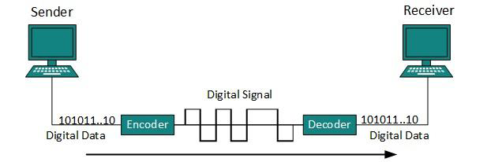
Line coding image
Digital signals which represents digital data, represented as discrete signals .
Encoding is the process of putting a sequence of characters into a specialized format for efficient transmission or storage.
Decoding the conversion of an encoded format back into the original sequence of characters.

Slide 14
There are three types of line coding schemes available:
Unipolar encoding schemes :. uses single voltage level to represent data.
Polar encoding schemes :. multiple voltage levels are used to represent binary values.
Bipolar encoding :. uses three voltage levels, positive, negative and zero.
G-Assignment1– is digital or analog signal is preferable (list reason)?
- Explain line coding schemes with graphical representation

Slide 15
Block Coding
To ensure accuracy of data frame received, redundant bits are used.
redundant bit(s) are added to each block of information bits to ensure synchronization and error detection
For example, in even parity one parity bit is added to make the count of 1s in the frame even. This way the original number of bits are increased. It is called Block Coding.
After block coding is done it is line coded for transmission.

Slide 16
Analog-to-Digital Conversion
Microphones create analog voice and camera creates analog videos, which are treated us analog data. To transmit this analog data over digital signals, we need analog to digital conversion.
Analog data is a continuous stream of data in the wave form whereas digital data is discrete. To convert analog wave into digital data, we use Pulse Code Modulation (PCM).
PCM is one of the most commonly used method to convert analog data into digital form. It involves three steps:
Sampling
Quantization
Encoding.

Slide 17
Sampling
The analog signal is sampled every T interval. Most important factor in sampling is the rate at which analog signal is sampled.
According to Nyquist Theorem, the sampling rate must be at least two times of the highest frequency of the signal.

Slide 18
Quantization
Sampling yields discrete form of continuous analog signal. Every discrete pattern shows the amplitude of the analog signal at that instance.
Quantization is approximation of the instantaneous analog value.

Slide 19
Encoding
In encoding, each approximated value is then converted into binary format

Slide 20
Transmission Impairments
Signals travel through transmission media, which are not perfect. The imperfection causes signal impairment. This means that the signal at the beginning of the medium is not the same as the signal at the end of the medium.
When signals travel through the medium they tend to deteriorate. This may have many reasons:
Attenuation: a loss of energy
Distortion: the signal changes its form or shape
Noise: Random disturbance or fluctuation in analog or digital signals is said to be Noise in signal, which may distort the actual information being carried.
G-Assignment-2 Explain the reasons behind transmission impairments

Slide 21
MODES OF DATA TRANSMISSION
The transmission mode decides how data is transmitted between two computers.
The binary data in the form of 1s and 0s can be sent in two different modes:
Parallel and
Serial

Slide 22
PARALLEL TRANSMISSION

Slide 23
In parallel transmission, the binary bits are organized into groups of fixed length. Both sender and receiver are connected in parallel with the equal number of data lines.
The sender sends all the bits at once on all lines. Because data lines are equal to the number of bits in a group or data frame, a complete group of bits (data frame) is sent once.
Advantage :- speed
Disadvantage :- is the cost of wires, as it is equal to the number of bits needs to send parallelly.

Slide 24
SERIAL TRANSMISSION
In serial transmission, bits are sent one after another in a queue manner.
Serial transmission requires only one communication channel as oppose parallel transmission where communication lines depends upon bit word length.

Slide 25
SERIAL TRANSMISSION

Slide 26
Serial transmission can be either asynchronous or synchronous.
ASYNCHRONOUS SERIAL TRANSMISSION
- It is named so because there's no importance of timing. Data-bits have specific pattern and helps receiver recognize when the actual data bits start and where it ends. For example, a 0 is prefixed on every data byte and one or more 1s added at the end.
Two continuous data-frames (bytes) may have gap between them.

Slide 27
SYNCHRONOUS SERIAL TRANSMISSION
- It is up to the receiver to recognize and separate bits into bytes.
- Advantage of synchronous transmission is speed and it has no overhead of extra header and footer bits as in asynchronous transmission.

Slide 28
Multiplexing
It is the set of techniques that allows the simultaneous transmission of multiple signals across a single data link.
Multiplexing is done using a device called Multiplexer (MUX) that combine n input lines to generate one output line i.e. (many to one).
At the receiving end a device called Demultiplexer (DEMUX) is used that separate signal into its component signals i.e. one input and several outputs (one to many).

Slide 29
Advantages of Multiplexing
More than one signals can be sent over single medium or link
Effective use of the bandwidth of medium

Slide 30
Multiplexing vs. No Multiplexing

Slide 31
Types of Multiplexing
Frequency Division Multiplexing
It is an analog technique.
Signals of different frequencies are combined into a composite signal and is transmitted on the single link.
Bandwidth of a link should be greater than the combined bandwidths of the various channels.
Each signal is having different frequency.
Channels are separated by the strips of unused bandwidth called Guard Bands (to prevent overlapping).

Slide 32
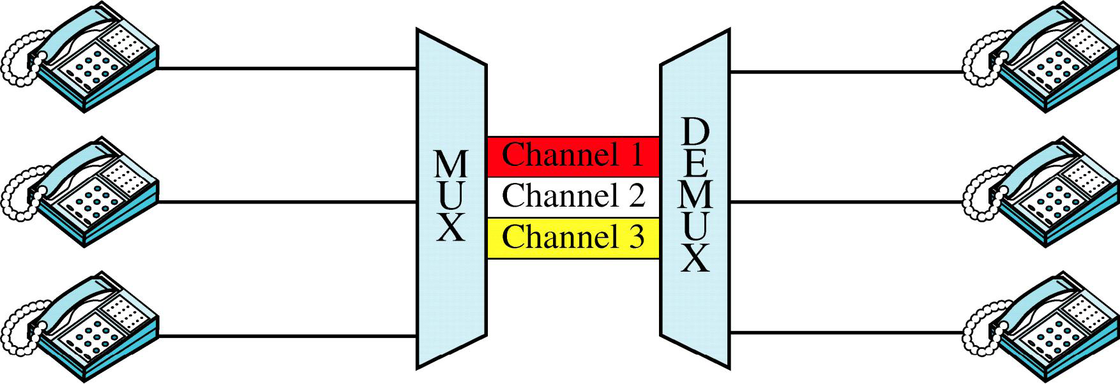
FDM

Slide 33
Wave Division Multiplexing
WDM is an analog multiplexing technique.
Working is same as FDM.
In WDM different signals are optical or light signals that are transmitted through optical fiber.
Various light waves from different sources are combined to form a composite light signal that is transmitted across the channel to the receiver.
At the receiver side, this composite light signal is broken into different light waves by Demultiplexer.
This Combining and the Splitting of light waves is done by using a PRISM. Prism bends beam of light based on the angle of incidence and the frequency of light wave.

Slide 34
Time Division Multiplexing
It is the digital multiplexing technique.
Channel/Link is not divided on the basis of frequency but on the basis of time.
Total time available in the channel is divided between several users.
Each user is allotted a particular time interval called time slot or slice.
In TDM the data rate capacity of the transmission medium should be greater than the data rate required by sending of receiving devices.

Slide 35
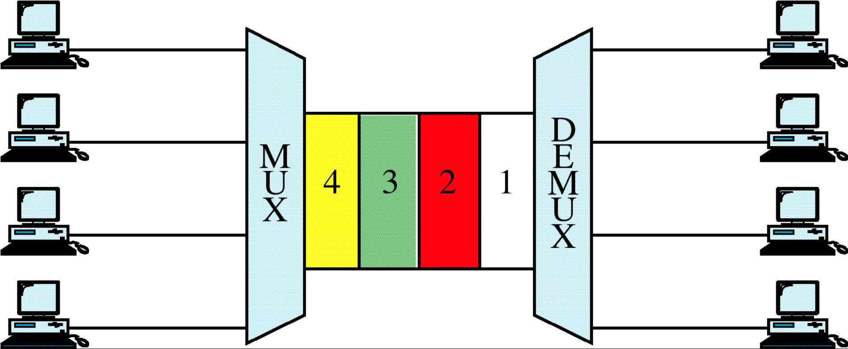
TDM
Group discussion on diagram

Slide 36
Types of TDM
Synchronous TDM
Each device is given same Time Slot to transmit the data over the link, whether the device has any data to transmit or not.
Each device places its data onto the link when its Time Slot arrives, each device is given the possession of line turn by turn.
If any device does not have data to send then its time slot remains empty.
Time slots are organized into Frames and each frame consists of one or more time slots.
If there are n sending devices there will be n slots in frame.

Slide 37
Disadvantages of STDM
The channel capacity cannot be fully utilized. Some of the slots go empty in certain frames.
Asynchronous TDM
Also known as Statistical Time Division multiplexing.
In this time slots are not Fixed i.e. slots are Flexible.
Total speed of the input lines can be greater than the capacity of the path.
In ASTDM we have n input lines and m slots i.e. m less than n (m<n).
Slots are not predefined rather slots are allocated to any of the device that has data to send.

Slide 38
Signal Encoding Techniques
G-Assignment 3

Slide 39
Data Transmission Error Detection and Correction
Data-link layer uses some error control mechanism to ensure data bit streams are transmitted with certain level of accuracy. But to understand how errors is controlled, it is essential to know what types of errors may occur.
There may be three types of errors:
Single bit error: In a frame, there is only one bit, anywhere though, which is corrupt.
Multiple bits error: Frame is received with more than one bits in corrupted state.
Burst error: Frame contains more than1 consecutive bits corrupted.

Slide 40
Error control mechanism may involve two possible ways:
Error detection
Error correction
Error Detection :
Errors in the received frames are detected by means of Parity Check and CRC (Cyclic Redundancy Check).
-In both scenario, few extra bits are sent along with actual data to confirm that bits received at other end are same as they were sent.
-If the checks at receiver's end fails, the bits are corrupted.

Slide 41
PARITY CHECK
- One extra bit is sent along with the original bits to make number of 1s either even.
- The sender while creating a frame counts the number of 1s in it. for example, if even parity is used and number of 1s is even then one bit with value 0 is added. This way number of 1s remain even. Or if the number of 1s is odd, to make it even a bit with value 1 is added.
-The receiver simply counts the number of 1s in a frame. If the count of 1s is even and even parity is used, the frame is considered to be not-corrupted and is accepted.
- If the count of 1s is odd and odd parity is used, the frame is still not corrupted. If a single bit flips in transit, the receiver can detect it by counting the number of 1s. But when more than one bits are in error it is very hard for the receiver to detect the error

Slide 42
CYCLIC REDUNDANCY CHECK(CRC)
-is a different approach to detect if the frame received contains valid data. This technique involves binary division of the data bits being sent.
-The sender performs a division operation on the bits being sent and calculates the remainder. Before sending the actual bits, the sender adds the remainder at the end of the actual bits. Actual data bits plus the remainder is called a codeword. The sender transmits data bits as codewords.
-At the other end, the receiver performs division operation on codewords using the same CRC divisor. If the remainder contains all zeros the data bits are accepted, otherwise there has been some data corruption occurred in transit.

Slide 43
Error Correction
In digital world, error correction can be done in two ways:
Backward Error Correction: When the receiver detects an error in the data received, it requests back the sender to retransmit the data unit.
Forward Error Correction: When the receiver detects some error in the data received, it uses an error-correcting code, which helps it to auto-recover and correct some kinds of errors.
NB: Backward Error Correction, is simple and can only be efficiently used where retransmitting is not expensive, for example fiber optics. But in case of wireless transmission retransmitting may cost too much, in such case Forward Error Correction is used.

