Slide 1
Ambo University
Woliso Campus ,Technology and Informatics School
Department of Computer Science
Data Communication and Computer Networks

Slide 2
CHAPTER TWO
INTRODUCTION TO COMPUTER NETWORKS

Slide 3
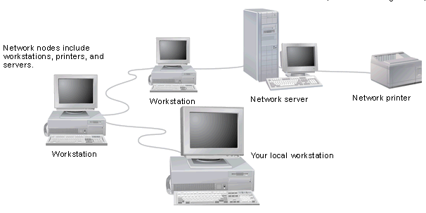
Computer Networks
A network is a set of devices (often referred to as nodes) connected by communication links to communicate data.
A node can be a computer, printer, or any other device capable of sending and/or receiving data generated by other nodes on the network.

Slide 4
Network Applications
Computer systems and peripherals are connected to form a network.
They provide numerous advantages:
  Resource sharing such as printers and storage devices
  Exchange of information by means of e-mails and FTP
  Information sharing by using Web or Internet
  Interaction with other users using dynamic web pages
  Video conferences
  Parallel computing
  Instant messaging

Slide 5
Types of Computer networks
Computer networks are classified based on various factors.
They include:
Geographical span -LAN, MAN and WAN
Administration -Private network & public network
Architecture-Client/Server & peer-to-peer
A private network is used inside an organization.

Slide 6
Types of Network- Geographical Span
LAN
A local area network (LAN) is usually privately owned and links the devices in a single office, building, or campus.
LAN size is limited to a few kilometres.
In the early 1980s, LANs might have consisted of a handful of computers connected in a peer-to-peer fashion.
Today’s LANs are typically much larger and more complex client/server networks.

Slide 7
MAN
A metropolitan area network (MAN) is a network with a size between a LAN and a WAN.
It normally covers the area inside a town or a city.
MAN-is A network that is larger than a LAN and connects clients and servers from multiple buildings.
Because of the distance it covers, a MAN may use different transmission technology and media than a LAN.

Slide 8
WAN
A wide area network (WAN) provides long-distance transmission of data, image, audio, and video information over large geographic areas that may comprise a country, a continent, or even the whole world.
The largest and most varied WAN in the world is the Internet.

Slide 9
Types of Network-Architecture
Computers can be positioned on a network in different ways relative to each other.
They can have different levels of control over shared resources.
They can also be made to communicate and share resources according to different schemes.
The following sections describe two fundamental network models:
peer-to-peer and client/server.

Slide 10
Peer-to-Peer
In a peer-to-peer network:-
There are no dedicated servers.
There is no hierarchy among the computers.
All the computers are equal and therefore are known as peers.
Each computer functions as both a client and a server.
There is no administrator responsible for the entire network.
The user at each computer determines what data on that computer is shared on the network.

Slide 11
Peer-to-Peer Networks
The simplest form of a network is a peer-to-peer network.
In a peer-to-peer network, every computer can communicate directly with every other computer.
By default, no computer on a peer-to-peer network has more authority than another.
However, each computer can be configured to share only some of its resources and prevent access to other resources.
Every computer is capable of sending and receiving information to and from every other computer.

Slide 12
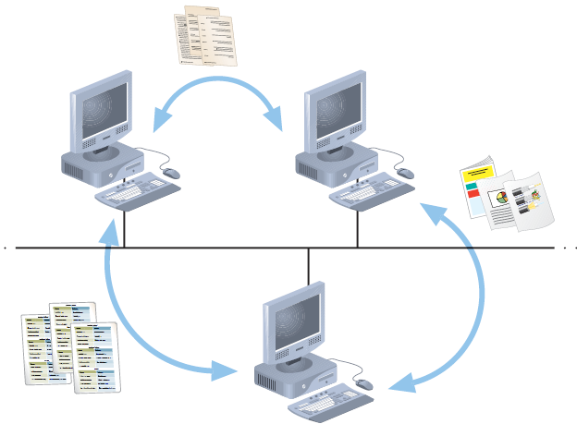
Peer-to-Peer Networks

Slide 13
Client/Server Networks
A network that uses a server to enable clients to share data, data storage space, and devices is known as a client/server network.
Client—A computer on the network that requests resources or services from another computer on a network.
Clients usually take the form of personal computers, also known as workstations.
Every computer on a client/server network acts as a client or a server.
Clients on a client/server network do not share their resources directly with each other, but rather use the server as an intermediary.

Slide 14
Client/Server Networks
Clients and servers communicate through connectivity devices such as switches or routers.
Server—A computer on the network that manages shared resources; servers usually have more processing power, memory, and hard disk space than clients.
To function as a server, a computer must be running an NOS (network operating system).
An NOS is a special type of software designed to do the following:
  Manage data and other resources for a number of clients.
  Ensure that only authorized users access the network.

Slide 15
Client/Server Networks
  Restrict when and from where users can access the network.
  Dictate which rules computers will use to communicate.
  Supply applications to clients.
Examples of NOS: UNIX and Linux, Microsoft Windows Server 2003 or Server 2008, and Mac OS X Server.
(But, stand-alone computer, or a client computer, uses an operating system, such as Windows XP/7 or Windows Vista, which has more limited resource management capabilities.)

Slide 16
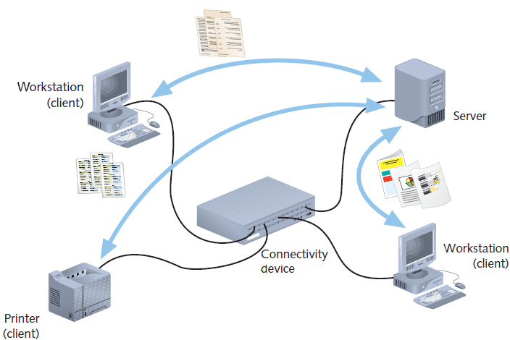
Client/Server Networks

Slide 17
Client/Server
In an environment with more than 10 users, a peer-to-peer will probably not be adequate.
Therefore, most networks have/required dedicated servers.
A dedicated server is one that functions only as a server and is not used as a client or workstation.
Client requests the server to serve the requests.
Specialized Servers
Some of the examples of different types of servers included on many large networks.

Slide 18
Specialized Servers
1-File Servers
File servers offer services that allow network users to share files.
2- Print Servers
Allow users to share printers
Allow multiple and simultaneous access to printing facilities.
3- Database Servers
Database server can provide a network with powerful database services.
4 -Application Servers
Servers store vast amounts of data that is organized to make it easy to retrieve.
An application server differs from a file server in that with file server the data or file is downloaded to the computer which making the request.
With an application server, the database /file stays on the server and only the results of a request are downloaded to the computer which making the request.

Slide 19
Specialized Servers
5-Mail Servers
Mail servers - separate server and client applications.
Data selectively downloaded from the server to the client.
6-Web Servers
Stores different web pages.
7- Proxy Server
A Proxy Server implements Internet connectivity and network security for an entire organization.

Slide 20
Network Topologies
Types of Connection
There are two possible types of connections: point-to-point and multipoint.
Point-to-Point
A point-to-point connection provides a dedicated link between two devices.
The entire capacity of the link is reserved for transmission between those two devices.
e.g connection b/n television and its remote control
Multipoint
A multipoint connection is one in which more than two specific devices share a single link.

Slide 21
Physical Topology
The topology of a network is the geometric representation of the relationship of all the links and linking devices (usually called nodes) to one another.
The topology- is physical layout of a computer network.
Topologies vary according to the needs of the organization, available hardware and expertise.
There are five basic topologies possible:
    Bus
    Ring
    Star
    Mesh
    Hybrid

Slide 22
Bus
A bus topology is multipoint connection.
One long cable acts as a backbone to link all the devices in a network.

Slide 23
Bus
Advantages
Connecting a computer or peripheral to a linear bus is easy.
This topology requires least amount of cabling to connect the computers and therefore, less expensive.
It is easy to extend a bus since two cables can be joined into longer cable with a connector.
Disadvantages
Entire network shuts down if there is a failure on the backbone.
Heavy traffic can slow down a bus because computers on such networks do not coordinate.

Slide 24
Ring
In a ring topology, each device has a dedicated point-to-point connection with only the two devices on either side of it.

Slide 25
Ring
Advantage
Ring topology is easy to install and reconfigure.
Every computer is given equal access to the ring.
Hence, no single computer can monopolize the network.
Disadvantages
Failure in any cable or node breaks the loop and can take down the entire network.
Maximum ring length and number of nodes are limited.

Slide 26
Star
In a star topology, each device has a dedicated point-to-point link only to a central controller, usually called a hub.
The devices are not directly linked to one another.

Slide 27
Star
Advantages of Star
Star topology is easy to install and wire.
The network is not disrupted even if a node fails or is removed from the network.
Fault detection and removal of faulty parts is easier in star topology.
Disadvantages of Star
It requires a longer length of cable.
If the hub fails, nodes attached to it are disabled.
The cost of the hub makes the network expensive as compared to bus and ring topology.

Slide 28
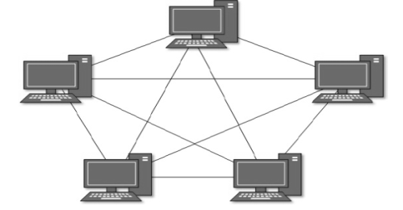
Mesh
In a mesh topology, every device has a dedicated point-to-point link to every other device.

Slide 29
Mesh
Advantages of Mesh Topology
The use of large number of links eliminates network congestion.
If one link becomes unusable, it does not disable the entire system.
Disadvantages of Mesh Topology
The amount of required cabling is very large.
As every node is connected to the other, installation and reconfiguration is very difficult.
The amount of hardware required in this type of topology can make it expensive to implement.

Slide 30
Hybrid
A network structure whose design contains more than one topology is said to be hybrid topology.
Hybrid topology inherits merits and demerits of all the incorporating topologies.

