Slide 1
Ambo University
Woliso Campus Technology and Informatics School
Department of Computer Science
Data Communication and Computer Networks
Network Models

Slide 2
Network Models
Computer networks are created by different entities.
Standards are needed so that these heterogeneous networks can communicate with one another.
The two best-known standards are the OSI model and the TCP/IP model.
Protocols are sets of instructions designed and coded by programmers.

Slide 3
The OSI Model
It was developed by the International Organization for Standardization (ISO).
It is a model for a computer protocol architecture and as a framework for developing protocol standards.
An ISO standard that covers all aspects of network communications is the Open Systems Interconnection (OSI) model.
Comprises of seven layers

Slide 4
Advantages of OSI
Network communication is broken into smaller, more manageable parts.
Allows different types of network hardware and software to communicate with each other.
All layers are independent and changes does not affect other layers.
Easier to understand network communication.

Slide 5
Why layered communication?
To reduce complexity of communication task by splitting it into several layered small tasks
• assists in protocol design
• foster competition
• changes in one layer do not affect other layers
• provides a common language

Slide 6
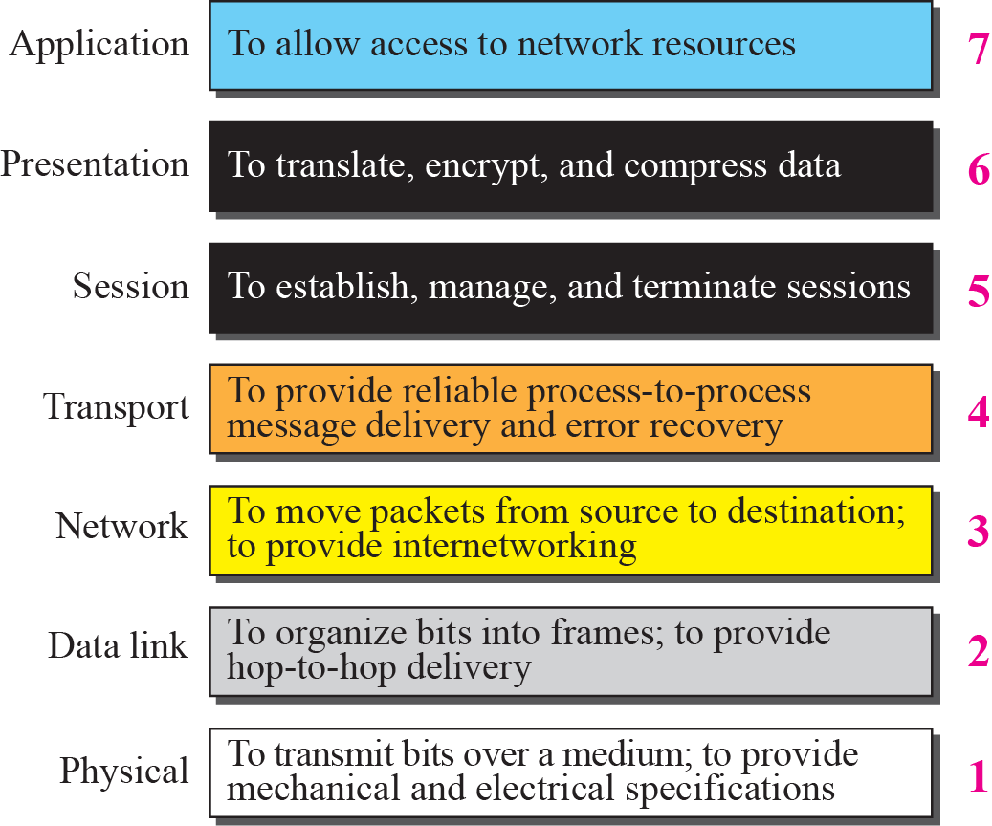
Summary of OSI Layers

Slide 7
LAYER 7: APPLICATION
The application layer is responsible for providing services to the user.
Closest to the user and provides user interfaces
Establishes the availability of intended communication partners.
Examples of Application layer protocols are: Telnet, SMTP, FTP, SNMP, HTTP, DNS, DHCP

Slide 8
LAYER 6: PRESENTATION
Presentation layer is concerned with the syntax and semantics of the information exchanged between two systems
Presentation layer serves as a translator.
This layer is primarily responsible for the translation, encryption and compression of data
Defines coding and conversion functions
This layer also manages security issues by providing services such as data encryption and data compression
Examples of these formats and schemes are: MPEG, QuickTime, ASCII, EBCDIC, GIF, TIFF, JPEG
For example, the popular audio format MP3uses MPEG compression.
Notes:
encryption is used to keep secret all data transmitted. It uses secret key
Encryption key — a short bit string used to encrypt a message
Decryption key — a short bit string used to decrypt a message

Slide 9
LAYER 5: SESSION
The session layer defines how to start, control and end conversations (called sessions) between applications
Establishes dialog control between the two computers in a session, regulating which side transmits, plus when and how long it transmits (Full duplex)
Synchronization: Allows processes to add check points. E.g. Insert check point at every 100 pages of 2000 pages file to ensure that each 100-page unit is received & acknowledged.

Slide 10
LAYER 4: TRANSPORT
It regulates information flow to ensure process-to- process connectivity between host applications reliably and accurately
Adds service point address or Port address
Segmentation & Re-assembly: SEGMENTS data from sending node and reassembles data on receiving node
Flow control / Error control at Source to destination level
Connection oriented transport service ensures that data is delivered error free, in sequence with no losses or duplications
Establishes, maintains and terminates virtual circuits
Connection oriented / Connectionless:
-TCP (Reliable, provides guaranteed delivery),
-UDP (Unreliable, less overhead, reliability can be provided by
the Application layer)
Provides multiplexing: the support of different flows of data to different applications on the same host
Notes:
The process of encoding information in an attempt to make it secure from unauthorized access, particularly during
transmission.
The reverse of this process is known as decryption. we need a method to label the different processes.
In other words, they need addresses. In the TCPIIP architecture, the label assigned to a process is called a port address.
7.3 Addressing
at the data link layer, we need a MAC address
at the network layer, we need an IP address
at the transport layer, we need a transport-layer address, called a port number, to choose among several processes

Slide 11
LAYER 3: NETWORK
Defines source to destination delivery of packets across NWs
Defines logical addressing and best path determination.
Treat each packet independently
Defines how routing works and how routes are learned
Converts frames to packets
Routed protocols ( encapsulate data into packets) and Routing protocols (create routing tables) work on this layer
Examples of Routed protocols are: IP, IPX, AppleTalk and Routing protocols are OSPF, IGRP/EIGRP, RIP, BGP
Routers operate at Layer 3.

Slide 12
LAYER 2: DATA LINK
Packages raw bits from the physical layer into FRAMES
The data link layer provides reliable transit of data across a physical link by using the Media Access Control (MAC) addresses
  Source & Destination ( address of device that connects one Network to next) address
    Flow Control: refers to a set of procedures used to restrict the amount of data that the sender can send before receiving an acknowledgement
  Error Control: refers to both error detection and error correction
Data Link LAN specifications: Fast Ethernet, Token Ring, FDDI .
Data Link WAN specifications are: Frame Relay, PPP, X.25.
Bridges and Switches operate at this layer
Notes:
hardware address The address assigned
to a network interface card (NIC) by the original manufacturer or by the network
administrator if the interface card is configurable.
This address identifies the local device address to the rest of the network and allows messages to find the correct destination.
Also known as the physical address, media access control (MAC) address, or Ethernet address.

Slide 13
Sub layers of Layer 2
Logical link layer (LLC)
  Used for communication with upper layers
  Error correction
  Flow control
Media Access Control (MAC)
  Access to physical medium
Frames include information about:
Which computers are in communication with each other
When communication between individual computers begins and when it ends
Which errors occurred while the computers communicated (LLC)

Slide 14
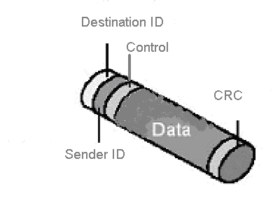
Data Link- Layer 2
e.g. of a simple data frame.
The sender ID represents the address of the computer that is sending the information.
The destination ID represents the address of the computer to which the information is being sent.
The control information is used for frame type, and routing information.
The cyclical redundancy check (CRC) provides error correction and verification.

Slide 15
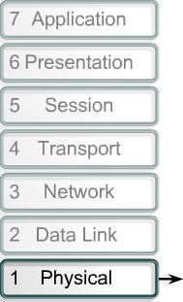

Layer 1: Physical Layer
Physical Layer
  Define physical characteristics of network. E.g. wires, connector, voltages, data rates, Asynchronous, Synchronous Transmission
  Handles bit stream or binary transmission
  Used to maintain, activate and deactivate physical link.
  For receiver it reassembles bits and send to upper layer for frames.
  For Sender it convert frames
  into bit stream and send on
  transmission medium.

Slide 16
Properties of Physical Layers
Deals with bit stream.
Transmits raw bit stream over physical cable
defines cables, cards, and physical aspects
defines NIC attachments to hardware, how cable is attached to NIC
defines techniques to transfer bit stream to cable
Layer 1 Device: Repeater, Hub, Multiplexer

Slide 17
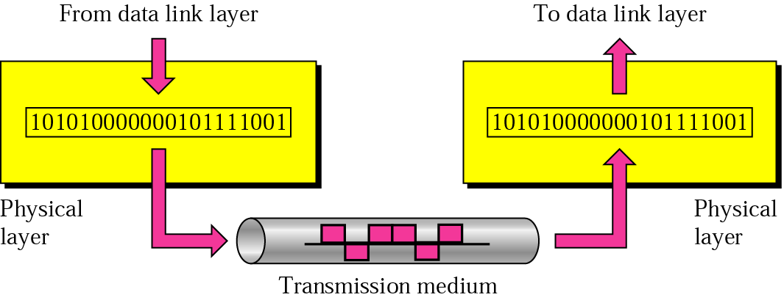
Physical layer
physical
connection
Transporting bits from one end node to the next
type of the transmission media (twisted-pair, coax, optical fiber, air)
bit representation (voltage levels of logical values)
data rate (speed-the number of bits sent each second)
synchronization of bits (time synchronization)

Slide 18
Difference between Layer 1 and Layer 2
Layer 1 cannot communicate with upper layers
Layer 2 does this using LLC
Layer 1 cannot identify computer
Layer 2 uses addressing process
Layer 1 can only describe stream of bits
Layer 2 uses framing to organize bits

Slide 19
Data Encapsulation
Data Encapsulation is the process of adding a header to wrap/envelop the data that flows down the OSI model.
The 5 Steps of Data Encapsulation are:
  1. The Application, Presentation and Session layers create DATA from users' input.
  2. The Transport layer converts the DATA to SEGMENTS
  3. The Network layer converts the Segments to Packets (datagram)
  4. The Data Link layer converts the PACKETS to FRAMES
  5. The Physical layer converts the FRAMES to BITS.
Notes:
Node-to-node-data link layer-Mac Address to deliver data to the next node
Host-to-host-network layer-IP address needed to deliver to the host
Process-to-process-transport layer –real communication-port number/address

Slide 20
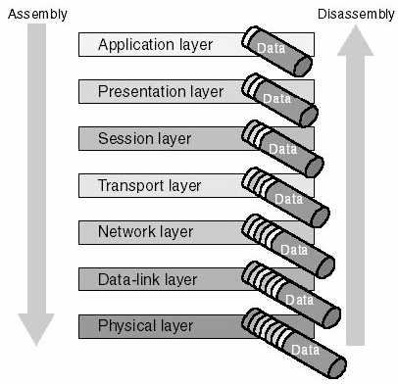
OSI Reference Model
Packet assembly and disassembly process

Slide 21
TCP/IP PROTOCOL SUITE
By IETF: The Internet Engineering Task Force/DoD (Department of Defense)
The TCP/IP protocol suite was developed prior to the OSI model.
Therefore, the layers in the TCP/IP protocol suite do not match exactly with those in the OSI model.
The original TCP/IP protocol suite was defined as four software layers built upon the hardware.
Today, however, TCP/IP is thought of as a five-layer model with the layers named similarly to the ones in the OSI model.
Notes:
ANSI (American National Standards Institute)

Slide 22
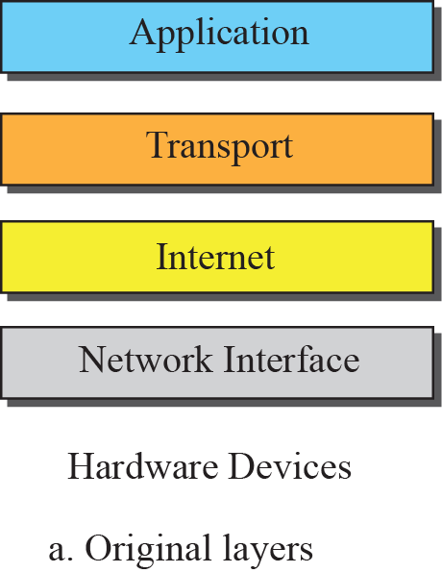
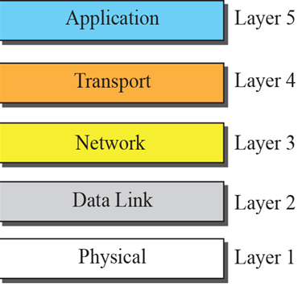

Layers in the TCP/IP Protocol Suite
b. Categorization into Five layers
Notes:
Five layers system

Slide 23
The key features of a protocol
In the context of data networking, a protocol is a formal set of rules and conventions that governs how computers exchange information over a network medium.
The peer layers communicate by means of formatted blocks of data that obey a set of rules or conventions known as a protocol. The key features of protocol are:
Syntax – Syntax.-refers to the structure or format of the data, meaning the order in which they are presented.
Semantics - control info. & error handling
Timing - speed matching & sequencing-decides when data should be sent and how fast they can be sent.
Notes:
Syntax. The term syntax refers to the structure or format of the data, meaning the
order in which they are presented. For example, a simple protocol might expect the
first 8 bits of data to be the address of the sender, the second 8 bits to be the address
of the receiver, and the rest of the stream to be the message itself.
Semantics. The word semantics refers to the meaning of each section of bits.
How is a particular pattern to be interpreted, and what action is to be taken based
on that interpretation? For example, does an address identify the route to be taken
or the final destination of the message?
Timing. The term timing refers to two characteristics: when data should be sent
and how fast they can be sent. For example, if a sender produces data at 100 Mbps
but the receiver can process data at only 1 Mbps, the transmission will overload the
receiver and some data will be lost.

Slide 24
OSI and TCP/IP similarities
Similarities include:
Both have layers.
Both have application layers, though they include very different services.
Both have comparable transport and network layers.
Both assume packets are switched. This means that individual packets may take different paths to reach the same destination. This is contrasted with circuit-switched networks where all the packets take the same path.

Slide 25
OSI and TCP/IP Differences
Differences include:
TCP/IP combines the presentation and session layer issues into its application layer.
TCP/IP combines the OSI data link and physical layers into the network access layer.
TCP/IP appears simpler because it has fewer layers.
TCP/IP protocols are the standards around which the Internet developed, so the TCP/IP model gains credibility just because of its protocols.
In contrast, networks are not usually built on the OSI protocol, even though the OSI model is used as a guide.

Slide 26
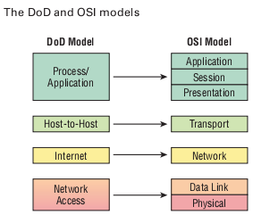
Network Models

Slide 27
TCP/IP Process/Application layer
These process integrate the various activities and duties spanning the focus of the OSI’s corresponding top three layers (Application, Presentation, and Session).
Controls user-interface specifications.

Slide 28
TCP/IP Host-to-Host/Transport layer
The Host-to-Host layer parallels the functions of the OSI’s Transport layer, defining protocols for setting up the level of transmission service for applications.
It tackles issues like creating reliable end-to-end communication and ensuring the error-free delivery of data.
It handles packet sequencing and maintains data integrity.

Slide 29
TCP/IP INTERNET LAYER
The Internet layer corresponds to the OSI’s Network layer, designating the protocols relating to the logical transmission of packets over the entire network.
It takes care of the addressing of hosts by giving them an IP (Internet Protocol) address and handles the routing of packets among multiple networks.

Slide 30
TCP/IP NETWORK ACCESS LAYER
At the bottom of the DoD model, the Network Access layer implements the data exchange between the host and the network.
The equivalent of the Data Link and Physical layers of the OSI model, the Network Access layer oversees hardware addressing and defines protocols for the physical transmission of data.
The reason TCP/IP became so popular is because there were no set physical layer specifications, so it could run on any existing or future physical network!

Slide 31
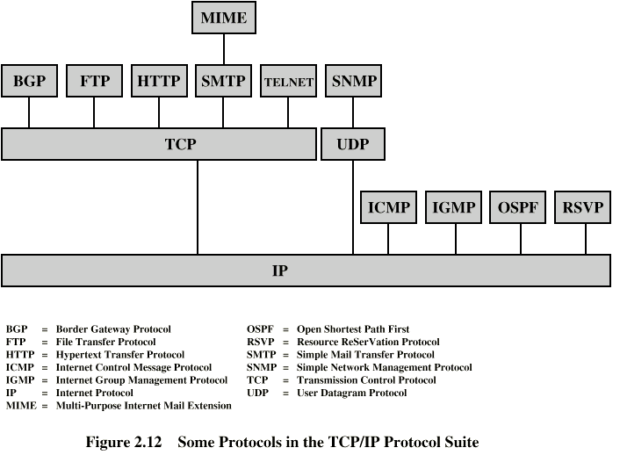
Some TCP/IP Protocols
Notes:
Each layer in the TCP/IP protocol suite interacts with its immediate adjacent layers. This use of each individual layer is not required by the architecture. As Stallings DCC8e Figure 2.5 suggests, it is possible to develop applications that directly invoke the services of any one of the layers. Most applications require a reliable end-to-end protocol and thus make use of TCP. Some special-purpose applications do not need the services of TCP. Some of these applications, such as the Simple Network Management Protocol (SNMP), use an alternative end-to-end protocol known as the User Datagram Protocol (UDP); others may make use of IP directly. Applications that do not involve internetworking and that do not need TCP have been developed to invoke the network access layer directly.

Slide 32
Some of application layer protocols and their functions

Slide 33
Application layer protocol- Simple Mail Transfer Protocol (SMTP)
Governs the transmission of mail messages and attachments
SMTP is used in the case of outgoing messages
More powerful protocols such as POP3 and IMAP4 are needed and available to manage incoming messages
POP3(Post Office Protocol version 3) is the older protocol
IMAP4(Internet Mail Access Protocol version 4) is the more advanced protocol

Slide 34
Application layer protocol- Telnet
Telnet is a protocol used to log on to remote hosts using the TCP/IP protocol suite.
Using Telnet, a TCP connection is established and keystrokes on the user’s machine act like keystrokes on the remotely connected machine.
Often, Telnet is used to connect two dissimilar systems (such as PCs and UNIX machines).
Through Telnet, you can control a remote host over LANs and WANs such as the Internet.
For example, network managers can use Telnet to log on to a router from a computer elsewhere on their LAN and modify the router’s configuration.

Slide 35
Application layer protocol- File Transfer Protocol (FTP)
File Transfer Protocol (FTP) lets us transfer files, and it can accomplish this between any two machines using it.
But accessing a host through FTP is only the first step.
Users must then be subjected to an authentication login that’s usually secured with passwords and usernames implemented by system administrators to restrict access.
FTP’s functions are limited to listing and manipulating directories, typing file contents, and copying files between hosts.

Slide 36
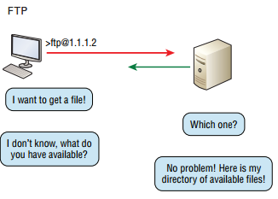

Slide 37
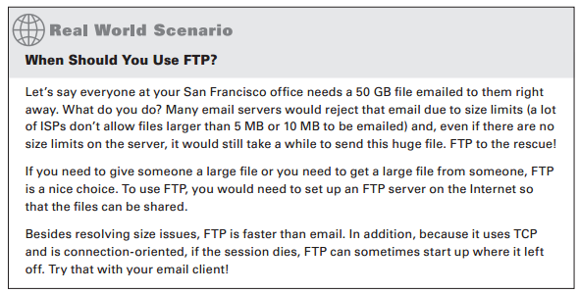

Slide 38
Trivial File Transfer Protocol (TFTP)
Trivial File Transfer Protocol (TFTP) is stock version of FTP, but it’s the protocol of choice if you know exactly what you want and where to find it because it’s fast and so easy to use!
But TFTP doesn’t offer the abundance of functions that FTP does because it has no directory-browsing abilities, meaning that it can only send and receive files
There’s no authentication as with FTP, so it’s even more insecure, and few sites support it because of the inherent security risks.
A significant difference between FTP and TFTP is that TFTP relies on UDP at the Transport layer, but FTP uses TCP protocol.

Slide 39
Simple Network Management Protocol (SNMP)
Simple Network Management Protocol (SNMP) collects and manipulates valuable network information.
It gathers data from a network management station (NMS) at fixed or random intervals, requiring them to disclose certain information, or even asking for certain information from the device.
In addition, network devices can inform the NMS about problems as they occur so the network administrator is alerted.

Slide 40
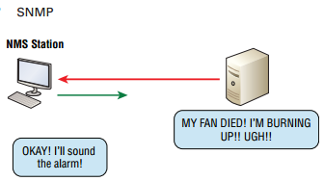
SNMP

Slide 41
Hypertext Transfer Protocol (HTTP)
It’s used to manage communications between web browsers and web servers and opens the right resource when you click a link, wherever that resource may actually reside.
In order for a browser to display a web page, it must find the exact server that has the right web page, plus the exact details that identify the information requested.
The browser can understand what you need when you enter a Uniform Resource Locator (URL), which we usually refer to as a web address, e.g. http://www.lammle.com/forum and http://www.lammle.com/blog.
Each URL defines the protocol used to transfer data, the name of the server, and the particular web page on that server.

Slide 42
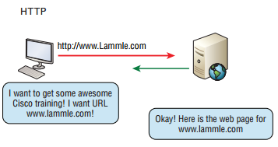

Slide 43
Hypertext Transfer Protocol Secure (HTTPS)
Hypertext Transfer Protocol Secure (HTTPS) is also known as Secure Hypertext Transfer Protocol.
It uses Secure Sockets Layer (SSL).
Sometimes you’ll see it referred to as SHTTP or S-HTTP, which were slightly different protocols, but since Microsoft supported HTTPS, it became the de facto standard for securing web communication.
But no matter-as indicated, it’s a secure version of HTTP that arms you with a whole bunch of security tools for keeping transactions between a web browser and a server secure.

Slide 44
Domain Name Service (DNS)
The Domain Name System (DNS) is a directory lookup service that provides a mapping between the name of a host on the Internet and its numerical address.
Domain Name Service (DNS)-resolves hostnames- to IP addresses specifically, Internet names, such as www.au.edu.et
But you don’t have to actually use DNS. You just type in the IP address of any device you want to communicate with and find the IP address of a URL by using the Ping program.
For example, >ping www.cisco.com will return the IP address resolved by DNS.

Slide 45
Domain Name System (DNS)
Resolves domain names to IP addresses and vice versa
An IP address identifies hosts on a network and the Internet as well, but DNS was designed to make our lives easier.
The IP address would change and no one would know what the new one was.
DNS allows you to use a domain name to specify an IP address.
DNS Server
www.amu.edu.et
10.1.0.15

Slide 46
Domain Name
A domain name is represented by a series of character strings, called labels, separated by dots.
Each label represents a level in the domain naming hierarchy.
E.g In the domain name www.google.com, com is the top-level domain (TLD), google is the second-level domain, and www is the third-level domain.
Each second-level domain can contain multiple third level domains.
E.g In addition to www.google.com, Google also owns the following domains: news.google.com, maps.google.com, and mail.google.com.

Slide 47
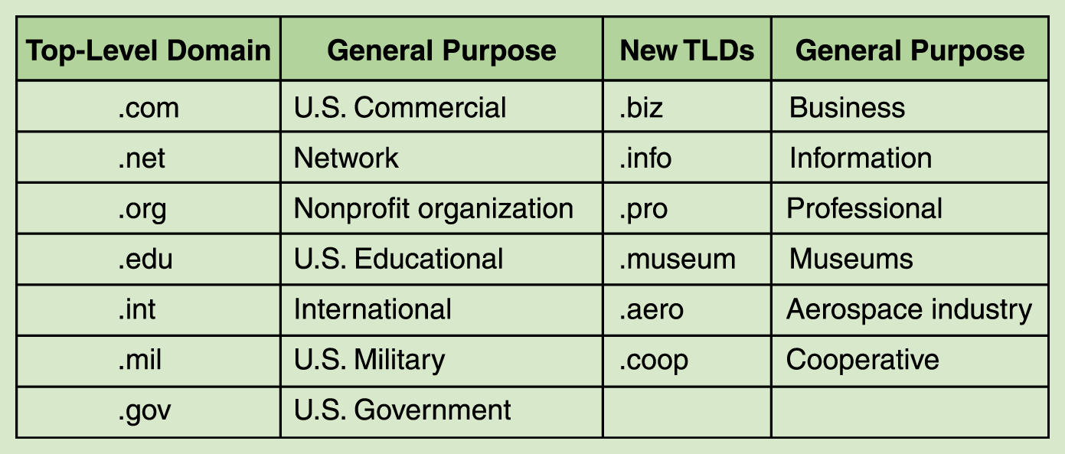
DNS cont’d…
The very last section of the domain is called its top-level domain (TLD) name
Top-level domains, including some relatively new ones

Slide 48
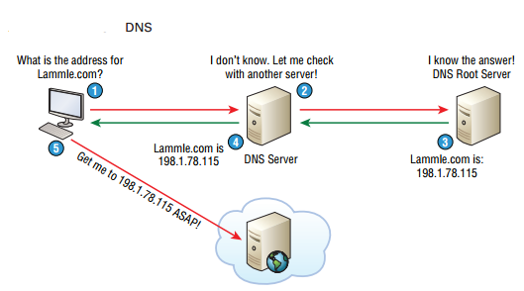

Slide 49
Dynamic Host Configuration Protocol (DHCP)
Dynamic Host Configuration Protocol (DHCP) assigns IP addresses to hosts dynamically.
It allows for easier administration and works well in small to very large network environments.
Many types of hardware can be used as a DHCP server, including a Cisco router.
A DHCP address conflict occurs when two hosts use the same IP address. This sounds bad, and it is!

Slide 50
A lot of information a DHCP server can provide to a host when the host is requesting an IP address from the DHCP server.
Here’s a list of the most common types of information a DHCP server can provide:
IP address
Subnet mask
Domain name
Default gateway (routers)
DNS server address
Notes:
Process-to-process delivery needs two identifiers, IP address and the port number, at each end to make a connection.
The combination of an IP address and a port number is called a socket address.
In addition to an IP address, every device on a TCP/IP-based network is identified by a subnet
mask. A subnet mask is a special 32-bit number that, when combined with a device’s IP
address, informs the rest of the network about the segment or network to which the device
is attached.
A gateway is analogous to your local post office, which gathers your outbound mail and
decides where to forward it.
It also handles your inbound mail on its way to your mailbox.

Slide 51
This is the four-step process a client takes to receive an IP address from a DHCP server:
1. The DHCP client broadcasts a DHCP Discover
message looking for a DHCP server (Port 67).
2. The DHCP server that received the DHCP Discover message sends a layer 2 unicast DHCP Offer message back to the host.
The client then broadcasts to the server a DHCP Request message asking for the offered IP address and possibly other information.
The server finalizes the exchange with a unicast DHCP Acknowledgment message.
Etc….

Slide 52
Some of Transport layer protocols and their functions

Slide 53
TCP(Transmission Control Protocol)
TCP: takes large blocks of information from an application and breaks them into segments.
It numbers and sequences each segment to keep the order the application intended.
After these segments are sent on the transmitting host, TCP waits for an acknowledgment of the receiving end’s.
Retransmitting any segments that aren’t acknowledged.
It is Connection oriented means that a virtual connection is established before any user data is transferred.

Slide 54
TCP cont’d..
TCP can also recognize duplicate messages and will discard them appropriately.
If the sending computer is transmitting too fast for the receiving computer, TCP can employ flow control mechanisms to slow data transfer.
TCP can also communicates delivery information to the upper-layer protocols and applications it supports.
All these characteristics makes TCP an end-to-end reliable transport protocol.

Slide 55
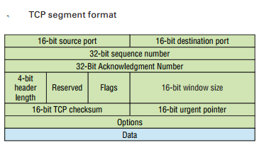
TCP SEGMENT FORMAT

Slide 56
Some of fields in TCP segment
Source port : This is the port number of the application on the host sending the data.
Destination port: This is the port number of the application requested on the destination host.
Sequence number: A number used by TCP that puts the data back in the correct order or retransmits missing or damaged data during a process called sequencing.
Acknowledgment number: The value is the TCP octet that is expected next.

Slide 57
Cont’d…
Header length: The number of 32-bit words in the TCP header, which indicates where the data begins.
Reserved: for future use, Always set to zero.
Code bits/flags: Controls functions used to set up and terminate a session.
-it used to determine segment purpose, e.g. SYN, ACK
Window: is window size the sender willing to accept, in octets.
Checksum: The cyclic redundancy check (CRC), used because TCP doesn’t trust the lower layers and checks everything.
The CRC checks the header and data fields
-TCP keeps check that if bytes are damaged, through checksum.
Etc….

Slide 58
User Datagram Protocol (UDP)
User Datagram Protocol (UDP) is basically the scaled-down economy model of TCP, which is why UDP is sometimes referred to as a thin protocol.
Like a thin person , a thin protocol doesn’t take up a lot of room—or in this case, require much bandwidth on a network.
UDP does not sequence the segments and does not care about the order in which the segments arrive at the destination.
UDP just sends the segments off and forgets about them.

Slide 59
UDP cont’d…
It doesn’t follow segments, check up on them, or even allow for an acknowledgment of safe arrival. Because of this, it’s referred to as an unreliable protocol.
This does not mean that UDP is ineffective, only that it doesn’t deal with reliability issues at all.
Furthermore, UDP doesn’t create a virtual circuit or doesn’t contact the destination before delivering information to it.
- Because of this, it’s also considered a connectionless protocol.

Slide 60
UDP cont’d…
NOTE:
Since UDP assumes that the application will use its own reliability method, it doesn’t use any itself.
This presents an application developer with a choice when running the Internet Protocol stack: TCP for reliability or UDP for faster transfers.
TCP sequences the segments so they get put back together in exactly the right order, which is something UDP just can’t do.

Slide 61
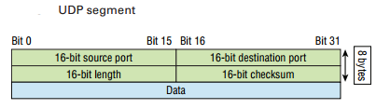
UDP in short
Minimum overhead.
Used to send short messages.
Not reliable as TCP (out of order, missing datagram, duplicate datagram).
Lack of flow control and error control
Faster and efficient
Communication takes place using ports.
Header contains following information:
  Source port number (16 bits)
  Destination port number (16 bits)
  Total length(16 bits)
  checksum(16 bits)

Slide 62
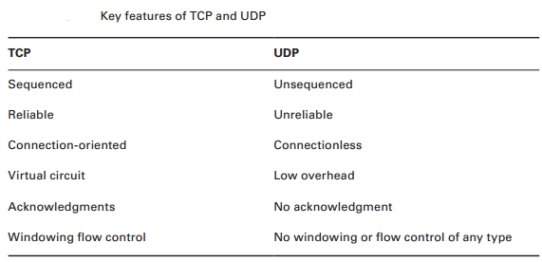

Slide 63
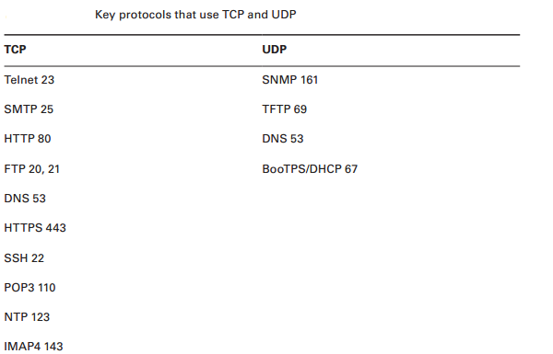

Slide 64
Some of Internet or Network layer protocols and their functions

Slide 65
Internet Protocol (IP) (Layer 3 protocol)
  Used for data communication in packet switched network
  Unreliable and connectionless (no specific path)
  Unreliable
    Data corruption
    Packet lost
    Out of order
  Packet called Datagram
  Internetworking computers
  Internet Protocol versions: IPv4, IPv6

Slide 66
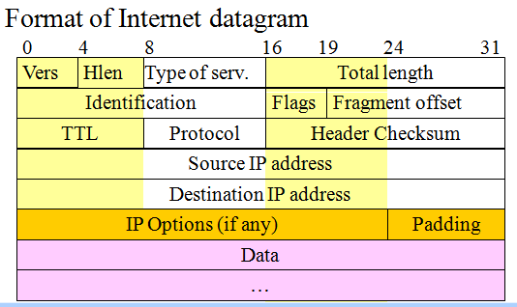
IP

Slide 67
Cont’d…
Source & destination IP address (32 bits each): contain IP address of sender and intended recipient.
Options (variable length): Mainly used to record a route, or timestamps, or specify routing.
Identification: copied into fragment, allows destination to know which fragments belong to which datagram
Fragment Offset (12 bits): specifies the offset in the original datagram of the data being carried in the fragment
  Measured in units of 8 bytes starting at 0
Flags (3 bits): control fragmentation

Slide 68
ARP Protocol (layer 3)
Stands for address resolution protocol
Finding physical address from logical address
Host or router transmit IP datagram packet containing logical address obtained from DNS.
Query is broadcast but reply is uncast.
Request contains sender and receiver IP plus sender physical address.
Reply contains physical address of the receiver.

Slide 69
Cont’d…
Reverse of ARP=RARP
Finding logical address from physical address
Request broadcast to network reply is uncast.
Based on client/server protocol.

Slide 70
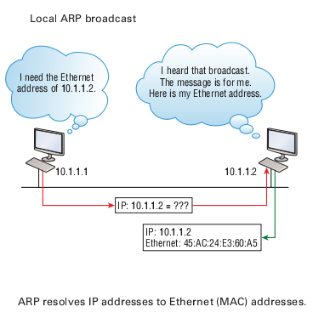

Slide 71
ICMP (Internet Control Message Protocol)(Layer 3)
Used to report errors with delivery of IP data.
E.g. if particular service or host not reachable or to check routers are correctly routing .
Ping tool uses ICMP to check host is reachable and how long it takes to reach.
ICMP message is delivered in IP packet.
Error reporting not error correction.
Two types of messages
  Error reporting message
    Problems with router or host e.g. destination unreachable, time exceeded, parameters problem
  Query message
    Help in getting specific information. e.g. neighbors

Slide 72
ICMP Errors
Network Errors:
  Host or network unreachable
  Network congestion message:
    When router buffers too many packets, and don’t process with same speed as received, generates source quench message. Too many messages results congestion.
  Time exceed
    ICMP timeout message is generated when host is unreachable.

Slide 73
IGMP Layer 3
Internet Group Management Protocol
IGMP-is used to facilitate the simultaneous transmission of a message to a group of recipients.
Protocol that manages group membership.
Provides information to multicast routers about the membership status of hosts.
Routers use IGMP to determine which hosts belong to a multicast group
Hosts use IGMP to join or leave a multicast group.

