Slide 1
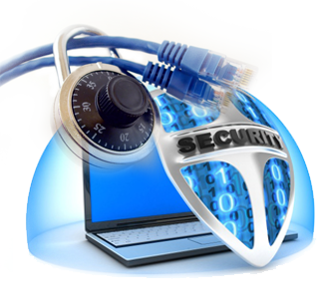
COMPUTER SECURITY
UNIT-7 operating system , web and database system security

Slide 2


Operating System Security –
System Access Threats
System access threats fall into two general categories:
Intruders
Malicious
software

Slide 3



Intruders
Clandestine user
an individual who seizes supervisory control of the system and uses this control to evade auditing and access controls or to suppress audit collection
Masquerader
Misfeasor
a legitimate user who accesses data, programs, or resources for which such access is not authorized, or who is authorized for such access but misuses his or her privileges
an individual who is not authorized to use the computer and who penetrates a system’s access controls to exploit a legitimate user’s account

Slide 4

Malicious Software
Programs that exploit vulnerabilities in computing systems
Also referred to as malware
Can be divided into two categories:
  parasitic
    fragments of programs that cannot exist independently of some
actual application program, utility, or system program
    viruses, logic bombs, and backdoors are examples
  independent
    self-contained programs that can be scheduled and run by the operating system
    worms and bot programs are examples

Slide 5
Countermeasures
RFC 4949 (Internet Security Glossary) defines intrusion detection as a security service that monitors and analyzes system events for the purpose of finding, and providing real-time or near real-time warning of, attempts to access system resources in an unauthorized manner
Intrusion detection systems (IDSs) can be classified as:
  host-based IDS
    monitors the characteristics of a single host and the events occurring within that host for suspicious activity
  network-based IDS
    monitors network traffic for particular network segments or devices and analyzes network, transport, and application protocols to identify suspicious activity

Slide 6
IDS Components
User interface
enables a user to view output from the system or control the behavior of the system
Sensors
Analyzers
receive input from one or more sensors or from other analyzer
responsible for collecting data
the input for a sensor may be any part of a system that could contain evidence of an intrusion
responsible for determining if an intrusion has occurred
may equate to a manager, director, or console component
types of input to a sensor include network packets, log files, and system call traces
may provide guidance about what actions to take as a result of the intrusion

Slide 7


Authentication
In most computer security contexts, user authentication is the fundamental building block and the primary line of defense
RFC 4949 defines user authentication as the process of verifying an identity claimed by or for a system entity
An authentication process consists of two steps:
  identification step
    presenting an identifier to the security system
  verification step
    presenting or generating authentication information that corroborates the binding between the entity and the identifier

Slide 8

Means of Authentication
Something the individual knows
  examples include a password, a personal identification number (PIN), or answers to a prearranged set of questions
Something the individual possesses
  examples include electronic keycards, smart cards, and physical keys
  referred to as a token
Something the individual is (static biometrics)
  examples include recognition by fingerprint, retina, and face
Something the individual does (dynamic biometrics)
  examples include recognition by voice pattern, handwriting characteristics, and typing rhythm

Slide 9
Access Control
Implements a security policy that specifies who or what may have access to each specific system resource and the type of access that is permitted in each instance
Mediates between a user and system resources, such as applications, operating systems, firewalls, routers, files, and databases
A security administrator maintains an authorization database that specifies
what type of access to which resources is allowed for this user
  the access control function consults this database to determine whether to grant access
An auditing function monitors and keeps a record of user accesses to system resources

Slide 10
Firewalls
Design goals:
The firewall acts as a choke point, so that all incoming traffic and all outgoing traffic must pass through the firewall
The firewall enforces the local security policy, which defines the traffic that is authorized to pass
The firewall is secure against attacks
Can be an effective means of protecting a local system or network of systems from network-based security threats while affording access to the outside world via wide area networks and the Internet
Traditionally, a firewall is a dedicated computer that interfaces with computers outside a network and has special security precautions built into it in order to protect sensitive files on computers within the network

Slide 11
Operating Systems Hardening
Basic steps to use to secure an operating system:
  Install and patch the operating system
  Harden and configure the operating system to adequately address the
identified security needs of the system by:
    removing unnecessary services, applications, and protocols
    configuring users, groups and permissions
    configuring resource controls
  Install and configure additional security controls, such as antivirus, host-based firewalls, and intrusion detection systems (IDS), if needed
  Test the security of the basic operating system to ensure that the steps taken adequately address its security needs

Slide 12
Operating System Installation:
Initial Setup and Patching
System security begins with the installation of the operating System
Ideally new systems should be constructed on a protected network
The initial installation should comprise the minimum necessary for the desired system, with additional software packages included only if they are required for the function of the system
The overall boot process must also be secured
Care is also required with the selection and installation of any additional device driver code, since this executes with full kernel level privileges, but is often supplied by a third party

Slide 13

Remove Unnecessary Services, Applications, and Protocols
The system planning process should identify what is actually required for a given system so that a suitable level of functionality is provided, while eliminating software that is not required to improve security
When performing the initial installation the supplied defaults should not be used, but rather the installation should be customized so that only the required packages are installed
Many of the security-hardening guides provide lists of services, applications, and protocols that should not be installed if not required
Strong preference is stated for not installing unwanted software, rather than installing and then later removing or disabling it as many uninstall scripts fail to completely remove all components of a package
  should an attacker succeed in gaining some access to a system, disabled software could be re-enabled and used to further compromise a system
  it is better for security if unwanted software is not installed, and thus not available for use at all

Slide 14

Configure Users, Groups, and Authentication
The system planning process should consider:
the types of information they can access
how and where they are defined and authenticated
the categories of users on the system
the privileges
they have
Restrict elevated privileges to only those users that require them
At this stage any default accounts included as part of the system installation should be secured
Those accounts which are not required should be either removed or at least disabled
System accounts that manage services on the system should be set so they cannot be used for interactive logins
Any passwords installed by default should be changed to new values with appropriate security
Any policy that applies to authentication credentials and to password security is configured

Slide 15

Configure Resource Controls
Once the users and their associated groups are defined, appropriate permissions can be set on data and resources to match the specified policy
This may be to limit which users can execute some programs or to limit which users can read or write data in certain directory trees
Many of the security-hardening guides provide lists of recommended
changes to the default access configuration to improve security

Slide 16
Install Additional Security Controls
Further security improvement may be possible by installing and configuring additional security tools such as antivirus software, host-based firewall, IDS or IPS software, or application white- listing
Some of these may be supplied as part of the operating systems installation, but not configured and enabled by default
Given the wide-spread prevalence of malware, appropriate antivirus is a critical security component
IDS and IPS software may include additional mechanisms such as traffic monitoring or file integrity checking to identify and even respond to some types of attack
White-listing applications limits the programs that can execute in the the system to just those in an explicit list

Slide 17
Test the System Security
The final step in the process of initially securing the base operating system is security testing
The goal is to ensure that the previous security configuration steps are correctly implemented and to identify any possible vulnerabilities that must be corrected or managed
Suitable checklists are included in many security-hardening guides
There are also programs specifically designed to review a system to ensure that a system meets the basic security requirements and to scan for known vulnerabilities and poor configuration practices
This should be done following the initial hardening of the system and then
repeated periodically as part of the security maintenance process

Slide 18



Security Maintenance
The process of security maintenance includes the following steps:
regularly testing system security
performing regular backups
using appropriate software maintenance processes to patch and update all critical software and to monitor and revise configuration as needed
recovering from security compromises
monitoring and analyzing logging information

Slide 19
Logging
Logging can generate significant volumes of information so it is important that sufficient space is allocated for them
A suitable automatic log rotation and archive system should be configured to assist in managing the overall size of the logging information
Some form of automated analysis is preferred as it is more likely to identify abnormal activity
  manual analysis of logs is tedious and is not a reliable means of detecting adverse events
Effective logging helps ensure that in the event of a system breach or failure, system administrators can more quickly and accurately identify what happened and more effectively focus their remediation and recovery efforts
Logging information can be generated by the system, network, and applications
The range of logging data acquired should be determined during the system planning stage

Slide 20
Data Backup and Archive
Performing regular backups of data on a system is another critical control that assists with maintaining the integrity of the system and user data
The needs and policy relating to backup and archive should be determined during the system planning stage
  key decisions include whether the copies should be kept online or offline and whether copies should be stored locally or transported to a remote site
Backup
  the process of making copies of data at regular intervals, allowing the recovery of lost or corrupted data over relatively short time periods of a few hours to some weeks
Archive
  the process of retaining copies of data over extended periods of time, being months or years, in order to meet legal and operational requirements to access past data

Slide 21
Access Control Scheme
When a user logs on to a Windows system a name/password scheme is used to authenticate the user
If the logon is accepted a process is created for the user and an access token is
associated with that process object
  the access token includes a security ID (SID) which is the identifier by which this user is known to the the system for purposes of security
  the token also contains SIDs for the security groups to which the user belongs
The access token serves two purposes:
it keeps all necessary security information together to speed access validation
it allows each process to modify its security characteristics in limited ways without affecting other processes running on behalf of the user

Slide 22
Web Security
What is web security?
Almost everything relies on computers and the Internet now
  communication (email, cell phones)
  transportation (car engine systems , airplane navigation )
  medicine (equipment, medical records)
  shopping (online stores, credit cards)
  entertainment (digital cable, mp3s)
Web Security, also known as “Cyber security” involves protecting that information by preventing, detecting, and responding to attacks.

Slide 23
What can Web users do?
The first step in protecting yourself is to recognize the risks and become familiar with some of the terminology associated with them.

Slide 24
Web Security: Terminologies
Hacker – people who seek to exploit weaknesses in software and computer systems for their own gain.
Viruses – It you to actually do something before it infects your computer. This action could be opening an email attachment or going to a particular web page.
Worms - Worms propagate without user intervention. Once the victim computer has been infected the worm will attempt to find and infect other computers.
Trojan horses - A Trojan horse program is software that claims to be one thing while in fact doing something different behind the scenes.
Ransomware : A form of trojan that has been around since 1989 (as the “PC CYBORG” trojan) It infects the target computer by encrypting the owner's personal files. The victim is then contacted and offered a key to decrypt the files in exchange for cash

Slide 25
KeyLoggers:
Traditionally, Keyloggers are software that monitor user activity such as keys typed using keyboard.
Modern keyloggers can,
  Record keystrokes on keyboard
  Record mouse movement and clicks
  Record menus that are invoked
Take screenshots of the desktop at predefined intervals (like 1 screenshot every second) Such recorded data could be uploaded in real-time or when internet connection becomes available, by,
  Email attachment
  File Transfer (FTP)

Slide 26
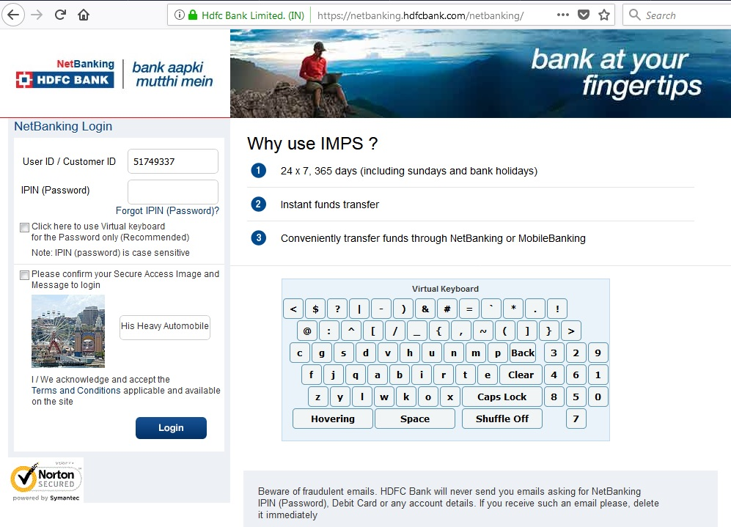
Keylogger Prevention :
  Use Anti-Spyware (prevention)
  Firewall (manual detection)
  Automatic Form fillers (protection from keylogging)
  In public (insecure) places,
-use on-screen keyboards
(START-> ALL PROGRAMS ->ACCESSORIES -> ACCESSIBILTY -> ON-SCREEN KEYBOARD)
Firewalls: Mechanism for content regulation and data filtering
  Blocking unwanted traffic from entering the subnetwork (inbound)
  Preventing subnet users' use of unauthorised material/sites (outbound)

Slide 27
Aspects of data Security
Privacy : Keeping your information private , Your personal details are a valuable asset Businesses are increasingly looking to target individuals more effectively, data about those individuals is in demand Buying and selling lists of email addresses and demographic details is big business
Integrity : Knowing that the information has not been changed , Maintaining the data integrity of any communication is vital. Integrity can be preserved by using strong encryption methods. Even if an intruder see the transmission, it would be useless since its encrypted.
Authenticity : Knowing who sent the information , We need to authenticate a message to make sure it was sent by the correct person. Digital signature is used for the purpose Public key , Private key method can also be used to authenticate.

Slide 28
Web Security Issues
  Malicious websites
  SPAM
  419 Scams
  Phishing
  DDOS
  Botnets
(All aspects are inter-related)
Phishing : This is a method of luring an unsuspecting user into giving out their username and password for a secure web resource, usually a bank or credit card account.
  Usually achieved by creating a website identical to the secure site
  User is sent email requesting them to log in, and providing a link to the bogus site
  When user logs in, password is stored and used to access the account by the attacker
  Difficult to guard against, particularly if using HTML email

Slide 29
Phishing
Phishing Email sample:
Subject: Verify your E-mail with Citibank
This email was sent by the Citibank server to verify your E-mail address. You must complete this process by clicking on the link below and entering in the small window your Citibank ATM/Debit Card number and PIN that you use on ATM.
This is done for your protection - because some of our members no longer have access to their email addresses and we must verify it.
To verify your E-mail address and access your bank account, click on the link below:
https://web.da-us.citibank.com/signin/citifi/scripts/email_verify.jsp
Thank you for using Citibank
The link uses an anchor text, and the actual website opens as,
http://citibusinessonline.da.us.citibank.com.citionline.ru/...
Instead of,
http://www.citibank.com/us/index.htm

Slide 30
Take Action
If everyone keep their systems secure, such threats can never happen.
Small gestures can avoid gigantic problems in our context.
Action Plan
    Use Anti-virus
    Use Anti-Spyware
    Be aware not to fall for scams and
    phishing attacks
    Report SPAM

Slide 31
Database System Security
  Overview To Database Security.
  Why need of database security.
  What is Database Security
  Concepts of Database Security.
  Threats to Database and counter measures
  Methods of securing database.
  Through firewall
  Database Abstraction

Slide 32
Overview
  Threats and risk to database have increased, So there is a need for security of the database.
  The majority companies store sensitive data in database. E.g.: Credit card number
Data will be easily corrupted
If there is no
security to
database what
happens???
It is important to restrict access to the
database from authorized users to
protect sensitive data.

Slide 33
Security risk to database includes
Unauthorized database users
Unauthorized Database Administrator
Unauthorized access to Database
Unauthorized alternation to available data
Lack of access to Database services
Sensitive data includes
Bank/Demat accounts
Credit card, Salary, Income tax data\
University admissions, marks/grades
Land records, licenses

Slide 34

Definition of Database Security
Database Security is defined as the process by which “Confidentiality, Integrity and Availability” of the database can be protected

Slide 35
Database Security Concepts
Confidentiality
Enforced by encrypting the data in the stored database
Encryption is a technique or a process by which the data is encoded in such a way that only that authorized users are able to read the data.
Encryption is rendering sensitive data unreadable to unauthorized users.
Integrity
Enforced by defining which user has to be given permission to access the data in the database
Data related to employee may have permission for viewing records and altering only the part of information like his contact details, where as the person like Human resource manager will have more privileges.
Availability
Database must have not unplanned downtime.
To ensure this ,following steps should be taken
Restrict the amount of the storage space given to each user in the database.
Limit the number of concurrent sessions made available to each database user.
Back up the data at periodic intervals to ensure data recovery in case of application users.
For Example:

Slide 36
Threats to database
SQL Injection.
Unauthorized access
Password Cracking.
Network Eavesdropping

Slide 37
SQL Injection
A form of attack on a database-driven Web site in which the attacker executes unauthorized SQL commands by taking advantage of insecure code on a system connected to the Internet, bypassing the firewall
Vulnerabilities:
Poor Input validation to web application.
Unsafe ,dynamically constructed SQL commands.
Weak permissions that fail to restrict the application to Database
Countermeasures
Your application should constrain and sanitize input data before using it in SQL queries.
Use type safe SQL parameters for data access. These can be used with stored procedures or dynamically constructed SQL command strings. Using SQL parameters ensures that input data is subject to type and length checks
Use a SQL Server login that has restricted permissions in the database. Ideally, you should grant execute permissions only to selected stored procedures in the database and provide no direct table access.

Slide 38
Unauthorized Access
Direct access to your database server should be restricted to specific client computers to
prevent unauthorized server access.
Vulnerabilities
Failure to block the SQL Server port at the perimeter firewall
Lack of IPSec or TCP/IP filtering policies
Countermeasures
Make sure that SQL Server ports are not visible from outside of the perimeter network.
Within the perimeter, restrict direct access by unauthorized hosts, for example, by using IPSec or TCP/IP filters

Slide 39
Password cracking
A common first line of attack is to try to crack the passwords of well known account names, such as SA (the SQL Server administrator account).
Vulnerabilities
Weak or blank passwords
Passwords that contain everyday words
Countermeasures
Create passwords for SQL Server login accounts that meet complexity requirements.
Avoid passwords that contain common words found in the dictionary.

Slide 40
Network Eavesdropping
  Eavesdropping refers to unauthorized access of reading messages
  The deployment architecture of most applications includes a physical separation of the data access code from the database server. As a result, sensitive data, such as application-specific data or database login credentials, must be protected from network eavesdroppers.
Vulnerabilities
Insecure communication channels
Passing credentials in clear text to the database; for example:
Using SQL authentication instead of Windows authentication
Using SQL authentication without a server certificate

Slide 41
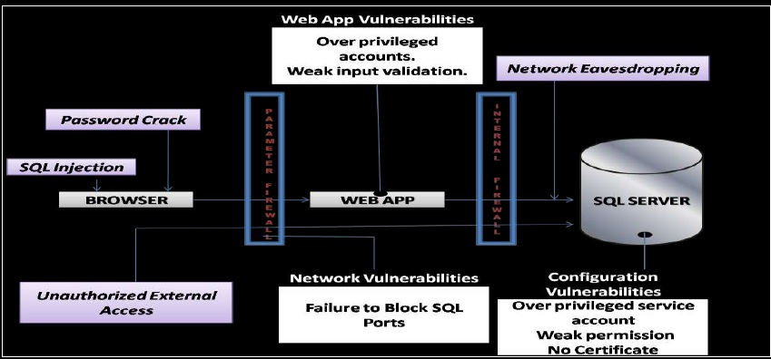
Diagrammatic Representation

Slide 42
Methods of securing the database
Authorization - privileges, views.
Authentication – passwords.
Encryption - public key / private key, secure sockets.
Logical - firewalls, net proxies.

Slide 43
Security of the database through
FIREWALLS
  A FIREWALL is dedicated software on another computer which inspects network traffic passing through it and denies (or) permits passage based on set of rules. Basically it is a piece of software that monitors all traffic that goes from your system to another via the Internet or network and Vice Versa
  Database Firewalls are a type of Web Application Firewalls that monitor databases to identify and protect against database specific attacks that mostly seek to access sensitive information stored in the databases.

Slide 44
How Database FIREWALL works
The Database Firewalls include a set of pre-defined, customizable security audit policies and they can identify database attacks based on threat patterns called signatures.
The SQL input statements (or) queries are compared to these signatures, which are updated frequently by the vendors to identify known attacks on the database.
But all the attacks on the databases may not be familiar.
Database Firewalls build (or come with) white list of approved SQL commands(or) statements that are safe.
All the input commands are compared with this white list and only those that are already present in the white list are sent to the database.

Slide 45
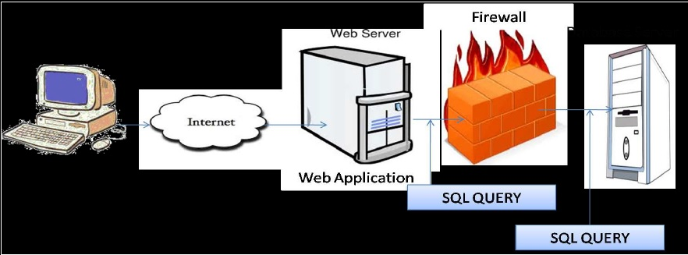
Diagrammatic Representation

Slide 46
Advantages of using FIREWALL
  Database Firewalls maintains the black list of certain specific and potentially harmful commands(or) SQL statements and do not allow these type of inputs.
  Database Firewalls identifies the database, operating system and protocol vulnerabilities in the databases and intimate the administrator, who can take steps to patch them.
  Database Firewalls monitors for database responses (from the DB server) to block potential data leakage.
  Database Firewalls notifies the suspicious activities, instead of blocking them right away.
  Database Firewalls can evaluate factors like IP address, time, location, type of applications (source), etc from which the abnormal database access requests are emanating and then decide whether to block them or not, based on these factors as per the policies set by the administrator.

Slide 47
Security of the database Through
Abstraction
Data encryption enables to encrypt sensitive data, such as credit card numbers, stored in table columns.
Encrypted data is decrypted for a database user who has access to the data.
Data encryption helps protect data stored on media in the event that the storage media or data file gets stolen.

Slide 48
How data Encryption Works
  Data encryption is a key-based access control system. Even if the encrypted data is retrieved, it cannot be understood until authorized decryption occurs, which is automatic for users authorized to access the table.
  When a table contains encrypted columns, a single key is used regardless of the number of encrypted columns. This key is called the column encryption key.
  The column encryption keys for all tables, containing encrypted columns, are encrypted with the database server master encryption key and stored in a dictionary table in the database.
  The master encryption key is stored in an external security module that is outside the database and accessible only to the security administrator.

Slide 49
Advantages of Data Encryption
  As a security administrator, one can be sure that sensitive data is safe in case the storage media or data file gets stolen.
  You do not need to create triggers or views to decrypt data. Data from tables is decrypted for the database user.
  Database users need not be aware of the fact that the data they are accessing is stored in encrypted form. Data is transparently decrypted for the database users and does not require any action on their part.
  Applications need not be modified to handle encrypted data. Data encryption/decryption is managed by the database.

Slide 50
Authorization
Read authorization - allows reading, butnot modification of data
Insert authorization - allows insertion of new data, but not modification of existing data.
Update authorization - allows modification, but not deletion of data.
Delete authorization - allows deletion of data

Slide 51
Privileges in Database
Select: allows read access to relation, or the ability to query using the view
Insert: the ability to insert tuples
Update: the ability to update using the SQL update statement
Delete: the ability to delete tuples.

Slide 52
Privilege To Grant Privileges
With grant option: allows a user who is granted a privilege to pass the privilege on to other users.
Example: grant select on branch to U1 with grant option gives U1 the select privileges on branch and allows U1 to grant this privilege to others.

