Slide 1
COMPUTER SECURITY
UNIT-8: Types of attacks , malware and access control

Slide 2
Top 8 Network Attacks by Type in 2017
Network attacks are launched every hour of every day, and they evolve at an astounding pace. Every year brings new attacks and trends.
Below are the top eight network attacks by type, recorded from April to June 2017, and published in the Sep , 2017 Quarterly Threat Report from McAfee Labs.
The report is based on data collected from millions of sensors managed by McAfee.

Slide 3
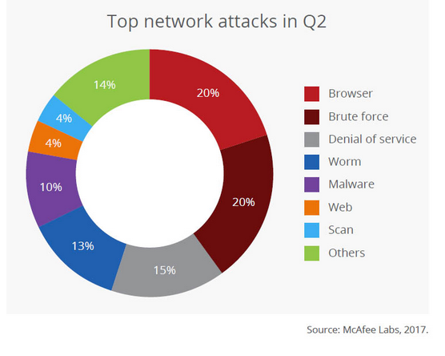
Top Network Attacks

Slide 4
8 Types of Network Security Attacks
1. Browser Attacks – 20%
2. Brute Force Attacks – 20%
3. Denial-of-Service (DDoS) Attacks – 15%
4. Worm Attacks – 13%
5. Malware Attacks – 10%
6. Web Attacks – 4%
7. Scan Attacks – 4%
8. Other Attacks – 14%

Slide 5
1. Browser Attacks – 20%
Browser-based network attacks tied for the second-most common type. They attempt to breach a machine through a web browser, one of the most common ways people use the internet. Browser attacks often start at legitimate, but vulnerable, websites. Attackers breach the site and infect it with malware.
When new visitors arrive (via web browser), the infected site attempts to force malware onto their systems by exploiting vulnerabilities in their browsers. The web browsers with the most vulnerabilities discovered in 2016 are, in descending order, according to the Symantec Internet Security Threat Report 2017 :
Microsoft Internet Explorer / Edge
Google Chrome
Mozilla Firefox
Apple Safari
Opera

Slide 6
2. Brute Force Attacks – 20%
Brute force attacks are akin to kicking down the front door of a network. Rather than attempting to trick a user into downloading malware, the attacker tries to discover the password for a system or service through trial and error.
These network attacks can be time consuming, so attackers typically use software to automate the task of typing hundreds of passwords.
Brute force attacks are one reason it’s important to follow Password best Practices, especially on critical resources such as network routers and servers.
Passwords that are long and complex are exponentially more difficult to crack via brute force than stupid passwords like “123456”, “qwerty”, and “password”. Rest assured: these are among the first keys an attacker will try.

Slide 7
3. Denial-of-Service (DDoS) Attacks – 15%
Denial-of-service attacks, also known as distributed denial-of-service attacks (DDoS), are third on the list on the list of network security attacks, and they continue to grow stronger every year.
DoS Attacks attempt to overwhelm a resource – such as websites, game servers, or DNS servers – with floods of traffic. Typically the goal is to slow or crash the system.
One in three businesses (33%) experienced a DDoS attack in 2017, according to a Kaspersky Labs Survey of 5,200 people from businesses in 29 countries. Half of respondents said DDoS attacks are growing in frequency and complexity.
DDoS can also be used to distract from other network attacks that can be far more damaging.
“In the first half of 2017, over half of those respondents affected by a DDoS attack (53%) claimed that it was used as a smokescreen,” according to Kaspersky’s press release.

Slide 8
4. Worm Attacks – 13%
Malware typically requires user interaction to start infection. For example, the person may have to download a malicious email attachment, visit an infected website, or plug an infected thumb drive into a machine.
Worm attacks spread on their own. They are self-propagating malware that does not require user interaction. Typically, they exploit system vulnerabilities to spread across local networks and beyond.
WannaCry Ransomware , which infected more than 300,000 computers in a few days, used worm techniques to attack networks and machines.
WannaCry targeted a widespread Windows vulnerability to quickly breach a machine. Once a machine was infected, the malware scanned the connected LANs and WANs to find and infect other vulnerable hosts.

Slide 9
5. Malware Attacks – 10%
Malware is, of course, malicious software – applications that have been created to harm, hijack, or spy on the infect system. It’s not clear why “worm attacks” were not included in this category – as they are typically associated with malware. Perhaps it was to emphasize the prevalence of work attacks during Q2 2017. Regardless Malware is widespread and well known. Three common ways it spreads include:
Phishing emails – Attackers create messages to lure victims into a false sense of security, tricking them into downloading attachments that turn out to be malware.
Malicious websites – Attackers can set up websites that include exploit kits designed to find vulnerabilities in the system of site visitors and use them to force malware onto their systems. The sites can also be used to disguise malware as legitimate downloads.
Malvertising – Clever attackers have discovered ways of using advertising networks to distribute their wares. When clicked, the malicious ads can redirect users to a malware-hosting website. Some Malvertising Attacks do not even require user interaction to infect a system.

Slide 10
6. Web Attacks – 4%
Public-facing services – such as web applications and databases – are also targeted for network security attacks.
The most common web application attacks in Q2 2017, according to Positive Research:
Cross-Site Scripting (XSS) – 39.1% – An attacker breaches a vulnerable website or web application and injects malicious code. The code executes a malicious script on users’ browsers when the page is loaded.
SQL Injection (SQLi) – 24.9% – Rather than submitting standard data into a text-box or other data-entry field, the attacker enters SQL statements to trick the application into revealing or manipulating its data.
Path Traversal – 6.6% – Attackers craft HTTP requests to circumvent access controls and navigate to other directories and files in the system. For example, rather than being limited to the content of a single website, a path traversal attack can grant an attacker access to the core files of the site’s web server.

Slide 11
7. Scan Attacks – 4%
Rather than outright network attacks, scans are pre-attack reconnaissance. Attackers use widely available scanning tools to probe public-facing systems to better understand the services, systems, and security in place.
Port scanner – A simple tool used to determine a system’s open ports. Several types exist, with some intended to prevent detection by the scanned target.
Vulnerability scanner – Collects information on a target and compares it to known security vulnerabilities. The result is a list of known vulnerabilities on the system and their severity.

Slide 12
8. Other Attacks – 14%
We can only speculate on the network attack types bundled into “other”. That said, here are some of the usual suspects:
Physical Attacks – Attempts to destroy or steal network architecture or systems in an old-school, hands-on way. Stolen laptops are a common example.
Insider Attacks – Not every network attack is performed by an outsider. Angry employees, criminal third-party contractors, and bumbling staff members are just a few potential actors. They can steal and abuse access credentials, misuse customer data, or accidentally leak sensitive information.
Advanced Persistent Threats – The most advanced network attacks are performed by elite teams of hackers who adapt and tailor techniques to the target environment. Their goal is usually to steal data over an extended period by hiding and “persisting”.

Slide 13
Malware

Slide 14
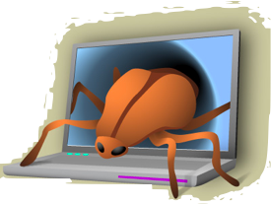
Malware
What is Malware?
Malware is any software that is used to:
Disrupt the operation of a computer
Gather sensitive information
Gain access to private computer systems.
“ A Malware is a set of instructions that run on your computer and make your system do something that an attacker wants it to do. “
What does Malware stand for?
Malicious Software

Slide 15
Malware
There are four different types of Malware that you need to be aware of:
Spyware
Ransomware
Phishing
Viruses
Malware is an ’umbrella’ term that covers all of these types.

Slide 16
Malware
Lesson Aims
1
To understand the term Malware
2
To understand the different types of Malware
3
To understand the how to prevent Malware

Slide 17
What is Malware?
Malware
Malware is any software that is used to:
1
Disrupt the operation of a computer
2
Gather sensitive information
3
Gain access to private computer systems.

Slide 18
Malware Terminologies
Before we move onto the crucial details, here is a quick look at some of the common terms and abbreviations that you will see when discussing malware.
Ways of Spread
Drive-by download: The unintended download of computer software from the Internet. It either refers to the download that happens without the knowledge of a user, or the download that a person authorizes but without the understanding of the consequences.
​Homogeneity: A setup where all the systems are running on the same operating system and connected to the same network. This increases the chances of a worm in one computer to easily spread to others on that network.
​Vulnerability: A security defect in software that can be attacked by a malware. It could be a design flaw, programming error, or some other kind of inherent weakness in a software implementation, application or operating system.
​Backdoor: An opening or break left in a software, hardware, network or system security by design, usually for debugging purposes.

Slide 19
Malware
There are four different types of Malware that you need to be aware of:
1
Viruses
2
Spyware
3
Phishing
4
Ransomware
Malware is an ’umbrella’ term that covers all of these types.

Slide 20
Viruses
What is a Virus?
It is a simple program designed to cause harm to a computer.
They spread by duplicating and attaching itself to other files, usually email attachments.
Some virus damage is insignificant but inconvenient.
Some virus damage is disastrous, erasing or corrupting important data.
ACTIVITY
Watch this video to learn more: https://www.youtube.com/watch?v=mPQKRxzJF6g

Slide 21
Spyware
What is Spyware?
Spyware is software designed to secretly collect data about the user.
Once the data is collected, it is covertly sent to the attackers computer over the Internet.
Like other Malware, they can be spread through email, USB sticks and advertisements, among others.
ACTIVITY
Watch this video to learn more: https://www.youtube.com/watch?v=LGpTM0wAz0M

Slide 22
Phishing
What is Phishing?
This is when a fake website pretends to be a real website.
This is often achieved by imitating (copying) the look of the real website.
One of the most common types of sites that are imitated are banking websites.
Their purpose is to steal the users online banking credentials so they can steal money.
ACTIVITY
Watch this video to learn more: https://www.youtube.com/watch?v=GqD3nrHJfn8

Slide 23
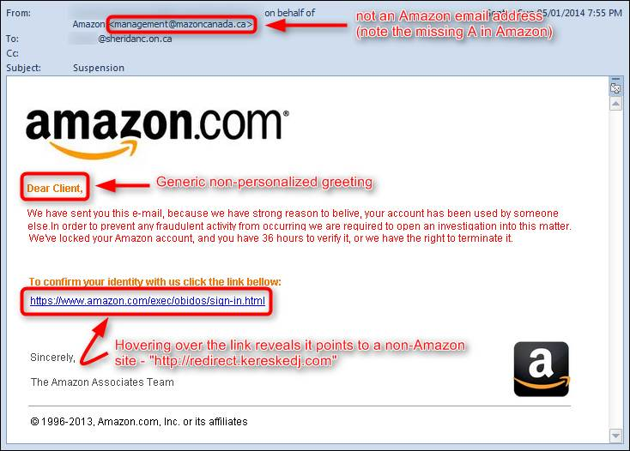
Phishing: Example Email 1

Slide 24
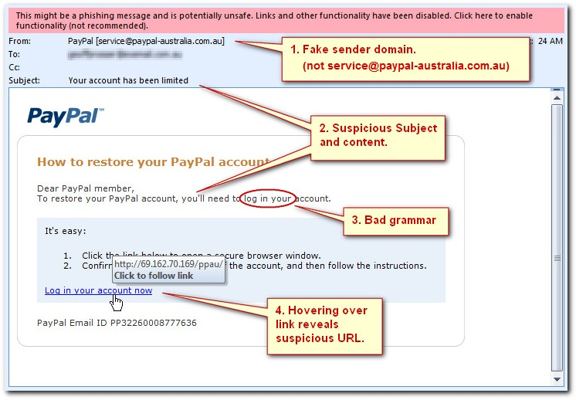
Phishing: Example Email 2

Slide 25
Ransomware
What is Ransomware?
Ransomware is a fairly new type of malware.
It is designed to block access to the users own files until a fee is paid.
The fee is usually paid in a currency called bitcoins, a type of virtual currency that can be traded for real money.
Once the fee is paid, they are usually given access to their files again.
ACTIVITY
Watch this video to learn more: https://www.youtube.com/watch?v=15Sc1mMM7do

Slide 26
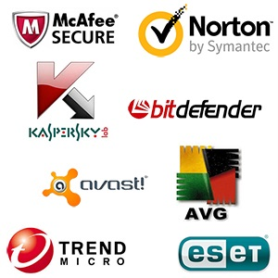
Preventing Malware
What can you do to help prevent Malware?
Use well-known Anti-Malware or Virus Protection software.
Good software will protect from all threats, not just viruses.
Just installing it is not enough, it should be updated regularly, at least weekly, this can be done automatically.
Just as importantly, always have a backup of you work!

Slide 27
Activity
Examples
Q
Name a type of Malware that locks the user out of their own files.
A
Ransomware
Q
Name a type of Malware that is hard to detect and collects personal information.
A
Spyware
Q
ILOVEYOU was an example of which type of Malware?
A
Virus

Slide 28
Access Control
Access control is a process to determine “Who does what to what,” based on a policy.
It is controlling access of who gets in and out of the system and who uses what resources, when, and in what amounts.
Access control is restricting access to a system or system resources based on something other than the identity of the user
Access control consists of four elements:
subjects
objects
operations
a reference monitor

Slide 29
Access Control
Subjects are system users and groups of users while objects are files and resources such as memory, printers, and scanners including computers in a network.
An access operation comes in many forms including Web access, server access, memory access, and method calls.
Whenever a subject requests to access an object, an access mode must be specified.
There are two access modes:
observe - in this mode, the subject may only look at the content of the object. This mode is the typical read in which a client process may request a server to read from a file.
Alter – in this mode, the subject may change the content of the object

Slide 30
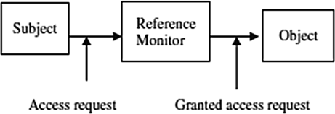
Access Control
For example a user, initiates an access request for a specified system resource, usually a passive object in the system such as a Web resource. The request goes to the reference monitor. The job of the reference monitor is to check on the hierarchy of rules that specify certain restrictions. A set of such rules is called an access control list (ACL). The access control hierarchy is based on the URL path for a Web access, or file path for a file access such as in a directory. When a request for access is made, the monitor or server goes in turn through each ACL rule, continuing until it encounters a rule that prevents it from continuing and results in a request rejection or comes to the last rule for that resource, resulting into access right being granted.
See Figure 8.1 Access Control Administration

Slide 31
Access Control
Access rights refer to the user’s ability to access a system resource.
There are four access rights:
execute,
read,
append,
write. Fig. 8.2 Access modes and access rights
The user is cautioned not to confuse access rights and access modes.
The difference lies in the fact that you can perform any access right within each access mode.
Figure 8.2 shows how this can be done. Note that according to the last column in Figure 8.2 there are X marks in both rows because in order to write, one must observe first before altering. This prevents the operating system from opening the file twice, one for the read and another for a write.

Slide 32
Access rights can be set individually on each system resource for each individual user and group.
It is possible for a user to belong to a few groups and enjoy those groups’ rights. However, user access rights always take precedence over group access rights regardless of where group rights are applied. If there are inherited group access rights, they take precedence over user default access rights.
A user has default rights when the user has no assigned individual or group rights from root down to the folder in question. In the cascading of access rights application, user access rights that are closest to the resource being checked by the monitor take precedence over access rights assignments that are farther away.
Who sets these rights? - The owner of the resource sets the access rights to the resource.
In a global system, the operating systems owns all system resources and therefore sets the access rights to those resources. However, the operating system allows folders and file owners to set and revoke access rights.

Slide 33
Access Control Techniques and Technologies
Because a system, especially a network system, may have thousands of users and resources, the management of access rights for every user per every object may become complex.
Several control techniques and technologies have been developed to deal with this problem; they include:
Access Control Matrix,
Capability Tables,
Access Control Lists,
Role-Based Access Control,
Rule-Based Access Control,
Restricted Interfaces,
Content-Dependent Access Control.

Slide 34
These new techniques and technologies have necessitated new approaches to system access control. For a long time, access control was used with user- or group-based access control lists, normally based in operating systems.
However, with Web-based network applications, this approach is no longer flexible enough because it does not scale in the new environment. Thus, most Web-based systems employ newer techniques and technologies such as role-based and rule-based access control, where access rights are based on specific user attributes such as their role, rank, or organization unit.

Slide 35
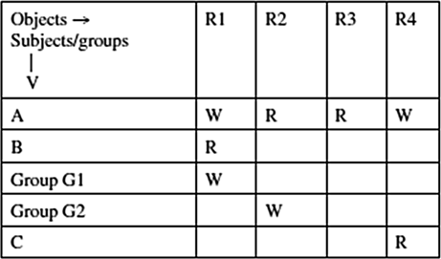
Access Control Matrix
All the information needed for access control administration can be put into a matrix with rows representing the subjects or groups of subjects and columns representing the objects.
The access that the subject or a group of subjects is permitted to the object is shown in the body of the matrix.
For example, in the matrix in Figure 8.3, user A has permission to write in file R4.
One feature of the access control matrix is its sparseness. Because the matrix is so sparse, storage consideration becomes an issue, and it is better to store the matrix as a list.
Figure 8.3 ➔

Slide 36
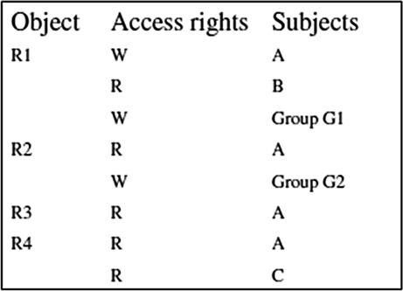
Access Control Lists
In the access control lists (ACLs), groups with access rights to an object are stored in association to the object. If you look at the access matrix in Figure 8.3, each object has a list of access rights associated with it. In this case each object is associated with all the access rights in the column. For example, the ACL for the matrix in Figure 8.3 is shown in Figure 8.4.
ACLs are very fitting for operating systems as they manage access to objects.
Figure 8.4 ➔

Slide 37
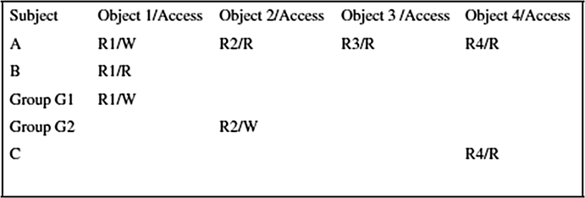
Access Control Capability
A capability specifies that “the subject may do operation O on object X.”
Unlike the ACLs, where the storage of access rights between objects and subjects is based on columns in the access control matrix, capabilities access control storage is based on the rows. This means that every subject is given a capability, a forgery-proof token that specifies the subject’s access rights.
From the access matrix in Figure 8.3, we can construct a capability as shown in Figure 8.5.

Slide 38
Role-Based Access Control
The changing size and technology of computer and communication networks are creating complex and challenging problems in the security management of these large networked systems.
The changing technology and large numbers of users joining the networks are making the administration of systems extremely costly and prone to error when it is based solely on access control lists for each user on the system individually.
System security in role-based access control (RBAC) is based on roles assigned to each user in an organization. For example, one can take on a role as a chief executive officer, a chief information officer, or chief security officer.
A user may be assigned one or more roles, and each role is assigned one or more privileges that are permitted to users in that role. Access decisions are then based on the roles individual users have as part of an organization.
The process of defining roles is based on a thorough analysis of how an organization operates and include input from a wide spectrum of users in an organization.

Slide 39
Role-Based Access Control
Access rights are grouped by role name, and the use of resources is restricted to individuals authorized to assume the associated role.
Users are granted membership into roles based on their competencies and responsibilities in the organization.
The types of operations that a user is permitted to perform in the role he or she assumes are based on that user's role. User roles are constantly changing as the user changes responsibilities and functions in the organizations, and these roles can be revoked.
Role associations can be established when new operations are instituted, and old operations can be deleted as organizational functions change and evolve.
RBAC is also based on the concept of least privilege that requires identifying the user's job functions, determining the minimum set of privileges required to perform that function, and restricting the user to a domain with those privileges and nothing more.

Slide 40
Rule-based access control
Rule-based access control (RBAC), also known as policy-based access control (PBAC), is based on the least privileged concept.
It is also based on policies that can be algorithmically expressed.
RBAC is a multi-part process where one process assigns roles to users just like in the role-based access control techniques.
The second process assigns privileges to the assigned roles based on a predefined policy.
Another process is used to identify and authenticate the users allowed to access the resources.
It is based on a set of rules that determine users’ access rights to resources within an organization’s system.
Many organizations, for example limit the scope and amount, sometimes the times, employees, based on their ranks and roles , can retrieve from the site.
Such limits may be specified based on the number of documents that can be downloaded by an employee during a certain time period and on the limit of which part of the Web site such an employee can access.

Slide 41
Restricted Interfaces
As the commercial Internet grows in popularity, more and more organizations and individuals are putting their data into organization and individual databases and restricting access to it.
For the user to get access to restricted data, the user has to go via an interface. Any outside party access to restricted data requires a special access request, which many times requires filling in an online form. The interfaces restrict the amount and quality of data that can be retrieved based on filter and retrieval rules. In many cases, the restrictions and filters are instituted by content owners to protect the integrity and proprietary aspects of their data.
The Web site itself and the browser must work in cooperation to overcome the over-restriction of some interfaces. Where this is impossible, hidden data is never retrievable.

Slide 42
Content-Dependent Access Control
In content-dependent access control, the decision is based on the value of the attribute of the object under consideration.
Content-dependent access control is very expensive to administer because it involves a great deal of overhead resulting from the need to scan the resource when access is to be determined. The higher the level of granularity, the more expensive it gets. It is also extremely labor-intensive.

Slide 43
Access Control Systems
Physical Access Control
Most accesses to an organization systems are expected to originate from remote sites and, therefore, access the system via the network access points In a limited number of cases, system access can come from intruders physically gaining access on the system itself, where they can install password cracking programs.
Studies have shown that a great majority of system break-ins originate from inside the organization. Access to this group of users who have access to the physical premises of the system must be appropriate

Slide 44
Access Control Systems - Access Cards
Cards as access control devices have been in use for sometime now. Access cards are perhaps the most widely used form of access control system worldwide.
With advanced digital technology, cards now contain magnetic strips and embedded microchips.
Many companies require their employees to carry identity cards or identity badges with a photograph of the card holder or a magnetic strip for quick identification.
Access cards are used in most e-commerce transactions, payment systems, and in services such as health and education. These types of identification are also known as electronic keys.

Slide 45
Access Control Systems - Electronic Surveillance
Electronic surveillance consists of a number of captures such as video recordings, system logs, keystroke and application monitors, screen-capture software commonly known as activity monitors, and network packet sniffers.
Video recordings capture the activities at selected access points. Increasingly these video cameras are now connected to computers and actually a Web, a process commonly now referred to as webcam surveillance. Many of these cameras are now motion-activated and they record video footage shot from vantage points at the selected points. For access control, the selected points are system access points. The video footage can be viewed live or stored for later viewing. These captures can also be broadcast over the Internet or transmitted to a dedicated location or sent by e-mail.
Keystroke monitors are software or hardware products that record every character typed on keyboards. Software-based keystroke monitors capture the signals that move between keyboard and computer as they are generated by all human-computer interaction activities that include Packet sniffers work at a network level to sniff at network packets as they move between nodes. Based on the analysis, they can monitor e-mail messages, Web browser usage, node usage, traffic into a node, nature of traffic, and how often a user accesses a particular server, application, or network.

Slide 46
Access Control Systems - Biometrics
Biometric technology, based on human attributes, something you are, aims to confirm a person's identity by scanning a physical characteristic such as a fingerprint, voice, eye movement, facial recognition, and others.
It has probably been one of the oldest access control techniques. However, during the past several years and with heightened security, biometric technology has become increasingly popular. The technology, which can be used to permit access to a network or a building, has become an increasingly reliable, convenient and cost-effective means of security.
Current technology has made biometric access control much more practical than it has ever been in the past. Now a new generation of low-cost yet accurate fingerprint readers is available for most mobile applications so that screening stations can be put up in a few minutes.
Technological advances have resulted in smaller, high-quality, more accurate, and more reliable devices. Improvements in biometrics are essential because bad biometric security can lull system and network administrators into a false sense of safety. In addition, it can also lock out a legitimate user and admit an intruder. So care must be taken when procuring biometric devices.

Slide 47
Access Control Systems - Event Monitoring
Event monitoring is a cousin of electronic monitoring in which the focus is on specific events of interest. Activities of interest can be monitored by video camera, webcam, digital or serial sensors, or a human eye.
It can be used to capture screenshots; monitor Internet activity; and report a computer's use; keystroke by keystroke; and human voice, including human movement.
The activities recorded based on selected events can be stored, broadcast on the Internet, or sent by e-mail to a selected remote location or user.

