Slide 1
6.2 Security

Slide 2
Contents
Security problem
Program threat
Network and system threat
Security tools
Cryptography
Authentication
Intrusion defense
Firewall

Slide 3
Security problem
Security must consider external environment of the system, and protect it from:
unauthorized access.
malicious modification or destruction
accidental introduction of inconsistency.
These are management, rather than system, problems.
Easier to protect against accidental than malicious misuse.
We say that the system is secure if its resources are used and accessed as intended under all circumstances.

Slide 4
Security problem(con’t…)
Security has many facets. Three of the more important ones are the nature of the threats, the nature of intruders, and accidental data loss.
Threat: make sure data confidentiality, integrity, availability and etc
Intruders: people who are nosing around places where they have no business being are called intruders or sometimes adversaries
Intruders act in two different ways.
Passive intruders just want to read files they are not authorized to read
Active intruders are more malicious; they want to make unauthorized changes to data.

Slide 5
Security problem(con’t…)
Accidental data loss:
In addition to threats caused by malicious intruders, valuable data can be lost by accident.
Some of the common causes of accidental data loss are
Acts of God: fires, floods, earthquakes, wars, riots, or rats gnawing backup tapes.
Hardware or software errors: CPU malfunctions, unreadable disks or tapes, telecommunication errors, program bugs.
Human errors: incorrect data entry, wrong tape or CD-ROM mounted, wrong program run, lost disk or tape, or some other mistake.

Slide 6
Security Violation Categories
Breach of confidentiality
Unauthorized reading of data
Breach of integrity
Unauthorized modification of data
Breach of availability
Unauthorized destruction of data
Theft of service
Unauthorized use of resources
Denial of service (DOS)
Prevention of legitimate use

Slide 7
Security Violation Methods
Masquerading (breach authentication)
Pretending to be an authorized user to escalate privileges
Replay attack
As is or with message modification
Man-in-the-middle attack
Intruder sits in data flow, masquerading as sender to receiver and vice versa
Session hijacking
Intercept an already-established session to bypass authentication

Slide 8
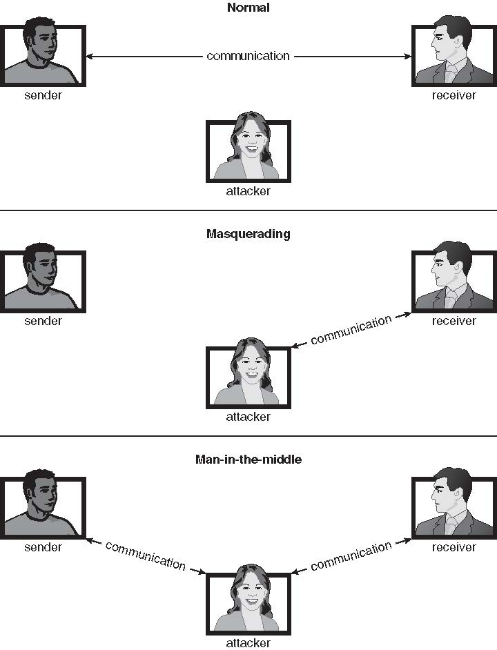
Standard Security Attacks

Slide 9
Security Measure Levels
Impossible to have absolute security, but make cost to perpetrator sufficiently high to deter most intruders
Security must occur at four levels to be effective:
Physical
Against armed or surreptitious entry by intruders.
Human
Careful screening of users to reduce the chance of unauthorized access.
Network
No one should intercept the data on the network.
Operating system
The system must protect itself from accidental or purposeful security beaches.
A weakness at a high level of security allows circumvention of low-level measures.

Slide 10
Security measures at OS level
User authentication
Verifying the user’s authentication
Program threats
Misuse of programs unexpected misuse of programs.
System threats
Worms and viruses
Intrusion detection
Detect attempted intrusions or successful intrusions and initiate appropriate responses to the intrusions.
Cryptography
Ensuring protection of data over network

Slide 11
Program Threats
Many variations, many names
Trojan Horse
Code segment that misuses its environment
Exploits mechanisms for allowing programs written by users to be executed by other users
Spyware, pop-up browser windows, covert channels
Up to 80% of spam delivered by spyware-infected systems
Trap Door
The designer of the code might leave a hole in the software that only she is capable of using.
Specific user identifier or password that circumvents normal security procedures
Could be included in a compiler
Logic Bomb
Program that initiates a security incident under certain circumstances

Slide 12
Program Threats(con’t…)
Stack and Buffer Overflow
Exploits a bug in a program (overflow either the stack or memory buffers.)
The attacker determines the vulnerability and writes a program to do the following.
Overflow an input-field, command-line argument, or input buffer until it writes into the stack.
Overwrite the current return address on the stack with the address of the exploit code in the next step.
Write a simple set of code for the next space in the stack that includes commands that the attacker wishes to execute, for example, spwan a shell.

Slide 13
System Threats
Viruses
Code fragment embedded in legitimate program
Self-replicating, designed to infect other computers
Very specific to CPU architecture, operating system, applications
Usually borne via email or as a macro
Visual Basic Macro to reformat hard drive
Sub AutoOpen()
Dim oFS
Set oFS = CreateObject(’’Scripting.FileSystemObject’’)
vs = Shell(’’c:command.com /k format c:’’,vbHide)
End Sub

Slide 14
System Threats (Cont.)
Virus dropper inserts virus onto the system
Many categories of viruses, literally many thousands of viruses
File / parasitic
Boot / memory
Macro
Source code
Polymorphic to avoid having a virus signature
Encrypted
Stealth
Tunneling
Multipartite
Armored

Slide 15
System Threats(con’t…)
Worms – use spawn mechanism; standalone program
The worm spawns copies of itself, using up systems resources and perhaps locking out system use by all other processes.
Internet worm
Exploited UNIX networking features (remote access) and bugs in finger and sendmail programs.
Grappling hook program uploaded main worm program.
Denial of Service
Overload the targeted computer preventing it from doing any useful work.
Downloading of a page.
Partially started TCP/IP sessions could eat up all resources.
Difficult to prevent denial of service attacks.

Slide 16
Threat Continues
Attacks still common, still occurring
Attacks moved over time from science experiments to tools of organized crime
Targeting specific companies
Creating botnets to use as tool for spam and DDOS delivery
Keystroke logger to grab passwords, credit card numbers

Slide 17
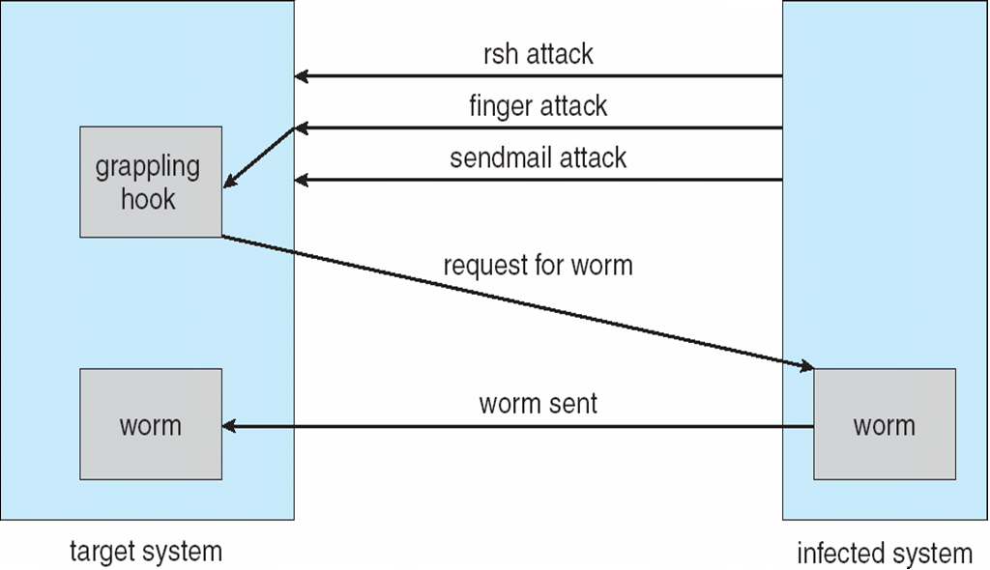
The Morris Internet Worm

Slide 18
Threat Monitoring
Check for suspicious patterns of activity – i.e., several incorrect password attempts may signal password guessing.
Audit log – records the time, user, and type of all accesses to an object; useful for recovery from a violation and developing better security measures.
Scan the system periodically for security holes; done when the computer is relatively unused.

Slide 19
Threat Monitoring (Cont.)
Check for:
Short or easy-to-guess passwords
Unauthorized set-uid programs
Unauthorized programs in system directories
Unexpected long-running processes
Improper directory protections
Improper protections on system data files
Dangerous entries in the program search path (Trojan horse)
Changes to system programs: monitor checksum values

Slide 20
FireWall
A firewall is placed between trusted and untrusted hosts.
A firewall is a computer or router that sits between trusted and untrusted systems. It monitors and logs all connections.
The firewall limits network access between these two security domains.
Spoofing: An unauthorized host pretends to be an authorized host by meeting some authorization criterion.

Slide 21
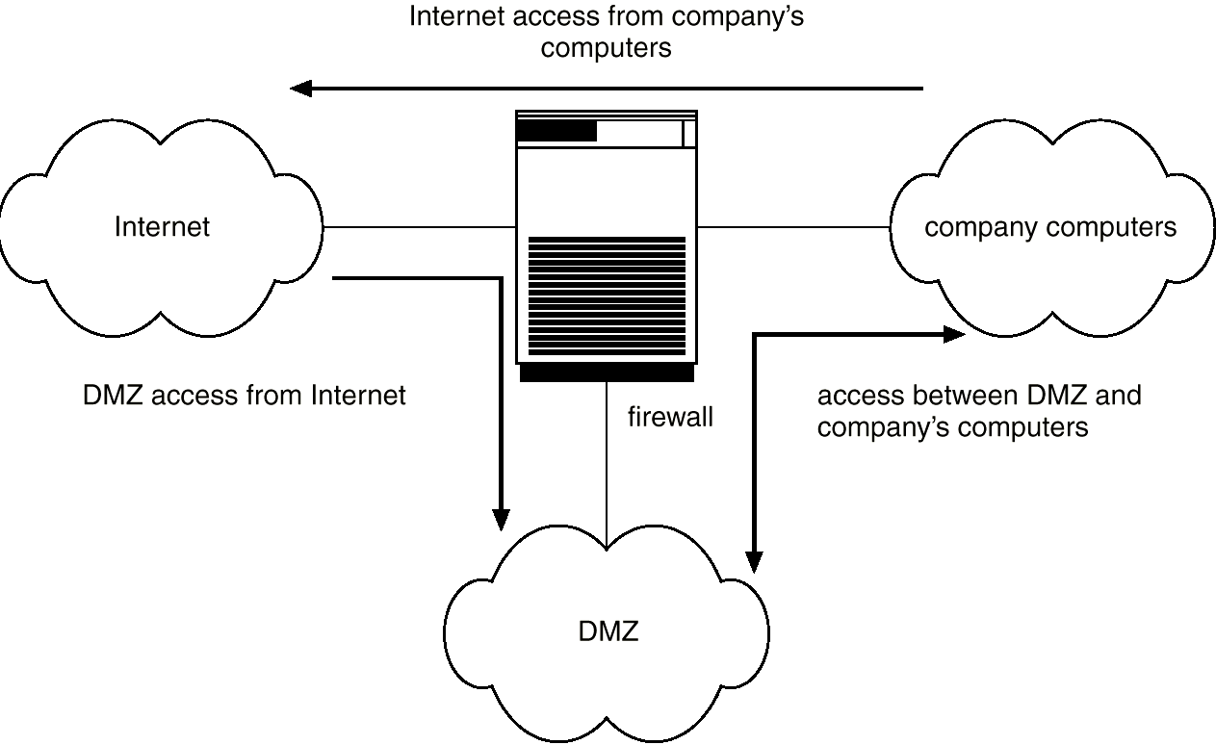
Network Security Through Domain Separation Via Firewall
DMZ: Demilitarized zone

Slide 22
Intrusion Detection
Detect attempts to intrude into computer systems.
Wide variety of techniques
The time of detection
The type of inputs examined to detect intrusion activity
The range of response capabilities.
Alerting the administrator, killing the intrusion process, false resource is exposed to the attacker (but the resource appears to be real to the attacker) to gain more information about the attacker.
The solutions are known as intrusion detection systems.
Detection methods:
Auditing and logging.
Install logging tool and analyze the external accesses.
Tripwire (UNIX software that checks if certain files and directories have been altered – I.e. password files)
Integrity checking tool for UNIX.
It operates on the premise that a large class of intrusions results in anomalous modification of system directories and files.
It first enumerates the directories and files to be monitored for changes and deletions or additions. Later it checks for modifications by comparing signatures.
System call monitoring
Detects when a process is deviating from expected system call behavior.

Slide 23
Cryptography
Eliminate the need to trust the network.
Cryptography enables a recipient of a message to verify that the message was created by some computer possessing a certain key.
Keys are designed to be computationally infeasible to derive from the messages
Means to constrain potential senders (sources) and / or receivers (destinations) of messages
Based on secrets (keys)
Enables
Confirmation of source
Receipt only by certain destination
Trust relationship between sender and receiver

Slide 24
Encryption
Constrains the set of possible receivers of a message
Encrypt clear text into cipher text.
Properties of good encryption technique:
Relatively simple for authorized users to encrypt and decrypt data.
Encryption scheme depends not on the secrecy of the algorithm but on a parameter of the algorithm called the encryption key.
Extremely difficult for an intruder to determine the encryption key.
Data Encryption Standard substitutes characters and rearranges their order on the basis of an encryption key provided to authorized users via a secure mechanism. Scheme only as secure as the mechanism.
RSA : public/private key algorithm is popular

Slide 25
Encryption(con’t…)
Constrains the set of possible receivers of a message
Encryption algorithm consists of
Set K of keys
Set M of Messages
Set C of ciphertexts (encrypted messages)
A function E : K → (M→C). That is, for each k ∈ K, E_{k} is a function for generating ciphertexts from messages
Both E and E_{k} for any k should be efficiently computable functions
A function D : K → (C → M). That is, for each k ∈ K, D_{k} is a function for generating messages from ciphertexts
Both D and D_{k} for any k should be efficiently computable functions

Slide 26
Encryption (Cont.)
An encryption algorithm must provide this essential property: Given a ciphertext c ∈ C, a computer can compute m such that E_{k}(m) = c only if it possesses k
Thus, a computer holding k can decrypt ciphertexts to the plaintexts used to produce them, but a computer not holding k cannot decrypt ciphertexts
Since ciphertexts are generally exposed (for example, sent on the network), it is important that it be infeasible to derive k from the ciphertexts

Slide 27
Symmetric Encryption
Same key used to encrypt and decrypt
Therefore k must be kept secret
DES was most commonly used symmetric block-encryption algorithm (created by US Govt)
Encrypts a block of data at a time
Keys too short so now considered insecure
Triple-DES considered more secure
Algorithm used 3 times using 2 or 3 keys
2001 NIST adopted new block cipher - Advanced Encryption Standard (AES)
Keys of 128, 192, or 256 bits, works on 128 bit blocks
RC4 is most common symmetric stream cipher, but known to have vulnerabilities
Encrypts/decrypts a stream of bytes (i.e., wireless transmission)
Key is a input to pseudo-random-bit generator
Generates an infinite keystream

Slide 28
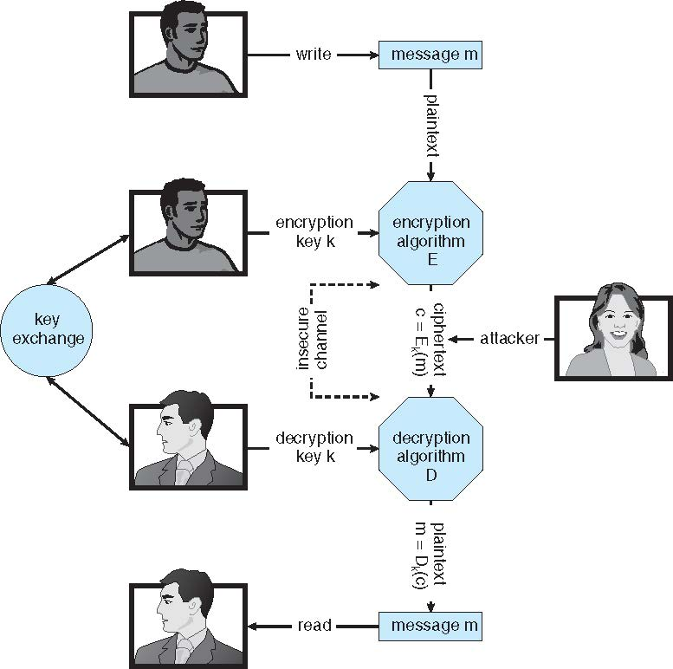
Secure Communication over Insecure Medium

Slide 29
Asymmetric Encryption
Public-key encryption based on each user having two keys:
public key – published key used to encrypt data
private key – key known only to individual user used to decrypt data
Must be an encryption scheme that can be made public without making it easy to figure out the decryption scheme
Most common is RSA block cipher
Efficient algorithm for testing whether or not a number is prime
No efficient algorithm is know for finding the prime factors of a number

Slide 30
Asymmetric Encryption (Cont.)
Formally, it is computationally infeasible to derive k_{d,N} from k_{e,N}, and so k_{e} need not be kept secret and can be widely disseminated
k_{e} is the public key
k_{d} is the private key
N is the product of two large, randomly chosen prime numbers p and q (for example, p and q are 512 bits each)
Encryption algorithm is E_{ke,N}(m) = m^{ke} mod N, where k_{e} satisfies k_{e}k_{d} mod (p−1)(q −1) = 1
The decryption algorithm is then D_{kd,N}(c) = c^{kd} mod N

Slide 31
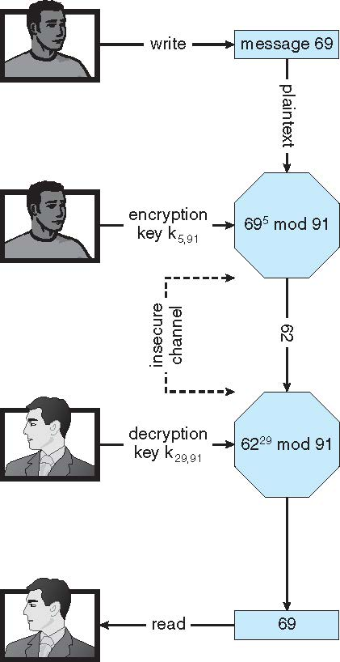
Encryption using RSA Asymmetric Cryptography

Slide 32
Cryptography (Cont.)
Note :
symmetric cryptography based on transformations
asymmetric based on mathematical functions
Asymmetric much more compute intensive
Typically not used for bulk data encryption

Slide 33
Authentication
Constraining set of potential senders of a message
Complementary to encryption
Also can prove message unmodified
Algorithm components
A set K of keys
A set M of messages
A set A of authenticators
A function S : K → (M→ A)
That is, for each k ∈ K, S_{k} is a function for generating authenticators from messages
Both S and S_{k} for any k should be efficiently computable functions
A function V : K → (M × A→ {true, false}). That is, for each k ∈ K, V_{k} is a function for verifying authenticators on messages
Both V and V_{k} for any k should be efficiently computable functions

Slide 34
Authentication (Cont.)
For a message m, a computer can generate an authenticator a ∈ A such that V_{k}(m, a) = true only if it possesses k
Thus, computer holding k can generate authenticators on messages so that any other computer possessing k can verify them
Computer not holding k cannot generate authenticators on messages that can be verified using V_{k}
Since authenticators are generally exposed (for example, they are sent on the network with the messages themselves), it must not be feasible to derive k from the authenticators
Practically, if V_{k}(m,a) = true then we know m has not been modified and that send of message has k
If we share k with only one entity, know where the message originated

Slide 35
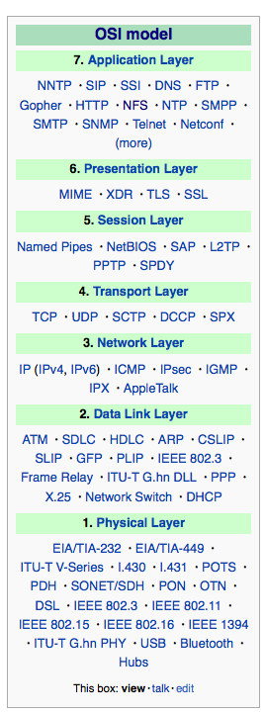
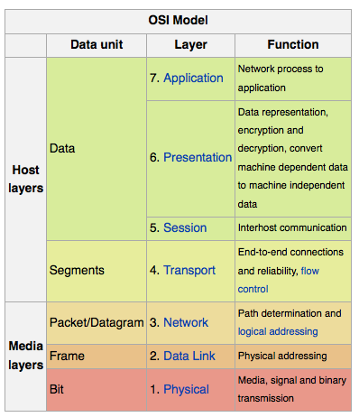
Implementation of Cryptography
Can be done at various layers of ISO Reference Model
SSL at the Transport layer
Network layer is typically IPSec
IKE for key exchange
Basis of Virtual Private Networks (VPNs)
Why not just at lowest level?
Sometimes need more knowledge than available at low levels
i.e. User authentication
i.e. e-mail delivery

Slide 36
User Authentication
Crucial to identify user correctly, as protection systems depend on user ID
User identity most often established through passwords, can be considered a special case of either keys or capabilities
Passwords must be kept secret
Frequent change of passwords
History to avoid repeats
Use of “non-guessable” passwords
Log all invalid access attempts (but not the passwords themselves)
Unauthorized transfer
Passwords may also either be encrypted or allowed to be used only once
Does encrypting passwords solve the exposure problem?
Might solve sniffing
Consider shoulder surfing
Consider Trojan horse keystroke logger
How are passwords stored at authenticating site?

Slide 37
Passwords
Encrypt to avoid having to keep secret
But keep secret anyway (i.e. Unix uses superuser-only readably file /etc/shadow)
Use algorithm easy to compute but difficult to invert
Only encrypted password stored, never decrypted
Add “salt” to avoid the same password being encrypted to the same value
One-time passwords
Use a function based on a seed to compute a password, both user and computer
Hardware device / calculator / key fob to generate the password
Changes very frequently
Biometrics
Some physical attribute (fingerprint, hand scan)
Multi-factor authentication
Need two or more factors for authentication
i.e. USB “dongle”, biometric measure, and password

