Slide 1
2.4 CPU scheduling

Slide 2
Contents:
Introduction to scheduling
Categories of scheduling algorithm
CPU scheduling
Scheduling criteria
Scheduling algorithms
Multiprocessor scheduling
Threads scheduling

Slide 3
Introduction to scheduling
When a computer is multiprogrammed, it frequently has multiple processes competing for the CPU at the same time.
When more processes are there in the ready state than the number of available CPUs, the operating system must decide which process to run first.
The part of the operating system that makes the choice is called the scheduler and the algorithm it uses is called the scheduling algorithm.

Slide 4
Process scheduling queues
The objective of multi-programming
  To have some process running at all times.
Timesharing: Switch the CPU frequently that users can interact the program while it is running.
If there are many processes, the rest have to wait until CPU is free.
Scheduling is to decide which process to execute and when.
Scheduling queues:-Several queues used for scheduling:
  Job queue – set of all processes in the system.
  Ready queue – set of all processes residing in main memory, ready and waiting to execute.
  Device queues – set of processes waiting for an I/O device.
    Each device has its own queue.
Process migrates between the various queues during its life time.

Slide 5
schedulers
A process in a job-queue is selected in some fashion and assigned to memory/CPU.
The selection process is carried out by a scheduler. Schedulers are of three types:
Long-term scheduler (or job scheduler) – selects which processes should be brought into the ready queue from the job queue (determine the degree of multi-programming)
Short-term scheduler (or CPU scheduler) – selects which process should be executed next and allocates CPU
Medium-term ( or Emergency) scheduler: swap out the process from memory (ready queue) and swapped in again later (it decrease the degree of multiprogramming).

Slide 6
Passive Programs
Disk
Memory
Long Term Scheduler
Short Term Scheduler
Open program
CPU
Process
Select a process from job to ready queue
Assign the CPU to a process from ready queue
Process
Swap a process from ready to job queue
Job (input) Queue
Medium Term Scheduler

Slide 7
Degree of multi-programming is the number of processes that are placed in the ready queue waiting for execution by the CPU.
Process 1
Process 2
Process 3
Degree of
Multi-Programming
Process 4
Process 5
Memory

Slide 8
Since Long term scheduler selects which processes to brought to the ready queue, hence, it increases the degree of multiprogramming.
Long Term Scheduler
Process 1
Disk
Process 2
Degree of
Multi-Programming
Process 3
Process 4
Process 5
Job Queue
Memory

Slide 9
Since Medium term scheduler picks some processes from the ready queue and swap them out of memory, hence, it decreases the degree of multiprogramming.
Medium Term Scheduler
Process 1
Disk
Process 2
Degree of
Multi-Programming
Process 3
Process 4
Process 5
Memory
Job Queue

Slide 10
Categories of Scheduling Algorithms
For different environments different scheduling algorithms are needed.
This situation arises because different application areas (and different kinds of operating systems) have different goals.
Three environments worth distinguishing are
  Batch.
  Interactive.
  Real time.
In batch systems, there are no users impatiently waiting at their terminals for a quick response.
This approach reduces process switches and thus improves performance.

Slide 11
Categories of Scheduling Algorithms(con’t..)
In an environment with interactive users, preemption is essential to keep one process from hogging the CPU and denying service to the others.
Even if no process intentionally ran forever, due to a program bug, one process might shut out all the others indefinitely.
Preemption is needed to prevent this behavior.
In systems with real-time constraints, preemption is, oddly enough, sometimes not needed because the processes know that they may not run for long periods of time and usually do their work and block quickly.
The difference with interactive systems is that real-time systems run only programs that are intended to further the application at hand. Interactive systems are general purpose and may run arbitrary programs that are not cooperative or even malicious.

Slide 12
Categories of Scheduling Algorithms(con’t..)
Scheduling algorithms can be divided into two categories
with respect to how they deal with clock interrupts.
Preemptive scheduling: allows releasing the current executing process from CPU when another process (which has a higher priority) comes and need execution.
Non-preemptive scheduling: once the CPU has been allocated to a process, the process keeps the CPU until it release the CPU .

Slide 13
Preemptive Scheduling
CPU
Non- Preemptive Scheduling
CPU

Slide 14
CPU Scheduling

Slide 15
CPU scheduling
CPU Scheduling is the method to select a process from the ready queue to be executed by CPU when ever the CPU becomes idle.
CPU scheduling decisions may take place when a process:
  1. Switches from running to waiting state
  2. Switches from running to ready state
  3. Switches from waiting to ready
  4. Terminates

Slide 16
Scheduling Criteria
CPU Utilization:
The percentage of times while CPU is busy to the total time ( times CPU busy + times it is idle). Hence, it measures the benefits from CPU.
To maximize utilization, keep CPU as busy as possible.
CPU utilization range from 40% (for lightly loaded systems) to 90% (for heavily loaded) (Explain why? CPU utilization can not reach 100%, because of the context switch between active processes).

Slide 17
System Throughput:
The number of process that are completed per time unit (hour)
Turnaround time:
For a particular process, it is the total time needed for process execution (from the time of submission to the time of completion).
It is the sum of process execution time and its waiting times (to get memory, perform I/O, ….).
Waiting time:
The waiting time for a specific process is the sum of all periods it spends waiting in the ready queue.
Response time.
It is the time from the submission of a process until the first response is produced (the time the process takes to start responding).

Slide 18
It is desirable to:
Maximize:
  CPU utilization.
  System throughput.
Minimize:
  Turnaround time.
  Waiting time.
  Response time.

Slide 19
Scheduling Algorithms
First Come First Serviced (FCFS) algorithm
  The process that comes first will be executed first.
  Not preemptive(The first job is allowed to run as long as it wants to be executed.).
  It is easy to understand and equally easy to program.
  With this algorithm, a single linked list keeps track of all ready processes.
Weakness
  A single process may egoistically control the CPU time.
  It is not good for time sharing tasks.
  FCFS—discriminates against short jobs since any short jobs arriving after long jobs will have a longer waiting time.

Slide 20


First Come First Serviced (FCFS) algorithm(con’t..)
Ready queue
FCFS Scheduling
CPU

Slide 21
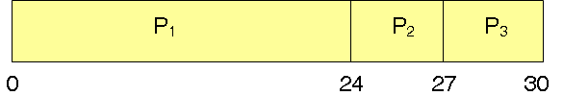
Consider the following set of processes, with the length of the CPU burst (Execution) time given in milliseconds:
The processes arrive in the order
P1, P2, P3. All at time 0.
Gant chart:
waiting times and turnaround times for each process are:
Hence, average waiting time= (0+24+27)/3=17 milliseconds
Burst Time | Process
24 | P1
3 | P2
3 | P3
1
2
3
P3 | P2 | P1 | Process
27 | 24 | 0 | Waiting Time (WT)
30 | 27 | 24 | Turnaround Time (TAT)
+
Execution Time

Slide 22
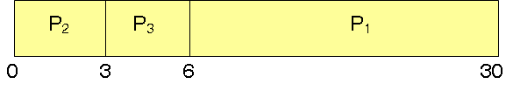
Repeat the previous example, assuming that the processes arrive in the order P2, P3, P1. All at time 0.
Gant chart:
waiting times and turnaround times for each process are:
Hence, average waiting time= (6+0+3)/3=3 milliseconds
Burst Time | Process
24 | P1
3 | P2
3 | P3
3
1
2
P3 | P2 | P1 | Process
3 | 0 | 6 | Waiting Time (WT)
6 | 3 | 30 | Turnaround Time (TAT)

Slide 23
Shortest-Job-First (SJF) scheduling
When CPU is available, it will be assigned to the process with the smallest CPU burst (non preemptive).
If two processes have the same next CPU burst, FCFS is used.
  Shortest job first is provably optimal when all the jobs are available simultaneously.
  Mainly used in the long-term-scheduler.
SJF Scheduling
X
10
5
18
7
18
10
7
5
CPU
Note: numbers indicates the process execution time

Slide 24
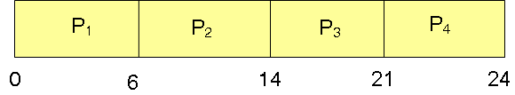
Consider the following set of processes, with the length of the CPU burst time given in milliseconds:
The processes arrive in the order
P1, P2, P3, P4. All at time 0.
1. Using FCFS
Gant chart:
waiting times and turnaround times for each process are:
Hence, average waiting time= (0+6+14+21)/4=10.25 milliseconds
Burst Time | Process
6 | P1
8 | P2
7 | P3
3 | P4
P4 | P3 | P2 | P1 | Process
21 | 14 | 6 | 0 | Waiting Time (WT)
24 | 21 | 14 | 6 | Turnaround Time (TAT)

Slide 25

2. Using SJF
Gant chart:
waiting times and turnaround times for each process are:
Hence, average waiting time= (3+16+9+0)/4=7 milliseconds
Burst Time | Process
6 | P1
8 | P2
7 | P3
3 | P4
P4 | P3 | P2 | P1 | Process
0 | 9 | 16 | 3 | Waiting Time (WT)
3 | 16 | 24 | 9 | Turnaround Time (TAT)

Slide 26
Shortest-Remaining-Time-First (SRTF)
  It is a preemptive version of the Shortest Job First
  It allows a new process to gain the processor if its execution time less than the remaining time of the currently processing one.
  When a new job arrives, its total time is compared to the current process' remaining time.
  If the new job needs less time to finish than the current process, the current process is suspended and the new job started
SRTF Scheduling
2
10
7
5
4
3
CPU

Slide 27
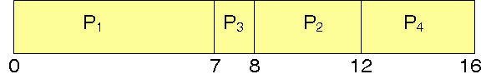
Consider the following set of processes, with the length of the CPU burst time given in milliseconds:
The processes arrive in the order
P1, P2, P3, P4. as shown in table.
1. Using SJF
Gant chart:
waiting times and turnaround times for each process are:
Hence, average waiting time= (0+6+3+7)/4=4 milliseconds
Arrival Time | Burst Time | Process
0 | 7 | P1
2 | 4 | P2
4 | 1 | P3
5 | 4 | P4
P4 | P3 | P2 | P1 | Process
7 | 3 | 6 | 0 | Waiting Time (WT)
11 | 4 | 10 | 7 | Turnaround Time (TAT)

Slide 28
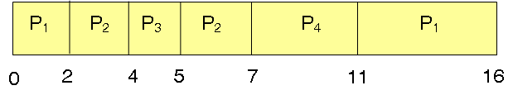
2. Using SRTF
Gant chart:
waiting times and turnaround times for each process are:
Hence, average waiting time= (9+1+0+2)/4=3 milliseconds
Arrival Time | Burst Time | Process
0 | 7 | P1
2 | 4 | P2
4 | 1 | P3
5 | 4 | P4
P4 | P3 | P2 | P1 | Process
2 | 0 | 1 | 9 | Waiting Time (WT)
6 | 1 | 5 | 16 | Turnaround Time (TAT)

Slide 29
Round Robin scheduling
Is one of the oldest, simplest, fairest, and most widely used algorithms.
Allocate the CPU for one Quantum time (also called time slice) Q to each process in the ready queue.
  If the process has blocked or finished before the quantum has elapsed, the CPU switching is done when the process blocks, of course.
This scheme is repeated until all processes are finished.
A new process is added to the end of the ready queue.
setting the quantum too short causes too many process switches and lowers the CPU efficiency, but setting it too long may cause poor response to short interactive requests.

Slide 30
Round Robin scheduling(con’t..)
  A quantum of around 20-50 msec is often a reasonable compromise
  RR—treats all jobs equally (giving them equal bursts of CPU time) so short jobs will be able to leave the system faster since they will finish first.
Round Robin Scheduling
Q
Q
Q
Q
Q
Q
Q
Q
Q
Q
Q
Q
Q
Q
Q
Q
CPU
CPU
CPU
CPU

Slide 31
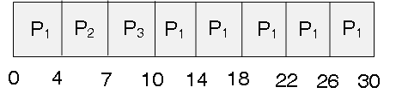
Consider the following set of processes, with the length of the CPU burst time given in milliseconds:
The processes arrive in the order
P1, P2, P3. All at time 0.
use RR scheduling with Q=2 and Q=4
RR with Q=4
Gant chart:
waiting times and turnaround times for each process are:
Hence, average waiting time= (6+4+7)/3=5.66 milliseconds
Burst Time | Process
24 | P1
3 | P2
3 | P3
P3 | P2 | P1 | Process
7 | 4 | 6 | Waiting Time (WT)
10 | 7 | 30 | Turnaround Time (TAT)

Slide 32
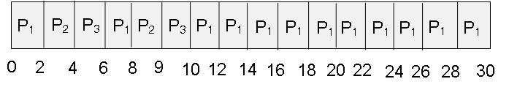
RR with Q=2
Gant chart:
waiting times and turnaround times for each process are:
Hence, average waiting time= (6+6+7)/3=6.33 milliseconds
Burst Time | Process
24 | P1
3 | P2
3 | P3
P3 | P2 | P1 | Process
7 | 6 | 6 | Waiting Time (WT)
10 | 9 | 30 | Turnaround Time (TAT)

Slide 33
Explain why? If the quantum time decrease, this will slow down the execution of the processes.
Sol:
Because decreasing the quantum time will increase the context switch (the time needed by the processor to switch between the processes in the ready queue) which will increase the time needed to finish the execution of the active processes, hence, this slow down the system.

Slide 34
Priority scheduling
A priority number (integer) is associated with each process
The CPU is allocated to the process with the highest priority (smallest integer).
  It is often convenient to group processes into priority classes and use priority scheduling among the classes but round-robin scheduling within each class.
There are two types:
  Preemptive
  nonpreemptive
Priority Scheduling
X
10
5
18
7
18
10
7
5
CPU
Note: numbers indicates the process priority

Slide 35
Problems with Priority scheduling
Problem ≡ Starvation (infinite blocking)– low priority processes may never execute
Solution ≡ Aging – as time progresses increase the priority of the process
Very low priority process
Very low priority process
Very low priority process
28
26
8
8
30
5
4
2
Starvation
Aging

Slide 36
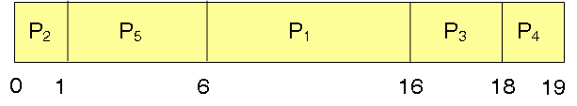
Consider the following set of processes, with the length of the CPU burst time given in milliseconds:
The processes arrive in the order
P1, P2, P3, P4, P5. All at time 0.
1. Using priority scheduling
Gant chart:
waiting times and turnaround times for each process are:
Hence, average waiting time= (6+0+16+18+1)/5=8.2 milliseconds
priority | Burst Time | Process
3 | 10 | P1
1 | 1 | P2
4 | 2 | P3
5 | 1 | P4
2 | 5 | P5
P5 | P4 | P3 | P2 | P1 | Process
1 | 18 | 16 | 0 | 6 | Waiting Time (WT)
6 | 19 | 18 | 1 | 16 | Turnaround Time (TAT)

Slide 37
Multi-level queuing scheduling
Ready queue is partitioned into separate queues:
    foreground (interactive)
    background (batch)
Each queue has its own scheduling algorithm,
    foreground – RR
    background – FCFS
Scheduling must be done between the queues.
    Fixed priority scheduling: (i.e., serve all from foreground then from background). Possibility of starvation.
    Time slice: each queue gets a certain amount of CPU time which it can schedule amongst its processes; i.e., 80% to foreground in RR;20% to background in FCFS
There are two types:
  Without feedback: processes can not move between queues.
  With feedback: processes can move between queues.

Slide 38
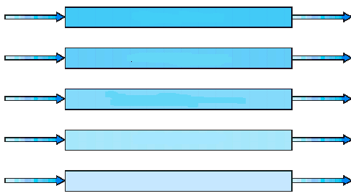
Multi-level queuing without feedback:
Divide ready queue into several queues.
Each queue has specific priority and its own scheduling algorithm (FCFS, …).
High priority Queue
Low priority Queue

Slide 39
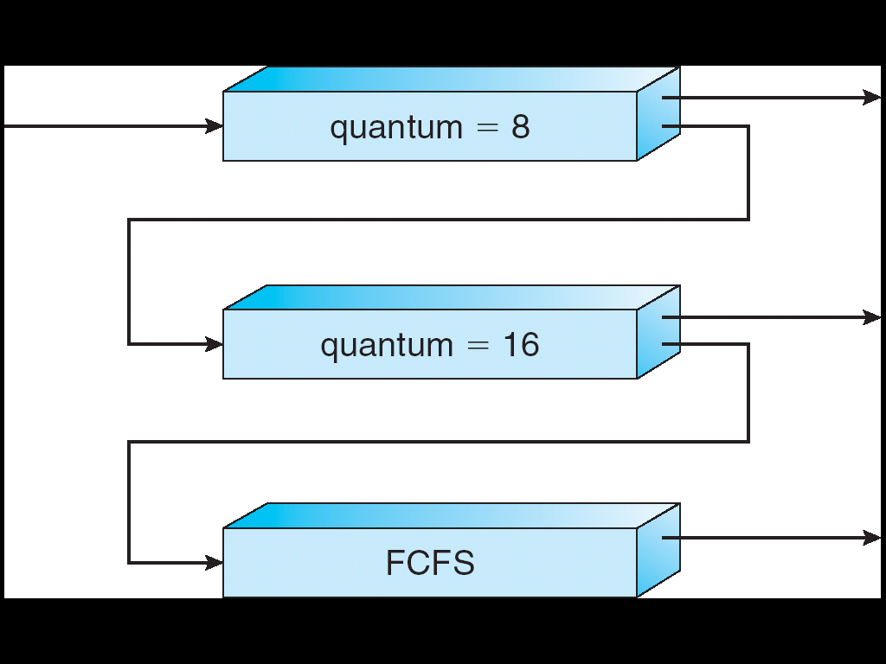
Multi-level queuing with feedback:
Divide ready queue into several queues.
Each queue has specific Quantum time as shown in figure.
Allow processes to move between queues.
Queue 0
Queue 1
Queue 2

Slide 40
Multiple-Processor Scheduling
CPU scheduling more complex when multiple CPUs are available.
  In Symmetric Multiprocessors systems all CPUs can perform scheduling independently(complex task).
  Asymmetric multiprocessor systems :- only one processor(Master CPU) handles all the scheduling tasks.
Asymmetric multiprocessing – only one processor accesses the system data structures, alleviating the need for data sharing.
Load sharing :Load must be fairly distributed among processors to maximize processors use. Load balancing is especially important when each processor has its own private queue.
Two general approaches.
    push migration:- keeping load balance by pushing processes from overloaded processor to an idle one.
    pull migration:-an idle processor pulls processes from an overloaded one.

Slide 41
Thread scheduling
Recall that there are two types of threads.
  User level threads and kernel level threads.
On OS systems supporting them, it is kernel-level-threads -not processes- that are scheduled by the operating system.
User level-threads are managed by the thread library, and the kernel is unaware of them.
To run on CPU, user-level threads must be mapped to an associated kernel level thread
On systems implementing many-to-one and many-to-many models, the thread library schedules user level-thread threads on the available resources→ this scheme is called process contention scope(PCS)- (since threads of same process compete for CPU).
To decide which kernel-thread to schedule to CPU the kernel uses system-contention-schedule(SCS). Competition for CPU with SCS takes pace among all threads in the system. Systems using one -to-one models(such as windows XP, Solaris 9, Linux) uses only SCS.

Slide 42

Any Questions?

