Slide 1
2.5 Deadlock

Slide 2
Contents:
Introduction
Resource
Deadlock characterization
Deadlock modeling
Deadlock handling mechanism
Deadlock prevention
Deadlock detection and recovery
Deadlock avoidance
Two phase locking
Communication deadlock
Live lock
starvation

Slide 3
Introduction
A set of processes is deadlocked if each process in the set is waiting for an event that only another process in the set can cause.
all the processes are waiting, none of them will ever cause any of the events that could wake up any of the other members of the set, and all the processes continue to wait forever.
Each member of the set of deadlocked processes is waiting for a resource that is owned by a deadlocked process.
None of the processes can run, none of them can release any resources, and none of them can be awakened.
This kind of deadlock is called a resource deadlock. It is probably the most common kind, but it is not the only kind.

Slide 4
Analogy
Deadlock
System Breakdown

Slide 5
Resource deadlock
A set of blocked processes, each:
  holding a resource
  and waiting to use a resource held by another process in the set.
Deadlock:
1
2
Give me your recourse
Give me your recourse first
Resource
Deadlock
Resource
Process A
Process B
Hence, blocked processes will never change state (Explain why?) because the resource it has requested is held by another waiting process.

Slide 6
Resource
A major class of deadlocks involve resources.
Deadlocks can occur when processes have been granted exclusive access to devices, data records, files, and so forth.
In general the objects granted to a process is referred to as resources.
A resource can be a hardware device (e.g., a tape drive) or a piece of information (e.g., a locked record in a database).
process must request a resource before using it and release it after making use of it. Each process utilizes a resource as follows:
  Request :A process requests for an instance of a resource type. If the resource is free, the request will be granted. Otherwise the process should wait until it acquires the resource
  Use :The process uses the resource for its operations
  Release : The process releases the resource

Slide 7
Resource Types
Preemptive Resources
A resource that can be taken away from the process owning it with no ill effects
    Ex: Memory.
Non Preemptive Resources
A resource that cannot be taken away from its current owner without causing the computation to fail.
Ex: CD recorder,

Slide 8
Resource type (con’t…)
Memory: is a preemptive recourse ,Because, It allows a low priority process to swapped out form it to the disk when a higher priority process arrives and needs a larger amount of memory than the available. The low priority process can resume execution later (swapped in again).

Slide 9
Assume a system with 32 kb memory size.
5kb are used for OS, 10 kb for the low priority process.
Hence, the available space is 17 kb.
A higher priority process arrives and needs 20 kb.
Disk
Swap in the high priority process
Swap out the low priority process to disk
high priority process finishes execution
OS (5 kb)
OS (5 kb)
OS (5 kb)
OS (5 kb)
High Priority process (20 kb)
Low Priority process (10 kb)
Available
27 Kb
Available
27 Kb
Available
17 Kb
Available
7 Kb
Swap in the low priority process again to
resume execution
High
Priority
20 Kb

Slide 10
Resource type (con’t…)
CD recorder: is non preemptive resource, because ,If a process has begun to burn a CD-ROM, suddenly taking the CD recorder away from it and giving it to another process will result in a bad CD.

Slide 11
Deadlock characterization
Deadlock can arise if four conditions hold simultaneously in a system.
Deadlock conditions
Mutual Exclusion
Circular
wait
Hold and
wait
No preemption

Slide 12
Mutual Exclusion only one process can use a resource at a time.
1
1
Hold and Wait
A process holding at least one resource is waiting for additional resource held by another processes
2
2

Slide 13
No Preemption
A resource is released only by the process holding it after it completed its task
3
3
Circular Wait
A set of a processes each waits for another one in a circular fashion.
4
4
Note: the four conditions must occur to have a deadlock. If one condition is absent, a deadlock may not exist.

Slide 14
Circular
wait
There exists a set {P_{0,} P_{1,} P_{2, …..,} P_{n}} of waiting processes such that:
P₀ waiting for a resource held by P_{1.}
P₁ waiting for a resource held by P_{2.}
P₂ waiting for a resource held by P_{3.}
P_{n} waiting for a resource held by P_{0.}
P₀
P_{n}
P₁
Circular Wait
P₂
P₃
P₄

Slide 15
Deadlock modeling
In order to solve the deadlock problem, we must find a method to express it.
This can be achieved using resource allocation graph.
The graphs have two kinds of nodes and directed arc.
processes, shown as circles
resources, shown as squares.
A directed arc from a resource node to a process node means that the resource has previously been requested by, granted to, and is currently held by that process.
A directed arc from a process to a resource means that the process is currently blocked waiting for that resource.

Slide 16
Deadlock modeling(con’t…)
P (Process Set) ≡ set of processes in the system
P = {P₁, P₂, P₃, ……., P_{n}}
Process
R (Resource Set) ≡ set of Resource types in the system
R = {R₁, R₂, R₃, ……., R_{m}}
Resource
Edge
R_{j}
R_{j}
P_{i}
P_{i}
( Request edge )
( Assignment edge )
Process P_{i} requests an instance of resource R_{j}
An instance of Resource R_{j} is assigned to Process P_{i}
E (Edge Set) ≡ set of all edges in Resource Allocation Graph.
E = {P_{n} → R_{m}, R_{x} →P_{y}, …….. }

Slide 17
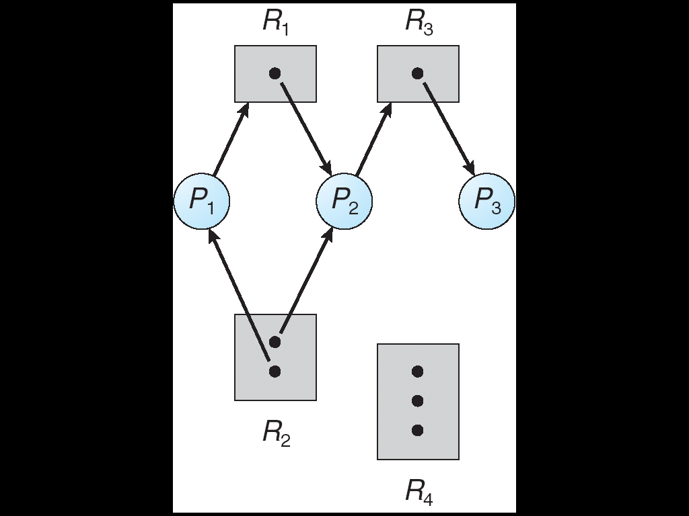
Example:
Deadlock modeling(con’t…)
1
Resource instances:
  One instance of R1 and R3.
  Two instances of R2.
  Three instances of R4.
2
Processes States:
Waiting | Holding | Process
Instance of R1 | Instance of R2 | P1
Instance of R3 | Instance of R1 and R2 | P2
------- | Instance of R3 | P3

Slide 18
Deadlock modeling(con’t…)
If a Resource Allocation Graph contains a cycle, then a deadlock may or may not exist.
Case 1: The system has one instance per resource type
If a cycle exists, the system in a deadlock state.
Each process involved in the cycle is deadlocked.
P₁
Cycle:
P1 → R1 → P2 → R2
R₂
R₁
Cycle
(Deadlock)
As show, no chance to break the cycle because:
  No process can finish execution.
  No way to free a resource.
P₂

Slide 19
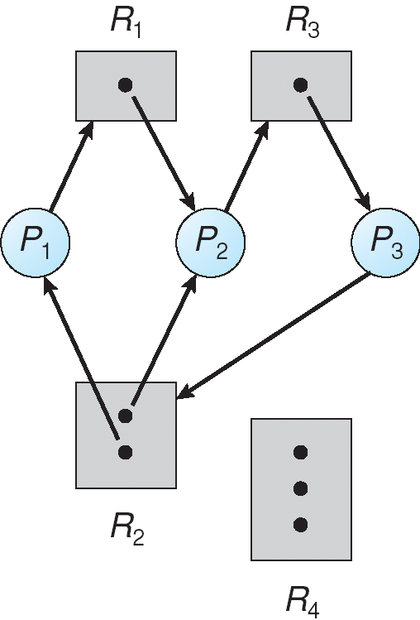
Case 2: The system has more than one instance per resource type
If a cycle exists, the system may or may not be in a deadlock state.
Ex 1: a cycle with deadlock:
Two Cycles exists:
P1 → R1 → P2 → R3 → P3 →R2
P2 → R3 → P3 → R2
As show, P1, P2, and P3 are deadlocked

Slide 20
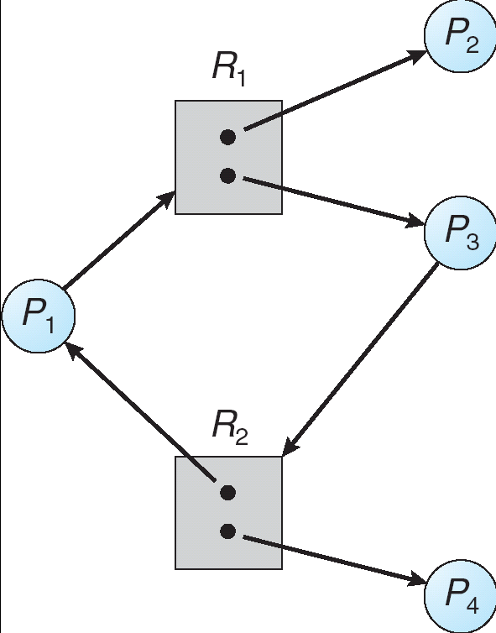
Ex 2: a cycle without deadlock:
Cycle:
P1 → R1 → P3 → R2
There is no deadlock because:
P4 may release its instance of R2.
This resource can be then allocated to P3 which breaking the cycle.
Also P2 may release its instance of R1.
This resource can be allocated to P1.

Slide 21
Deadlock handling mechanism
Deadlock problems can be handled in one of the following 4 ways:
  Using a protocol avoids deadlock by ensuring that a system will never enter a deadlock state (deadlock avoidance)
  structurally negating one of the four required conditions (deadlock prevention).
  Allow the system to enter a deadlock state and then recover(deadlock detection and recovery)
  Ignore the problem and pretend that deadlocks never occur in the system(ostrich algorithm); used by most operating systems, including UNIX

Slide 22
Deadlock prevention
Mutual Exclusion – This is not required for sharable resources; however to prevent a system from deadlock, the mutual exclusion condition must hold for non-sharable resources
Hold and Wait – in order to prevent the occurrence of this condition in a system, we must guarantee that whenever a process requests a resource, it does not hold any other resources. Two protocols are used to implement this:
    Require a process to request and be allocated all its resources before it begins execution or
    Allow a process to request resources only when the process has none

Slide 23
Deadlock prevention(con’t…)
Both protocols have two main disadvantages:
  Since resources may be allocated but not used for a long period, resource utilization will be low
  A process that needs several popular resources has to wait indefinitely because one of the resources it needs is allocated to another process. Hence starvation is possible.
No Preemption
If a process holding certain resources is denied further request, that process must release its original resources allocated to it

Slide 24
Deadlock prevention(con’t…)
If a process requests a resource allocated to another process waiting for some additional resources, and the requested resource is not being used, then the resource will be preempted from the waiting process and allocated to the requesting process
        Preempted resources are added to the list of resources for which the process is waiting
        Process will be restarted only when it can regain its old resources, as well as the new ones that it is requesting
        This approach is practical to resources whose state can easily saved and retrieved easily

Slide 25
Deadlock prevention(con’t…)
Circular Wait
A linear ordering of all resource types is defined and each process requests resources in an increasing order of enumeration.
So, if a process initially is allocated instances of resource type R, then it can subsequently request instances of resources types following R in the ordering

Slide 26
Deadlock detection and recovery
The system does not attempt to prevent deadlocks from occurring.
It lets them occur, tries to detect when this happens, and then takes some action to recover after the fact.
In this mechanism, the system must provide :
  A deadlock detection algorithm that examines the state of the system if there is an occurrence of deadlock
  An algorithm to recover from the deadlock

Slide 27
Deadlock Detection with One Resource of Each Type
only one resource of each type exists.
If the resource allocation graph contains one or more cycles, a deadlock exists.
Any process that is part of a cycle is deadlocked. If no cycles exist, the system is not deadlocked.
Many algorithms for detecting cycles in directed graphs are known.
Below we will give a simple one that inspects a graph and terminates either when it has found a cycle or when it has shown that none exists.

Slide 28
Deadlock Detection with One Resource of Each Type
The algorithm operates by carrying out the following steps as specified:
For each node, N in the graph, perform the following five steps with N as the starting node.
Initialize L to the empty list, and designate all the arcs as unmarked.
Add the current node to the end of L and check to see if the node now appears in L two times. If it does, the graph contains a cycle(listed in L) and the algorithm terminates.
From the given node, see if there are any unmarked outgoing arcs. If so, go to step 5 ; if not, go to step 6.

Slide 29
Deadlock Detection with One Resource of Each Type
Pick an unmarked outgoing arc at random and mark it. Then follow it to the new current node and go to step 3.
If this node is the initial node, the graph does not contain any cycles and the algorithm terminates. Otherwise, we have now reached a dead end. Remove it and go back to the previous node, that is, the one that was current just before this one, make that one the current node, and go to step 3.

Slide 30
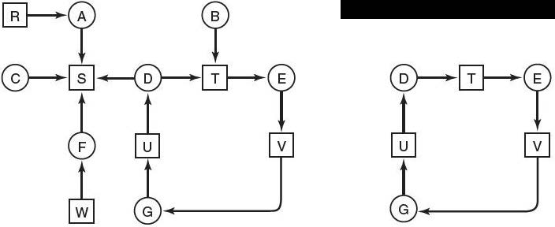
Example
The order of processing the nodes is from left to right, top to bottom i.e (R, A, B, C, S, D, T, E, F, and so forth.)
Start at R and initialize L to the empty list.
Then we add R to the list and since it appear only once in L. visit unmark outgoing arc from R.
There is only one outgoing arc which is move to A and add it to L, giving L = [R, A].and visit unmarked for node A. and follow to node S.

Slide 31
Example(con’t…)
Since there is no unmarked outgoing node, it backtrack to previous node A. also the outgoing arc from node visited or marked, it backtrack to previous node, which is root node R. so from this sub graph there is no cycle found, go to another which is Node A.
Follow the same step as node R. it cannot found cycle. Then got the node B.
Following the same step we can get L= [B, T, E, V, G, U, D] at given instant time. By choosing one of outgoing arc randomly from Node we can get L= [B, T, E, V, G, U, D,T], if we pick T.
Since T is found twice in L, it found cycle from node b, which is deadlock. At this time algorithm is terminated.

Slide 32
Deadlock Detection with Multiple Resources of Each Type
multiple copies of some of the resources exist.
Matrix-based algorithm for detecting deadlock among n processes, P 1 through P n is used.
The algorithm uses several data structures similar to the ones in banker’s algorithm.
  Existence: A vector of length m indicates the total number of existing instance of each resources type.
  Available: A vector of length m indicates the number of available resources of each type.
  Allocation: An n x m matrix defines the number of resources of each type currently allocated to each process.
  Request: An n x m matrix indicates the current request of each process. If Request [i_{j}] = k, then process P_{i} is requesting k more instances of resource type. R_{j}.

Slide 33
Deadlock Detection Algorithm
1. Let Work and Finish be vectors of length m and n, respectively Initialize:
  (a) Work = Available
  (b) For i = 1,2, …, n, if Allocation_{i} ≠ 0, then
  Finish[i] = false; otherwise, Finish[i] = true.
2. Find an index i such that both:
  (a) Finish[i] == false
  (b) Request_{i} ≤ Work; If no such i exists, go to step 4.
Work = Work + Allocation_{i}
Finish[i] = true; go to step 2
If Finish[i] == false, for some i, 1 ≤ i ≤ n, then the system is in deadlock state.
Moreover, if Finish[i] == false, then P_{i} is deadlocked.
Notes:
* Algorithm requires an order of O(m x n²⁾ operations to detect whether the system is in deadlocked state.

Slide 34
Deadlock Detection Algorithm (contd.)
Example
Five processes P₀ through P₄; three resource types :A (7 instances), B (2 instances), and C (6 instances)
Allocation Request Available Existing
A B C A B C A B C A B C
P₀ 0 1 0 0 0 0 0 0 0 7 2 6
P₁ 2 0 0 2 0 2
P₂ 3 0 3 0 0 0
P₃ 2 1 1 1 0 0
P₄ 0 0 2 0 0 2
Sequence <P₀, P₂, P₃, P₁, P₄> will result in Finish[i] = true for all i.

Slide 35
Deadlock Detection Algorithm (cont.)
P₂ requests an additional instance of type C.
Request
A B C
P₀ 0 0 0
P₁ 2 0 1
P₂ 0 0 1
P₃ 1 0 0
P₄ 0 0 2
State of system?
  Can reclaim resources held by process P₀, but insufficient resources to fulfill other processes; requests.
  Deadlock exists, consisting of processes P₁, P₂, P₃, and P₄.

Slide 36
Recovery from Deadlock
Once a deadlock has been detected, recovery strategy is needed. There are two possible recovery approaches:
    Process termination
    Resource preemption
  Process Termination
    Abort all deadlocked processes
    Abort one process at a time until the deadlock cycle is eliminated
  In which order should we choose a process to abort? Chose the process with
      Least amount of processor time consumed so far
      Least amount of output produced so far
      Most estimated time remaining
      Least total resources allocated so far
      Lowest priority
Notes:
In which order should we choose a process to abort?
Priority of the process
How long a process has computed, and how much longer it would take to completion?
Resources the process has used
Resources process needs to complete execution
How many processes will need to be terminated
Is process interactive or batch?

Slide 37
Recovery from Deadlock
Resource Preemption
In this recovery strategy, we successively preempt resources and allocate them to another process until the deadlock is broken
While implementing this strategy, there are three issues to be considered
  Selecting a victim – which resources and process should be selected to minimize cost just like in process termination. The cost factors may include parameters like the number of resources a deadlocked process is holding, number of resources it used so far
  Rollback – if a resource is preempted from a process, then it can not continue its normal execution
    The process must be rolled back to some safe state and started
  Starvation – same process may always be picked as victim several times. As a result, starvation may occur. The best solution to this problem is to only allow a process to be picked as a victims for a limited finite number of times. This can be done by including the number of rollback in the cost factor

Slide 38
Deadlock avoidance
Deadlock avoidance scheme requires each process to declare the maximum number of resources of each type that it may need in advance
The deadlock-avoidance algorithm dynamically examines the resource-allocation state to ensure that there can never be a circular-wait condition.
Resource-allocation state is defined by the number of available and allocated resources, and the maximum demands of the processes.
Simplest and most useful model requires that each process declare the maximum number of resources of each type that it may need.

Slide 39
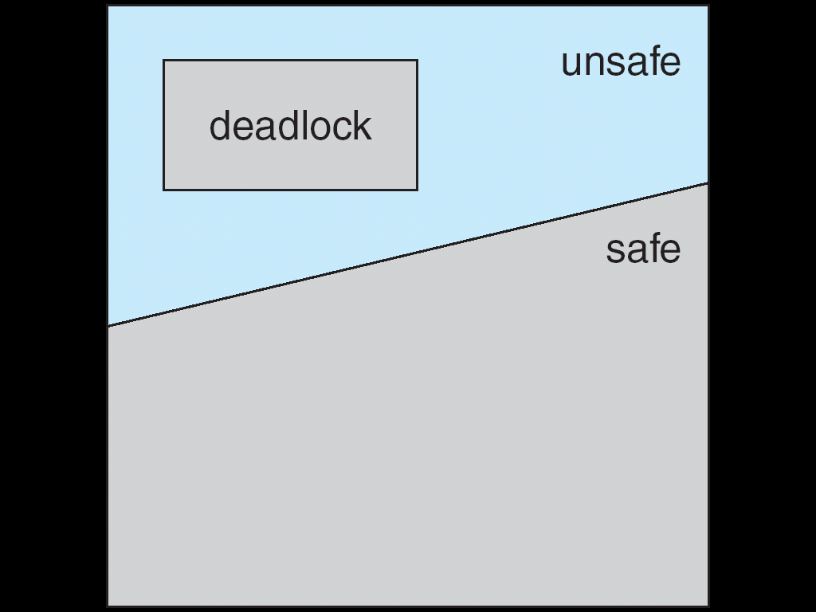
Safe and Unsafe States
A state is said to be safe if there is some scheduling order in which every process can run to completion even if all of them suddenly request their maximum Number of resources immediately.
A state said to be unsafe if there is no granted, given to any of process to complete.
If a system is in a safe state, then there are no deadlocks.
If a system is in unsafe state, then there is a possibility of deadlock
Deadlock avoidance method ensures that a system will never enter an unsafe state

Slide 40
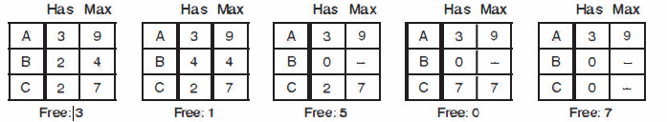
Example(safe state)
the state of is safe because the system, by careful scheduling, can avoid deadlock.

Slide 41
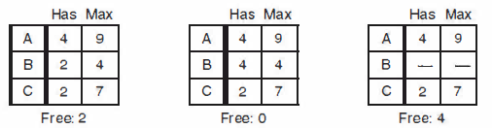
Example(unsafe state)
the state of is unsafe because the system, have no sequence that guarantees completion.

Slide 42
Deadlock Avoidance Algorithms
Based on the concept of safe state, we can define algorithms that ensures the system will never deadlock.
If there is a single instance of a resource type,
  Use a resource-allocation graph
If there are multiple instances of a resource type,
  Use the Dijkstra’s banker’s algorithm

Slide 43
Deadlock Avoidance Algorithms (contd.)
Resource-Allocation Graph Scheme
A new type of edge (Claim edge), in addition to the request and assignment edge is introduced.
Claim edge P_{i} → R_{j} indicates that process P_{i} may request resource R_{j} at some point in the future. The edge resembles a request edge but is represented by a dashed line in the graph
  Claim edge is converted to request edge when a process requests a resource
  Request edge is converted to an assignment edge when the resource is allocated to the process
  When a resource is released by a process, assignment edge reconverts to a claim edge
  If no cycle exists in the allocation, then system is in safe state otherwise the system is in unsafe state

Slide 44
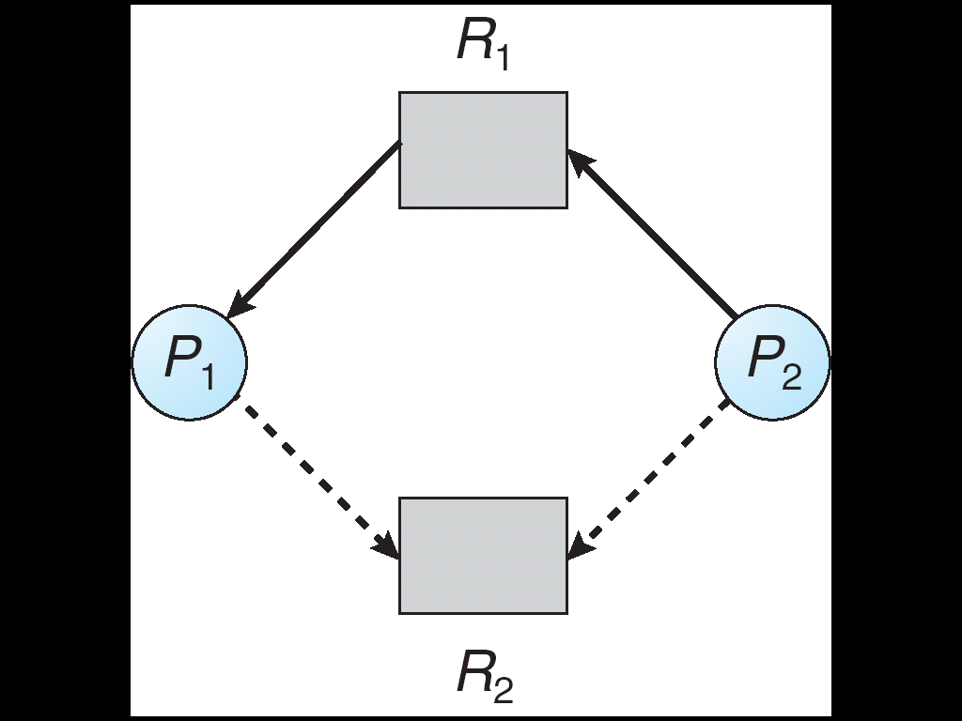
Deadlock Avoidance Algorithms (contd.)
Assignment Edge
Request Edge
Claim Edge
Suppose that process P_{i} requests a resource R_{j}
The request can be granted only if converting the request edge to an assignment edge does not result in a cycle in the resource allocation graph

Slide 45
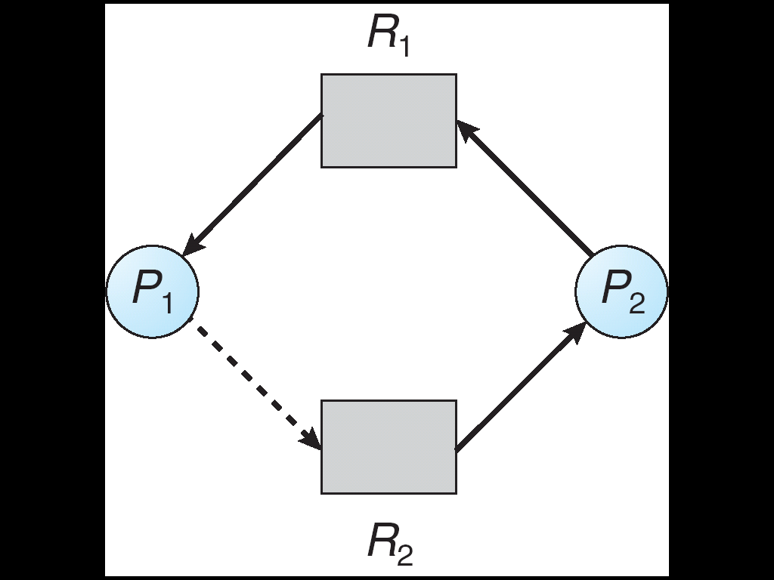
Deadlock Avoidance Algorithms (contd.)
Example: consider the following resource allocation graph:
Suppose that
P₂ requests R₂
Although R₂ is free, we can not allocate it to P₂ since this creates a cycle
Cycle

Slide 46
Deadlock Avoidance Algorithms (contd.)
Banker’s Algorithm
This algorithm is used when there are multiple instances of resources
When a process enters a system, it must declare the maximum number of each instance of resource types it may need
  The number however may not exceed the total number of
  resource types in the system
When a process requests a resource it may have to wait
When a process gets all its resources it must return them in a finite amount of time

Slide 47
Deadlock Avoidance Algorithms (contd.)
Banker’s Algorithm
The following data structures are used in the algorithm:
Let n = number of processes, and
m = number of resources types.
Available: Vector of length m.
  If available [j] = k, there are k instances of resource type R_{j} available.
Max: n x m matrix.
  If Max [i,j] = k, then process P_{i} may request at most k instances of resource type R_{j}.
Allocation: n x m matrix.
  If Allocation[i,j] = k then P_{i} is currently allocated k instances of R_{j.}
Need: n x m matrix.
  If Need[i,j] = k, then P_{i} may need k more instances of R_{j} to complete its task
  Need [i,j] = Max[i,j] – Allocation [i,j]
Notes:
Available [m] : One dimensional array of size m. It indicates the number of available resources of each type. For example, if Available [i] is k, there are k instances of resource ri.
Max [n,m] : Two dimensional array of size n*m. It defines the maximum demand of each process from each resource type. For example, if Max [i,j] is k, process pi may request at most k instances of resource type rj.
Allocation [n,m] : Two dimensional array of size n*m. It defines the number of resources of each type currently allocated to each process.
Need [n,m] : Two dimensional array of size n*m. It indicates the remaining need of each process, of each resource type. If Need [i,j] is k, process pi may need k more instances of resource type rj. Note that Need [i,j] = Max [i,j] - Allocation [i,j].Request [n,m] : Two dimensional array of size n*m. It indicates the pending requests of each process, of each resource type.

Slide 48
Deadlock Avoidance Algorithms (contd.)
Banker’s Algorithm
The algorithm is as follows:
Process pi makes requests for resources. Let Request(i) be the corresponding request vector. So, if pi wants k instances of resource type rj, then Request(i)[j] = k
If Request(i) !≤ Need(i), there is an error.
Otherwise, if Request(i) !≤ Available, then pi must wait
Otherwise, Modify the data structures as follows :
    Available = Available - Request(i)
    Allocation(i) = Allocation(i) + Request(i)
    Need(i) = Need(i) - Request(i)
Check whether the resulting state is safe. (Use the safety algorithm presented in the next slide)
If the state is safe, do the allocation. Otherwise, pi must wait for Request(i)

Slide 49
Deadlock Avoidance Algorithms (contd.)
Banker’s Algorithm
Safety Algorithm
It is used to identify whether or not a system is in a safe state. The algorithm can be described as follow:
Let Work and Finish be vectors of length m and n, respectively. Initialize:
      Work = Available
      Finish [i] = false for i = 0, 1, …, n- 1.
2. Find an i such that both:
  (a) Finish [i] = false
  (b) Need_{i} ≤ Work; If no such i exists, go to step 4.
3. Work = Work + Allocation_{i}
Finish [i] = true; go to step 2.
4. If Finish [i] == true for all i, then the system is in a safe state.

Slide 50
Deadlock Avoidance Algorithms (contd.)
Banker’s Algorithm
Examples of Banker’s algorithm:
Assume a system has
  5 processes P₀ through P₄;
  3 resource types: A (10 instances), B (5instances), and C (7 instances)
Need
A B c
P₀ 7 4 3
P₁ 1 2 2
P₂ 6 0 0
P₃ 0 1 1
P₄ 4 3 1
  Allocation Max Available
  A B C A B C A B C
P₀ 0 1 0 7 5 3 3 3 2
P₁ 2 0 0 3 2 2
P₂ 3 0 2 9 0 2
P₃ 2 1 1 2 2 2
P₄ 0 0 2 4 3 3
The system is in a safe state since the sequence < P₁, P₃, P₄, P₂, P₀> satisfies safety criteria

Slide 51
Deadlock Avoidance Algorithms (contd.)
Banker’s Algorithm
Example: P₁ Request (1,0,2)
Check that Request ≤ Available (that is, (1,0,2) ≤ (3,3,2) ⇒ true
Executing safety algorithm shows that sequence < P₁, P₃, P₄, P₀, P₂> satisfies safety requirement.
Can request for (3,3,0) by P₄ be granted?
Can request for (0,2,0) by P₀ be granted?
  Allocation Max Available
  A B C A B C A B C
P₀ 0 1 0 7 5 3 3 3 2
P₁ 2 0 0 3 2 2
P₂ 3 0 2 9 0 2
P₃ 2 1 1 2 2 2
P₄ 0 0 2 4 3 3
Allocation Need Available
A B C A B C A B C
P₀ 0 1 0 7 4 3 2 3 0
P₁ 3 0 2 0 2 0
P₂ 3 0 1 6 0 0
P₃ 2 1 1 0 1 1
P₄ 0 0 2 4 3 1

Slide 52
Two-Phase Locking
Deadlock avoidance and prevention are not terribly promising in the general case for deadlock handling.
When multiple processes are running at the same time, there is a real danger of deadlock.
The approach often used is called two-phase locking.
In the first phase, the process tries to lock all the records it needs, one at a time.
If it succeeds, it begins the second phase, performing its updates and releasing the locks.

Slide 53
Communication deadlock
process wants something that another process has and must wait until the first one gives it up.
Another kind of deadlock can occur in communication systems (e.g., networks), in which two or more processes communicate by sending messages.
A common arrangement is that process A sends a request message to process B, and then blocks until B sends back a reply message.
Communication deadlocks cannot be prevented by ordering the resources (since there are none) or avoided by careful scheduling (since there are no moments when a request could be postponed).
The technique that can usually be employed to break communication deadlocks: timeouts.
In most network communication systems, whenever a message is sent to which a reply is expected a timer is also started.
If the timer goes off before the reply arrives, the sender of the message assumes that the message has been lost and sends it again (and again and again if needed).

Slide 54
Livelock
In some situations, polling (busy waiting) is used to enter a critical region or access a resource.
Let pair of processes (process A and process B)using two resources.
process A is use resource 1 and request resource 2 and process 2 use resource 2 and request
if the processes wait for required resource by spooling rather than blocking, this situation is called livelock.
Thus we do not have a deadlock (because no process is blocked) but we have something functionally equivalent to deadlock; will make no further progress.

Slide 55
Starvation
A problem closely related to deadlock and livelock is starvation.
When processes wait for execution, but it cannot be possible to get CPU to be run, because of scheduler or something else these processes are said to be under starvation.

Slide 56
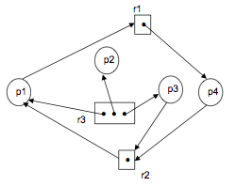
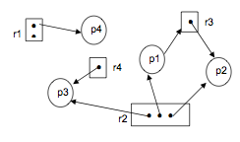
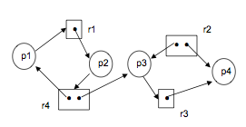
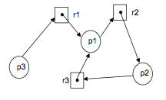
Exercises
For each of the resource allocation graphs below, determine whether there is a deadlock or not. Give explanations for each of your answers.
b.
a.
c.
d.

Slide 57
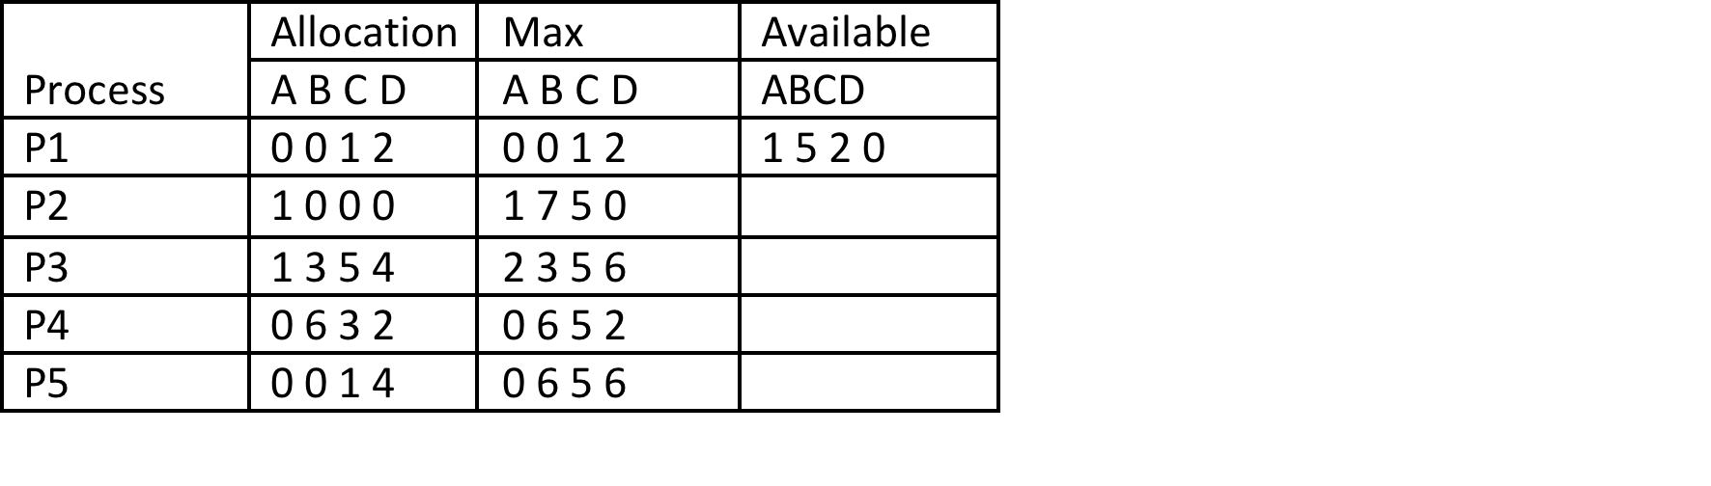
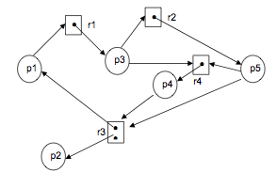
Exercises
There are four processes in a system and they are going to share nine tape drives. Their current and maximum number of allocation numbers are as follows :
Is the system in a safe state? Why or why not?
Is the system deadlocked? Why or why not?
Explain if the system in the given resource allocation graph here is deadlocked. If not, give an execution order of the processes which successfully terminates

Slide 58
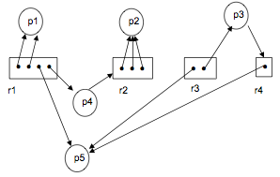
Exercises
Given the resource allocation graph below:
Apply the deadlock detection algorithm and either indicate why the system is deadlocked, or specify a safe allocation sequence
b. If the process P2 also request 2 instances of resource r1, does the system enter a deadlock? Why?
Consider the following snapshot of a system:
  Use the banker’s algorithm to answer the following questions:
    What is the content of the matrix Need?
    Is the system in a safe state?
    If a request from process P1 arrives for (0,4,2,0), can the request be granted immediately?

