Slide 1
Chapter 3
memory management

Slide 2
2.1 Main memory

Slide 3
Content
Background
Logical versus Physical Address Space
Swapping
Contiguous Allocation
Paging
Segmentation
Segmentation with Paging

Slide 4
Background
Program must be brought into memory and placed within a process for it to be executed.
In a multiprogramming system, the “user” part of memory must be further subdivided to accommodate multiple processes.
The task of subdivision is carried out dynamically by the operating system and is known as memory management.
Main memory and registers are only storage CPU can access directly.
Register access in one CPU clock (or less), Main memory can take many cycles
Cache sits between main memory and CPU registers
Memory needs to be allocated efficiently to pack as many processes into memory as possible.
Problem
      how to manage relative speed of accessing physical memory?
      How to Ensure correct operation to protect the operating system from being accessed by user process and user processes from one another?

Slide 5
Background(con’t….)
  To provide the above protection, we need to ensure that each process has a separate address space.
  Determine the legal addresses that the process can access legally
  Ensure that a process can access only these legal addresses.
This protection can be done using two registers
  Base registers: - holds the physical address where its
  program begins in memory
  Limit registers:-holds the length of the program.
    Use a HW to compare every address generated in user space with registers value
    A trap is generated for any attempt by a user process to access beyond the limit.
    Base and limit registers are loaded only by the OS, using special privileged instructions
Defines legal addresses
Ensures memory protection

Slide 6
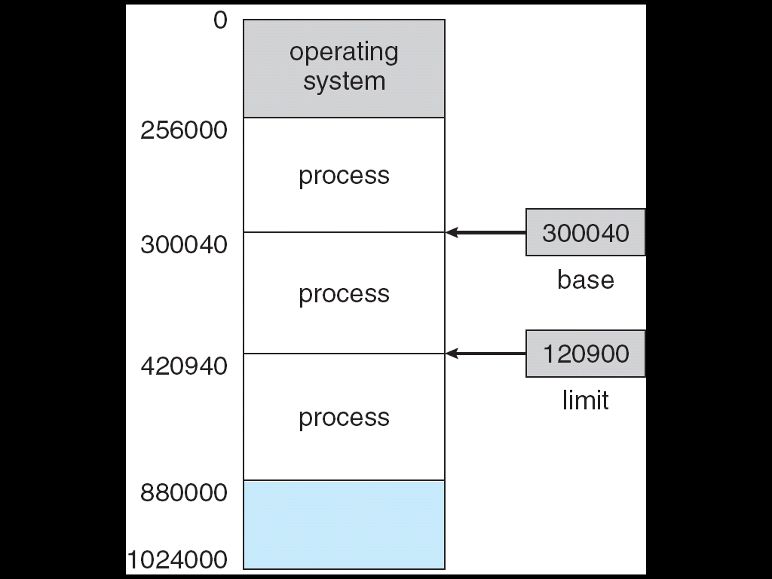
Background(con’t….)
A pair of base and limit registers define the logical address space.
300040+120900=
Valid address=[300040,420940]

Slide 7
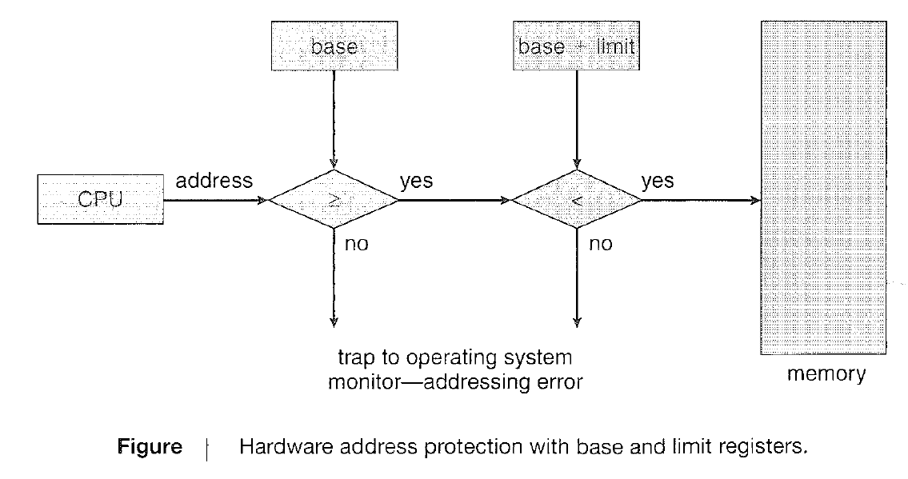
Background(con’t….)
A pair of base and limit registers define the logical address space.

Slide 8
Address Binding
Usually a program resides in a disk in the form of executable binary file.
It is brought to memory for execution (it may be moved between disk and memory in the meantime).
When a process is executed it accesses instructions and data from memory. When execution is completed the memory space will be freely available.
A user program may be placed at any part of the memory.
A user program passes through a number of steps before being executed.
Addresses may be represented in different ways during these steps.
    Symbolic addresses:- addresses in source program(eg count)
    Re-locatable addresses:(eg. 14 bytes from the beginning of this module)
    Absolute addresses:-(eg. 74014)
What’s the purpose of binding?

Slide 9
Address Binding(con’t…)
Address binding of instructions and data to memory addresses can happen at three different stages.
  Compile time:
        If memory location is known a prior, absolute code can be generated; must recompile code if starting location changes.
  Load time:
        Must generate re-locatable code if memory location is not known at compile time.
  Execution time:
        Binding delayed until runtime if the process can be moved during its execution from one memory segment to another
        Need hardware support for address maps (e.g. base and limit registers).
What’s the purpose of binding?

Slide 10
Binding time tradeoffs
  Early binding
      compiler - produces efficient code
      allows checking to be done early
      allows estimates of running time and space
  Delayed binding
      Linker, loader
      produces efficient code, allows separate compilation
      portability and sharing of object code
  Late binding
      VM, dynamic linking/loading, overlaying, interpreting
      code less efficient, checks done at runtime
      flexible, allows dynamic reconfiguration

Slide 11
Logical vs. Physical Address Space
The concept of a logical address space that is bound to a separate physical address space is central to proper memory management.
  Logical Address: or virtual address - generated by CPU
    Set of logical addresses generated by a program is called logical address space.
  Physical Address: address seen by memory unit.
    Set of physical addresses corresponds to logical space is called physical address space
Logical and physical addresses are the same in compile-time and load-time address-binding schemes; logical (virtual) and physical addresses differ in execution-time address-binding scheme.
Memory Management Unit (MMU)
  Hardware device that maps virtual to physical address.
  In MMU scheme, the value in the relocation register is added to every address generated by a user process at the time it is sent to memory.
  The user program deals with logical addresses; it never sees the real physical address.
What’s the difference between logical and physical addresses?

Slide 12
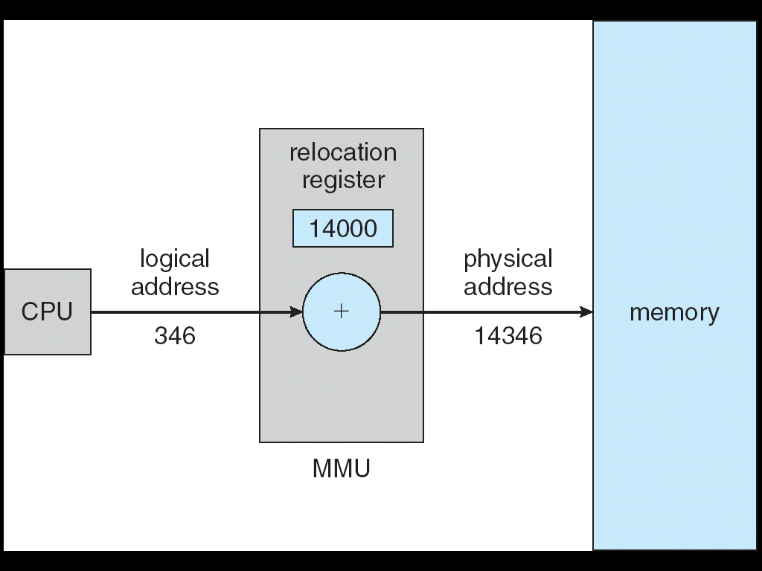
Dynamic relocation using a relocation register

Slide 13
Swapping
  A process can be swapped temporarily out of memory to a backing store and then brought back into memory for continued execution.
      Backing Store - fast disk large enough to accommodate copies of all memory images for all users; must provide direct access to these memory images.
      Roll out, roll in - swapping variant used for priority based scheduling algorithms; lower priority process is swapped out, so higher priority process can be loaded and executed.
      System maintains a ready queue of ready-to-run processes which have memory images on disk.

Slide 14
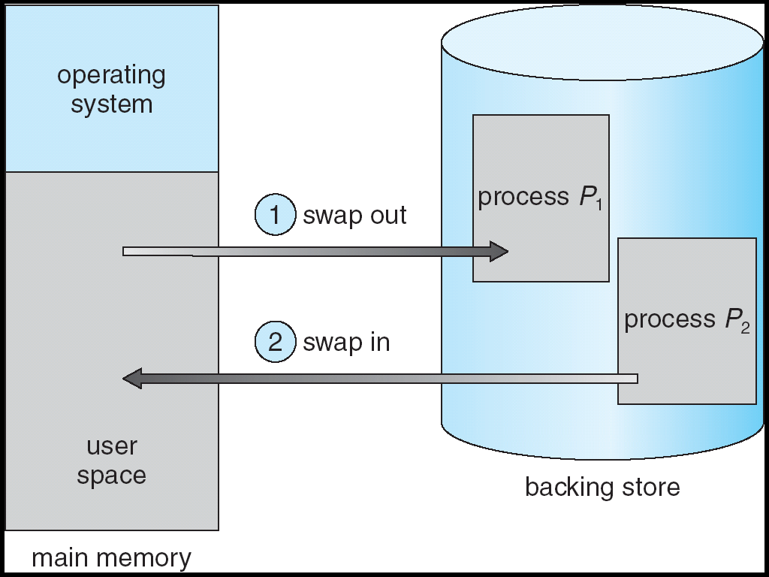
Schematic View of Swapping
Swapping is done when
  Quantum expires
  Priority issues arises
Conditions for swapping
  Process to be executed must be not in memory
  No sufficient free memory location

Slide 15
Contiguous Allocation
Each process is contained in a single contiguous section of memory.
Main memory usually divided into two partitions
    Resident Operating System, usually held in low memory with interrupt vector.
    User processes then held in high memory.
Single partition allocation
    Relocation register scheme used to protect user processes from each other, and from changing OS code and data.
    Relocation register contains value of smallest physical address; limit register contains range of logical addresses - each logical address must be less than the limit register.
    When CPU scheduler selects a process for execution, the dispatcher loads the relocation and limit registers with the correct values.
    Every address generated by CPU is compared against these values.
    ➔ensures memory protection of OS and other processes from being modified by the running process.

Slide 16
Contiguous Allocation(con’t…)
Multiple partition Allocation
    Hole - block of available memory; holes of various sizes are scattered throughout memory.
    When a process arrives, it is allocated memory from a hole large enough to accommodate it.
    Operating system maintains information about which partitions are :
      allocated partitions
      free partitions (hole)
OS
OS
OS
OS
Process 5
Process 5
Process 5
Process 5
Process 9
Process 9
Process 8
Process 10
Process 2
Process 2
Process 2
Process 2

Slide 17
Fixed Partitioning
Divide memory into several fixed-sized partitions.
Each partition contains one process.
Degree of multiprogramming is bound by the number of partitions.
When a partition is free, a process is selected from the input queue and is loaded into the free partition.
When the process terminates, the partition becomes available for another process.

Slide 18
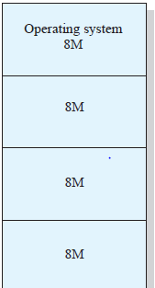
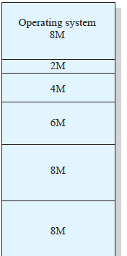
Fixed Partitioning
Equal size partition
unequal size partition

Slide 19
Fixed Partitioning
Equal-size partitions
  any process whose size is less than or equal to the partition size can be loaded into an available partition
  if all partitions are full, the operating system can swap a process out of a partition
  a program may not fit in a partition. The programmer must design the program with overlays
  because all partitions are of equal size, it does not matter which partition is used
Unequal-size partitions
  can assign each process to the smallest partition within which it will fit
  queue for each partition
  processes are assigned in such a way as to minimize wasted memory within a partition.

Slide 20
Fixed Partitioning(con’t…)
Its no longer used because it has various drawbacks like:
    Degree of multiprogramming is bounded by the number of partitions.
    Internal fragmentations.
Internal fragmentations: is the phenomenon, in which there is wasted space internal to a partition due to the fact that the block of data loaded is smaller than the partition

Slide 21
Internal fragmentation
Process 1
(7 KB)
Input Queue
(in the disk)
10 KB
Process 2
(9 KB)
4 KB
8 KB
9 KB
7 KB
10 KB
Internal Fragmentation
Process 3
(8 KB)
10 KB
As shown
This method suffers from internal fragmentations.
The degree of multiprogramming is bounded to 3 although it can be 4.

Slide 22
Dynamic Partitioning
Partitions are of variable length and number
Initially, all memory is available for user processes, and is considered as one large block of available memory.
When a process arrives and needs memory, we search for a hole large enough for this process using: First fit, Best fit, Worst fit
If we find one, we allocate only as much memory as is needed, keeping the rest available to satisfy future requests.

Slide 23
Dynamic Partitioning
Operating system satisfy a request of size n from a list of free holes-using algorithms:
First fit: allocate the first hole that is big enough (fastest method).
Best fit: allocate the smallest hole that is big enough (produces the smallest leftover hole).
Worst fit: allocate the largest hole (produces the largest leftover hole which may be more useful than the smaller leftover hole from a best-fit approach.

Slide 24
OS
Process 4
(4 KB)
Process 1
(7 KB)
Input Queue
(in the disk)
Process 5
(9 KB)
Process 2
(9 KB)
9 KB
4 KB
8 KB
9 KB
7 KB
Process 3
(8 KB)

Slide 25
Using First Fit
Memory
0
OS
Base
999
Start address of process
1040
1000
1010
Process
Legal range
20
1040
Process
Limit
1060
Executable file
(Size =20 memory words)
1070
Process
1100
1125
Process
1150
Loader
1200
Process
1250
1255

Slide 26
Using Best Fit
Memory
OS
Base
1000
Start address of process
1100
1010
Process
Legal range
20
1040
Limit
Executable file
(Size =20 memory words)
1070
Process
1100
Process
1120
1125
Process
Loader
1150
1200
Process
1250
1255

Slide 27
Using Worst Fit
Memory
OS
Base
1000
Start address of process
1150
1010
Process
Legal range
20
1040
Limit
Executable file
(Size =20 memory words)
1070
Process
1100
1125
Process
Loader
1150
Process
1170
1200
Process
1250
1255

Slide 28
Dynamic Partitioning
The degree of multiprogramming changing according to the number of pro
This method suffers from external Fragmentations. cesses in the memory (in ready queue).
External fragmentation: is the phenomenon, in which memory that is external to all partitions becomes increasingly fragmented.

Slide 29
External fragmentation
OS
Process 4
Input Queue
(in the disk)
Process 2
Process 3
External Fragmentations
4 KB
8 KB
9 KB
7 KB
Process 9
Process 20
As shown:
dynamic partition is suffered from external Fragmentations.

Slide 30
Compaction
OS
OS
Process 4
Process 4
Input Queue
(in the disk)
Process 2
Process 2
Process 3
Process 3
4 KB
8 KB
9 KB
7 KB
Process 9
Process 9
Process 20
Process 20
A new hole to store a new process
Compaction:
Is a movement of the memory contents to place all free memory in a one large block sufficient to store new process.
It is a solution for the external fragmentation but it is expensive and is not always possible.

Slide 31
End
Next section
Paging
and
segmentation

