Slide 1
Paging and Segmentation

Slide 2
contents
basic method
address translation
Page table
segmentation

Slide 3
Basic method
Paging is a memory-management scheme that permits the physical-address space of a process to be noncontiguous.
it is commonly used in most operating systems.
Divide physical memory into fixed-sized blocks called frames.
Divide Process into blocks of same size called pages
size is power of 2, between 512 bytes and 8,192 bytes
Use a page table which contains base address of each page in physical memory.
To run a program of size n pages, need to find n free frames and load program
Set up a page table to translate logical to physical addresses

Slide 4
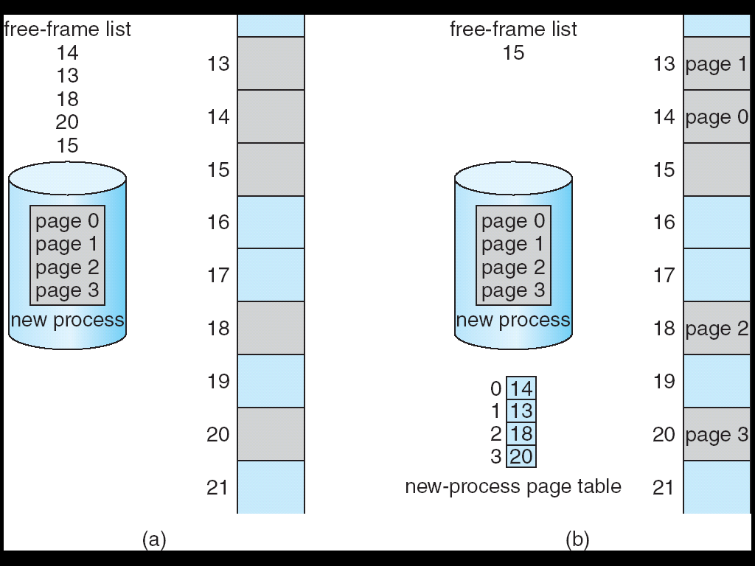
Basic method
When a process arrives the size in pages is examined
Each page of process needs one frame.
If n frames are available these are allocated, and page table is updated with frame number.
Before allocation
After allocation

Slide 5
Address translation
Address generated by CPU is divided into:
Page number (p) – used as an index into a page table which contains base address of each page in physical memory.
Page offset (d) – combined with base address to define the physical memory address that is sent to the memory unit.
Page number is an index to the page table.
The page table contains base address of each page in physical memory.
The base address is combined with the page offset to define the physical address that is sent to the memory unit.
The size of logical address space is 2^{m} and page size is 2^{n} address units.
Higher m-n bits designate the page number
n lower order bits indicate the page offset.
logical address
p | d
page offset (n)
Page number(m-n)

Slide 6
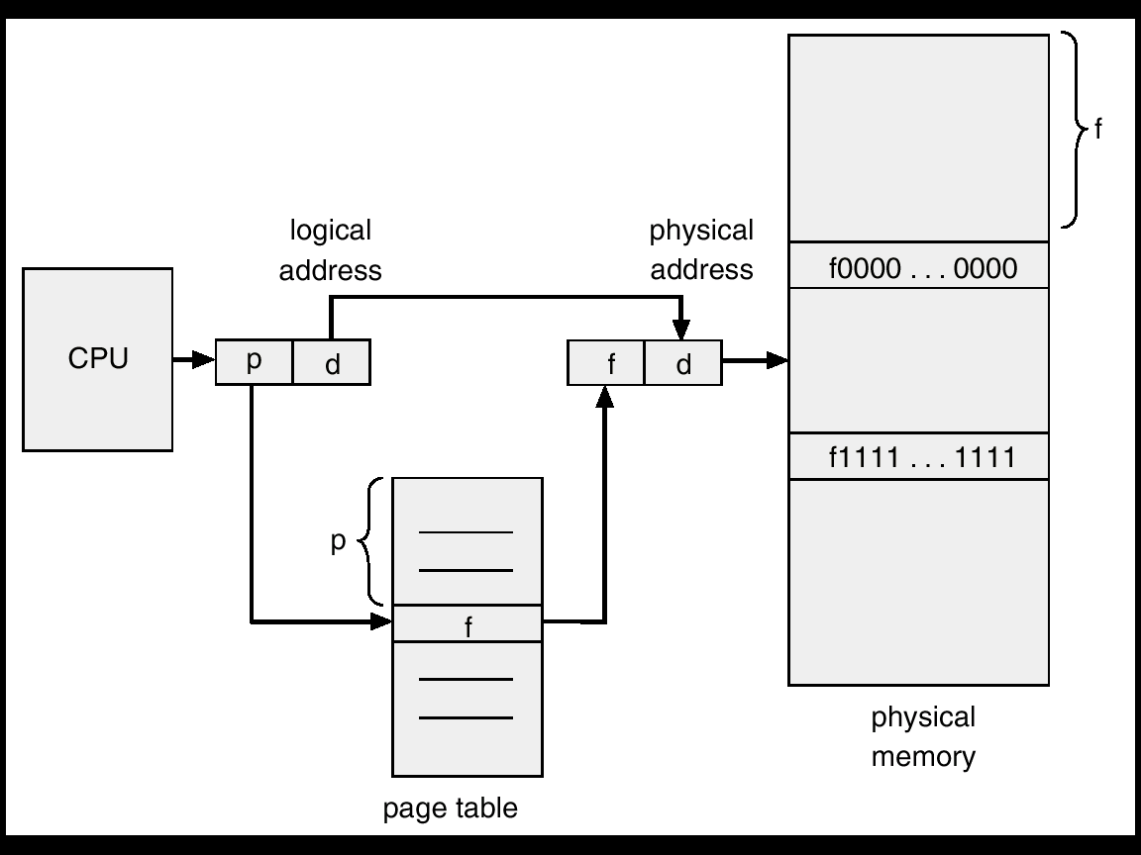
Address Translation Architecture

Slide 7
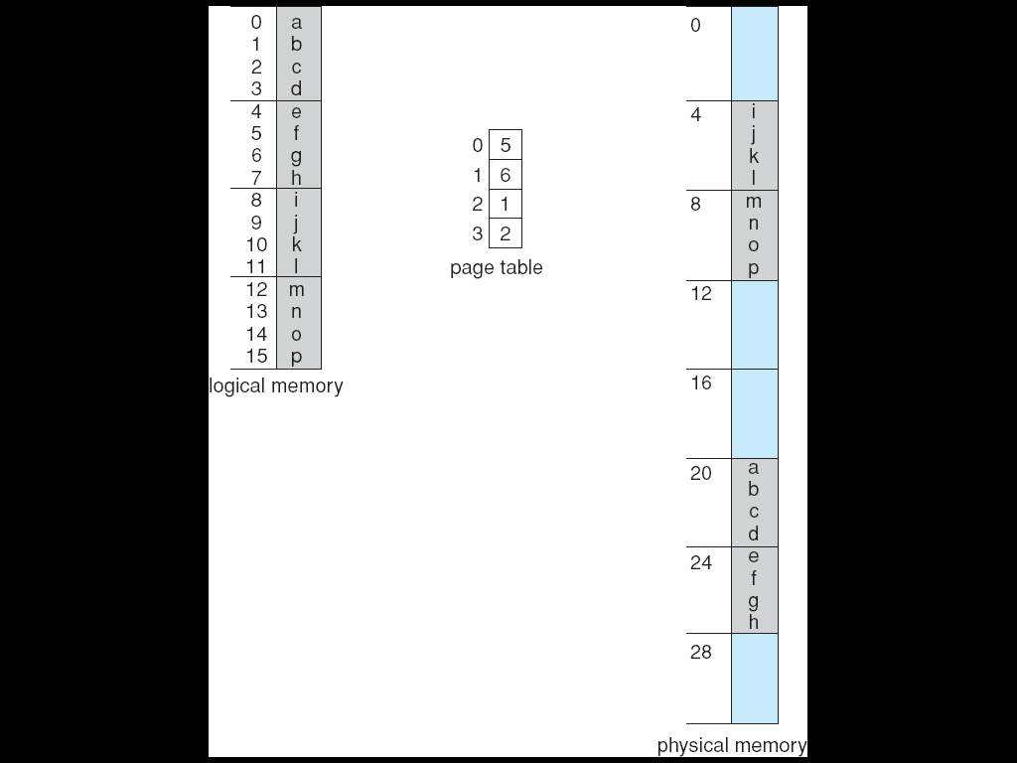
Paging Example
Assume:-
page size=4 bytes
physical memory = 32 bytes (8 pages).
How a logical memory address can be mapped into physical memory?
Example : Logical address 0(containing ‘a’)
00000---→address of a.
Page number=000(the 3 higher order bit)
Offset number=00( the last 2 least bit)
address a exist: i. is on page 0.
ii. Is at offset 0.
then Indexing into the page table using page number, you can get page 0 is in frame 5.
Page number is changed into frame number; offset number is used as it is.
➔ Finally logical address 0 is mapped to physical 20, i.e. 20=[(5x4)+0]
Logical address 0 maps 5*4+0=20
Logical address 3 maps to= 5*4+3=23
Logical address 4 maps to =6*4+0=24
Logical address 13 maps to= 2*4+1=9.

Slide 8
More on Paging
In paging scheme, Pages are allocated as units.
In this scheme there is no external fragmentation.
But internal fragmentation is inevitable.
Example:-
assume page size=2048 bytes.
a process of 61442 bytes needs 30 pages plus 2 bytes. Since units are managed in terms of pages 31 pages are allocated.
Internal fragmentation=2046 bytes!!!!.
In the worst case a process needs n pages plus 1 byte. So it will be allocated n+1 pages.
In paging scheme, is there any chance for user process to enter an address of the OS or an other user process ? Why?
➔Fragmentation =(page size-1 byte) ~ entire page.

Slide 9
Page table
page table is used to map virtual pages onto page frames.
Page table can have the following important fields.
Page frame number: represented the page frame number in physical memory.
Present/absent bit: indicate whether the page to which the entry belongs is currently in memory or not.
bit 1-→ the entry is valid and can be used.
Bit 0→ the virtual page is not currently in memory. Accessing a page table entry with this bit set to 0 causes a page fault.
Protection bits: tell what kinds of access are permitted. In the simplest form, this field contains 1 bit, with 0 for read/write and 1 for read only.
Modified bit: is bit set when page is written . If the page in it has been modified, it must be written back to the disk. If it has not been

Slide 10
Page table(con’t…)
Referenced bit: is set whenever a page is referenced, either for reading or writing.
Its value is to help the operating system choose a page to evict when a page fault occurs and plays an important role in several of the page replacement algorithms
Cache disable: With this bit, caching can be turned off. This feature is important for pages that map onto device registers rather than memory.

Slide 11
Implementation of Page Table
Two options: Page table can be kept in registers or main memory
Page table is kept in main memory due to bigger size.
Ex: address space = 2³² to 2⁶⁴
Page size= 2¹²
Page table= 2³² / 2¹²=2²⁰
If each entry consists of 4 bytes, the page table size = 4MB.
Page-table base register (PTBR) points to the page table.
Page-table length register (PRLR) indicates size of the page table.
PTBR, and PRLR are maintained in the registers.
In this scheme every data/instruction access requires two memory accesses. One for the page table and one for the data/instruction.
Memory access is slowed by a factor of 2.
Swapping might be better !
The two memory access problem can be solved by the use of a special fast-lookup hardware cache called associative memory or translation look-aside buffers (TLBs)
What’s the purpose of using TLB?

Slide 12
Associative Memory
Is associative high speed memory.
Each entry in TLB consists two parts: key and value.
If TLB is presented with item, item compared with all keys simultaneously.
If item is found corresponding field is returned.
TLB is used for page table with page number and frame as its two column.
Associative memory contains only few page table entries.
Address translation (p, d)
If p is in associative register, get frame # out
Otherwise get frame # from page table in memory
Page #(p)
Frame #(d)
Why associative memory is needed?

Slide 13
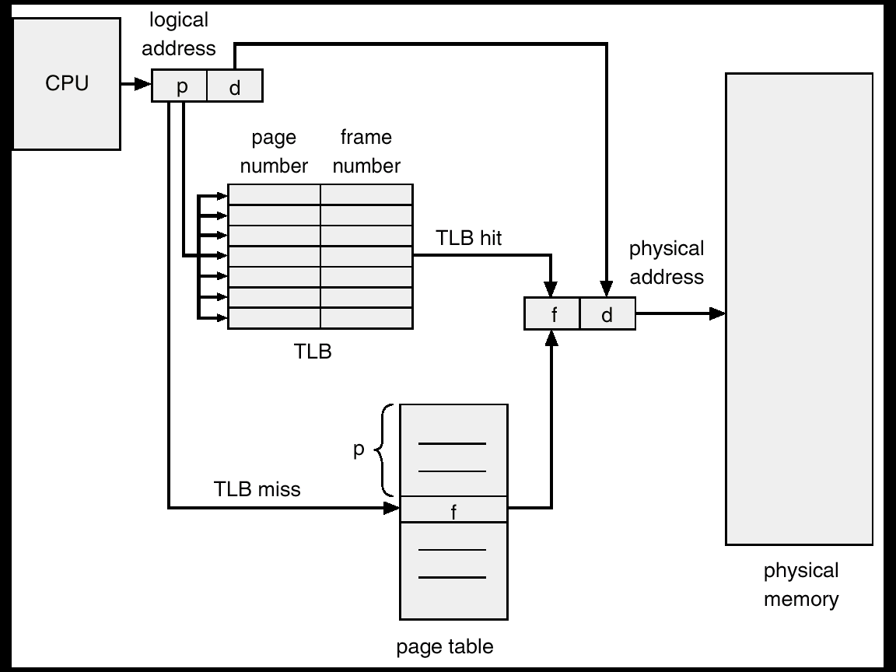
Paging Hardware With TLB

Slide 14
Effective Access Time
Associative Lookup = ε time unit, Assume memory cycle time is 1 microsecond
Hit ratio – percentage of times that a page number is found in the associative registers; ratio related to number of associative registers
Hit ratio = α
Effective Access Time (EAT)= EAT = (1 + ε) α + (2 + ε)(1 – α) = 2 + ε – α
Example:
hit ratio= 20ns for TLB search and 100ns for memory cycle(120)
Miss ratio=20n for TLB search , 100ns for getting page frame number, 100ns for memory access(20ns +100ns+100ns=220ns)
Effective access time=hit ratio*Associate memory access time +miss ratio* memory access time.
0.80 * 120+0.20*220=140 nsec.
40 % slowdown.
For 98-percent hit ratio, we have
Effective access time= 0.98*120+0.02*220
= 122 nanoseconds
= 22 % slowdown.
Compare miss ratio wit hit ratio

Slide 15
Structure of the Page Table
Hierarchical Paging
Hashed Page Tables
Inverted Page Tables
Reading Assignment

Slide 16
Segmentation
Memory-management scheme that supports user view of memory.
A program is a collection of segments. A segment is a logical unit such as:
main program,
procedure,
function,
local variables, global variables,
common block,
stack,
symbol table, arrays

Slide 17
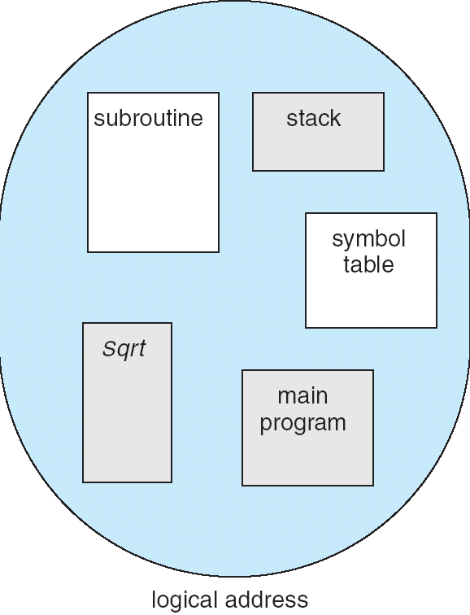
User’s View of a Program

Slide 18
Logical View of Segmentation
1
1
1
4
2
3
2
4
2
3
3
user space
physical memory space

Slide 19
Segmentation Architecture
Logical address consists of a two tuple
<segment-number, offset>
Segment Table
Maps two-dimensional user-defined addresses into one-dimensional physical addresses.
Each table entry has
Base - contains the starting physical address where the segments reside in memory.
Limit - specifies the length of the segment.
Segment-table base register (STBR) points to the segment table’s location in memory.
Segment-table length register (STLR) indicates the number of segments used by a program;.
Note: segment number s is legal if s < STLR.

Slide 20
Segmentation Architecture (cont.)
Relocation is dynamic - by segment table
Sharing
Code sharing occurs at the segment level.
Shared segments must have same segment number.
Allocation - dynamic storage allocation problem
use best fit/first fit, may cause external fragmentation.
Protection
protection bits associated with segments
read/write/execute privileges
array in a separate segment - hardware can check for illegal array indexes.

Slide 21
Segmented Paged Memory
Segment-table entry contains not the base address of the segment, but the base address of a page table for this segment.
Overcomes external fragmentation problem of segmented memory.
Paging also makes allocation simpler; time to search for a suitable segment (using best-fit etc.) reduced.
Introduces some internal fragmentation and table space overhead.
Multics - single level page table
IBM OS/2 - OS on top of Intel 386
uses a two level paging scheme

Slide 22
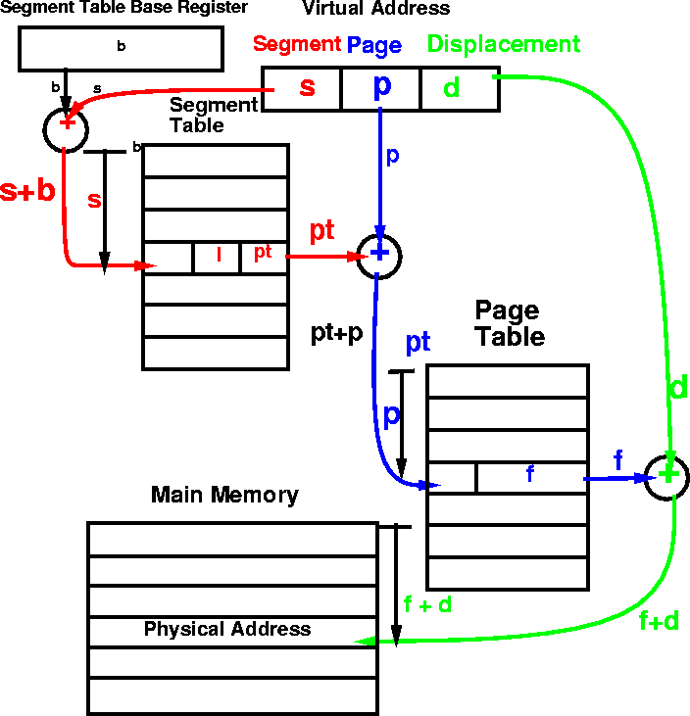
MULTICS address translation scheme

Slide 23
Segmented Paged Memory
Thank you

