Slide 1
3.2 Virtual Memory

Slide 2
Contents
  Background
  Demand Paging
  Advantages of VM: Process Creation
  Page Replacement
  Allocation of Frames
  Thrashing

Slide 3
Background
First requirement for execution is Instructions must be in physical memory
One Approach is Place entire logical address in main memory.
The size of the program is limited to size of main memory.
Normally entire program may not be needed in main memory.
  Programs have error conditions.
  Arrays, lists, and tables may be declared by 100 by 100 elements, but seldom larger than 10 by 10 elements.
  Assembler program may have room for 3000 symbols, although average program may contain less than 200 symbols.
  Certain portions or features of the program are used rarely.
Benefits of the ability to execute program that is partially in memory:
  User can write programs and software for entirely large virtual address space.
  More programs can run at the same time.
  Less I/O would be needed to load or swap each user program into memory.

Slide 4
Background(con’t…)
Virtual memory is a technique that allows the execution of processes that may not be completely in memory.
  Programs are larger than main memory.
  VM abstract main memory into an extremely large, uniform array of storage.
Separation of user logical memory from physical memory.
  Only part of the program needs to be in memory for execution.
  Logical address space can therefore be much larger than physical address space.
  Allows address spaces to be shared by several processes.
  Allows for more efficient process creation.
  Frees the programmer from memory constraints.
Virtual memory can be implemented via:
  Demand paging
  Demand segmentation

Slide 5
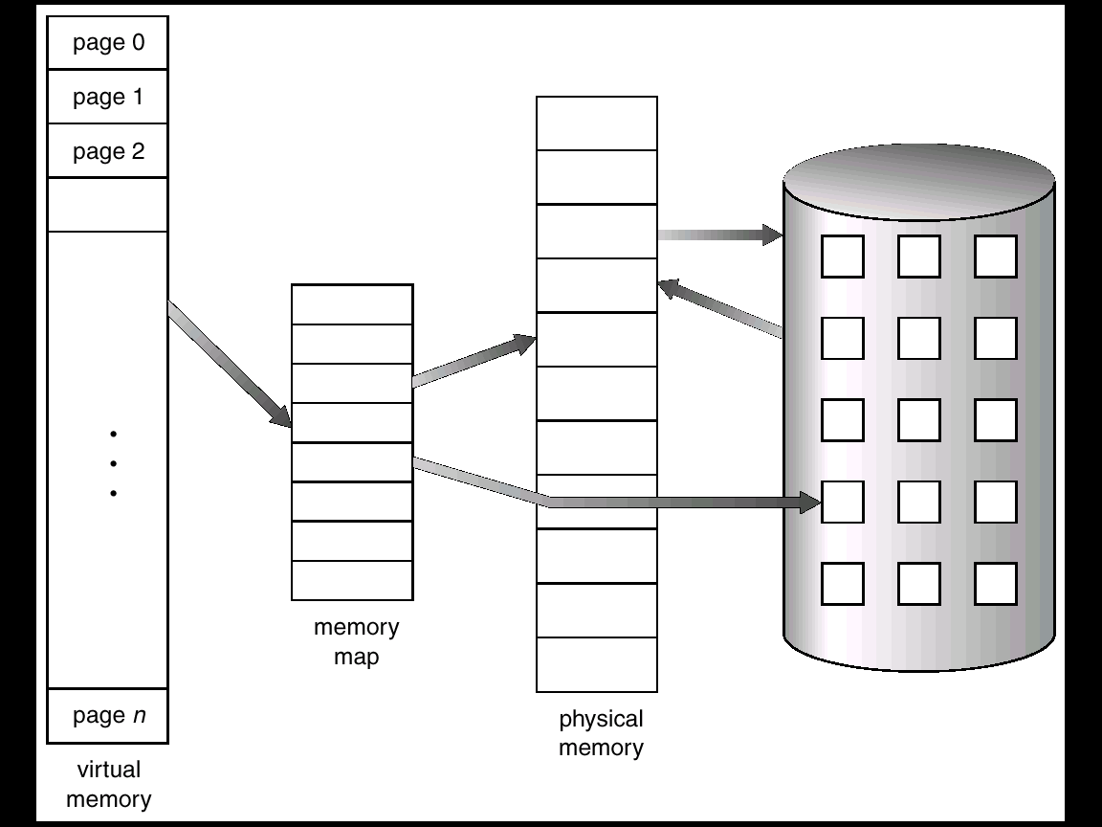
Virtual Memory That is Larger Than Physical Memory

Slide 6
Demand Paging
Paging system with swapping.
  When we execute a process we swap into memory.
For demand paging, we use lazy swapper.
  Never swaps a page into memory unless required.
  Bring a page into memory only when it is needed.
    Less I/O needed
    Less memory needed
    Faster response
    More users
Page is needed ⇒ reference to it
  invalid reference ⇒ abort
  not-in-memory ⇒ bring to memory

Slide 7
Presence Bit
With each page table entry a presence bit is associated
(1 ⇒ in-memory, 0 ⇒ not-in-memory)
Initially presence bit is set to 0 on all entries.
Example of a page table snapshot.
During address translation, if presence bit in page table entry is 0 ⇒ page fault.
Frame #
presence bit
1
1
1
0
1
0
0
page table

Slide 8
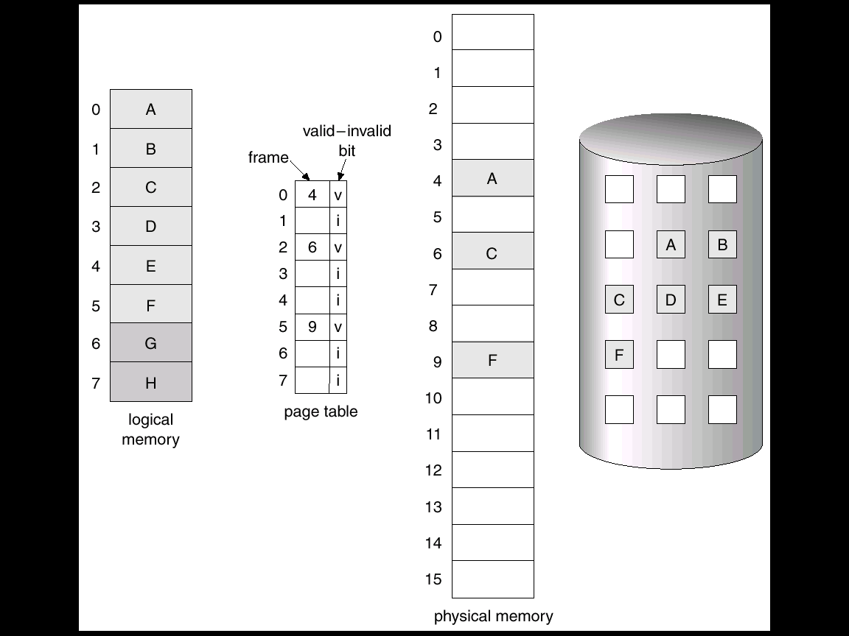
Page Table When Some Pages Are Not in Main Memory

Slide 9
Page Fault
If there is ever a reference to a page, first reference will trap to OS ⇒ page fault
OS looks at another table to decide:
  Invalid reference ⇒ abort.
  Just not in memory.
    Get empty frame.
    Swap page into frame.
    Reset tables, validation bit = 1.
    Restart instruction:

Slide 10
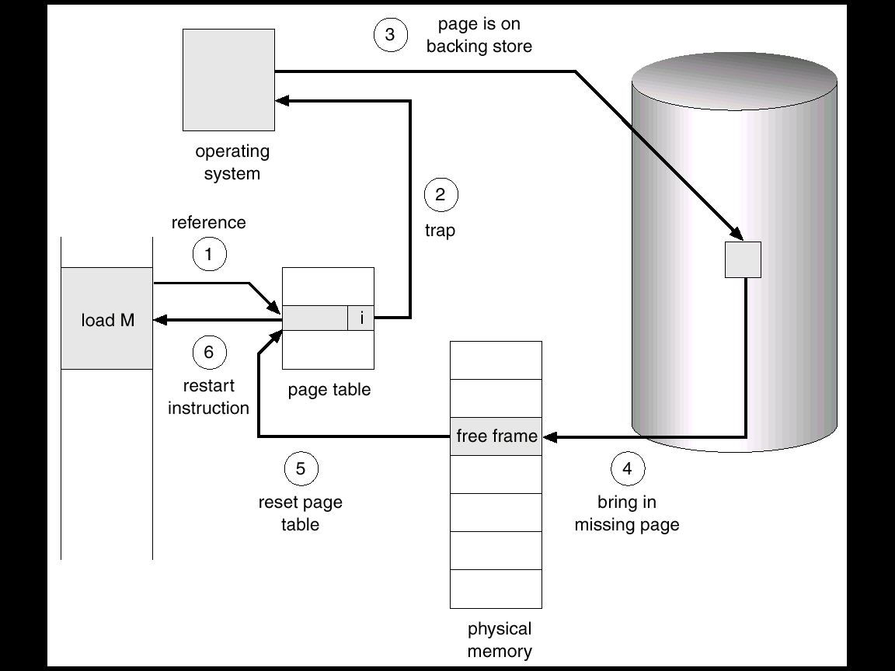
Steps in Handling a Page Fault
Check the internal table, to determine whether this reference is valid or invalid.
If the reference is invalid, then trap to OS.
Find free frame.
Schedule disk operation.
Modify the internal table to indicate that page is in main memory.
Restart the instruction.

Slide 11
Page Replacement
Prevent over-allocation of memory by modifying page-fault service routine to include page replacement.
Basic Page Replacement
Find the location of the desired page on disk.
Find a free frame:
  If there is a free frame, use it.
  If there is no free frame, use a page replacement algorithm to select a victim frame. And change page table accordingly.
Read the desired page into the (newly) free frame. Update the page table.
Restart the process.

Slide 12
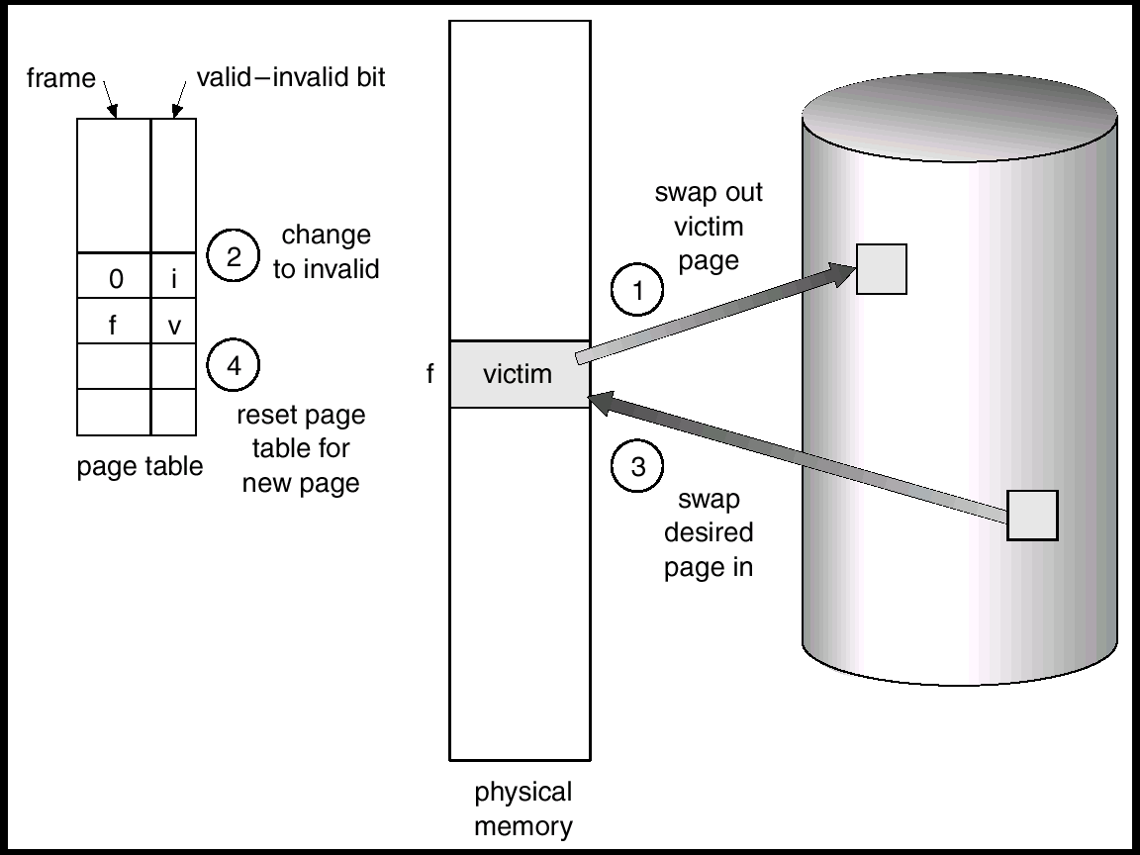
Page Replacement

Slide 13
Page Replacement algorithm
Page fault forces a choice
  No room for new page (steady state)
  Which page must be removed to make room for an incoming page?
How is a page removed from physical memory?
  If the page is unmodified, simply overwrite it: a copy already exists on disk
  If the page has been modified, it must be written back to disk: prefer unmodified pages?
Better not to choose an often used page
  It’ll probably need to be brought back in soon

Slide 14
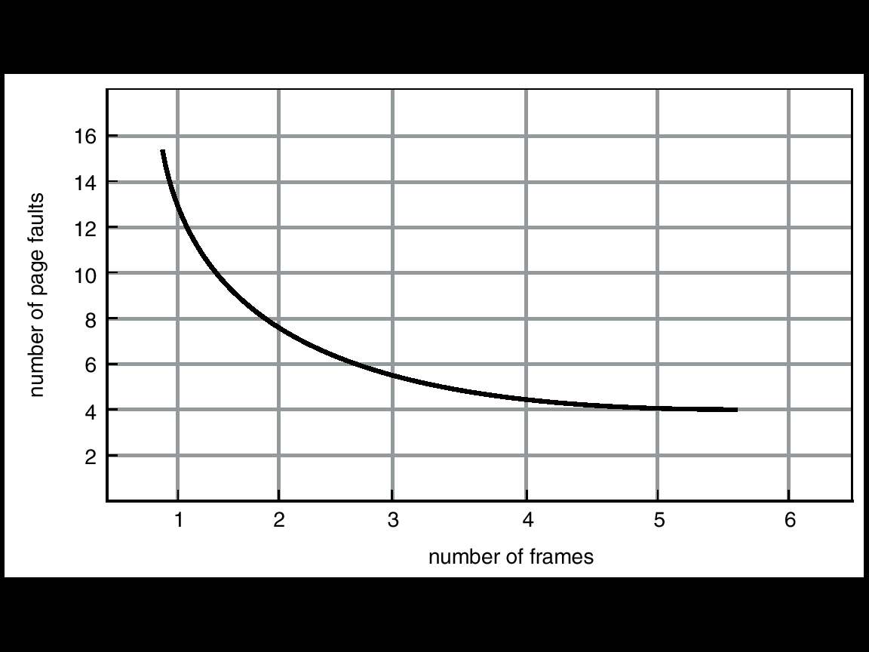
Page Replacement Algorithms(con’t…)
Produce lowest page-fault rate.
Evaluate algorithm by running it on a particular string of memory references (reference string) and computing the number of page faults on that string.
In all our examples, the reference string is :1, 2, 3, 4, 1, 2, 5, 1, 2, 3, 4, 5.
Graph of Page Faults Versus The Number of Frames

Slide 15
Optimal page replacement algorithm
replace the page that will be used furthest in the future
Only works if we know the whole sequence!
Nice, but not achievable in real systems!
Example: 4 frames and 1, 2, 3, 4, 1, 2, 5, 1, 2, 3, 4, 5 string references
4
6 page faults
            5
Used for measuring how well your algorithm performs.
How can you know what the future references will be?
1
2
3
4

Slide 16
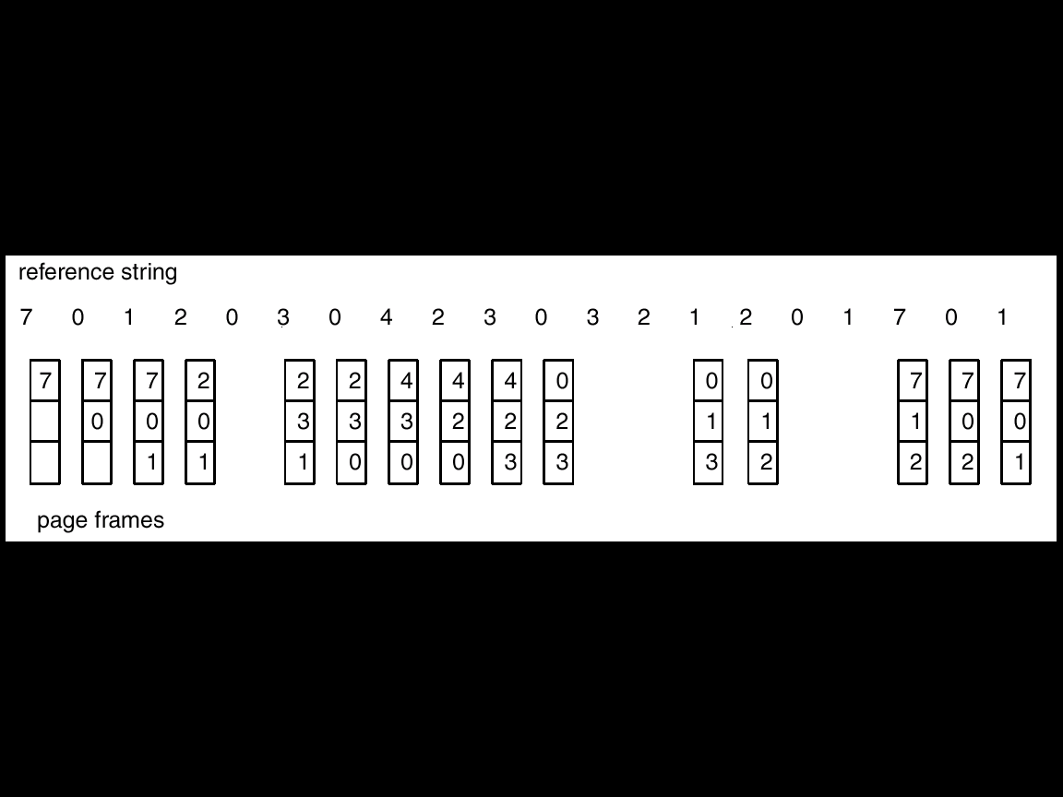
First-In-First-Out (FIFO) Algorithm
Oldest page is replaced; FIFO queue; replace the head of the queue
  Example-1 :Reference string: 1, 2, 3, 4, 1, 2, 5, 1, 2, 3, 4, 5
more frames ⇒ more page faults
Another example FIFO page replacement algorithm.
1
1
1
1
5
4
4
5
2
2
1
3
9 page faults
2
2
1
5
10 page faults
Using 3 frames
Using 4 frames
3
3
2
4
3
3
2
4
4
3

Slide 17
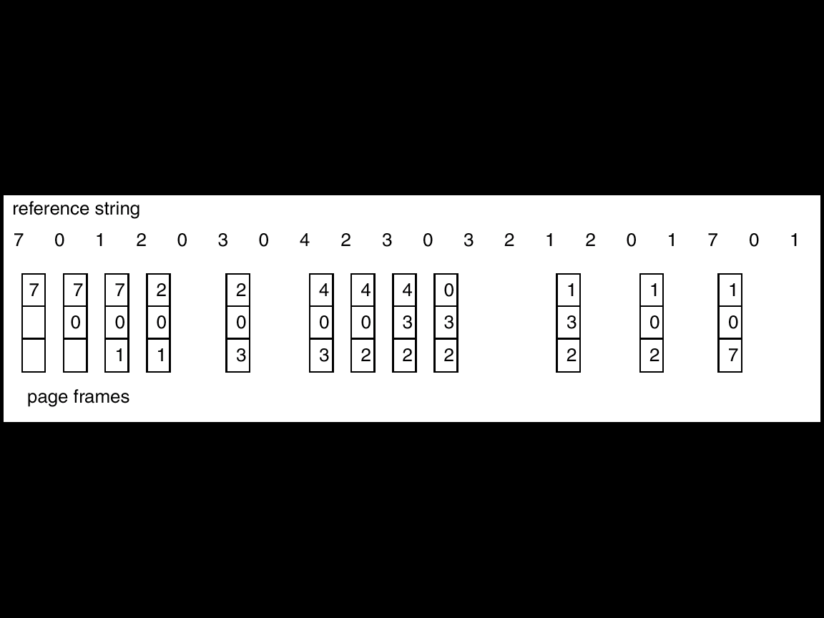
Least Recently Used (LRU) Algorithm
The page that has not been used for longest period of time is replaced.
Reference string: 1, 2, 3, 4, 1, 2, 5, 1, 2, 3, 4, 5
1
5
2
3
5
4
LRU Page Replacement
4
3
The performance is good. But, How to Implement ?

Slide 18
LRU Algorithm Implementation
Counter implementation
  keep counter in each page table entry
  Global counter increments with each CPU cycle
  Copy global counter to PTE counter on a reference to the page
  For replacement, evict page with lowest counter value
Stack implementation
  keep a stack of page numbers in a double link form:
    Page referenced:
      move it to the top
      requires 6 pointers to be changed
      Update is expensive
  No search for replacement
  Top is the most recently used page and bottom is the LRU page.

Slide 19
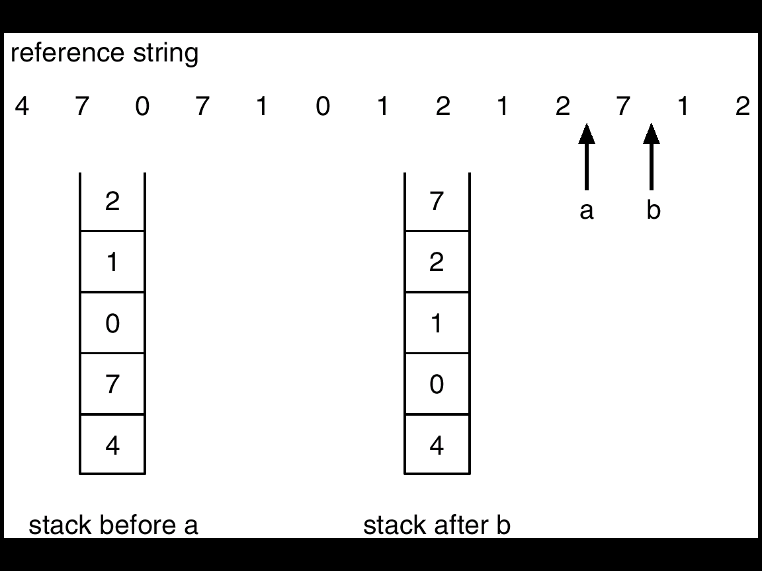
Use Of A Stack to Record The Most Recent Page References
Performance issue: Stack and Counters
The updating of stack or counter must be done on every memory reference.
If we use interrupt for every reference, to allow software to update data structures, it would slow every reference by a factor of 10.
  Few systems tolerate such degradation in performance.
Sol:
  Systems follow LRU approximation implemented through hardware.

Slide 20

LRU Approximation Algorithms
Second chance page replacement algorism
Modify FIFO to avoid throwing out heavily used pages
If reference bit is 0, throw the page out
  If reference bit is 1
  Reset the reference bit to 0
  Move page to the tail of the list
  Continue search for a free page
Still easy to implement, and better than plain FIFO
referenced
unreferenced

Slide 21
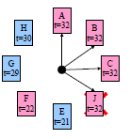
LRU Approximation Algorithms
Second-Chance (clock) Page-Replacement Algorithm
Same functionality as second chance
Simpler implementation
  “Clock” hand points to next page to replace
  If R=0, replace page
  If R=1, set R=0 and advance the clock hand
Continue until page with R=0 is found
  This may involve going all the way around the clock…

Slide 22
LRU Approximation Algorithms
Not frequently used(NRU)
Each page has reference bit and dirty bit
  Bits are set when page is referenced and/or modified
Pages are classified into four classes
  0: not referenced, not dirty
  1: not referenced, dirty
  2: referenced, not dirty
  3: referenced, dirty
Clear reference bit for all pages periodically
  Can’t clear dirty bit: needed to indicate which pages need to be flushed to disk
  Class 1 contains dirty pages where reverence bit has been cleared
Algorithm: remove a page from the lowest non-empty class
  Select a page at random from that class
Easy to understand and implement
Performance adequate (though not optimal)
Other algorithms: Counting Algorithms
Keep a counter of the number of references that have been made to each page.
LFU Algorithm: replaces page with smallest count.
MFU Algorithm: based on the argument that the page with the smallest count was probably just brought in and has yet to be used.
MFU and LFU are not used
  Implementation is expensive
  Do not approximate OPT well

Slide 23
Allocation of Frames
Each process needs minimum number of pages allocation.
If there is a single process, entire available memory can be allocated.
Multi-programming puts two or more processes in memory at same time.
We must allocate minimum number of frames to each process.
Two major allocation schemes.
  fixed allocation
  priority allocation

Slide 24
Allocation of Frames(con’t…)
fixed partition
Equal allocation – e.g., if 100 frames and 5 processes, give each 20 pages.
Proportional allocation – Allocate according to the size of process.
2. Priority Allocation:- Use a proportional allocation scheme using priorities rather than size.
If process P_{i} generates a page fault,
  select for replacement one of its frames.
  select for replacement a frame from a process with lower priority number.

Slide 25
Global vs. Local Allocation
Global replacement – process selects a replacement frame from the set of all frames; one process can take a frame from another.
Local replacement – each process selects from only its own set of allocated frames.
With local replacement # of frames does not change.
  Performance depends on the paging behavior of the process.
  Free frames may not be used
With global replacement, a process can take a frame from another process.
  Performance depends not only paging behavior of that process, but also paging behavior of other processes.
In practice global replacement is used.

Slide 26
Thrashing
If a process does not have “enough” pages, the page-fault rate is very high. This leads to:
  low CPU utilization.
  operating system thinks that it needs to increase the degree of multiprogramming.
  another process is added to the system.
Thrashing is High paging activity.
Thrashing ≡ a process is spending more time in swapping pages in and out.
If the process does not have number of frames equivalent to number of active pages, it will very quickly page fault.
Since all the pages are in active use it will page fault again.

Slide 27
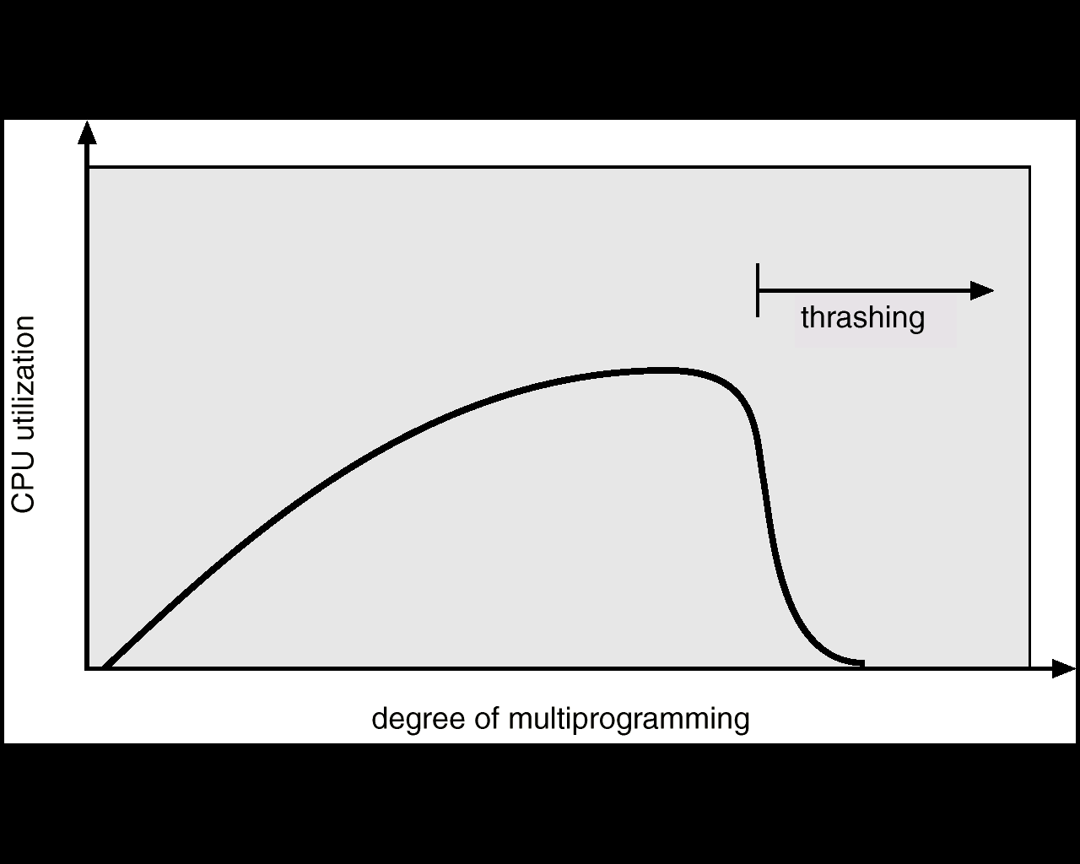
Thrashing
Why does paging work?
Locality model
  Process migrates from one locality to another.
  Localities may overlap.
Why does thrashing occur?
Σ size of locality > total memory size

Slide 28
Causes of thrashing
OS monitors CPU utilization
  If it is low, increases the degree of MPL
Consider that a process enters new execution phase and starts faulting.
It takes pages from other processes
Since other processes need those pages, they also fault, taking pages from other processes.
The queue increases for paging device and ready queue empties
CPU utilization decreases.
Solution: provide process as many frames as it needs.
But how we know how many frames it needs ?
Locality model provides hope.

Slide 29
Locality model
Locality is a set of pages that are actively used together.
A program is composed of several different localities which may overlap.
  Ex: even when a subroutine is called it defines a new locality.
The locality model states that all the programs exhibit this memory reference structure.
This is the main reason for caching and virtual memory!
If we allocate enough frames to a process to accommodate its current locality, it fault till all pages are in that locality are in the MM. Then it will not fault.
If we allocate fewer frames than current locality, the process will thrash.

Slide 30
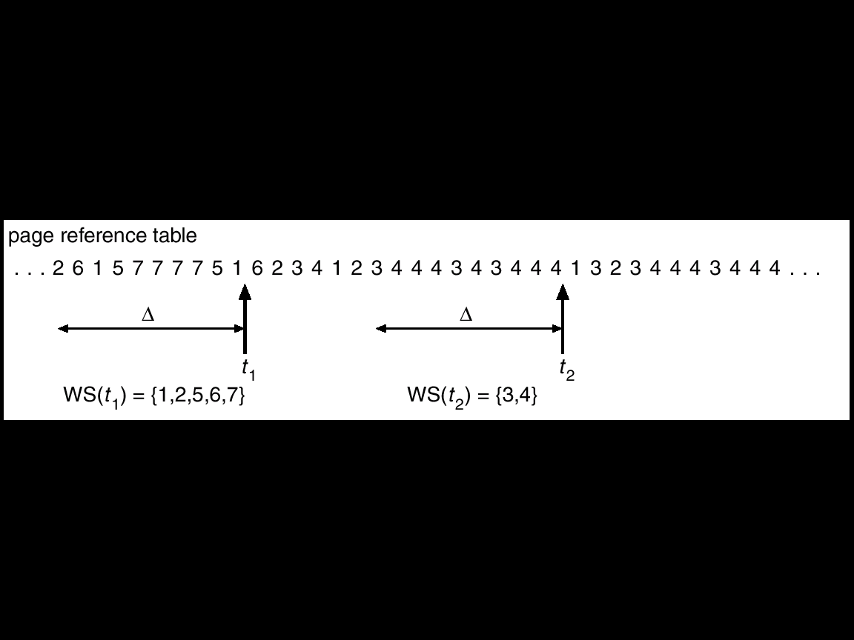
Working-Set Model
Based on locality->Define a parameter Δ;
Δ ≡ working-set window ≡ a fixed number of page references
Example: 10,000 instruction
Most recent references are examined
WSS_{i} (working set of Process P_{i}) = total number of pages referenced in the most recent Δ (varies in time)
  if Δ too small will not encompass entire locality.
  if Δ too large will encompass several localities.
  if Δ = ∞ ⇒ will encompass entire program.
D = Σ WSS_{i} ≡ total demand frames
if D > m ⇒ Thrashing
Policy: if D > m, then suspend one of the processes.

Slide 31
Working Set(con’t…)
OS monitors the WS of each process allocates to that working set enough frames equal to WS size.
If there are enough extra frames, another process can be initiated.
If D>m, OS suspends a process, and its frames are allocated to other processes.
The WS strategy prevents thrashing by keeping MPL as high as possible.
However, we have to keep track of working set.
Keeping track of Working Set
Approximate with interval timer + a reference bit, -> Example: Δ = 10,000
  Timer interrupts after every 5000 time units.
  Keep in memory 2 bits for each page.
  Whenever a timer interrupts copy and sets the values of all reference bits to 0.
  If one of the bits in memory = 1 ⇒ page in working set.
Why is this not completely accurate?
  We can not tell when the reference was occurred.
  Accuracy can be increased by increasing frequency of interrupts which also increases the cost.

Slide 32
The End

