Slide 1
Chapter 5
File system

Slide 2
contents
File concept
File naming
File type
File access
File attribute
File operation
File structure
Directory
Directory structure
Directory operation
File system implementation
Implementing directory

Slide 3
File concept
All computer applications need to store and retrieve information.
While a process is running, it can store a limited amount of information within its own address space.
But the following requirements yields for long-term information storage:
    It must be possible to store a very large amount of information.
    The information must survive the termination of the process using it.
    Multiple processes must be able to access the information concurrently.
Magnetic disks have been used for years for this long-term storage.

Slide 4
File concept(cont……)
disk support two operations: Read block and Write block.
with these two operations one could, in principle, solve the long-term storage problem.
Just a few of the questions that quickly arise are:
  How do you find information?
  How do you keep one user from reading another user's data?
  How do you know which blocks are free?.
So to solve this problem the operating system use a new abstraction called the file which is logical units of information created by processes
As a whole, that part of the operating system dealing with files is known as the file system

Slide 5
File naming
Files are an abstraction mechanism and provide a way to store information on the disk and read it back later.
The most important characteristic of any abstraction mechanism is the way the objects being managed are named.
when a process creates a file, it gives the file a name. When the process terminates, the file continues to exist and can be accessed by other processes using its name.
The exact rules for file naming vary somewhat from system to system, but all current operating systems allow strings of one to eight letters as legal file names.

Slide 6
File naming (con’t… )
Frequently digits and special characters are also permitted.
Some file systems distinguish between upper and lower case letters, whereas others do not. UNIX falls in the first category; MS-DOS falls in the second.
Many operating systems support two-part file names, with the two parts separated by a period, as in prog.c.
In some systems (e.g., UNIX), file extensions are just conventions and are not enforced by the operating system.
In contrast, Windows is aware of the extensions and assigns meaning to them.

Slide 7
File type
Many operating systems support several types of files.
UNIX and Windows, for example, have regular files and directories.
UNIX also has character and block special files.
Regular files: are the ones that contain user information. They are either ASCII files or binary files.
Directories: are system files for maintaining the structure of the file system.
Character special files: are related to input/output and used to model serial I/0 devices, such as terminals, printers, and networks.
Block special files: are used to model disks. In this chapter we will be primarily interested in regular files.

Slide 8
File access
File can be access either sequentially or randomly.
Sequential access: a process could read all the bytes or records in a file in order, starting at the beginning, but could not skip around and read them out of order.
Random access: Files bytes or records can be read in any order. Used when the storage medium was magnetic disk. Essential for many applications.
This method is used in UNIX and Windows.

Slide 9
File attribute
Every file has a name and its data.
In addition, all operating systems associate other information with each file, for example, the date and time the file was last modified and the file's size.
We will call these extra items the file's attributes , Some people call them metadata.
The list of attributes varies considerably from system to system.

Slide 10
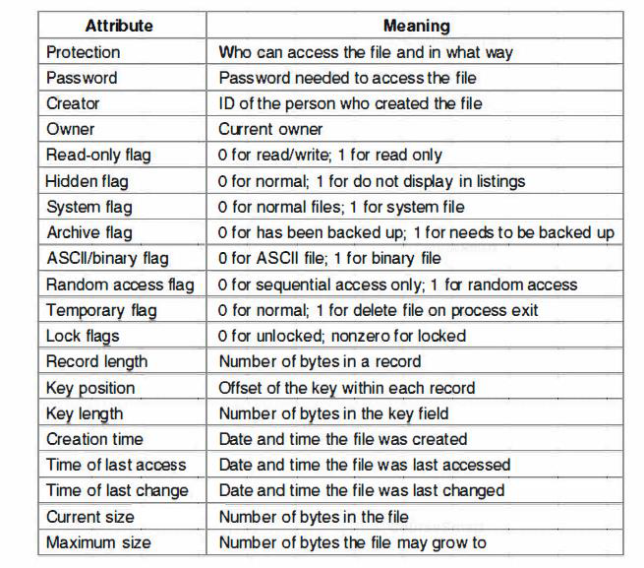
File attribute(con’t…)

Slide 11
File operation
Different systems provide different operations to allow storage and retrieval.
Create: The file is created with no data. The purpose of the call is to announce that the file is coming and to set some of the attributes.
Delete: When the file is no longer needed, it has to be deleted to free up disk space.
Open: Before using a file, a process must open it. The purpose of the open call is to allow the system to fetch the attributes and list of disk addresses into main memory for rapid access on latter caller.

Slide 12
File operation(con’t…)
Close: When all the access are finished, the attributes and disk addresses are no longer needed, so the file should be closed to free up internal table space.
Read: Data are read from file. Usually, the bytes come from the current position. The caller must specify how much data are needed and must also provide a buffer to put them in.
Write: Data are written to the file again, usually at the current position. If the current position is the end of the file, the file’s size increases. If the current position is in the middle of the file, existing data are and lost forever.

Slide 13
File operation(con’t…)
Append: This call is a restricted in the form of write. It can only add data to the end of the file.
Seek: For random access files, a method is needed to specify from where to take the data. One common approach is a system call, seek, that repositions the file pointer to a specific place in the file. After this call has completed, data can be read from, or written to, that position.
Get Attributes: Processes often need to read file attributes to do their work.

Slide 14
File operation(con’t…)
Set Attributes: Some of the attributes are user settable and can be changed after the file has been created. This system call makes that possible.
    The protection mode information is an obvious example.
    Most of the flags also fall in this category.
Rename: It frequently happens that a user needs to change the name of an existing file. This system call makes that possible

Slide 15
File structure
Files can be structured in any of several ways.
Three common possibilities are:
Byte sequence: All it sees are bytes. Any meaning must be imposed by user-level programs.
      Both UNIX and Windows use this approach.
Record sequence: Central to the idea of a file being a sequence of records is the idea that the read operation returns one record and the write operation overwrites or appends one record.
    Used in database system.
Tree: File consists of tree not necessarily all the same length, each containing a key field in a fixed position in the record. The tree is sorted on the key field, to allow rapid searching for a particular key.

Slide 16
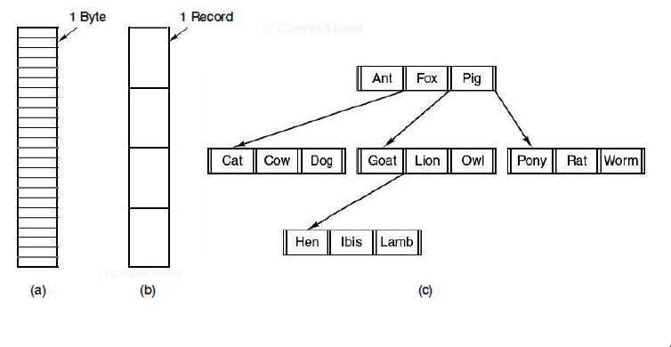
File structure (con’t….)
(a) Byte sequence. (b) Record sequence. (c) Tree.

Slide 17
Directory
To keep track of files, file systems normally have directories or folders, which in many systems are themselves files and containing information about all files.

Slide 18
Directory structure
Defines the organization or logical structure of directory.
Single-Level Directory Systems:
The simplest form of directory system is having one directory containing all the files.
they require unique name and Sometimes it is called the root directory.
The advantages of this scheme are its simplicity and the ability to locate files quickly-there is only one place to look, after all.
It is often used on simple embedded devices such as telephones, digital cameras, and some portable music players.

Slide 19
Directory structure(con’t…)
Hierarchical Directory Systems:
With this approach, there can be as many directories as are needed to group the files in natural ways.
When the file system is organized as a directory tree, some way is needed for specifying file names.
Two different methods are commonly used.
  In the first method, each file is given an absolute path name consisting of the path from the root directory to the file.
  Example : /usr/ast/mailbox
The other kind of name is the relative path name. This is used in conjunction with the concept of the working directory (also called the current directory). A user can designate one directory as the current working directory
For example, if the current working directory is /usr/ast, then the file whose absolute path is /usr/ast/mailbox can be referenced simply as mailbox.

Slide 20
Directory operation
They allowed system calls for managing directories exhibit more variation from system to system than system calls for files.
Create: A directory is created. It is empty except for dot and dot dot, which are put there automatically by the system .
Delete: A directory is deleted. Only an empty directory can be deleted.
Opendir: Directories can be read. Before a directory can be read, it must be opened, analogous to opening and reading a file.
Closedir: When a directory has been read, it should be closed to free up internal table space.

Slide 21
Directory operation(con’t…)
Readdir: This call returns the next entry in an open directory, no matter which of the possible directory structures is being used.
Rename: In many respects, directories are just like files and can be renamed the same way files can be.
Link: Linking is a technique that allows a file to appear in more than one directory. This system call specifies an existing file and a path name, and creates a link from the existing file to the name specified by the path
  track of the number of directory entries containing the file), is sometimes called a hard link.
Unlink: A directory entry is removed. If the file being unlinked is only present in one directory (the normal case), it is removed from the file system. If it is present in multiple directories, only the path name specified is removed. The others remain.
In UNIX, the system call for deleting files (discussed earlier) is, in fact, unlink.

Slide 22
File system implementation
Users are concerned with how files are named, what operations are allowed on them, what the directory tree looks like, and similar interface issues.
Implementers are interested in how files and directories are stored, how disk space is managed, and how to make everything work efficiently and reliably

Slide 23
File system layout
Most disks can be divided up into one or more partitions, with independent file systems on each partition.
Sector 0 of the disk is called the MBR (Master Boot Record) and is used to boot the computer.
The end of the MBR contains the partition table and gives the starting and ending addresses of each partition.
One of the partitions in the table is marked as active
When the computer is booted, the BIOS reads in and executes the MBR.
The first thing the MBR program does is locate the active partition, read in its first block, called the boot block, and execute it.

Slide 24
File system layout(con’t…)
The program in the boot block loads the operating system contained in that partition.
every partition starts with a boot block, even if it does not contain a bootable operating system.
Often the file system will contain some of the items
superblock : contains all the key parameters about the file system and is read into memory when the computer is booted or the file system is first touched.
Typical information in the superblock includes: a magic number, to identify the file system type, the number of blocks, in the file system, and other key administrative information.

Slide 25
File system layout(con’t…)
Free space management: includes information about free blocks in the file system, for example in the form of a bitmap or a list of pointers. This might be followed by the
i-nodes :an array of data structures, one per file, telling all about the file.
root directory : which contains the top of the file system tree.
Finally, the remainder of the disk contains all the other directories and files.

Slide 26
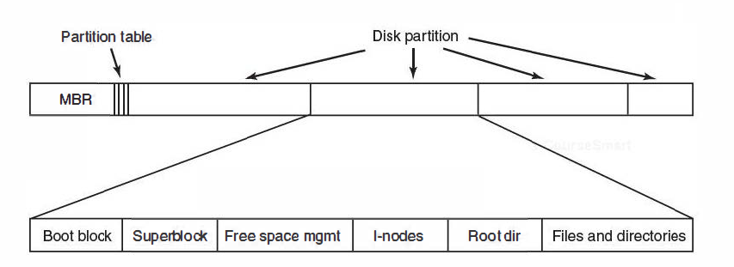
File system layout(con’t…)
A possible file system layout.

Slide 27
Implementing files
Probably the most important issue in implementing file storage is keeping track of which disk blocks go with which file.
Various methods are used in different operating systems.
      Contiguous allocation
      Linked list allocation
      i-node

Slide 28
Contiguous allocation
The simplest allocation scheme is to store each file as a contiguous run of disk blocks.
it is simple to implement because keeping track of where a file's blocks are is reduced to remembering two numbers: the disk address of the first block and the number of blocks in the file
the read performance is excellent because the entire file can be read from the disk in a single operation.
Only one seek is needed (to the first block). After that, no more seeks or rotational delays are needed, so data come in at the full bandwidth of the disk.
Thus contiguous allocation is simple to implement and has high performance.
contiguous allocation also has a fairly significant drawback: over the course of time, the disk becomes fragmented.

Slide 29
      Linked list allocation
keep each one as a linked list of disk blocks.
The first word of each block is used as a pointer to the next one and the rest of the block is for data.
Unlike contiguous allocation, every disk block can be used in this method. No space is lost to disk fragmentation (except for internal fragmentation in the last block).
it is sufficient for the directory entry to merely store the disk address of the first block. The rest can be found starting there.
although reading a file sequentially is straightforward, random access is extremely slow.

Slide 30
      Linked list allocation(con’t…)
the amount of data storage in a block is no longer a power of two because the pointer takes up a few bytes.
Both disadvantages of the linked list allocation can be eliminated by taking the pointer word from each disk block and putting it in a table in memory.

Slide 31
      i-node
method for keeping track of which blocks belong to which file is to associate with each file a data structure called an i-node (index-node)
lists the attributes and disk addresses of the file's blocks.
The big advantage of this scheme over linked files using an in-memory table is that the i-node need only be in memory when the corresponding file is open.

Slide 32
      Implementing directory
The main function of the directory system is to map the ASCII name of the file onto the information needed to locate the data.
a directory consists of a list of fixed-size entries, one per file, containing a (fixed-length) file name, a structure of the file attributes, and one or more disk addresses (up to some maximum) telling where the disk blocks are.

Slide 33
      Implementing directory(con’t…)
Nearly all modem operating systems support longer, variable-length file names.
    How can these be implemented?
The simplest approach is to set a limit on file name length, typically 255 characters
One alternative is to give up the idea that all directory entries are the same size.
With this method, each directory entry contains a fixed portion, typically starting with the length of the entry, and then followed by data with a fixed format and other.
A disadvantage of this method is that when a file is removed, a variable-sized gap is introduced into the directory into which the next file to be entered may not fit.

Slide 34
      Implementing directory(con’t…)
Another way to handle variable-length names is to make the directory entries themselves all fixed length and keep the file names together in a heap at the end of the directory.
This method has the advantage that when an entry is removed, the next file entered will always fit there.
In all of the designs so far, directories are searched linearly from beginning to end when a file name has to be looked up.
One way to speed up the search is to use a hash table in each directory.
The table entry corresponding to the hash code is inspected.

Slide 35
      Implementing directory(con’t…)
If it is unused, a pointer is placed there to the file entry.
If that slot is already in use, a linked list is constructed, headed at the table entry and threading through all entries with the same hash value.
A different way to speed up searching large directories is to cache the results of searches.

Slide 36
The end

