Slide 1
Seminar on Current Trends in Information Technology
(ITec3141)

Slide 2
Way of Seminar presentation

Slide 3
Verbal Presentation
Getting started
Greeting the audience - Calling for attention
Introducing yourself and your institution
Stating the purpose of a talk - giving a short introduction .

Slide 4
Verbal Presentation
Stating the purpose of a talk.
Alternatives
  giving a short introduction
  begin by giving a short introduction to your subject.
  You may want to use a rhetorical question.

Slide 5
Verbal Presentation
The overview - presenting the structure of the talk.
Give your audience a map
"Tell them what you're going to tell them; tell them; then tell them what you told them.“
To make an overview, choose a sequencer:

Slide 6
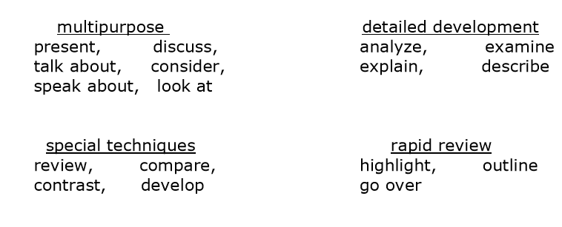
The overview
Select a verb that reflects the approach you intend to use:

Slide 7
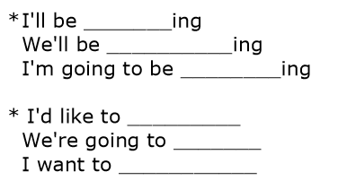
The overview
Put the pieces together in a structure:

Slide 8
The overview
Example
  “First of all, I'll be presenting a historical view of AIDS and how it spread. Then, we'll analyze the segments of the population most susceptible to the disease at its beginnings and compare them to the types of cases we are finding today. Finally, we'll try to forecast the evolution of AIDS in the coming years.”

Slide 9
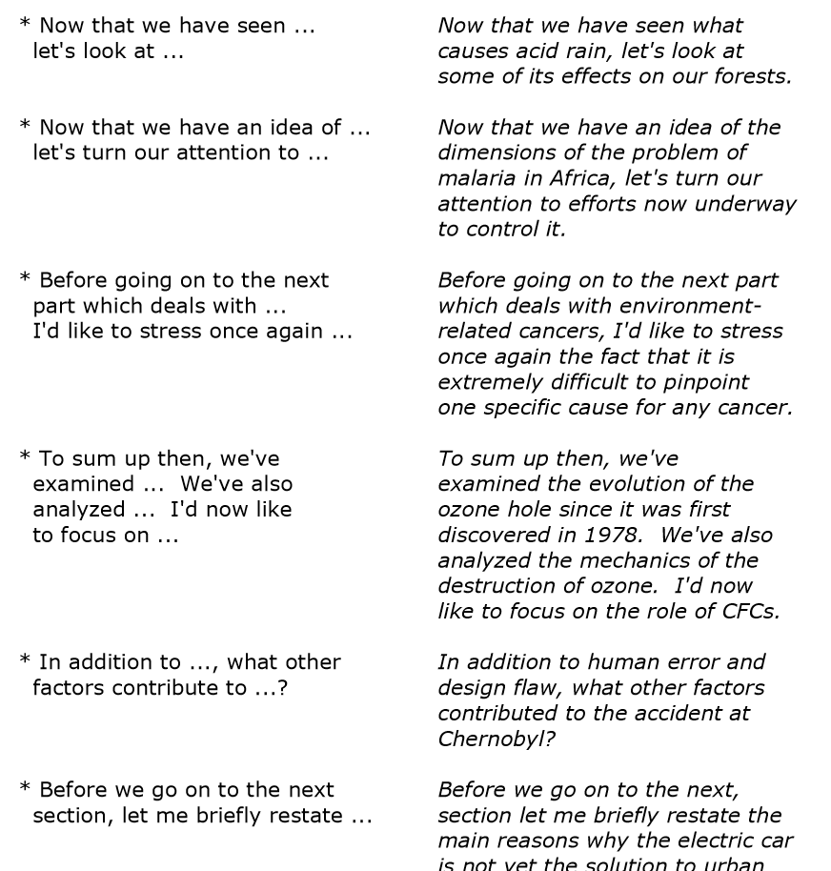
The Body of the Presentation
Transitions
Notes:
Remember, for the transitions to do their job efficiently, you must do your job: articulate and stress the key words.

Slide 10
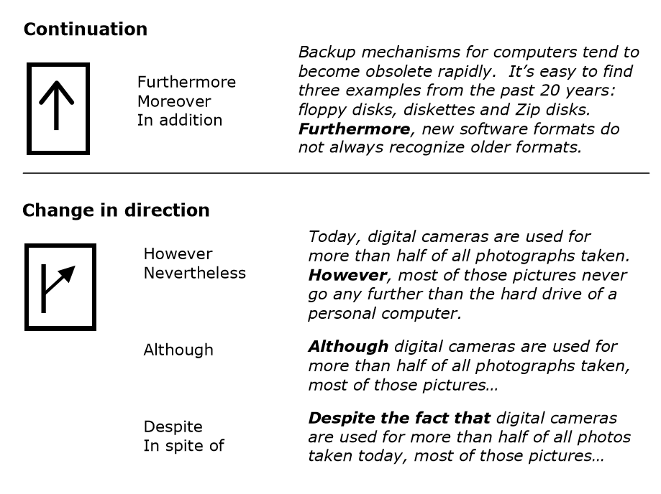
Road signs

Slide 11
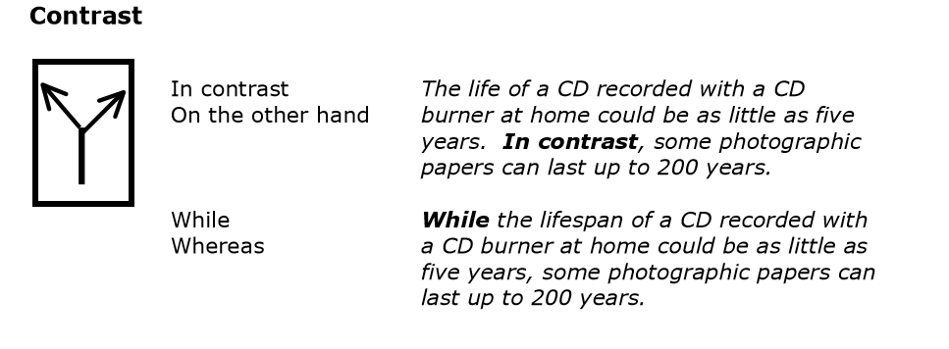
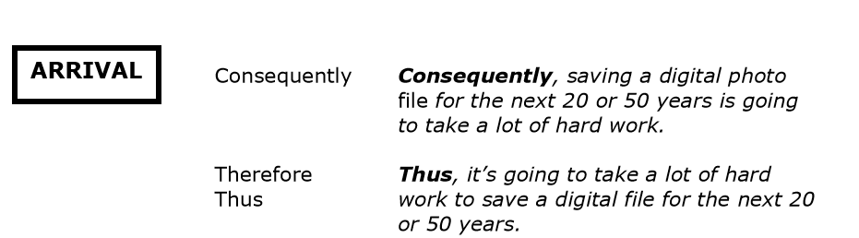
Road signs

Slide 12
Restating the important idea
* In simple terms, this means that ...
* To put it in more concrete terms ...
* The point I'm trying to make here is ...
* What I mean by this is ...
* Basically, what this means is ...

Slide 13
Using quotations
* To quote Professor Grand, "The earth is as flat as a pancake."
* Professor Grand has said, and I quote, "The earth is ..."
* Here I'd like to quote what Professor Grand has said about ...
* Professor Grand has often said that the earth is flat—"as flat as a pancake"—to use his exact words.
* I have here a quotation from Professor Grand. It says, "The earth is ...

Slide 14
Expressing opinion
Avoid preceding everything you say with, "in my opinion," or "I think that.
To signal another person's opinion
  * According to Professor Grand ... (an authority on the subject)
  * Lauren Thompson has expressed the opinion that ...
  * In a recent article, D.J. Tehl stated that ...
  * In Mr. John Mugg's opinion ...
To signal a widely-held opinion
  * It is commonly thought that ...
  * According to conventional wisdom

Slide 15
Expressing opinion
To signal your opinion
  * In my opinion ....
  * I think that ...
  * It is my view that ...
  * It seems to me that ....

Slide 16
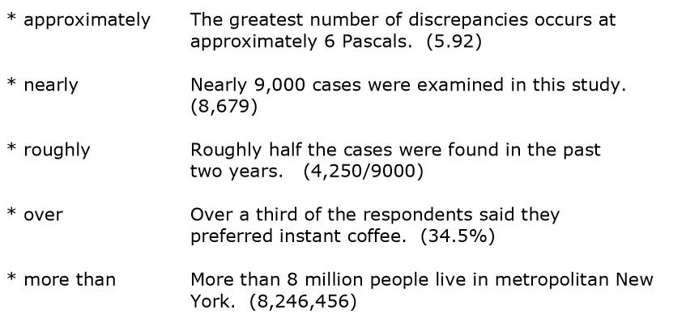
Using numbers

Slide 17
Using charts, graphs, tables
Could be very helpful!
Introduce the chart or graph before you show it.
You shouldn't simply state what the listener can easily see.

Slide 18
The Conclusion
Signaling the conclusion
To conclude ... * In conclusion ... * As a conclusion * This brings me to the end of my presentation this afternoon.
You may want to refer to something you said at the beginning of your talk .
Now that you have raised the level of attention, this is no time to make any digressions

Slide 19
The final summary ,Conclusion, Calling for Questions
Tell them what you've told them. Review the main points. Recall the most important examples.
End with a strong statement and thank your audience. Pause before thanking the audience.
Invite your audience to ask question.

