Slide 1

Broadband-ISDN

Slide 2
INTRODUCTION
ISDN is an acronym, which means Integrated Services Digital Network.
BISDN is an extension of ISDN in terms of capabilities, i.e. it not only has the narrowband capability of ISDN but also the broadband capability.
It is a set of CCITT / ITU standards for digital transmission over ordinary telephone copper wire as well as over other media.
ISDN is the integration of both analogue or voice data, together with digital data over the same network.

Slide 3
DEFINITION
“A service requiring transmission channels capable of supporting rates greater than the primary rate.” →ITU-T.
Any service inquiry with a speed greater than 1.544 Mbps is defined as broad band,and any communications based on this speed are called broadband communications.

Slide 4
BROWNY POINTS
BISDN is an extension of ISDN only in term of the name. Everything is different including protocol, architecture, transmission, and switching technology.
Designed to exploit the advances in technology.
Provides for integration of wide range of communications facilities and the support of universal communications with the following characteristics.
      Worldwide exchange between any two subscribers in any
      medium.
      Retrieval and sharing of information from multiple
      sources, in multiple media.
      Distribution of a wide variety of materials to home or
      office, on demand.

Slide 5
GOAL
“The Goal of BISDN is to achieve complete integration of services, ranging from low-bit--rate bursty signals to high-bit-rate continuous real-time signals”.

Slide 6
BROAD BAND SERVICE
Interactive Services
1.Conversational Services
2.Messaging Services
3.Retrieval Services
Distribution Services
2.control (broadcast service)
3.With user individual control
1.Without user individual presentation1

Slide 7
BROAD BAND SERVICE
Interactive Services
Two-way exchange of information (other than control signaling (information) between two subscribers or between a subscriber and a service provider.
Distribution Services
Primarily one way transfer of information, from service provider to B-ISDN subscriber.

Slide 8
BROAD BAND SERVICES
Distribution Services Without User Presentation Control
Referred also as broadcast services
Provide a continuos flow of information, which is distributed from a central source to an unlimited number of authorized receivers connected to the network.
User can access this flow of information but has no control over it.
Example: High definition television (HDTV)

Slide 9
BROAD BAND SERVICES
Distribution Services With User Presentation Control
Distribute information from a central source to a large number of users.
Information is provided as a sequence of information entities (e.g. , frames) with cyclical repetition.
User has the ability of individual access to the cyclical distributed information and can control start and order of presentation.
Example: cable text

Slide 10
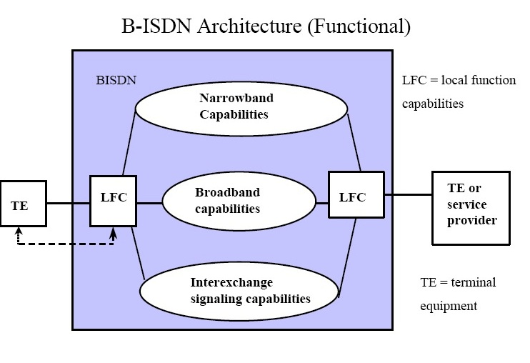
ARCHITECTURE

Slide 11
TRANSMISSION STRUCTURE
Three new transmission services
          Full-duplex 155 Mbps
          Asymmetrical 155 Mbps (subscriber to the network), and 622 Mbps (network to subscriber)
          Full duplex 622 Mbps - for multiple video

Slide 12
PROTOCOL REFERENCE MODEL
Control Plane
Higher Layers
Higher Layers
User Plane
ATM Adaptation Layer
ATM Layer
Management Plane
Physical Layer

Slide 13
REFERENCE MODEL
The B-ISDN reference protocol model
consists of three planes:
Management Plane
User Plane
Control Plane

Slide 14
B-ISDN COMPARED WITH OSI MODEL
CBR
VBR
ABR
UBR
Signaling
Network Layer
ATM Adaptation Layer
Link Layer
ATM Layer
Physical Layer
Physical Layer

Slide 15
B-ISDN SERVICES
Interactive Services
  Conversational Services
  Messaging Services
  Retrieval Services
Distributive Services
  No User Control of Presentation
  User Controlled Presentation

Slide 16
APPLICATIONS
Enhanced Phone Services
Customer Premise Equipment
High Speed Data Transfers
Telemessaging
Videotex
Tele-conferencing
Telecontrol, Telepolling
Tele-financing
Online Services
Remote Video Surveillance

Slide 17
CONCLUSION
ISDN is an underlying technology, which provides cost- effective networking through the public telephone networks.
ISDN is an important step forward in the adaptation of the network to handle the increasing global demand for computer-to computer data communications.
ISDN brings us closer to the goal of a ubiquitous multi-service network, integrating voice, data, video and image.

