Slide 1
CHAPTER 3
LINTELS AND ARCHES

Slide 2

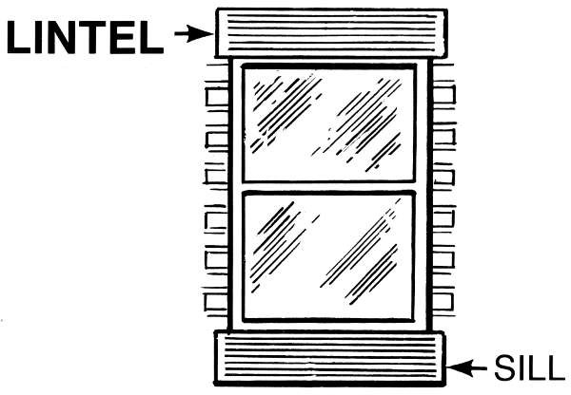
Lintels
A lintel is a horizontal structural member which is placed across the openings.
Ever openings of doors and windows should have a lintel and could have a sill.

Slide 3
cont.….
CLASSIFICATION OF LINTELS
According to their material of constructions lintels could be classified as:
Timber Lintels
Stone Lintels
Brick Lintels
Reinforced Brick Lintels
Steel Lintels
Reinforced Cement Concrete Lintels

Slide 4
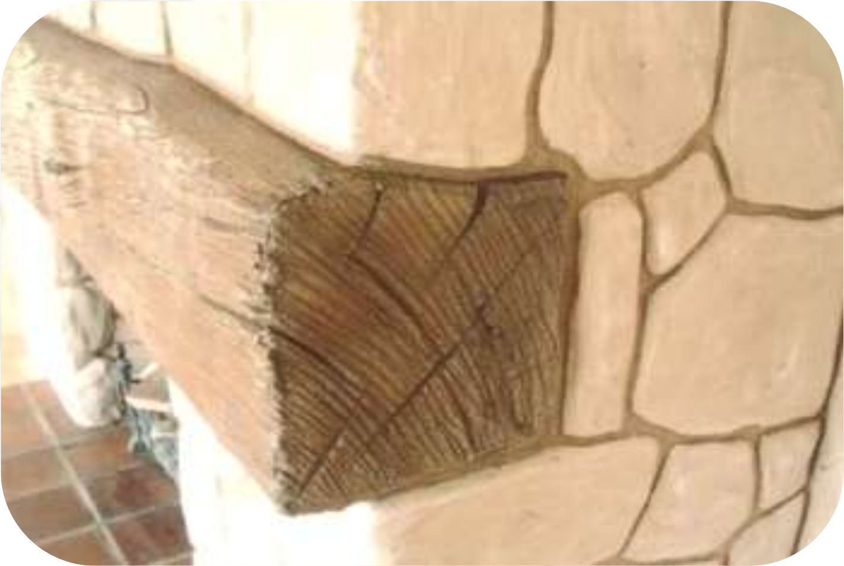
cont.….
Timber Lintels:
Easily available in hilly areas
Relatively costly but they are structurally weak and vulnerable to decay.
Easily decay

Slide 5

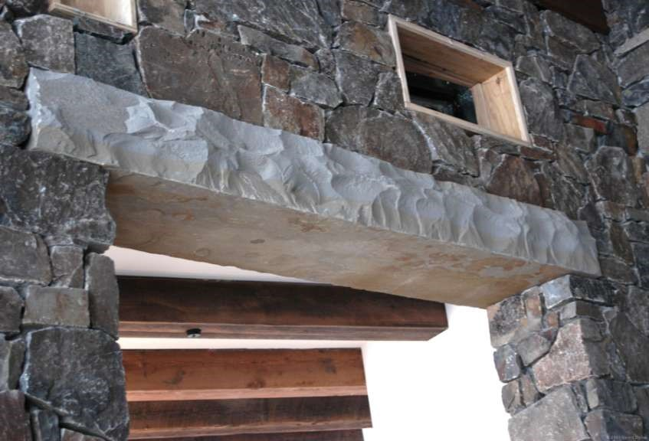
cont.….
2) Stone Lintels
Where stones are easily available areas.
A simple stone slab of greater thickness
Not chosen because of its high cost and its inability to withstand the transverse stress load.

Slide 6
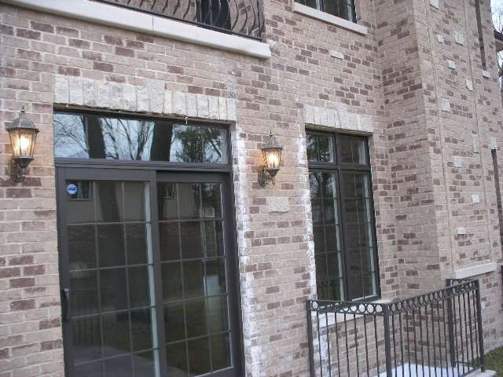
cont.….
3) Brick Lintels
Must use hard, well burnt and first class bricks.
For a very short spans.
Bricks with frogs are more suitable.
What kind of brick is a brick with frogs????

Slide 7
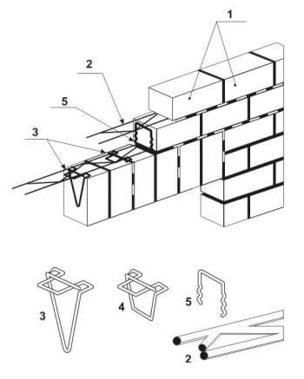
cont.….
4) Reinforced Brick Lintel
For large spans and heavy loads.
Reinforced with mild steel bars.
Very common due to durability, strength and fire resisting properties.
Joints are filled with cement concrete.

Slide 8
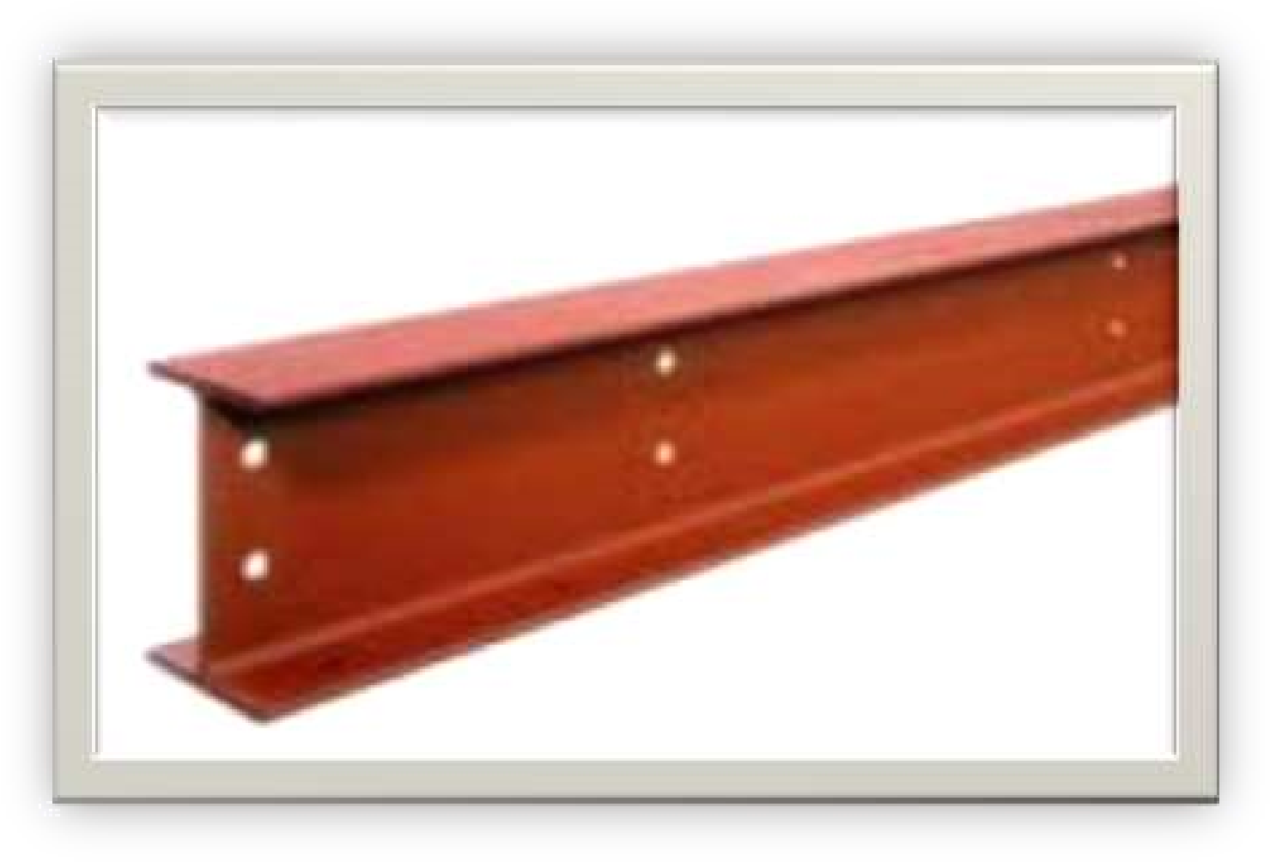
cont.….
5) Steel Lintels
Provided at large openings and where the super imposed loads are heavy.
Consists rolled steel joints.
Either used singly or in combination with bolts on their joints.

Slide 9
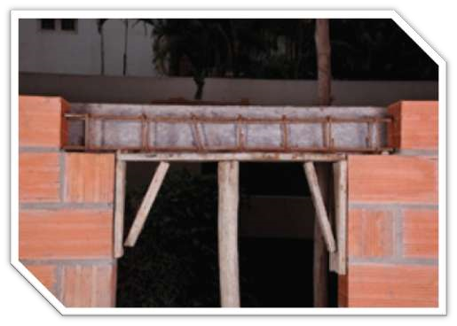
cont.….
6) Reinforced Cement Concrete Lintels
Commonly used.
May be pre-cast.
Should be provided the pre-cast one when the smaller spans are needed.
The depth of the lintel depend on the length of the opening and the load above the lintel.

Slide 10
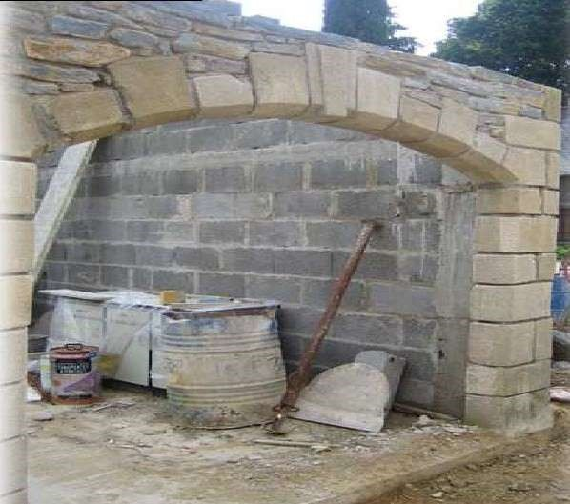
Arches
The structure constructed of wedge shaped block of stones or bricks jointed together with mortar and provided across the opening to carry the weight of the structure above the opening.

Slide 11
cont.….
Technical terms
Abutment: the end support of the arch.
Pier: the intermediate support.
Intrados: the inner curve or the inner surface of the arch.
Extrados: the outer curve or surface of the arch.
Voussoirs: arch stones which are the wedge shaped units forming the arch.
Springing stones: an imaginary line joining the two springing joints.
Crown: the highest point of the extrados or the highest part of the arch.
Keystone: the highest central wedge shaped block of an arch.

Slide 12

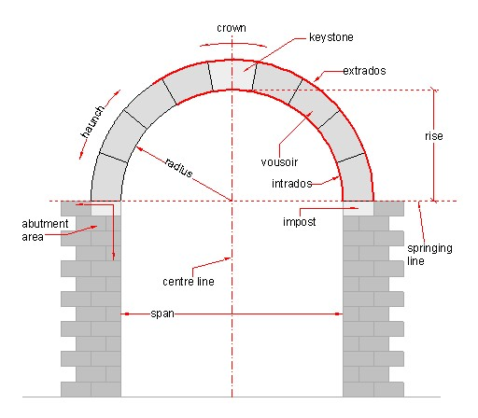
cont.….
Elements

Slide 13
cont.….
Skewback: the surface of the abutment on which the arch rests.
Span: the clear horizontal distance between the two supports.
Rise: the vertical distance between the two supports.
Depth of the arch: perpendicular distance between the intrados and extrados.
Haunch of an arch: portion of the arch between the key and the skewback.
Span drill: this is a triangular walling enclosed by the extrados , a horizontal line from the crown and a perpendicular line from the springing of the outer curves.

Slide 14
cont.….
Failure of an arch
What kind of stress do you think will an faces????
Crushing of the masonry
Sliding of voussoirs
Rotation of some joints about an edge
Uneven settlement of an abutment or pier

Slide 15
cont.….
Crushing of the masonry
This kind of failure will occur when
Compression stress > the safe crushing strength of the masonry unit and mortar
This kind of failures could be maintained by using
Good strength of materials.
The size of the voussoirs should be adequate.
Should be designed properly.
Sliding of voussoirs
Due to the transverse shear the sliding of voussoirs could happen.
To safeguard this problem higher height of voussoirs is best suited.

Slide 16
cont.….
Rotation of some joints about an edge
The line of resistance should be kept within intrados and extrados.
The line of the thrust should be made to cross the joint away from the edge to prevent the crushing of the edges.
Uneven settlement of an Abutment or Pier
Causes secondary stress in an arch.
The abutment should be strong enough to bear all the load from the arch.
The arch should be symmetrical, so unequal settlement of the two abutment is minimized.

Slide 17
cont.….
Classification Of An Arch
According to
Material of construction
Shape of curve formed by their soffit or intrados
Number of centers

Slide 18
cont.….
According to materials of construction
Brick arches
Rough Brick Arches
Made with ordinary bricks which are not wedge shaped
Relieving arches
Curve is obtained by mortar.
Axed Brick Arches
Cut and wedge shaped bricks
Joints with uniform thickness
Not dressed finally (attractive appearance is not necessary)
3. Gauged Brick Arches
Accurately prepared to wedge shape(Rubber bricks)
Lime puffy used for binding

Slide 19
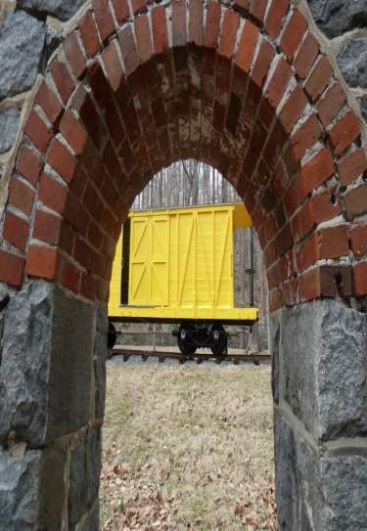
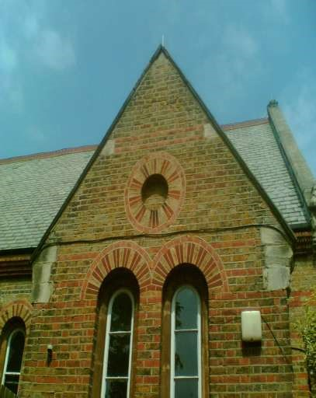
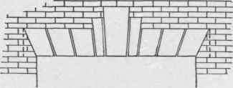
cont.….
Axed brick arches
Rough brick arches
Gauged brick arches

Slide 20
cont.….
Stone Arches
Rubble Arches
Rubble stones which are hammer dressed
Uses cement mortar for binding
For small spans up to 1m
Ashlar Arches
stones are cut to proper shape of voussoirs which are fully dressed
Properly joined with cement or lime
The voussoirs made of fall thickness of the arch

Slide 21


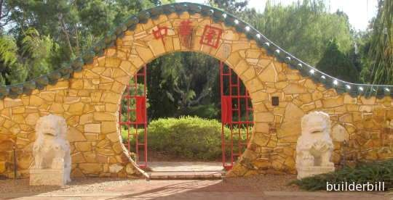
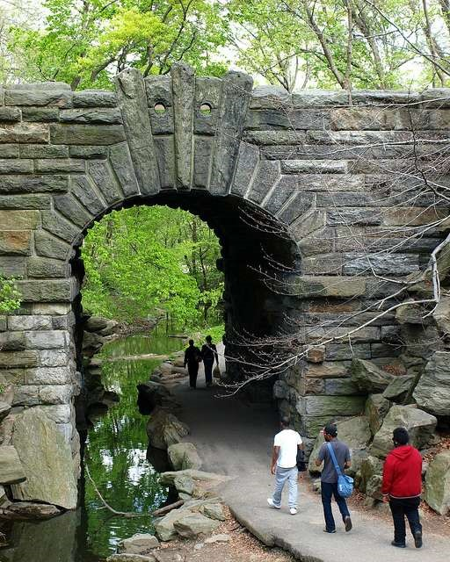
cont.….
Rubble arches
Ashlar arches

Slide 22
cont.….
Gauged Arches
Precast Concrete Arches
For small openings
Cement concrete block voussoirs
Without reinforcement
Monolithic Concrete Arches
Plain or reinforced depend on the span and magnitudes of loading we will use cast-in-situ concrete.
Suitable for large span openings(up to 3m)
Curing is done 2 up to 4 weeks.

Slide 23
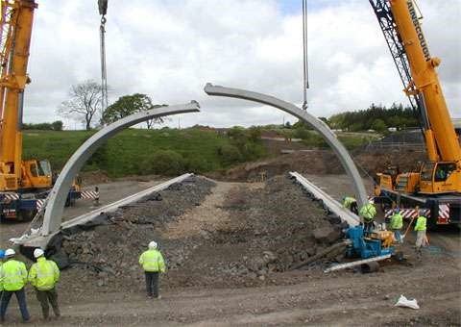
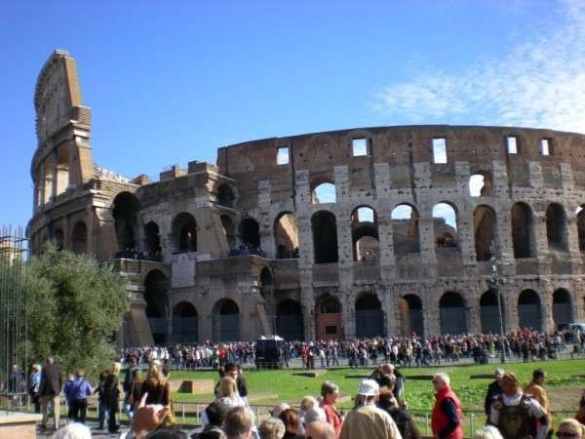
cont.….
Precast concrete arches
Monolithic concrete arches

Slide 24
cont.….
According to shape
Flat Arches
Acts as a lintel.
Joints radiate to center
For light loads
Span up to 1.5m
Segmental Arches
Segmental in shape
Joints radiate from a center of arch which lies below the springing line.
Provided over lintel.
Semi-circular Arches
Semi circular arches of soffit
Center of the arch lies on the springing line.

Slide 25



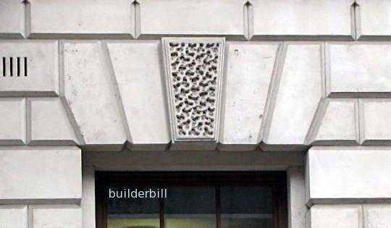
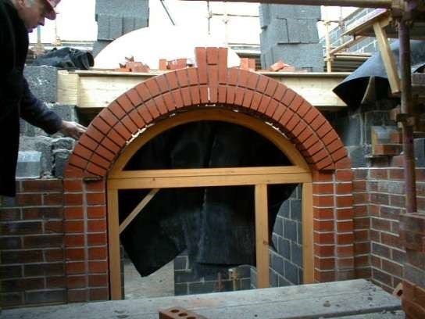
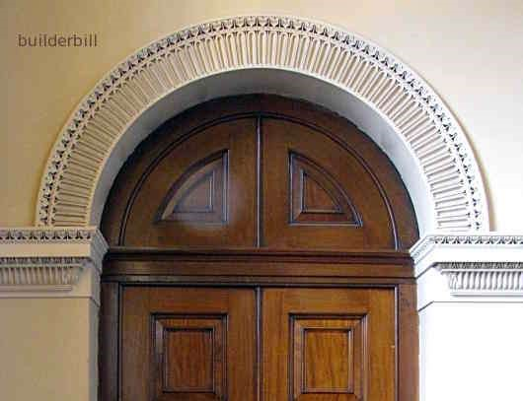
cont.….

Slide 26
cont.….
Relieving Arch
When wooden lintels is provided on a large opening, in order to relieve the load of the masonry above the lintel provided we will construct a brick relieving arch above the lintel.
Dutch or French Arch
Similar to a flat arch in design, but differs in shape and method of construction.
For small openings.

Slide 27

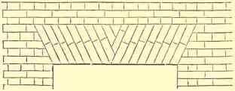
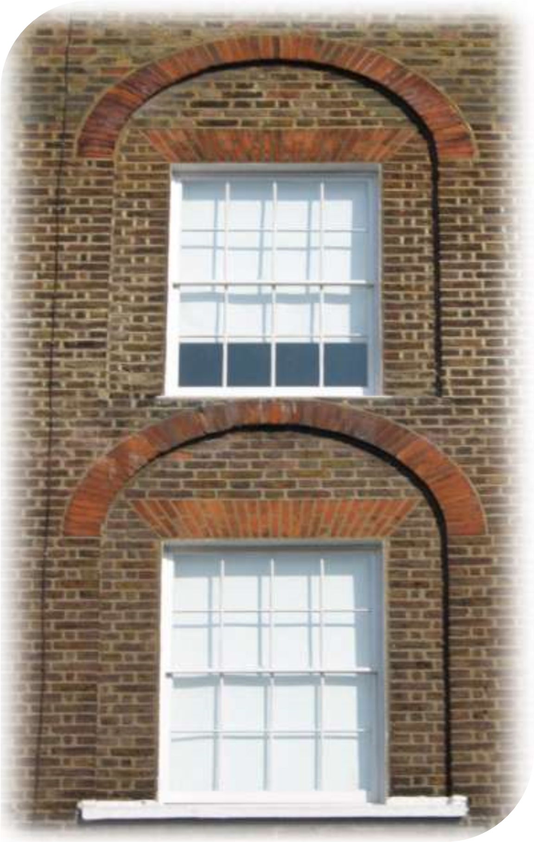
cont.….

Slide 28
cont.….
Classification based on number of centers
One centered arch
Segmental, semi-circular, flat arches come under this category.
Sometimes a perfectly circular arch known as bull-eyes arch, is provided for circular window.
Two centered arch
Pointed, semi-elliptical arches
Three centered arch
Elliptical arches come under this category
Four centered arches
Venetian arch
Four centers
Five centered arches
Gives good semi-elliptical shape.

Slide 29
cont.….
Quiz
Give only short answers.
What is the weakness of timber lintels and stone lintels??
The depth of the lintels on reinforced cement concrete lintel depend on………………..
…….
…….
Define
Voussoirs
Extrados
Skewback
Mention ways of failures in arch.
Mention types of brick arches.

