Slide 1
CHAPTER THREE
Construction Project Management

Slide 2
Construction Project Management
Projects and project Management
Process management
Stake holders Management

Slide 3
Definitions of Project
According to (PMI 2004), a project is defined as it is a temporary endeavor undertaken to create a unique product, service, or result
According to (US Federal Transit Administration;2006) project is made up of a group of interrelated work activities constrained by a specific scope, budget, and schedule to deliver capital assets needed to achieve the strategic goals of an Agency.

Slide 4
Definitions of Project…
According to (Locker & Gordon;1996) a project is a unique process, consisting of a set of coordinated and controlled activities with an assumed start and known finish dates, undertaken to achieve an objective conforming to specific requirements including constraints of time, cost and resources.
Even though most of the definitions given by different scholars are more or less similar, this research considers the definition given by (PMI, 2004).

Slide 5
CATAGORIES OF A PROJECT
Three broad categories of projects can be identified (Dennis Lock, 1987) each with its own characteristics:
Manufacturing projects
Projects requiring external organizations, and
Management projects

Slide 6
CATAGORIES OF A PROJECT……
Manufacturing projects:
In this category projects involve the following activities:
  Original design work
  Prototype testing, if necessary,
  Manufacturing,
  Assembling, and
  Installation and commissioning.

Slide 7
CATAGORIES OF A PROJECT……
except installation and commissioning works, most of the activities are carried out under the control of the manufacturer. Such projects are often made for a fixed price, promised delivery dates, and a set of unambiguous data specifications

Slide 8
CATAGORIES OF A PROJECT……
Projects requiring external organizations
Such projects include civil engineering, construction, petrochemical, mining, etc; which aims to establish buildings or operating plant on required sites requiring external or supplementary organization to the mother organization on these sites. Such projects need more attention to the problems of communications and organization than the manufacturing projects.

Slide 9
CATAGORIES OF A PROJECT……
Management Projects
The employment of an external manager or managing teams offering services to organizations
    To ensure effective and efficient management system
    To ensure efficient installation and start up of new approaches
    To follow projects of the above nature on behalf of clients and / or financiers, etc

Slide 10
Project Management
  3.2.1 Project Management
Projects have inherently been part of the human activities since civilization started.
However, the practice of project management as a science, in our world, is aged not more than three to four decades.
researchers and theorists tried to suggest the reason for emphasis on project management, in the last three decades as:

Slide 11
Project Management…
The need on getting things done on time and within cost budgets,
The fierce competition among organizations in succeeding to get projects
Welfare and safety requirements
Performance and customer satisfaction relationships, and

Slide 12
Project Management…
The new business development – Downsizing, Flattening, Empowering employees and outsourcing have also contributed to two stages of development:
The traditional project management approach, and
The new project management approach.

Slide 13
Project Management…
Project management can literally mean achieving successful project completion with the resources and time constraints

Slide 14
The Traditional Project Management Approach
The changing environment internally and externally to organizations gives rise to complex and an uncertain situations that cause to see into the pros and cons of the traditional project management system.

Slide 15
The Traditional Project Management Approach….
The problems in the traditional project management system fall into three distinct items.
It is in attention to the importance of customer satisfaction (Through Time, Budget, and Specification or Performance)

Slide 16
The Traditional Project Management Approach….
There is a general trend and acceptance in the traditional approach that customer satisfaction can be fulfilled through the third constraint – Specification. However, practical experience showed that it failed to take adequate account of customer needs and wants. This is largely because specifications are created by experts who:
.

Slide 17
The Traditional Project Management Approach….
lack the skills and training to work with customers,
don’t understand the customers’ business,
design and build products that are personal interest to themselves, and
often drive to establish specification that will gain them the admiration of their fellow experts

Slide 18
The Traditional Project Management Approach….
Its single minded focus on a fixed set of tools for dealing with scheduling, budgeting, and resource allocation
The traditional approach being single-minded in these fixed sets of tools makes mastery of these tools are likely to be a good project management approach.

Slide 19
The Traditional Project Management Approach….
Its narrow definition what it should be concerned with
Traditional project management often limits the project life cycle to four phases: concept, planning, execution and close out. With this life cycle, the project team members can wash their hands of the deliverables after it is handed over to the customer; Which is the most practical problem for construction activities in customer satisfaction.
( the phase should extend to operation and maintenance

Slide 20
The Traditional Project Management Approach….
Traditional project management holds a constricted view that primarily sees project managers as implementers. Often, project managers do not involve in the decision making process at the inception phase of the project rather it is handed over to him, whose charge is to do the job within the pre-determined scope.

Slide 21
The new project Management Approach
The new project management recognizes most of the traditional approaches are still relevant to today’s changing environment.
Therefore the new approaches rather than establishing its own total frame of assumptions, it aims to enhance the traditional approach by aligning it with the new business in the world

Slide 22
The new project Management Approach…
These alignments fall into three basic and central issues of the new project management system:
Become more customer basis
If projects are carried out in accordance with the needs and wants of the customer, it is then be called that the project management becomes more customer basis.

Slide 23
The new project Management Approach…
Redefine the role of the project manager
Neither stable nor free from competition, today’s business environment could not fulfill its intended purpose successfully with the traditional approach thinking of project managers as pure implementers.

Slide 24
The new project Management Approach…
project managers input in project identification, preparation, appraisal and negotiation and approval stages of the inception phase of the project cycle is very necessary.

Slide 25
The new project Management Approach…
Projects (including construction projects) are carried out using identified project phases.
Project phases are understood as the processes at which projects are formulated, implemented and completed.
These processes are well understood in many literatures as The Project Life Cycle under Process Management.

Slide 26
Processes Management
Process management in Construction Projects can be understood using concepts developed in Project Cycle for Construction Management Process System for Project Scope Management.

Slide 27
Processes Management
Projects (including construction projects) are carried out using identified project phases.
Project phases are understood as the processes at which projects are formulated, implemented and completed. These processes are well understood in many literatures as The Project Life Cycle.

Slide 28
Construction Management Process System
Construction projects as it posses its unique characteristics from other projects, its project cycle exhibited contextual phases.
Construction process as a concept covers sub processes having different characteristics.
These sub processes can be grouped under three major classifications:

Slide 29
Construction Management Process System
Core processes
Administrative processes and
Public regulatory processes. These processes are termed Project Processes

Slide 30
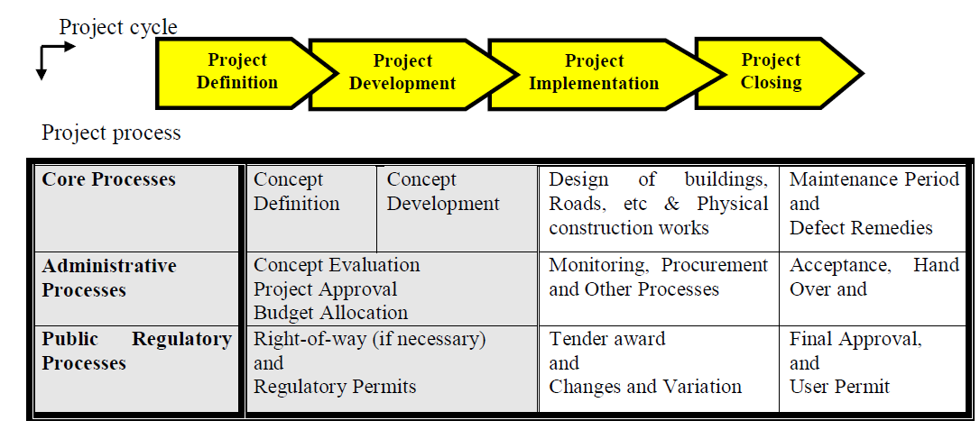
Construction Management process system

Slide 31
Construction Management Process System
Wubishet, 2004 in his dissertation combined these characteristics and came up with a modified project management process using a three by two matrix.

Slide 32
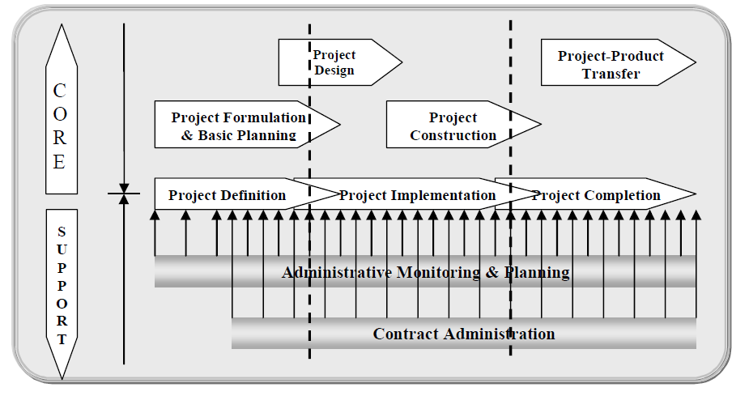

Slide 33
Stakeholders Management
Stakeholders can be defined as either individuals or units or the organization itself for which they claim a stake in the project such that they get benefit from or affected by the whole processes of the project and its deliverables.
Stakeholders can generally be classified under Internal and External stakeholders. Stakeholders for Public Construction projects

Slide 34
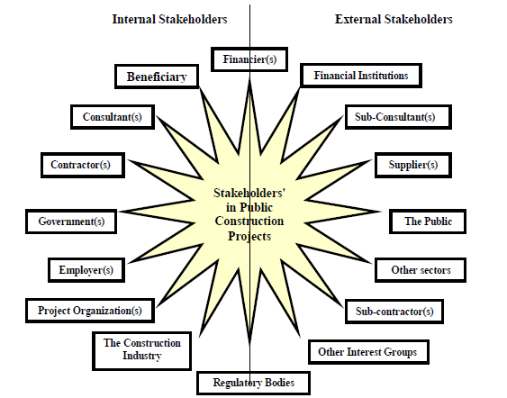
Stakeholders in Public Construction Projects

Slide 35
Further to these a comprehensive four by four matrix was developed in order to clearly show stakeholders’ roles

Slide 36
Stakeholders Roles
 | Project Owners | Project Providers | Project Regulators | Other Interest Groups
Budgetary Stakeholders | Client / Employer | ---- | Financiers / Sponsors | Legislative bodies
Contractual Stakeholders | Client / Employer | Consultant / Contractor | ---- | Financial Institutions
Regulatory Stakeholders | Client (Partial) | Consultant (Partial) | Public works bodies | General Audit
Collateral Stakeholders | Beneficiaries / Users | Suppliers / Sub-con | Public | Associations/Institutions

Slide 37
    Stakeholders Relationships Management
Stakeholders’ relationships management is meant that attitudes, objectives and self serving interests of individuals, groups or organizations who have stakes in the project are reflected in their relationships to affect the success of the project. As a result, projects need to manage such relationships in order to ensure their successful completions. The following steps are useful for successful Project stakeholder management:

Slide 38
Stakeholders Relationships Management
Stakeholders’ Identification
Stakeholders’ Information gathering on recurrent attitudes, strategy (Vision, Mission, Objectives, etc) and self-serving interests
Stakeholders’ SWOT Analysis
Stakeholders’ predicted / expected Behavior
Stakeholders’ Relationships Management Strategy

Slide 39
Stakeholders Relationships Management
Recent important skills required for project stakeholders’ management are
  Communication
  Negotiation
  Alliance
  Socializations
  Organization Culture and value building skills

Slide 40
Stakeholders Relationships Management
The weak and untrustworthy relationships among stakeholders have been one of the major factors for low project performances.
This has been found related to the perception of these stakeholders practiced during their involvement in the project management processes.
A chained and low level of trust and commitment was evidenced between

Slide 41
Stakeholders Relationships Management
Project Financiers’ (PFs) and Project Owners;
Project Owners (POs) and Project Doers (PDs); and
Within Project Owners (that is between Implementing Agencies & Beneficiaries).

