Slide 1
Cost Engineering
Chapter one :-Principles of Cost Engineering
Chapter two:- Tender and pre-tender cost estimating
Chapter three :-Quality and value engineering

Slide 2
Chapter one
Principles of Cost Engineering

Slide 3
Cost Engineering
“Accurately forecasting the cost of future projects is vital to the survival of any business.“
Cost Engineering is a dynamic process that begins in the very early stages of a project and ends when the project is turned over to the owner. As a project moves along time, the amount of information generated increases. The information improves an estimate’s accuracy but also costs more to develop and takes more time. Cost estimating is critical in the development of the project because it informs the owner of costs, which in turn guide design decisions.

Slide 4
Cost Engineering (Cont’d)
Cost engineering is concerned with problems of cost estimation, cost control, and business planning and management science, including problems of project management, planning, scheduling, and profitability analysis of engineering projects and processes.
•It needs understanding Construction Technology
Management Theory and technique: pre contract planning, tendering policy and the organization of resources
Quantity surveying including an understanding of contract documentation and forms of contract Construction economics

Slide 5
Cost Estimation
•Cost estimating is the process of determining quantities and predicting or forecasting, within a defined scope, the costs required to construct and equip a facility.
Cost estimates are performed at a certain point in time, based on information available at the time with given resources and time constraints.

Slide 6
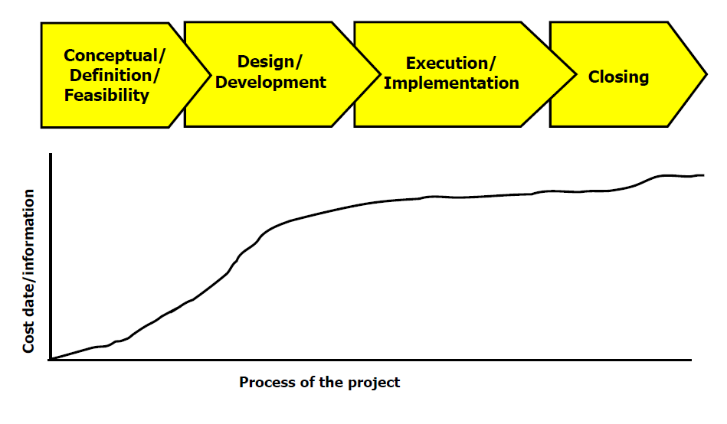
Construction Project Life Cycle Closing
Cost estimating techniques and accuracy vary along life cycle

Slide 8
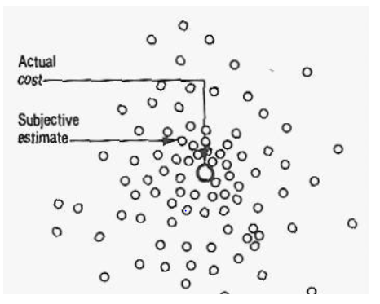
Difficulties in Cost Estimation Objective
Objective is to hit the target or at least get close to it.
Subjective

Slide 9
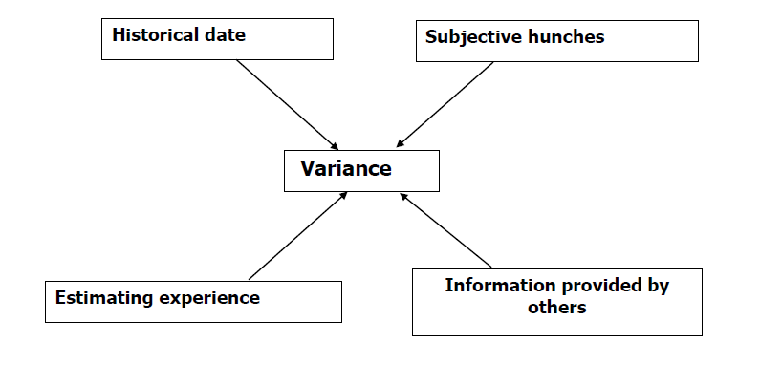
Estimates are based on:
•Previously recorded data (historical data)
•The estimators own past experience.
•Previous experience of others.
•Hunches (Intuition).

Slide 10
costs associated with construction projects
a)Initial Capital Cost
•Land acquisition, including assembly, holding and improvement
•Planning and feasibility studies
•Architectural and engineering design
•Construction, including materials, equipment and labor
•Field supervision of construction
•Construction financing including overhead costs
•Insurance and taxes during construction
•Owner's general office overhead
•Equipment and furnishings not included in construction
•Inspection and testing

Slide 11
b)Subsequent Operation and Maintenance Costs
•Land rent, if applicable
•Operating staff
•Labor and material for maintenance and repairs
•Periodic renovations
•Insurance and taxes
•Financing costs
•Utilities
•Owner's other expenses

Slide 12
Building Costs, Non Building Costs, & Life cycle costs

Slide 13
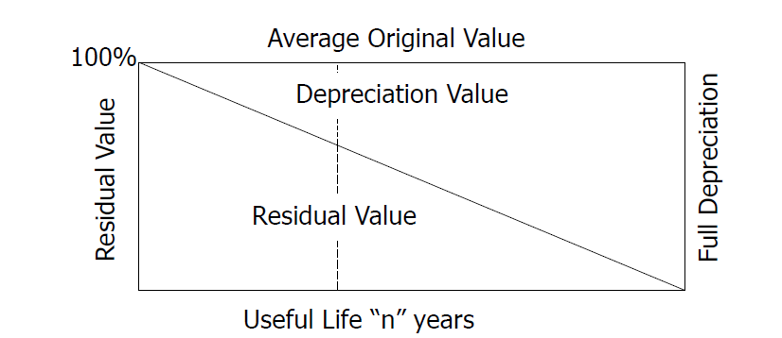
Terminologies for Cost Engineers
Construction Cost
Valued consumption of goods /material/ and performance /labor work/ of different kind and amount for the purpose of the production
Depreciation/ Depletion Costs
Costs of goods/equipment/or plant distributed for the whole useful life to compensate its deterioration to the work

Slide 14
Terminologies for Cost Engineers
Interest Value/ Cost of capital
•All-in Material Rate
Value of goods foregone by not using resources at their best allocation. Opportunity cost A rate which includes the cost of material delivered to site, waste, unloading, handling, storage and preparing for use.
•All-in Labor Rate
A compounded rate which includes payment to operatives and the costs which arise directly from the employment of labor.
•All-in Plant Rate
A compounded rate which includes the costs originating from the ownership or hire of plant together with operating costs.

Slide 15
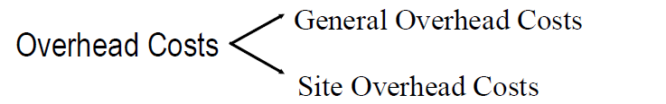
Terminologies for Cost Engineers
Direct Cost
Costs directly rendered to the production of the work. It includes, all-in material costs, all-in labor costs and all-in plant costs
Mark-up Cost
The sum added to an estimate in respect of the general overhead costs including profit and risk.
Production Cost
Costs representing the sum of direct costs (all-in costs) and site overhead costs. Costs required for production of the works on site.

Slide 16
Cost Engineering Traits
1.Conflicting Issues of quality, size, performance and cost
2.Cost Engineering combines both science and art
3.Cost Engineering does not offer guarantees of costs
4.Costing can only be as accurate as the information upon which it is based
5.Cost estimate accuracy increases as the design becomes more precisely defined
6.Cost estimate is based on previous estimates

Slide 17
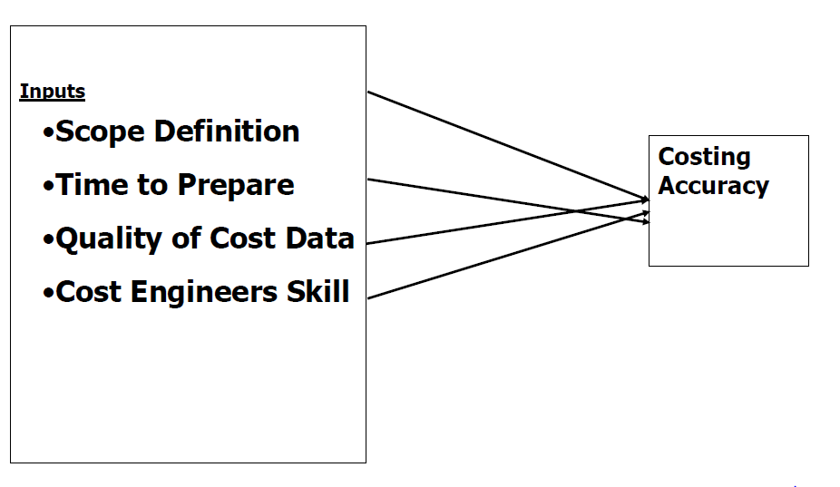
Cost Engineering Traits (cont’d)

Slide 18
Considerations in Costing
Project price is affected by
I. Size of the project,
ii. quality of the project,
iii. Location of the project,
iv. construction time, and
v. other general market conditions

Slide 19
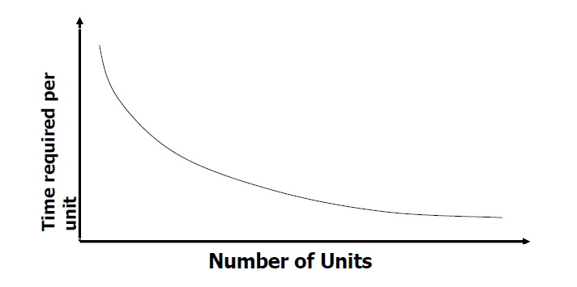
Project Size
As projects get bigger, they get more expensive but at a less rapid rate
Learning Curve
Experience lowers costs today and in the future. Also known as “Experience curve”

Slide 20
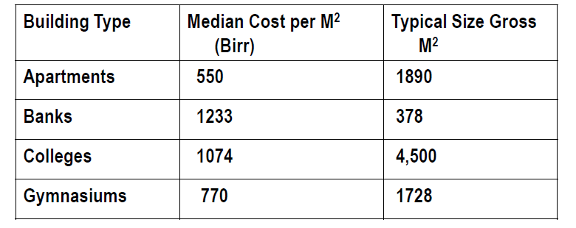
Typical project size and method for modifying for economy of scale
Determine the cost per m2 of 3780 m2 apartment building

Slide 21
ii. Quality
As the quality specifications increase the costs of projects also get higher.
iii. Location
Various location difficulties described are:
Remoteness
Confined sites
Labor availability 4.
Weather
5. Design considerations (related to location).
6. Vandalism and site security

Slide 22
iv. Construction Time
The longer the construction, the higher uncertainty in the estimates.
V . Other Reasons
• Market conditions (work load)
• Complexity of projects
• Emerging or new markets

Slide 23
Difficulties in costing
Example: What are the difficulties presented in pricing a block work item
1. Choice of work method
2. Output of Crew
3. Cost of Labor
4. Cost of material and % of wastage allowance
5. Addition of overheads and profit

Slide 24
The Function of Cost Engineering in Construction
1. Arranging finance, administrative approval and fund allotment
2. Guide decision making among alternatives
3. Provides guidelines to the designer (on material, size)
4. Prepare engineering estimate
5. Negotiation tool between contracting parties
6. Help in fixing completion periods
7. To justify investment : Cost benefit analysis
8. To invite tenders and prepare bills for payment
9. For Valuation purposes

Slide 25
Summary of reasons for Variability of Estimates
1. Quantity take off. 11. Location Factors
2. Material Costs. 12. Cost associated with the time element of the construction project and escalation costs.
3. Labor Costs. . 13. Overheads.
4. Labor productivity forecasts. 14. Profit element
5. Work Methods. 15. Contingency and risk allocation.
6. Equipment costs. 16.Errors in estimate formulation.
7. Indirect Job costs.
8. Subcontractor quotations. 17.Basis of information used to formulate estimate
9. Material suppliers quotations 18. Market forces
10. Unknown site conditions.

Slide 26
Chapter two
Tender and pre-tender cost estimating:

Slide 27
Price forecasting
a sound cost forecast will be based on cost element data from inception of the work to the date of the forecast, the cost trend of that data compared to accomplishments, and a cost estimate of the work remaining to be completed. Cost element history in the proper activity structure is essential for realistic cost forecasts. The combinations of these elements produce the Estimate at Completion (EAC) for the project.
• Large variances in costs or scheduling can severely affect the viability of a project compromising cash flow and profitability.

Slide 28
It must be undertaken using strict and auditable methods to ensure its defendable and objective.
• Remember, not all activities need to be forecasted in each reporting period. Only those activities that are not playing-out as initially planned need to be addressed. A forecast can be considered a precursor to a Potential Change Order. Unlike a change order however, a forecast is a well-informed prediction of trends that are arising that need to be identified and captured prior to a change order. Any predicted trends that turn out to be true, can then be converted into a change order and become part of the project budget & schedule. The forecast should be submitted as a package along with the progress measurement for approval.

Slide 29
Price indices
This section explains indexes and their use in cost estimation. An indexes a ratio or other number based on observation and used as an indicator or measure. A preliminary cost estimate is often based on a cost index. A cost index is a ratio of the cost of something today to its cost sometime in the past. The index is dimensionless and measures relative cost change over time.

Slide 30
Because these indexes are sensitive to technological change, the predefined quantity and quality of elements used to define the index may be hard to retain over time, thus causing “index creep.” Timely updating of the index is very important One such index that most people are familiar with is the Consumer Price Index (CPI), which shows the relationship between present and past
costs for many of the things that “typical” consumers must buy. This index includes such items as rent, food, transportation, and certain ser­ vices. Other indexes track the costs of equipment, and goods and services that are more pertinent to the engineering disciplines.

Slide 31
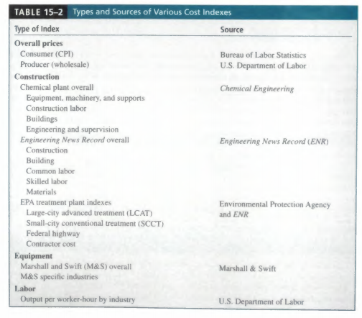
Types and Sources of Various Cost Indexes

Slide 32
A typical problem faced by an engineer is estimating the current or future cost of equipment, plants, or buildings. One way to make such estimates is to obtain costs of similar projects from an earlier date and update these costs to the present time.
Prices of equipment, plants, or buildings vary from time to time in accordance with competitive market conditions and the general state of inflation or deflation of a country’s currency. They also vary at any given time form one area of the country to another area and from one country to another country. These differences in price form one time to another time period and from one location to another can be measured by cost indexes.

Slide 33
A Cost Index is the ration of cost or price for a given commodity or service or set of commodities or services at a given time and place compared to the cost or price at a base or standard time and place. Remember, cost indexes are based on present cots compared with cost history. As published, they usually do not forecast future escalation; they leave that up to the discretion of the individual user.

Slide 34
Types of Construction Price Indices
Input Price Indices
Input price indices measure changes in the price of inputs to the construction process by monitoring separately the cost of each factor. This generally entails the compilation of a weighted index of the costs of wages and materials.
Output Price Indices
Output price indices measure changes in the prices of what is produced by entities engaged in construction activity. Output price indices cover most of the items normally built into the price paid by purchasers or clients to entities involved in producing the completed output of the construction activity. These generally include materials, labour, equipment hire, land preparation costs, bathroom/kitchen fittings, overheads, profits, and trade margins.

Slide 35
Seller’s Price Indices
Seller’s price indices measure changes in the prices of construction output paid by the purchaser or final owner of the output of construction activity. These price indices are conceptually broader in item coverage than almost all input and output indices.
Typical examples would be house price indices compiled in the United States and Canada. These indices include most factors which influence movements in home prices including supply factors (wage rates, material costs, and productivity) and demand factors ( demographic changes, incomes and availability of mortgage finance). These indices are the closest approximations in item coverage to the actual price paid for construction output.

Slide 37
Types and methods of Estimates
• Approximate Estimate and Detailed Estimate Estimating Methods
• Project Comparison Estimating or Parametric Cost Estimating,
• Area & Volume Estimating,
• Assembly & System Estimating, and
• Unit Price & Schedule Estimating.

Slide 38
Among the factors that one has to consider during construction pricing include:
•Work at hand in reference to contractor’s assets deployed to the work,
•The geographical areas in which the firm will operate,
•Type of structure the organization seek to control,
•Type of services the organization is to deliver,
•Type of client the organization is to favor, ( private, local authority, community services, )
•The ultimate goal of the financial manager (profit maximization or wealth maximization),
•Projected risks and uncertainties of the project,
•Form of the bid: (open, short-listed, pre-qualification, etc)

Slide 39
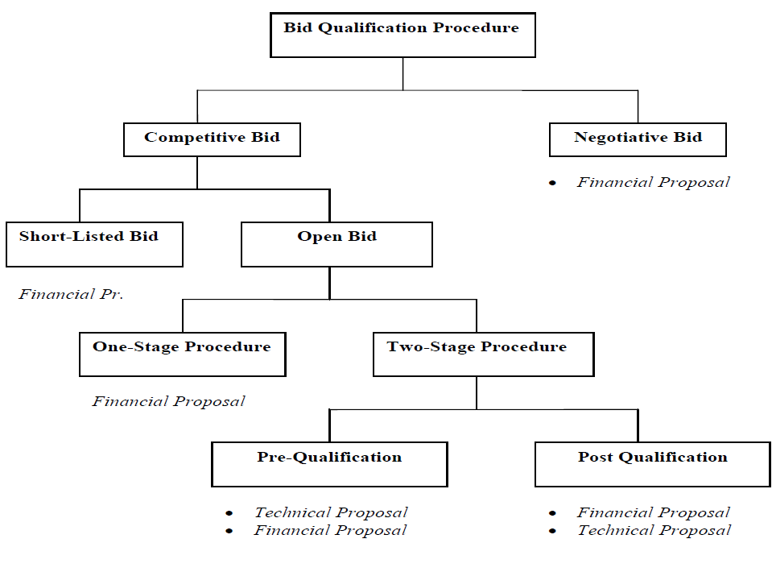

Slide 40
Tendering Procedure
In order that the tendering policy of the firm be maintained it is necessary that a procedure for the preparation of all tenders be established. This will vary with different contractors, depending on size and personnel, but a basis could follow the stages set out by the Ministry of Infrastructure.
Decision to Tender:
•A management decision based on the firm’s position at the time of invitation in relation to:
•Production workload,
•Future commitments,
•Market,
•Capital,
•Associated risk,
•Prestige, reputation
•Estimating workload,
•Time for preparation of tender

Slide 41
Collection of Information
•If management decides to tender for the project, the estimating staff should assemble information about project costs. An accurate estimate can only be produced when each element is broken down into its simplest terms and the cost estimated on factual information.
•Some of the factors required include:
•Time scale for tendering with key dates as mentioned in the invitation to bid,
•Examination of contract documents, with preliminaries attached with the tender,

Slide 42
Assessment of client and design team,
•Enquiries to suppliers and sub-contractors with a time scale,
•Site and locality visit,
•Discussion with site management, plant and planning department, Evaluation of alternatives
•Preparation of detailed construction method statement and pre-tender programme, developed to include production outputs, gang sizes, plant details, etc.

Slide 43
Preparation of estimate:
•Having assembled all the information, the next task of the estimating staff is to build the cost of the unit rates. This requires the calculation of all-in rates for labor, plant, materials and extending these, using the production details from the pre-tender programme. The cost of any on site administration and services, known as project overheads is also calculated. These net production costs, together with a project appraisal report are then submitted to management for adjudication.

Slide 44
Detail Cost Estimation
A. Project Cost estimation
is the process of valuing on monetary expression, including the cost of all possible entrants necessary for the planning, implementing and monitoring stages of the proposed project under consideration.
❑ Cost estimation is the determination of the probable cost of a project.
❑ Project Cost includes:
▪ Preliminary investigation (project appraisal costs);
▪ Design and supervision (consultancy cost);
▪ Construction works (contractor’s cost);
▪ Land owning cost, and
▪ Monitoring costs.

Slide 45
B. Detailed Cost Estimate (Based on Item Rate)
As the design is completed a detailed pre-bid estimate can be prepared.
Detailed Cost Estimate is the most reliable and accurate type of estimate.
The quantities of items are carefully prepared from the drawings and the total cost worked out from up to date market rates.
A detail cost estimate thus requires:
Quantity surveying, and
Analysis of the different rates for the quantities prepared.

Slide 46
2.Fundamental Approach to Construction Cost Estimation
Efficient construction cost estimates shall address properly the required project quality, completion time of works and of course the construction cost of the project.
In deciding to participate in the intended project tender, the contractor shall carefully assess the impact of the following key factors:
Type of project; Method of tendering; Type of construction contract; Number and progress of contracts already at hand; Resource availability i.e. skilled manpower, plants and machineries; and Financial position

Slide 47
Once decision is made to participate in the intended tender, the contractor shall give due attention to the following major items listed below:
General and particular conditions of contract contained in the bidding documents;

Slide 48
1.General and Particular Conditions of Contract
❑ Proper understanding of the General and Particular conditions of contract is mainly important for construction cost estimation in identifying the responsibilities and cost implications on the project.
▪ Amount and type of performance security;
▪ Amount of advance payment and advance repayment conditions;
▪ Time for completion of the whole project;
▪ Limit of liquidated damages
▪ Limit of Retention money;
▪ Claims and disputes settlement, Applicable laws;
▪ Price escalation, Tax exemptions, Insurance of the works and Owner’s risks.

Slide 49
2.Technical Specification
❑ Technical specifications specify the following crucial information to the contractor and it is the sole basis both for the construction methods to be adapted and the construction cost of the project.
▪ Quality of materials;
▪ Quality of machineries and plants;
▪ Quality of workmanship;
▪ Erection and installation methods; and
▪ Test and inspection requirements and methods.

Slide 50
3. Drawings
❑ The contractor mainly understands from the drawings what type of construction methods to be adapted during cost estimation as well as construction of the project.
❑ Some of the construction methods which need to be addressed during cost estimation of this building project are:
▪ Concrete production, transportation and placement;
▪ Transportation of materials to different floors;
▪ Methods and type of scaffolding, shuttering works;
▪ Erection and installation of glazing works; and
▪ Temporary access for manpower working at different floors, and Skilled manpower requirement

Slide 51
4.Estimated Bill of Quantities
❑ Estimated quantities of work are also the basis to determine the type and number of resources to be deployed during construction of the project.
❑ Moreover, construction methods shall be selected in such a way the given quantity of works can be executed during the completion time of the project.

Slide 52
5. Supporting Documents
❑ Supporting documents such as geological formations, hydrological data and other technical reports like socio-economic studies are usually provided by the owner to contractors for their own interpretations for heavy construction projects.
❑ Therefore, the contractor shall have the technical ability and experience in interpreting the technical data provided to determine construction methods to be adapted which directly affects the construction cost estimates.

Slide 53
6. Site Visit
❑ In order to prepare competent and reasonable construction cost estimates, the contractor must visit the
project site unless the site is familiar to the contractor with previous reliable site information.
❑ The contractor shall prepare his own checklists during the site visit which shall address, but not limited to, the following issues which have direct impact on the construction costs of the intended project.
▪ Location of the site;
▪ Location of local construction materials;
▪ Access roads;
▪ Water and power supply;
▪ Communication facilities;
▪ Environmental protection; and
▪ Existing facilities.
12

Slide 54
7. Method of Measurement
❑ Contractors shall thoroughly understand the method of measurement incorporated within the bidding documents before starting any cost breakdown calculations.
▪ BaTCoDA Technical specification and method of measurement (March 1991);
▪ ERA standard specifications (2002); and
▪ Civil Engineering Standard Method of Measurement (CESMM) etc.

Slide 55
8. Construction Method Statement
❑ Construction method statements give the clear picture of each project activity execution during the construction phase of the project.
❑ The required quality of works as per the specifications, estimated quantity of works, safety standards, as well as time for completion are the sole basis in determining the construction method statements of a project.
❑ Construction method statements shall clearly indicate the following crucial construction issues:
▪ Skill and number of manpower required;
▪ Type and specification of equipments required;
▪ Quantity and quality of materials required;
▪ Proposed working crews;
▪ Estimated crew productivity;
▪ Estimated duration for completion; and
▪ Expected defects and remedial measures.

Slide 56
3. Project Costs
❑ Construction Cost: the sum of all costs, direct and indirect, inherent in converting a design plan for material and equipment into a project ready for startup, but not necessarily in production operation.
▪ Direct costs, which include the direct cost of materials, labor as well as equipments; and
▪ Indirect costs, which include but not limited to head office and site overhead costs.
❑ Having identified the different cost components associated with labor, material, plant and equipment, subcontractor, and overheads, bid price can be mathematically represented as the sum of total cost and mark up.

Slide 57
Determining Bid Price
❑ Bid price = Total cost + Mark up
=Direct cost + Indirect Cost + Mark Up
=(labor cost + plant and equipment cost + materials cost + sub-contractors’ cost) + (Project overheads +common labor and plant and equipment) + (general overheads + profits + allowances for risks)

Slide 58
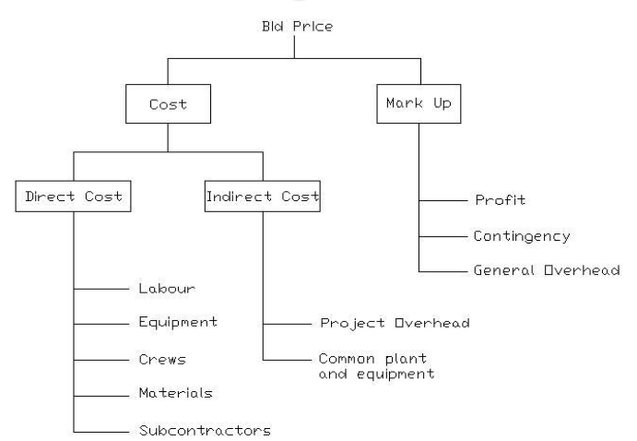
Determining Bid Price

Slide 59
Direct Construction Cost
❑ Direct Construction cost is the Cost of installed equipment, material and labor directly involved in the physical construction of the permanent facility; costs incurred directly in the performance of an activity.
❑ Direct costs are those costs, which can be attributed to a single task of construction work. These costs are usually associated with a construction labor crew performing a task using specific equipment and materials for the task.
❑ Direct construction costs are all costs that can be specifically booked with an activity in a project.
❑ The current trend is to assign as much as possible costs to direct costs as these costs can be budgeted, monitored and controlled far more effectively than the indirect costs.

Slide 60
The direct costs mainly include material, labor, equipment and subcontract costs as described below.
▪ Direct Material costs: These costs referring to the cost of materials, consumables and components used for executing an activity including the allowances for scrap and wastages.
▪ Direct Labor costs: All costs related to the workers working on a specific activity such as carpenters, masons, erectors, painters, plumbers and so on.
▪ Direct Equipment costs: These costs referring to the costs of machineries and plants used in executing a specific activity.
▪ Subcontract costs: In case some specific activities are subcontracted, the subcontract price will be considered as the direct cost of the activities to be executed by the subcontractor.

Slide 61
Indirect Construction Cost
❑ Indirect Construction Costs are all costs which do not become a final part of the installation or constructed facility, but which are required for the orderly completion of the installation; costs incurred indirectly for the accomplishment of the project.
❑ Indirect construction costs are all costs, which can not be directly booked under a specific activity in a construction project but required to keep the whole project operational.
❑ These costs are also called overhead costs, which mainly include the head office and site overhead costs.

Slide 62
Indirect Construction Cost
Site overhead costs
❑ Site overhead costs are all costs required to run the whole operation of a specific construction project at site level.
❑ These costs are not associated with specific activity in a project but rather shared proportionally by all activities within the project. Some of the site overhead costs are listed below with further clarifications.
▪ Site management costs: These costs refer to costs related with salaries and benefit packages of the site management members in the project site.
▪ Indirect labor costs: salaries and benefits of staffs other than the site management members working at the project site such as site engineers, office engineers, administrative and finance staffs, data collectors and so on.

Slide 63
Indirect Construction Cost
Site overhead costs
▪Mobilization and demobilization costs –These costs are mainly transportation costs.
▪ Tender Expenses – These costs are related with the costs of the contract performance security, advance repayment guarantee, contractor’s all risk insurance,insurance of the works and third party insurance depending on the contract conditions agreed.
▪ Site offices –site offices are constructed from different materials such as corrugated iron sheets, prefabricated materials, material packing steel containers, steel structure and normal hollow concrete blocks.
▪ Expertise service costs – These costs will be incurred when professional services are required at the project
site such as lawyers, claim experts and so on.

Slide 64
Indirect Construction Cost
Site overhead costs
▪ Office furniture and equipments – Different office furniture and equipments are required depending on the size and location of the project.
▪ Office running expenses - The site office operation requires different expenses such as telephones, fax, internet service, mail service and stationery.
▪ Radio communications - If the coverage area of the construction project is vast, hand held and stationed radio communications may be used within the site and with the head office.

Slide 65
Indirect Construction Cost
Site overhead costs
▪ Camp facilities – The costs of construction and operation of other facilities such as restaurants, recreational centers and playgrounds are also included under the camp facilities.
▪ Access roads – Depending on the topography and location of the project site, different access roads may be required to construct such as detour roads, access roads to quarry and disposal areas, etc.
▪ Water and power supply – All the site offices, camp facilities, the construction itself requires water and power supply for operating the whole project properly.
▪ Workshops garages and warehouses, Bank charges, Transportation and travel expenses, Insurance charges, etc…

Slide 66
Indirect Construction Cost
Common workmen
❑ Expenses associated with workmen used for different activities in a manner that their role cannot be directly attributed to any single activity, is uniformly distributed in all the items of bill of quantities.
Such workmen may include safety steward, quality control technicians, survey helpers, security men and the workmen employed in accounting office, time office, stores, etc.

Slide 67
Mark-up
Mark up can be seen as the sum of general overheads, provision for risks and profit margin.
1. General Overheads
Several expenses incurred at the corporate headquarters of a company cannot be directly traced to any particular project and accordingly such expenses are charged from the running projects on pro rata basis.

Slide 68
Mark-up
❑ General Overheads Such expenses include those incurred towards research and development, publicity and advertisement, the cost of unsuccessful bids that necessarily needs to be distributed over other projects, recruitment of personnel, salaries of security personnel at the head office etc. and are termed as ‘general overheads’.
❑ The ‘general overheads’ for a construction company varies between 2-3% of the contract value depending on factors such as turnover, staff strength, nature of expenses incurred at head-office, and the number of projects in hand currently etc.

Slide 69
Mark-up
2. Contingency for Risks
❑ Construction projects are risky proposition full of uncertainties and risks. In spite of different details known at the tendering stage there are uncertainties and risks pertaining to timely completion, budget escalation, site conditions, soil characteristics, labor, and material availability and so on.
❑ In order to safeguard against these eventualities contractors keep certain contingencies provisions so that should these risks materializes one can use the contingency provisions to take care of the risks. Indeed, higher the uncertainties involved with a project at the time of tender, higher is the contingency provisions.

Slide 70
Mark-up
3. Profit
This is a reward of carrying out the business and thus taking risk. Risky business carries more profit and vice versa.

Slide 71
4. Unit Rate Analysis
General
❑ Construction cost estimation formats and procedures shall also serve as the basis for different purposes as listed below in managing the project during construction.
▪ Construction planning;
▪ Project cash flow preparation;
▪ Productivity data collection;
▪ Material consumption data collection;
▪ Construction monitoring;
▪ Performance evaluation and controlling;
▪ Performance related pay;
▪ Subcontractor’s price evaluation;
▪ Variations and claims validation; and
▪ Remedial measures and improvements.

Slide 72
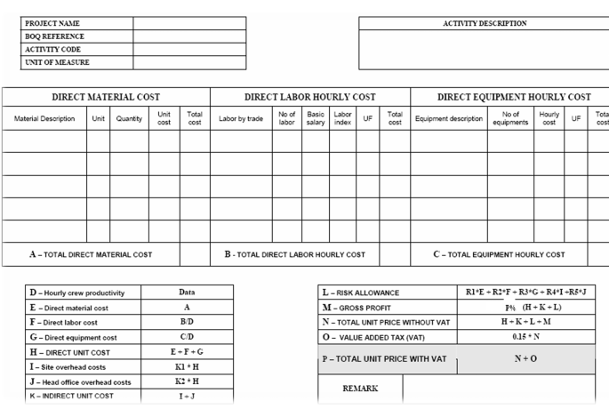
4. Unit Rate Analysis General

Slide 73
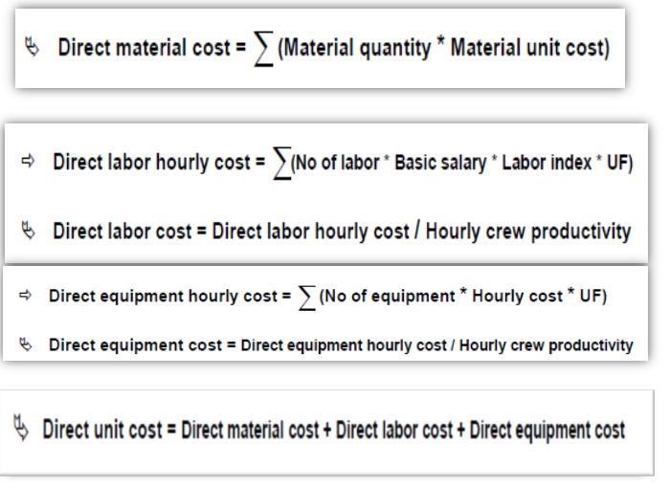

Slide 74
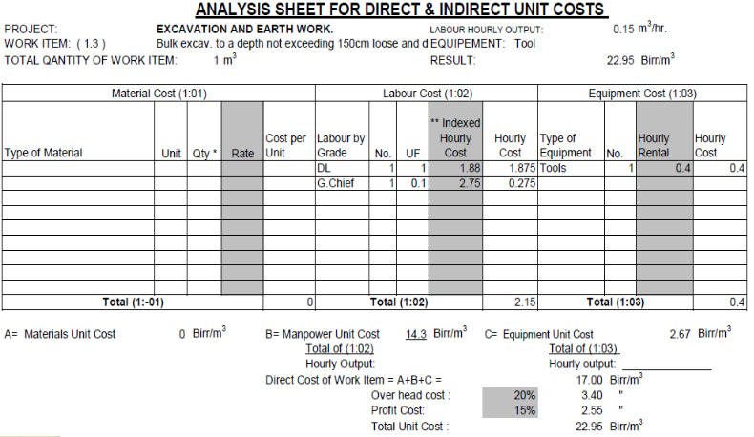
4. Unit Rate Analysis Unit Rate Analysis Format Examples

Slide 75
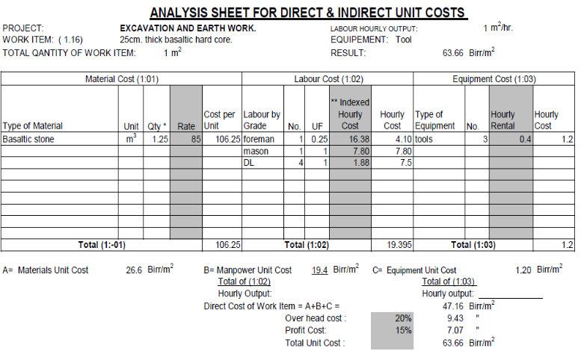
4. Unit Rate Analysis

Slide 76
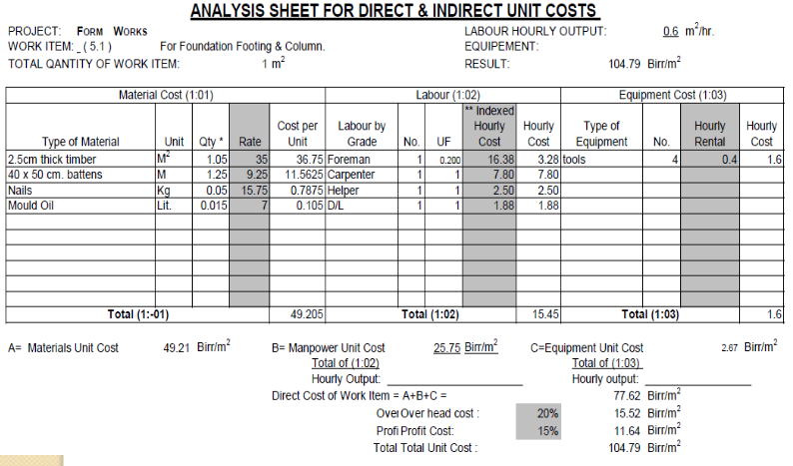

Slide 77
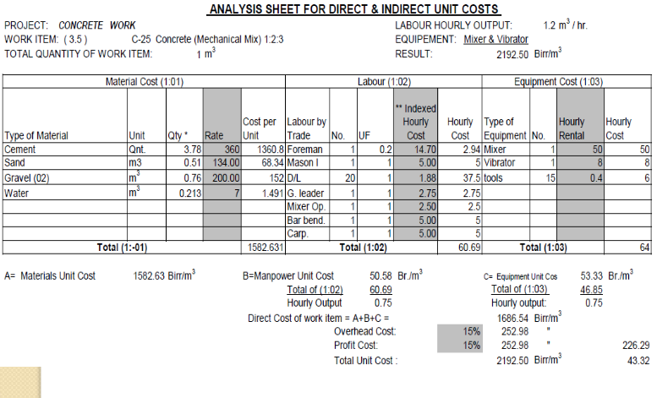

Slide 78
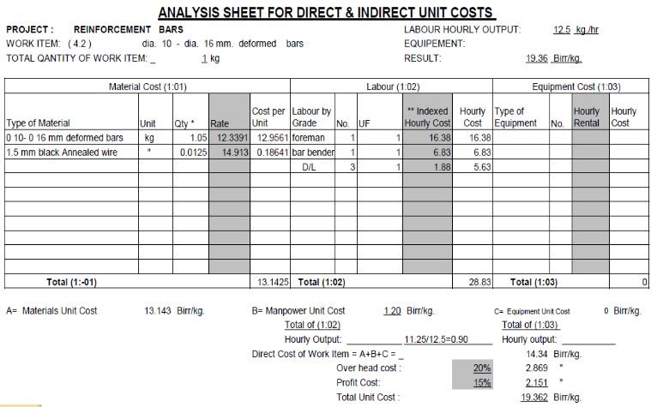

Slide 79
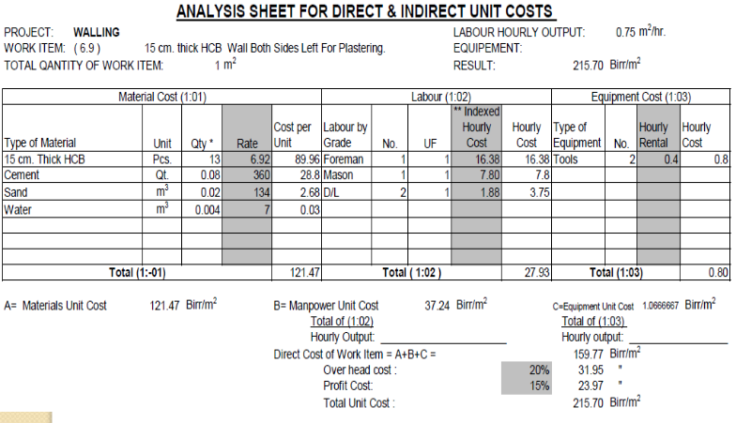
4. Unit Rate Analysis Unit Rate Analysis Format Examples

Slide 80
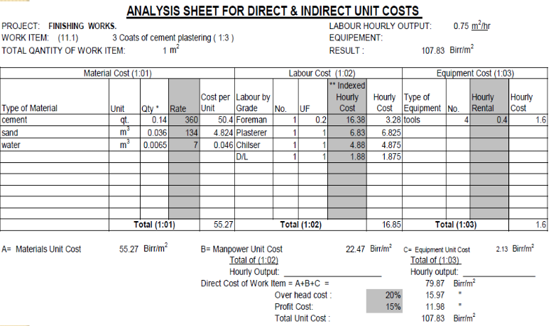
4. Unit Rate Analysis Unit Rate Analysis Format Examples

Slide 81
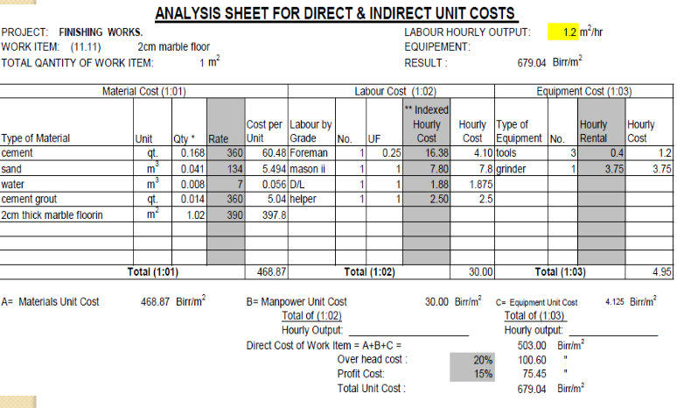
4. Unit Rate Analysis Unit Rate Analysis Format Examples

Slide 82
5. Risk Analysis for Cost Estimation
5.1 Risk Analysis: General
❑ Cost estimation is prediction. Little in cost estimating is certain.
❑ Cost risks
▪ Acts of God: Flood, Earthquake, Landslide, Fire, Wind damage;
▪ Physical: subsurface conditions;
▪ Financial & Economic: uncertainty with high inflation and interest rates, Availability of funds, Exchange rate fluctuations, Financial default;
▪ Construction Related: Labor strikes, Labor productivity, Different site conditions, Design changes, Equipment failure, inability of a subcontractor to perform, Damage to structure, Damage to equipment, Labor injuries, Fire, Theft, offsite accidents by vehicles;

Slide 83
Design Related: Incomplete design scope, Design assumptions, Defective design/ constructability, Errors and omissions, Inadequate specifications;
▪ Political/public and Environmental: Changes in laws and regulations (such as environmental protection and public safety regulations), Requirement for permits/ disapproval of the required project permits, Law and order, Pollution and safety rules; and
▪ Organizational and Contractual: Contractual relations, Attitudes of participants, Communication, risks assigned by c

Slide 84
5.2 Cost Risk Assessment
5.2.1 General Risk Assessment Approach
❑ The general approach to think about risk assessment includes:
▪ Recognize that uncertainty exists;
▪ Identify the key sources of significant uncertainty;
▪ Reduce the uncertainty whenever possible;
▪ Account for the uncertainty that cannot be reduced; and
Step 1: Identify the key sources of significant uncertainty
❑ It is important to rigorously investigate and identify the key sources of significant uncertainty in a cost estimate.

Slide 85
Step 2: Reduce the uncertainty whenever possible.
❑ Reducing significant uncertainties whenever possible within the resource constraints (time, money, personnel, and expertise)
❑ Finally, when significant uncertainty has been identified and cannot be reduced it must be accounted for in an explicit fashion.

Slide 86
Cost Indexes
1. Cost Indexes: a typical problem faced by an engineer is estimating the current or future cost of equipment, plants, or buildings.
❑ One way to make such estimates is to obtain costs of similar projects from an earlier date and update these costs to the present time.
❑ Prices of equipment, plants, or buildings vary from time to time in accordance with competitive market conditions and the general state of inflation or deflation of a country’s currency.
❑ They also vary at any given time form one area of the country to another area and from one country to another country.
❑ These differences in price from one time to another time period and from one location to another can be measured by cost indexes.

Slide 87
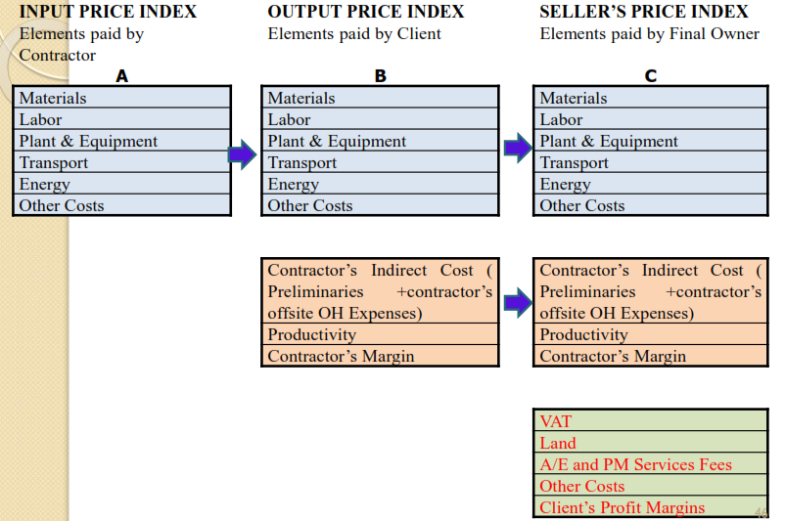

Slide 88
3. VALUE ENGINEERING
Value Engineering is a systematic and organized effort to identify the functions of a product, system or procedure and to attain that function with minimum cost without jeopardizing quality, aesthetics, appearance etc. It is an organized creative approach which has for its purpose the efficient identification of unnecessary cost without scarifying reliability, performance or maintainability.

Slide 89
Value engineering studies may be performed by Consultants during design development as a contractor performed pre-construction services or by the contractor during construction. The most effective time to conduct such studies is during design development. Some construction contracts contain a value engineering incentive provision that allows the contractor to share in the savings that results from approved value engineering change proposals. Value engineering change proposals submitted by the contractor are reviewed by the consultant and owner for acceptability

Slide 90
If approved, up to 50% of the savings in construction cost may go to the contractor. The percentage split between the owner and the contractor will be stated in the value engineering provision of the contract.
The value of a component or system can be defined as its function plus quality divided by its life-cycle cost.
Value of a component = ( Function + Quality ) - Worth benefit Life Cycle-Cost
Life-Cycle Cost = Initial or Construction Cost + Operating Cost+ Maintenance Cost+ Depreciation Cost – any Salvage Value

Slide 91
Value Engineering seeks the highest value design components by Improving utility with same cost or maintains same function with less cost. In general Value engineering:
Enhances value of money,
Effects improvements in function, performance and quality,
Enables people pin point areas that need attention and improvement,
Provides a method of generating ideas and alternatives for possible solution to a problem,
Provides a vehicle for dialogue,
Documents the rationale for decisions,
Improves the value of goods and services.

Slide 92
Steps in Value Engineering
1.Information Gathering
2.Speculation through Creative Thinking
3.Evaluation through preliminary Life-Cycle Costing:
4.Development of Technical Solutions:
5.Presentation of Alternative Options:

Slide 93
Tasks of a Value Engineer
Forecasting Expenditure Flows
Advising on Cost Limits and Preparing Budgets
Advising on Cash Flow Forecasting
Advising on Life Cycle Costing
Cost Analysis
Cost Benefit Analysis
Estimating
Evaluating Alternative Designs
Undertaking Feasibility Studies
Investment Appraisal
Project Cost Planning

Slide 94
Value Engineering For Construction
Reducing Construction Production Costs
Finishing the job before Time schedule
Quality improvement and Correction
Reducing Mistakes and Deficiencies in Project Drawings to Minimum

Slide 95
Cost- Benefit Analysis
It is a systematic process for calculating and comparing benefits and cost of a project, decision or policy.
Present and future benefits (income) and costs need to be estimated to determine the attractiveness (worthiness) of a new product investment alternative
It has two purposes:
To determine if it is a sound investment/decision
To provide basis for comparing projects

Slide 96
Benefit/Cost Ratio
Initially used in the economic analysis of public sector evaluation by reducing the effect of politics and special interest
It can use equivalency computation based on PW, AW and FW values.

Slide 97
Public Sector Projects
These projects are owned, used and financed by the citizenry of any government level.
Areas of public sector that require engineering economic analysis:
Health
Safety
Economic welfare
Utilities

Slide 98
Benefit Cost Analysis of a Single Project
The B/C ratio is calculated using one of these relations:
B/C=PW of benefits/PW of costs
B/C=AW of benefits/AW of costs
B/C=FW of benefits/FW of costs
If B/C≥ 1, accept the project as economically acceptable for the estimates and discount rate applied.
If B/C <1, the project is not economically acceptable.

Slide 99
Conventional B/C Ratio
It is the most widely use B/C ratio in public and private sector.
The disbenefits are subtracted from the benefits and not added to the cost

Slide 100
Modified B/C ratio
In this method the maintenance and operation (M&O)is in the numerator and treated as disbenefits
Salvage value is included in the denominator as a negative cost

Slide 101
Benefit and Cost Difference
It is a measure of worth which does not involve ratio, and is based on the difference between the PW, AW or FW of benefits and cost.
If B – C is ≥0; the project is acceptable

Slide 102
Problem
The fire chief of a medium-sized city has estimated that the initial cost of a new fire station will be B4million. Annual costs are estimated at B50,000. benefits to citizen of B550,000 per year and disbenefits of B90,000 per year has also been identified. Use a discount rate of 4% per year and determine if the station is economically justified by modified B/C ratio

Slide 103
1)Write the definition of value engineering
2) Give= investment = $71.89,benefits = $167.41
costs = $26.87 , disbenefits = $80.12
is economically acceptable? Calculate using modified B/C ratio

Slide 104
Cash Flow
The estimated inflow (revenues) and the outflow (Costs) of money are called cash flow.
The cash flow diagram is used to evaluate money along with its equivalent with time: forward time or backward time

Slide 105
Cash Flow
Engineering projects generally have economic consequences that occur over an extended period of time
For example, if an expensive piece of machinery is installed in a plant were brought on credit, the simple process of paying for it may take several years
The resulting favorable consequences may last as long as the equipment performs its useful function
Each project is described as cash receipts or disbursements (expenses) at different points in time

Slide 106
Categories of Cash Flows
The expenses and receipts due to engineering projects usually fall into one of the following categories:
First cost: expense to build or to buy and install
Operations and maintenance (O&M): annual expense, such as electricity, labor, and minor repairs
Salvage value: receipt at project termination for sale or transfer of the equipment (can be a salvage cost)
Revenues: annual receipts due to sale of products or services
Overhaul: major capital expenditure that occurs during the asset’s life

Slide 107
Cash Flow diagrams
The costs and benefits of engineering projects over time are summarized on a cash flow diagram (CFD). Specifically, CFD illustrates the size, sign, and timing of individual cash flows, and forms the basis for engineering economic analysis
A CFD is created by first drawing a segmented time-based horizontal line, divided into appropriate time unit. Each time when there is a cash flow, a vertical arrow is added − pointing down for costs and up for revenues or benefits. The cost flows are drawn to relative scale

Slide 108
Drawing a Cash Flow Diagram
In a cash flow diagram (CFD) the end of period t is the same as the beginning of period (t+1)
Beginning of period cash flows are: rent, lease, and insurance payments
End-of-period cash flows are: O&M, salvages, revenues, overhauls
The choice of time 0 is arbitrary. It can be when a project is analyzed, when funding is approved, or when construction begins
One person’s cash outflow (represented as a negative value) is another person’s inflow (represented as a positive value)
It is better to show two or more cash flows occurring in the same year individually so that there is a clear connection from the problem statement to each cash flow in the diagram

