Slide 1
Chapter 2 Quantity Surveying
2.1 Introduction
Quantity surveying is a term or process used in the construction industry to take;
measurements of civil works,
prepare specifications, and
estimate the cost of works either for each trade of work or for the whole project.

Slide 2
The ff tasks are covered in quantity surveying:
1. Preparation of specification
2. Taking measurements of civil works (Taking off quantities and preparing BOQ)
3. Preparation of approximate (preliminary) cost estimate at the very early stage of the project
4. Preparation of detail cost estimate at different stages (taking as built measurements
5. Preparation of tender documents and examining tenders
6. Preparation schedule of prices to negotiate with pre-qualified bidders (labor rates, material supply rates, equipment rental rates)
7. Determination of values of works (executed works) and preparation of payment certificates
8. Preparation of final accounts on completion of all of the works.
9. Valuation of property

Slide 3
2.2 Measurement of Civil Works
Measurement of civil works includes the billing of each trade of work either from drawings or the building itself for defining the extent of works under each trade.
The standard book, which is used here, is standard technical specification & method of measurement for construction of buildings by BaTCoDA, March 1991.

Slide 4
Mensuration in Quantities:
is the term used by mathematicians to describe the measurement of lengths, areas and volumes of different figures.
Girth(perimeter)
One of the most frequently used techniques when booking dimensions is 'girthing‘.
Most buildings are based on a square or rectangular plan shape and it is often necessary to establish the perimeter of individual rooms internally or externally.
This length is required for foundations, walls and associated items.

Slide 5
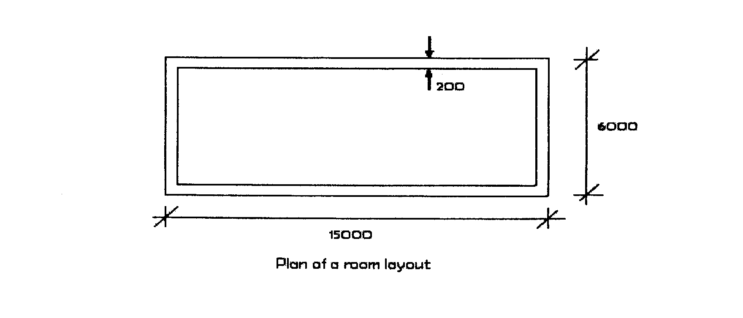
The length can be calculated by determining:
The total internal length of the wall
The total external length of the wall
The center line length of the wall

Slide 6
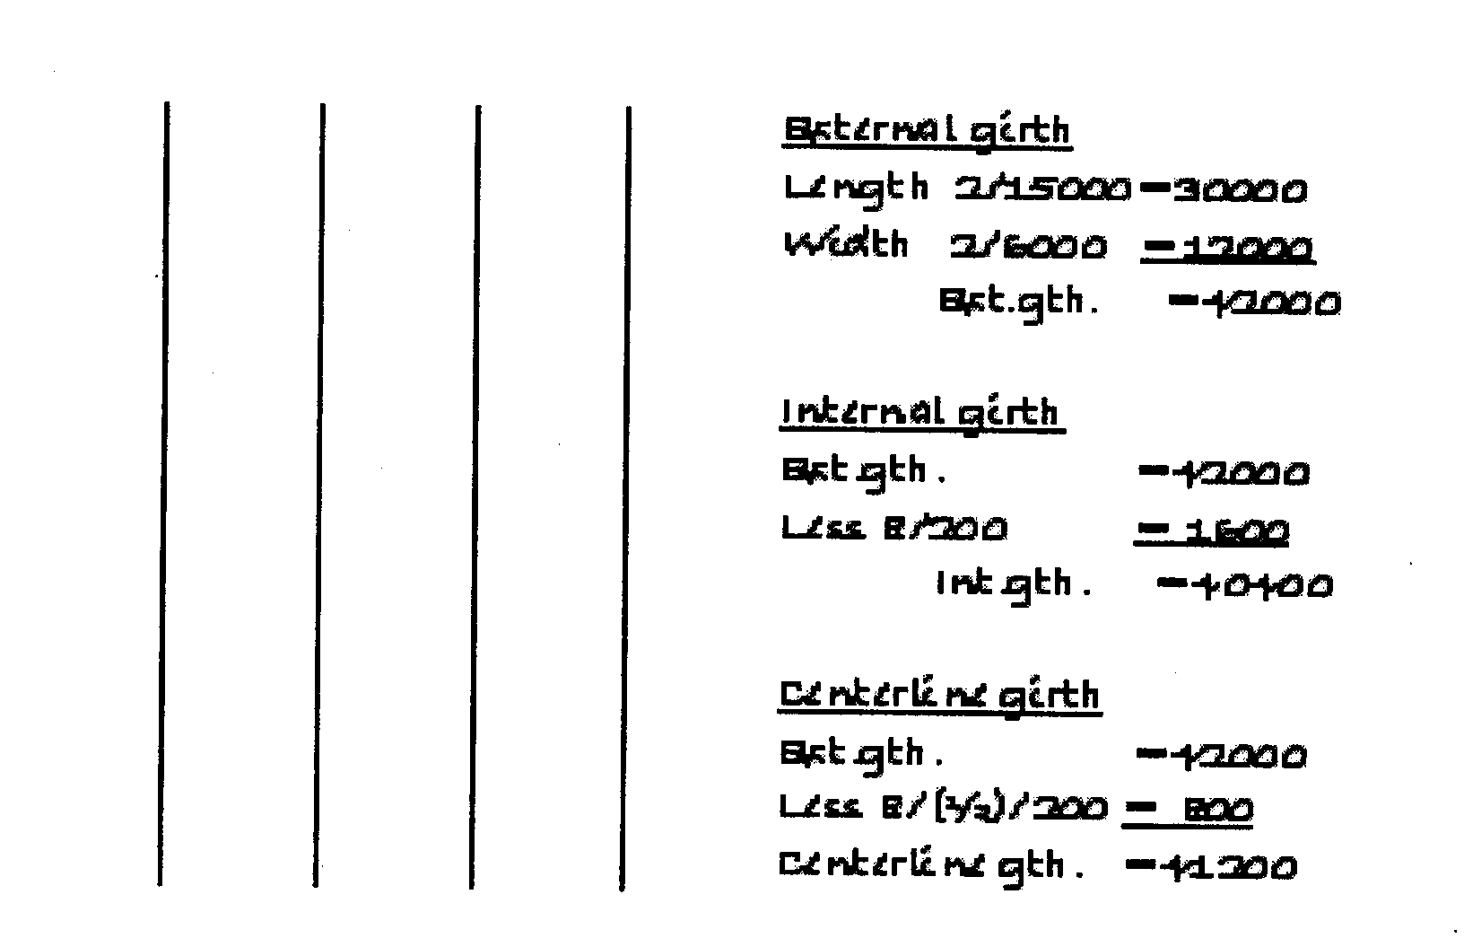
Determine the internal, external and centerline girths for the room plan shown below.

Slide 7
2.3 Basic principles of taking off
Drawings shall be fully understood clearly and detailed.
During discrepancies in detailing, dimensioning or if missing items exist obtain clarification from the designer.
The BoQ shall accurately represent the works to be executed.
Works, which cannot be measured accurately, shall be expressed as provisional quantity (PQ) and will result in provisional sum (PS) and lump sum (LS)
Prepared in such a way that discrepancies or mistakes in taking off will not result in excessive variation in the project cost which directly affect the budget allocation for the project.

Slide 8
With the understanding that measurements are taken to the nearest cm.
Built items shall generally include all possible entrants which will make labor, materials (including storing, loading, unloading and handling), fixing, use of plant and equipment, wastage of materials, equipment establishing charges and profit; otherwise it shall be stated specifically.

Slide 9
With the understanding that there is a standard paper format to carry out measurements of civil works, namely take off sheet or dimension paper, bending schedule and specification worksheet.
Prior knowledge of the regulations is necessary (For e.g. roofing is measured in horizontal projection).
Measurements of civil works shall be carried out in such a way that it can be easily checked and audited.

Slide 10
Specification worksheet (BOQ format)
This is a complete list of all items of work involved in connection with the estimate for a project with the description, quantity and unit of rate against each item of work.
It is the format which is used in a bill of quantity to list (include) a short description of the specification along with its measuring unit, quantity and unit prices to determine the total cost for each trade of item.
Project
Item | Description | Unit | Quantity | Unit price | Total price

Slide 11
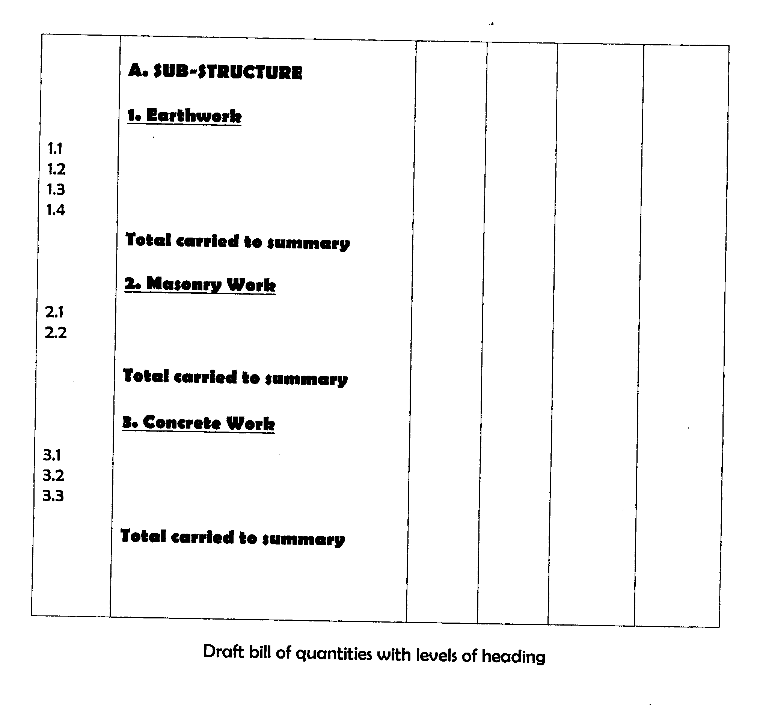

Slide 12
There are four clearly defined steps in preparation of Bill of Quantities:
Taking off
Squaring
Abstracting
Writing the final Bill

Slide 13
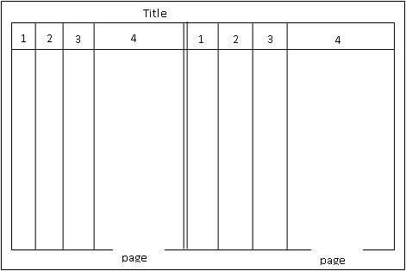
1. Taking off
This is the process of preparing / defining a detailed list of all labor and materials necessary for the work and entering the items on properly dimensioned paper.

Slide 14
Column 1 is used for stating the number of times an item occurs and is called the timising column.
Column 2 is called dimension column as it is used to enter the dimensions of the items of works. the dimensions are entered in the order indicated below.
Length
width
height or thickness
Column 3 is called squaring column, where as
Column 4 is called description column.

Slide 15
2. Squaring:
The dimensions entered in column2 are squared or cubed as the case may be, multiplied by the timizing factor, and the result entered in column3
3. Abstracting:
The squared dimensions are transferred to abstract sheets and all similar dimensions are collected in the same category to obtain the total quantity of each item.
4. Writing the Final Bill
After the abstract sheets have been completed and checked, the final bill of quantity is written.

Slide 16
Bending(Bar) Schedule: the format used to define quantity of reinforcement bars.

Slide 17
2.4 Types Of Taking Off
There are various methods of taking off quantities for computation of girth.
Centre line method –suitable only when the cross sections of all walls are symmetrical. In this method centre line length is found and same is used for taking off quantities (therefore only width and depth vary).
Crossing method – lengths and breadths of walls as shown in plan are taken for working out various items and this method is useful only if the offsets of footings are symmetrical.
In- to- in and out- to-out method –some wall lengths are taken out to out and others in to in (offsets are added to out to out lengths) and same are deducted from in -to-in lengths; used for any type of measurement irrespective of condition of symmetry.

Slide 18
Chapter 3
Technical Spec. and Method of Measurements for the diff. trade of Works
3.1. Building Project
I. SUB STRUCTURE
Any structure below the ground floor slab level including the basement, retaining walls, ground slab, grade beam, and foundation is called a substructure. substructure work categorized as follows:
1. Excavation and earthworks
2. Concrete works
3. Masonry works

Slide 19
1. Excavation and Earthworks
A) Site clearance:
Removal of materials (including trees, bushes and the top 20 to 30 cm soil), any other obstruction from the site.
A working space of 1m is required on each side.
Clearing site vegetation is measured in m² and embraces bushes, scrub, undergrowth trees .
Removal of trees is measured as enumerated item

Slide 20
B) Excavation (bulk excavation)
Excavation to get reduced levels of every structural element below the ground level is called bulk excavation.
Working space for bulk excavation is 25 cm (not used for shallow masonry)
Depth of excavation less than 30 cm – measured per m² ,depth > 30 cm per m³
Ordinary soil - with boulders and without boulders
can easily be removed by shovel without problem.
Weathered rock –it can be divided easily without blasting
Rock- bedded rocks that cannot be dug without blasting (requires using

Slide 21
C) Deep Excavation
It is the actual excavation for the foundation and is measured in m³.
D) Fill / Embankment
Shall be measured in m3 of net volume to be filled. Fill is required because the reduced level of every structural element above the structure has to be covered. The subdivisions under fill are:
Back fill: - filling by using the excavated soil but by removing coarse particles.
Borrow fill: - filling by using fill material from another place when there is shortage of fill or when better quality material is required.
E) Disposal - cleaning the building area including cart away. measured with m³

Slide 22
2. Concrete Works
Cast in situ concrete – formed on site
-Requires formwork and reinforcement
Prefabricated concrete –fabricated (manufactured) in a factory and brought to the site
- Joined to make a building
- Does not require formwork
- Needs a special care when connecting the different elements
Fast to construct a building, though the different elements may lack homogeneity.
Pretension (Post tensioned) Concrete
- Bending up the concrete itself to make it ready for the downward.

Slide 23
2. Concrete Works
Concrete ancillaries- windowsills, lintels, expansion joints
- permanent and temporary embedded material
- measured in ml or enumerated
Testing of concrete – destructive and non destructive tests
- Cylindrical/ cubical compressive tests to check the grade of the concrete.
- Slump test
- Structural tests (e.g. Non-destructive test)
- Ingredient Material test

Slide 24
2. Concrete Works
Grades of Concrete
C5 - lean concrete, measured with m²
C15- for totally supported structural elements 1:2:5
C20- used for slabs; mix proportion is 1:2:4
C25- Commonly used structural Concrete; mix proportion is 1:2:3
C30-Used for chemical stores and nuclear plants

Slide 25
B) Formwork
A temporary structural element, which supports slabs, beams in casting concrete.
– measured in m²
Period of removal (minimum):
1. Vertical formwork to columns, walls and beams: 16 hrs
2. Soffits formwork to slab: 21 days
3. props to cantilever slabs: 14 days
4. Soffits formwork to beams: 21 days
5. Props to cantilever beams: 14 days

Slide 26
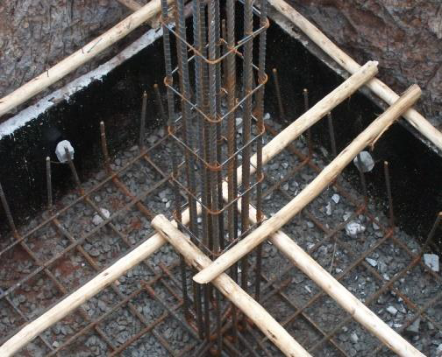
C) Reinforcement
The reinforcement bars are tied by 1.6 mm mild steel wire and measured in kg.
A temporary structural element, which supports slabs, beams in casting concrete.

Slide 27
3. Masonry Works
Stone for below ground work shall be chiseled from natural stone.
Stone wall is measured by volume, whereas stone pavement is measured by area, specifying thickness
Stone obtained from quarries shall be hard and sound, free from vents, cracks, fishers, discoloration or other defects that will adversely affect strength or appearance.
Stone chips to be produced shall not be less than 450 mm average and 380 mm in individual length.

Slide 28
II. Superstructure
1. Concrete works
a. Concrete - as discussed in substructure part
b. Formwork: Specify the type of material used and where to use (zigba or steel) – m2
c. Reinforcement: Weight per unit length for Ф6 is 0.222 kg/m; for any other diameter d2, with weight per unit length w2
w2 = (d2* d2 /162)

Slide 29
2. Masonry works:
a) Stone masonry:-Measured by volume
b) Hollow and solid concrete blocks, measured by area specifying the thickness.
The standard thicknesses of HCBs are 10cm, 15cm, and 20cm.
There are different classes of HCBs
Class A = 42 kg/ cm2 (for light loads)
Class B =35 kg /cm2 (for external walls)
Class C =20 kg/cm2 (for partition walls)
Class AA=70 kg/cm2 (for load bearing sub structural works)
Class A-AA= 50 kg/cm2 (for load bearing super structural works)
Class AA and A-AA shall be obtained from 0.1 aggregate not from pumice or red ash

Slide 30
2. Masonry works:
The standard thicknesses of HCBs are 10cm, 15cm, and 20cm.
c) Bricks masonry: measured by area specifying the thickness.
Bricks are fire resistant, watertight and can also resist compressive action of up to 200 kPa
The thicknesses of brick masonry are 25 cm (for double layer) and 12 cm (for single layer)
Adobe walls
It is a mixture of clay, water and ‘chid’ with high resistance to drying shrinkage and cracking

Slide 31
2. Masonry works:
Building mortar (binding material)
Ingredients of mortar are:-
Cement: - usually Portland cement
Sand: - crushed or river sand with diameter less than 4.75 mm
Lime: -hydrated lime
The mix proportions are
a) Stone masonry: -1:3 mix
b) Brick and block masonry: -1:4 mix
c) Compo mortar (lime): -1:2:9 mix

Slide 33
3. Measurement of Roof Structure
Galvanized corrugated iron sheet (CIS)
CIS less than G32 cannot be used for roofing and wall cladding of permanent structures but for temporary works e.g. fence works, for provisional works
G26 G28 G30 G32 and G35 G26 is the thickest
Galvanized plain steel sheet (GPSS)
GPSS is used for wall cladding, ridge cup, gutter, down pipes, flashing, copping, edge trimmers etc; shall be to the size, thickness and galvanization required; shall not be less 21 than G28; G24 is usually used for gutter, down pipes; Overlaps at edges shall be minimum 15 cm

Slide 34
3. Measurement of Roof Structure
Aluminum corrugated sheet for roofing and cladding
The minimum thickness shall be 24 SWG (SWG = standard wire gauge)
Roof clay tiles
Tiles shall be manufactured in wet weather and prepared from clay.
Clay tiles shall show clean fracture when broken and shall not be less than 10 mm thick
Clay tiles shall be fixed to timber using roof, nails, the holes in clays shall be pierced (using embedded in clay tiles)
Gutter and down pipe
Gutters shall be laid to slopes not less than 0.05 percent
Gutter and down pipes shall be overlapped min 15 cm and joints welded Roof clay tiles

Slide 35
3. Measurement of Carpentry and joinery works
Carpentry: -work on timber intended for structural purposes e.g. columns, beams, slab,
truss etc
Joinery: - work on timber intended for finishing purposes e.g. floor finishes, wall claddings, doors and windows, ceilings etc

Slide 36
3. Measurement of Roof Structure
Roof cover, side cladding, and the like shall be measured by area (m2 ), flat over the projection area without addition for slopes and laps.
Ridges, flashing, down pipes etc shall be measured by length stating girth (development length) and without addition for laps, passing angles etc.
Fittings, such as running outlets, stopped ends, offsets and connecting shoes, are enumerated and measured extra over the pipe or gutter on which they occur.

Slide 37
III. Measurement of Finishing's
The term Finishing includes operations associated with the completion of the floors, walls and ceilings of a building. These are screeding, plastering, wall and floor tiling, wallpapering and painting.
Plastering and pointing works
The ingredients are:
- Cement (ordinary Portland cement), Lime
- Gypsum (such as plaster of Paris )
- Aggregate (fine or crushed aggregates), water
Surfaces to receive plaster, pointing or screed shall be thoroughly cleaned and wetted
If the thickness of plastering is greater than 2.5cm, it may crack)

Slide 38
III. Measurement of Finishing's
First coat: - mix proportion 1:2.5(cement: aggregate by volume)
- minimum thickness of 5 mm
spread by trowel , stretched off level and allowed to cure for 24 hours before applying the second coat
Second coat: - mix proportion 1:1:6 (cement: lime: aggregate by volume)
- 1: 4 (cement: aggregate by volume)
- max thickness of 12 mm
- dried for 21 days
Fine finish or fine coat cement plaster
- mix proportion 1:2 (cement +fine sand )
- max thickness of 3 mm
- shall be finished truly and level
- We use fine sand for smooth finish as final coat

Slide 39
III. Measurement of Finishing's
Cement pointing
- mix proportion 1:2 (cement :fine aggregate)
- can be flush or recess pointing
Flush pointing: finished level and even to the wall
Recess pointing: depth not less than 5mm
Pointed surface shall be cement dusted or cement pasted to form smooth surface and wetted for seven days
Method of measurement
plaster and pointing works shall be measured by area.
Internal and external works shall be measured separately

Slide 40
III. Measurement of Finishing's
Floor and wall finish
Terrazzo tiles: -used for floor finish and skirting
- shall be precast or cast in situ elements
- shall have a minimum topping of two parts of marble or granite chipping from an approved quality with one part cement
- the minimum grading of the chip shall be 5mm
- usually have a thickness of 2 cm
- shall be applied onto 3 cm thick cement screed bedding (specified thickness )
Precast cement tiles
- produced from crushed aggregates (0.1 mm gravel) and sand mix
- minimum thickness shall be 20mm
- cheaper than terrazzo tile

Slide 41
III. Measurement of Finishing's
Ceramic and mosaic tiles
- shall be glazed type of approved color , texture and size
- shall be 6mm thick for walls and not less than 15mm for floors
- mosaic tiles shall be in regular square or hexagonal sizes not exceeding 25mm in dimension of each size
PVC tiles
- usually thermoplastic
- the tiles and skirting shall be resistant to household oil and acids
- the glue (adhesive ) for fixing PVC tiles and skirting shall be in accordance with manufacturer’s instruction
- usually 2mm thick PVC tiles and 48 mm cement screed is used

Slide 42
III. Measurement of Finishing's
GLAZING
- glazing shall be measured by area
- glazing to louvers and special fixing may be enumerated by stating size and thickness
- shall be understood as included: -Bedding, mastic, fixing, beading, cleaning etc.
PAINTING WORKS
Painting shall be measured by area
- Special application to edges shall be measured in length stating the girth
- Internal and external surfaces shall be measured separately
Shall be understood as included:-
- Trimming, cutting, matching patterns, cleaning, priming

Slide 43
General rules of measurement
Work to attached beams is included with ceiling finishes, whilst work to attached columns is included with wall finishes.
Finishes to isolated beams and columns must be given separately as should work in staircase.
The principal unit of measurement for wall, floor and ceiling finishes is m². Where the width does not exceed 300 mm the unit of measurement is linear.

Slide 44
IV. Measurement of Plumbing Installation
Plumbing installations in domestic buildings involve a number of different systems associated by the supply, distribution and disposal of water within and out of a building ­above the ground and below the ground.
Pipe work: Pipes are measured in linear meters over all fittings and branches, stating the type, nominal size and the method of jointing and fixing.
Fittings are enumerated and measured as extra-over the pipe work on which they occur

Slide 45
Sanitary Appliances: This includes washbasins, urinals, baths, shower trays and sinks.
These appliances are enumerated giving details in the description of their type, size, capacity and method of fixing

Slide 46
Order of Measurement
1. Connection to water authority's main and all work up to boundary of site
2. Underground service and rising main from site boundary up to cold-water storage tank
3. Branches to rising main
4. Cold water storage tank and associated Work
5. Down services with branches
6. Sanitary appliances such as sinks, wash basins, baths and water closets.
7. Discharge pipes - waste, soil and vent pipes.
8. Any other work connected with the plumbing installation

Slide 47
THANK YOU!!!

