Slide 1
CHAPTER 6 Introduction to Resource Management

Slide 2
Objectives
To clearly identify resource used in construction industry.
To explain ideas behind optimization clearly.
Get a broad picture of the various applications of optimization methods.
Introduction

Slide 3
Introduction
The construction industry exists in an environment that is both economically and technologically dynamic.
Time, money, and resource constraints, coupled with the high market competition have forced many construction firms to focus more closely on their operations.

Slide 4
Introduction
Resource Definition
Resource is any thing that can be used to satisfy construction needs.
Types of Resource

Slide 5
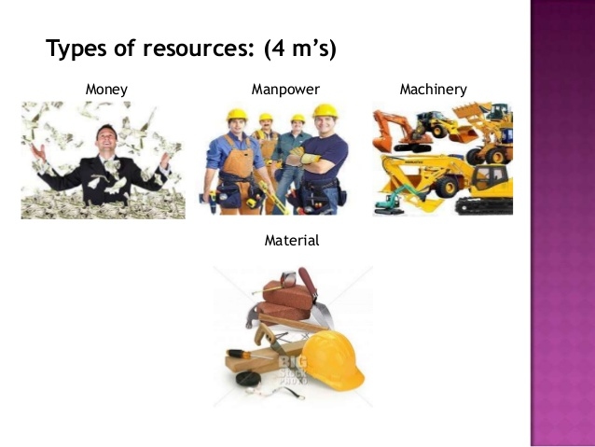
Introduction

Slide 6
Introduction
Optimization : The act of obtaining the best result under the given circumstances.
Design, construction and maintenance of engineering systems involve decision making both at the managerial and the technological level
Goals of such decisions :
to minimize the effort required or
to maximize the desired benefit

Slide 7
Introduction (contd.)
Optimization : Defined as the process of finding the conditions that give the minimum or maximum value of a function, where the function represents the effort required or the desired benefit.

Slide 8
Introduction (contd.)
Resource optimization is the set of processes and methods to match the available resources (human, machinery, financial) with the needs of the organization in order to achieve established goals.

Slide 9
applications of optimization.
Design of structural units in construction, machinery, and in space vehicles.
Maximizing benefit/minimizing product costs in various manufacturing and construction processes.
Optimal path finding in road networks/freight handling processes.
Optimal production planning, controlling and scheduling.
Optimal Allocation of resources or services among several activities to maximize the benefit.
Transportation problem
Agricultural applications
Military applications

Slide 10
Art of Modeling : Model Building
Development of an optimization model can be divided into five major phases.
Collection of data
Problem definition and formulation
Model development
Model validation and evaluation or performance
Model application and interpretation of results

Slide 11
Data collection
Data collection
may be time consuming but is the fundamental basis of the model-building process
extremely important phase of the model-building process
the availability and accuracy of data can have considerable effect on the accuracy of the model and on the ability to evaluate the model.

Slide 12
Problem Definition
Problem definition and formulation, steps involved:
identification of the decision variables;
formulation of the model objective(s);
the formulation of the model constraints.
In performing these steps one must consider the following.
Identify the important elements that the problem consists of.
Determine the number of independent variables, the number of equations required to describe the system, and the number of unknown parameters.

Slide 13
Model development
Model development includes:
the mathematical description,
parameter estimation,
input development, and
software development
The model development phase is an iterative process that may require returning to the model definition and formulation phase.

Slide 14
Model Validation and Evaluation
This phase is checking the model as a whole.
Model validation consists of validation of the assumptions and parameters of the model.
Sensitivity analysis to test the model inputs and parameters.
This phase also is an iterative process and may require returning to the model definition and formulation phase.
One important aspect of this process is that in most cases data used in the formulation process should be different from that used in validation.

Slide 15
Modeling Techniques
Different modeling techniques are developed to meet the requirement of different type of optimization problems. Major categories of modeling approaches are:
classical optimization techniques,
linear programming,
nonlinear programming,
geometric programming,
dynamic programming,
integer programming,
stochastic programming,
evolutionary algorithms, etc.
Linear programming will be discussed in the subsequent lectures.

