Slide 1
COTM 4504: CONTRACT ADMINISTRATION
CHAPTER 1
Procurement/ Tender

Slide 2
General Overview
Construction Industry is an industry which is involved in the planning, building, execution and evaluation of all types of civil works.
Construction projects can be broadly classified as:
  Building Construction (includes facilities for habitation, institutional , educational, light industrial (e.g. warehouse), commercial, social and recreational purposes),
  Engineered Construction (includes highway and heavy (e.g. dams, sewage plant) construction), and
  Industrial Construction
CI is among the leading industry in producing employment and contribute to the overall national development.

Slide 3





Cont…
The main players in the construction industry are:
    The Client:
    The Consultant:
    The Contractor:
    Insurance Companies:
    Banks:
    Suppliers:
    Permitting Agencies:
    Public:

Slide 4
















Too Many Participants
Job Supervisors
Subs
Corporate Management
Owners
Field Labor
RE Agents
Suppliers
Design
Center
Sales & Marketing
Manufacturers
Accounting
Banks & Mortgage Lendors
Scheduling
Local Municipalities
Purchasing
Estimating

Slide 5

Ethiopian Construction
Roads Projects ( More 43 Billion Birr in 5 yrs)
  Many road projects under the federal & regional state Road authorities.
  Light weight railway project
Hydropower projects
  Great renascence dam
  Tekeze
  Gilgel Gibe I. II, and III
Buildings projects
  Housing projects at federal & regional state level ( 400,000 houses ( 16 B. Birr)
  The 31 universities.
  Many health centers.

Slide 6

Procurement
Outline
  1.Procurement
  1.1. What is Procurement?
  1.2. Contract/project delivery system
  1.3. Stages of Civil Engineering projects
  1.4. Bid preparation
  1.5. Bid evaluation
  1.6. Selection of bidders
  1.7. Statistical approach in tendering

Slide 7
1.PROCUREMENT
1.1What is Procurement?
1.1.1 Procurement
  Procurement is the acquisition of appropriate goods, works and or services at the best possible total cost of ownership to meet the needs of the purchaser in terms of quality, quantity ,time ,and location.
  The complete action or process of acquiring or obtaining personnel ,material ,services ,or property by means authorized in pertinent directives.
  Corporations and public bodies often define processes intended to promote fair and open competition for their business while minimizing exposure to fraud and collusion.

Slide 8
Cont…
In short , Procurement is Obtaining goods , works ,consultancy or other services through purchasing , hiring or obtaining by any other contractual means.
Tendering/Bidding : is a stage in the procurement process extending from advertisement (invitation to bid) up to signing of contract.
Tender/Bid is an offer which incorporates: the sum of money , time and other conditions required to carry out the contract obligations in order to complete a project or apart of it consisting of specified works.
When signed and submitted the Bid/Tender creates a legally binding and valid offer.

Slide 9
1.1.2 What is to be Procured?
Consultancy Services : a service of an intellectual and advisory nature provided by consultants using their professional skills to study , design and organize specific projects ,advice clients ,conduct training and transfer knowledge.
Services : mean any object of procurement not related to professional skills other than works ,good sand consultancy services ; such as transportation ,printing and duplicating books , maintenance , security , electricity , telecommunication and water supply services.

Slide 10
  1.2 Contract/Project Delivery Methods
Contract/project delivery system is the way Project Owners together with Project Regulators and Financiers determine the assignment of responsibilities to Project Stakeholders along the Construction Process.
It is often determined during the basic planning phase of the construction project.
Delivery systems are basically classified into two broad areas:
  Force Account,
  Outsourced.

Slide 11
  1.2.1 Force Account
Definition
Work ordered on a construction project without an existing agreement on its cost and performed with the understanding that the contractor will bill the owner according to the cost of labor, materials, and equipment, plus a certain percentage for overhead and profit .
When the project owners engage them selves to undertake the project ,it is called a force account delivery system.
Such a system is often promoted if the Project Owners believe that there is a comparative advantage in quality ,cost and time.

Slide 12
  1.2.2 Outsourced delivery systems
Most of the project delivery methods/systems are found under the category of out sourcing.
The criteria for such category are based on: segmentation , integration and financing.
  Segmented Delivery Methods
      Design-Bid-Build(DBB);
      Design-Build(DB);
      Construction Management(CM);
      Pure Operation sand Maintenance (O&M)

Slide 13
Cont…
  3. Integrated Process Delivery Methods
      Design-Build-Operate;
      Design-Build-Operate-Maintain;
      Design-Build-Finance-Operate;
  2. External Financing Methods
      Design-Build-Finance-Operate;
      Build-Own-Operate;
      Build-Own-Operate-Transfer;

Slide 14
  1.2.2 Outsourced delivery systems
  A.Segmented Delivery Methods
A . Design-Bid-Build , DBB ( Traditional Method )
  After Project Owners did prepare the Basic Planning that identifies construction project programs , they call upon the participation of Design and/or Supervision Consultants.
  This Consultant will carry out the design together with the necessary tender documents which will be the basis for tendering to select Contractors.

Slide 15
Cont..
For many years ,DBB has been the most common method of project delivery for public projects ,and form any private projects as well.
DBB is effective on projects
  Where the owner needs both professional design services and construction services.
  Where the designer does not require detailed knowledge of the means and methods of construction.
DBB provides the owner with a high degree of control.

Slide 16
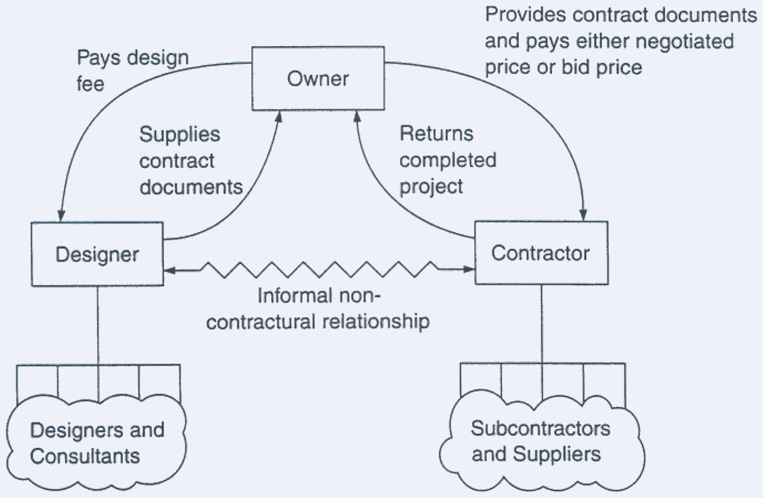
Cont…
(Two Separate Contracts for Design & Construction)

Slide 17
Cont…
Disadvantages:
  Innovation not optimized;
  Usually cost overruns;
  Disputes between parties;
  Client retains risks;
  Usually low bid-incentive for change orders;
  Owner responsible for errors and omissions.
Advantages:
  Applicable to a wide range of projects,
  Well established and easily understood,
  Clearly defined roles for all parties,
  Provides the lowest initial price that competitive bidders can offer,
  Extensive litigation has resulted in well established legal precedents,
  Insurance and bonding are well defined.

Slide 18
B. Design- Bid , DB (Turnkey)
Design Build or Turnkey , in principle , reduces numbers of procurement processes engaged in the fragmented process and employ only one procurement process and a single design build contractor to provide the entire Construction Implementation Process (design and construction ).
The design builder performs design and construction according to design parameters , performance criteria and other requirements established by the employer or his representative.
In this arrangement both the design and construction liability rests with the Contractor

Slide 19
Cont…
Advantages.
    Single source responsibility both for design & construction;
    Integrating design & construction;
    Reduction in administration;
    Innovation;
    Cost savings;
    Construct ability optimized;
    Most risks transferred to the design-builder;
    Design reflects.

Slide 20
C. Construction Management , CM
Under CM the Owner contracts separately , but some what simultaneously , with a design consultant and with a firm whose primary expertise is construction ( the Construction Manager).
The owner procures the management services of the Construction Manager (in most cases a general contracting construction firm) early in the design phase.
Types of CM delivery system:
  CM at Free : as agent,
  CM at Risk : as a constructor.

Slide 21
Advantages may include
CM At Free
  Provides a managing & administering services for all phases of a project;
  Treats planning, design, construction as an integrated tasks;
  Some costs & schedule control;
CM At Risk
  Good for clients with insufficient staff;
  Responsible for time & cost overrun;
  Holds & manages the trade contractors;
  Constructability design review;
  Works closely as a teaming effort & encouraging partnering & trust;

Slide 22
Disadvantages may include
CM At Free
  No contractual relationship with trade contractors;
  No contractual responsibility for outcomes of a project;
  Client retains the risks;
CM At Risk
  Duplication of administration & additional paperwork;
    More paper work for the client;
    Some duplication of administration;
  Fast tracking difficult to control with designer & CM;
  Sometimes difficult to manage all phased packages with costs, changes & schedules;

Slide 23
D. Design-Build-Operate , DBO
According to FIDIC , the DBO approach to contracting combines design , construction , and long term (ex.20 years) operation (and maintenance) of a facility in to one single contract awarded to a single contract or (who will usually be a joint venture or consortium representing all the skills for in a DBO arrangement).
The advantages are categorized in terms of :
  time ,
  finance and quality.

Slide 24
Cont…
Time
  With possibilities to overlap some design & build activities it will be possible to minimize delays & optimize the smooth flow of construction activities.
Finance
  With cost restraints & commitments & other risks being carried by the contractor, there is less risk of price over-run.
Quality
  With the contractor responsible for 20 years operation, he has an interest to design & build quality plant with low operation & maintenance costs.
  Not only will then plant be “fit for purpose” but it will be “built to last”.
The FIDIC has now prepared conditions of contract which facilitate the D-B-O process.

Slide 25
E. Build-Operate-Transfer , BOT
BOT is a form of procurement and contract delivery system that promotes Public Private Partnership (PPP) in which a private company is contracted to finance , design , construct , operate for a certain period (usually 10 years) and transfer the facility to the Project Owner.
The typical BOT project contract is the process where by a government grants a concession to a project development company to develop and operate what would normally be a public sector project , for a given period of time known as the concession period.
BOT project involves a potentially complex contractual structure.

Slide 26

G. Delivery systems based on Financing method
Design-build-operate-transfer ; DBOT
Design-build-operate-maintain ; DBOM
Design-build-own-operate-transfer ;DBOOT

Slide 27
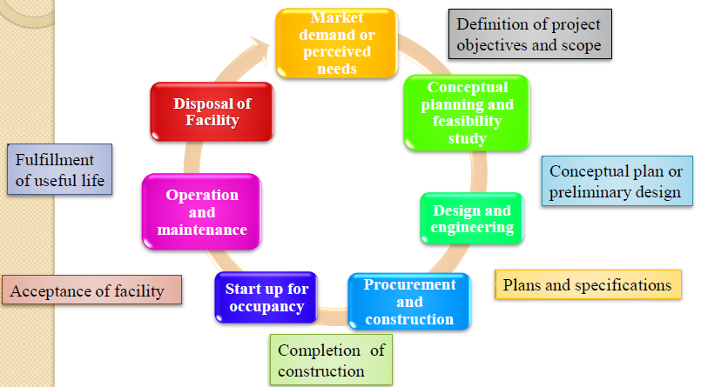
1.3.Stages of Civil Engineering Projects
The project life cycle of a construction project may be viewed as a process through which a project is implemented from cradle to grave.

Slide 28
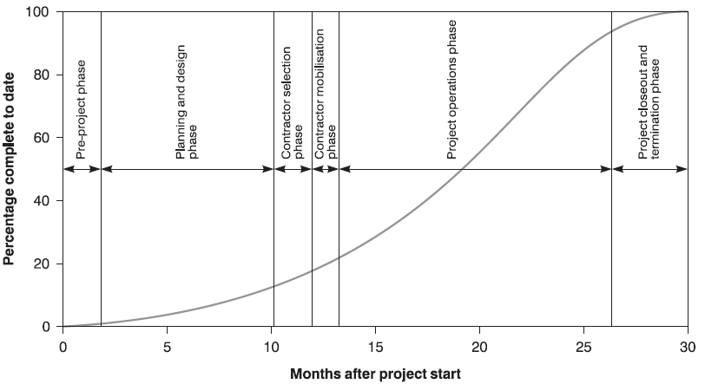
Cont…
The major stages in construction projects encompass:
  Pre-design stage
  Design stage
  Processing construction bids stage
  Construction stage
  Completion and handover (contract closeout)

Slide 29

1.3.1 Pre-design stage
It encompasses the following major activities:
  Carry out feasibility study,
  Selection of suitable site,
  Preparation of tentative cost estimates,
  Making topography of the site,
  Preliminary sub-surface investigation.

Slide 30
1.3.2 Design stage
It encompasses the preparation of:
        Concept design,
        Preliminary design,
        Final design,
        Engineer’s cost estimate,
        Bid documents,
        Drawing sand design reports.

Slide 31

1.3.3 Tender/ Bid stage.
What is Tender?
    Tender is an offer which incorporates the sum of money, time and other conditions required to carry out the contract obligations in order to complete a project or a part of it consisting of specified works .
    Will be started after the design complete and project budget must be approved .
client contractor
client consultant
main contractor sub-contractor

Slide 32


Difference between a contract and a tender
A tender formally means an invitation to trade under the terms of offer.
A contract is the term used for when the parties have reached agreement.

Slide 33
Cont…
The following activities need attention during processing of construction bids.
A . Bid documents and related issues:
  Preparation of bid documents
  Clarity of bid documents,
  Validity of bid security,
  Amendment of bid document (if any),
  Site visit ,
  Performance Security etc.

Slide 34
Cont…
B . Bid processing and award of contract:
  Determination of project category (possible procurement method),
      Competitive bidding (ICB,NCB),
      Limited/restricted bidding( ICB,NCB),
      Direct contracting (appointment/ negotiated contract)
      Force account
  Announcement of invitation for pre-qualification,
    Public bid opening,
    Bid evaluation and award process,
      Preliminary examination of bids.
      Evaluating bids.
      Propose award.
      Bid evaluation report.
      Contract award.
    Rejection of all bids,
    Preparation of contract document,
    Signing of contract.

Slide 35
1.3.4 Construction stage
Construction stage is the critical phase since the result of all prior planning , design and the total pre-construction decisions are brought to fruition.
The success of this stage mainly depends on the relation and strength of the construction team (main stake holders).
The main activities in construction phase are construction supervision and contract administration.
I . Construction supervision :
  Site control,
  Quality control,
  Quantity control,
  Monthly and quarterly progress evaluation meetings.

Slide 36
Cont…
ii. Contract administration:
  It covers the major activities of addressing changes , payments ,claims etc.
  It will be dealt with in detail under chapter2

Slide 37
1.3.5 Contract closeout stage
Transition from design and construction to the actual use of the constructed facility.
The management team must provide documentation , shop drawings , as built drawings , and operation manuals to the owner organization.
Assessment of the project team’s performance is crucial in this stage for a voiding mistakes in the future.
Actual activity costs and durations should be recorded and compared with that was planned.

Slide 38
1.4 Bid Preparation
1.4.1 Preparation of Bid Documents
The Bidding document shall in corporate all in formation necessary for prospective bidders to prepare their bids.
The detail and complexity of bid documents may vary with the size and nature of the proposed bid package and contract.
The consultant hired for the job/the client prepares all the design and tender document which includes Legal & Technical section .

Slide 39
Cont…
A) Legal section
  Invitation to bidders
  Instruction to bidders
  Conditions of contract
    GCC & SCC
  Tender forms
    Form of tender
    Appendix to form of tender
    Certificate of tender visit to site
    Form of tender security(bank grantee)
    Form of agreement
    Form of performance bank grantee
    Form of grantee for advance payment
  Schedule of Supplementary information
B) Technical section
  The contract drawings
  The specification
  The bill of quantities
  The bill of schedule
  Soil investigation reports
  Addenda

Slide 40
Cont…
Bid documents for works include:
  Bidding information,
  Contractual information.
Contractors are responsible for all duties , taxes and other levies ; hence , bidders shall take these factors into consideration in preparing their bids.

Slide 41
Cont…
Bidding Information
  It’s part of a tender document , where bidders are required to respond ( provide their offer , data , information) in accordance with the requirement of the documents within the bidding period.
Bidding Information Comprises:
    Invitation for bid(IFB),
    Instruction to bidders (ITB),
    Bid Data Sheet (BDS),
    Bid forms including BOQ,
    Addenda(Bid Amendment).

Slide 42
Cont..
B. Contractual Information:
  Documents included in the tender document to furnish bidders with full and detailed information of the project for application after winning the contract.
  The bidder should utilize such information to provide a fair and reasonable offer to the bidding document.
Contractual Information Comprises :
    Agreement form (Contract Agreement),
    Standard (General) Conditions of contract,
    particular or special conditions of contract,
    Technical specifications and Methods of measurement,
    Drawings,
    Appendix to Contract Agreement.

Slide 43
1.4.2 Invitation to bidders
This is a document that describes ,
  The name of the projects
  Its locations
  The principal elements of the work to be done
  The sources of finance
  Where & when to obtain the tender documents and the return address and date
  Amount of bid security
  Date of site visit and,
  Pre-bid meeting etc

Slide 44
Sample Form of Tender
Date: [insert date]
Procurement Ref. No.: [insert tender reference no]
Page [insert page no] of [insert total n0 of pages] pages
To: [insert complete name of Employer]
We, the undersigned, declare that:
We have examined and have no reservations to the Bidding Documents, including Addenda No.: [insert the number and issuing date of each Addenda];
We offer to execute the [insert the name & procurement ref. no of the Contract] in conformity with the Bidding Documents for the Contract Price of [insert amount in no & words] Ethiopian Birr, excluding any discounts offered below;
The advance payment required is …..…. Ethiopian Birr:
The discounts offered & the methodology for their application are: …………………
Our bid shall be valid for a period of [specify the no of days that the bid is valid for] calendar days from the date fixed for the bid submission deadline in accordance with the ITB, & it shall remain binding upon us & may be accepted at any time before the expiration of that period;
We, including any subcontractors / suppliers for any part of the contract, have nationality from the following eligible countries: [insert the nationality of the Bidder, including that of all parties that comprise the Bidder, if the Bidder is a JV, and the nationality of each subcontractor and supplier]
We have no conflict of interest in accordance with the ITB;
Our firm, its affiliates or subsidiaries - including any subcontractors / suppliers for any part of the contract - has not been debarred from participation in public procurement by the Government of the FDRE, in accordance with the ITB ;
We have read & understood the provisions on fraud and corruption in the ITB and we undertake to abide by the Code of Ethical Conduct for Bidders during the procurement process and the execution of any resulting contract;
We understand that this bid, together with your written acceptance thereof included in your notification of award, shall constitute a binding contract between us, until a formal contract is prepared and executed.
We understand that you are not bound to accept the lowest evaluated bid or any other bid that you may receive.
We accept / do not accept the appointment of [insert name of ……. proposed in the BDS] as the ………... and propose instead that [insert name] be appointed as ……. Whose fees and biographical data are attached.
Signed: [insert signature]
In the capacity of [insert legal capacity of person signing the Bid]
Name: [insert complete name of person signing the Bid]
Duly authorized to sign the bid for and on behalf of: [insert complete name of Bidder]
Dated on ____ day of _________ , _____ [insert date of signing]

Slide 45
1.4.3 Time for Preparation of Bids
Time for preparation and submission of bids depend on the particular circumstances of the project ,magnitude and complexity of the contract.
The time to be all owed for the first call is 30 calendar days to enable prospective bidders to conduct investigations before submitting their bids.
In some cases the employer is encouraged to convene a pre-bid meeting and arrange site visits.
Concise instructions as to the time , date and place for submission of tenders should be given.

Slide 46
Instruction to bidders
The instruction to bidders contains information which is relevant to the tender
Preparations such as,
  A brief description of the works and its location,
  Validity of tenders
  Tender security
    Amount and types of currency as well as bank form
  Ruling language of the contract documents
  Site visit dates
    The employer arranges site visit to acquaint with the prevailing site conditions
  Pre-bid meeting
    After site visit pre bid conference will be arranged by the employer to answer question raise by the tenders
  Dead line of submission of tenders
  PPA SBD\Wks-SBD-ICB-Section 1.doc
  PPA SBD\Wks-SBD-ICB-Section 2.doc

Slide 47
1.4.4 Submission of tender
The employer will distribute a blank forms that will be filled by the bidders
All bids should be submitted in a sealed envelope marked on the outside with the name of the project and the bidders name & address
All tenders received at the closing date are opened & read to be evaluated under established procedures & conditions
Any tender that is not submitted through the indicated procedures will be disqualified

Slide 48
1.4.5 Evaluation of tender
After the invitation to bidders is floated, tenders will submit their proposal to the client carries out an evaluation of the bids through comparisons of different offers
The first step in evaluation process is public opening and reading of offer in the presences of all competitors.
At this stage the name of the tenders offering bids are readout and recorded with a general check on establishing,
  Conformity with instruction to bidders
  Validity of tenders (based on various criteria)
  Check tender security and
  Readout & recording of bid prices

Slide 49
Cont…
Subsequent to this the employer /consultant then starts the formal bid evaluation processes
The evaluation processes includes the following
    General contractual and administrative evaluation
    Technical evaluation
    Financial evaluation
General contractual and administrative evaluation
    Prior to a detailed bid evaluation a general conformity check is carried out
    Usually this check insures compliance with the legal/contractual aspect of the contact and may include whether there are deviations or not

Slide 50
Cont….
Financial evaluation
    The evaluation of the financial part is straightforward .
    The prices are corrected for arithmetic errors and then added up and compared with each other , some of the issues that are considered in financial evaluations are:
  Verifications readout prices
      Checking of submitted prices are the same as the figures readout during the opening ceremony
  Check & adjust arithmetic errors, omissions, adjustment, additions.
  Based on the analysis of the above factor, bids are then compared with each other and then the lowest bid value is then selected

Slide 51
Cont…
Technical evaluation
  Besides the priced bill of quantity contractors are required to submit a technical compliance documents
  This technical compliance document will require submission of requested details
  The evaluation processes contains some of the following issues
    Completeness of the bid
    General compliance of the tender requirements
    Substantial responsiveness to the technical Specification & biding documents
    Alternative proposal if any
    Review of the proposed organization /staff organization charts
    Cash flow
    Schedule of suppliers
    Financial stability details etc

Slide 52
Cont….
Combined financial & technical evaluation (cont…)
  The above evaluation outcome are then combined to take into consideration the various aspects and quantified financially as the need may be
  The steps of combined evaluation include,
    assessing the combined capability of the bidder ( technical &financial)
    Comparisons of the bids and ranking of tenders as evaluated
    PPA SBD\Wks-SBD-ICB-Section 3.doc

Slide 53
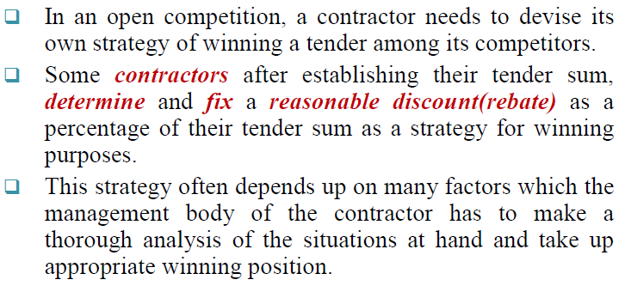
1.7 Statistical Approach of Tendering

Slide 54
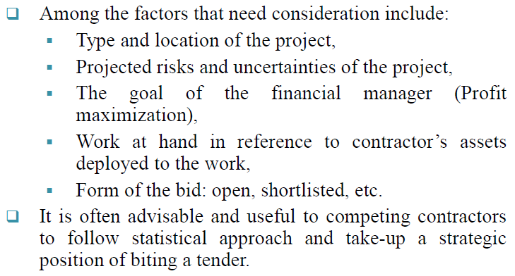
Cont…

Slide 55


