Slide 1
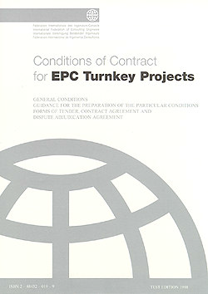




COTM4242– procurement management and contracts administration
Meseret Hussen(MSc)

Slide 2
COTM 4242: procurement management and contracts administration
CHAPTER 3 CLAIMS AND DISPUTE RESOLUTION 3.2 Dispute Resolution

Slide 3
Outline
Claims
1. Dispute
2. Construction Disputes
3. Dispute Resolution
4. Dispute Resolution Mechanisms

Slide 4
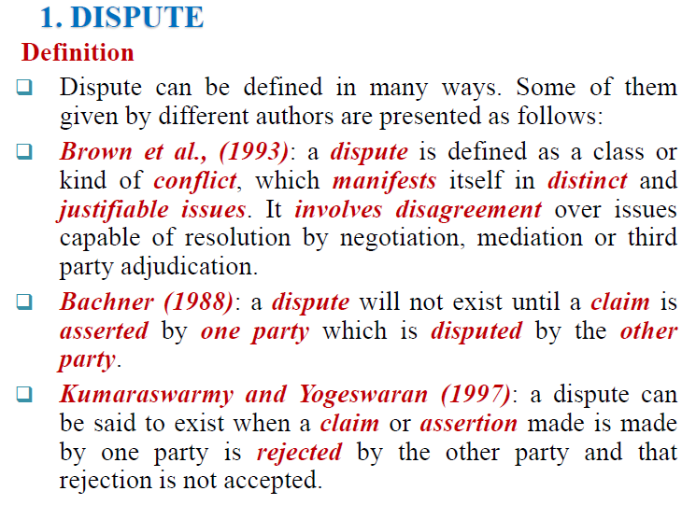

Slide 5
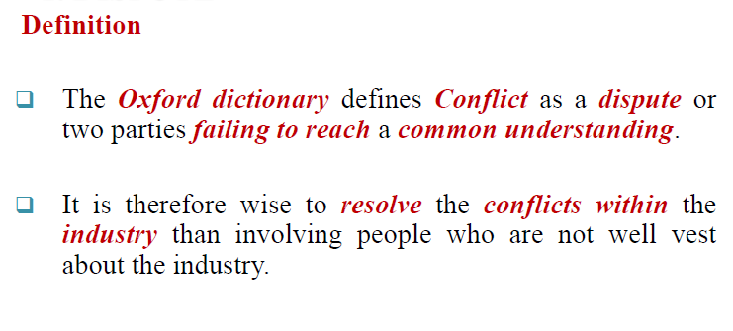
Cont…..

Slide 6
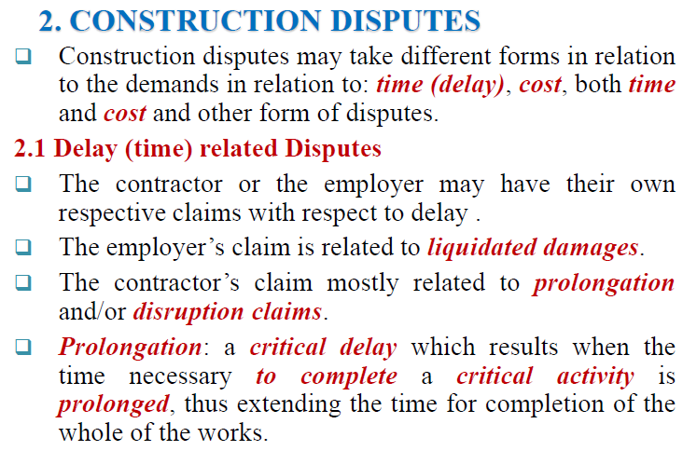

Cont….

Slide 7
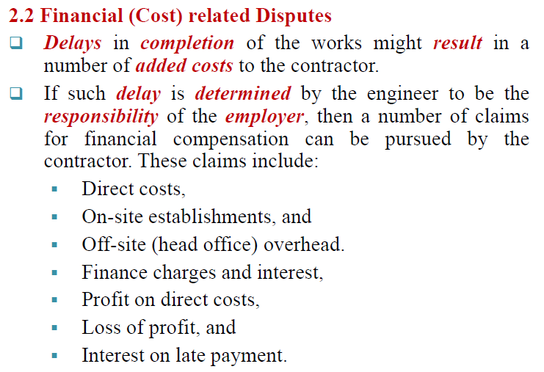
Cont…

Slide 8
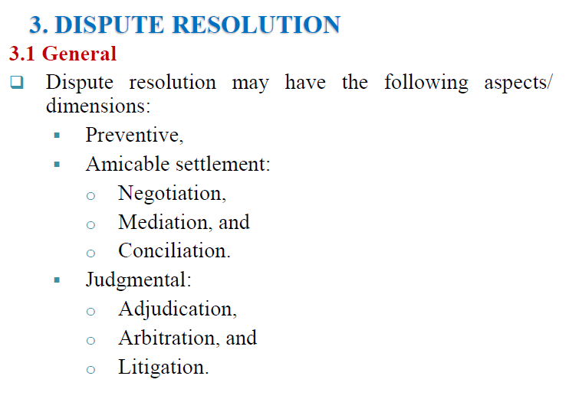

Slide 9
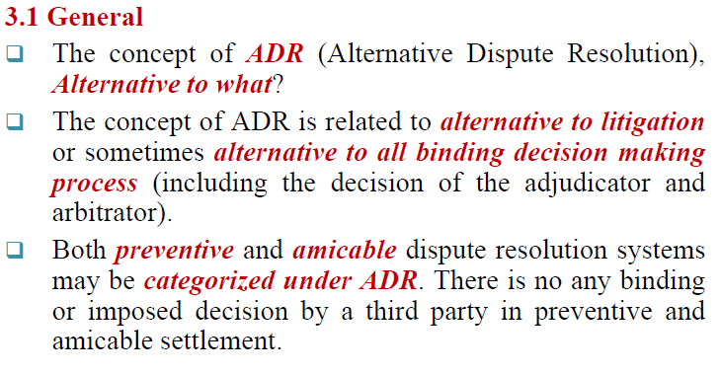
Cont…

Slide 10
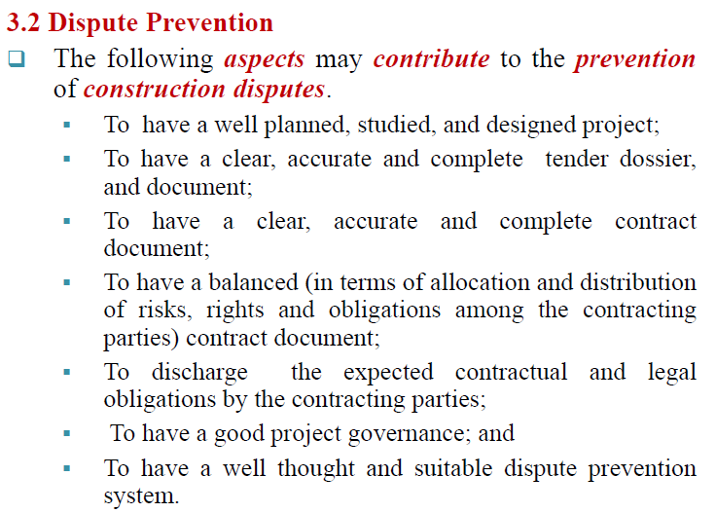
Cont….

Slide 11
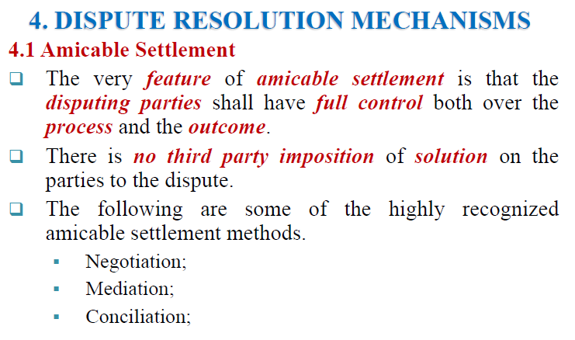

Slide 12
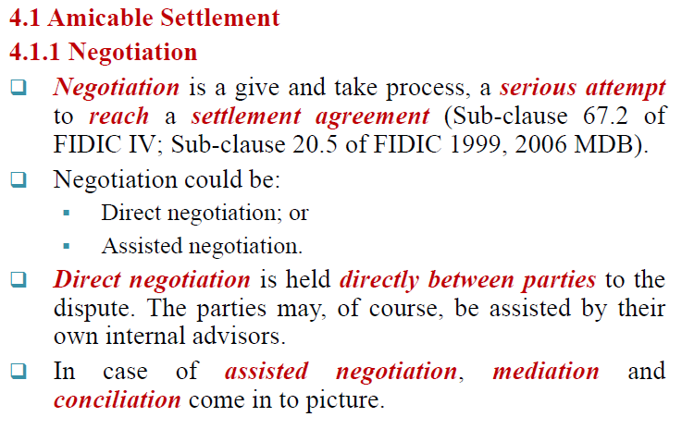
Cont…

Slide 13
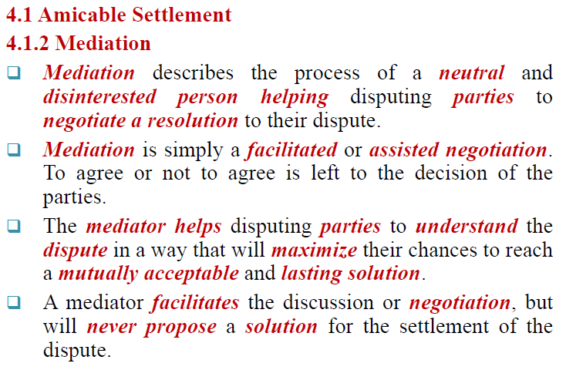
Cont…

Slide 14
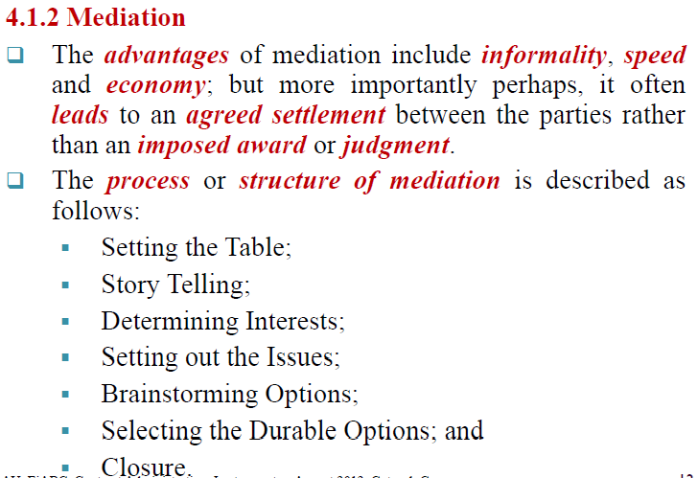
Cont….

Slide 15
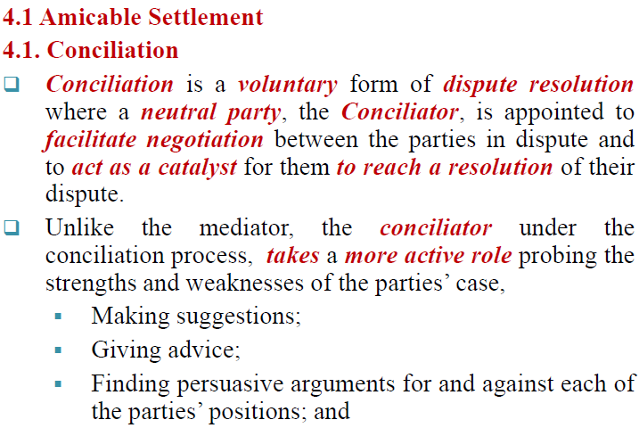
Cont….

Slide 16
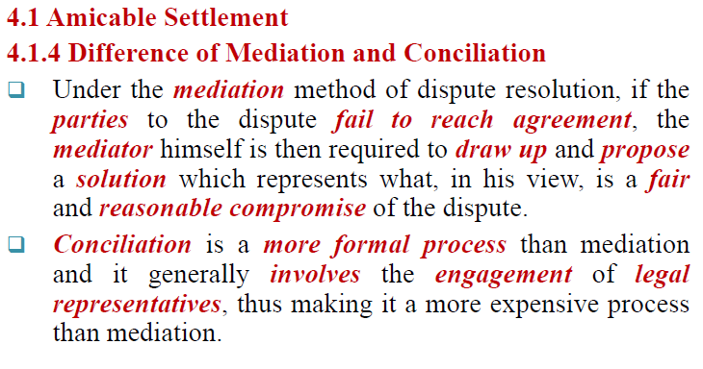
Cont….

Slide 17
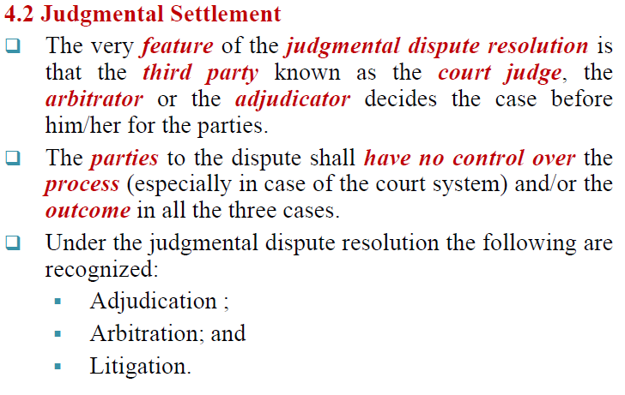
Cont…

Slide 18
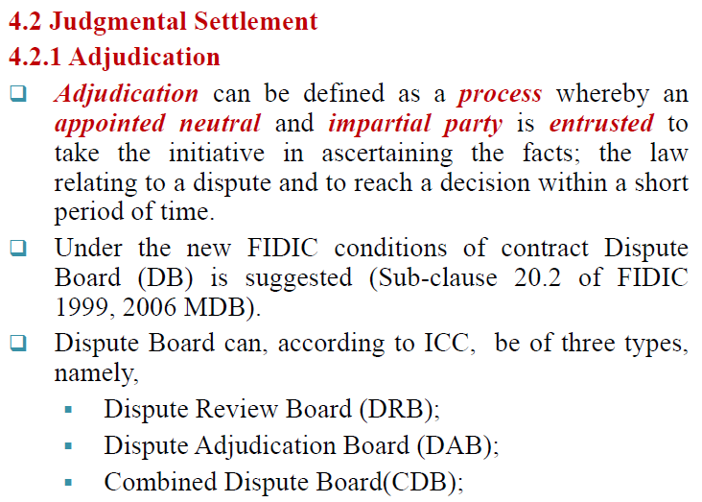
Cont…

Slide 19
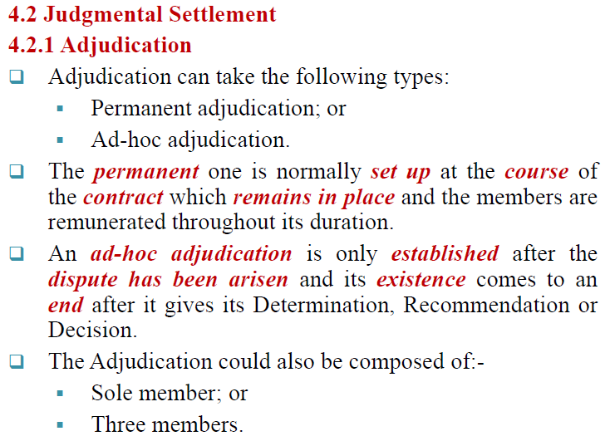
Cont…

Slide 20
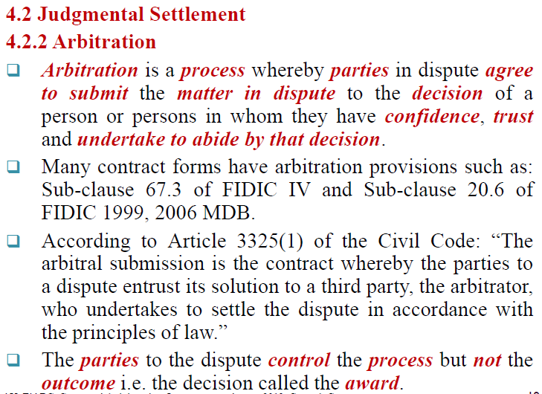
Cont…

Slide 21
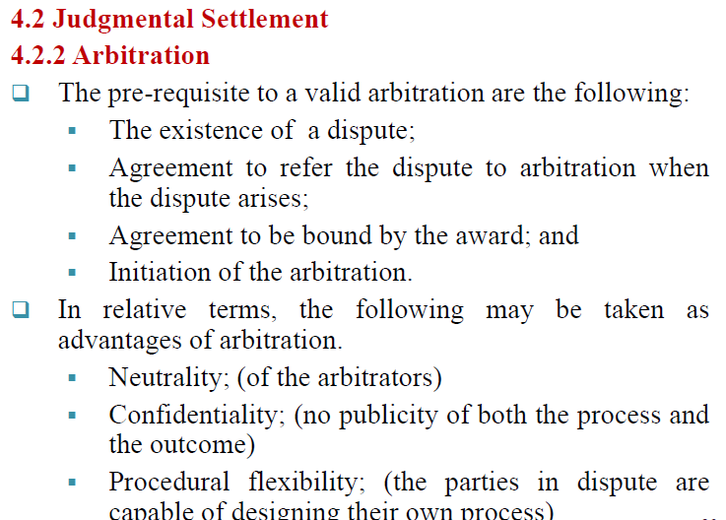
Cont…

Slide 22
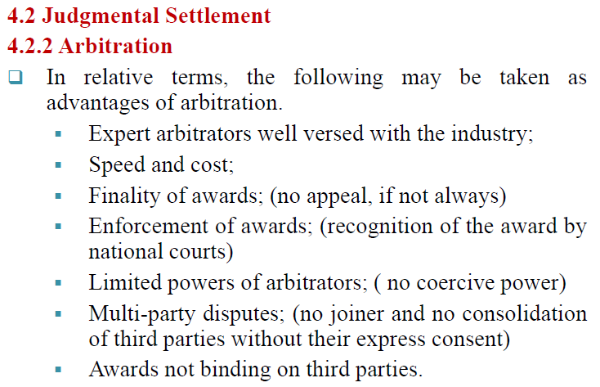
Cont…

Slide 23
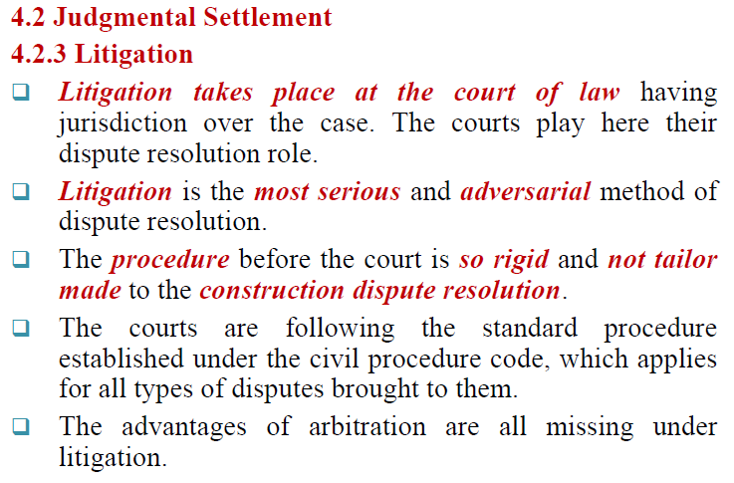
Cont…

Slide 24
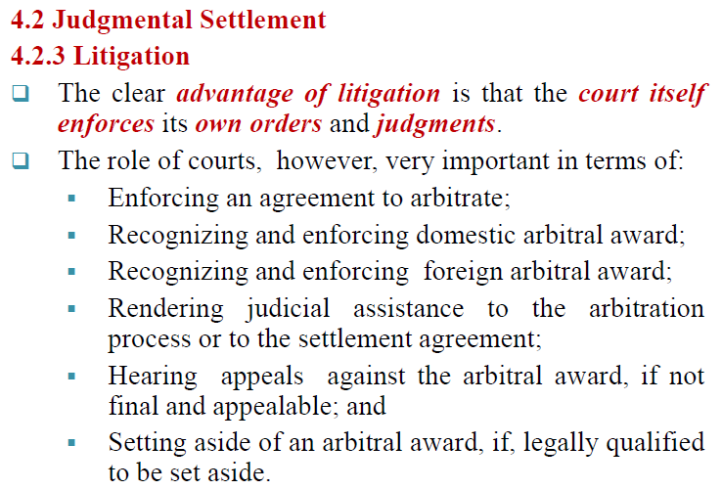
Cont…

Slide 25

THE END

