Slide 1
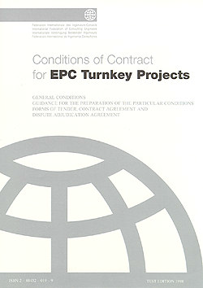


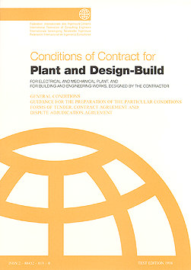
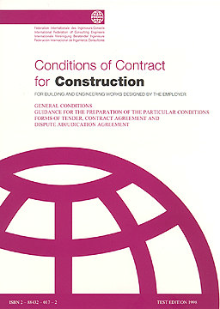
COTM4242– procurement management and contracts administration

Slide 2
COTM 4504: procurement management and contracts administration
CHAPTER 2
2.1 Contracts in General and
Construction Contracts

Slide 3
Outline
Contracts in General and Construction Contracts
1. Contract: Definition
2. Elements of Contract
3. Effects of Contract
4. Construction Contracts
5. Types of Construction Contracts

Slide 4
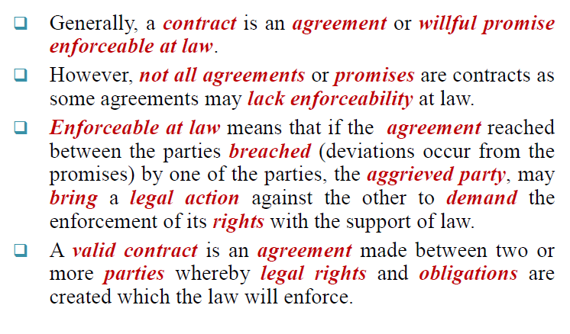
1. CONTRACT: DEFINITION

Slide 5
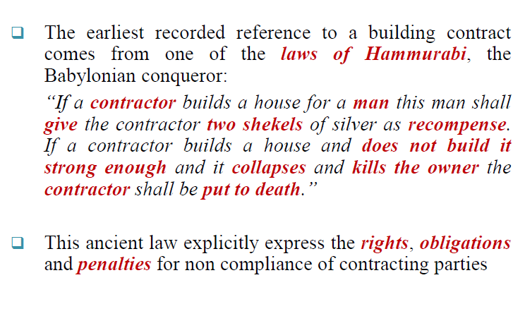
Cont…

Slide 6
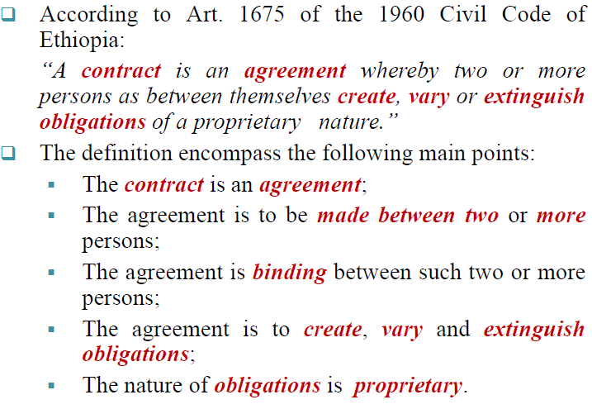
Cont…

Slide 7
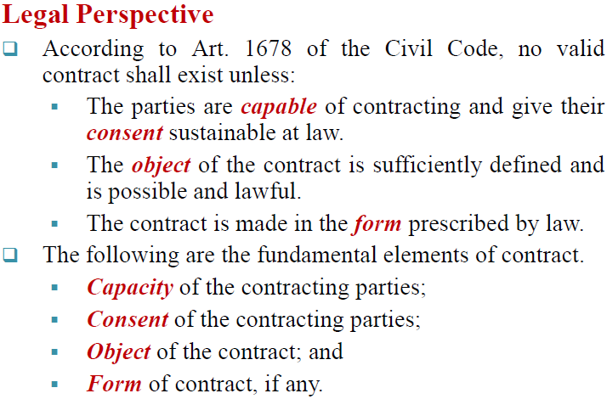
2. ELEMENTS OF CONTRACT

Slide 8
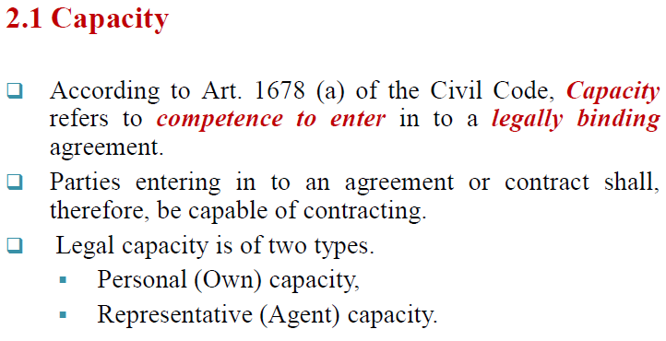
Cont….

Slide 9
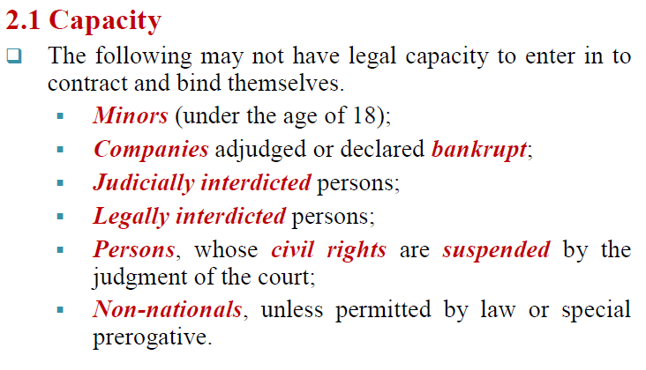
Cont….

Slide 10
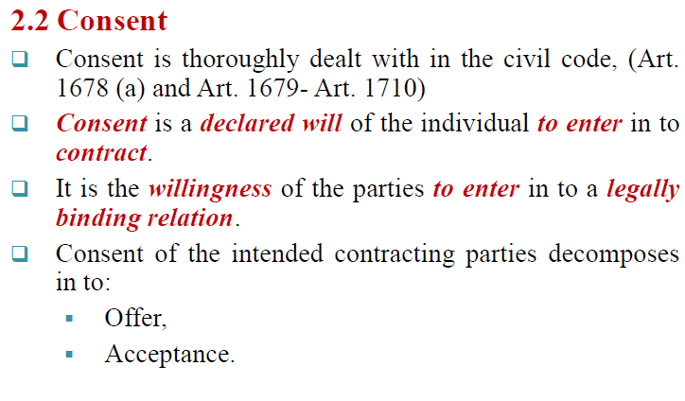
Cont…

Slide 11
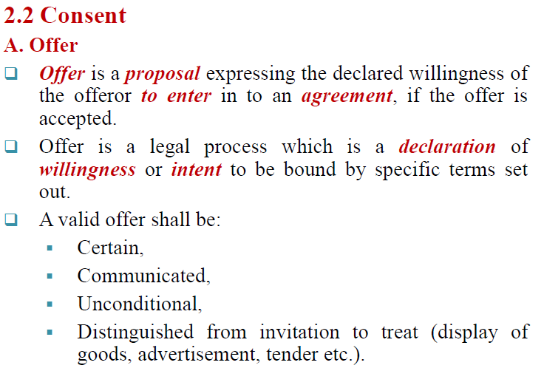
Cont….

Slide 12
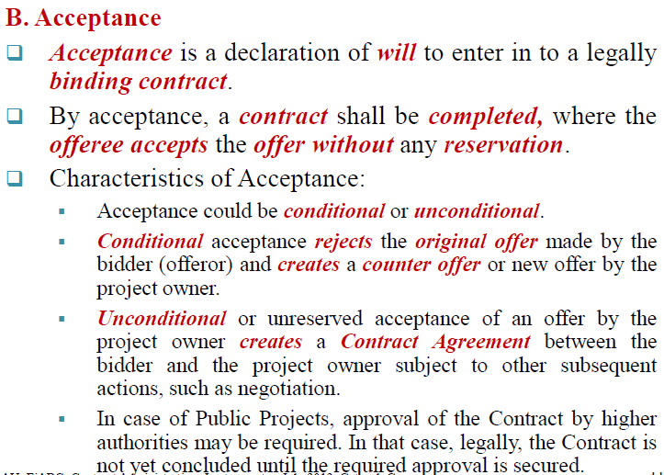
Cont….

Slide 13
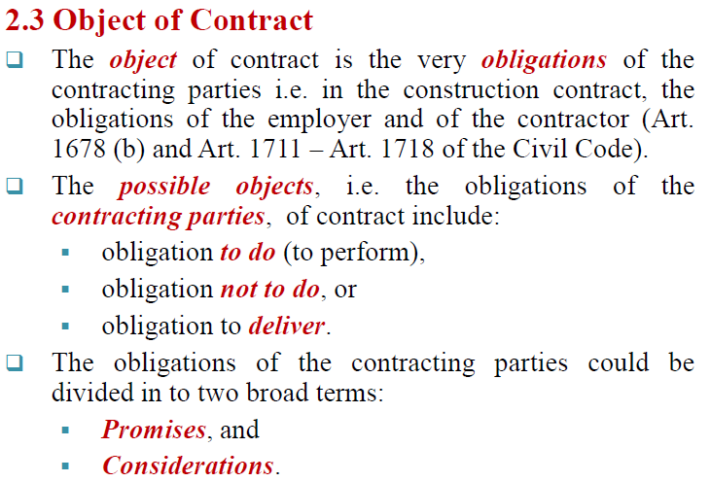
Cont….

Slide 14
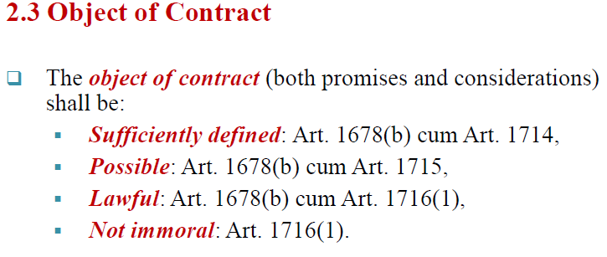
Cont….

Slide 15
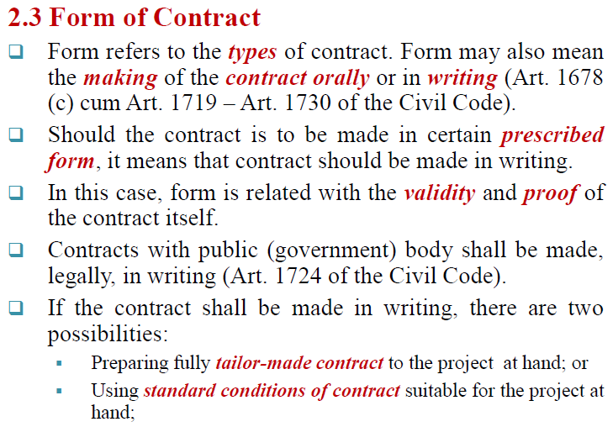
Cont…..

Slide 16
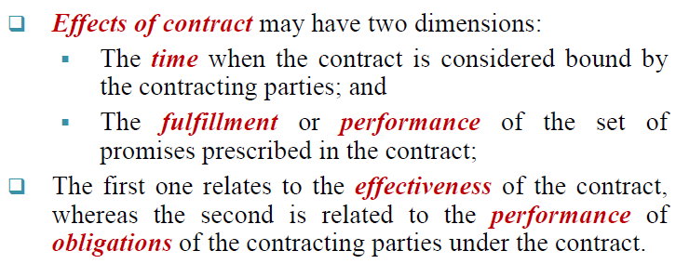
3. EFFECTS OF CONTRACT

Slide 17
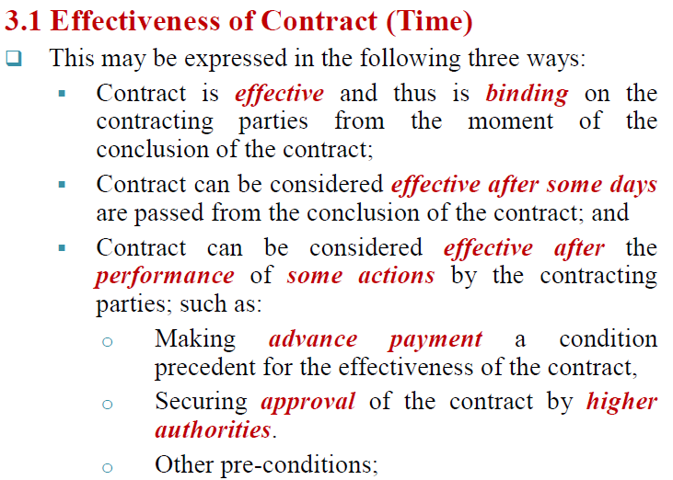
Cont..

Slide 18
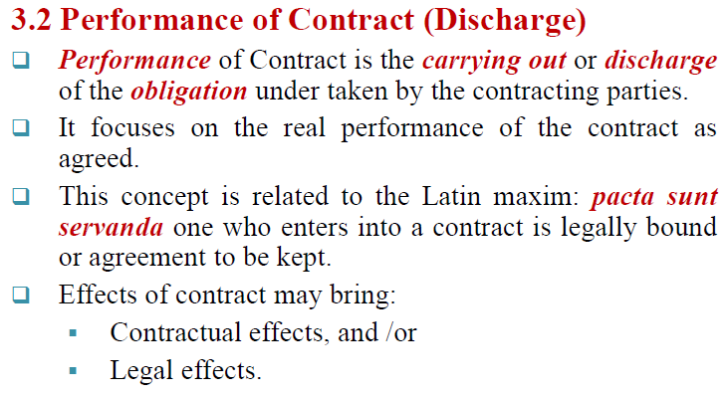
Cont…

Slide 19
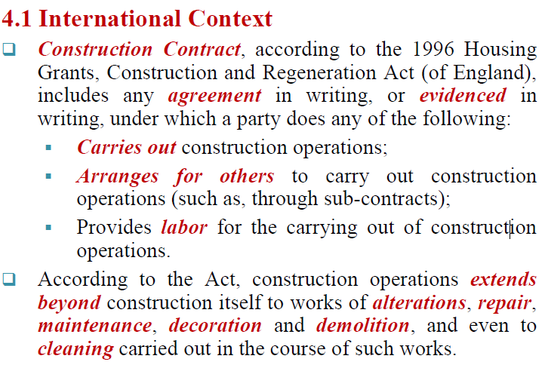
4.CONSTRUCTION CONTRACTS

Slide 20
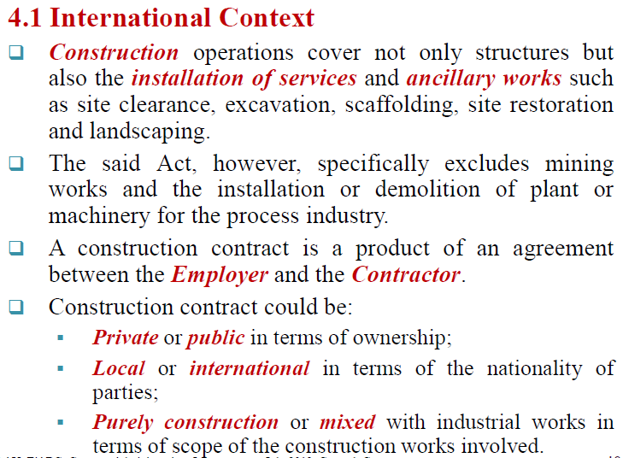
Cont…

Slide 21
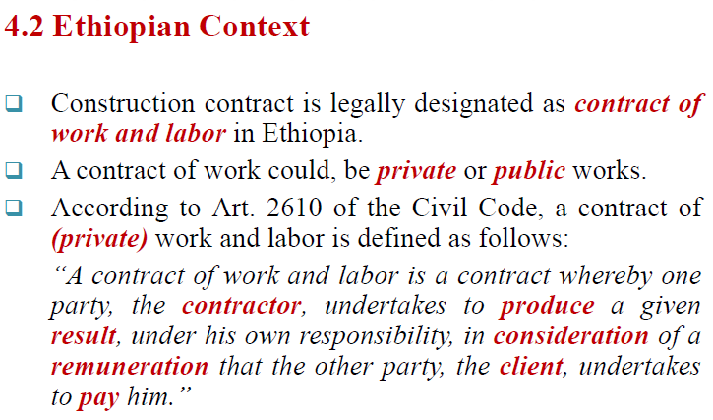
Cont….

Slide 22
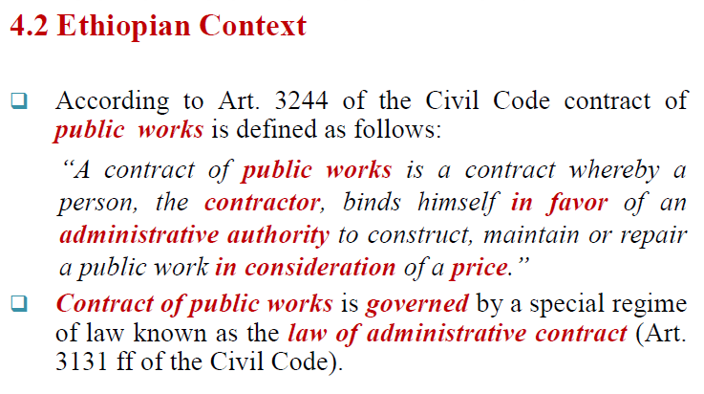
Cont…

Slide 23
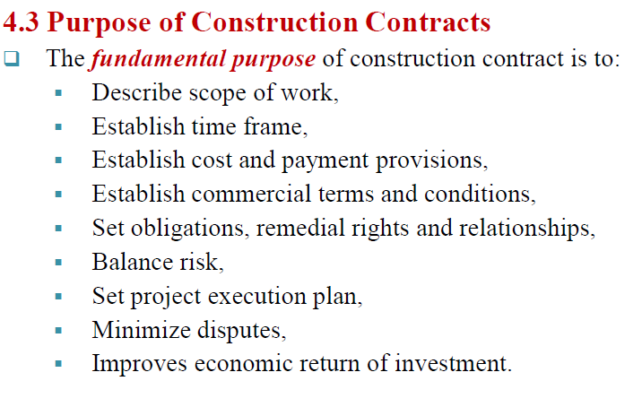
Cont..

Slide 24
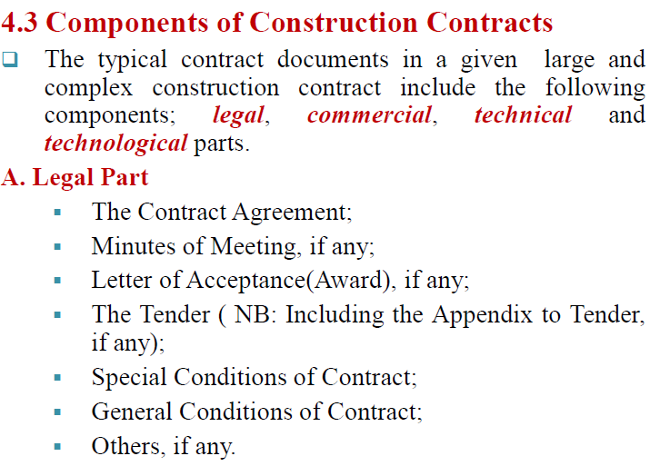
Cont….

Slide 25
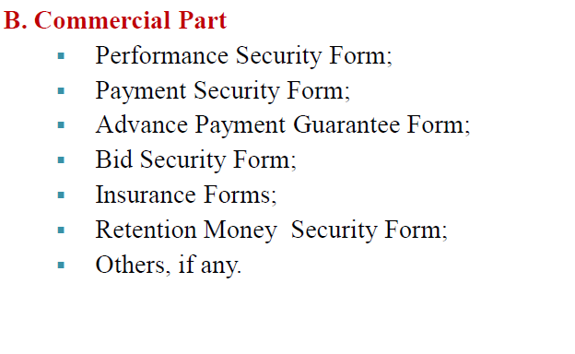
Cont….

Slide 26
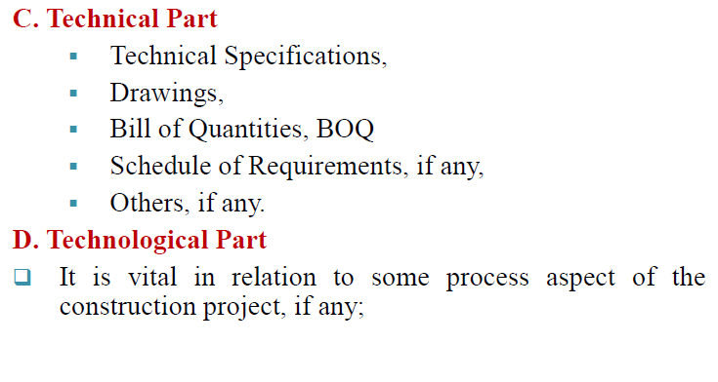
Cont….

Slide 27
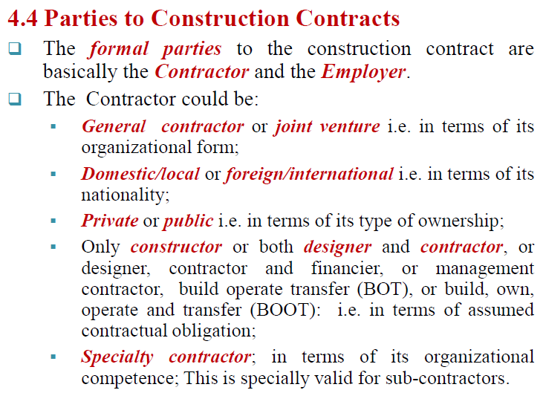
Cont….

Slide 28
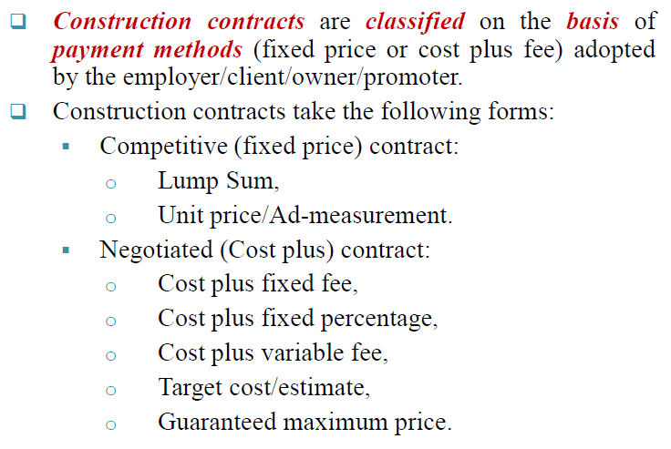
Cont…

Slide 29
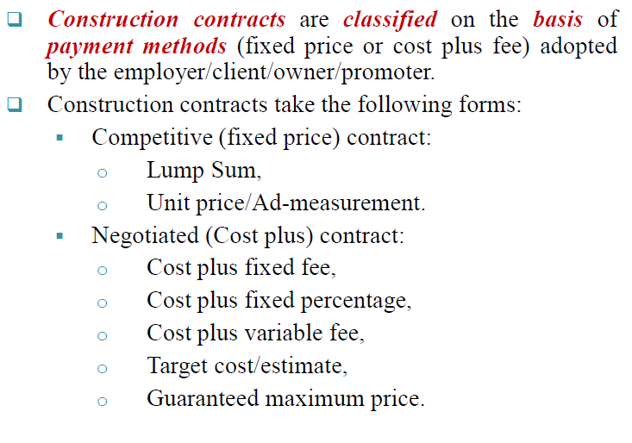
TYPES OF CONSTRUCTION CONTRACTS

Slide 30
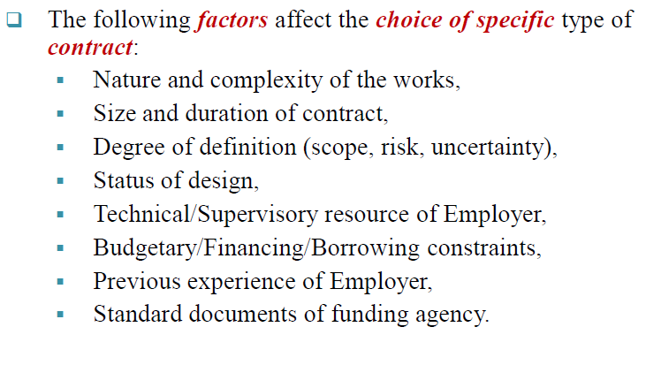
Cont…

Slide 31
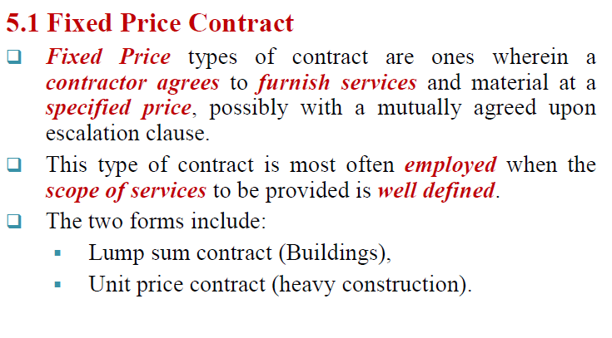
Cont….

Slide 32
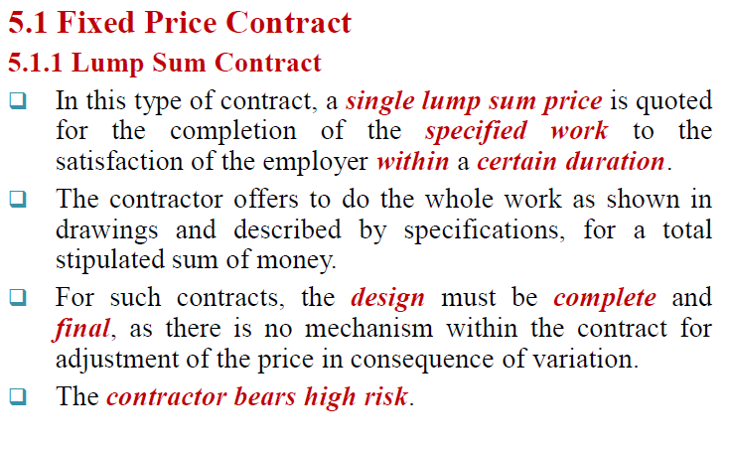
Cont…

Slide 33
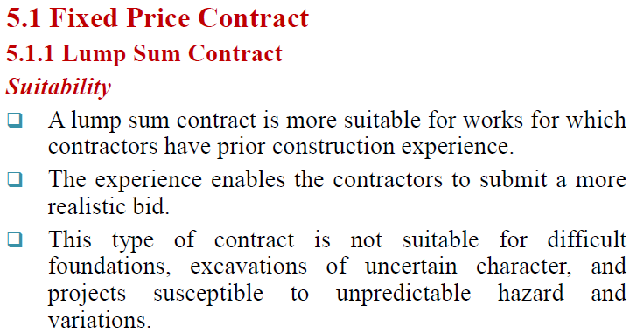
Cont…

Slide 34
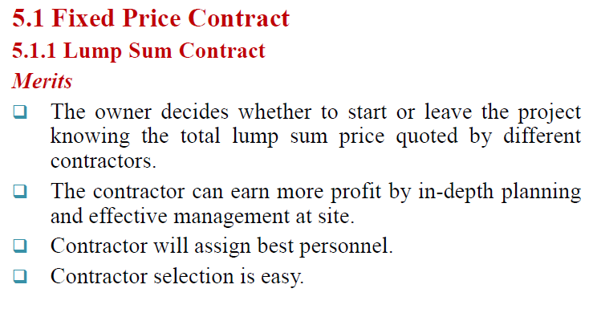
Cont….

Slide 35
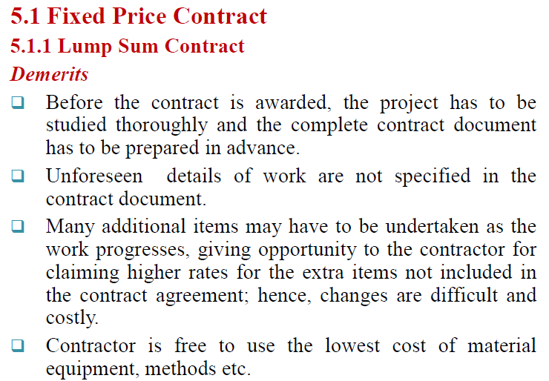
Cont….

Slide 36
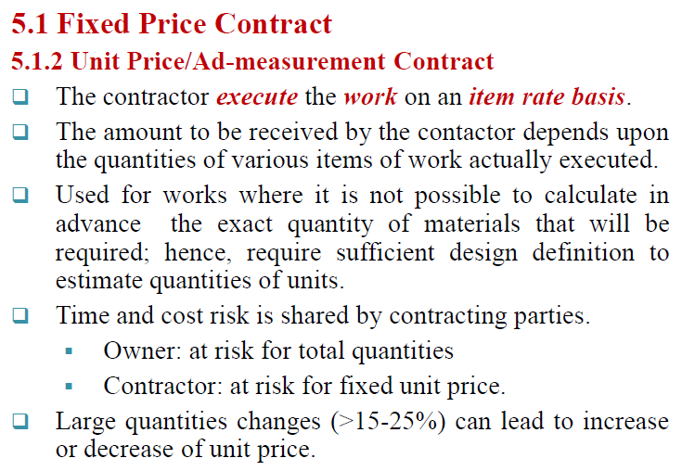
Cont….

Slide 37
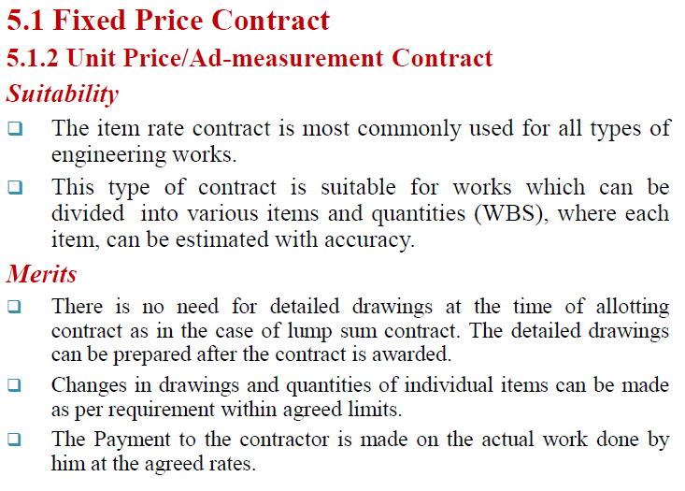
Cont..

Slide 38
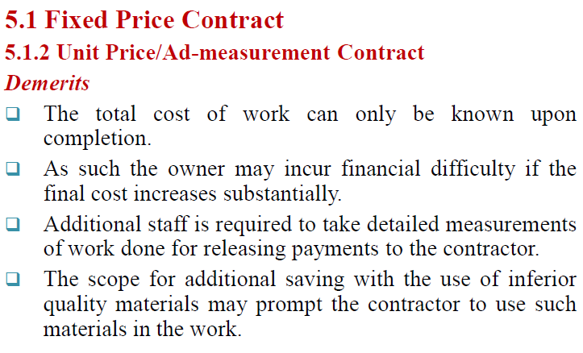
Cont…

Slide 39
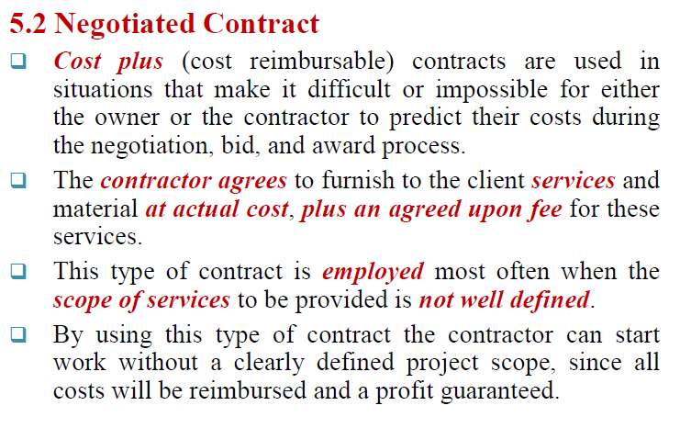
Cont…

Slide 40
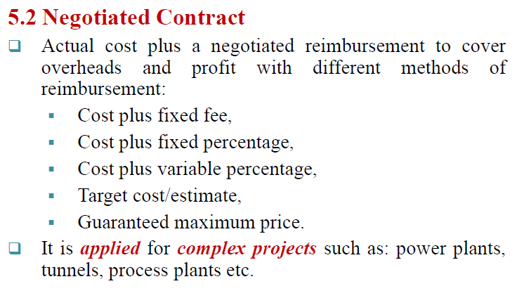
Cont….

Slide 41
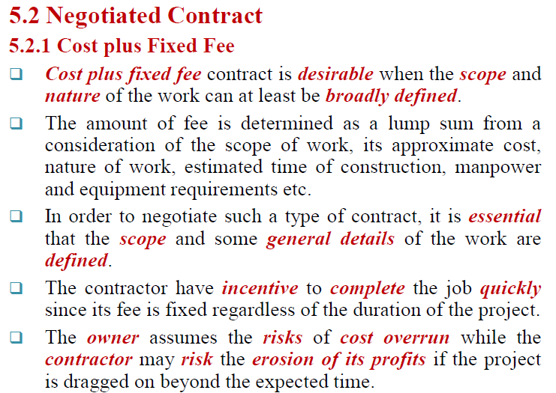
Cont….

Slide 42
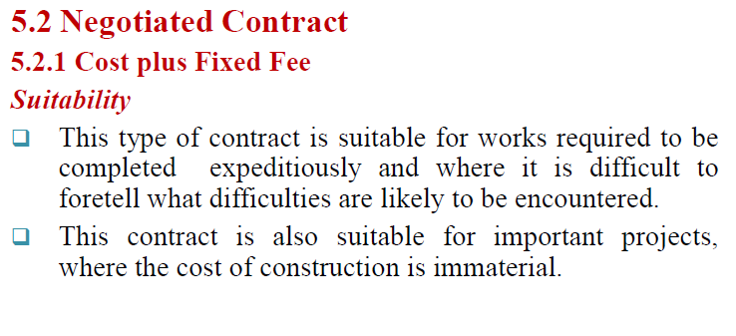
Cont….

Slide 43
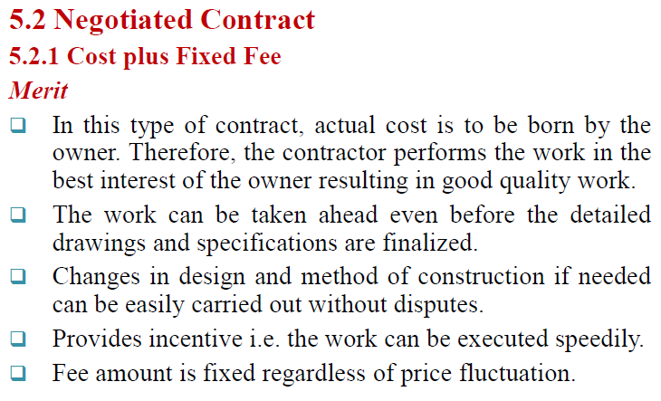
Cont…

Slide 44
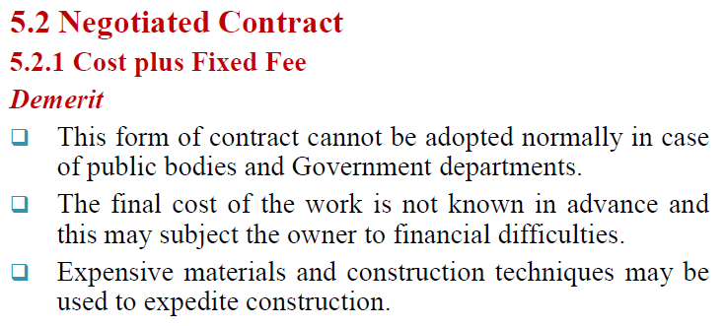
Cont…

Slide 45
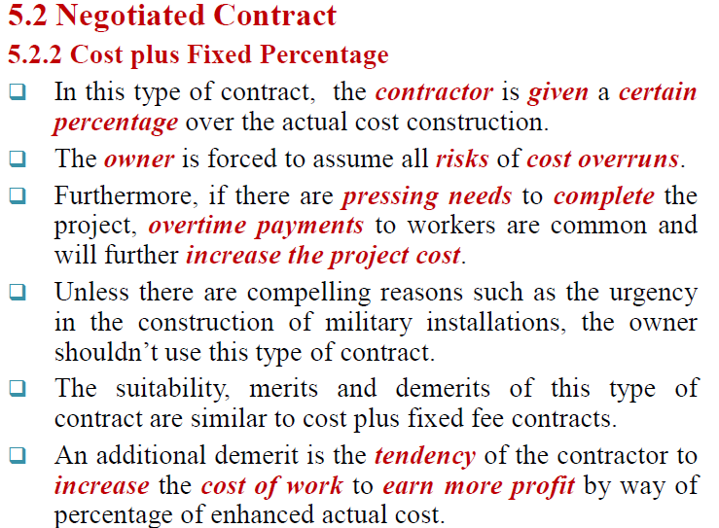
Cont…

Slide 46
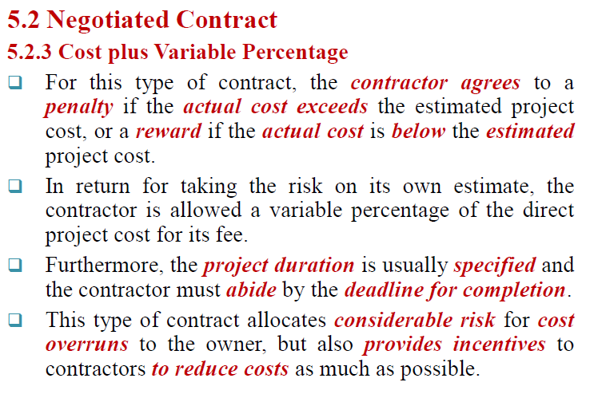
Cont….

Slide 47
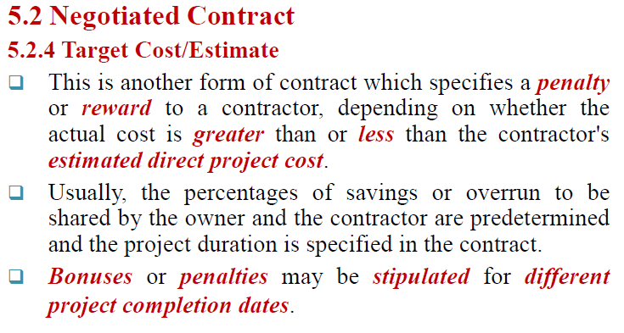
Cont….

Slide 48
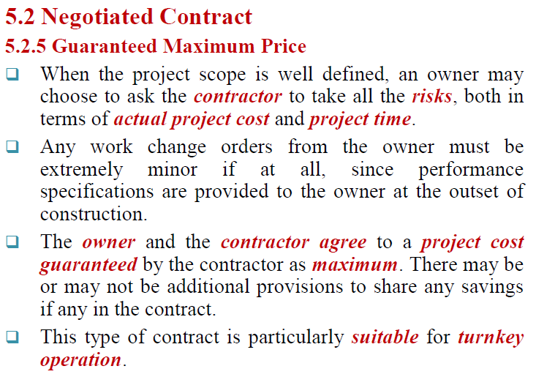
Cont..

Slide 49


