Slide 1
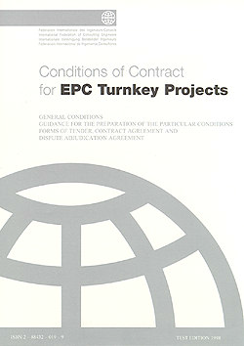




COTM4242– procurement management and contracts administration
Meseret Hussen (MSC)

Slide 2
COTM 4504: CONTRACT ADMINISTRATION
CHAPTER 2
CONTRACTS
2.3 Contracts Management

Slide 3
Outline
Contracts Management
1. Contracts Management
2. Conditions of Contract
3. Contract Administration
4. Obligation and Rights of Parties

Slide 4
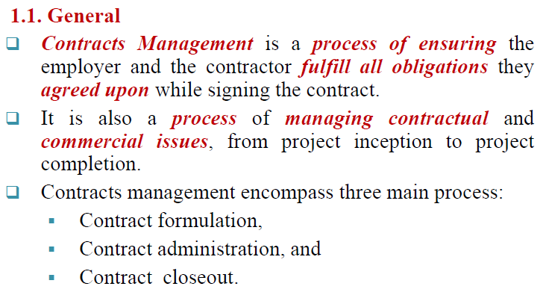
1. Contracts Management

Slide 5
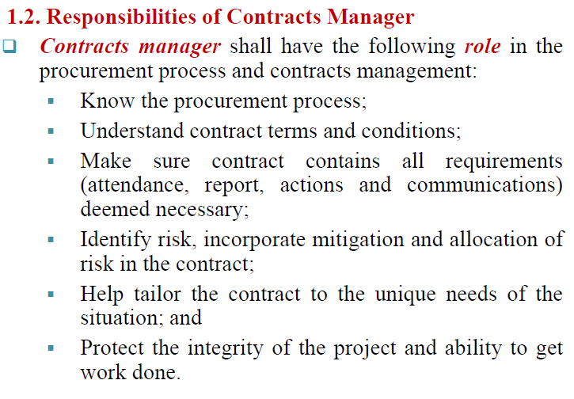
Cont...

Slide 6
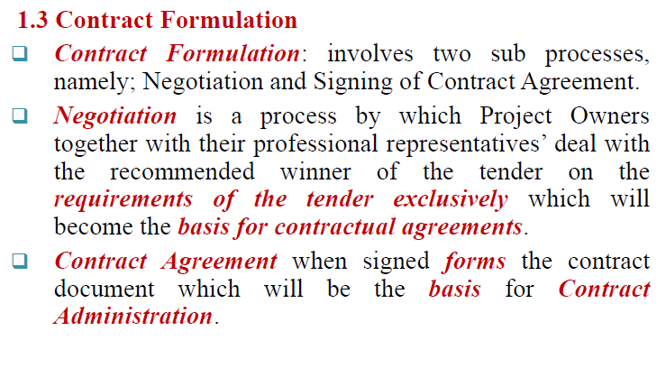
Cont…

Slide 7
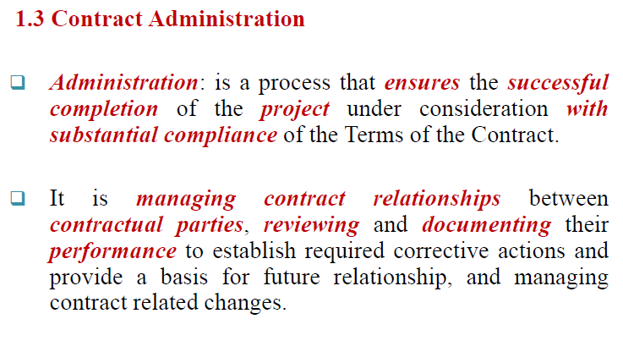
Cont…

Slide 8
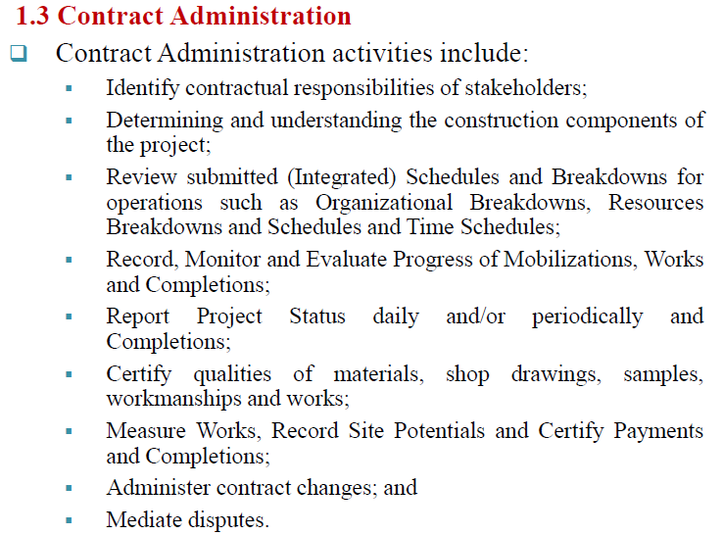
Cont…

Slide 9
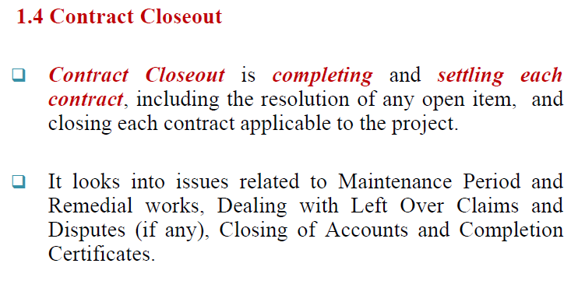
Cont…

Slide 10
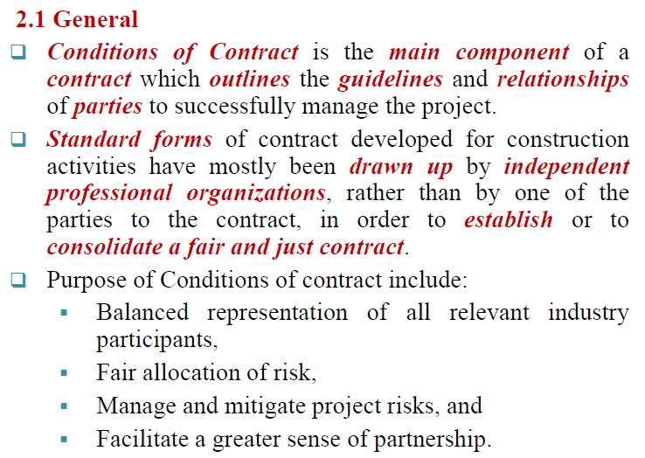
2. CONDITIONS OF CONTRACT

Slide 11
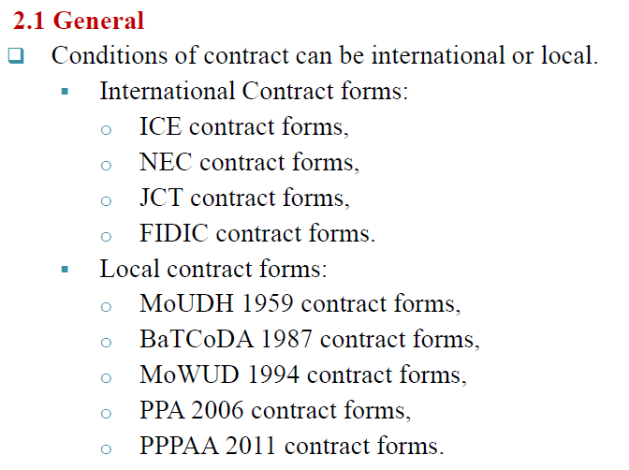
Cont….

Slide 12
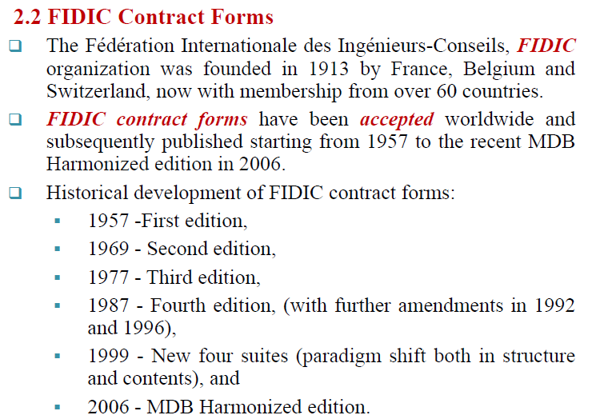
Cont…..
7

Slide 13
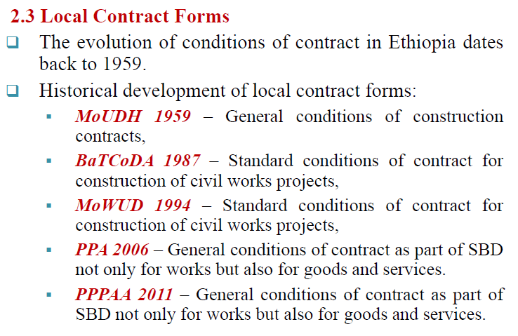
Cont….

Slide 14
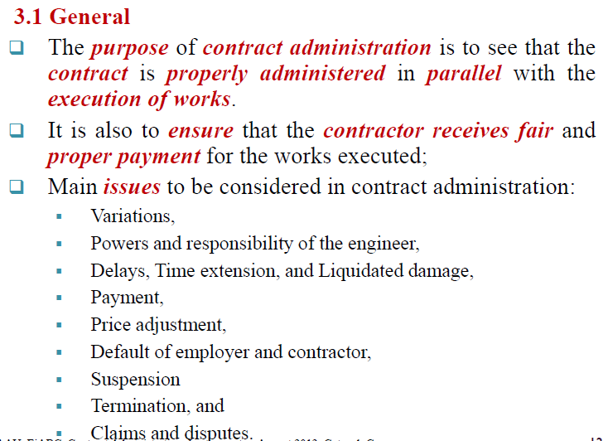
Cont….

Slide 15
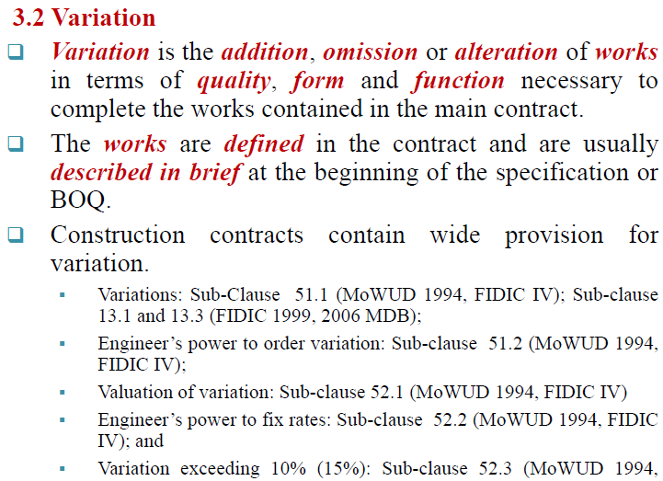
Cont…

Slide 16
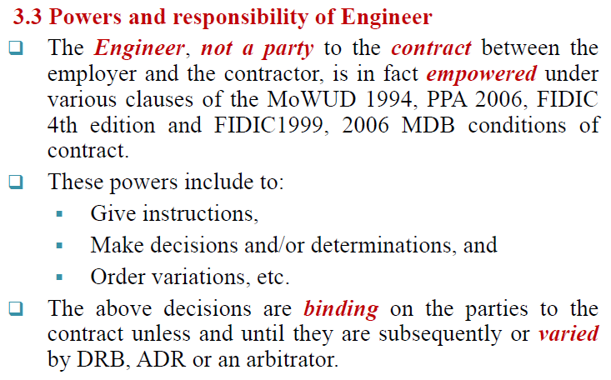
Cont….

Slide 17
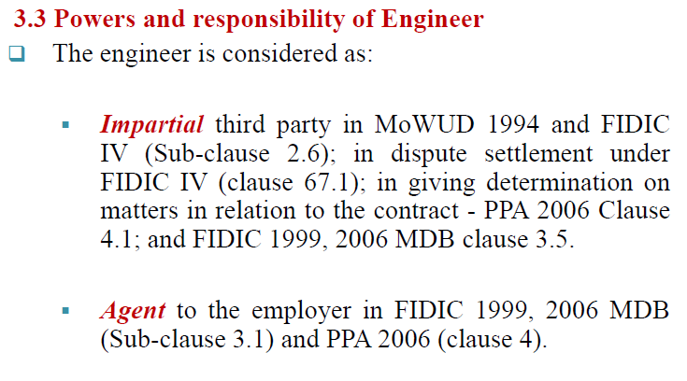
Cont….

Slide 18
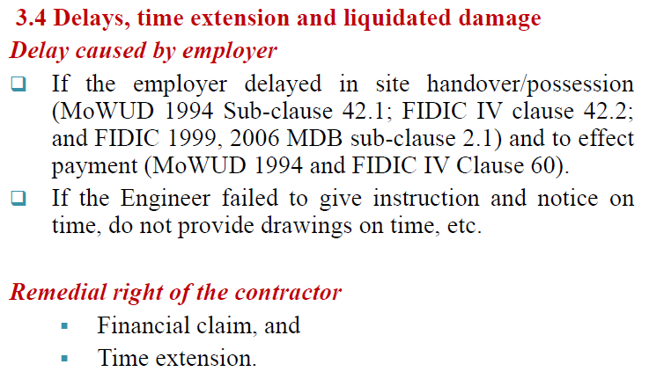
Cont….

Slide 19
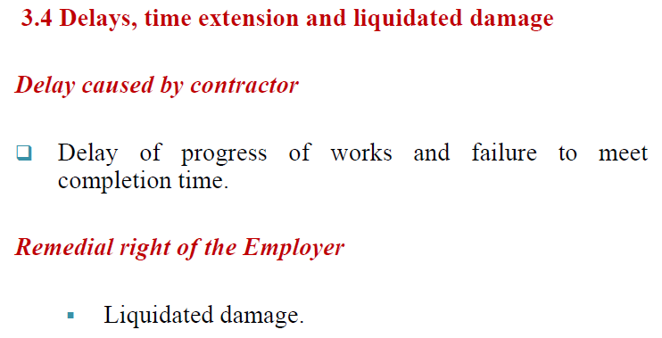
Cont….

Slide 20
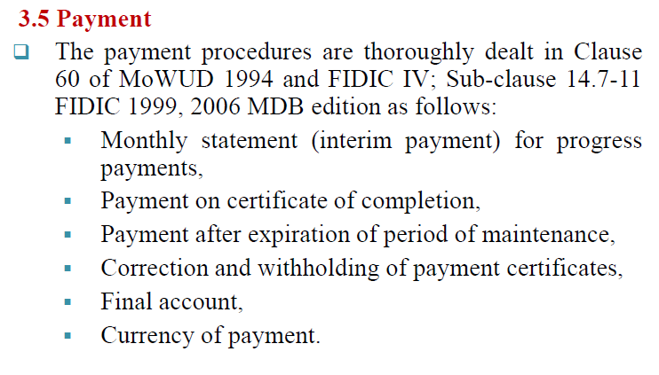
Cont….

Slide 21
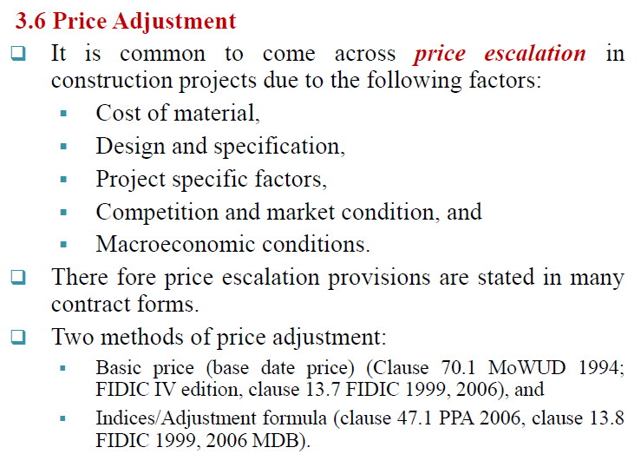
Cont…

Slide 22
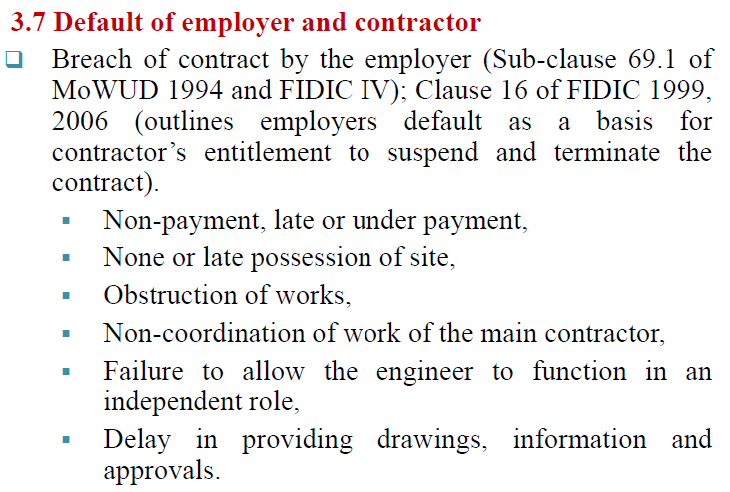
Cont…

Slide 23
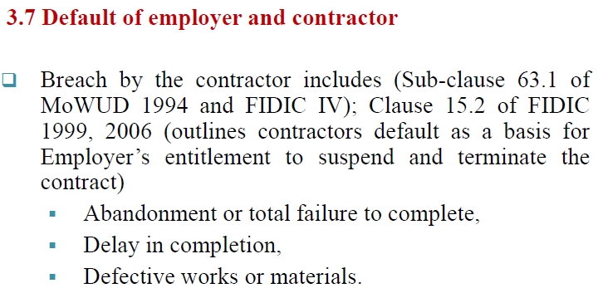
Cont….

Slide 24
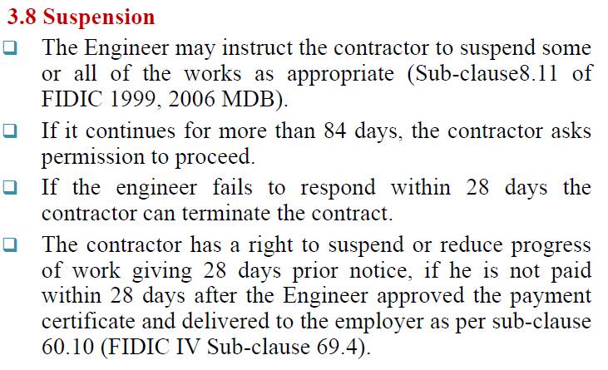
Cont….

Slide 25
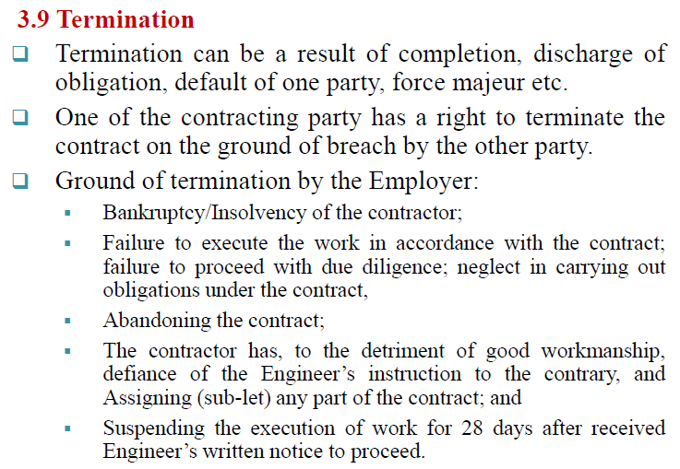
Cont…

Slide 26
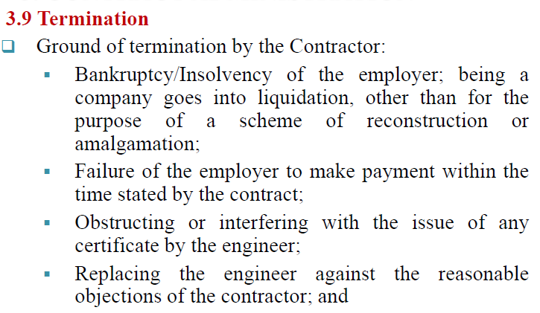
Cont…..

Slide 27
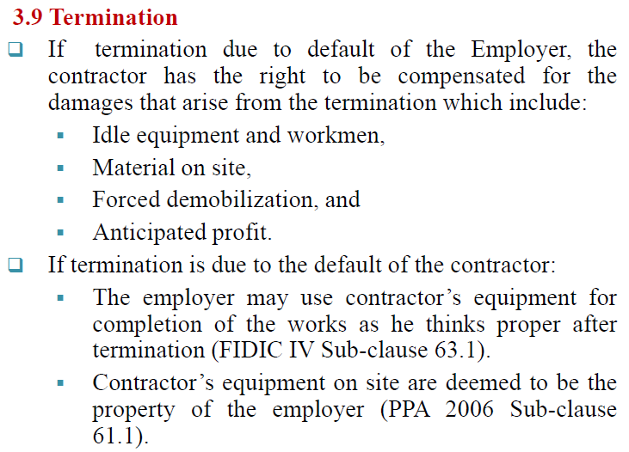
Cont…

Slide 28
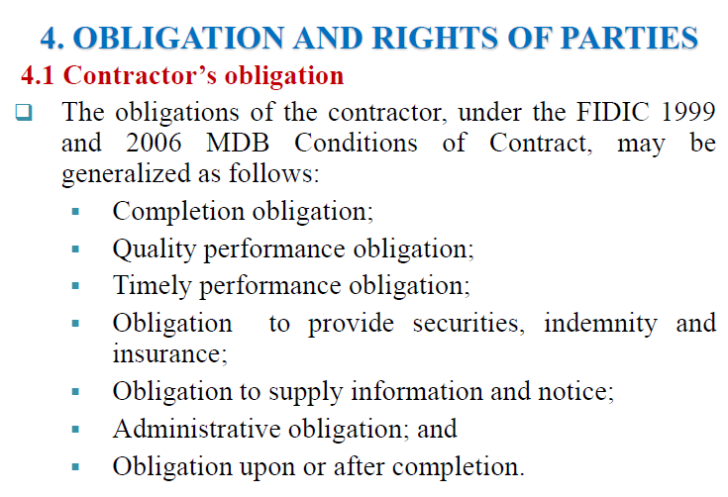

Slide 29
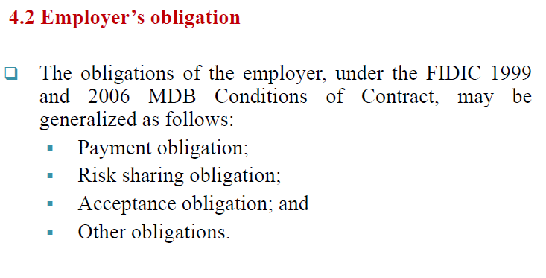
Cont…

Slide 30
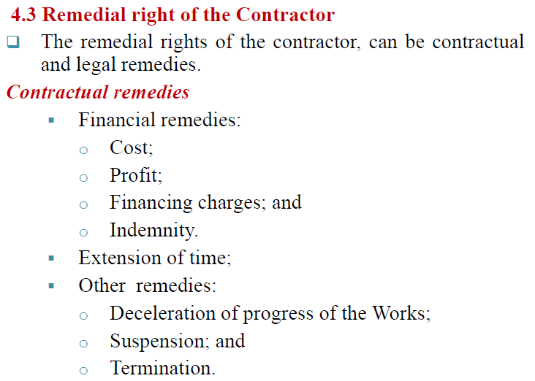
Cont….

Slide 31
Cont…

Slide 32
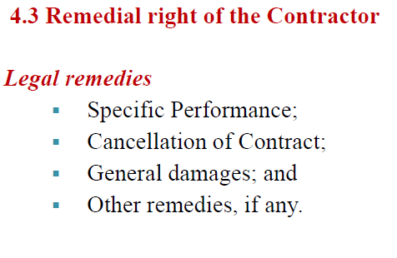
Cont…

Slide 33
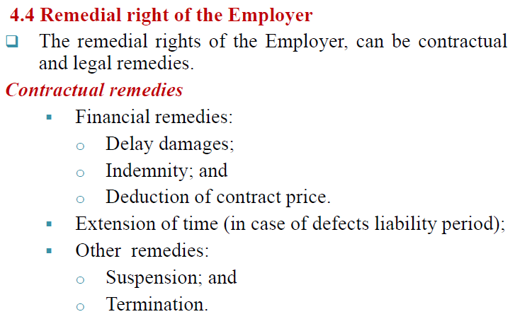
Cont….

Slide 34
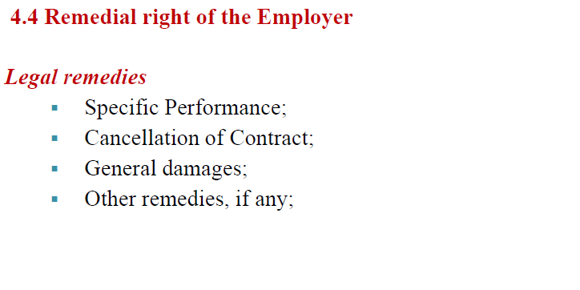
Cont….

Slide 35


