Slide 1
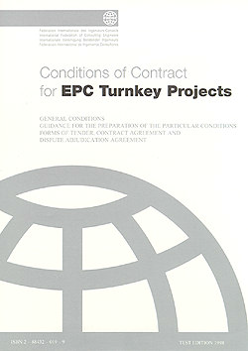




COTM 4242 – procurement management and contracts administration
Meseret Hussen(MSC)

Slide 2
COTM 4242: procurement management and contracts administration
CHAPTER 2
CONTRACTS 2.2 Contracts Management

Slide 3
Outline
Contract Documents
1. Construction Documents
2. Bidding Requirements
3. Contract Documents
4. Bonds/Guarantee Forms

Slide 4
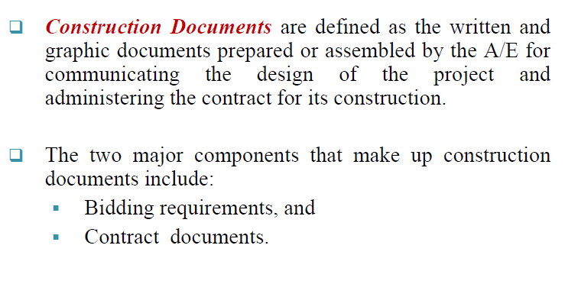
1.Construction Documents

Slide 5
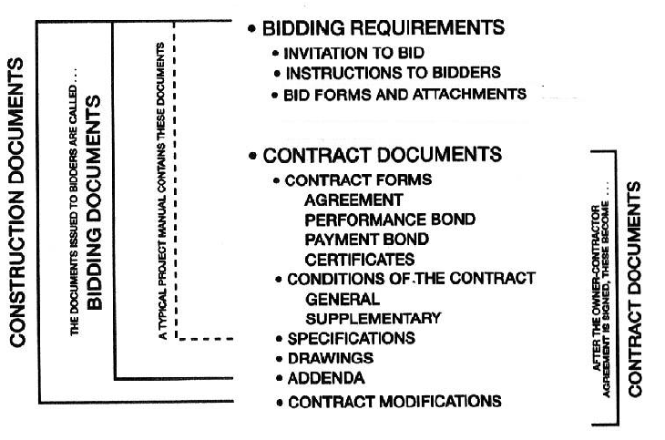
Cont….

Slide 6
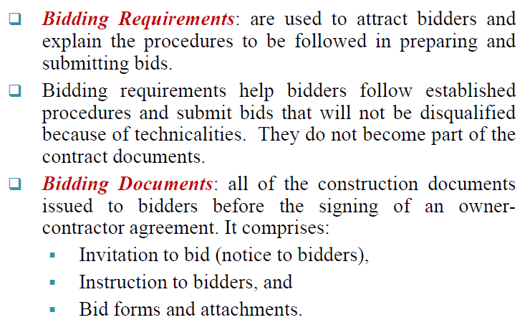
2. BIDDING REQUIREMENTS

Slide 7
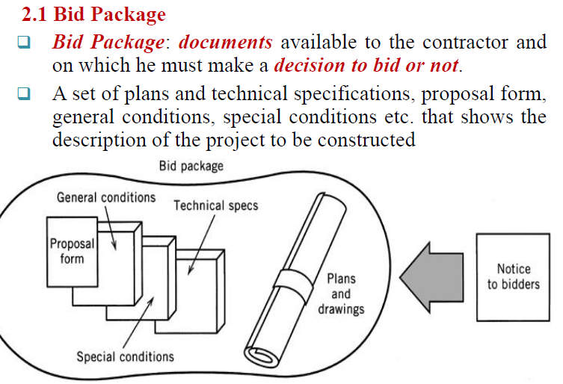
Cont….

Slide 8
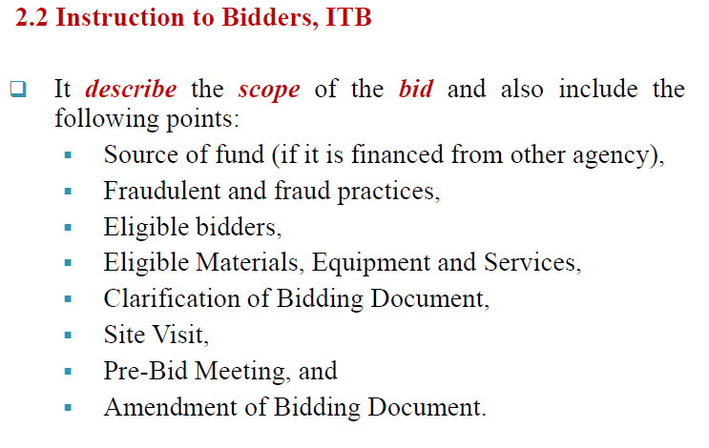
Cont….

Slide 9
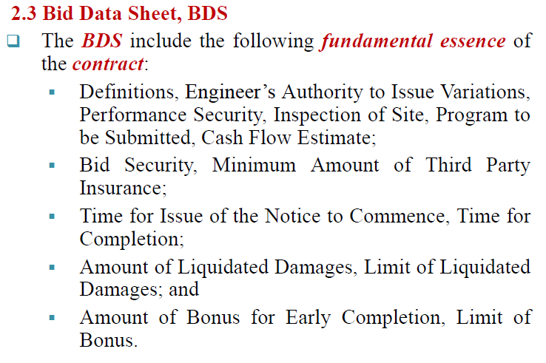
Cont….

Slide 10
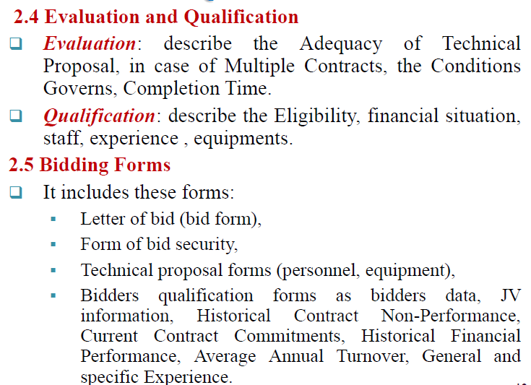
Cont….

Slide 11
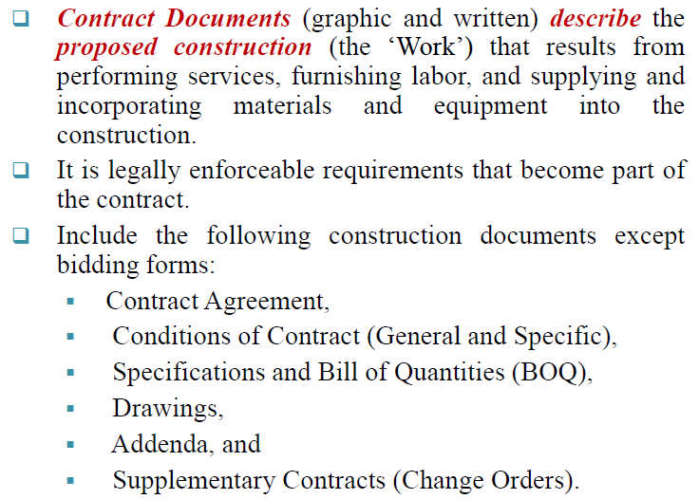
3. CONTRACT DOCUMENTS

Slide 12
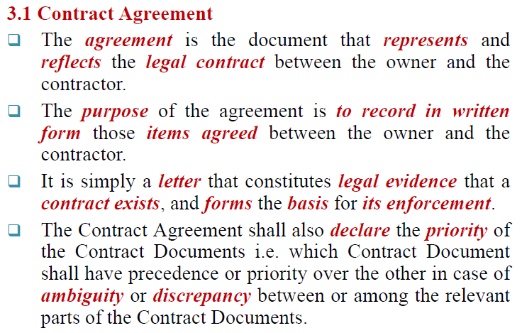
CONT.

Slide 13
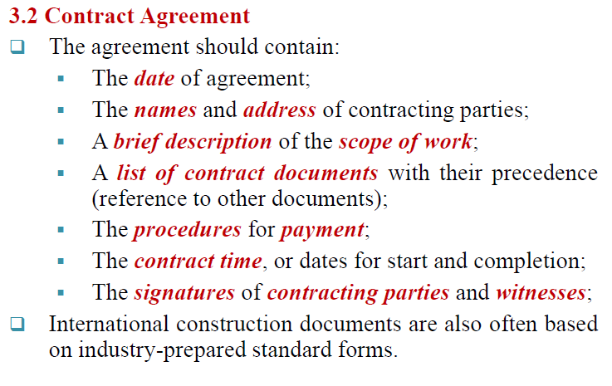
Cont..

Slide 14
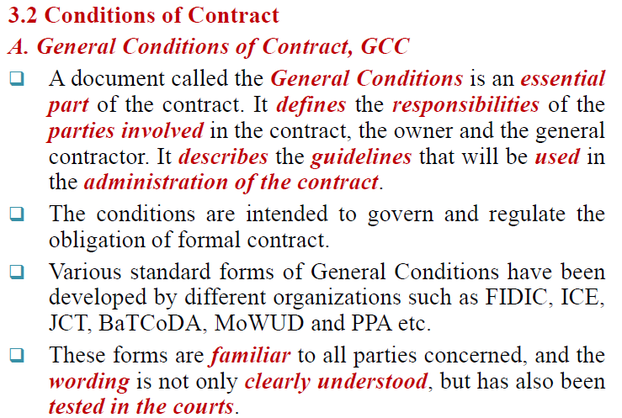
Cont…

Slide 15
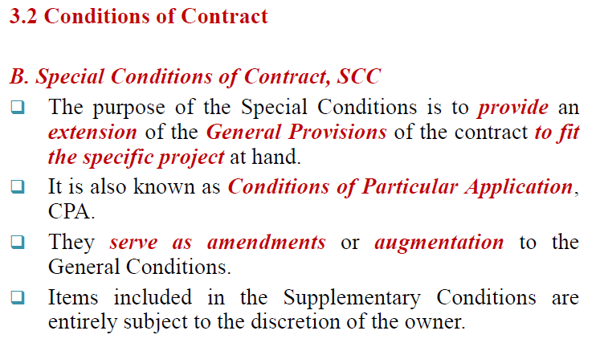
Cont…

Slide 16
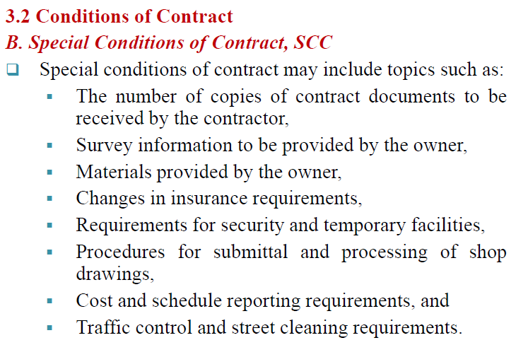
Cont…

Slide 17
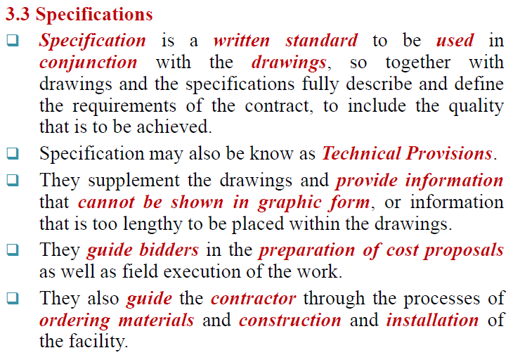
Cont..

Slide 18
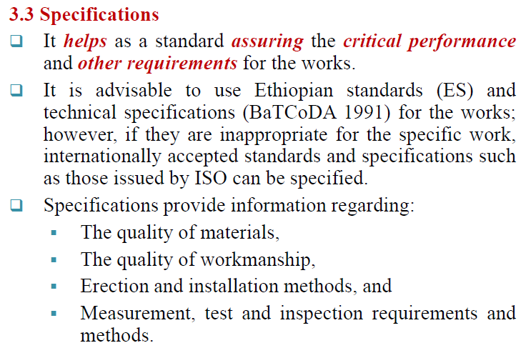
Cont..

Slide 19
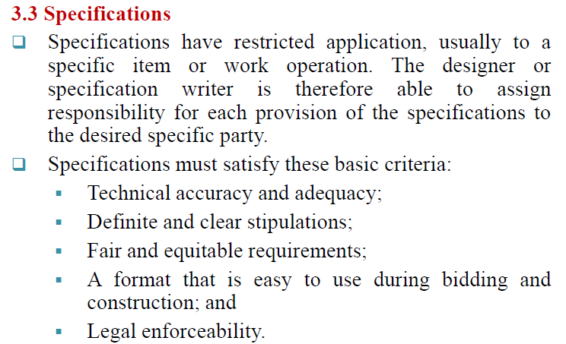
Cont….

Slide 20
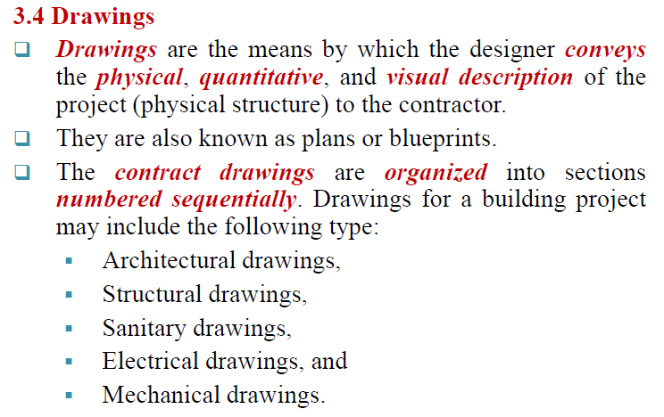
Cont…

Slide 21
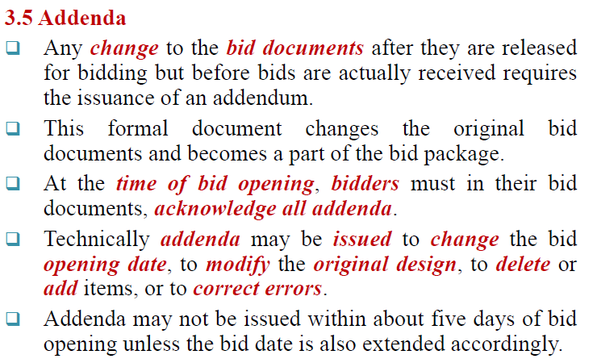
Cont…

Slide 22
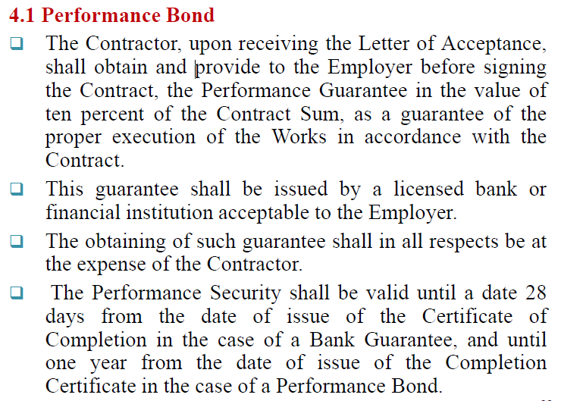
4. BOND/GUARANTEE FORMS

Slide 23
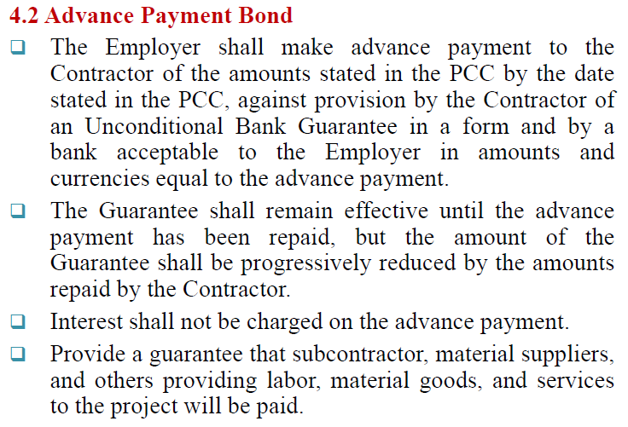
Cont…

Slide 24
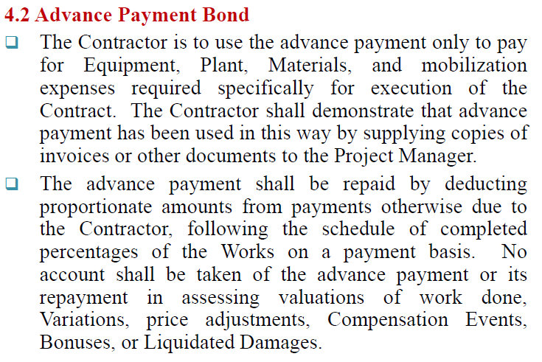
Cont…

Slide 25
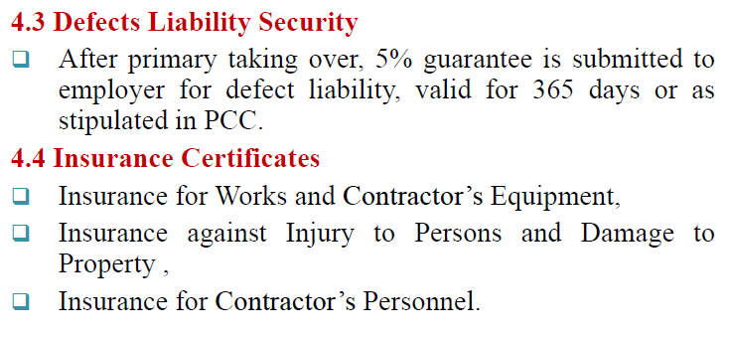
Cont…

Slide 26


