Slide 1
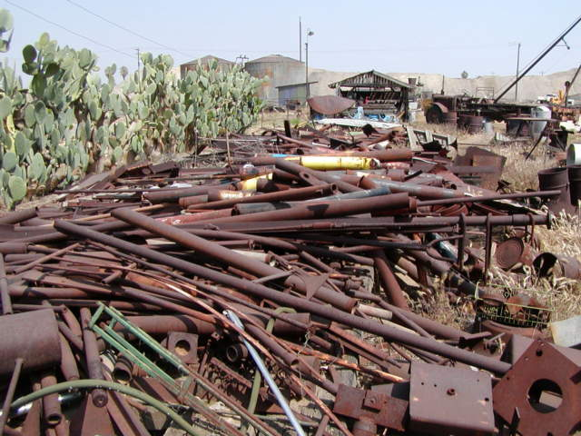
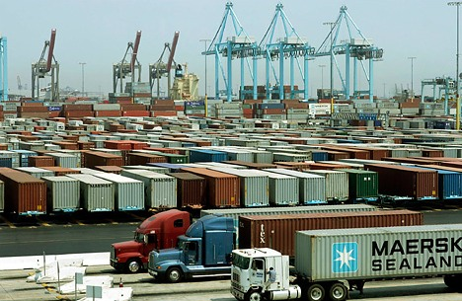
Construction PERFORMANCE AND REOURCE OPTIMIZATION CHAPTER 1 OVERVIEW OF CONSTRUCTION PERFORMANCE MANAGEMENT

Slide 2
Performance management…
What is Performance Management?
Performance management is the process of ensuring individual and team effort support the organisational objectives and to realise key stakeholder expectations and wealth creation in all the identified value drivers of the organisation.

Slide 3
Performance management…
Performance management is a continuous process of identifying, measuring and developing performance in organizations by linking each individual’s performance and objectives to the organization’s overall mission and goals. (Ms.B. Kaviya and , Ms.C.Hema,2015)

Slide 4
Performance management…
Performance management is the process through which supervisors and those they lead gain a shared understanding of work expectations and goals, exchange performance feedback, identify learning and development opportunities, and evaluate performance results.
It is through this process that organizations are able to create and sustain a workplace environment that:
Values continuous improvement
Adapts well to change
Strives to attain ambitious goals
Encourages creativity
Promotes learning and professional development
Is engaging and rewarding for employees

Slide 5
Performance management…
According to Neely et al. (1995) performance measurement is a topic which is often discussed but rarely defined. These authors state:
Performance measurement can be defined as the process of quantifying the efficiency and effectiveness of action.
A performance measure can be defined as a metric (or indicator) used to quantify the efficiency and/or effectiveness of an action.
A performance measurement system can be defined as the set of metrics used to quantify both the efficiency and effectiveness of actions.

Slide 6
Performance management…
Construction project performance evaluation continues to be one of the primary competitive issues.
Performance measurement (PM) is an integral part of management and defined as a process of quantifying both the efficiency and effectiveness of an action (Neely et al., 2005).
Some of the major concerns of performance measurement include “What to measure?”, “Which measures are used?”, “How to measure?” and “How to interpret results?” (Sandanayake and Oduoza, 2007).

Slide 7
Construction Performance management Basics
How does construction industry perform?
Industry’s clients are not satisfied
The supply team is not satisfied
Industry’s bad reputation
Low profitability
Lack of innovation and development

Slide 8
Construction Performance management Basics
Industry’s clients are not satisfied
Quality of construction is poor (repairs and reworks)
Inefficiency of the construction team to respond to clients complaints and inquiries
Lack of innovation on behalf of the contractor and designer
Disputes and claims
Incomplete as build drawings and information about the building and its requirements

Slide 9
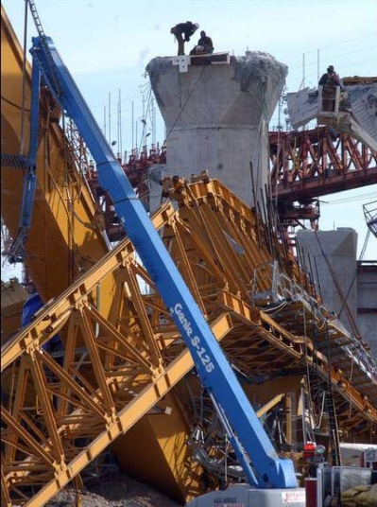
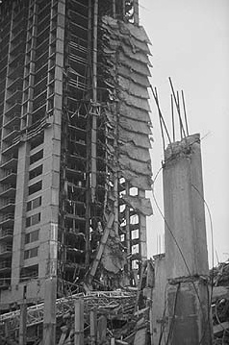
Construction Performance management Basics
Workers are not satisfied
Bad health and safety record (too many accidents)
Bad working conditions (weather, facilities)
Job security
Frequently changing location of work

Slide 10
Construction Performance management Basics
The supply team is not satisfied
According to the Egan’s rethinking construction report, the health and safety record of construction is the second worst of any industry.

Slide 11
Construction Performance management Basics
DETR statistics shows that people working in the construction industry...
are getting older
are likely to work for a small firm
are quite likely to be self-employed
are working longer hours than other industries
are more likely to be involved in an accident
are paid around the average for all industries and services

Slide 12
Construction Performance management Basics
Industry has bad reputation
Lack of performance
Lack of innovation and development
‘Cowboy’(unreliable) builders
Industry dominated by the old craft culture
Fragmented and adversarial
The competition for the best talent is very high (for example the choice between becoming a doctor, lawyer or civil engineer).

Slide 13
Construction Performance management Basics
Low profitability
(short cuts, bankruptcy, lack of investment in research and development)
High business failure (mainly SME’s)
Profitability is low (across the board)
According to the Egan’s rethinking construction report, the construction has a low and unreliable rate of profitability

Slide 14
Construction Performance management Basics
Lack of innovation and development
Lack of high technology in design and construction
Lack of branding
Building products are behind in terms of value and intelligence.
High reliance on site based and unskilled labour
Demand for buildings is largely client led

Slide 15
Construction Performance management Basics
Current State: Industry and Practice
Design and construction are two separate processes
longer than necessary duration
inefficient design
tension and adversarial culture
Architect is project leader
focus on design and aesthetics rather than cost, time and quality of service
limited project management skills

Slide 16
Construction Performance management Basics
Current State: Industry and Practice
Competitive tendering is the most common way in which contractors and professionals obtain work
focus on cost rather than value
innovation suffer
discontinued project teams
high tendering cost
planning and estimating suffer

Slide 17
Construction Performance management Basics
Current State: Industry and Practice
Construction is dominated by the old craft culture (site based)
quality control suffer
sensitivity to weather and site conditions
less reliance on technology and modern production methods
limited standardisation and hence high cost and duration

Slide 18
Construction Performance management Basics
Current State: Industry and Practice
Industry is fragmented and construction is performed by specialist subcontractors
long supply chains that are difficult to manage and control
training and development suffer
disputes and tension rise

Slide 19
Construction Performance management Basics
Current State: Industry and Practice
Different projects are procured by different temporary teams
discontinuity of teams means that on each new project practitioners face an initial period of team building
different organisations would have different processes and technology.
no branding and strategic product development between design, manufacturing and assembly.

Slide 20
Construction Performance management Basics
Current State: Industry and Practice
Project team responsibility ends at completion of construction
life cycle costing is not taken into account
information on the performance of the building in meeting consumers’ (occupiers) needs are not fed back to project teams.

Slide 21
Construction Performance management Basics
Current State: Industry and Practice
Client is not the consumer and industry is dominated by occasional clients.
lack of real customer focus
misalignment of interest between stakeholders.
Clients are inexperienced and have limited power to exert change in industry

Slide 22
Construction Performance management Basics
Current State: Industry and Practice
Need to price before production
high financial risk
need to complete all design before construction cost can be estimated.
project performance is judged by the extent to which cost can be kept to the estimated (rather than the extent to which value is maximised).

Slide 23
Construction Performance management Basics
Current State: Project Management
Main focus was on setting cost, time and quality targets and then meeting these targets.
Construction was unique and hence management concepts and tools had to come from within the industry,
PM in the main is to do with maximising efficiency and predictability given the scenario. Boundaries and “rules of the game” were assumed to be fixed (e.g. use of standard forms of contracts)

Slide 24
Construction Performance management Basics
Current State: Project Management
In traditional project management, a project has a well-defined scope and can be understood as a sequential dependent series of activities
The project is managed by central authority to ensure activities meet schedule and budget targets
Control actions attempt to return the project to its plan
So how would project management look like if, for example, design was not completed at start of construction?

Slide 25
Construction Performance management Basics
Questions to be asked
How can the Construction Industry be improved?
What are the developments needed?
How can project management contribute to this development
Assuming that road for change is a long one, where do we initially put our effort to get maximum returns?

Slide 26
Construction Performance management Basics
Main Findings and the Change Agenda
Procurement system should be concurrent and integrated (concurrent engineering)
Tackle fragmentation and adversarial culture by partnering and teambuilding
Improve productivity, quality and cost by adopting “new” management concept (Lean, Benchmarking, VM, SCM, Process mapping and Reengineering)
Industry must measure its performance and define scopes for improvement (KPI)
Briefing the team (client empowerment, visualisation)

Slide 27
Construction Performance management Basics
Main Findings and the Change Agenda
Move away from competitive tendering and cost as the selection criteria
More use of standardisation and pre-assembly
Respect the people working in the industry (training, better working conditions, etc)
Take full advantage of IT and other new technology
Develop people and culture necessary to facilitate all of the above

Slide 28
Construction Performance management Basics
Performance Planning and indicators
Performance Management is the process of:
Planning Performance (setting KPA’s, objectives and standards that are linked to corporate strategy, development plans).
Maintaining Performance (monitoring, feedback, coaching and mentoring, regular interactions re goal achievement)
Reviewing Performance (formal feedback and ratings – evaluating performance)
Rewarding of performance (increases, bonuses, incentives, etc)

Slide 29
Construction Performance management Basics
Performance Planning covers 80% of the process and it includes:
Identifying Key Value Drivers of stakeholders
Defining Key Performance Areas (KPA’s)
Defining Objectives
Defining Targets
Devel a training & development plan

Slide 30
Construction Performance management Basics
Performance tools and measurement
Highly competitive and profound changes in the construction industry are forcing construction executives to continuously improve the performance of their firms. According to Luu et al. (2008).
‘‘performance measurement is the heart of cease-less improvement. As a general rule, benchmarking is the next step to improve contractors’ efficiency and effectiveness of products and processes’’.
The main objective of performance evaluation is to assist managers and members of the organization in developing the direction, traction and speed of their organization ( Cokins, 2006).

Slide 31
Construction Performance management Basics
Formerly, construction companies used financial measures to measure and evaluate their performance. 'The dissatisfaction with financially based performance measurement started in the 1950s and has built momentum since the late 1970s’’ (Bassioni et al., 2004).
The main problem lies in the fact that financial indicators are lagging indicators, in the sense that they tell the results of managerial actions already taken. However, managers need current, up-to-date, and mostly non financial information to be able to take better decisions (Bassioni et al., 2004).

Slide 32
Construction Performance management Basics
After a long dependence on financial measures, many studies and researches have been conducted to develop performance measurement frameworks that included financial and non financial indicators.
The balanced scorecard (BSC), first proposed in 1992 issue of Harvard Business Review (HBR) by Kaplan and Norton, presents four different performance perspectives from which executives can choose measure.
The BSC complements:
Financial indicators and operational measures
customer satisfaction
internal processes, and
The organization innovation and improvement activities

Slide 33
Performance Measurement and monitoring
Performance Measurement
Definition
“a process that involves the assignment of numerals to objects or events according to rules or to represent properties”
“the process of determining how successful organizations or individuals have been in attaining their objectives”
Performance measures are the numerical or quantitative indicators that show how well each objective is being met (Sapri & Pitt, 2005).

Slide 34
Performance Measurement and monitoring
Bititci et al. (1997) explain the distinction between performance management and measurement in that the first “… is seen as a closed loop control system which deploys policy and strategy, and obtains feedback from various levels in order to manage the performance of the system”
performance measurement system “… is the information system which is at the heart of the performance management process and it is of critical importance to the effective and efficient functioning of the performance management system.”

Slide 35
Performance Measurement and monitoring
Purpose of PMe
Position checking: to continually monitor progress and define current position.
Position communicating: to inform employees and customers on at least an annual/Monthly basis through performance reports in order to increase transparency and encourage participation.
Priorities confirmation: to identify the priorities of activities, performance information, and data to be provided.
Progress compulsion: to enable the organization to discover potential improvement areas in order to improve performance.

Slide 36
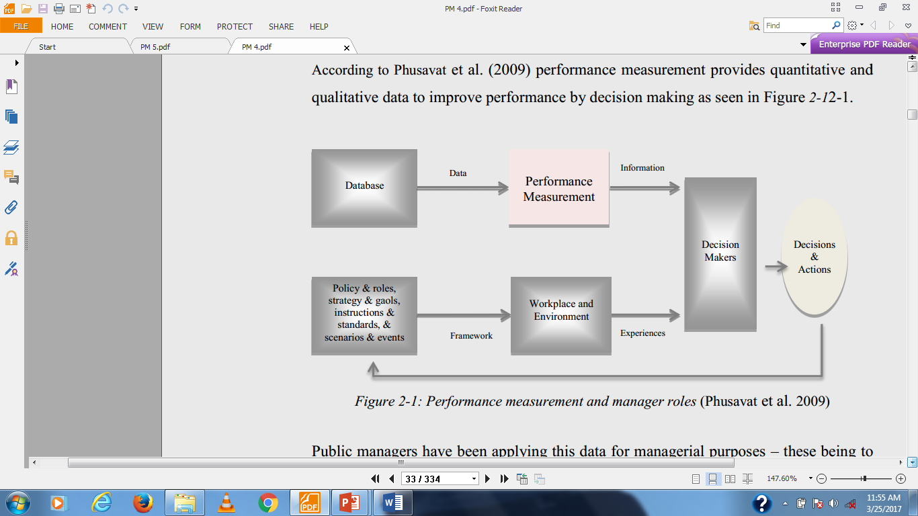
Performance Measurement and monitoring

Slide 37
Performance Measurement and monitoring
Process of Performance Measurement
There are so many process recommended by different researchers at different times
Determine requirements and identify PMs;
Identify desired goals;
Monitor achievements; and,
Have on-going reviews of areas of failure.

Slide 38
Performance Measurement and monitoring
Or
as per (Kim et al. 2007):
Performance measurement is an on-going process, the purpose of which is to enhance the improvement, and achievement of aims and objectives. It can be summarized in five steps

Slide 39
Performance Measurement and monitoring
Measuring performance phase, which includes establishing basic attributes of performance management, performance objectives, success factors and targets.
Store phase, which is the recording of data and information, as well as defining the way which they are demonstrated.
Analysis of phase.
Reporting performance phases.
Using data phase.

Slide 40
Performance Measurement and monitoring
Models of Performance Measurement/Management
BSC
Pyramid
International key Quality Awards Models
New generation models

Slide 41
Performance Measurement and monitoring
Balanced Scorecard /BSC
The name Balanced Scorecard invokes two images: that of a balance and that of a scorecard used to keep a record by making marks or notches on a card or tally board.
The Balanced Scorecard (BSC) is a performance management system which incorporates four main measurement categories (perspectives) each of which with a wide range of potential sub-measures.

Slide 42
Performance Measurement and monitoring
BSC
Financial Perspective
The Internal Business Process Perspective
The Customer Perspective
Innovation, learning and growth perspective(Recent Contributions)

Slide 43
Performance Measurement and monitoring
The difference with traditional approaches to performance measurement is that it includes a range of "leading and lagging" indicators - customer perspective, internal/business processes, learning and growth, and financial - to evaluate whether a business is moving toward its strategic goals (Gentia Software 1998 p5).
BSC recognizes that the financial measures are lagging indicators and therefore the result of the other three leading indicators.

Slide 44
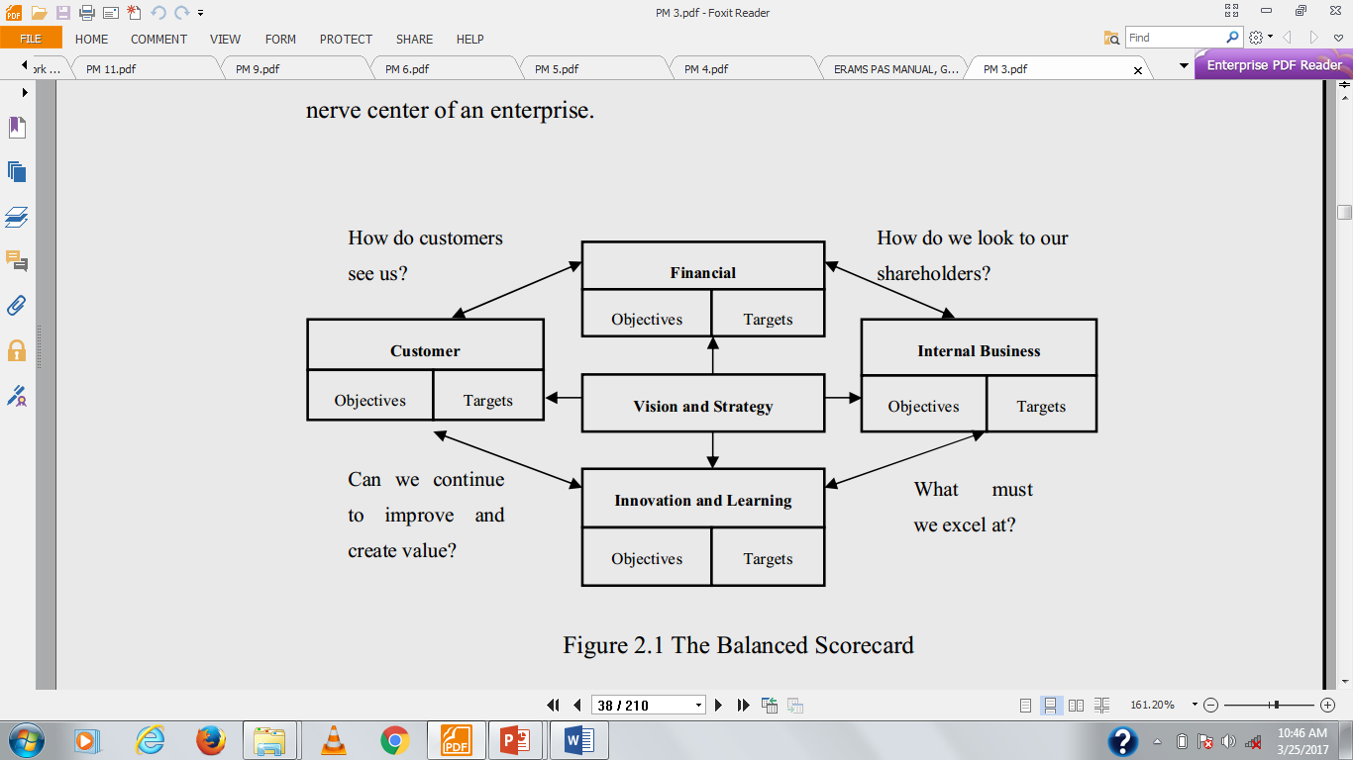
Performance Measurement and monitoring

Slide 45
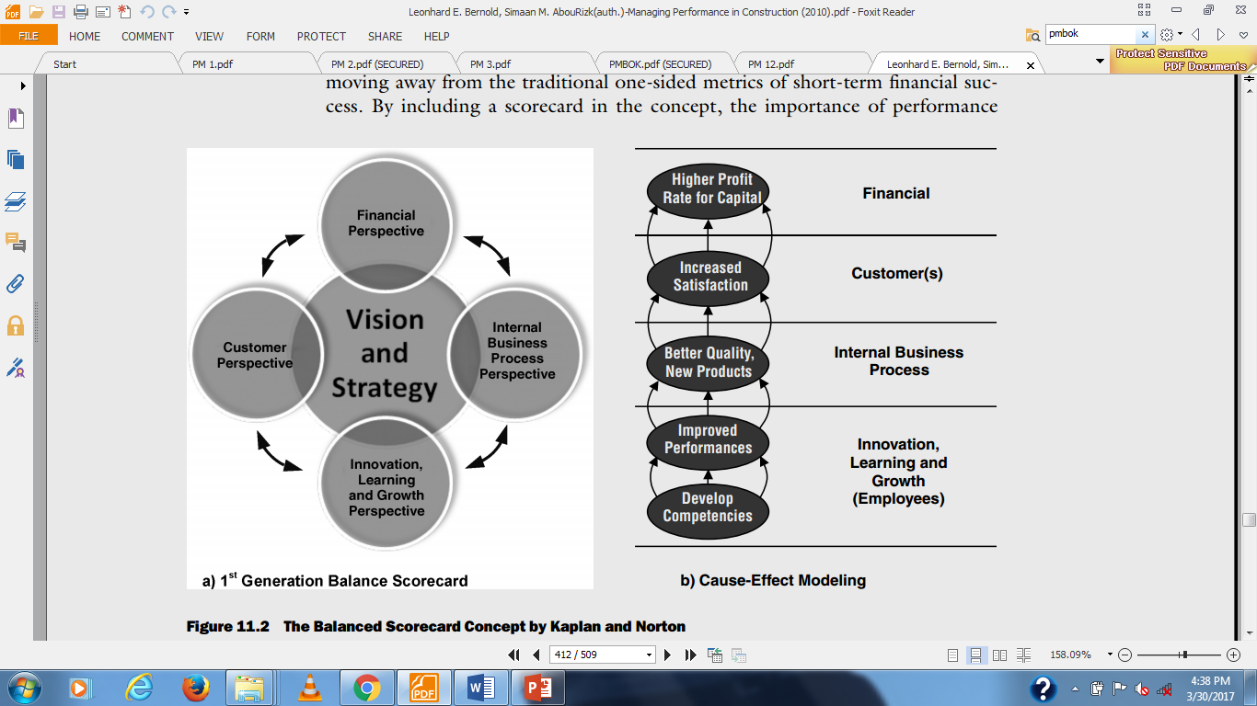
Performance Measurement and monitoring

Slide 46
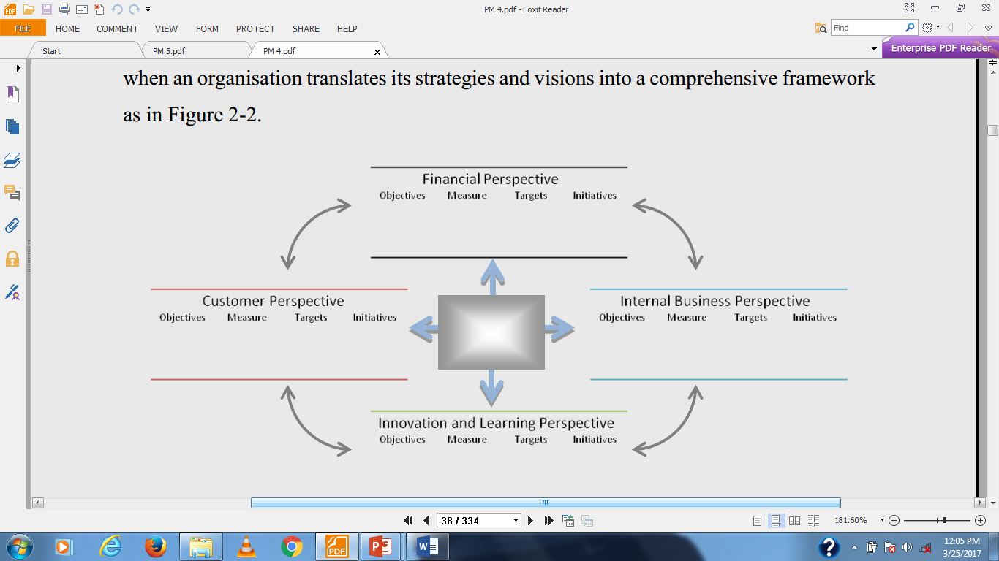
Performance Measurement and monitoring

Slide 47
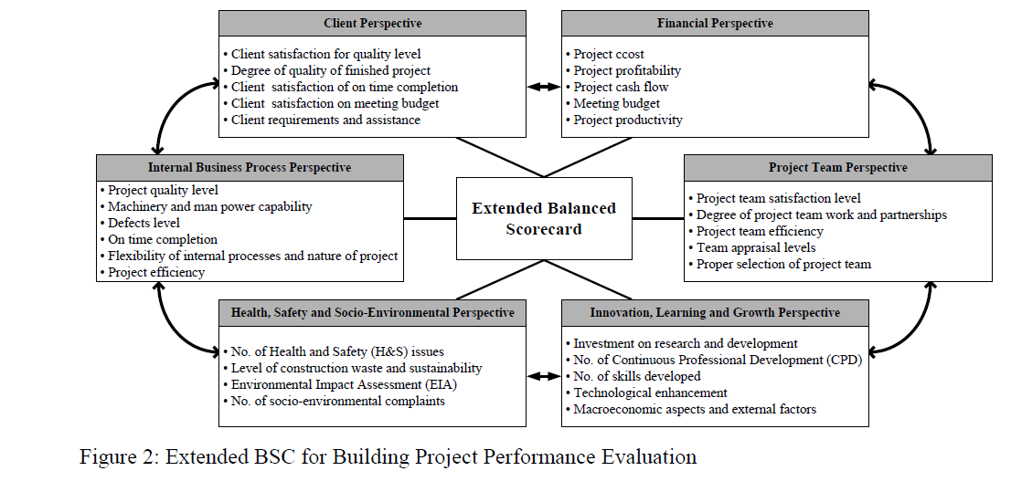
Performance Measurement and monitoring
Wadugodapitiya, R. R. M. M. K.and etal

Slide 48
Performance Measurement and monitoring
International key Quality Awards Models
Malcolm Baldridge National Quality Award (MBNQA)
leadership,
information and analysis
strategic planning
human resources development and management
process management
business results, and
customer focus and satisfaction

Slide 49
Performance Measurement and monitoring
Leadership: How upper management leads the organization, and how the organization leads within the community.
Strategy: How the organization establishes and plans to implement strategic directions.
Customers: How the organization builds and maintains strong, lasting relationships with customers.
Measurement, analysis, and knowledge management: How the organization uses data to support key processes and manage performance.
Workforce: How the organization empowers and involves its workforce.
Operations: How the organization designs, manages and improves key processes.
Results: How the organization performs in terms of customer satisfaction, finances, human resources, supplier and partner performance, operations, governance and social responsibility, and how the organization compares to its competitors.

Slide 50
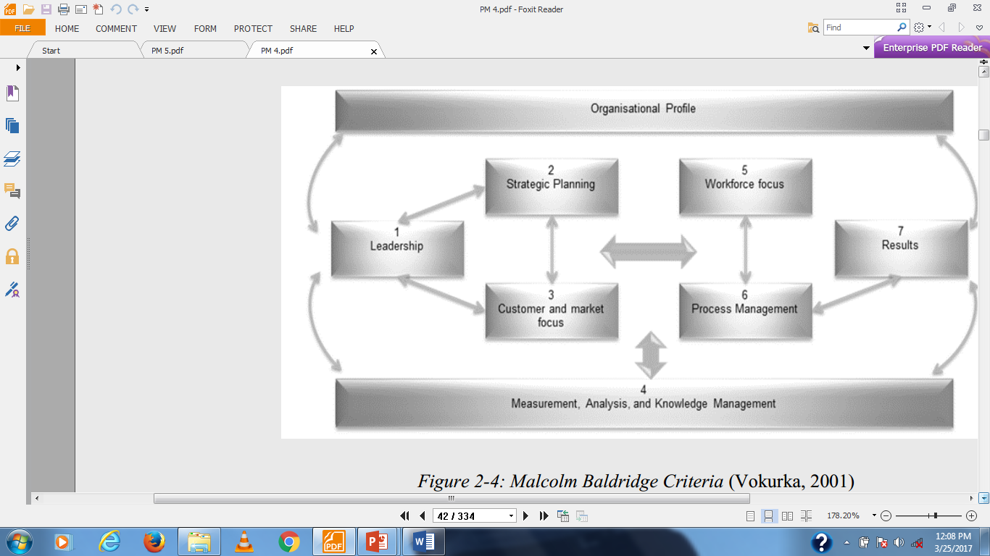
Performance Measurement and monitoring

Slide 51
Performance Measurement and monitoring
The EFQM (European Foundation for Quality Management) excellence model)
A non-prescriptive framework based on nine criteria, can be used to assess an organization's progress towards excellence.
The model recognizes that there are many approaches to achieving sustainable excellence in all aspects of performance.

Slide 52
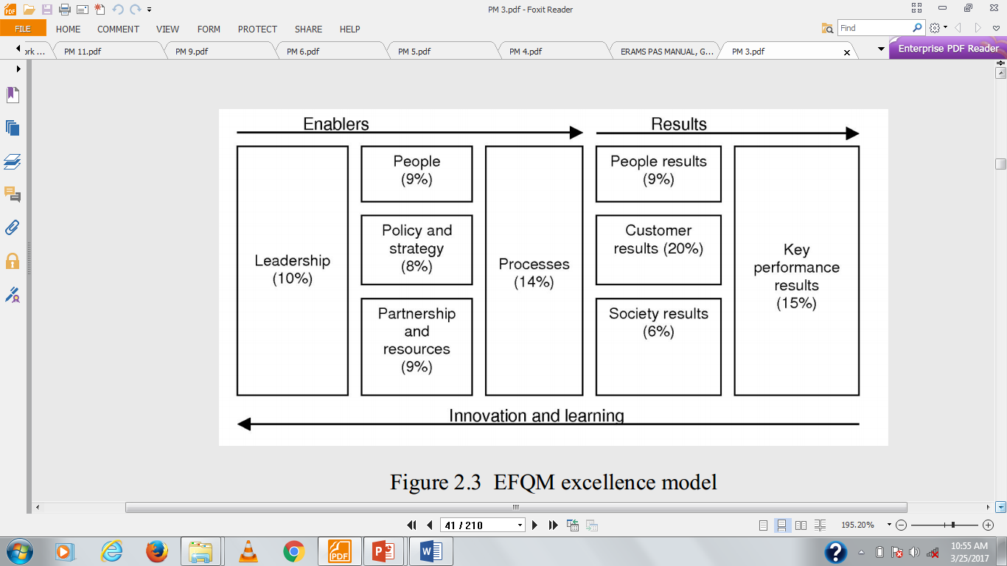
Performance Measurement and monitoring

Slide 53
Performance Measurement and monitoring
Performance pyramid
The strategic measurement analysis and reporting technique (SMART) system (also known as the performance pyramid) was developed as a result of dissatisfaction with traditional performance measures such as utilization, efficiency, productivity and other financial variances

Slide 54
Performance Measurement and monitoring
Level 1: At the top of the organization is the corporate vision or Mission through which the organization describes how it will achieve long-term success and Competitive Advantage.
Level 2: This focuses on the achievement of an organization's CSFs/Critical success factors and core competences/in terms of market-related measures and financial measures. The Marketing and financial success of a proposal is the initial focus for the achievement of corporate vision.
Level 3: The marketing and financial strategies set at level 2 must be linked to the achievement of customer satisfaction, increased flexibility and high productivity at the next level. These are the guiding forces that drive the strategic objectives of the organization.
Level 4: The status of the level 3 driving forces can be monitored using the lower level departmental indicators of quality, delivery, cycle time and waste.

Slide 55
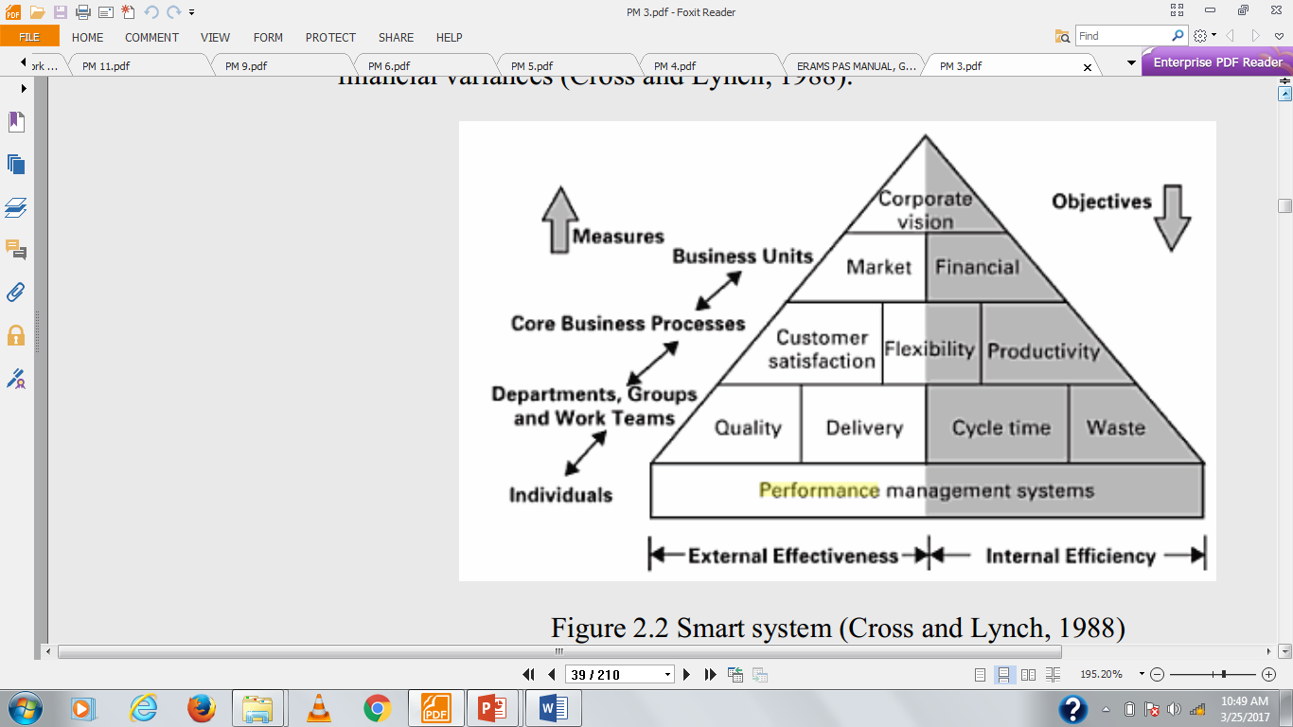
Performance Measurement and monitoring

Slide 56
Performance Measurement and monitoring
 | Enumeration:
STRONG POINTS | • attempt to integrate corporate objectives with operational performance indicators • manage PM strategically
WEAK POINTS | • does not provide any mechanism to identify key performance indicators • fails to specify the form of the measures • does not explicitly integrate the concept of continuous improvement

Slide 57
Performance Measurement and monitoring
Others
The Performance Prism
Kanji Business Excellence Measurement System (KBEMS)
Theory of Constraints (TOC)

Slide 58
Performance Measurement and Monitoring
Key Performance indicators
What is KPI
KPI‘ A set of quantifiable measures that a company or industry uses to gauge or compare performance in terms of meeting their strategic and operational goals.
KPIs vary between companies and industries, depending on their priorities or performance criteria. Also referred to as "key success indicators (KSI)".

Slide 59
Performance Measurement and Monitoring
Objectives of KPI
Improve personnel’s understanding of KPIs.
Improve personnel’s awareness of maintenance performance.
KPIs are directly linked to the overall goals of the company.
KPIs are measurements that define and track specific business goals and objectives.
The larger or smaller organizational strategies require monitoring, improvement, and evaluation.
Once an organization has analyzed its mission, identified all its stakeholders, and defined its goals, it needs a way to measure progress toward those goals.
KPIs are utilized to track or measure actual performance against key success factors.

Slide 60
Performance Measurement and Monitoring
Key Success Factors (KSFs) only change if there is a fundamental shift in business objectives.
Key Performance Indicators (KPIs) change as objectives are met, or management focus shifts.
Why do we Use KPI’s
Performance effectiveness.
For the accuracy,
actual reflection of the process
efficacy in delivering the outcome.
The effects of a change can be monitored reliably, repeatedly and accurately by KPI.

Slide 61
Performance Measurement and Monitoring
A KPI can be used to
Closely monitor the results of actions
Detect potential problems and it can drive improvement.
It is reasonable to use the KPI as a tool to improve ongoing process performance.

Slide 62
Performance Measurement and Monitoring
Uses of KPI
A key performance indicator (KPI) or performance indicator is used to measure the performance.
To make the decision making process easier.
Key Performance Indicators (KPIs) help organizations to understand how well they are performing in relation to their strategic goals and objectives.
They are used by an organization to evaluate its success or the success of a particular activity in the organization.

Slide 63
Performance Measurement and Monitoring
Uses of KPI (Cont’d)
To analyze the operational details of the organization.
It helps to focus on the facts clearly.
Key performance indicators are used periodically assess the performances of organizations, business units, and their division, departments and employees.

Slide 64
Performance Measurement and Monitoring
How to design KPI’s
KPIs should be clearly linked to the strategy, i.e. the things that matter the most.
KPIs have to provide the answers to our most important questions.
KPIs should be primarily designed to empower employees and provide them with the relevant information to learn.
Identifying the KPI’s Related to strategic aims.
Identify what makes the organization success or failures.
Controllable and accountable.
Qualitative and quantitative.
Long term and short term

Slide 65
Performance Measurement and Monitoring
How to design KPI’s (cont’d)
Consider Stakeholder needs.
Identify important aspects.
Establish Company Goals and KPIs.
Select Performance Indicators and Metrics.
Set Targets and Track Performance.

Slide 66
Performance Measurement and Monitoring
How Are KPIs Evaluated
A KPIs status and score are determined by comparing its actual value against the thresholds that you define.
The performance status of a KPI is represented by the status icon that you assign to each range.

Slide 67
Performance Measurement and Monitoring
Advantages of KPIs
Identifies everything that is easy to measure and count.
Visibility on performance and strategic goal
Agility/Quickness in decision making
Efficient management
A team work on the basis of shared and measurable objectives.
KPI’s do not give answers, rather they raise questions and direct once attention

Slide 68
Performance Measurement and Monitoring
Advantages of KPIs
It helps to measure both the financial and operational goals of a company.
Improve operations.
Increase project flexibility.
Better job costing processes.
KPIs focus employees attention on the tasks and processes.

Slide 69
Performance Measurement and Monitoring
Disadvantages KPIs
The KPI’s is intended to simply improve future results without reference to external parties and benchmarks.
In that case one must develop KPI’s which use existing data available to the organization.
Frequency of Data Collection.
Should be measured frequently.
No connection with the external database.

Slide 70
Performance Measurement and Monitoring
Types of KPI
Process KPIs - measure the efficiency or productivity of a business process. Examples - Days to deliver an order.
Input KPIs - measure assets and resources invested in or used to generate business results. Examples – Amount/Dollars spent on research and development, Funding for employee training, Quality of raw materials.
Output KPIs - measure the financial and nonfinancial results of business activities. Examples - Revenues, Number of new customers acquired.
Leading KPI measure activities that have a significant effect on future performance. Drive the performance of the outcome measure, being predictor of success or failure.

Slide 71
Performance Measurement and Monitoring
Lagging KPI is a type of indicator that reflect the success or failure after an event has been consumed. Such as most financial KPIs, measure the output of past activity. Outcome KPI - Reflects overall results or impact of the business activity in terms of generated benefits, as a quantification of performance. Examples are customer retention, brand awareness.
Qualitative KPI - A descriptive characteristic, an opinion, a property or a trait. Examples are employee satisfaction through surveys which gives a qualitative report.
Quantitative KPI - A measurable characteristic, resulted by counting, adding, or averaging numbers. Quantitative data is most common in measurement and therefore forms the backbone of most KPIs. Examples are Units produced per man-hour.

Slide 72
Performance Measurement and Monitoring
Characteristics of a good KPI
KPI is always connected with the corporate goals.
A KPI are decided by the management.
They are the leading indicators of performance desired by the organization.
Easy to understand
A KPI need to be: Specific, Measurable, Achievable, Result-oriented or Relevant and Time-bound

Slide 73
Performance Measurement and monitoring
What are the most common KPI for construction Projects
S.N | Author Name | Country | KPI
1 | Jastaniah (1997) | Saudi Arabia | 1. Client satisfaction
 |  |  | 2. Planning period
 |  |  | 3. Staff experience
 |  |  | 4. Communication
 |  |  | 5. Safety
 |  |  | 6. profitability
 |  |  | 7. Payment
 |  |  | 8. claims
 |  |  | 9. Closeness to budget

Slide 74
Performance Measurement and monitoring
S.N | Author Name | Country | KPI
1 | Egan (1998) | UK | 1. Predictability Time, cost
 |  |  | 2. Construction cost
 |  |  | 3. Construction time
 |  |  | 4. Productivity
 |  |  | 5. Safety
 |  |  | 6. profitability
 |  |  | 7. defects
 |  |  | 8. Client Satisfaction

Slide 75
Performance Measurement and monitoring
S.N | Author Name | Country | KPI
1 | Rankin et al. (2008) and Canadian Construction Innovation Council (CCIC)(2007 | Canada | 1. Time
 |  |  | 2. Cost
 |  |  | 3. Quality
 |  |  | 4. Safety
 |  |  | 5. scope
 |  |  | 6. Innovation
 |  |  | 7. Sustainability
 |  |  | 8. Client Satisfaction

Slide 76
Performance Measurement and monitoring
S.N | Author Name | Country | KPI
1 | Department of the Environment, Transport, and the Regions (DETR), 2000 Department of the Environment, Transport, and the Regions (DETR) (2000) | UK | 1. Time
 |  |  | 2. Cost
 |  |  | 3. Quality
 |  |  | 4. Client Satisfaction
 |  |  | 5. Client changes
 |  |  | 6. Business Performance
 |  |  | 7. Health and safety

Slide 77
Performance Measurement and monitoring
S.N | Author Name | Country | KPI
1 | Luu et al. (2008) | Vietnam | 1. Construction cost
 |  |  | 2.Construction time
 |  |  | 3. Customer satisfaction
 |  |  | 4. Quality management
 |  |  | 5. Team Performance
 |  |  | 6. Change Management
 |  |  | 7. Materials management
 |  |  | 8.Safety

Slide 78
Performance Measurement and Monitoring
The main KPIs in Infrastructure sector
The main five KPI’s in Infrastructure sector are:
Client Satisfaction.
Construction Time & Cost.
Productivity.
Defects.
Profitability

Slide 79
2.3 Performance Improvement principles and tools
Productivity
Lean concept
Kaizen
BSC
BPR
EVM
TQM
Concurrent Engineering
Benchmarking

Slide 80
Productivity
Productivity in construction
Construction productivity, which is measured by output per unit of resource input, plays a key role in the success of a construction project. High productivity leads to lower unit cost to carry out a task or operation. It is highly related to cost and time performance of a project
Factors affecting construction labor productivity:
Industry related factors
Project related factors
Labor related factors
Management related factors

Slide 81
Productivity…
Industry related factors
Investment
Government
Research and development
Weather
Building code and specification

Slide 82
Productivity…
Project related factors
Project design
Design changes
Method of construction
Type of contract
Location
Type of project
Work type
Physical element

Slide 83
Productivity…
Labor related factors
Supply and demand
Unions rules
Crew composition
Crew size
Skills
Capabilities
Motive

Slide 84
Productivity…
Management related factors
Planning and scheduling
Control
Project organization
Supervision
Materials and tools availability
Lack of motivation of workers
Site layout
Work redoing over crowded areas and delays

Slide 85
Productivity…
Causes and Effects of Management
Ineffectiveness
The management ineffectiveness causes ….. delays which result in …..poor productivity.

Slide 86
Productivity…
Planning and scheduling
Lack of project planning and scheduling is one of the important reasons of low construction productivity.
Planning a project can reduce production costs by increasing productivity of craftsman and optimizing utilization of available resources.

Slide 87
Productivity…
Control
Problems arise every day that could not have been foreseen.
Adverse weather
Material delivery delays
Labor disputes
Job accidents
Without time control, rescheduling could not accomplished and so productivity will suffer due to lack of coordination and communication and resource shortage.
Can disrupt the original plans

Slide 88
Productivity…
Project Organization
The main task of any organization is to plan, direct and control.
Poor organization result in poor productivity.
Defining individual positions of authority and responsibility will lead to an effective operating environment and good productivity.

Slide 89
Productivity…
Supervision
Although unnecessary supervision will increase the cost of work, insufficient supervision will result in confusion delays and decrease productivity.
The labor productivity is increased by increasing the number of man hours per day that the field supervisor spent in contact with the crew.

Slide 90
Productivity…
Material and tool availability
Unavailability of material and tool had a significant adverse impact on the productivity of labor.
Material unavailability loss between 6.4 and 8.4 man-hr/week
Tool unavailability loss between 3.4 and 5.1 man-hr/week
When formal material management programs are applied in any project, a minimum 6% improvement in labor productivity should be achieved.

Slide 91
Productivity…
Work redoing and delays
Work redone maintained a position as one of three worst problems leading to poor productivity.
The amount of times spent on rework was between 4.9 – 7.7 man-hr/week.
Causes of work redone were mainly due to engineering and management inefficiencies.
Craftsmen spent an average of 14.3% of their time redoing work.

Slide 92
Productivity…
Lack of motivation
The greater the worker motivation, the greater his expenditure of effort.
Lack of material, frequent change orders, conflict of crews because of improper scheduling, lack of equipment, etc. frustrate the worker and produce low productivity.

Slide 93
Productivity…
Site layout
Site layout of the project is a very important organization tasks.
The assigned location of different job components affects productivity, safety, workers satisfaction, and communication.
Approximately, 7% of a day is nonproductive because of a non optimal site layout.

Slide 94
Productivity…
Information and communication
Lack of information, uncertainty regarding design factors, site conditions, client wishes, and regulatory requirement result in design delay, redesign and substantial loss of productivity.
Approximately, 9% of a day is nonproductive because of poor or inadequate communications at the job site.

Slide 95
Productivity…
Authority and decision making
Group participation in decision making has been proven to be an effective method of increasing productivity.
Participation of work group in changing work methods increases productivity by 14% compared to non participating groups.

Slide 96
Productivity…
Productivity VS Quality
Quality means; inspection, quality control, quality assurance, and total quality management.
Low quality of construction will cause redoing work.
Redoing work affects the production rate and decrease the output.
When output decreases, productivity decreases.

Slide 97
Productivity…
Production rate increase
Use shifts
Use two or more shifts instead of one shifts
Apply overtime
Increase shift period to 10 hours instead of 8 hours
Increase resources
Use more resources to increase production rate

Slide 98
Productivity…
Production rate
a
c
d
50 hr/week
60 hr/week
b
e
Time
10 -12 week
Overtime Effect on Output

Slide 99
Productivity…
Methods to improve construction productivity
Step 1 → Inspire Your Workers
Step 2 → Improve Communications
Step 3 → Lay Out A Productive Jobsite
Step 4 → Schedule Your Work
Step 5 → Analyze Project Reports
Step 6 → Manage Equipment Productively
Step 7 → Improve Safety
Step 8 → Pay Attention To Quality

