Slide 1

CHAPTER 4

Slide 2
Cost management is the process, which is necessary to ensure that the planned development of a design and procurement of a project is such that the price for its construction provides value for money (VFM) and is within the limits anticipated by the client.
Construction is a major capital expenditure, which clients do not commence until they are certain that there is a benefit. This benefit may be for society in the case of public projects, with justification based on a cost–benefit analysis, or purely based on financial considerations in the case of private projects.

Slide 3
Most clients are working within tight pre-defined budgets, which are often part of a larger overall scheme. If the budget is exceeded or the quality not met the scheme could fail.
Pre contract estimating sets the original budget – forecasting the likely expenditure to the client. This budget should be used positively to ensure that the design stays within the scope of the original scheme

Slide 4
When developing an estimate the following factors need to be considered:
Land acquisition including legal fees;
Client’s own organization costs allocated to the project (this obviously varies but can be as much as 10% of the overall project budget);
Site investigation (frequently underrated and under-budgeted resulting in unnecessary extra costs and time – could be as much as 1% of budget);
Enabling works, decontamination;

Slide 5
Insurances (many major clients prefer to insure against the risks and take out a project insurance policy covering both themselves and the contractor – may be up to 1% of the budget);
Consultants’ fees including design (on large transportation and infrastructure projects this can be as much as 15–20% of the budget);
Construction costs (typically account for between 70% and 80% of the project sum) (excluding land);
Value added tax (VAT) (currently charged at 15%);
Contingency and risks (covers for the unknown and may be between 20% and 25%) or if project of long duration the contingency factor could be double or triple these items;
Financing and legal costs (financing costs can be substantial depending on financing method chosen and typical bank rate – could be anything between 7% and 20%; lawyers are expensive – anything up to £500 per hour and more).

Slide 6
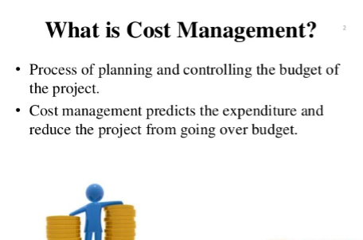

Slide 7
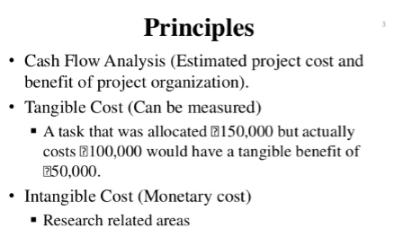


Slide 8
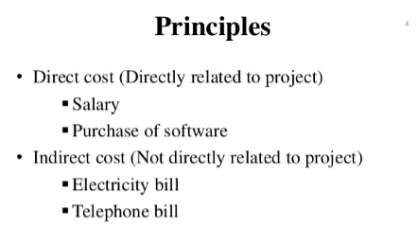


Slide 9
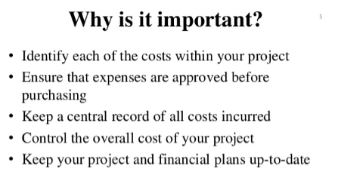


Slide 10


Slide 11
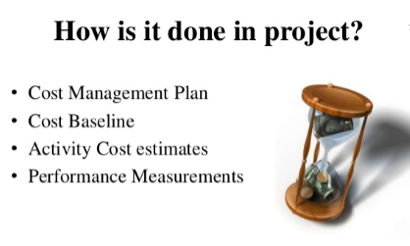

Slide 12
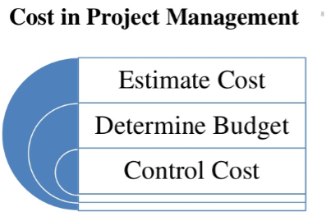

Slide 13
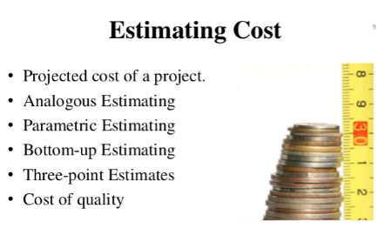

Slide 14
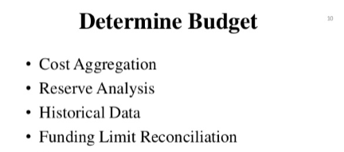


Slide 15
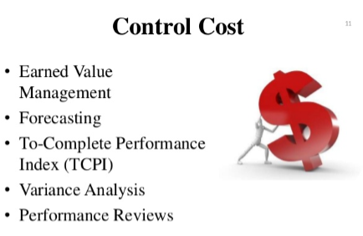

Slide 16
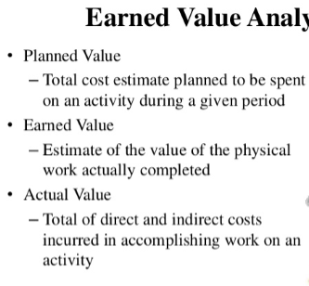


Slide 17
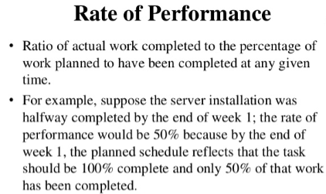


Slide 18
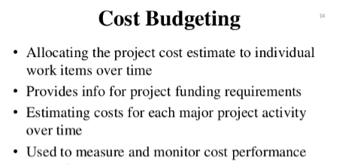


Slide 19
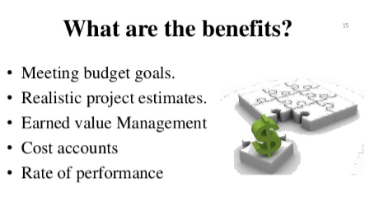

Slide 20
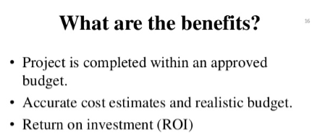


Slide 21
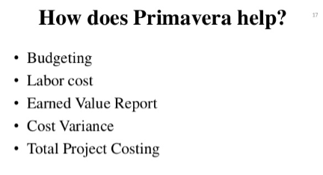

Slide 22
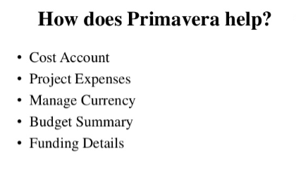

Slide 23
