Slide 1
Chapter Six Java Web Technology

Slide 2
Java Web Technology
There are different types of Web Technologies in Java, of which the following are the most well-known technologies.
Servlet
Java Server Page (JSP)
Java Server Face(JSF)

Slide 3
Servlet

Slide 4
Objectives
To understand the concept of servlets.
To run servlets with Tomcat.
To know the servlets API.
To create simple servlets.
To create and process HTML forms.
To develop servlets to access databases.
To use hidden fields, cookies, and HttpSession to track sessions.
To send images from servlets.

Slide 5
Introduction
What is a web application?
A web application is an application accessible from the web.
A web application is composed of web components like Servlet, JSP, JSF, etc. and other elements such as HTML, CSS, and JavaScript.
The web components typically execute in Web Server and respond to the HTTP request.
Website
Website is a collection of related web pages that may contain text, images, audio and video.
The first page of a website is called home page.
Each website has specific internet address (URL) that you need to enter in your browser to access a website.
Website is hosted on one or more servers and can be accessed by visiting its homepage using a computer network.
A website is managed by its owner that can be an individual, company or an organization.
A website can be of two types:
Static Website /Web Content
Dynamic Website /Web Content

Slide 6
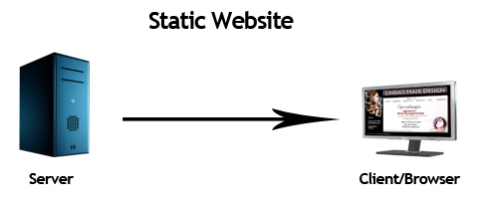
Static website/Web Content
Static website is the basic type of website that is easy to create.
You don't need the knowledge of server side programming and database design to create a static website.
Its web pages are coded in HTML.
Static web contents contain fixed number of pages and format of web page is fixed which delivers information to the client.
Static web pages display the exact same information whenever anyone visits it.
This works fine for static information that does not change regardless of who requests it or when it is requested.
Static information is stored in files.

Slide 7
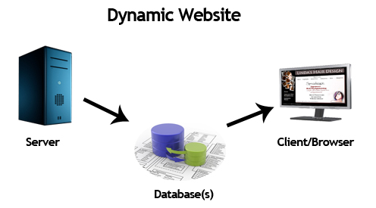
Dynamic website/Web Content
Dynamic website is a collection of dynamic web pages whose content changes dynamically.
It accesses content from a database or Content Management System (CMS).
Therefore, when you alter or update the content of the database, the content of the website is also altered or updated.
Dynamic website uses client-side scripting or server-side scripting, or both to generate dynamic content.
Client side scripting generates content at the client computer on the basis of user input.
The web browser downloads the web page from the server and processes the code within the page to render information to the user.
In server side scripting, the software runs on the server and processing is completed in the server then plain pages are sent to the user. Dynamic Web pages are generated by Web servers.
Example:
Stock quotes are updated whenever a trade takes place.
Election vote counts are updated constantly on Election Day.
Weather reports are frequently updated.
The balance in a customer’s bank account is updated whenever a transaction takes place.

Slide 8
Static vs Dynamic website
Static Website | Dynamic Website
Prebuilt content is same every time the page is loaded. | Content is generated quickly and changes regularly.
It uses the HTML code for developing a website. | It uses the server side languages such as PHP, SERVLET, JSP, and ASP.NET etc. for developing a website.
It sends exactly the same response for every request. | It may generate different HTML for each of the request.
The content is only changed when someone publishes and updates the file (sends it to the web server). | The page contains "server-side" code which allows the server to generate the unique content when the page is loaded.
Flexibility is the main advantage of static website. | Content Management System (CMS) is the main advantage of dynamic website.

Slide 9
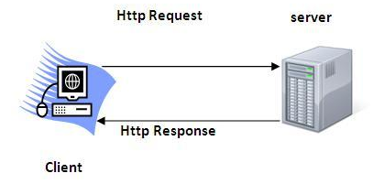
HTTP (Hyper Text Transfer Protocol)
The Hypertext Transfer Protocol (HTTP) is application-level protocol for collaborative, distributed, hypermedia information systems.
It is the data communication protocol used to establish communication between client and server.
HTTP is TCP/IP based communication protocol, which is used to deliver the data like image files, query results, HTML files etc on the World Wide Web (WWW) with the default port is HTTP 80.
It provides the standardized way for computers to communicate with each other.

Slide 10
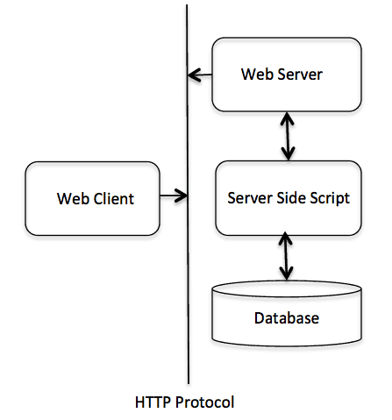
The Basic Architecture of HTTP
HTTP is request/response protocol which is based on client/server based architecture.
In this protocol, web browser, search engines, etc. behave as HTTP clients and the Web server like Servlet behaves as a server
The below diagram represents the basic architecture of web application and depicts where HTTP stands:

Slide 11
Servlet
Servlet technology is used to create a web application (resides at server side and generates a dynamic web page).
Servlet technology is robust and scalable because of java language.
Servlets are Java programs that run on a Web server.
Servlets can be used to process client requests or produce dynamic Web pages.
JSP, JSF, and Java Web services are based on servlets.
Before Servlet, CGI (Common Gateway Interface) scripting language was common as a server-side programming language.

Slide 12
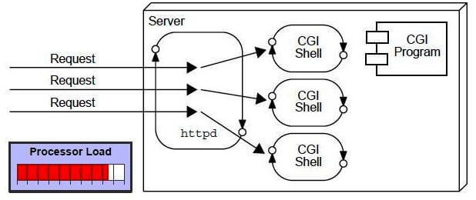
CGI (Common Gateway Interface)
CGI technology enables the web server to call an external program and pass HTTP request information to the external program (CGI Program) to process the request.
For each request, it starts a new process.
CGI was proposed to generate dynamic Web content.
The CGI program processes the request and generates a response at runtime.
Disadvantages of CGI
There are many problems in CGI technology:
If the number of clients increases, it takes more time for sending the response.
For each request, it starts a process, and the web server is limited to start processes.
It uses platform dependent language e.g. C, C++, perl.

Slide 13
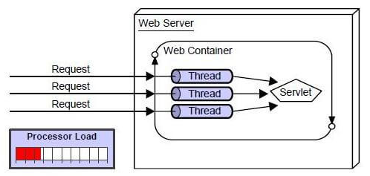
Advantages of Servlet
There are many advantages of Servlet over CGI.
The web container creates threads for handling the multiple requests to the Servlet.
Threads have many benefits over the Processes such as they share a common memory area, lightweight, cost of communication between the threads are low.
The advantages of Servlet are as follows:
Better performance: because it creates a thread for each request, not process.
Portability: because it uses Java language.
Robust: JVM manages Servlets, so we don't need to worry about the memory leak, garbage collection, etc.
Secure: because it uses java language.

Slide 14
CGI vs. Servlets
CGI provides a relatively simple approach for creating dynamic Web applications that accept a user request, process it on the server side, and return responses to the Web browser.
But CGI is very slow when handling a large number of requests simultaneously, because the Web server spawns a process for executing each CGI program.
Each process has its own runtime environment that contains and runs the CGI program.
It is not difficult to imagine what will happen if many CGI programs were executed simultaneously.
System resource would be quickly exhausted, potentially causing the server to crash.

Slide 15
CGI vs. Servlets
Java servlets are successful technology to solve the performance problem of CGI programs .
Java servlets are Java programs that function like CGI programs.
All servlets run inside a servlet container or a servlet server or a servlet engine.
A servlet container is a single process that runs in a JVM.
The JVM creates a thread to handle each servlet.
All the threads share the same memory allocated to the JVM.
Servlets are much more efficient than CGI.
As Java programs, Servlets are object oriented, portable, and platform independent.

Slide 16
The GET and POST Methods
The two most common HTTP requests or methods are GET and POST.
The Web browser issues a request using a URL or an HTML form to trigger the Web server to execute the servlet program.
When issuing a request from an HTML form, either a GET method or a POST method can be used.
If the GET method is used, the data in the form are appended to the request string as if it were submitted using a URL.
If the POST method is used, the data in the form are packaged as part of the request file.
The server program obtains the data by reading the file.
The POST method is more secure than the GET method.

Slide 17
GET and POST
The GET and POST methods both send requests to the Web server.
The POST method always triggers the execution of the corresponding the servlet program.
The GET method may not cause the servlet program to be executed, if the previous same request is cached in the Web browser.
Web browsers often cache Web pages so that the same request can be quickly responded to without contacting the Web server.
To ensure that a new Web page is always displayed, use the POST method.
For example, use a POST method if the request will actually update the database.
If your request is not time sensitive use the GET method to speed up performance.

Slide 18
GET vs POST
GET | POST
1) In case of Get request, only limited amount of data can be sent because data is sent in header. | In case of Post request, large amount of data can be sent because data is sent in body.
2) Get request is not secured because data is exposed in URL bar. | Post request is secured because data is not exposed in URL bar.
3) Get request can be bookmarked. | Post request cannot be bookmarked.
4) Get request is idempotent. It means second request will be ignored until response of first request is delivered | Post request is non-idempotent.
5) Get request is more efficient and used more than Post. | Post request is less efficient and used less than get.

Slide 19
The Servlet API
The servlet APIs are grouped into two packages: javax.servlet and javax.servlet.http packages.
The javax.servlet and javax.servlet.http packages represent interfaces and classes for servlet API.
The javax.servlet package contains many interfaces and classes that are used by the servlet or web container. These are not specific to any protocol.
The javax.servlet.http package contains interfaces and classes that are responsible for http requests only.
Every servlet is a subclass of the HttpServlet class.
You need to override appropriate methods in the HttpServlet class to implement the servlet.

Slide 20
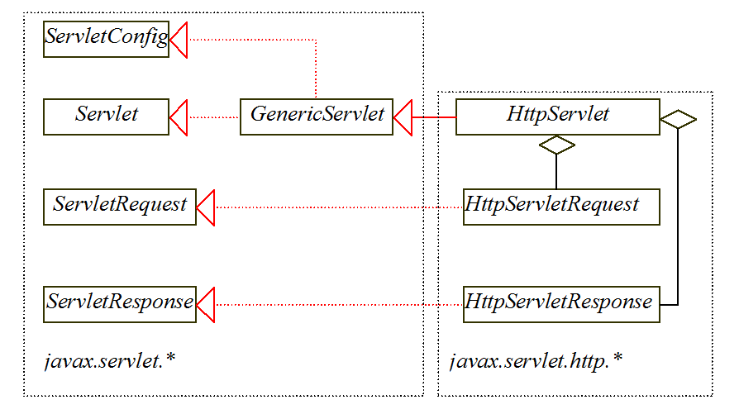
The Servlet API

Slide 21
The Servlet Interface
The javax.servlet.Servlet interface defines the methods that all servlets must implement. The methods are listed below:
public void init() throws ServletException;
public void service(ServletRequest request, ServletResponse response)throws ServletException, IOException;
public void destroy();

Slide 22
Servlet Life Cycle
The init, service, and destroy methods are known as life-cycle methods and are called in the following sequence :
The init method is called when the servlet is first created and is not called again as long as the servlet is not destroyed.
The service method is invoked each time the server receives a request for the servlet. The server spawns/produces/generates a new thread and invokes service.
The destroy method is invoked after a timeout period has passed or as the Web server is terminated. This method releases resources for the servlet.

Slide 23
Servlet Life Cycle
The JVM uses the init, service, and destroy methods to control the servlet.

Slide 24
The GenericServlet Class
The javax.servlet.GenericServlet class defines a generic, protocol independent servlet. This class is abstract class.
It implements javax.servlet.Servlet and javax.servlet.ServletConfig.
ServletConfig is an interface that defines four methods:
getInitParameter(),
getInitParameterNames(),
getServletContext((), and
getServletName()
These methods are used for obtaining information from a Web server during initialization.
All the methods in Servlet and ServletConfig are implemented in GenericServlet except service.

Slide 25
The HttpServlet Class
The javax.servlet.http.HttpServlet class defines a servlet for the HTTP protocol.
It extends GenericServlet and implements the service method.
The service method is implemented as a dispatcher of HTTP requests.
The HTTP requests are processed in the following methods:
doGet is invoked to respond to a GET request.
doPost is invoked to respond to a POST request.
doDelete is invoked to respond to a DELETE request. Such a request is normally used to delete a file on the server.
doPut is invoked to respond to a PUT request. Such a request is normally used to send a file to the server.
doOptions is invoked to respond to an OPTIONS request. This returns information about the server, such as which HTTP methods it supports.
doTrace is invoked to respond to a TRACE request. Such a request is normally used for debugging. This method returns an HTML page that contains appropriate trace information.

Slide 26
The HttpServlet Class
All these methods use the follow signature:
protected void doXxx(HttpServletRequest req, HttpServletResponse resp) throws ServletException, java.io.IOException
The HttpServlet class provides default implementation for these methods.
You need to override doGet, doPost, doDelete, and doPut if you want the servlet to process a GET, POST, DELETE, or PUT request.
NOTE: GET and POST requests are often used, whereas DELETE, PUT, OPTIONS, and TRACE are not.

Slide 27
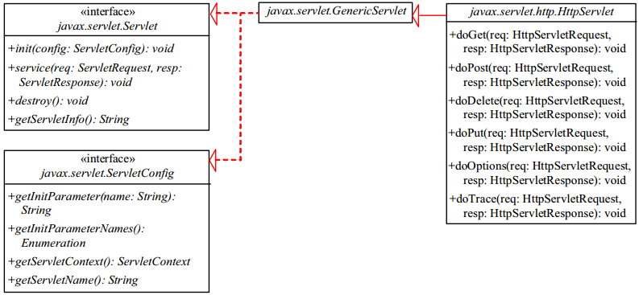
The relationship b/n interfaces and classes
HttpServlet inherits abstract class GenericServlet, which implements interfaces Servlet and ServletConfig.

Slide 28
The ServletRequest Interface
Every doXxx method in the HttpServlet class has a parameter of the HttpServletRequest type, which is an object that contains HTTP request information, including parameter name and values, attributes, and an input stream.
HttpServletRequest is a subinterface of ServletRequest.
ServletRequest defines a more general interface to provide information for all kinds of clients.
The frequently used methods in these two interfaces are shown in Figure below.

Slide 29
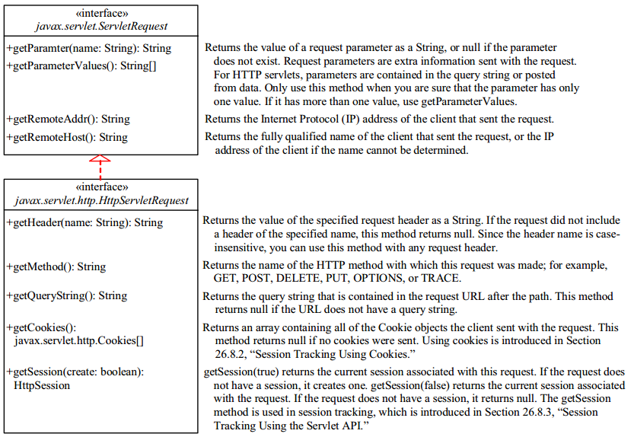
The ServletRequest Interface

Slide 30
The HttpServletResponse Interface
Every doXxx method in the HttpServlet class has a parameter of the HttpServletResponse type, which is an object that assists a servlet in sending a response to the client.
HttpServletResponse is a subinterface of ServletResponse.
ServletResponse defines a more general interface for sending output to the client.

Slide 31
The HttpServletResponse Interface

Slide 32
Creating Servlets
To run Java servlets, you need a servlet container.
Many servlet containers are available for free, but the two popular ones are Tomcat and GlassFish.
Both Tomcat and GlassFish are bundled and integrated with NetBeans 7 (Java EE version).
When you run a servlet from NetBeans, Tomcat or GlassFish will be automatically started.
You can choose to use either of them, or any other application server.
GlassFish has more features than Tomcat and it takes more system resource.

Slide 33
Creating Servlets
To write a Java servlet, you define a class that extends the HttpServlet class.
The servlet container runs and controls the execution of the servlet through the methods defined in the HttpServlet class.
A servlet does not have a main method.
A servlet depends on the servlet engine to call the methods.
Every servlet has a structure like the one shown below:

Slide 34
Creating Servlets
import javax.servlet.*; import javax.servlet.http.*; import java.io.*; public class MyServlet extends HttpServlet { public void init() throws ServletException { ... } public void doGet(HttpServletRequest request, HttpServletResponse response) throws ServletException, IOException { ... } public void doPost(HttpServletRequest request, HttpServletResponse response) throws ServletException, IOException { ... }
public void destroy() { ... }
}

Slide 35
Creating Servlets
The servlet engine controls the servlets using init, doGet, doPost, destroy, and other methods.
By default, the doGet and doPost methods do nothing.
To handle a GET request, you need to override the doGet method; to handle a POST request, you need to override the doPost method.
The doGet method is invoked when the Web browser issues a request using the GET method.
The doGet method has two parameters, request and response.
Request is for obtaining data from the Web browser and response is for sending data back to the browser.

Slide 36
Example: Creating Servlets
import javax.servlet.*;
import javax.servlet.http.*;
import java.io.*;
public class CurrentTime extends HttpServlet { public void doGet(HttpServletRequest request, HttpServletResponse response) throws ServletException, IOException { response.setContentType("text/html"); PrintWriter out = response.getWriter(); out.println("<p>The current time is " + new java.util.Date());
// Close stream out.close(); }
}

Slide 37
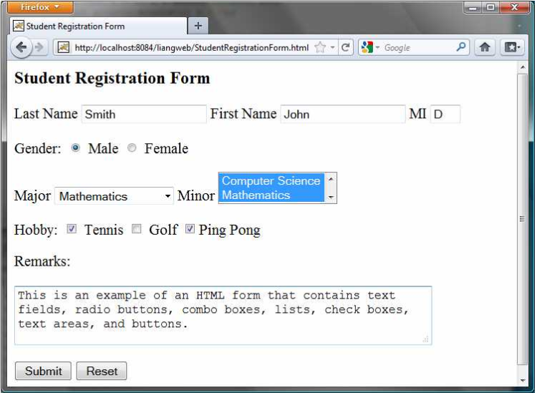
HTML Forms
HTML forms enable you to submit data to the Web server in a convenient form.
As shown in the following Figure, the form can contain text fields, text area, check boxes, combo boxes, lists, radio buttons, and buttons.

Slide 38
HTML tags to construct HTML forms
1. <form>
<form> ... </form> defines a form body.
The attributes for the <form> tag are action and method.
The action attribute specifies the server program to be executed on the Web server when the form is submitted.
The method attribute is either get or post.
2. <label>
<label> ... </label> simply defines a label.

Slide 39
HTML tags to construct HTML forms
3. <input>
<input> defines an input field.
The attributes for this tag are type, name, value, checked, size, and maxlength.
The type attribute specifies the input type.
Possible types are text for a one-line text field, radio for a radio button, and checkbox for a check box.
The name attribute gives a formal name for the attribute. This name attribute is used by the servlet program to retrieve its associated value.
The names of the radio buttons in a group must be identical.
The value attribute specifies a default value for a text field and text area.
The checked attribute indicates whether a radio button or a check box is initially checked.
The size attribute specifies the size of a text field, and the maxlength attribute specifies the maximum length of a text field.

Slide 40
HTML tags to construct HTML forms
4. <select>
<select> ... </select> defines a combo box or a list.
The attributes for this tag are name, size, and multiple.
The size attribute specifies the number of rows visible in the list.
The multiple attribute specifies that multiple values can be selected from a list.
Set size to 1 and do not use a multiple for a combo box.

Slide 41
HTML tags to construct HTML forms
5. <option>
<option> ... </option> defines a selection list within a <select> ... </select> tag.
This tag may be used with the value attribute to specify a value for the selected option (e.g., <option value = "CS">Computer Science).
If no value is specified, the selected option is the value.
6. <textarea>
<textarea> ... </textarea> defines a text area.
The attributes are name, rows, and cols.
The rows and cols attributes specify the number of rows and columns in a text area.

Slide 42
HTML Forms
<html> <head> <title>Student Registration Form</title> </head> <body> <h3>Student Registration Form</h3> <form action = "GetParameters” method = "get"> <!-- Name text fields --> <p><label>Last Name</label> <input type = "text" name = "lastName" size = "20" /> <label>First Name</label> <input type = "text" name = "firstName" size = "20" /> <label>MI</label> <input type = "text" name = "mi" size = "1" /></p> <!-- Gender radio buttons --> <p><label>Gender:</label> <input type = "radio" name = "gender" value = "M" checked /> Male <input type = "radio" name = "gender" value = "F" /> Female</p> <!-- Major combo box --> <p><label>Major</label> <select name = "major" size = "1"> <option value = "CS">Computer Science</option> <option value = "Math">Mathematics</option> <option>English</option> <option>Chinese</option> </select>

Slide 43
HTML Forms
<!-- Minor list -->
<label>Minor</label> <select name = "minor" size = "2" multiple> <option>Computer Science</option> <option>Mathematics</option> <option>English</option> <option>Chinese</option> </select></p> <!-- Hobby check boxes --> <p><label>Hobby: </label> <input type = "checkbox" name = "tennis" /> Tennis <input type = "checkbox" name = "golf" /> Golf <input type = "checkbox" name = "pingPong" checked />Ping Pong </p> <!-- Remark text area --> <p>Remarks: </p> <p><textarea name = "remarks" rows = "3" cols = "56"> </textarea></p> <!-- Submit and Reset buttons --> <p><input type = "submit" value = "Submit" />
<input type = "reset" value = "Reset" /></p> </form> </body> </html>

Slide 44
The End!!

