Slide 1
Chapter Two Streams and File I/O

Slide 2
Introduction
Java uses the concept of a stream to make I/O operation fast.
I/O means Input/Output.
The java.io package contains all the classes required for input and output operations.
A stream can be defined as a sequence of data.
An I/O Stream is a sequence of data that is read from a source and write to a destination.
All these streams represent an input source and an output destination.
Source
input
output
Destination
Program
stream
stream
keyboard or file
screen or file

Slide 3
The Java File Class
Java File class represents the files and directory pathnames in an abstract manner.
The File class is useful for retrieving information about files or directories from disk.
The File class contains the methods for obtaining the properties of a file/directory and for renaming and deleting a file/directory.
The File class has different methods which can be used to manipulate the files.
Absolute path: An absolute file name (or full name) contains a file name with its complete path and drive letter.
Relative path: A relative file name is in relation to the current working directory.

Slide 4
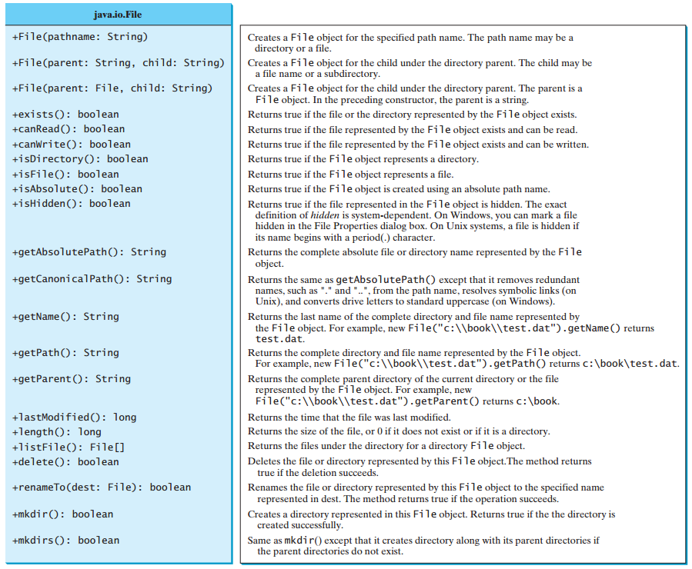
The File Class

Slide 5
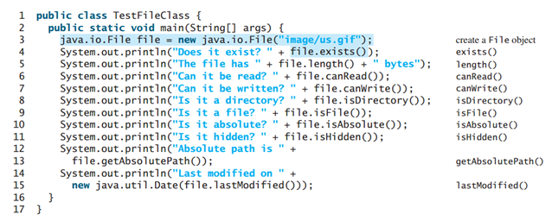
Example: The File Class
This program demonstrates how to create a File object and use the methods in the File class to obtain its properties. The program creates a File object for the file us.gif.
The lastModified() method returns the date and time when the file was last modified.

Slide 6
Text File and Binary File
There are two types of files: Text file or Binary file.
Data stored in a Text file are represented in human-readable form.
Data stored in a binary file are represented in binary form. You cannot read binary files.
Binary files are designed to be read by programs.
For example, the Java source programs are stored in text files and can be read by a text editor, but the Java .class files are stored in binary files and are read by the JVM.
The advantage of binary files I/O are more efficient to process than text files I/O, because binary file I/O does not require encoding and decoding. But Text file I/O requires encoding and decoding.
For example, the decimal integer 199 is stored as the sequence of three characters: '1', '9', '9' in a text file and the same integer is stored as a byte-type value C7 in a binary file, because decimal 199 equals to hex C7.

Slide 7
Text File Input and Output
The Scanner class uses for reading text data from a file and the PrintWriter class uses for writing text data to a file.
Text data is read using the Scanner class and written using the PrintWriter class.
To create an object using Scanner class is:
Scanner input = new Scanner(new File(filename));
To create an object using PrintWriter class is:
PrintWriter output = new PrintWriter(filename);

Slide 8
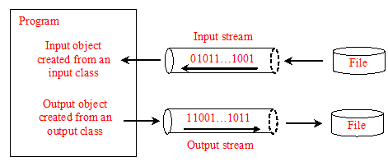
File Input and Output
Scanner input = new Scanner(new File("temp.txt"));
System.out.println(input.nextLine());
PrintWriter output = new PrintWriter("temp.txt");
output.print("Java 101");
output.close();

Slide 9
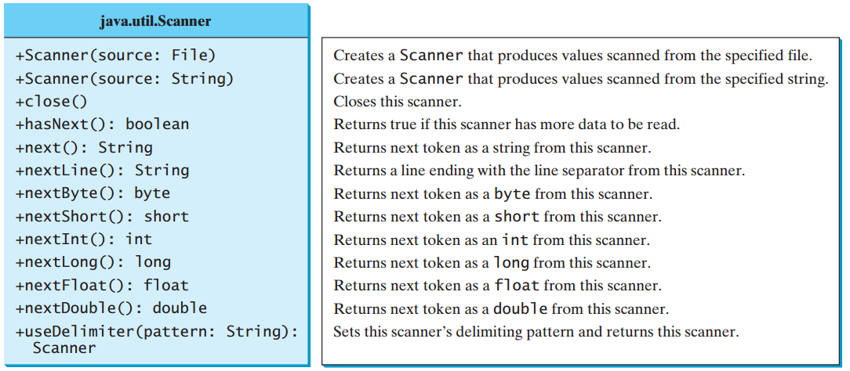
Scanner Class

Slide 10
PrintWrite Class

Slide 11
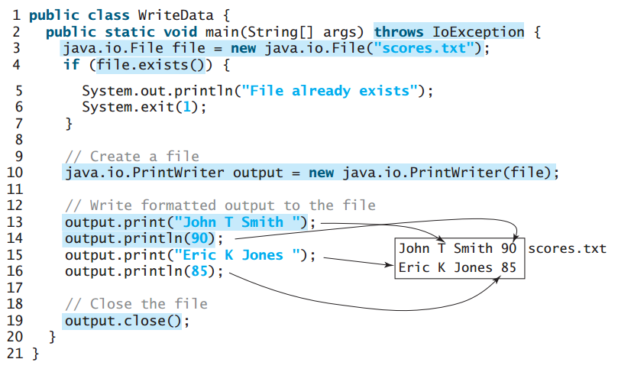
Example: wring data using PrintWriter

Slide 12
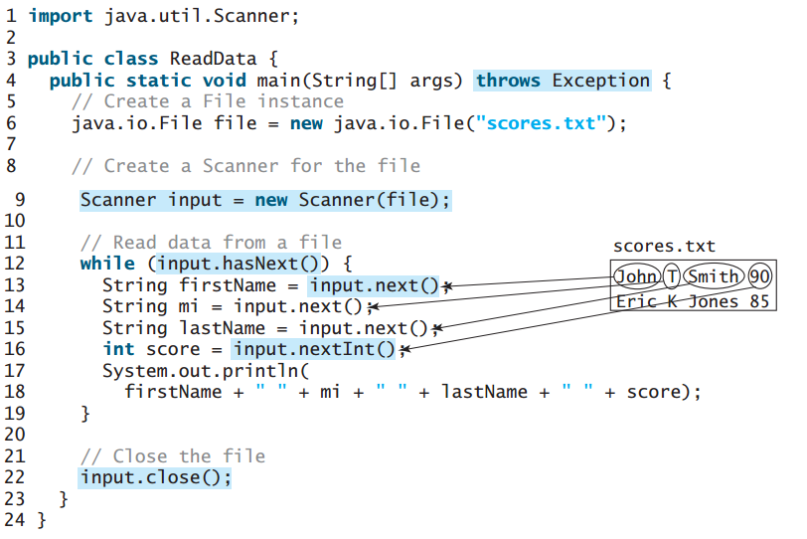
Example: reading data using Scanner

Slide 13
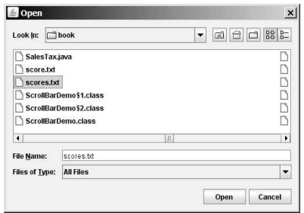
File Dialogs
The JFileChooser class is a GUI component which is used for displaying a file dialog.
The JFileChooser class is found in the java package javax.swing.JFileChooser.

Slide 14
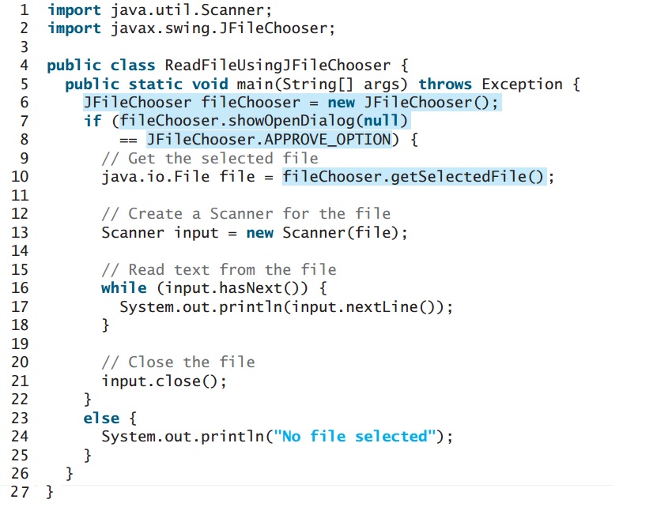
Example: File Dialogs

Slide 15
Types I/O Streams/Files
There are three types of I/O streams in Java
Byte I/O Stream
Character I/O Stream
Standard I/O Stream

Slide 16
1. Byte I/O Streams
It is an input and output data in its binary format.
Java byte streams are used to perform input and output of 8-bit bytes.
All byte stream classes are descended from two abstract classes: InputStream and OutputStream.
The InputStream is used to read data from a source and the OutputStream is used for writing data to a destination.
There are many classes related to byte streams but the most frequently used classes are, FileInputStream and FileOutputStream.

Slide 17
1. Byte I/O Streams
Computers do not differentiate between binary files and text files.
All files are stored in binary format, and thus all files are essentially binary files. Text I/O requires encoding and decoding.
For example, suppose you write the string "199" using text I/O to a file.
The ASCII or Unicode code for character 1 is 49 (0x31 in hex) and for character 9 is 57 (0x39 in hex).
Thus, to write the characters 199, three bytes— 0x31, 0x39, and 0x39—are sent to the output, as shown in Figure (a) below.
Binary I/O does not require conversions.
When you write a byte to a file, the original byte is copied into the file.
When you read a byte from a file, the exact byte in the file is returned.
For example, a byte-type value 199 is represented as 0xC7 in the memory and appears exactly as 0xC7 in the file, as shown in Figure (b) below.

Slide 18
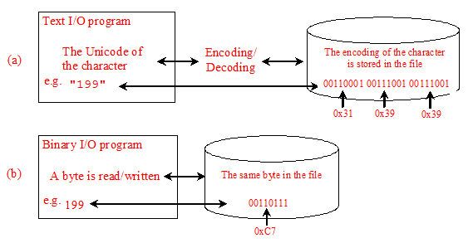
1. Byte I/O Streams
Binary I/O is more efficient than text I/O, because binary I/O does not require encoding and decoding. Binary files are independent of the encoding scheme on the host machine and thus are portable. Java programs on any machine can read a binary file created by a Java program. This is why Java class files are binary files. Java class files can run on a JVM on any machine.

Slide 19
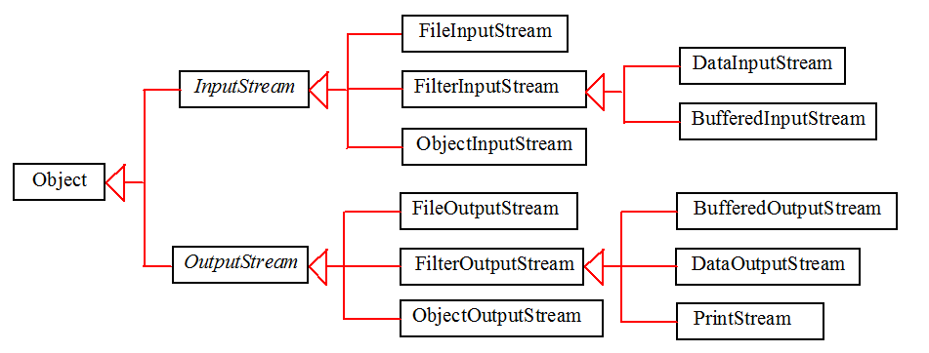
1. Byte I/O Classes
The abstract InputStream is the root class for reading byte data and the abstract OutputStream is the root class for writing byte data.

Slide 20
InputStream
The value returned is a byte as an int type.

Slide 21
OutputStream

Slide 22
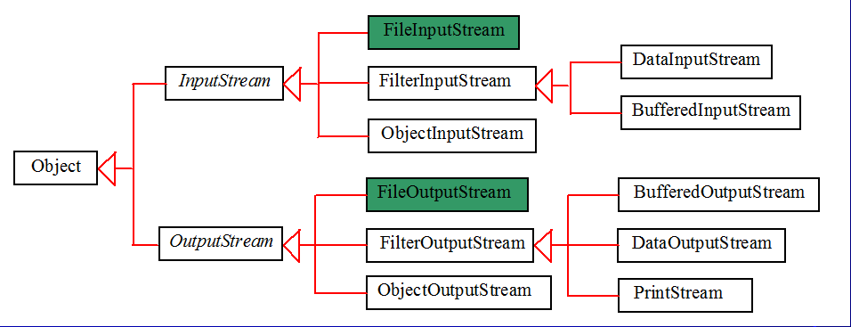
FileInputStream/FileOutputStream
FileInputStream/FileOutputStream is for reading/writing bytes from/to files.
FileInputStream/FileOutputStream associates a binary input/output stream with an external file.
All the methods in FileInputStream/FileOuptputStream are inherited from its superclasses.

Slide 23
FileInputStream
To construct a FileInputStream, use the following constructors:
public FileInputStream(String filename)
public FileInputStream(File file)
A java.io.FileNotFoundException would occur if you attempt to create a FileInputStream with a non-existent file.

Slide 24
FileOutputStream
To construct a FileOutputStream, use the following constructors:
public FileOutputStream(String filename)
public FileOutputStream(File file)
public FileOutputStream(String filename, boolean append)
public FileOutputStream(File file, boolean append)
If the file does not exist, a new file would be created.
If the file already exists, the first two constructors would delete the current contents in the file.
To retain the current content and append new data into the file, use the last two constructors by passing true to the append parameter.

Slide 25
Example: FileInputStream/FileOutputStream
import java.io.*;
public class TestFileStream {
public static void main(String[] args) thorw IOException { // Create an output stream to the file FileOutputStream output = new FileOutputStream("temp.dat");
// Output values to the file for (int i = 1; i <= 10; i++) output.write(i); // Close the output stream output.close();
// Create an input stream for the file FileInputStream input = new FileInputStream("temp.dat");
// Read values from the file int value; while ((value = input.read() )!= -1) System.out.print(value + " ");
// Close the output stream input.close(); }
}
This program uses binary
I/O to write ten byte
values from 1 to 10 to a
file named temp.dat and
reads them back from
the file.

Slide 26
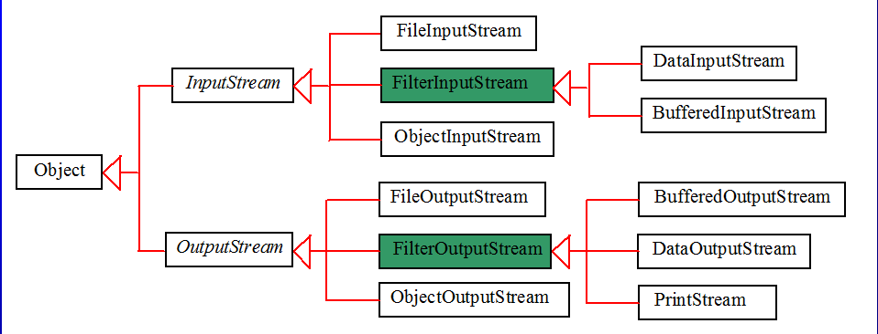
FilterInputStream/FilterOutputStream
Filter streams are streams that filter bytes for some purpose. The basic byte input stream provides a read method that can only be used for reading bytes. If you want to read integers, doubles, or strings, you need a filter class to wrap the byte input stream. Using a filter class enables you to read integers, doubles, and strings instead of bytes and characters. FilterInputStream and FilterOutputStream are the base classes for filtering data. When you need to process primitive numeric types, use DataInputStream and DataOutputStream to filter bytes.

Slide 27
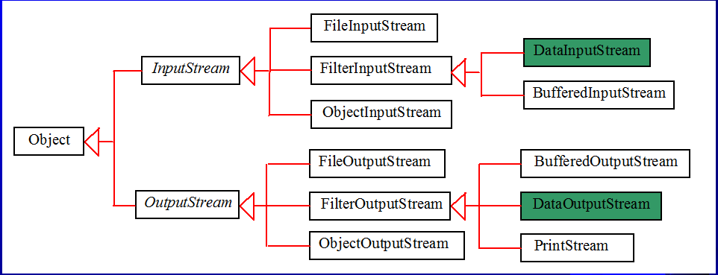
DataInputStream/DataOutputStream
DataInputStream reads bytes from the stream and converts them into appropriate primitive type values or strings.
DataOutputStream converts primitive type values or strings into bytes and output the bytes to the stream.

Slide 28
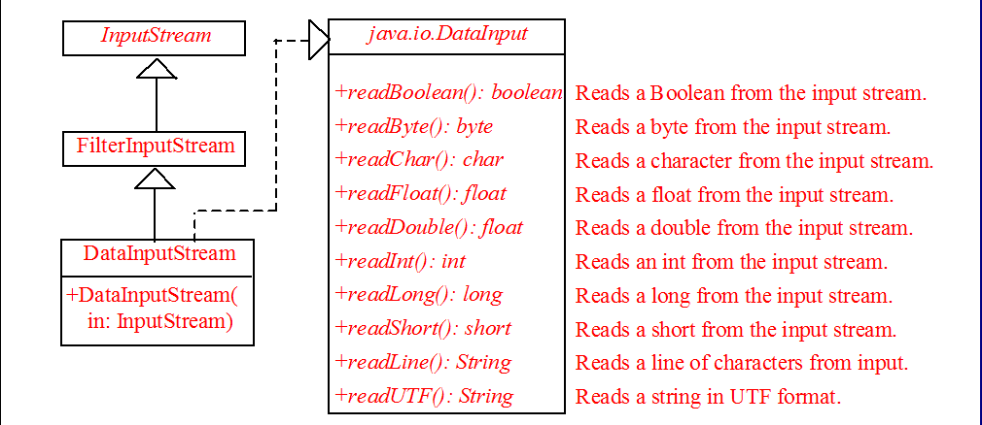
DataInputStream
DataInputStream extends FilterInputStream and implements the DataInput interface.

Slide 29
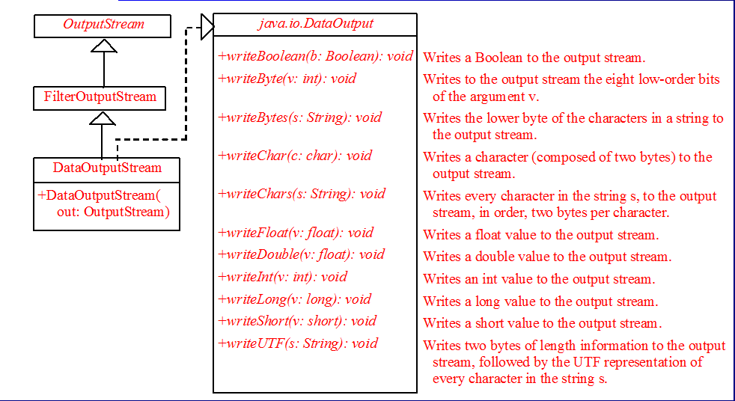
DataOutputStream
DataOutputStream extends FilterOutputStream and implements the DataOutput interface.

Slide 30
Characters and Strings in Byte I/O
A Unicode consists of two bytes. The writeChar(char c) method writes the Unicode of character c to the output.
The writeChars(String s) method writes the Unicode for each character in the string s to the output.
The writeBytes(String s) method writes the lower byte of the Unicode for each character in the string s to the output.
The high byte of the Unicode is discarded.
The writeBytes method is suitable for strings that consist of ASCII characters, since an ASCII code is stored only in the lower byte of a Unicode.
If a string consists of non-ASCII characters, you have to use the writeChars method to write the string.

Slide 31
Characters and Strings in Byte I/O
Why UTF-8? What is UTF-8?
UTF-8 is a coding scheme that allows systems to operate with both ASCII and Unicode efficiently.
Most operating systems use ASCII. Java uses Unicode. The ASCII character set is a subset of the Unicode character set.
Since most applications need only the ASCII character set, it is a waste to represent an 8-bit ASCII character as a 16-bit Unicode character.
The UTF-8 is an alternative scheme that stores a character using 1, 2, or 3 bytes.
ASCII values (less than 0x7F) are coded in one byte. Unicode values less than 0x7FF are coded in two bytes. Other Unicode values are coded in three bytes.

Slide 32
DataInputStream/DataOutputStream
Data streams are used as wrappers on existing input and output streams to filter data in the original stream. They are created using the following constructors:
public DataInputStream(InputStream instream)
public DataOutputStream(OutputStream outstream)
The statements given below create data streams. The first statement creates an input stream for file in.dat; the second statement creates an output stream for file out.dat.
DataInputStream infile = new DataInputStream(new FileInputStream("in.dat"));
DataOutputStream outfile = new DataOutputStream(new FileOutputStream("out.dat"));

Slide 33
Example: DataInputStream/DataOutputStream
import java.io.*; public class TestDataStream { public static void main(String[] args) throws IOException { // Create an output stream for file temp.dat DataOutputStream output = new DataOutputStream(new FileOutputStream("temp.dat")); // Write student test scores to the file output.writeUTF("John"); output.writeDouble(85.5); output.writeUTF("Susan"); output.writeDouble(185.5); output.writeUTF("Kim"); output.writeDouble(105.25); // Close output stream output.close(); // Create an input stream for file temp.dat DataInputStream input = new DataInputStream(new FileInputStream("temp.dat")); // Read student test scores from the file System.out.println(input.readUTF()+ " " + input.readDouble()); System.out.println(input.readUTF() + " " + input.readDouble()); System.out.println(input.readUTF() + " " + input.readDouble()); }
}
This program writes student names and scores to a file named temp.dat and reads the data back from the file.

Slide 34
Checking End of File
Order and Format
CAUTION: You have to read the data in the same order and same format in which they are stored. For example, since names are written in UTF-8 using writeUTF, you must read names using readUTF.
TIP: If you keep reading data at the end of a stream, an EOFException would occur. So how do you check the end of a file? You can use input.available() to check it. input.available() == 0 indicates that it is the end of a file.

Slide 35
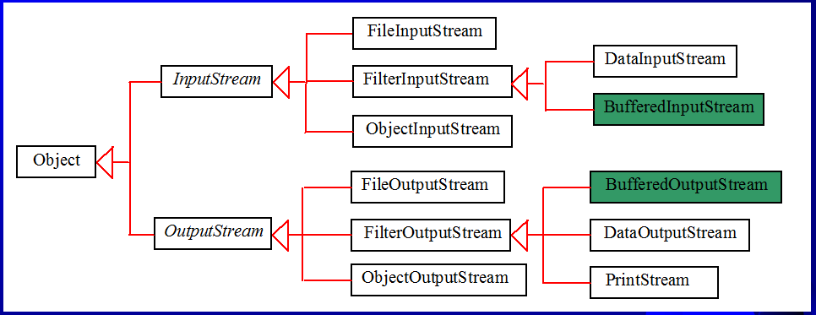
BufferedInputStream/BufferedOutputStream
Using buffers to speed up I/O
BufferedInputStream/BufferedOutputStream does not contain new methods. All the methods BufferedInputStream/BufferedOutputStream are inherited from the InputStream/OutputStream classes. BufferedInputStream/BufferedOutputStream manages a buffer behind the scene and automatically reads/writes data from/to disk on demand.

Slide 36
BufferedInputStream/BufferedOutputStream
BufferedInputStream/BufferedOutputStream can be used to speed up input and output by reducing the number of disk reads and writes.
Using BufferedInputStream, the whole block of data on the disk is read into the buffer in the memory once.
The individual data are then delivered to your program from the buffer, as shown in Figure (a) below.
Using BufferedOutputStream, the individual data are first written to the buffer in the memory.
When the buffer is full, all data in the buffer is written to the disk once, as shown in Figure (b) below.

Slide 37
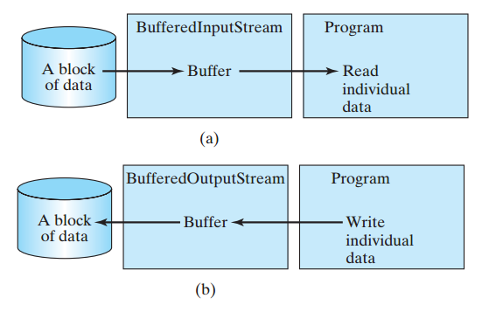
BufferedInputStream/BufferedOutputStream

Slide 38
Constructing BufferedInputStream/BufferedOutputStream
// Create a BufferedInputStream
public BufferedInputStream(InputStream in)
public BufferedInputStream(InputStream in, int bufferSize)
// Create a BufferedOutputStream
public BufferedOutputStream(OutputStream out)
public BufferedOutputStream(OutputStreamr out, int bufferSize)
If no buffer size is specified, the default size is 512 bytes.

Slide 39
BufferedInputStream/BufferedOutputStream
DataInputStream input = new DataInputStream(new BufferedInputStream(new FileInputStream("temp.dat")));
DataOutputStream output = new DataOutputStream(new BufferedOutputStream (new FileOutputStream("temp.dat")));

Slide 40
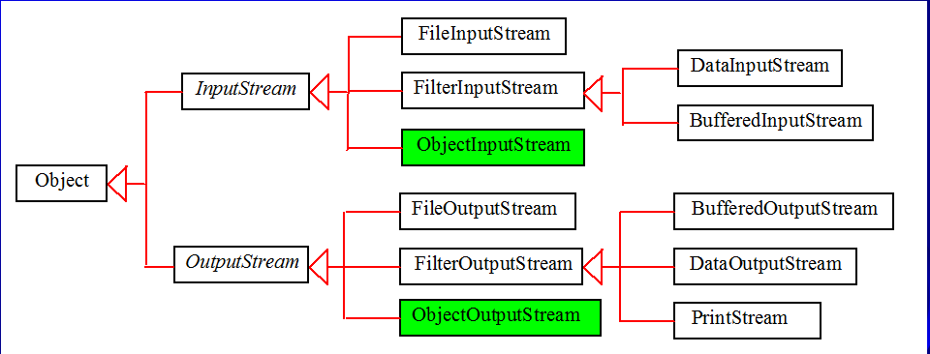
ObjectInputStream/ObjectOutputStream
DataInputStream/DataOutputStream enables you to perform I/O for primitive type values and strings. ObjectInputStream/ObjectOutputStream enables you to perform I/O for objects in addition for primitive type values and strings.

Slide 41
ObjectInputStream/ObjectOutputStream
ObjectInputStream/ObjectOutputStream classes can be used to read/write serializable objects.
DataInputStream/DataOutputStream enables you to perform I/O for primitive type values and strings.
ObjectInputStream/ObjectOutputStream enables you to perform I/O for objects in addition to primitive type values and strings.
Since ObjectInputStream/ObjectOutputStream contains all the functions of DataInputStream/DataOutputStream, you can replace DataInputStream/DataOutputStream completely with ObjectInputStream/ObjectOutputStream.

Slide 42
ObjectInputStream
ObjectInputStream extends InputStream and implements ObjectInput and ObjectStreamConstants.
ObjectStreamConstants contains the constants to support ObjectInputStream/ObjectOutputStream.

Slide 43
ObjectOutputStream
ObjectOutputStream extends OutputStream and implements ObjectOutput and ObjectStreamConstants.

Slide 44
Using Object Streams
You may wrap an ObjectInputStream/ObjectOutputStream on any InputStream/OutputStream using the following constructors:
// Create an ObjectInputStream
public ObjectInputStream(InputStream in)
// Create an ObjectOutputStream
public ObjectOutputStream(OutputStream out)

Slide 45
Serialization and Deserialization in Java
Serialization is a process of converting an object into a sequence of bytes which can be persisted to a disk or database or can be sent through streams.
Deserialization is the process of reconstructing the object from the serialized state.
It is the reverse process of creating an object from sequence of bytes.
An ObjectInputStream class deserializes objects and primitive data written using an ObjectOutputStream.
The ObjectOutputStream class is used to write primitive data types and Java objects to sequence of bytes.
Only objects that support the java.io.Serializable interface can be written to streams.

Slide 46
Example: Serializable program
import java.io.Serializable;
import java.io.*;
public class Student implements Serializable{
int id;
String name;
public Student(int id, String name) {
this.id = id;
this.name = name;
}
}
class Persist{
public static void main(String args[])throws Exception{
Student s1 =new Student(211,"ravi");
FileOutputStream fout=new FileOutputStream("file.txt");
ObjectOutputStream out=new ObjectOutputStream(fout);
out.writeObject(s1);
out.flush();
System.out.println("success");
}
}

Slide 47
Example: Deserializable program
import java.io.*;
public class Depersist{
public static void main(String args[])throws Exception{
FileInputStream input = new
FileInputStream("file.txt");
ObjectInputStream in=new ObjectInputStream(input);
Student s=(Student)in.readObject();
System.out.println(s.id+" "+s.name);
in.close();
}
}

Slide 48
2. Character I/O Streams
Character Stream is an input and output data as a sequence of characters.
Java Byte streams are used to perform input and output of 8-bit bytes, whereas Java Character streams are used to perform input and output for 16-bit Unicode.
All character stream classes are also descended from two abstract classes Read and Writer.
The most frequently used character stream classes are: FileReader and FileWriter.

Slide 49
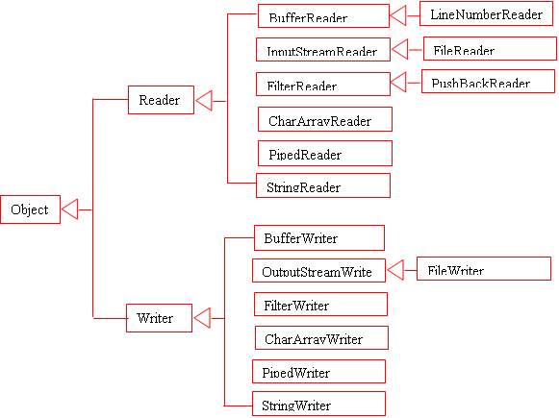
2. Character I/O Streams

Slide 50
3. Standard I/O Streams
All the programming languages provide support for standard I/O where the user's program can take input from a keyboard and then produce an output on the computer screen.
Java provides the following three standard streams:
Standard Input - This is used to feed the data to user's program and usually a keyboard is used as standard input stream and represented as System.in.
Standard Output - This is used to output the data produced by the user’s program and usually a computer screen is used for standard output stream and represented as System.out.
Standard Error - This is used to output the error data produced by the user’s program and usually a computer screen is used for standard error stream and represented as System.err.

Slide 51
The End!!

