Slide 1
Chapter One
GUI Programming- Java

Slide 2
Objectives
To distinguish simple GUI components.
To describe the Java GUI API hierarchy.
To create user interfaces using frames, panels, and simple UI components.
To understand the role of layout managers.
To use the FlowLayout, GridLayout, and BorderLayout managers to layout components in a container.
To specify colors and fonts using the Color and Font classes.
To use JPanel as subcontainers.

Slide 3
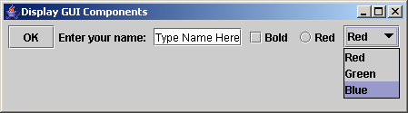
Creating GUI Objects
// Create a button with text OK
JButton jbtOK = new JButton("OK");
// Create a label with text "Enter your name: "
JLabel jlblName = new JLabel("Enter your name:");
// Create a text field with text "Type Name Here"
JTextField jtfName = new JTextField("Type Name Here");
// Create a check box with text bold
JCheckBox jchkBold = new JCheckBox("Bold");
// Create a radio button with text red
JRadioButton jrbRed = new JRadioButton("Red");
// Create a combo box with choices red, green, and blue
JComboBox jcboColor = new JComboBox(new String[]{"Red“,"Green“,"Blue"});
Text field
Check Box
Radio Button
Label
Button
Combo Box

Slide 4

Swing vs. AWT
So why do the GUI component classes have a prefix J? Instead of JButton, why not name it simply Button? In fact, there is a class already named Button in the java.awt package.
When Java was introduced, the GUI classes were bundled in a library known as the Abstract Windows Toolkit (AWT).
AWT is fine for developing simple graphical user interfaces, but not for developing comprehensive GUI projects.
Besides, AWT is prone/suffered/ to platform-specific bugs because its peer-based approach relies heavily on the underlying platform.
With the release of Java 2, the AWT user-interface components were replaced by a more robust, versatile, and flexible library known as Swing components.
Swing components are painted directly on canvases using Java code, except for components that are subclasses of java.awt.Window or java.awt.Panel, which must be drawn using native GUI on a specific platform.
Swing components are less dependent on the target platform and use less of the native GUI resource.
For this reason, Swing components that don’t rely on native GUI are referred to as lightweight components, and AWT components are referred to as heavyweight components.

Slide 5
Swing vs. AWT
Java AWT | Java Swing
AWT components are platform-dependent. | Java swing components are platform-independent.
AWT components are heavyweight. | Swing components are lightweight.
AWT doesn't support pluggable look and feel. | Swing supports pluggable look and feel.
AWT provides less components than Swing. | Swing provides more powerful components such as tables, lists, scrollpanes, colorchooser, tabbedpane etc.
AWT doesn't follows MVC(Model View Controller) where model represents data, view represents presentation and controller acts as an interface between model and view. | Swing follows MVC.

Slide 6
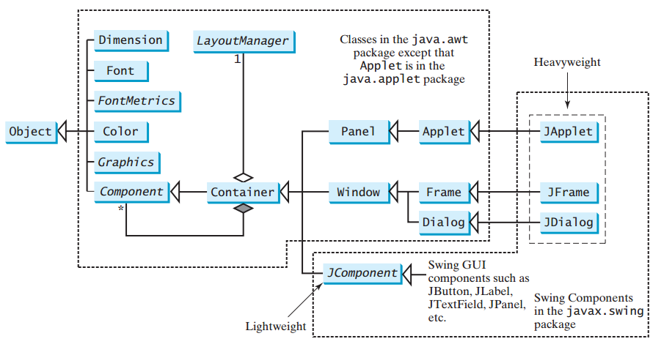
GUI Class Hierarchy (Swing and AWT)

Slide 7
The Java GUI API
The GUI API contains classes that can be classified into three groups: Component classes, Container classes, and Helper classes.
Component Classes: Component classes are elementary GUI entities, such as JButton, JLabel, JTextField etc.
Container Classes: The classes, such as JFrame, JPanel, and JApplet, JDialog are called container classes used to contain other components.
Helper Classes: The classes, such as Graphics, Color, Font, FontMetrics, and Dimension and LayoutManager, are called helper classes used to support GUI components.
Component is the root class of all the user-interface classes including container classes, and JComponent is the root class of all
the lightweight Swing components.
Both Component and JComponent are abstract classes.

Slide 8
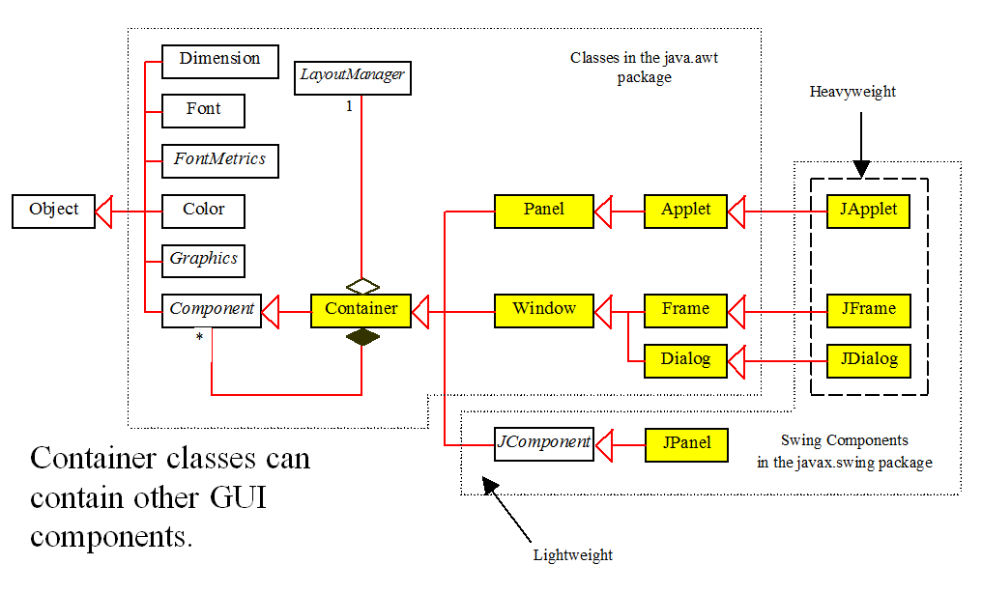
Container Classes
Container classes can contain other GUI components.

Slide 9
GUI Helper Classes
The helper classes are not subclasses of Component. They are used to describe the properties of GUI components such as graphics context, colors, fonts, and dimension.

Slide 10
Swing GUI Components

Slide 11
AWT (Optional)

Slide 12
Swing - Basic Components
A Strategy for Designing GUI
  Identify needed components
  Choose layout managers
    FlowLayout
    GridLayout
    BorderLayout
  Sketch the GUI

Slide 13
Swing - Basic Components
Category of components
  Container components
  Ordinary components
  Menu components

Slide 14
Swing - Basic Components
1. Container Components
    JFrame
    Jpanel
    Japplet
    JDialog

Slide 15
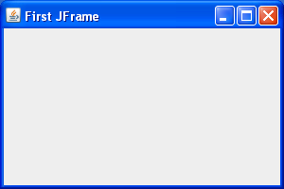
JFrame
Is an independent window that can be moved around on the screen independently of any other GUI windows.
Frame is a window that is not contained inside another window.
Frame is the basis to contain other user interface components in Java GUI applications.
The JFrame class can be used to create windows.
For Swing GUI programs, use JFrame class to create widows.

Slide 16
Creating JFrame…
import javax.swing.JFrame;
public class Simple extends JFrame {
public Simple() {
setSize(300, 200);
setTitle("First JFrame");
setDefaultCloseOperation(JFrame.EXIT_ON_CLOSE);
setLocationRelativeTo(null);
}
public static void main(String[] args) {
Simple simple = new Simple();
simple.setVisible(true);
}
}

Slide 17
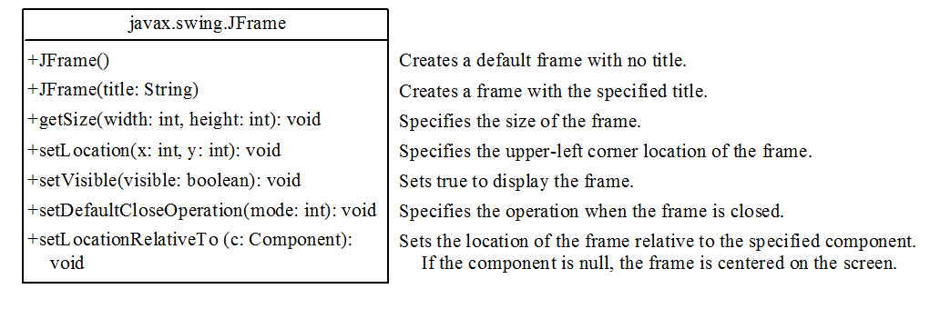
JFrame Class
JFrame Class

Slide 18
JPanel
A container can be placed inside another container.
Panels can be used as sub-containers to group GUI components to achieve the desired layout.
Panel is a blank rectangular component that can contain other components.
Each panel uses a layout manager to determine the position and size of its child components.
It is recommended that you place the user interface components in panels and place the panels in a frame.
You can also place panels in a panel.

Slide 19
JPanel
To add a component to JFrame, you actually add it to the content pane of JFrame.
To add a component to a panel, you add it directly to the panel using the add method.
You can use new JPanel() to create a panel with a default FlowLayout manager or new JPanel(LayoutManager) to create a panel with the specified layout manager.
Use the add(Component) method to add a component to the panel.
For example, JPanel p = new JPanel();
p.add(new JButton("OK"));

Slide 20
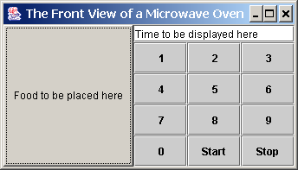
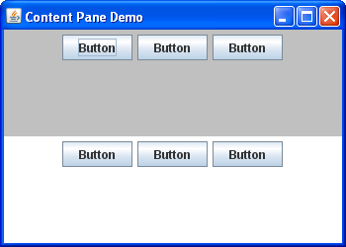
Creating a JPanel Interface - Example

Slide 21
Layout Managers
Each container contains a layout manager, which is an object responsible for laying out the GUI components in the container
Java’s layout managers provide a level of abstraction to automatically map your user interface on all window systems.
The UI components are placed in containers. Each container has a layout manager to arrange the UI components within the container.
Layout managers are set in containers using the setLayout(LayoutManager) method in a container.

Slide 22
Types of Layout Managers
There are three basic layout managers in Java.
  FlowLayout
  GridLayout
  BorderLayout

Slide 23
The FlowLayout Manager
FlowLayout is the simplest layout manager.
The components are arranged in the container from left to right in the order in which they were added.
When one row is filled, a new row is started.
You can specify the way the components are aligned by using one of three constants:
FlowLayout.RIGHT,
FlowLayout.CENTER, or
FlowLayout.LEFT.

Slide 24
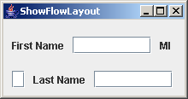
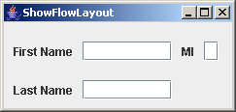
FlowLayout - Example
Write a program that adds three labels and text fields into the content pane of a frame with a FlowLayout manager.

Slide 25
FlowLayout - Example
import javax.swing.JLabel;
import javax.swing.JTextField;
import javax.swing.JFrame;
import java.awt.FlowLayout;
public class ShowFlowLayout extends JFrame{
public ShowFlowLayout() {
setLayout(new FlowLayout(FlowLayout.LEFT, 10,20) );
add(new JLabel("First Name")); add(new JTextField(8));
add(new JLabel("MI")); add(new JTextField(1));
add(new JLabel("Last Name")); add(new JTextField(8));
}
public static void main(String[] args) {
ShowFlowLayout frame = new ShowFlowLayout();
frame.setTitle("ShowFlowLayout");
frame.setSize(200, 200);
frame.setLocationRelativeTo(null); // Center the frame
frame.setDefaultCloseOperation(JFrame.EXIT_ON_CLOSE);
frame.setVisible(true);
}
}

Slide 26
FlowLayout Class Diagram

Slide 27
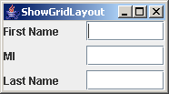
The GridLayout Manager
The GridLayout manager arranges components in a grid (matrix) formation.
The components are placed in the grid from left to right, starting with the first row, then the second, and so on, in the order in which they are added.
Example: Rewrite the program in the preceding example using a GridLayout manager instead of a FlowLayout manager to display the labels and text fields.

Slide 28
GridLayout - Example
import javax.swing.JLabel;
import javax.swing.JTextField;
import javax.swing.JFrame;
import java.awt.GridLayout;
public class ShowGridLayout extends JFrame {
public ShowGridLayout() {
setLayout(new GridLayout(3, 2, 5, 5));
add(new JLabel("First Name")); add(new JTextField(8));
add(new JLabel("MI")); add(new JTextField(1));
add(new JLabel("Last Name")); add(new JTextField(8));
}
public static void main(String[] args) {
ShowGridLayout frame = new ShowGridLayout();
frame.setTitle("ShowGridLayout");
frame.setSize(200, 125);
frame.setLocationRelativeTo(null); // Center the frame
frame.setDefaultCloseOperation(JFrame.EXIT_ON_CLOSE);
frame.setVisible(true);
}
}

Slide 29
GridLayout Class Diagram

Slide 30
The BorderLayout Manager
The BorderLayout manager divides the container into five areas: East, South, West, North, and Center.
Components are added to a BorderLayout by using the add method.
add(Component, index), where index is a constant BorderLayout.EAST, BorderLayout.SOUTH, BorderLayout.WEST, BorderLayout.NORTH, or BorderLayout.CENTER.

Slide 31
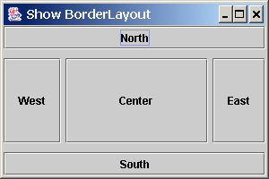
BorderLayout - Example
Writer program adds five buttons labeled East, South, West, North, and Center to the frame with a BorderLayout manager

Slide 32
BorderLayout - Example
import javax.swing.JButton;
import javax.swing.JFrame;
import java.awt.BorderLayout;
public class ShowBorderLayout extends JFrame {
public ShowBorderLayout() {
setLayout(new BorderLayout(5, 10));
add(new JButton("East"), BorderLayout.EAST);
add(new JButton("South"), BorderLayout.SOUTH);
add(new JButton("West"), BorderLayout.WEST);
add(new JButton("North"), BorderLayout.NORTH);
add(new JButton("Center"), BorderLayout.CENTER);
}
public static void main(String[] args) {
ShowBorderLayout frame = new ShowBorderLayout();
frame.setTitle("ShowBorderLayout");
frame.setSize(300, 200);
frame.setLocationRelativeTo(null); // Center the frame
frame.setDefaultCloseOperation(JFrame.EXIT_ON_CLOSE);
frame.setVisible(true);
}
}

Slide 33
BorderLayout Class Diagram

Slide 34
The Color Class
Each GUI component has background and foreground colors.
Colors are objects created from the Color class.
You can set colors for GUI components by using the java.awt.Color class.
Colors are made of red, green, and blue components, each represented by an int value that describes its intensity, ranging from 0 (darkest shade) to 255 (lightest shade).
This is known as the RGB model.
  Color c = new Color(r, g, b); r, g, and b specify a color by its red, green, and blue components.
Example:
Color c = new Color(228, 100, 255);

Slide 35
Standard Colors
Thirteen standard colors (black, blue, cyan, darkGray, gray, green, lightGray, magenta, orange, pink, red, white, yellow) are defined as constants in java.awt.Color.
You can use the following methods to set the component’s background and foreground colors:
  setBackground(Color c)
  setForeground(Color c)
Example: JButton jbt = new JButton("OK");
  jbt.setBackground(Color.yellow);
  jbt.setForeground(Color.red);

Slide 36
The Font Class
Each GUI component has the font property.
Fonts are objects created from the Font class.
You can create a font using the java.awt.Font class and set fonts for the components using the setFont method in the Component class.
Font Names
  Standard font names that are supported in all platforms are: SansSerif, Serif, Monospaced, Dialog, or DialogInput.
Font Style
  Font.PLAIN (0), Font.BOLD (1), Font.ITALIC (2), and Font.BOLD + Font.ITALIC (3)
Font myFont = new Font(name, style, size);
Example:
  Font myFont = new Font("SansSerif ", Font.BOLD, 16);
  Font myFont = new Font("Serif", Font.BOLD+Font.ITALIC, 12);
  JButton jbtOK = new JButton("OK");
  jbtOK.setFont(myFont);

Slide 37
Finding All Available Font Names
To find the fonts available on your system, you need to obtain an instance of java.awt.GraphicsEnvironment using its static method getLocalGraphicsEnvironment().
GraphicsEnvironment is an abstract class that describes the graphics environment on a particular system.
You can use its getAllFonts() method to obtain all the available fonts on the system and its getAvailableFontFamilyNames() method to obtain the names of all the available fonts.
Example:
GraphicsEnvironment e =
GraphicsEnvironment.getLocalGraphicsEnvironment();
String[] fontnames = e.getAvailableFontFamilyNames();
for (int i = 0; i < fontnames.length; i++)
System.out.println(fontnames[i]);

Slide 38
Common Features of Swing Components

Slide 39
ImageIcon Class
Image icons are objects created using the ImageIcon class.
Java uses the javax.swing.ImageIcon class to represent an icon.
An icon is a fixed-size picture; typically it is small and used to decorate components.
Images are normally stored in image files.
You can use new ImageIcon(filename) to construct an image icon.
For example, the following statement creates an icon from an image file us.gif in the image directory under the current class path:
ImageIcon icon = new ImageIcon("image/us.gif");
p.add(new JLable(icon));

Slide 40
2. Ordinary Components
Here is Some of the basic JComponents in which the user directly inputs data
JLabel
JButton
JCheckBox
JRadioButton
JScrollBar
JTextField
JPasswordField
JTextArea
JComboBox
JTable
JTree
JSlider
JTabbedPane
Jmenu
Jspinner
JColorChooser
JEditorPane
JTextPane
JFileChooser
JProgressBar
JDialog

Slide 41
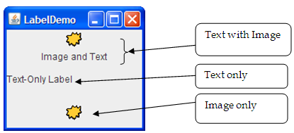
JLabel
A label is a display area for a short text, an image, or both.
With the JLabel class, you can display un-selectable text and images.
JFrame frame = new JFrame();
JLabel label = new JLable(“Name”)
frame.add(label);

Slide 42
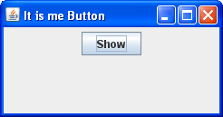
JButton
A button is a component that triggers an action when clicked.
There are a few steps in using a button: declaring it, creating it, adding it to a container (the content pane or a JPanel), and adding a listener that has code to execute when the user clicks on the button.
JButton btn = new JButton(text);
JButton btn = new JButton(text, image);
JButton btn = new JButton(image);

Slide 43
JButton
  JButton mybtn = new JButton("Do Something");
  mybtn.addActionListener(new ActionListener() {
  public void actionPerformed(ActionEvent e) {
  doMyAction(); // code to execute when button is pressed
  }
  }
  . . .
  JPanel content = new JPanel();
  content.add(mybtn); // add the button to a JPanel (eg,content).

Slide 44
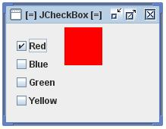
JCheckBox
JCheckBox is a widget that has two states. On and Off.
It is a box with a label.
If the checkbox is checked, it is represented by a tick in a box.
JCheckBox box = new JCheckBox()

Slide 45
JCheckBox…
Constructors
cb = | new JCheckBox(text); | Creates check box, initially unchecked.
cb = | new JCheckBox(text, state); | Creates check box, checked or not depending on state.
Methods
state = | cb.isSelected(); | Returns true if the check box is checked.
 | cb.setSelected(state); | Checks (true) or unchecks check box.
 | cb.addActionListener(action-listener); | Adds an action listener to the radio button. The action listener will be called if button is selected.
 | cb.addItemListener(item-listener); | Add an item listener to a radio button. The item listener will be called if the button is selected or deselected.

Slide 46
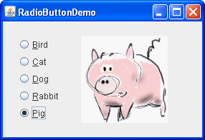
JRadioButton
Radio buttons are groups of buttons in which only one button at a time can be selected.

Slide 47
JRadioButton
  JRadioButton bird = new JRadioButton("Bird");
  JRadioButton cat = new JRadioButton("Cat");
  JRadioButton dog = new JRadioButton("Dog");
  ButtonGroup bg = new ButtonGroup();
  bg.add(bird);
  bg.add(cat);
  bg.add(dog);

Slide 48
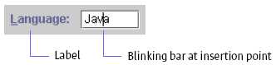

JTextField
A text field can be used to enter or display a string.
  JTextField firstName = new JTextField(20);
  JTextField surName = new JTextField(20);
  JTextField address = new JTextField(60);
  JPanel p=new JPanel();
  p.add(firstName);
  p.add(surName);
  p.add(address);

Slide 49
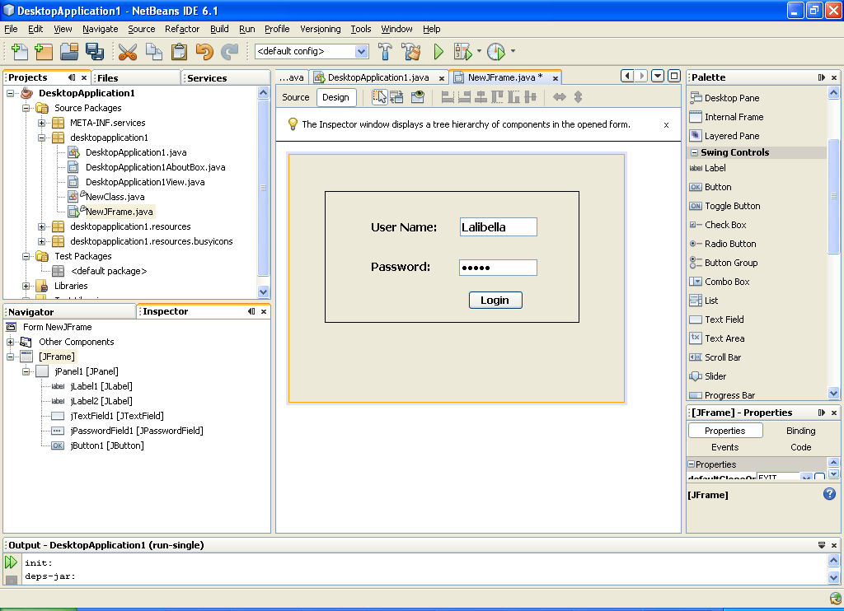
JPasswordField
Password field
JPasswordField userName = new JPasswordField(20);
JFrame f=new JFrame(“Example 01”); //you may use another container
f.add(userName);//adds the password field to a container

Slide 50
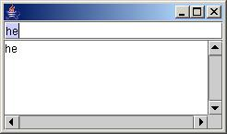
JTextArea
A JTextArea enables the user to enter multiple lines of text
Text Area
Effect of Scroll Pane
JTextArea textArea = new JTextArea(5, 20);
JScrollPane scrollPane = new JScrollPane(textArea);
textArea.setEditable(true);
JPanel p=new JPanel();
p.add(scrollPane);

Slide 51
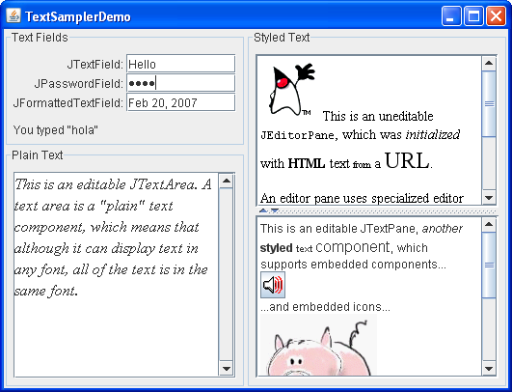
JTextArea

Slide 52
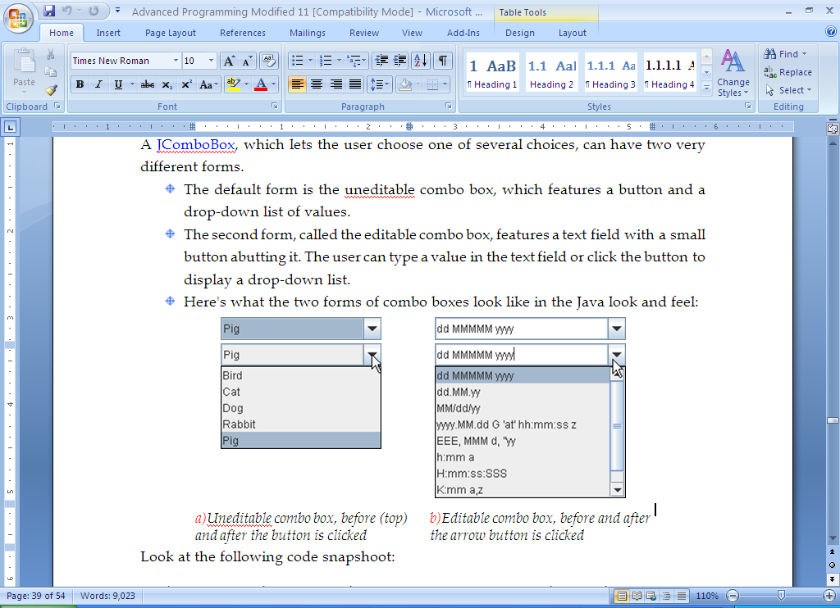
JComboBox
A combo box, also known as a choice list or drop-down list, contains a list of items from which the user can choose

Slide 53
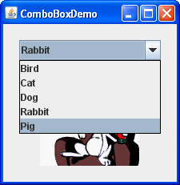
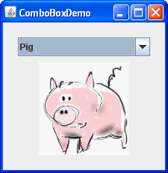
JComboBox
String[] pet = {"Bird", "Cat", "Dog", "Rabbit", "Pig"};
//Create the combo box, select item at index 4.
//Indices start at 0, so 4 specifies the pig.
JComboBox petList = new JComboBox(pet);
petList.setSelectedIndex(4);

Slide 54
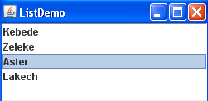
JList
  A list is a component that basically performs the same function as a combo box, but it enables the user to choose a single value or multiple values.
  String[] str = {"Math", "Computer", "Physics", "Chemistry"};
  JList list=new JList(str);
  JPanel p=new JPanel();
  p.add(list);

Slide 55

JList
Home work?
List area
Text box

Slide 56
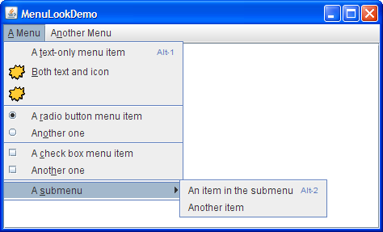
3. Menu Components

Slide 57
Menu Components
  import java.awt.event.*;
  import javax.swing.*;
  public class MenuComponent extends JFrame{
  public MenuComponent(){
  JMenuBar menuBar = new JMenuBar();
  JMenu menu = new JMenu("File");
  menu.setMnemonic(KeyEvent.VK_F);
  JMenuItem mi1 = new JMenuItem("Sub Menu 1");
  menu.add(mi1);
  JMenuItem mi2 = new JMenuItem("Sub Menu 2");
  menu.add(mi2);
  JMenuItem mi3 = new JMenuItem("Sub Menu 3");
  menu.add(mi3);
  menuBar.add(menu);
  setJMenuBar(menuBar);
  }
  public static void main(String[] args){
  MenuComponent frame = new MenuComponent();
  frame.setTitle("Menu Demo");
  frame.setSize(400,300);
  frame.setLocationRelativeTo(null);
  frame.setDefaultCloseOperation(JFrame.EXIT_ON_CLOSE);
  frame.setVisible(true);
  }
  }

Slide 58
End!!

