Slide 1
Java Server Faces (JSF)
Objectives
To explain what JSF is.
To create a JSF page using NetBeans.
To create a JSF managed bean.
To use JSF expressions in a facelet.
To use JSF GUI components.
To obtain and process input from a form.
To track sessions in application, session, view, and request scope.
To validate input using the JSF validators.
To bind database with facelets.

Slide 2
Introduction
Servlet is a primitive way to write server-side applications.
JSP provides a scripting capability and allows you to embed Java code in XHTML.
It is easier to develop Web programs using JSP than servlets.
However, JSP has some problems.
It can be very confused, because it mixes Java code with HTML.
Using JSP to develop User Interface(UI) is tedious.
JavaServer Faces (JSF) comes to solve this problem.
JSF enables you to completely separate Java code from HTML.
You can quickly build web applications by assembling reusable UI components in a page, connecting these components to Java programs, and wiring client-generated events to server-side event handlers.
The application developed using JSF is easy to debug and maintain.

Slide 3
Simple JSF Code
XML Declaration
<?xml version = '1.0' encoding='UTF-8' ?>
<!DOCTYPE html PUBLIC "-//W3C//DTD XHTML 1.0 Transitional//EN" "http://www.w3.org/TR/xhtml1/DTD/xhtml1-transitional.dtd">
<html xmlns = "http://www.w3.org/1999/xhtml" xmlns:h = "http://java.sun.com/jsf/html"> <h:head> <title>Facelet Title</title> </h:head> <h:body> Hello from Facelets </h:body>
</html>
DOCTYPE
Namespaces

Slide 4
Basic JSF Page
Facelets
A facelet is an XHTML page that mixes JSF tags with XHTML tags.
XML Declaration
It is used to state that the document conforms to the XML version 1.0 and uses the UTF-8 encoding.
This declaration is optional, but it is a good practice to use it.
It must be the first item to appear in the document.
DOCTYPE
It specifies the version of XHTML used in the document.
This can be used by the Web browser to validate the syntax of the document.
XML Comment
for documenting the contents in the file.
XML comment always begins with <!-- and end with -->.

Slide 5
Basic JSF Page
Namespaces
Namespaces are like Java packages.
Java packages are used to organize classes and to avoid naming conflict.
XHMTL namespaces are used to organize tags and resolve naming conflict.
Each xmlns attribute has a name and a value separated by an equal sign (=).
Example:
xmlns = http://www.w3.org/1999/xhtml specifies that any unqualified tag names are defined in the default standard xhtml namespace.
xmlns:h = http://java.sun.com/jsf/html allows the tags defined in the JSF tag library to be used in the document. These tags must have a prefix h.

Slide 6
Managed JavaBeans for JSF
JSF applications are developed using the MVC architecture, which separates the application’s data (model) from the graphical presentation (view).
The controller is the JSF framework that is responsible for coordinating interactions between view and the model.
In JSF, the facelets are the view for presenting data.
Data are obtained from Java objects.
Objects are defined using Java classes.
In JSF, the objects that are accessed from a facelet are JavaBeans objects.

Slide 7
Example: JavaBean
package jsfDemo;
import java.util.Date; import javax.faces.bean.ManagedBean; import javax.faces.bean.RequestScoped; @ManagedBean @RequestScoped public class TimeBean { public String getTime() { return new Date().toString(); } }

Slide 8
Code Description
TimeBean is a JavaBeans with the @ManagedBean annotation, which indicates that the JSF framework will create and manage the TimeBean objects used in the application.
The @Override annotation tells the compiler that the annotated method is required to override a method in a superclass.
The @ManagedBean annotation tells the compiler to generate the code to enable the bean to be used by JSF facelets.
The @RequestScope annotation specifies the scope of the JavaBeans object is within a request.
You can also use @SessionScope or @ApplicationScope to specify the scope for a session or for the entire application.

Slide 9
JSF Expressions
JSP scripting will not work with JSF.
JSF uses JSF expressions instead JSP scripting.
JSF expressions bind JavaBeans objects with facelets.
The syntax of a JSF expression is #{expression}

Slide 10
Example
<?xml version='1.0' encoding='UTF-8' ?>
<!DOCTYPE html PUBLIC "-//W3C//DTD XHTML 1.0 Transitional//EN" "http://www.w3.org/TR/xhtml1/DTD/xhtml1-transitional.dtd"> <html xmlns = "http://www.w3.org/1999/xhtml" xmlns:h = "http://java.sun.com/jsf/html"> <h:head> <title>Display Current Time</title> <meta http-equiv="refresh" content ="60" /> </h:head> <h:body> The current time is "#{timeBean.time}" </h:body> </html>

Slide 11
Code Description
The meta tag defined inside the h:head tag is used to tell the browser to refresh every 60 seconds.
The JSF expression #{timeBean.time} is used to obtain the current time.
timeBean is an object of the TimeBean class.
The object name can be changed in the @ManagedBean annotation using the this syntax: @ManagedBean(name = "anyObjectName“)
By default the object name is the class name with the first letter in lowercase.
The JSF expression can either use the property name or invoke the method to obtain the current time.
#{timeBean.time} Or #{timeBean.getTime()}

Slide 12
JSF GUI Components
JSF provides many elements for displaying GUI components.
The tags with the h prefix are in the JSF HTML Tag library.
The tags with the f prefix are in the JSF Core Tag library.
The following Table lists some of the commonly used elements.

Slide 13
JSF GUI Components
JSF Tag | Description
h:form | inserts an XHTML form into a page.
h:panelGroup | similar to a Java flow layout container.
h:panelGrid | similar to a Java grid layout container.
h:inputText | displays a textbox for entering input.
h:outputText | displays a textbox for displaying output.
h:commandButton | It submits a form to the application.
h:inputTextArea | displays a textarea for entering input.
h:commandLink | It links to another page or location on a page.
h:inputHidden | It allows a page author to include a hidden variable in a page.
h:inputFile | It allows a user to upload a file.
h:dataTable | It represents a data wrapper.
h:inputSecret | displays a textbox for entering password.
h:outputLabel | displays a label.

Slide 14
JSF GUI Components
JSF Tag | Description
h:outputLink | displays a hypertext link.
h:selectOneMenu | displays a combo box for selecting one item.
h:selectOneRadio | displays a set of radio button.
h:selectBooleanCheckbox | displays a checkbox.
h:selectOneListbox | displays a list for selecting one item.
h:selectManyListbox | displays a list for selecting multiple items.
f:selectItem | specifies an item in an h:selectOneMenu, h:selectOneRadio, or h:selectManyListbox.
h:outputFormat | It displays a formatted message.
h:message | displays a message for validating input.
h:messages | It displays localized messages.
h:dataTable | displays a data table.
h:column | specifies a column in a data table.
h:graphicImage | displays an image.

Slide 15
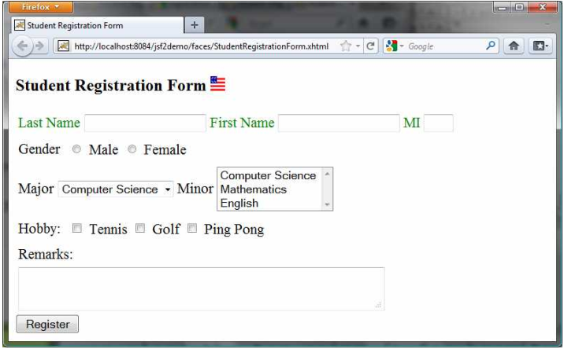
Example: JSF GUI Components
This example displays a student registration form by using some of JSF elements.

Slide 16
Example: JSF Code for the above GUI
<?xml version='1.0' encoding='UTF-8' ?> <!DOCTYPE html PUBLIC "-//W3C//DTD XHTML 1.0 Transitional//EN" "http://www.w3.org/TR/xhtml1/DTD/xhtml1-transitional.dtd"> <html xmlns = "http://www.w3.org/1999/xhtml" xmlns:h = "http://java.sun.com/jsf/html" xmlns:f="http://java.sun.com/jsf/core"> <h:head> <title>Student Registration Form</title> </h:head> <h:body> <h:form> <!-- Use h:graphicImage --> <h3>Student Registration Form <h:graphicImage name="usIcon.gif" library="image"/> </h3> <!-- Use h:panelGrid --> <h:panelGrid columns="6" style="color:green"> <h:outputLabel value="Last Name"/> <h:inputText id="lastNameInputText" /> <h:outputLabel value="First Name" /> <h:inputText id="firstNameInputText" /> <h:outputLabel value="MI" /> <h:inputText id="miInputText" size="1" /> </h:panelGrid>

Slide 17
Example: JSF Code for the above GUI
<!-- Use radio buttons --> <h:panelGrid columns="2">
<h:outputLabel>Gender </h:outputLabel> <h:selectOneRadio id="genderSelectOneRadio"> <f:selectItem itemValue="Male” itemLabel="Male"/> <f:selectItem itemValue="Female”itemLabel="Female"/> </h:selectOneRadio> </h:panelGrid> <!-- Use combo box and list --> <h:panelGrid columns="4"> <h:outputLabel value="Major "/> <h:selectOneMenu id="majorSelectOneMenu"> <f:selectItem itemValue="Computer Science"/> <f:selectItem itemValue="Mathematics"/> </h:selectOneMenu> <h:outputLabel value="Minor "/> <h:selectManyListbox id="minorSelectManyListbox"> <f:selectItem itemValue="Computer Science"/> <f:selectItem itemValue="Mathematics"/>
<f:selectItem itemValue="English"/> </h:selectManyListbox>
</h:panelGrid>

Slide 18
Example: JSF Code for the above GUI
<!-- Use check boxes --> <h:panelGrid columns="4"> <h:outputLabel value="Hobby: "/> <h:selectManyCheckbox id="hobbySelectManyCheckbox"> <f:selectItem itemValue="Tennis"/> <f:selectItem itemValue="Golf"/> <f:selectItem itemValue="Ping Pong"/> </h:selectManyCheckbox> </h:panelGrid>
<!-- Use text area --> <h:panelGrid columns="1"> <h:outputLabel>Remarks:</h:outputLabel> <h:inputTextarea id="remarksInputTextarea" style="width:400px; height:50px;" /> </h:panelGrid> <!-- Use command button --> <h:commandButton value="Register" /> </h:form> </h:body> </html>

Slide 19
Session Tracking
JSF supports session tracking using JavaBeans at the application scope, session scope, and request scope.
Additionally, JSF 2.0 supports the view scope, which keeps the bean alive as long as you stay on the view.
The view scope is between session and request scopes.

Slide 20
Input Validation
JSF provides several convenient and powerful ways for input validation.
You can use the standard validator tags in the JSF Core Tag Library or create custom validators.
The following Table lists some JSF input validator tags.
JSF Tag | Description
f:validateLength | validates the length of the input.
f:validateDoubleRange | validates whether numeric input falls within acceptable range of double values.
f:validateLongRange | validates whether numeric input falls within acceptable range of long values.
f:validateRequired | validates whether a field is not empty.
f:validateRegex | validates whether the input matches a regular expression.
f:validateBean | invokes a custom method in a bean to perform custom validation.

Slide 21
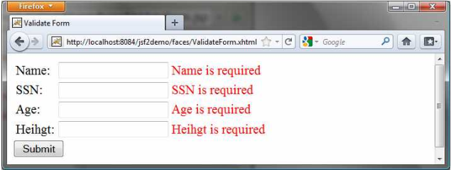
Example: Input Validation
This example illustrates that how the required messages are displayed if inputs are required.

Slide 22
Example: ValidationForm.html
<?xml version='1.0' encoding='UTF-8' ?> <!DOCTYPE html PUBLIC "-//W3C//DTD XHTML 1.0 Transitional//EN" "http://www.w3.org/TR/xhtml1/DTD/xhtml1-transitional.dtd"> <html xmlns="http://www.w3.org/1999/xhtml" xmlns:h="http://java.sun.com/jsf/html" xmlns:f="http://java.sun.com/jsf/core"> <h:head> <title>Validate Form</title> </h:head> <h:body> <h:form> <h:panelGrid columns="3"> <h:outputLabel value="Name:"/> <h:inputText id="nameInputText" required="true" requiredMessage="Name is required" validatorMessage="Name must have 1 to 10 chars" value="#{validateForm.name}"> <f:validateLength minimum="1" maximum="10" /> </h:inputText> <h:message for="nameInputText" style="color:red"/> <h:outputLabel value="SSN:" />

Slide 23
Example: ValidationForm.html …
<h:inputText id="ssnInputText" required="true" requiredMessage="SSN is required" validatorMessage="Invalid SSN” value="#{validateForm.ssn}">
<f:validateRegex pattern="[\d]{3}-[\d]{2}-[\d]{4}"/> </h:inputText> <h:message for="ssnInputText" style="color:red"/>
<h:outputLabel value="Age:" /> <h:inputText id="ageInputText" required="true" requiredMessage="Age is required" validatorMessage="Age must be betwen 16 and 120" value="#{validateForm.ageString}"> <f:validateLongRange minimum="16" maximum="120"/> </h:inputText> <h:message for="ageInputText" style="color:red"/> <h:outputLabel value="Heihgt:" /> <h:inputText id="heightInputText" required="true" requiredMessage="Heihgt is required“
validatorMessage="Heihgt must be betwen 3.5 and 9.5“
value="#{validateForm.heightString}“>

Slide 24
Example: ValidationForm.html …
<f:validateDoubleRange minimum="3.5" maximum="9.5"/> </h:inputText> <h:message for="heightInputText" style="color:red"/> </h:panelGrid> <h:commandButton value="Submit" /> <h:outputText style="color:red”
value="#{validateForm.response}" /> </h:form> </h:body> </html>

Slide 25
Example: ValidationForm.java
import javax.faces.bean.ManagedBean; import javax.faces.bean.RequestScoped; @ManagedBean @RequestScoped public class ValidateForm { private String name, ssn, ageString, heightString; public String getName() { return name; } public void setName(String name) { this.name = name; } public String getSsn() { return ssn; } public void setSsn(String ssn) { this.ssn = ssn; } public String getAgeString() { return ageString; }

Slide 26
Example: ValidationForm.java
public void setAgeString(String ageString) { this.ageString = ageString; } public String getHeightString() { return heightString; } public void setHeightString(String heightString) { this.heightString = heightString; } public String getResponse() { if (name == null || ssn == null || ageString == null || heightString == null) { return ""; } else { return "You entered " + " Name: " + name + " SSN: " + ssn + " Age: " + ageString + " Heihgt: " + heightString;
}
}
}

Slide 27
The End!!

