Slide 1
Chapter Five
Networking in Java

Slide 2
Networking Basics
Computer networking is to send and receive messages among computers on the Internet
To browse the Web or send email, your computer must be connected to the Internet.
Your computer can connect to the Internet through an Internet Service Provider (ISP) using a dialup, DSL, or cable modem, or through a local area network (LAN).
Java Networking is a concept of connecting two or more computing devices together so that we can share resources.
Advantage of Java Networking
  sharing resources
  centralize software management
When a computer needs to communicate with another computer, it needs to know an IP address.

Slide 3
Networking Basics
Internet Protocol (IP) addresses
  Uniquely identifies the computer on the Internet. or
  IP address is a unique number assigned to a node of a network.
  It is a logical address that can be changed.
  Every host on Internet has a unique IP address
  An IP address consists of four dotted decimal numbers ranging from 0 and 255, such as
      143.89.40.46, 203.184.197.198
      203.184.197.196, 203.184.197.197, 127.0.0.
  Since it is difficult to remember IP address, there is a special server called Domain Name Server(DNS), which translates hostname to IP address
  Example: DomainName: www.bdu.edu.et , www.google.com, localhost
        IP Addresess: 10.1.25.16 216.58.207.4 127.0.0.1
  One domain name can correspond to multiple internet addresses:
    www.yahoo.com:
      66.218.70.49; 66.218.70.50; 66.218.71.80; 66.218.71.84; …
  Domain Name Server (DNS) maps names to numbers

Slide 4
Networking Basics
A protocols is a set of rules that facilitate communications between machines or hosts.
Examples:
  HTTP: HyperText Transfer Protocol
  FTP: File Transfer Protocol
  SMTP: Simple Message Transfer Protocol
  TCP: Transmission Control Protocol
  UDP: User Datagram Protocol, good for, e.g., video delivery)
TCP:
  Connection-oriented protocol
  enables two hosts to establish a connection and exchange streams of data.
  Acknowledgement is send by the receiver. So, it is reliable but slow
  Uses Stream-based communications
  guarantees delivery of data and also guarantees that packets will be delivered in the same order in which they were sent.
UDP:
  Enables connectionless communication
  Acknowledgement is not sent by the receiver. So it is not reliable but fast.
  Uses packet-based communications.
  Cannot guarantee lossless transmission.

Slide 5
Networking Basics
Port Number
  The port number is used to uniquely identify different applications.
  It acts as a communication endpoint between applications.
  The port number is associated with the IP address for communication between two applications.
  Port numbers are ranging from 0 to 65536, but port numbers 0 to 1024 are reserved for privileged services.
  Many standard port numbers are pre-assigned
    time of day 13, ftp 21, telnet 23, smtp 25, http 80
  You can choose any port number that is not currently used by other programs.
  IP address + port number = "phone number " for service or application
MAC Address
  MAC (Media Access Control) Address is a unique identifier of NIC (Network Interface Controller).
  A network node can have multiple NIC but each with unique MAC.

Slide 6
Networking Basics
Client-Server interaction
  Communication between hosts is two-way, but usually the two hosts take different roles.
  Server waits for client to make request
    Server registered on a known port with the host ("public phone number")
    Listens for incoming client connections
  Client "calls" server to start a conversation
    Client making calls uses hostname/IP address and port number
    Sends request and waits for response
  Standard services always running
    ftp, http, smtp, etc. server running on host using expected port
  Server offers shared resource (information, database, files, printer, compute power) to clients

Slide 7
Socket-Level Programming
Java Socket programming is used for communication between the applications running on different JRE.
Java Socket programming can be connection-oriented or connection-less.
Socket and ServerSocket classes are used for connection-oriented socket programming.
DatagramSocket and DatagramPacket classes are used for connection-less socket programming.
Java socket programming provides facility to share data between different computing devices.
Send and receive data using streams
OutputStream
InputStream
Client
Server
InputStream
OutputStream

Slide 8
Client/Server Communications
Java provides the ServerSocket class for creating a server socket and the Socket class for creating a client socket.
Two programs on the Internet communicate through a server socket and a client socket using I/O streams.
Sockets are the endpoints of logical connections between two hosts and can be used to send and receive data.
Network programming usually involves a server and one or more clients.
The client sends requests to the server, and the server responds.
The client begins by attempting to establish a connection to the server.
The server can accept or deny the connection.
Once a connection is established, the client and the server communicate through sockets.
The server must be running when a client attempts to connect to the server.
The server waits for a connection request from a client.

Slide 9
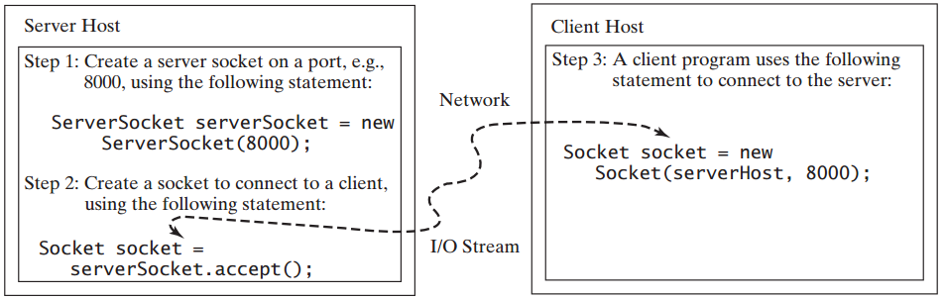
Client/Server Communications
The statements needed to create sockets on a server and a client are shown below.

Slide 10
Server Sockets
To establish a server, you need to create a server socket and attach it to a port, which is where the server listens for connections.
The port identifies the TCP service on the socket.
The following statement creates a server socket serverSocket:
ServerSocket serverSocket = new ServerSocket(port);
Attempting to create a server socket on a port already in use would cause the java.net.BindException.

Slide 11
Client Sockets
After a server socket is created, the server can use the following statement to listen for connections:
Socket socket = serverSocket.accept();
This statement waits until a client connects to the server socket.
The client issues the following statement to request a connection to a server:
Socket socket = new Socket(serverName, port);
This statement opens a socket so that the client program can communicate with the server.

Slide 12
Client Sockets
serverName is the server’s Internet host name or IP address.
The following statement creates a socket on the client machine to connect to the host 130.254.204.33 at port 8000:
Socket socket = new Socket("130.254.204.33", 8000)
Alternatively, you can use the domain name to create a socket, as follows:
Socket socket = new Socket(“www.google.com", 8000);
When you create a socket with a host name, the JVM asks the DNS to translate the host name into the IP address.

Slide 13
Data Transmission through Sockets
After the server accepts the connection, communication between the server and client is conducted the same as for I/O streams.
The statements needed to create the streams and to
exchange data between them are shown in the Figure below.

Slide 14
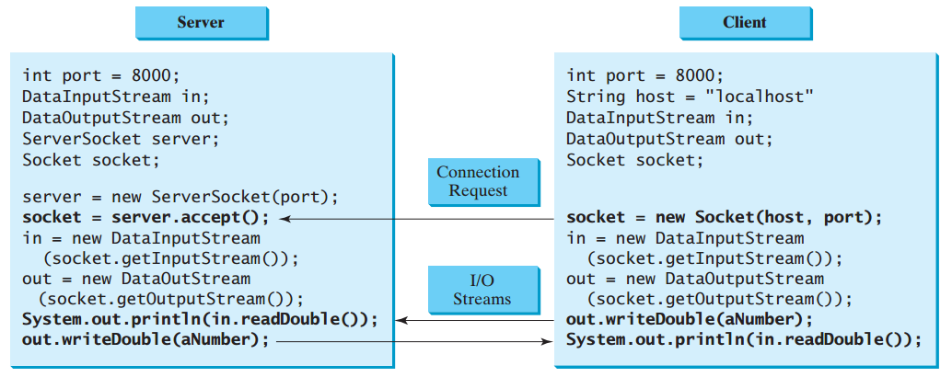
Data Transmission through Sockets

Slide 15
Data Transmission through Sockets
To get an input stream and an output stream, use the getInputStream() and getOutputStream() methods on a socket object.
For example, the following statements create an InputStream stream called input and an OutputStream stream called output from a socket:
InputStream input = socket.getInputStream();
OutputStream output = socket.getOutputStream();
DataInputStream in = new DataInputStream(input);
DataOutputStream out = new DataOutputStream(output));

Slide 16
Data Transmission through Sockets
The InputStream and OutputStream streams are used to read or write bytes.
You can use DataInputStream, DataOutputStream, BufferedReader, and PrintWriter to wrap on the InputStream and OutputStream to read or write data, such as int, double, or String.
The following statements, for instance, create the DataInputStream stream input and the DataOutputStream stream output to read and write primitive data values:
DataInputStream input = new DataInputStream (socket.getInputStream());
DataOutputStream output = new DataOutputStream (socket.getOutputStream());
The server can use input.readDouble() to receive a double value from the client, and output.writeDouble(d) to send the double value d to the client.
Binary I/O is more efficient than text I/O because text I/O requires encoding and decoding.
Therefore, it is better to use binary I/O for transmitting data between a server and a client to improve performance.

Slide 17
A Client/Server Example
Problem: Write a client and a server program that the client sends data to a server. The server receives the data, uses it to produce a result, and then sends the result back to the client. The client displays the result on the console. In this example, the data sent from the client is the radius of a circle, and the result produced by the server is the area of the circle. The client sends the radius to the server; the server computes the area and sends it to the client.

Slide 18
A Client/Server Example
The client sends the radius through a DataOutputStream on the output stream socket, and the server receives the radius through the DataInputStream on the input stream socket, as shown in Figure (A) below.
The server computes the area and sends it to the client through a DataOutputStream on the output stream socket, and the client receives the area through a DataInputStream on the input stream socket, as shown in Figure (B) below.

Slide 19
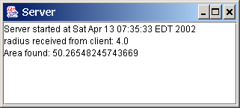
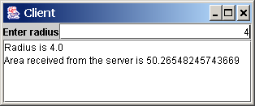
A Client/Server Example
Note: Start the server, then the client.

Slide 20
A Client/Server Example
import java.io.*;
import java.net.*;
import java.util.*;
import java.awt.*;
import javax.swing.*;
public class Server extends JFrame {
// Text area for displaying contents
private JTextArea jta = new JTextArea();
public static void main(String[] args) {
new Server();
}
public Server() {
// Place text area on the frame
setLayout(new BorderLayout());
add(new JScrollPane(jta), BorderLayout.CENTER);
setTitle("Server");
setSize(500, 300);
setDefaultCloseOperation(JFrame.EXIT_ON_CLOSE);
setVisible(true); // It is necessary to show the frame here!

Slide 21
A Client/Server Example
try {
// Create a server socket
ServerSocket serverSocket = new ServerSocket(8000);
jta.append("Server started at " + new Date() + '\n' );
// Listen for a connection request
Socket socket = serverSocket.accept();
// Create data input and output streams
DataInputStream inputFromClient = new DataInputStream(socket.getInputStream());
DataOutputStream outputToClient = new DataOutputStream(socket.getOutputStream());
while (true) {
// Receive radius from the client
double radius = inputFromClient.readDouble();
double area = radius * radius * Math.PI; // Compute area
// Send area back to the client
outputToClient.writeDouble(area);
jta.append("Radius received from client: " + radius + '\n' );
jta.append("Area found: " + area + '\n' );
}
}
catch(IOException ex) {
System.err.println(ex);
}
}
}

Slide 22
A Client/Server Example
import java.io.*;
import java.net.*;
import java.awt.*;
import java.awt.event.*;
import javax.swing.*;
public class Client extends JFrame {
// Text field for receiving radius
private JTextField jtf = new JTextField();
// Text area to display contents
private JTextArea jta = new JTextArea();
// IO streams
private DataOutputStream toServer;
private DataInputStream fromServer;
public static void main(String[] args) {
new Client();
}
public Client() {
// Panel p to hold the label and text field
JPanel p = new JPanel();
p.setLayout(new BorderLayout());
p.add(new JLabel("Enter radius"), BorderLayout.WEST);
p.add(jtf, BorderLayout.CENTER);
jtf.setHorizontalAlignment(JTextField.RIGHT);
setLayout(new BorderLayout());
add(p, BorderLayout.NORTH);
add(new JScrollPane(jta), BorderLayout.CENTER);
jtf.addActionListener(new TextFieldListener());
setTitle("Client");
setSize(500, 300);
setDefaultCloseOperation(JFrame.EXIT_ON_CLOSE);
setVisible(true); // It is necessary to show the frame here!

Slide 23
A Client/Server Example
try {
// Create a socket to connect to the server
Socket socket = new Socket("localhost", 8000);
// Socket socket = new Socket("130.254.204.33", 8000);
Socket socket = new Socket("liang.armstrong.edu", 8000);
// Create an input stream to receive data from the server
fromServer = new DataInputStream(socket.getInputStream());
// Create an output stream to send data to the server
toServer = new DataOutputStream(socket.getOutputStream());
}
catch (IOException ex) {
jta.append(ex.toString() + '\n' );
}
}

Slide 24
A Client/Server Example
private class TextFieldListener implements ActionListener {
@Override
public void actionPerformed(ActionEvent e) {
try {
// Get the radius from the text field
double radius = Double.parseDouble(jtf.getText().trim());
// Send the radius to the server
toServer.writeDouble(radius);
toServer.flush();
// Get area from the server
double area = fromServer.readDouble();
// Display to the text area
jta.append("Radius is " + radius + "\n");
jta.append("Area received from the server is “+area+ '\n');
}
catch (IOException ex) {
System.err.println(ex);
}
}
}
}

Slide 25
The InetAddress Class
The server program can use the InetAddress class to obtain the information about the IP address and host name for the client.
You can use the InetAddress class to find the client’s host name and IP address.
You can use the statement shown below to create an instance of InetAddress for the client on a socket.
InetAddress inet = socket.getInetAddress();
Next, you can display the client’s host name and IP address, as follows:
System.out.println("Client's host name is " + inet.getHostName());
System.out.println("Client's IP Address is " + inet.getHostAddress());
You can also create an instance of InetAddress from a host name or IP address using the static getByName() method.
For example, the following statement creates an InetAddress for the host www.bdu.edu.et.
InetAddress address = InetAddress.getByName(“www.bdu.edu.et");

Slide 26
Example: The InetAddress Class
import java.net.*;
public class IdentifyHostNameIP {
public static void main(String[] args) {
try {
InetAddress address = InetAddress.getByName("www.bdu.edu.et");
System.out.print("Host name:"+ address.getHostName());
System.out.println("IP address:"+ address.getHostAddress());
}
catch (UnknownHostException ex) {
System.err.println("Unknown host or IP address www.bdu.edu.et ");
}
}
}

Slide 27
Serving Multiple Clients
A server can serve multiple clients.
The connection to each client is handled by one thread.
Multiple clients are quite often connected to a single server at the same time.
You can use threads to handle the server's multiple clients simultaneously.
Simply create a thread for each connection.
Here is how the server handles the establishment of a connection:
    while (true) {
    Socket socket = serverSocket.accept();
    Thread thread = new ThreadClass(socket);
    thread.start();
    }
The server socket can have many connections.
Each iteration of the while loop creates a new connection.
Whenever a connection is established, a new thread is created to handle communication between the server and the new client; and this allows multiple connections to run at the same time.

Slide 28
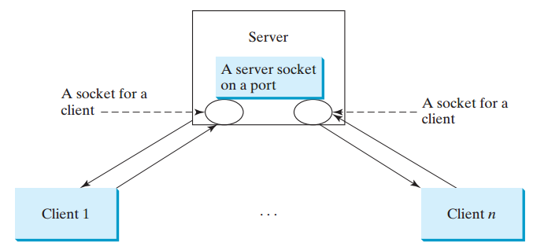
Example: Serving Multiple Clients
Note: Start the server first, then start multiple clients.

Slide 29
Example: Serving Multiple Clients
import java.io.*;
import java.net.*;
import java.util.*;
import java.awt.*;
import javax.swing.*;
public class MultiThreadServer extends JFrame {
// Text area for displaying contents
private JTextArea jta = new JTextArea();
public static void main(String[] args) {
new MultiThreadServer();
}
public MultiThreadServer() {
// Place text area on the frame
setLayout(new BorderLayout());
add(new JScrollPane(jta), BorderLayout.CENTER);
setTitle("MultiThreadServer");
setSize(500, 300);
setDefaultCloseOperation(JFrame.EXIT_ON_CLOSE);
setVisible(true); // It is necessary to show the frame here!
try {
// Create a server socket
ServerSocket serverSocket = new ServerSocket(8000);
jta.append("MultiThreadServer started at " + new Date() + '\n' );
// Number a client
int clientNo = 1;

Slide 30
Example: Serving Multiple Clients
while (true) {
// Listen for a new connection request
Socket socket = serverSocket.accept();
// Display the client number
jta.append("Starting thread for client " + clientNo +
" at " + new Date() + '\n' );
// Find the client's host name and IP address
InetAddress inetAddress = socket.getInetAddress();
jta.append("Client " + clientNo + "'s host name is “
+ inetAddress.getHostName() + "\n");
jta.append("Client " + clientNo + "'s IP Address is “
+ inetAddress.getHostAddress() + "\n");
// Create a new thread for the connection
HandleAClient task = new HandleAClient(socket);
// Start the new thread
new Thread(task).start();
// Increment clientNo
clientNo++;
}
}
catch(IOException ex) {
System.err.println(ex);
}
}

Slide 31
Example: Serving Multiple Clients
// Inner class
// Define the thread class for handling new connection
class HandleAClient implements Runnable {
private Socket socket; // A connected socket
/** Construct a thread */
public HandleAClient(Socket socket) {
this.socket = socket;
}
@Override /** Run a thread */
public void run(){
try {
// Create data input and output streams
DataInputStream inputFromClient = new DataInputStream(socket.getInputStream());
DataOutputStream outputToClient = new DataOutputStream(socket.getOutputStream());
// Continuously serve the client
while (true) {
// Receive radius from the client
double radius = inputFromClient.readDouble();
// Compute area
double area = radius * radius * Math.PI;
// Send area back to the client
outputToClient.writeDouble(area);
jta.append("radius received from client: " +
radius + '\n' );
jta.append("Area found: " + area + '\n' );
}
}
catch(IOException e) {
System.err.println(e);
}
}
}
}

Slide 32
Sending and Receiving Objects
A program can send and receive objects from another program.
In the preceding examples, you learned how to send and receive data of primitive types.
You can also send and receive objects using ObjectOutputStream and ObjectInputStream
on socket streams.
To enable passing, the objects must be serializable.
The following example demonstrates how to send and receive objects.

Slide 33
Example: Passing Objects in Network Programs
Write a program that collects student information from a client and send them to a server. Passing student information in an object.

Slide 34
Example: Passing Objects in Network Programs
public class StudentAddress implements java.io.Serializable {
private String name;
private String street;
private String city;
private String state;
private String zip;
public StudentAddress(String name, String street, String city,
String state, String zip) {
this.name = name;
this.street = street;
this.city = city;
this.state = state;
this.zip = zip;
}
public String getName() {
return name;
}
public String getStreet() {
return street;
}
public String getCity() {
return city;
}
public String getState() {
return state;
}
public String getZip() {
return zip;
}
}

Slide 35
Example: Passing Objects in Network Programs
import java.io.*;
import java.net.*;
import java.awt.*;
import java.awt.event.*;
import javax.swing.*;
import javax.swing.border.*;
public class StudentClient extends JApplet {
private JTextField jtfName = new JTextField(32);
private JTextField jtfStreet = new JTextField(32);
private JTextField jtfCity = new JTextField(20);
private JTextField jtfState = new JTextField(2);
private JTextField jtfZip = new JTextField(5);
// Button for sending a student's address to the server
private JButton jbtRegister = new JButton("Register to the Server");
// Indicate if it runs as application
private boolean isStandAlone = false;
// Host name or IP address
String host = "localhost";
public void init() {
// Panel p1 for holding labels Name, Street, and City
JPanel p1 = new JPanel();
p1.setLayout(new GridLayout(3, 1));
p1.add(new JLabel("Name"));
p1.add(new JLabel("Street"));
p1.add(new JLabel("City"));

Slide 36
Example: Passing Objects in Network Programs
// Panel jpState for holding state
JPanel jpState = new JPanel();
jpState.setLayout(new BorderLayout());
jpState.add(new JLabel("State"), BorderLayout.WEST);
jpState.add(jtfState, BorderLayout.CENTER);
// Panel jpZip for holding zip
JPanel jpZip = new JPanel();
jpZip.setLayout(new BorderLayout());
jpZip.add(new JLabel("Zip"), BorderLayout.WEST);
jpZip.add(jtfZip, BorderLayout.CENTER);
// Panel p2 for holding jpState and jpZip
JPanel p2 = new JPanel();
p2.setLayout(new BorderLayout());
p2.add(jpState, BorderLayout.WEST);
p2.add(jpZip, BorderLayout.CENTER);
// Panel p3 for holding jtfCity and p2
JPanel p3 = new JPanel();
p3.setLayout(new BorderLayout());
p3.add(jtfCity, BorderLayout.CENTER);

Slide 37
Example: Passing Objects in Network Programs
p3.add(p2, BorderLayout.EAST);
// Panel p4 for holding jtfName, jtfStreet, and p3
JPanel p4 = new JPanel();
p4.setLayout(new GridLayout(3, 1));
p4.add(jtfName);
p4.add(jtfStreet);
p4.add(p3);
// Place p1 and p4 into StudentPanel
JPanel studentPanel = new JPanel(new BorderLayout());
studentPanel.setBorder(new BevelBorder(BevelBorder.RAISED));
studentPanel.add(p1, BorderLayout.WEST);
studentPanel.add(p4, BorderLayout.CENTER);
// Add the student panel and button to the applet
add(studentPanel, BorderLayout.CENTER);
add(jbtRegister, BorderLayout.SOUTH);
// Register listener
jbtRegister.addActionListener(new ButtonListener());
// Find the IP address of the Web server
if (!isStandAlone)
host = getCodeBase().getHost();
}
/** Handle button action */
private class ButtonListener implements ActionListener {
@Override
public void actionPerformed(ActionEvent e) {
try {
// Establish connection with the server
Socket socket = new Socket(host, 8000);

Slide 38
Example: Passing Objects in Network Programs
// Create an output stream to the server
ObjectOutputStream toServer = new ObjectOutputStream(socket.getOutputStream());
// Get text field
String name = jtfName.getText().trim();
String street = jtfStreet.getText().trim();
String city = jtfCity.getText().trim();
String state = jtfState.getText().trim();
String zip = jtfZip.getText().trim();
// Create a StudentAddress object and send to the server
StudentAddress s =
new StudentAddress(name, street, city, state, zip);
toServer.writeObject(s);
}
catch (IOException ex) {
System.err.println(ex);
}
}
}

Slide 39
Example: Passing Objects in Network Programs
/** Run the applet as an application */
public static void main(String[] args) {
// Create a frame
JFrame frame = new JFrame("Register Student Client");
// Create an instance of the applet
StudentClient applet = new StudentClient();
applet.isStandAlone = true;
// Get host
if (args.length == 1) applet.host = args[0];
// Add the applet instance to the frame
frame.add(applet, BorderLayout.CENTER);
// Invoke init() and start()
applet.init();
applet.start();
// Display the frame
frame.pack();
frame.setVisible(true);
}
}

Slide 40
Example: Passing Objects in Network Programs
import java.io.*;
import java.net.*;
public class StudentServer {
private ObjectOutputStream outputToFile;
private ObjectInputStream inputFromClient;
public static void main(String[] args) {
new StudentServer();
}
public StudentServer() {
try {
// Create a server socket
ServerSocket serverSocket = new ServerSocket(8000);
System.out.println("Server started ");
// Create an object output stream
outputToFile = new ObjectOutputStream(
new FileOutputStream("student.dat", true));
while (true) {
// Listen for a new connection request
Socket socket = serverSocket.accept();
// Create an input stream from the socket
inputFromClient = new ObjectInputStream(socket.getInputStream());

Slide 41
Example: Passing Objects in Network Programs
// Read from input
Object object = inputFromClient.readObject();
// Write to the file
outputToFile.writeObject(object);
System.out.println("A new student object is stored");
}
}
catch(ClassNotFoundException ex) {
ex.printStackTrace();
}
catch(IOException ex) {
ex.printStackTrace();
}
finally {
try {
inputFromClient.close();
outputToFile.close();
}
catch (Exception ex) {
ex.printStackTrace();
}
}
}
}

Slide 42
The URL Class
Audio and images are stored in files.
The java.net.URL class can be used to identify the files on the Internet.
In general, a URL (Uniform Resource Locator) is a pointer to a "resource" on the World Wide Web.
A resource can be something as simple as a file or a directory.
You can create a URL object using the following constructor:
  public URL(String spec) throws MalformedURLException
For example, the following statement creates a URL object for http://www.sun.com:
  try {
  URL url = new URL("http://www.sun.com");
  }
  catch(MalformedURLException ex) {
  }

Slide 43
Creating a URL Instance
To retrieve the file, first create a URL object for the file.
For example, the following statement creates a URL object for http://www.cs.armstrong.edu/liang/index.html.
  URL url = new URL("http://www.cs.armstrong.edu/liang/index.html");
You can then use the openStream() method defined in the URL class to open an input stream to the file's URL.
  InputStream inputStream = url.openStream();

Slide 44
The End!!

