Slide 1

Primitive Data Types and Variables
Creating and Running Your First C# Program
Firomsa Wakjira
Windows Programming

Slide 2

Table of Contents
Primitive Data Types
  Integer
  Floating-Point / Decimal Floating-Point
  Boolean
  Character
  String
  Object
Declaring and Using Variables
✴
✴
✴
Identifiers
Declaring Variables and Assigning Values Literals
3.
Nullable types

Slide 3


Primitive Data Types

Slide 4
How Computing Works?
Computers are machines that process data
  Data is stored in the computer memory in variables
  Variables have name, data type and value
Example of variable definition and assignment in C#
Variable name
Data type
int count = 5;
Variable value

Slide 5

What Is a Data Type?
A data type:
  Is a domain of values of similar characteristics
  Defines the type of information stored in the computer memory (in a variable)
Examples:
  Positive integers: 1, 2, 3, …
  Alphabetical characters: a, b, c, …
  Days of week: Monday, Tuesday, …

Slide 6

Data Type Characteristics
A data type has:
  Name (C# keyword or .NET type)
  Size (how much memory is used)
  Default value
Example:
  Integer numbers in C#
  Name: int
  Size: 32 bits (4 bytes)
  Default value: 0

Slide 7

Integer Types

Slide 8
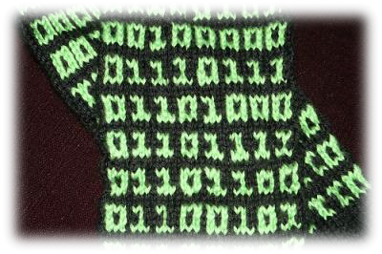
What are Integer Types?
Integer types:
  Represent whole numbers
  May be signed or unsigned
  Have range of values, depending on the size of memory used
The default value of integer types is:
  0 – for integer types, except
  0L – for the long type

Slide 9
Integer Types
Integer types are:
  sbyte (-128 to 127): signed 8-bit
  byte (0 to 255): unsigned 8-bit
✴ short (-32,768 to 32,767): signed 16-bit
  ushort (0 to 65,535): unsigned 16-bit
✴ int (-2,147,483,648 to 2,147,483,647): signed 32-bit
✴ uint (0 to 4,294,967,295): unsigned 32-bit

Slide 10

Integer Types (2)
More integer types:
✴ long (-9,223,372,036,854,775,808 to 9,223,372,036,854,775,807): signed 64-bit
✴ ulong (0 to 18,446,744,073,709,551,615):
unsigned 64-bit

Slide 11
Measuring Time – Example
Depending on the unit of measure we may use different data types:
byte centuries = 20; ushort years = 2000; uint days = 730480;
// Usually a small number
ulong hours = 17531520; // May be a very big number Console.WriteLine("{0} centuries is {1} years, or
{2} days, or {3} hours.", centuries, years, days, hours);

Slide 12

Integer Types
Live Demo

Slide 13

Floating-Point and Decimal Floating-Point Types

Slide 14

What are Floating-Point Types?
Floating-point types:
  Represent real numbers
  May be signed or unsigned
  Have range of values and different precision depending on the used memory
  Can behave abnormally in the calculations

Slide 15
Floating-Point Types
Floating-point types are:
✴ float (±1.5 × 10⁻⁴⁵ to ±3.4 × 10³⁸): 32-bits, precision of 7 digits
✴ double (±5.0 × 10⁻³²⁴ to ±1.7 × 10³⁰⁸): 64-bits, precision of 15-16 digits
The default value of floating-point types:
  Is 0.0F for the float type
  Is 0.0D for the double type

Slide 16

PI Precision – Example
See below the difference in precision when using float and double:
float floatPI = |  | 3.141592653589793238f;
double | doublePI | = 3.141592653589793238;
Console.WriteLine("Float PI is: {0} |  |  | ", floatPI);
Console.WriteLine("Double PI is: {0 |  |  | }", doublePI);
NOTE: The “f” suffix in the first statement!
  Real numbers are by default interpreted as double!
  One should explicitly convert them to float

Slide 17

Abnormalities in the Floating-Point Calculations
Sometimes abnormalities can be observed when using floating-point numbers
  Comparing floating-point numbers can not be performed directly with the == operator
Example:
double a = 1.0f;
double b = 0.33f;
double sum = 1.33f;
bool equal = (a+b == sum); // False!!!
Console.WriteLine("a+b={0} sum={1} equal={2}", a+b, sum, equal);

Slide 18

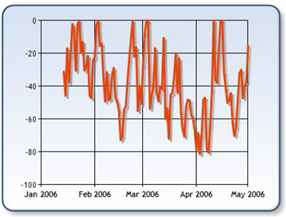
Decimal Floating-Point Types
There is a special decimal floating-point real number type in C#:
✴ decimal (±1,0 × 10⁻²⁸ to ±7,9 × 10²⁸): 128-bits, precision of 28-29 digits
  Used for financial calculations
  No round-off errors
  Almost no loss of precision
The default value of decimal type is:
  0.0M (M is the suffix for decimal numbers)

Slide 19

Floating-Point and Decimal Floating-Point Types
Live Demo

Slide 20


Boolean Type

Slide 21

The Boolean Data Type
The Boolean data type:
  Is declared by the bool keyword
  Has two possible values: true and false
  Is useful in logical expressions
The default value is false

Slide 22
Boolean Values – Example
Example of boolean variables taking values of
true or false:
int a = 1; int b = 2;
bool greaterAB = (a > b); Console.WriteLine(greaterAB); bool equalA1 = (a == 1); Console.WriteLine(equalA1);
// False
// True

Slide 23

Boolean Type
Live Demo

Slide 24


Character Type

Slide 25
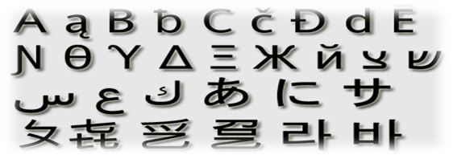
The Character Data Type
The character data type:
  Represents symbolic information
  Is declared by the char keyword
  Gives each symbol a corresponding integer code
  Has a '\0' default value
  Takes 16 bits of memory (from U+0000 to
U+FFFF)

Slide 26
Characters and Codes
The example below shows that every symbol has an its unique Unicode code:
char symbol = 'a';
Console.WriteLine("The code of '{0}' is: {1}", symbol, (int) symbol);
symbol = 'b';
Console.WriteLine("The code of '{0}' is: {1}", symbol, (int) symbol);
symbol = 'A';
Console.WriteLine("The code of '{0}' is: {1}", symbol, (int) symbol);

Slide 27
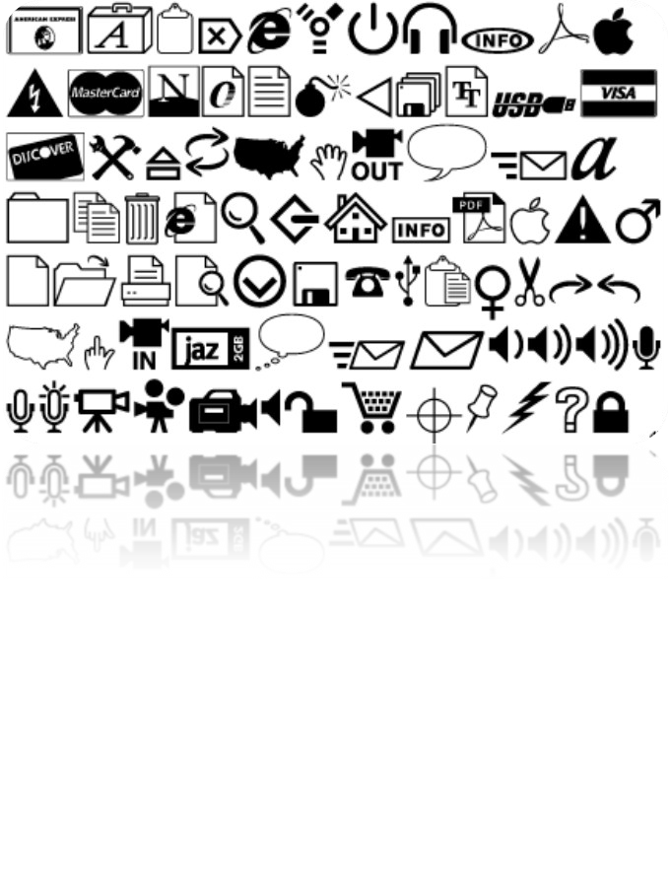
Character Type
Live Demo

Slide 28

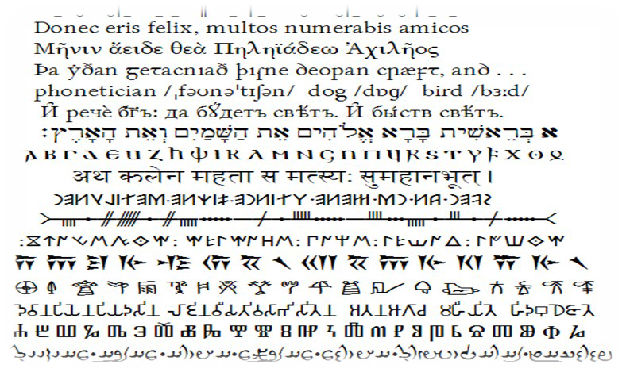
String Type

Slide 29
The String Data Type
The string data type:
  Represents a sequence of characters
  Is declared by the string keyword
  Has a default value null (no value)
Strings are enclosed in quotes:
string s = "Microsoft .NET Framework";
Strings can be concatenated
  Using the + operator

Slide 30
Saying Hello – Example
Concatenating the two names of a person to obtain his full name:
string firstName = "Ivan"; string lastName = "Ivanov";
Console.WriteLine("Hello, {0}!\n", firstName);
string fullName = firstName + " " + lastName; Console.WriteLine("Your full name is {0}.",
fullName);
  NOTE: a space is missing between the two names! We have to add it manually

Slide 31

String Type
Live Demo

Slide 32

Object Type

Slide 33
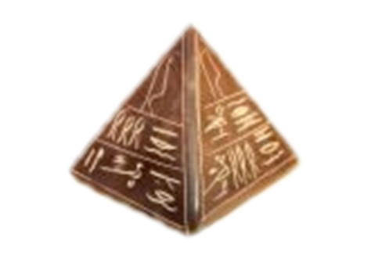

The Object Type
The object type:
  Is declared by the object keyword
  Is the base type of all other types
  Can hold values of any type

Slide 34
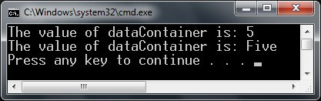
Using Objects
Example of an object variable taking different types of data:
object dataContainer = 5;
Console.Write("The value of dataContainer is: "); Console.WriteLine(dataContainer);
dataContainer = "Five";
Console.Write("The value of dataContainer is: "); Console.WriteLine(dataContainer);

Slide 35

Objects
Live Demo

Slide 36

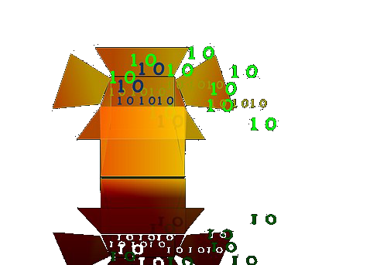
p
q
i
Introducing Variables

Slide 37

What Is a Variable?
A variable is a:
  Placeholder of information that can usually be changed at run-time
Variables allow you to:
  Store information
  Retrieve the stored information
  Manipulate the stored information

Slide 38

Variable Characteristics
A variable has:
  Name
  Type (of stored data)
  Value
Example:
int counter = 5;
Name: counter
Type: int
Value: 5

Slide 39
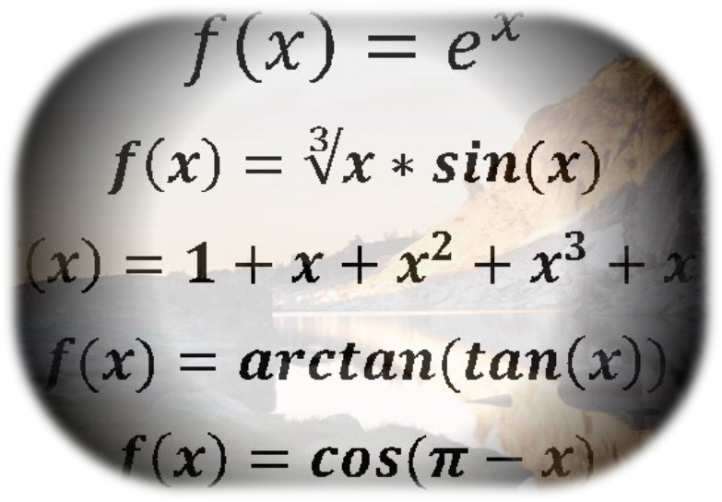
Declaring And Using Variables

Slide 40
Declaring Variables
When declaring a variable we:
  Specify its type
  Specify its name (called identifier)
  May give it an initial value
The syntax is the following:
<data_type> <identifier> [= <initialization>];
Example:
int height = 200;

Slide 41
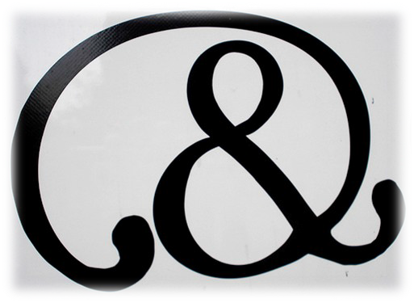
Identifiers
Identifiers may consist of:
  Letters (Unicode)
  Digits [0-9]
  Underscore "_"
Identifiers
  Can begin only with a letter or an underscore
  Cannot be a C# keyword

Slide 42
Identifiers (2)
Identifiers
  Should have a descriptive name
  It is recommended to use only Latin letters
  Should be neither too long nor too short
Note:
  In C# small letters are considered different than the capital letters (case sensitivity)

Slide 43
Identifiers – Examples
Examples of correct identifiers:
int New = 2; // Here N is capital
int _2Pac; // This identifiers begins with _
string | поздрав = "Hello"; // Unicode symbols | used
// The | following is more appropriate:
string | greeting = "Hello";
int n = 100; // Undescriptive
int numberOfClients = 100; // Descriptive
// Overdescriptive identifier:
int numberOfPrivateClientOfTheFirm = 100;
Examples of incorrect identifiers:
int new; int 2Pac;
// new is a keyword
// Cannot begin with a digit

Slide 44


Assigning Values To Variables

Slide 45

Assigning Values
Assigning of values to variables
  Is achieved by the = operator
The = operator has
  Variable identifier on the left
  Value of the corresponding data type on the right
  Could be used in a cascade calling, where assigning is done from right to left

Slide 46

Assigning Values – Examples
Assigning values example:
int firstValue = 5; int secondValue; int thirdValue;
// Using an already declared variable: secondValue = firstValue;
// The following cascade calling assigns
// 3 to firstValue and then firstValue
// to thirdValue, so both variables have
// the value 3 as a result:
thirdValue = firstValue = 3; // Avoid this!

Slide 47
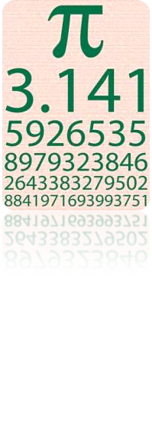
Initializing Variables
Initializing
  Is assigning of initial value
  Must be done before the variable is used!
Several ways of initializing:
  By using the new keyword
  By using a literal expression
  By referring to an already initialized variable

Slide 48
Initialization – Examples
Example of some initializations:
// The following would assign the default
// value of the int type to num: int num = new int(); // num = 0
// This is how we use a literal expression: float heightInMeters = 1.74f;
// Here we use an already initialized variable: string greeting = "Hello World!";
string message = greeting;

Slide 49
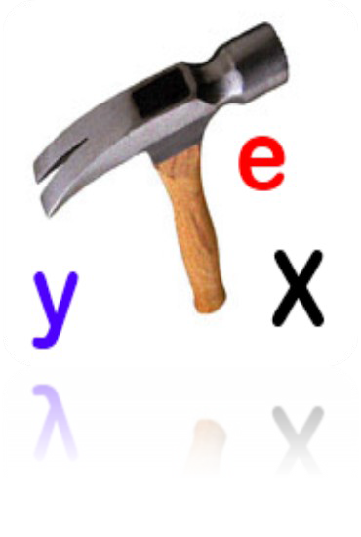

Assigning and Initializing Variables
Live Demo

Slide 50

Literals

Slide 51

What are Literals?
Literals are:
  Representations of values in the source code
There are six types of literals
  Boolean
  Integer
  Real
  Character
  String
✴ The null literal

Slide 52
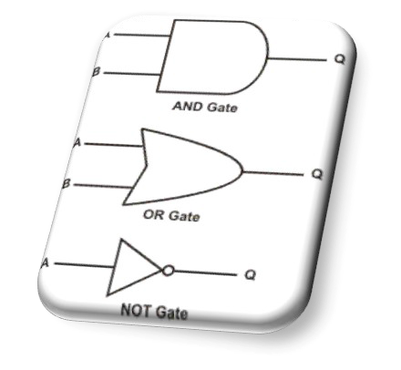
Boolean and Integer Literals
The boolean literals are:
  true
  false
The integer literals:
  Are used for variables of type int, uint, long, and ulong
  Consist of digits
  May have a sign (+,-)
  May be in a hexadecimal format

Slide 53
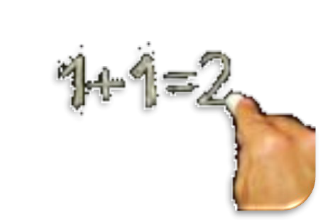
Integer Literals
Examples of integer literals
  The '0x' and '0X' prefixes mean a hexadecimal value, e.g. 0xA8F1
  The 'u' and 'U' suffixes mean a ulong or uint
type, e.g. 12345678U
  The 'l' and 'L' suffixes mean a long or ulong
type, e.g. 9876543L

Slide 54
Integer Literals – Example
// The following variables are
// initialized with the same value: int numberInHex = -0x10;
int numberInDec = -16;
// The following causes an error, because 234u is of type uint
int unsignedInt = 234u;
// The following causes an error, because 234L is of type long
int longInt = 234L;
Note: the letter ‘l’ is easily confused with the digit ‘1’ so it’s better to use ‘L’!!!

Slide 55
Real Literals
The real literals:
  Are used for values of type float, double and
decimal
  May consist of digits, a sign and “.”
  May be in exponential notation: 6.02e+23
The “f” and “F” suffixes mean float
The “d” and “D” suffixes mean double
The “m” and “M” suffixes mean decimal
The default interpretation is double

Slide 56
Real Literals – Example
Example of incorrect float literal:
// The following causes an error
// because 12.5 is double by default float realNumber = 12.5;
A correct way to assign floating-point value (using also the exponential format):
// The following is the correct
// way of assigning the value: float realNumber = 12.5f;
// This is the same value in exponential format: realNumber = 1.25e+7f;

Slide 57

Character Literals
The character literals:
  Are used for values of the char type
  Consist of two single quotes surrounding the character value: '<value>'
The value may be:
  Symbol
  The code of the symbol
  Escaping sequence

Slide 58
Escaping Sequences
Escaping sequences are:
  Means of presenting a symbol that is usually interpreted otherwise (like ')
  Means of presenting system symbols (like the new line symbol)
Common escaping sequences are:
\' for single quote
\\ for backslash
\" for double quote
\n for new line
\uXXXX for denoting any other Unicode symbol

Slide 59
Character Literals – Example
Examples of different character literals:
char symbol = 'a'; // An ordinary symbol
symbol | = | '\u006F'; | // | Unicode symbol code in
 |  |  | // | a hexadecimal format
symbol = '\u8449'; // 葉
(Leaf in Traditional Chinese)
symbol = '\''; // Assigning the single quote symbol symbol = '\\'; // Assigning the backslash symbol symbol = '\n'; // Assigning new line symbol
symbol = '\t'; // Assigning TAB symbol
symbol = "a"; // Incorrect: use single quotes

Slide 60
String Literals
String literals:
  Are used for values of the string type
  Consist of two double quotes surrounding the value: "<value>"
  May have a @ prefix which ignores the used escaping sequences: @"<value>"
The value is a sequence of character literals
string s = "I am a sting literal";

Slide 61
String Literals – Example
Benefits of quoted strings (the @ prefix):
// Here is a string literal using escape sequences string quotation = "\"Hello, Jude\", he said."; string path = "C:\\WINNT\\Darts\\Darts.exe";
// Here is an example of the usage of @ quotation = @""Hello, Jimmy!", she answered."; path = @"C:\WINNT\Darts\Darts.exe";
string str = @"some text";
In quoted strings \" is used instead of ""!

Slide 62
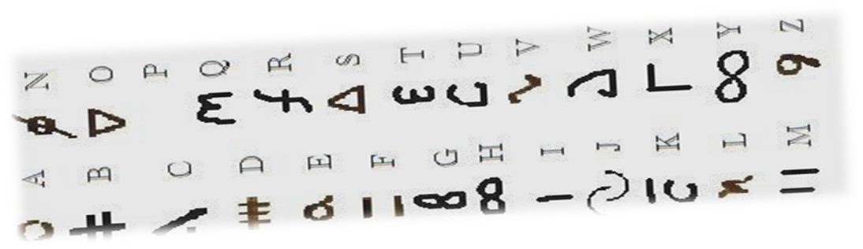
String Literals
Live Demo

Slide 63


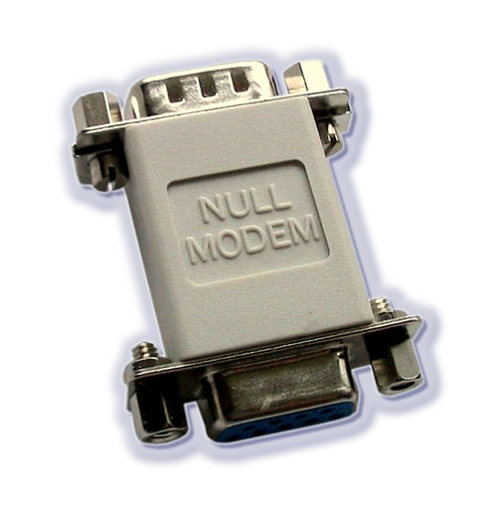
Nullable Types

Slide 64
Nullable Types
Nullable types are instances of the System.Nullable struct
  Wrapper over the primitive types
  E.g. int?, double?, etc.
Nullabe type can represent the normal range of values for its underlying value type, plus an additional null value
Useful when dealing with Databases or other structures that have default value null

Slide 65
Nullable Types – Example
Example with Integer:
int? someInteger = null; Console.WriteLine(
"This is the integer with Null value -> " + someInteger); someInteger = 5;
Console.WriteLine(
"This is the integer with value 5 -> " + someInteger);
Example with Double:
double? someDouble = null; Console.WriteLine(
"This is the real number with Null value -> "
+ someDouble); someDouble = 2.5; Console.WriteLine(
"This is the real number with value 5 -> " + someDouble);

Slide 66


Nullable Types
Live Demo

Slide 67




Primitive Data Types and Variables
Questions?

Slide 68
Exercises
Declare five variables choosing for each of them the most appropriate of the types byte, sbyte, short, ushort, int, uint, long, ulong to represent the following values: 52130, -115, 4825932, 97, -10000.
Which of the following values can be assigned to a variable of type float and which to a variable of type double: 34.567839023, 12.345, 8923.1234857, 3456.091?
Write a program that safely compares floating-point numbers with precision of 0.000001.

Slide 69
Exercises (2)
Declare an integer variable and assign it with the value 254 in hexadecimal format. Use Windows Calculator to find its hexadecimal representation.
Declare a character variable and assign it with the symbol that has Unicode code 72. Hint: first use the Windows Calculator to find the hexadecimal representation of 72.
Declare a boolean variable called isFemale and assign an appropriate value corresponding to your gender.

Slide 70
Exercises (3)
Declare two string variables and assign them with “Hello” and “World”. Declare an object variable and assign it with the concatenation of the first two variables (mind adding an interval). Declare a third string variable and initialize it with the value of the object variable (you should perform type casting).
Declare two string variables and assign them with following value:
The "use" of quotations causes difficulties.
Do the above in two different ways: with and without
using quoted strings.

Slide 71
Exercises (4)
Write a program that prints an isosceles triangle of 9 copyright symbols @. Use Windows Character Map to find the Unicode code of the @ symbol.
A marketing firm wants to keep record of its employees. Each record would have the following characteristics – first name, family name, age, gender (m or f), ID number, unique employee number (27560000 to 27569999). Declare the variables needed to keep the information for a single employee using appropriate data types and descriptive names.
Declare two integer variables and assign them with 5 and 10 and after that exchange their values.

