Slide 1


Loops
Execute Blocks of Code Multiple Times
Firomsa Wakjira
Windows Programming

Slide 2

Table of Contents
What is a Loop?
Loops in C#
  while loops
  do … while loops
  for loops
  foreach loops
Nested loops

Slide 3
What Is Loop?
A loop is a control statement that allows repeating execution of a block of statements
  May execute a code block fixed number of times
  May execute a code block while given condition holds
  May execute a code block for each member of a collection
Loops that never end are called an infinite loops

Slide 4

Using while(…) Loop
Repeating a Statement While Given Condition Holds

Slide 5
How To Use While Loop?
The simplest and most frequently used loop
while (condition)
{
statements;
}
The repeat condition
  Returns a boolean result of true or false
  Also called loop condition

Slide 6
While Loop – How It Works?
false
condition
true
statement

Slide 7
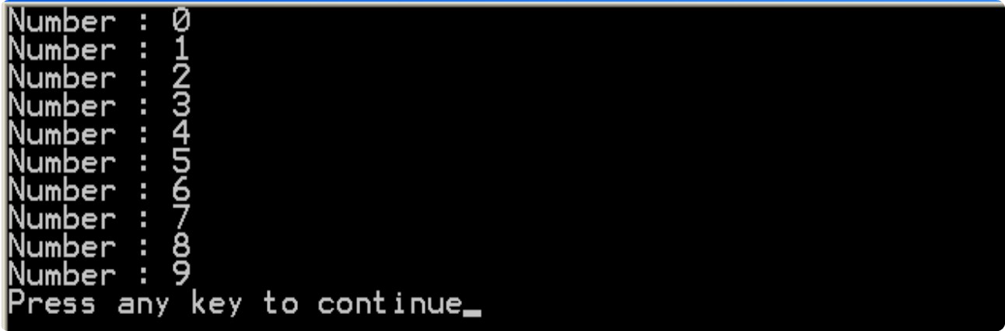
While Loop – Example
int counter = 0; while (counter < 10)
{
Console.WriteLine("Number : {0}", counter); counter++;
}

Slide 8

while(…)
Examples

Slide 9
Sum 1..N – Example
Calculate and print the sum of the first N natural numbers
Console.Write("n = ");
int n = int.Parse(Console.ReadLine());
int number = 1;
int sum = 1;
Console.Write("The sum 1");
while (number < n)
{
number++;
sum += number ;
Console.Write("+{0}", number);
}
Console.WriteLine(" = {0}", sum);

Slide 10

Calculating Sum 1..N
Live Demo

Slide 11
Prime Number – Example
Checking whether a number is prime or not
Console.Write("Enter a positive integer number: "); uint number = uint.Parse(Console.ReadLine());
uint divider = 2;
uint maxDivider = (uint) Math.Sqrt(number); bool prime = true;
while (prime && (divider <= maxDivider))
{
if (number % divider == 0)
{
prime = false;
}
divider++;
}
Console.WriteLine("Prime? {0}", prime);

Slide 12
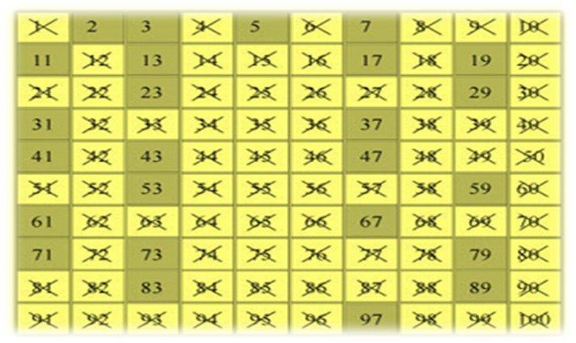
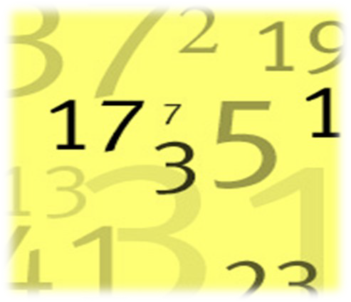
Checking Whether a Number Is Prime
Live Demo

Slide 13
Using break Operator
break operator exits the inner-most loop
static void Main()
{
int n = Convert.ToInt32(Console.ReadLine());
// Calculate n! = 1 * 2 * ... * n int result = 1;
while (true)
{
if(n == 1)
break; result *= n; n--;
}
Console.WriteLine("n! = " + result);
}

Slide 14
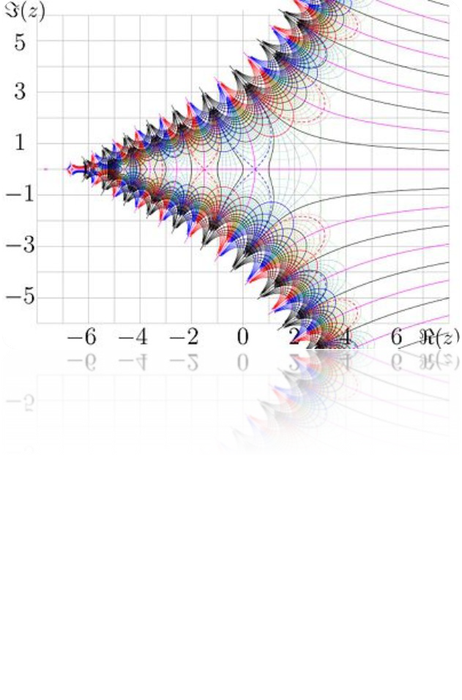
Calculating Factorial
Live Demo

Slide 15

do { … } while (…) Loop

Slide 16

Using Do-While Loop
Another loop structure is:
do
{
statements;
}
while (condition);
The block of statements is repeated
  While the boolean loop condition holds
The loop is executed at least once

Slide 17
Do-While Statement
statement
true
condition
false

Slide 18

do { … } while (…)
Examples

Slide 19
Factorial – Example
Calculating N factorial
static void Main()
{
int n = Convert.ToInt32(Console.ReadLine()); int factorial = 1;
do
{
factorial *= n; n--;
}
while (n > 0);
Console.WriteLine("n! = " + factorial);
}

Slide 20
Factorial with BigInteger –
Example
Calculating N factorial with BigInteger
using System.Numerics; static void Main()
{
int n = 1000;
Don't forget to add reference to System.Numerics.dl
l.
BigInteger factorial = 1; do
{
factorial *= n; n--;
}
while (n > 0);
Console.WriteLine("n! = " + factorial);
}

Slide 21
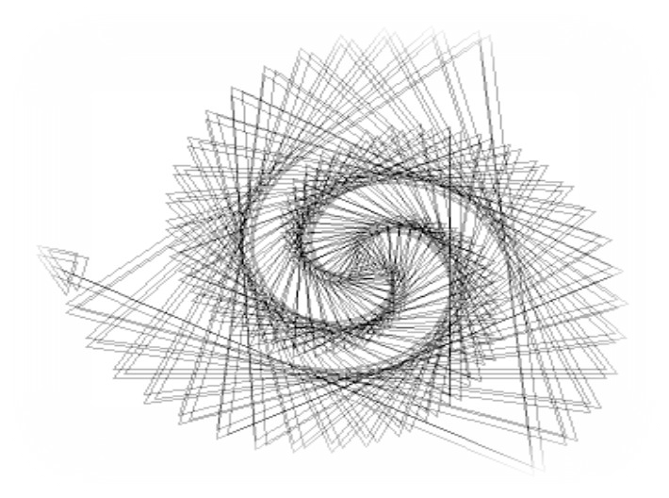
Factorial (do ... while)
Live Demo

Slide 22
Product[N..M] – Example
Calculating the product of all numbers in the interval [n..m]:
int n = int.Parse(Console.ReadLine()); int m = int.Parse(Console.ReadLine()); int number = n;
decimal product = 1; do
{
product *= number; number++;
}
while (number <= m); Console.WriteLine("product[n..m] = " + product);

Slide 23
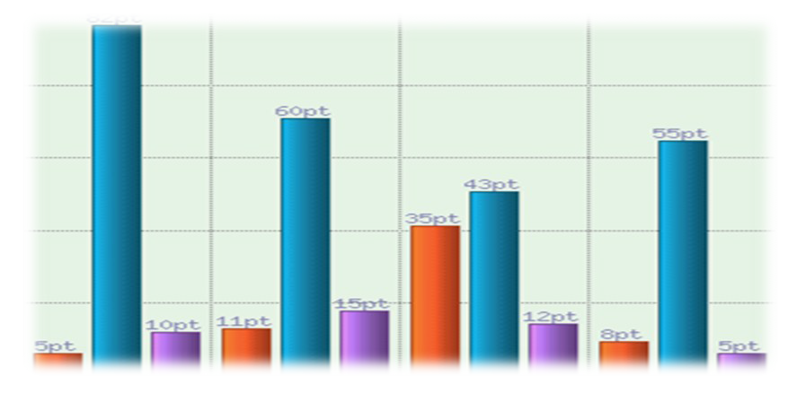
Product of the Numbers in the Interval [n..m]
Live Demo

Slide 24

for Loops

Slide 25
For Loops
The typical for loop syntax is:
for (initialization; test; update)
{
statements;
}
Consists of
  Initialization statement
  Boolean test expression
  Update statement
  Loop body block

Slide 26
The Initialization Expression
for ( ; ...; ...)
{
// Can use number here
}
// Cannot use number here
Executed once, just before the loop is entered
  Like it is out of the loop, before it
Usually used to declare a counter variable
iinntt nnuummbbeerr == 00

Slide 27
The Test Expression
for (int number = 0;
{
// Can use number here
}
// Cannot use number here
nnuummbbeerr << 1100
; ...)
Evaluated before each iteration of the loop
  If true, the loop body is executed
  If false, the loop body is skipped
Used as a loop condition

Slide 28
The Update Expression
for (int number = 0; number < 10;
{
// Can use number here
}
// Cannot use number here
nnuummbbeerr++++
)
Executed at each iteration after the body of the loop is finished
Usually used to update the counter

Slide 29

for Loop
Examples

Slide 30
Simple for Loop – Example
A simple for-loop to print the numbers 0…9:
for (int number = 0; number < 10; number++)
{
Console.Write(number + " ");
}
A simple for-loop to calculate n!:
decimal factorial = 1;
for (int i = 1; i <= n; i++)
{
factorial *= i;
}

Slide 31
Complex for Loop – Example
Complex for-loops could have several counter variables:
for (int i=1, sum=1; i<=128; i=i*2, sum+=i)
{
Console.WriteLine("i={0}, sum={1}", i, sum);
}
Result:
i=1, sum=1 i=2, sum=3 i=4, sum=7 i=8, sum=15
...

Slide 32

For Loops
Live Demo

Slide 33
N^M – Example
Calculating n to power m (denoted as n^m):
static void Main()
{
int n = int.Parse(Console.ReadLine()); int m = int.Parse(Console.ReadLine()); decimal result = 1;
for (int i=0; i<m; i++)
{
result *= n;
}
Console.WriteLine("n^m = " + result);
}

Slide 34

Calculating N^M
Live Demo

Slide 35
Using continue Operator
continue operator ends the iteration of the inner-most loop
Example: sum all odd numbers in [1, n]
that are not divisors of 7:
int n = int.Parse(Console.ReadLine()); int sum = 0;
for (int i = 1; i <= n; i += 2)
{
if (i % 7 == 0)
{
continue;
}
sum += i;
}
Console.WriteLine("sum = {0}", sum);

Slide 36

Using continue Operator
Live Demo

Slide 37
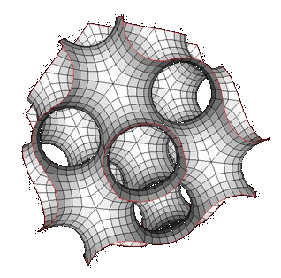
foreach Loop
Iteration over a Collection

Slide 38
For Loops
The typical foreach loop syntax is:
foreach (Type element in collection)
{
statements;
}
Iterates over all elements of a collection
  The element is the loop variable that takes sequentially all collection values
  The collection can be list, array or other group of elements of the same type

Slide 39
foreach Loop – Example
Example of foreach loop:
string[] days = new string[] {
"Monday", "Tuesday", "Wednesday", "Thursday", "Friday", "Saturday", "Sunday" };
foreach (String day in days)
{
Console.WriteLine(day);
}
The above loop iterates of the array of days
  The variable day takes all its values

Slide 40

foreach Loop
Live Demo

Slide 41

Nested Loops
Using Loops Inside a Loop

Slide 42
What Is Nested Loop?
A composition of loops is called a nested loop
  A loop inside another loop
Example:
for (initialization; test; update)
{
for (initialization; test; update)
{
statements;
}
…
}

Slide 43

Nested Loops
Examples

Slide 44
Triangle – Example
Print the following triangle:
1
1 2
…
1 2 3 ... n
int n = int.Parse(Console.ReadLine()); for(int row = 1; row <= n; row++)
{
for(int column = 1; column <= row; column++)
{
Console.Write("{0} ", column);
}
Console.WriteLine();
}

Slide 45

Triangle
Live Demo

Slide 46
Primes[N, M] – Example
Print all prime numbers in the interval [n, m]:
int n = int.Parse(Console.ReadLine()); int m = int.Parse(Console.ReadLine());
for (int number = n; number <= m; number++)
{
bool prime = true; int divider = 2;
int maxDivider = Math.Sqrt(num); while (divider <= maxDivider)
{
if (number % divider == 0)
{
prime = false; break;
}
divider++;
}
if (prime)
{
Console.Write("{0} ", number);
}
}

Slide 47

Primes in Range [n, m]
Live Demo

Slide 48
C# Jump Statements
Jump statements are:
  break, continue, goto
How continue woks?
  In while and do-while loops jumps to the test expression
  In for loops jumps to the update expression
To exit an inner loop use break
To exit outer loops use goto with a label
  Avoid using goto! (it is considered harmful)

Slide 49
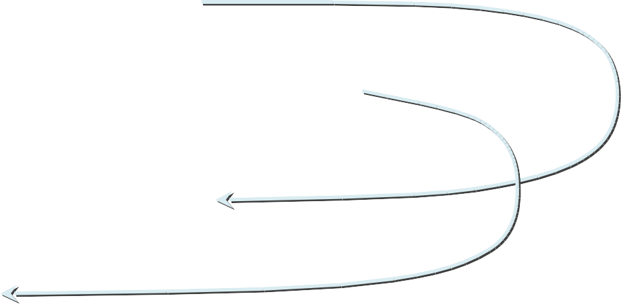
C# Jump Statements – Example
int outerCounter = 0;
for (int outer = 0; outer < 10; outer++)
{
for (int inner = 0; inner < 10; inner++)
{
if (inner % 3 == 0) continue;
if (outer == 7) break;
Label
if (inner + outer > 9) goto breakOut;
}
outerCounter++;
}
breakOut:

Slide 50

Loops – More Examples

Slide 51
Nested Loops – Examples
Print all four digit numbers in format ABCD
such that A+B = C+D (known as happy numbers)
Can you improve
static void Main()
{
for (int a =1 ; a <= 9; a++) for (int b = 0; b <= 9; b++)
this algorithm to
use 3 loops only?
for (int c = 0; c <= 9; c++) for (int d = 0; d <= 9; d++)
if (a + b == c + d) Console.WriteLine("{0}{1}{2}{3}",
a, b, c, d);
}

Slide 52

Happy Numbers
Live Demo

Slide 53
Nested Loops – Examples
Print all combinations from TOTO 6/49
static void Main()
{
int i1, i2, i3, i4, i5, i6; for (i1 = 1; i1 <= 44; i1++)
for (i2 = i1 + 1; i2 <= 45; i2++) for (i3 = i2 + 1; i3 <= 46; i3++)
Warning:
execution of this code could take too long time.
for (i4 = i3 + 1; i4 <= 47; i4++) for (i5 = i4 + 1; i5 <= 48; i5++)
for (i6 = i5 + 1; i6 <= 49; i6++)
Console.WriteLine("{0} {1} {2} {3} {4} {5}", i1, i2, i3, i4, i5, i6);
}

Slide 54

TOTO 6/49
Live Demo

Slide 55
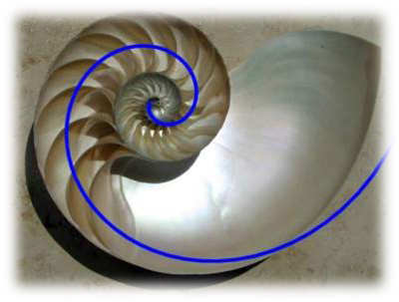
Summary
C# supports four types of loops:
  while
  do-while
  for loops
  foreach loops
Nested loops can be used to implement more complex logic
The operators continue, break & goto can control the loop execution

Slide 56




Loops
Questions?

Slide 57
Exercises
Write a program that prints all the numbers from 1 to N.
Write a program that prints all the numbers from 1 to N, that are not divisible by 3 and 7 at the same time.
Write a program that reads from the console a sequence of N integer numbers and returns the minimal and maximal of them.
Write a program that calculates N!/K! for given N and K (1<N<K).
Write a program that calculates N!*K! / (K-N)! for given N and K (1<N<K).

Slide 58
Exercises (2)
Write a program that, for a given two integer numbers N and X, calculates the sum
S = 1 + 1!/X + 2!/X² + … + N!/X^{N}
Write a program that reads a number N and calculates the sum of the first N members of the sequence of Fibonacci: 0, 1, 1, 2, 3, 5, 8, 13, 21, 34, 55, 89, 144, 233, 377, …
Each member of the Fibonacci sequence (except the first two) is a sum of the previous two members.
4. Write a program that calculates the greatest common divisor (GCD) of given two numbers. Use the Euclidean algorithm (find it in Internet).

Slide 59
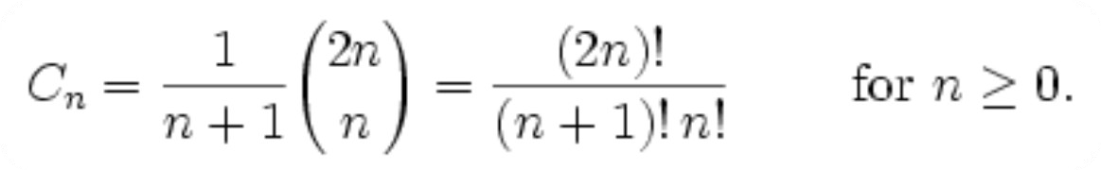
Exercises (3)
1. In the combinatorial mathematics, the Catalan numbers are calculated by the following formula:
Write a program to calculate the N^{th} Catalan number by given N.
5. Write a program that prints all possible cards from a standard deck of 52 cards (without jokers). The cards should be printed with their English names. Use nested for loops and switch-case.

Slide 60
Exercises (4)
1. Write a program that reads from the console a positive integer number N (N < 20) and outputs a matrix like the following:
N = 3 N = 4
1 | 2 | 3
2 | 3 | 4
3 | 4 | 5
1 | 2 | 3 | 4
2 | 3 | 4 | 5
3 | 4 | 5 | 6
4 | 5 | 6 | 7

Slide 61
Exercises (5)
1. * Write a program that calculates for given N how many trailing zeros present at the end of the number N!. Examples:
N = 10 → N! = 3628800 → 2
N = 20 → N! = 2432902008176640000 → 4
Does your program work for N = 50 000?
Hint: The trailing zeros in N! are equal to the number of its prime divisors of value 5. Think why!

Slide 62
Exercises (6)
1. * Write a program that reads a positive integer number N (N < 20) from console and outputs in the console the numbers 1 ... N numbers arranged as a spiral.
Example for N = 4
1 | 2 | 3 | 4
12 | 13 | 14 | 5
11 | 16 | 15 | 6
10 | 9 | 8 | 7

